Slide 1
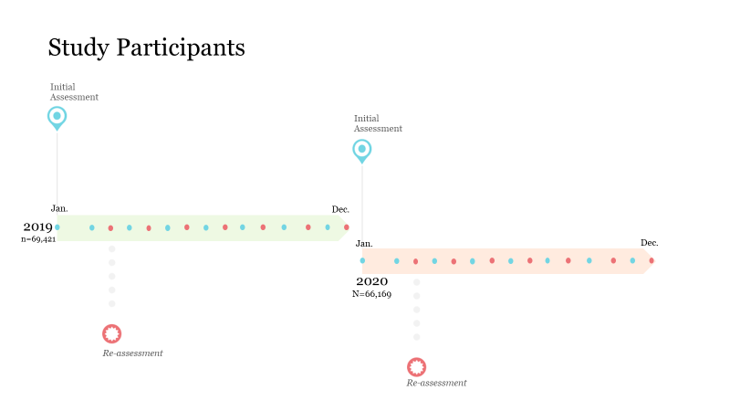
The intersectionality of gambling addiction recovery and mental illness: A Machine Learning Approach
Saahoon Hong; Betty Walton; Hea-Won Kim
Indiana University School of Social Work
Introduction Methods
Given that various gaming activities (i.e., casinos, TV and instant scratch lotteries, sports betting) are growing, COVID-19 related stress presents a severe threat to worsen addictive behaviors (Håkansson et al., 2020).
Furthermore, since certain forms of gambling, like internet-based and other forms of gambling activities, could remain unchangeably available to these adults in the COVID-19 related confinement, special attention to the gambling addiction as consequences of the COVID-19 pandemic is needed.
The purpose of this study is to examine and identify intersections of the first wave of the COViD-19 pandemic, recovery from problem gambling, and behavioral health needs.
The sample of adults aged 18 and above who participated in Midwestern state-funded mental health and addiction services in 2019 and 2020 was selected. Adults with the actionable needs on gambling at the initial assessment (654 out of a total of 135,590 adults) in either 2019 or 2020 were selected for the study if they took the re-assessment within the year.
All participants were taken the Adult Needs and Strengths Assessment (ANSA; Lyons, 2009) as the last assessment in either 2019 or 2020, including six domains: (1) strengths, (2) life functioning, (3) cultural factors, (4) caregiver needs, and resources, (5) behavioral health needs, and (6) risk behaviors. This study focused on the ANSA strengths and behavioral health needs ratings at the re-assessment, and four demographic information (i.e., age, gender, race/ethnicity, calendar year).
Each ANSA item was rated on a four-point scale, ranging from 0 (non-actionable) to 3 (immediate action required). Problem gambling was defined as rated “2” or “3” on a gambling item. These ratings were recoded into non-actionable (0) and actionable (1) and were examined by a machine learning decision tree model, chi-square automatic interaction detection (CHAID). In addition, being improved from problem gambling was suggested if a non-actionable rating on the gambling item was indicated in the re-assessment.
Results
Upon repeated decision tree constructions, an improvement from problem gambling was associated with the following items: (1) substance use; (2) impulse control; (3) education; (4) White or non-White; (5) resourcefulness; (6) age; (7) depression; (8) anxiety; (9) volunteering; (10) gender (male vs. female).
The most significant predictor for improvement from problem gambling was substance use. Among adults without actionable needs on substance use (n=251), 72.5% reported improvement. In contrast, only 37.8% of adults with actionable needs on substance use were rated as improved from problem gambling.
Furthermore, for those without actionable needs on substance use, actionable needs on depression were negatively associated with improvement from problem gambling. In contrast, resourcefulness as a useful strength, ages above 36, and being White were positively associated.
The results highlight that adults were more likely to improve problem gambling when they stayed absent from substance use and did not struggle with impulse control and depression. Resourcefulness was a critical strength item for this group's improvement.
In this manner, the current difficulties of substance use, impulse control, education, and resourcefulness were the significant barriers to improvement from problem gambling.
The overall model accuracy was .798, which indicated that the model distinguished well between improving from problem gambling and sustaining problem gambling.
Conclusions References & *Acknowledgements
The findings suggest that staying absent from substance use and non-actionable needs on impulse control/depression were primary predictors that led to gambling addiction recovery, regardless of the COVID-19 pandemic. Interestingly, White adults were more likely to be improved from problem gambling than their peers of color.
The machine learning-based gambling addiction recovery model could be a promising approach to detect the intersection of race/ethnicity, behavioral health challenges, and their improvement from problem gambling.
It could eventually be a basis for developing a gambling addiction recovery model for adults with needs for gambling addiction treatment at the initial assessment. Further research is also needed to explore the relationship between the identified intersections and other ANSA items. Such a relationship study will support the development of an efficient mental health and gambling recovery model.
Håkansson, A., Fernández-Aranda, F., Menchón, J. M., Potenza, M. N., & Jiménez-Murcia, S. (2020). Gambling during the COVID-19 crisis–a cause for concern. Journal of addiction medicine, 14(4), e10.
Lyons, J. S. (2009). Communimetrics: A communication theory of measurement in human service settings. New York: Springer.
*This study was developed through a collaborative effort by
the IU SSW ANSA/CANS Research Team and Indiana FSSA’s DMHA
Notes:
Single sided poster!

Slide 2
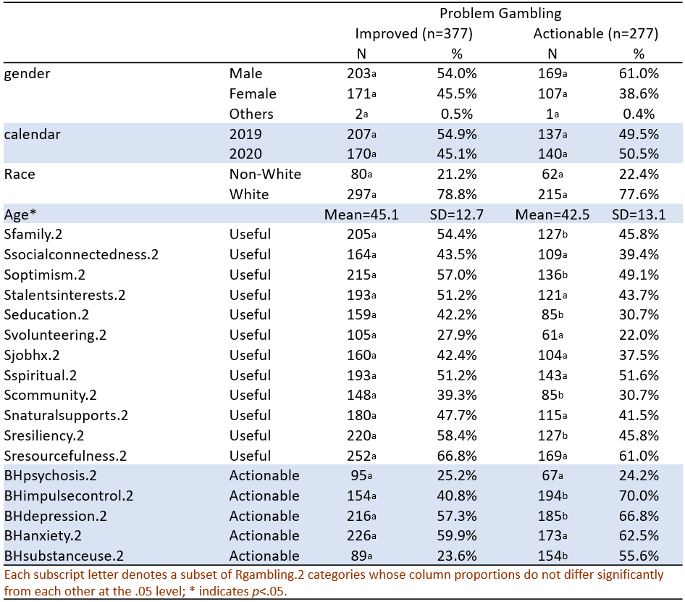
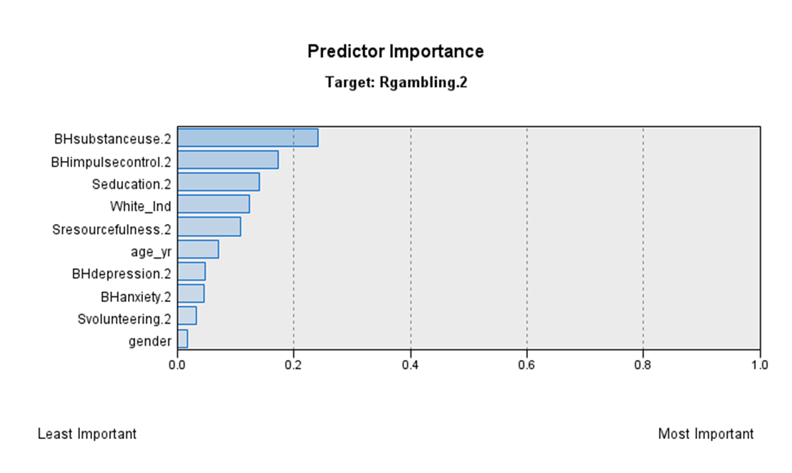
Table & Figure
Demographic & clinical characteristics (n=654)

Slide 3
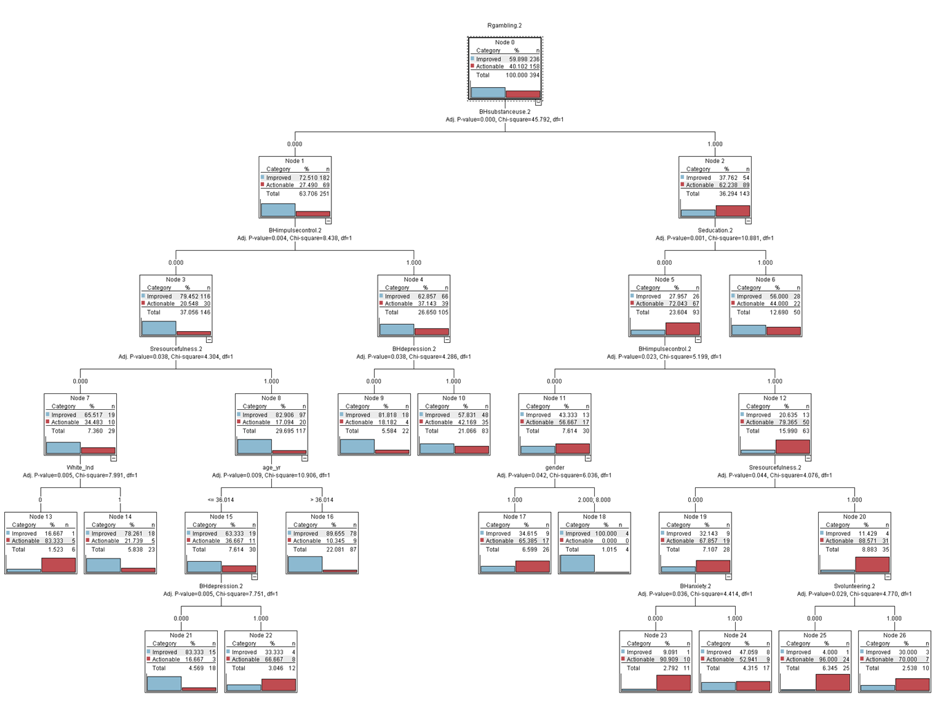
Figures
Decision Tree Model for Predicting the Improvement from Problem Gambling: CHAID Algorithm

