Slide 1

Negotiation Planning
Module 1: Foundations – Negotiation Planning, Part 1
the ONEAL project
Notes:
Negotiation planning a is large topic. It essentially provides the road map to how you execute your negotiations. Considering this, we have broken up negotiation planning into three lessons. This is the first video of the first lesson. The first lesson is focused on introducing negotiation planning and familiarizing you with negotiation concepts and strategies. The subsequent lessons, parts 2 and 3 will explain how to find and use information that you find about your library (an internal review) and the vendor (an external review) during the planning process.

Slide 2
1.
The Pre-Game
The bulk of the effort in negotiations
Notes:
In the prior lesson, Introduction to Negotiations, we discussed three major stages in negotiations – the pre-game, the game (think chess), and the post-game. The pre-game takes the most effort because this is where we do our negotiation planning.

Slide 3
Three Key Steps to the Pre-Game
Relationships
Build and maintain your relationships with vendors
Data
Collect and analyze internal and external data around the deal
Plan Strategies
Use the information you gathered to plan how to initiate negotiations and guide decision-making during negotiations
Notes:
There are three major steps in the pre-game:
The first is building and maintaining relationships with your vendors. This is critical for establish trust and maintaining respect during active negotiations. This step is ongoing and never really stops during the negotiation. It is helpful to not be talking to a sales representative for the very first time when you are trying to negotiate pricing and/or a license.
The second step is to collect and analyze internal and external data around the deal you are negotiating. This will be used to identify goals and interests of both parties.
The final step is to plan your negotiation strategies using the information you have found. This is about now you initiate your negotiations and make decisions during the negotiation.

Slide 4

Preparation that does not work!
Psyching up!
It makes the negotiation feel more personal and shifts the focus to be more positional.
Thompson, L. (2013) The truth about negotiations. New Jersey: Pearson Education
Image by rubyblossom
Notes:
The research is in – there is one type of negotiation preparation that does not work well….Psyching your self up prior to the negotiation. That is because then if the negotiation does not go your way, it feels much more personal and shifts the focus of the negotiation to be more positional.
Note not covered in video but added to further explain: What I mean about psyching yourself up is not about assuring yourself that you are prepared, it is about telling yourself that you are awesome and you’re going to do great! If you don’t come to agreement or you give up something important, then you personally will feel more like you have failed – It becomes personal and about your self-worth and not about having to make a choice.

Slide 5

Preparation that does work: Planning that considers both parties’ Interests
Image by Nicola Barnett
Notes:
What does work is planning that considers both parties’ interests. Planning also helps you keep centered so if you must make a hard decision such as to sign a deal that you don’t want because your alternative (cancelling) is too horrible based on current circumstance (such as lack of administrative and faculty buy-in) you do not take it personally. Instead, you pick yourself up and sign the deal while making plans to work on improving your alternatives prior to the next time the contract comes up for renegotiation. Planning also allows you to be nimble. It allows you to create solutions as you uncover and confirm the interests of the other party. It will help you determine how to present your offers most effectively. The next video in this lesson will talk about how you can use different strategies mid negotiation.

Slide 6
2.
Own your terms
Negotiation Planning Vocabulary
Notes:
But first we need to familiarize you with negotiation vocabulary.

Slide 7
BATNA
Best Alternative To a Negotiated Agreement. Everyone has a BATNA. You just may not like it.
Notes:
BATNA stands for Best Alternative To a Negotiated Agreement. Everyone always has a BATNA, but you may not like it. For instance, if you cancel and it’s a resource embedded into instruction for perhaps a chemistry class and it’s close to the start of a new term, cancelling will likely upset teaching faculty. You can improve that BATNA the next year by working with faculty to become familiar with an alternate resource through a trial. We will dive more deeply into BATNA in the third video of this lesson. Your BATNA should consider things beyond pricing including licensing terms.

Slide 8
Reservation Price
$
The bottom line, the point in the negotiation where you can go either way, either agreeing the to deal or walking away. This is informed by your BATNA.
Notes:
Reservation price is your bottom line, it’s the point in the negotiation where you can go either way, sign the deal or decide to walk away. This is informed by your BATNA and is often the maximum price you are willing to pay the seller informing one end of your ZOPA, or Zone of Possible Agreement.

Slide 9
ZOPA
Zone of Possible Agreement. It is the range between the minimum the seller is willing to sell and the maximum the buyer is willing to pay.
Notes:
ZOPA is the zone of possible agreement. It is the range between the minimum the seller is willing to sell a product or service and the maximum the buyer is willing to pay (often reservation price). While traditionally price focused, you can attempt to value other important aspects of your agreement such as NDAs, perpetual access, authorized users, accessibility when determining your ZOPA.

Slide 10
Finding ZOPA
Library Interests (Buyer)
Naturally easier for us to determine
This is the second step of the pre-game – collecting and analyzing data
You need to determine your BATNA, reservation price, and concessions
Vendor Interests (Seller)
Examine your data, available vendor pricing, industry trends, vendor intelligence and financial data.
Minimum seller is willing to sell
Maximum buyer is willing to pay
ZOPA
Notes:
Prior to starting your negotiation, you want to estimate your zone of possible agreement. As you uncover more information from the vendor on their goals (also known as interests) you will be updating your ZOPA during the negotiation. One end of the zone of possible agreement reflects library interests and is much easier for us to determine. This is all about collecting and analyzing our own internal data. You will need to determine your BATNA, reservation price, and concessions [or things that you are more flexible on]. Vendor interests (the seller) is much harder to determine. You should examine your own data about the vendor, available vendor pricing, industry trends, and vendor intelligence and financial data in order to estimate the minimum the vendor is willing to sell.

Slide 11
Concessions
What you are willing to give up to come to agreement.
Notes:
Concessions are what you are willing to give up to come to agreement. You may make different concessions depending on what you uncover about vendor interests. You want to be careful to not give up too much too early.

Slide 12
3.
Negotiation Strategies
Putting it all together so you can decide how to make decisions during the game (the negotiation aka chess match)
Notes:
Determining what negotiation strategies to use is all about putting all the data together so you can make decisions during the game (the negotiation aka the chess match). The next video in this lesson will explain different strategies you can employ.

Slide 13
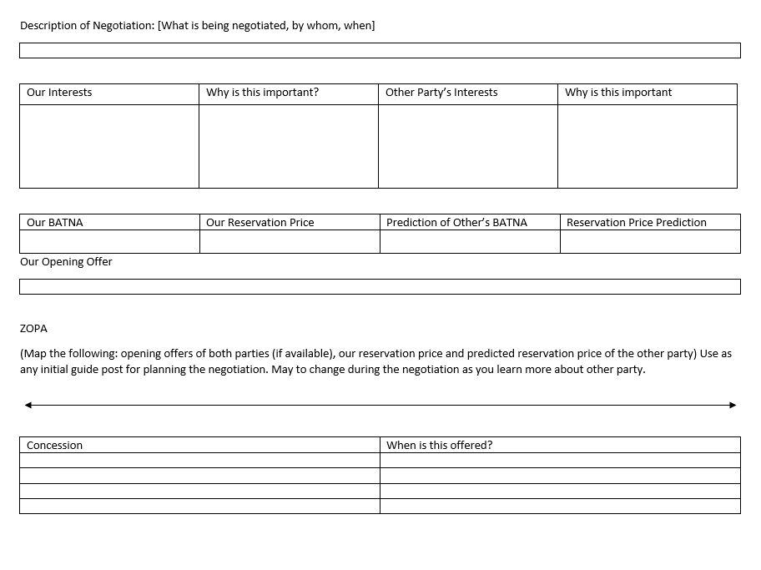
Negotiation Worksheet
Helpful guide for preparing any type of negotiation
Notes:
In your resources you will find a link to a worksheet you can use when preparing for any type of negotiation whether for work or in your personal life. This can be used to help you prepare the case studies in this curriculum by helping you think about the interests of you and the vendor, BATNA and reservation price, and concessions you’re willing to make (and when to make them).

Slide 14
Additional Videos in the module will cover
Playing the Game
BATNA
Notes:
Additional videos you will find in this lesson will be Playing the Game, which will walk you through different negotiation strategies and BATNA which will discuss strategies to consider in regard to using your BATNA including how to plan when you have little power.

Slide 15
Bibliography & Credits
Thompson, L. (2013) The truth about negotiations. New Jersey: Pearson Education
This presentation is the creative work of Katharine V. Macy, Collection Assessment Librarian & Subject Liaison for Business and Economics at Indiana University - Indianapolis, https://orcid.org/0000-0002-6283-7143
Presentation template by SlidesCarnival

