Slide 1

Launching a negotiation curriculum:
the ONEAL project
Discovering and addressing challenges faced during resource negotiations
March 4, 2024

Slide 2
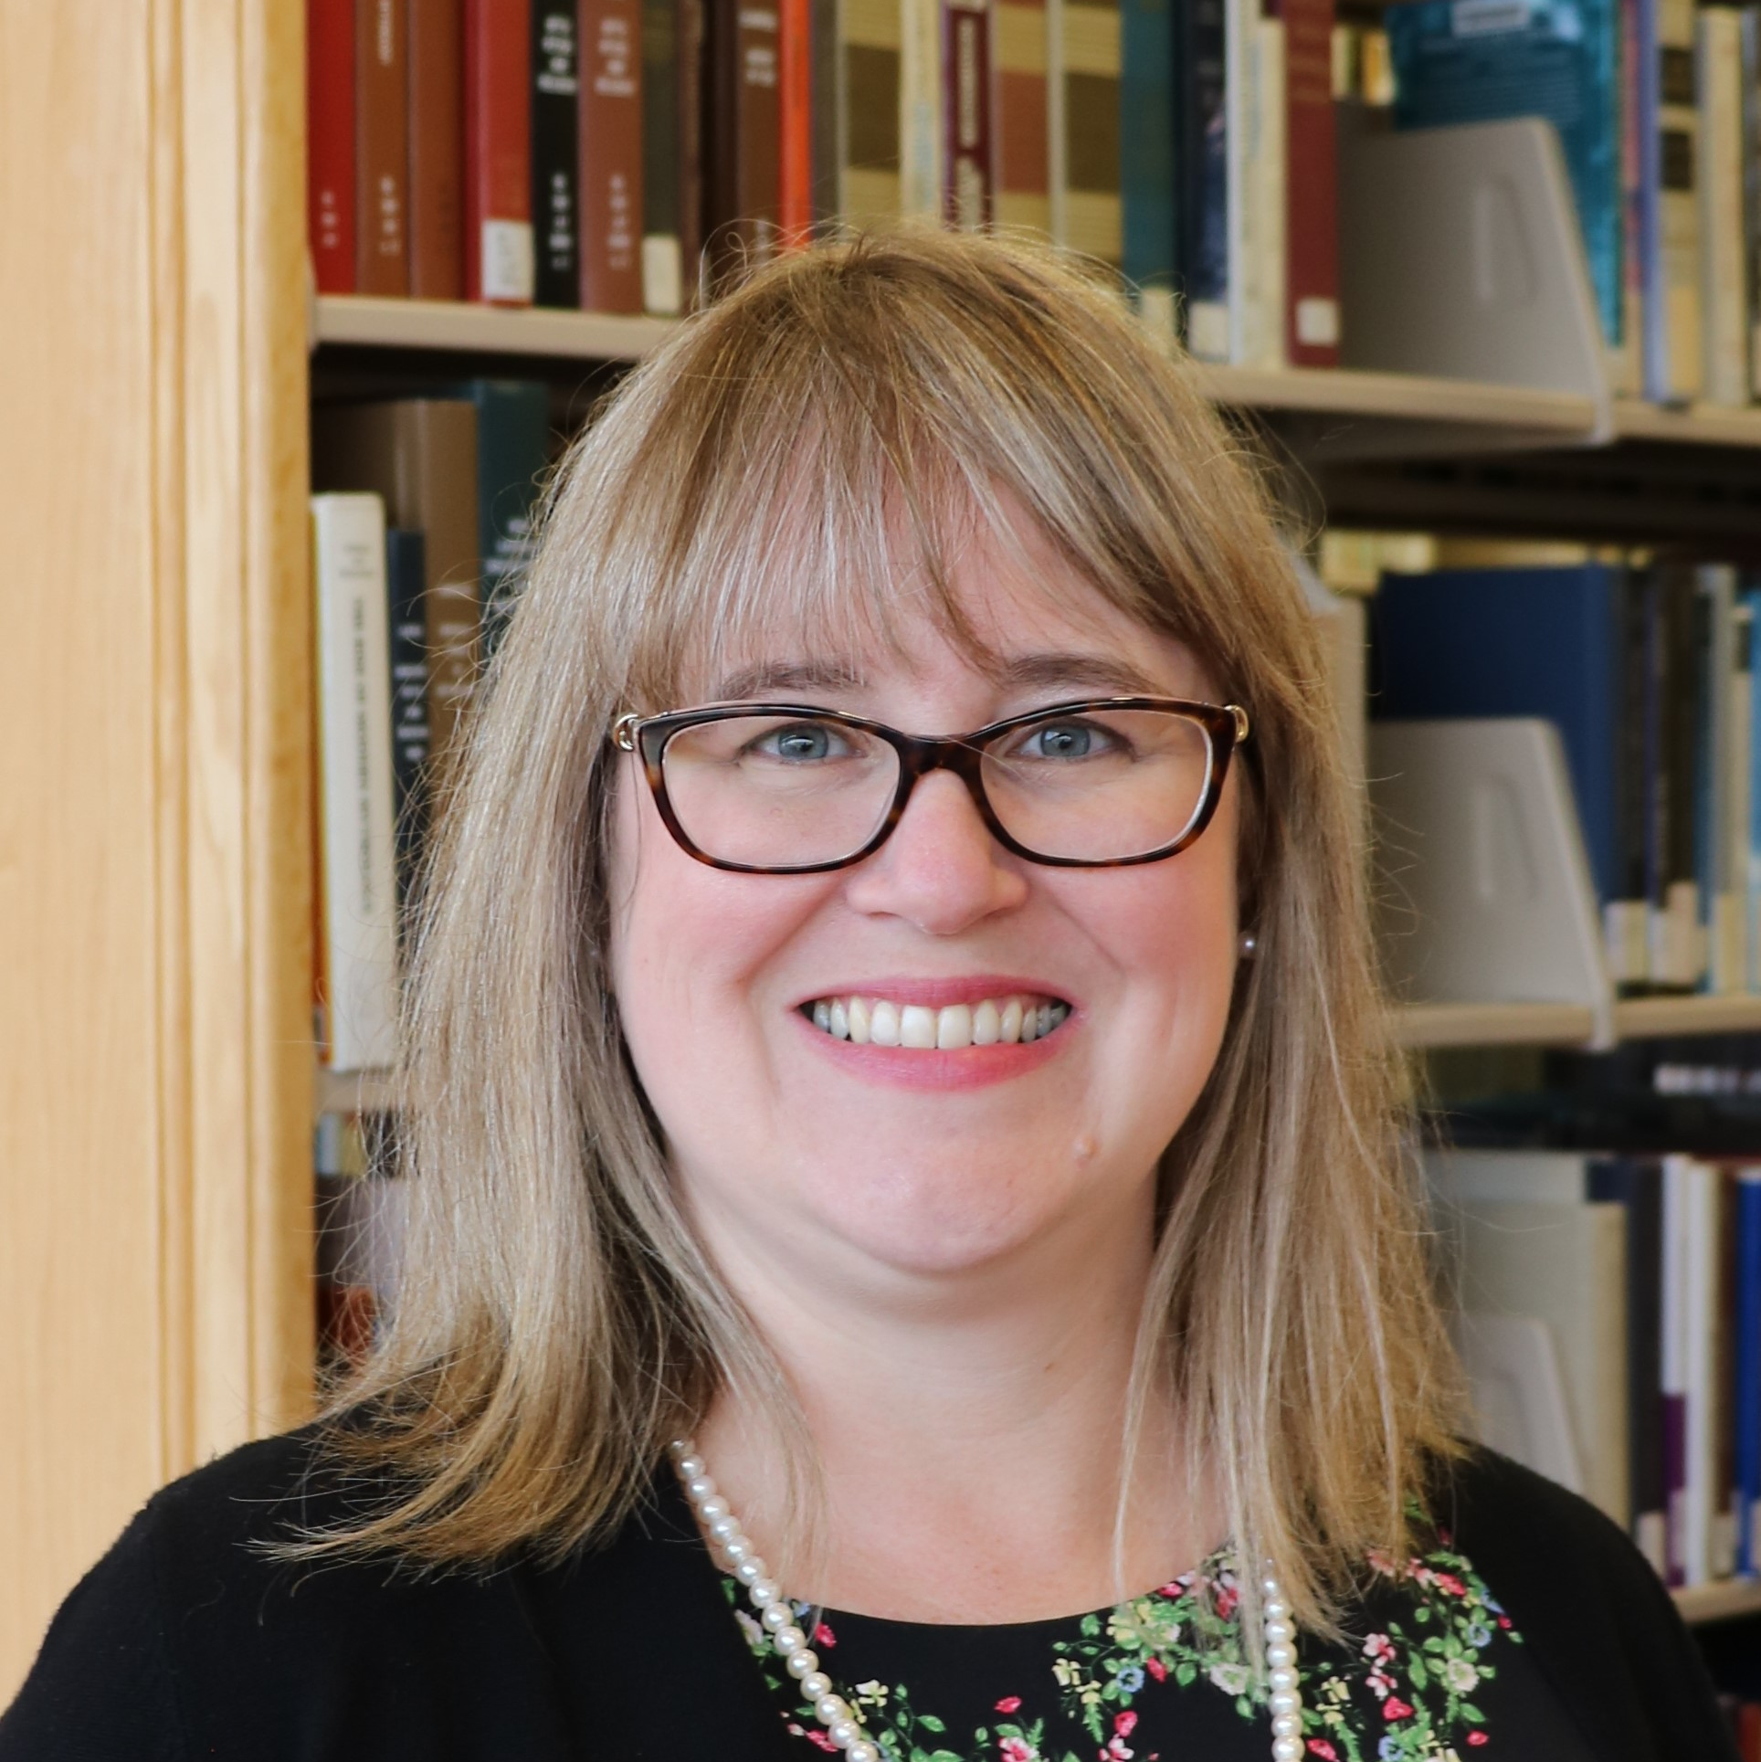


PROJECT TEAM
Katharine V. Macy
Scarlet Galvan
Courtney Fuson
Collection Assessment Librarian
Indiana University – Indianapolis (IUPUI)
macyk@iu.edu
Collection Strategist
Grand Valley State University
galvansc@gvsu.edu
Asset Management Librarian
Belmont University
courtney.fuson@belmont.edu

Slide 3
01
MISSION
What is our goal?

Slide 4
the ONEAL project
Creating an OER to teach negotiation skills to academic library workers who work with vendors.

Slide 5
Why do we need this?
Building a more sustainable future for libraries!
Professional development should be available for everyone!
Yes, we can and should negotiate!

Slide 6
—John F. Kennedy
“Let us never negotiate out of fear, but let us never fear to negotiate.”

Slide 7
93 attendees
35 interviewees
26 pilot testers
Average attendance to three community forums in Fall 2023
20 library workers
Participated in Curriculum Planning Workshop Nov 2023
Qualitative Research Study Spring 2023
Completed the Foundations curriculum Fall 2023
Notes:
Nothing for the community without the community

Slide 8
PROJECT TIMELINE
Planning & Creation of Foundations
Foundations Module Launch
FALL 2023
FALL 2024
AUG ‘22 – Sep ‘23
MAR ‘24
Pilot Test
Strategies Module & Issues

Slide 9
02
EXPLORE
Insights from the Inteview Study

Slide 10
Interview Study
Overall experience with negotiations
Describe a negotiation that went well and one that was particularly difficult
Challenges with negotiating
Desired training & Support
Notes:
As part of the ONEAL project we conducted an interview study to learn from a variety of academic library workers their overall experience with negotiations. This included asking them to describe a negotiation that went well as well as one that was particularly difficult. We also asked about the challenges they faced when negotiating and their desired training and support.

Slide 11
STUDY METHODS
ENSURE DIVERSITY IN BACKGROUND & INSTITUTIONS IN SELECTING SUBJECTS
35 SEMI-STRUCTURED INTERVIEWS
DATA WAS QUALITIVELY CODED USING DEDOOSE
Notes:
We sent out an invitation for people to participate and the project team carefully reviewed each candidate’s institutional and demographic background so we could ensure we included as many diverse voices as possible within this study. We selected 40 people and ended up with 35 recorded semi-structured interviews which we could analyze. We then qualitative coded using Dedoose to find key themes. We are going to use the interviews to create more case studies to include in the curriculum to publish later in 2024. Meanwhile we have some preliminary results to share.

Slide 12
DEMOGRAPHICS
40 PEOPLE SELECTED, 35 COMPLETED INTERVIEWS
52% worked at private institutions / 48% public institutions
68% had 6 or more years of experience
17% respondents identified as BIPOC
More details on the demographics are in the Appendix at the end of this presentation
Notes:
Before we get going on the results here are some demographics:
The split was 52/48 Private vs Public
68% of subjects had 6 or more years of experience
17% of respondents identified as BIPOC
For more details on demographics there is an appendix in this presentation.

Slide 13
INSTITUTIONAL CHARACTERISTS
Notes:
54% of the subjects had a Carnegie classification of Doctoral Universities: Very High Research Activity
2 participants worked for a consortia
From the pool of applicants, we selected at least 1 individual from each type of institution within the applicant pool so we can have a variety of institutional experiences.

Slide 14
DEGREE OF URBANIZATION
Notes:
Here is a breakdown to the degree of urbanization for each of the library workers’ institution.

Slide 15
BUSINESS DEAL ISSUES
Notes:
77% of subjects mentioned business deal issues, with pricing being the most frequently mentioned issue being negotiated (66% of subjects mentioned)

Slide 16
DIFFICULT LICENSING TERMS
Notes:
57.1% of subjects mentioned difficult licensing terms. The three terms most mention were centered on accessibility, NDAs or confidentiality, and Indemnity.

Slide 17
INTERNAL STAKEHOLDER ISSUES
Notes:
94.3% of those interviewed mentioned they experienced issues with internal stakeholders. The most frequent issues mentioned were around working with folks in the library and other faculty, which we will dive into further in a moment. However, folks also experience issues with administrators, procurement, students, general counsel, and donors. This also shows specifically some of the diffulties including advocacy and buy-in, lack of understanding, approaching stakeholders, and setting expectations.

Slide 18
LIBRARY ISSUES
Notes:
62.9% of respondents mentioned experiencing issues within their own library which the most significant issue is colleagues not being on the same page, working proactively when approaching negotiations, and lateral decision making/ creating agreement being the most frequent issue.

Slide 19
FACULTY ISSUES
Notes:
54.3% mentioned faculty issues with creating faculty buy-in being the largest issue at 34.3% of subjects mentioning it.

Slide 20
POSITIVE VENDOR BEHAVIORS
Notes:
62.9% mentioned positive vendor behaviors. 42.9% mentioning the work to maintain the relationship, 34.3% mentioning clear communication and transparency, 31.4% mentioning negotiating in good faith and highly responsive and 5.7% mentioning the vendor working as a partner.

Slide 21
NEGATIVE VENDOR BEHAVIORS
Notes:
Okay, this chart is a bit of an eye-chart – no worries the presentation is on the conference site! 97.1% commented on negative behaviors they had experienced when negotiating with the three largest issues being not understanding academic context, lack of responsiveness and lastly that the sales representative lacks knowledge (in general – can be about the product, aspects of the license, or the institution).

Slide 22
25.7%
Said vendor turnover is a problem
Notes:
25.7% mentioned vendor turnover as being a problem – I think this goes back to the issue mentioned on the prior slide about the sales representatives lacking knowledge.

Slide 23
OTHER NEGOTIATION CHALLENGES
Notes:
Showing only challenges that were over 10% of respondents
97.1% of subjects mentioned things that challenges that we classified as “other” – some are process related, some are contextual
Personal challenges was the largest category with 68.6% of respondents which we are going to dig into in the next slide.

Slide 24
PERSONAL CHALLENGES
Notes:
68.6% mentioned personal challenges when negotiating with the number 1 issue mentioned being lack of experience or training for negotiations, followed closely by finding it difficult to say no especially considering the service profession expectations.

Slide 25
NEGOTIATION STRATEGIES USED
Notes:
In negotiation examples – 94.3% of respondents spoke directly about strategies they used when negotiating
60% spoke to the analysis the did, 57.1% discussed clear communication, and 48.6% mention maintaining the vendor relationship or building trust.
Further down the list are more specific negotiation strategies and best practices such as using framing, BATNA, concessions, negotiating issues simultaneously and anchoring – which isn’t surprising since most library workers learn how to negotiate on the job and many have not had formal negotiation training. Something the ONEAL project hopes to remedy.

Slide 26
DESIRED TRAINING & SUPPORT
Notes:
71.4% of respondents provided feedback on the desired training and support they would like to have in negotiations with the top four things being: Licensing (40%), Negotiation Strategies (22.9%), Community and Shared licensing language at 17.1%. The ONEAL Project is doing our best to address three of those things: licensing, strategies, and community.

Slide 27
03
LAUNCH
Foundations Curriculum
March 2024

Slide 28
FOUNDATIONS
Intro to Curriculum
Intro to Negotiations
Negotiation Planning Part 2: Internal Review
Issues: Accessibility
Negotiation Planning Part 3: Vendor Research
Contracts & Licensing
Negotiation Planning Part 1: Strategy
Lessons included:

Slide 29
CURRICULUM CONTENT
LESSON PLANS
RECORDED LECTURES
HANDS-ON EXERCISES
CASE STUDIES
WORKBOOK
GROUP ACTIVITIES
Carefully constructed to maximize learning
Over 5 hours of recorded video
Using best pedagogical practice
Best way to improve is to practice!
All lessons are available for individual download or in workbook.
Activities to support classes and larger group learning

Slide 30
MLS/MLIS Instructors
Lesson plans, quizzes, and assignments will be available to download in a .docx file so you can easily copy and paste content into learning management systems

Slide 31
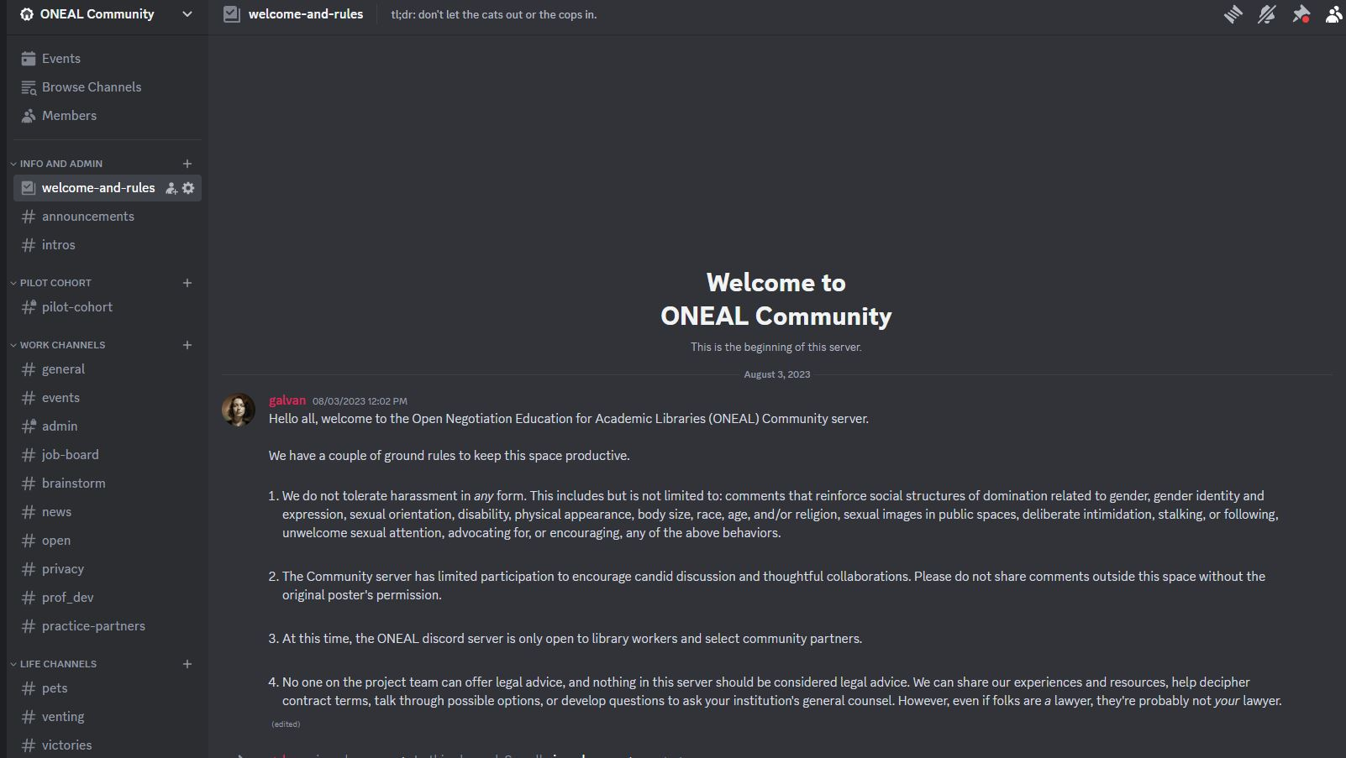
ONLINE COMMUNITY
https://oneal-project.org/discord/

Slide 32
MAILING LIST!
https://forms.gle/nw9bxqsxehxPTFoL8
Notes:
Join our mailing list and we will let you know once the curriculum launches – and we promise to only email you about the project.

Slide 33
JOIN US ON THIS ADVENTURE
Bring your expertise – we are looking for contributors!
More pilot testors as we build additional content.
Looking for mock negotiators– learners want to see examples of techniques in action

Slide 34
THANKS!
Do you have any questions?
https://oneal-project.org/contact/
MAILING LIST

Slide 35
04
APPENDIX
DEMOGRAPHICS

Slide 36
DEMOGRAPHICS: GENDER

Slide 37
DEMOGRAPHICS: RACE/ETHNICITY

Slide 38
DEMOGRAPHICS: EXPERIENCE

