Slide 1
Governance in the Commons: Dealing with research data

Slide 2

Heather Coates, MLS, MS
Digital Scholarship & Data Management Librarian
IUPUI University Library - Center for Digital Scholarship
Data Steward for Research Data, Indiana University

Slide 3
Indiana University
Data Governance Structure, Roles, and Key Processes

Slide 4
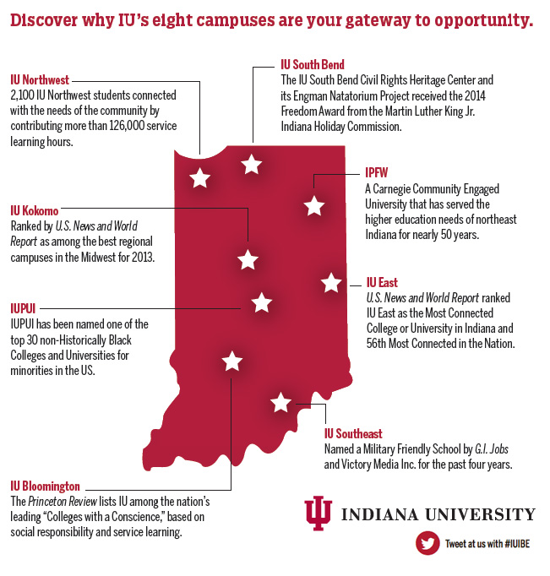
KEY FACTS ABOUT IU
111,000+ students on 8 campuses
21,000+ faculty & staff
$680 million in external funding for research and other activities
IU Bloomington - flagship residential campus
IUPUI - urban research & academic health sciences campus

Slide 5
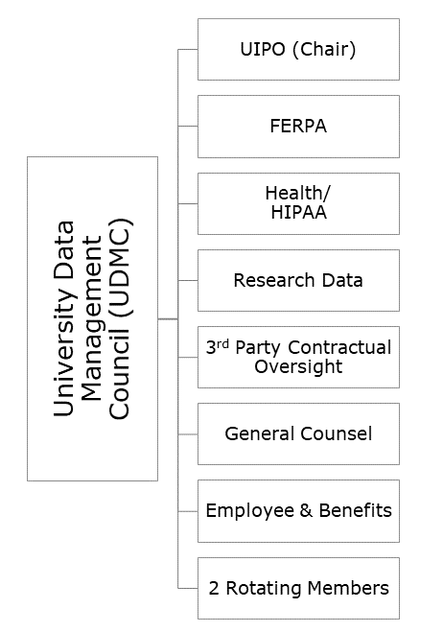
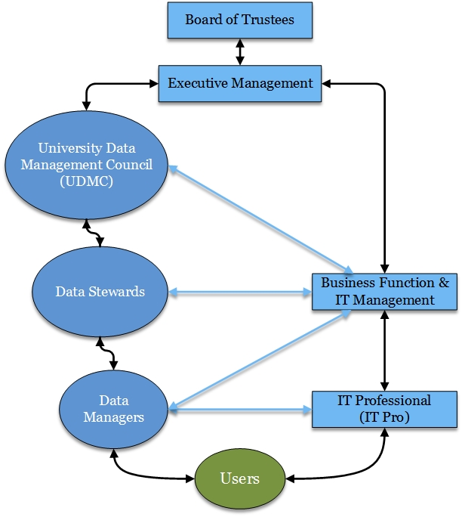
Data Governance Structure @ IU
Notes:
I was appointed the data steward for research data in early 2017, after some collaborative work to develop a research data management policy with the HIPAA Privacy Officer, Research Compliance, General Counsel, IU Health, and others. However, data governance has existed at IU since the 1990s.
At Indiana University, data management governance begins with the Board of Trustees and spans all levels of the institution. The Board of Trustees owns all information at the highest level, except information excluded by Intellectual Property policies. Various other administrators help manage data by creating management policies and implementing different levels of access authorization. These key administrators are referred to as Data Stewards and Data Managers.
UDMC is the Governing Body for Data Management at IU. It is chartered by the Office of the Vice President for Information Technology and works in conjunction with the University Risk and Assurance Council (URAC). The UDMC is comprised of six permanent members and two rotating membership positions.
Six permanent members include those who have compliance responsibilities for the largest segments of institutional data or by virtue of their university role have oversight responsibility for legal, contractual and/or policy requirements associated with protecting information. (See Appendix A, section I of the UDMC Charter.)
Up to two Data Stewards or individuals with strategic expertise and background relevant to data management, data privacy and security needs of the university may be appointed by the Council Members to a two-year rotating membership position.
The purpose of the UDMC is to provide university-wide strategic planning, governance and oversight for Indiana University’s institutional data. Data governance is a quality control discipline that encompasses the classification, collection, storage, access, use, sharing, maintenance, integrity, privacy and security of institutional information. As such the Council will strive to ensure that institutional data governance efforts support the university’s missions and strategic plans, address the entire information lifecycle, and adopt and implement safeguards that appropriately balance risk assessment with the need for university employees to access and use data for the efficient and effective execution of their duties.
Individually, each Data Steward has management and policy-making responsibilities for their specific data subject areas and as part of the virtual institutional data base.
Data managers are assigned responsibilities to receive, evaluate, and authorize or deny requests for access to systems, applications, and/or databases containing institutional information in electronic or in paper form.
Includes those individuals identified as a manager of systems containing institutional information: In the student information domain, Data Custodians may be delegated access approval responsibility by the Data Steward and Data Manager of their area.

Slide 6
Governance Responsibilities
Data Stewards shall develop and maintain high-level guidance for data access, management and handling... through the adoption of policies, standards, guidelines, and procedures or other appropriate documentation or tools for their defined subject area.
Institutional Data Standards checklist for on-prem platforms
3rd Party Assessment for cloud-based platforms
Consultations about data management & handling requests, processes, emergent issues
Development of guidance, resources, and training

Slide 7
Related Support & Issues
Research compliance, including human subjects, animal care, research integrity
Data Use/Transfer Agreements
Intellectual property, patents, commercialization
Other Research Agreements
EU GDPR compliance
Funder requirements
Publisher requirements
Research Compliance
Research Administration
OVPR (IUB)/OVCR (IUPUI)
Innovation & Commercialization Office
Center for Advanced Cybersecurity
University IT Services - Research Technologies, Health Technology Services, Advanced Visualization Lab, Digital Humanities Cyberinfrastructure
IU Libraries

Slide 8
The changing culture of academic research

Slide 9
A changing research landscape
Reproducibility crisis
Adopt recommendations from the report Open Science by Design: Realizing a Vision for 21st Century Research
(NAS, 2018)
Lagging trust in science & expertise
Americans say open access to data and independent review inspire more trust in research findings.
(Pew Research Center, 2019)
Data as a commodity
“The value of data increases with their use.”
(Paul Uhlir, 2010)
Notes:
Resources:
Reproducibility crisis
Lagging trust in science & expertise

Slide 10
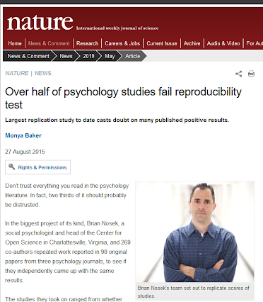
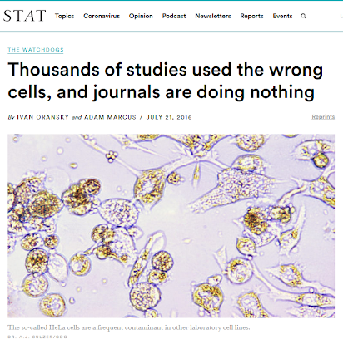
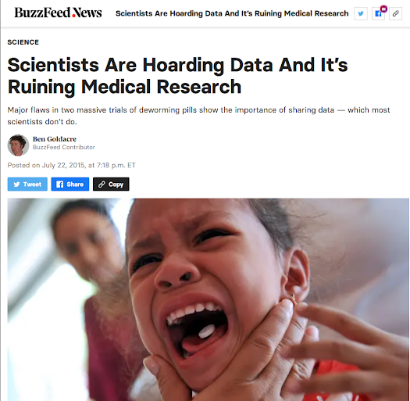
Notes:
Source links for images & stories:
Over half of psychology studies fail reproducibility test - http://www.nature.com/news/over-half-of-psychology-studies-fail-reproducibility-test-1.18248
Scientists are hoarding data - http://www.buzzfeed.com/bengoldacre/deworming-trials
Thousands of studies used the wrong cells - https://www.statnews.com/2016/07/21/studies-wrong-cells/

Slide 11
What are the stakes?
Harm to research participants
Waste/Loss of research funding
Data loss and publication retraction
Inability to recruit top faculty and students
Loss of sponsor confidence
Loss of public trust
*Slide adapted from Swamy, G. (2020). Accelerating public access to research data. Keynote presentation at the AAU/APLU Summit on Public Access to Research Data, Washington, D. C.

Slide 12
A renewed focus on research integrity
Singapore Statement Principles
Honesty in all aspects of research
Accountability in the conduct of research
Professional courtesy and fairness in working with others
Good stewardship of research on behalf of others
Notes:
Doing the best research possible given the available resources, research aims, selected approach and methodology
Source: https://wcrif.org/guidance/singapore-statement

Slide 13
A renewed focus on research integrity
Singapore Statement Responsibilities
Integrity (trustworthiness)
Adherence to regulations
Research methods
Research records
Research findings
Reporting irresponsible research practices
Responding to irresponsible research practices
Research environments
Societal considerations
Notes:
Source: https://wcrif.org/guidance/singapore-statement
14 Responsibilities, only some of which are listed here
1. Integrity: Researchers should take responsibility for the trustworthiness of their research.
2. Adherence to Regulations: Researchers should be aware of and adhere to regulations and policies related to research.
3. Research Methods: Researchers should employ appropriate research methods, base conclusions on critical analysis of the evidence and report findings and interpretations fully and objectively.
4. Research Records: Researchers should keep clear, accurate records of all research in ways that will allow verification and replication of their work by others.
5. Research Findings: Researchers should share data and findings openly and promptly, as soon as they have had an opportunity to establish priority and ownership claims.
6. Authorship: Researchers should take responsibility for their contributions to all publications, funding applications, reports and other representations of their research. Lists of authors should include all those and only those who meet applicable authorship criteria.
7. Publication Acknowledgement: Researchers should acknowledge in publications the names and roles of those who made significant contributions to the research, including writers, funders, sponsors, and others, but do not meet authorship criteria.
8. Peer Review: Researchers should provide fair, prompt and rigorous evaluations and respect confidentiality when reviewing others' work.
9. Conflict of Interest: Researchers should disclose financial and other conflicts of interest that could compromise the trustworthiness of their work in research proposals, publications and public communications as well as in all review activities.
10. Public Communication: Researchers should limit professional comments to their recognized expertise when engaged in public discussions about the application and importance of research findings and clearly distinguish professional comments from opinions based on personal views.
11. Reporting Irresponsible Research Practices: Researchers should report to the appropriate authorities any suspected research misconduct, including fabrication, falsification or plagiarism, and other irresponsible research practices that undermine the trustworthiness of research, such as carelessness, improperly listing authors, failing to report conflicting data, or the use of misleading analytical methods.
12. Responding to Irresponsible Research Practices: Research institutions, as well as journals, professional organizations and agencies that have commitments to research, should have procedures for responding to allegations of misconduct and other irresponsible research practices and for protecting those who report such behavior in good faith. When misconduct or other irresponsible research practice is confirmed, appropriate actions should be taken promptly, including correcting the research record.
13. Research Environments: Research institutions should create and sustain environments that encourage integrity through education, clear policies, and reasonable standards for advancement, while fostering work environments that support research integrity.
14. Societal Considerations: Researchers and research institutions should recognize that they have an ethical obligation to weigh societal benefits against risks inherent in their work

Slide 14
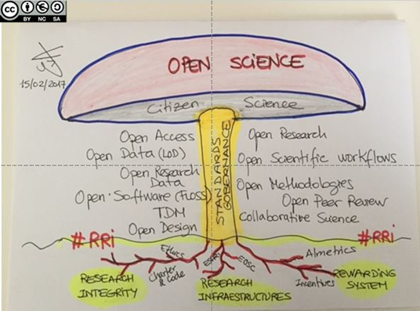
Open Science as a set of tools & practices
“Open Science is the practice of science in such a way that others can collaborate and contribute, where research data, lab notes and other research processes are freely available, under terms that enable reuse, redistribution and reproduction of the research and its underlying data and methods.”
- FOSTER portal

Slide 15
Information is a public good
Principles of the scholarly commons (FORCE11)
P1. The scholarly commons is an agreement among knowledge producers and users.
P2. Research and knowledge should be freely available to all who wish to use or reuse it.
P3. Participation in the production and use of knowledge should be open to all who wish to participate
version 0.1.1, archived in Zenodo at https://doi.org/10.5281/zenodo.569952

Slide 16
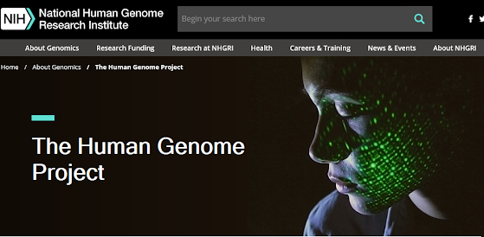
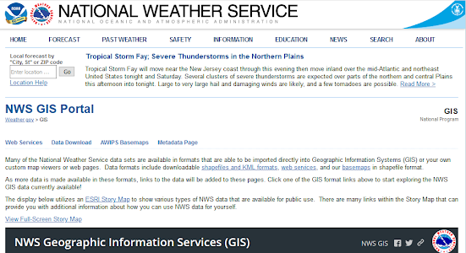
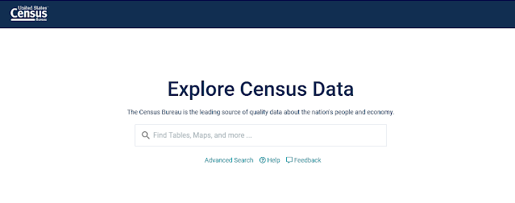
Open data is a vital resource in our daily lives
Notes:
Source links for images & resources:
National Weather Service - https://www.weather.gov/gis/
The Human Genome Project - https://www.genome.gov/human-genome-project
Census data - https://data.census.gov/cedsci/

Slide 17
Expectations have changed for data sharing
Funder policies on data sharing
Funder policies on data management plans (DMP)
DMP as elements of the award contract
Publisher and journal policies on the availability of data underlying published results
FAIR Data Principles
TOP Guidelines for publishers
Adoption of data citation infrastructure and practices

Slide 18
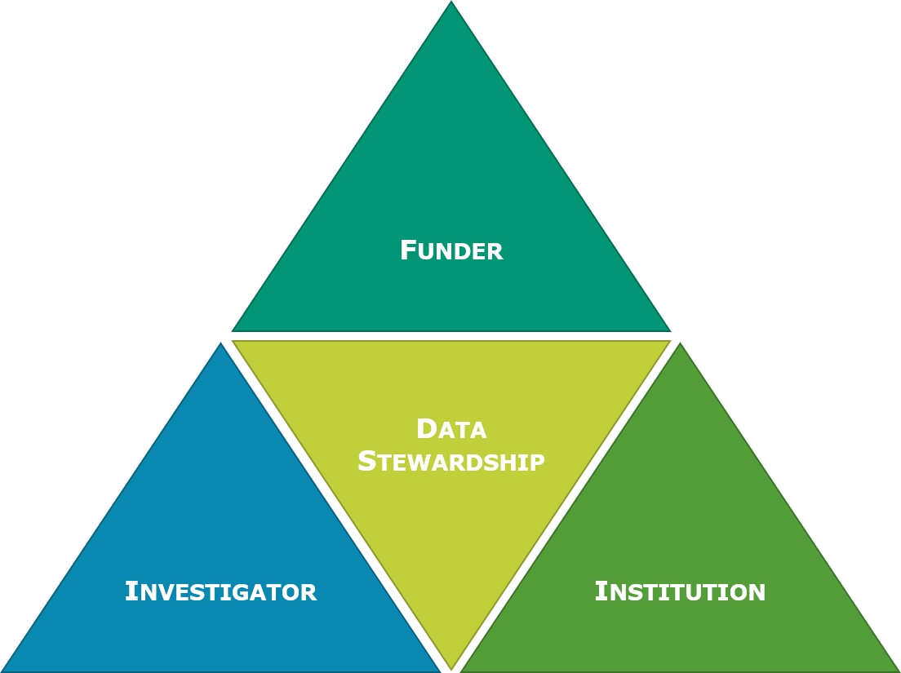
Data stewardship is a shared responsibility
Notes:
“Data governance is a quality control discipline that encompasses the classification, collection, storage, access, use, sharing, maintenance, integrity, privacy and security of institutional information.”

Slide 19
Governing research data
Scoping, challenges, & opportunities

Slide 20
Institutions should foster a culture of research integrity.
Notes:
Attentiveness
Attentiveness is crucial to the ethics of care because care requires a recognition of others' needs in order to respond to them.[17] The question which arises is the distinction between ignorance and inattentiveness.[17] Tronto poses this question as such, "But when is ignorance simply ignorance, and when is it inattentiveness"?[17]
Responsibility
In order to care, we must take it upon ourselves, thus responsibility. The problem associated with this second ethical element of responsibility is the question of obligation. Obligation is often, if not already, tied to pre-established societal and cultural norms and roles. Tronto makes the effort to differentiate the terms "responsibility" and "obligation" with regards to the ethic of care. Responsibility is ambiguous, whereas obligation refers to situations where action or reaction is due, such as the case of a legal contract.[17] This ambiguity allows for ebb and flow in and between class structures and gender roles, and to other socially constructed roles that would bind responsibility to those only befitting of those roles.
Competence
To provide care also means competency. One cannot simply acknowledge the need to care, accept the responsibility, but not follow through with enough adequacy - as such action would result in the need of care not being met.[17]
Responsiveness
This refers to the "responsiveness of the care receiver to the care".[17] Tronto states, "Responsiveness signals an important moral problem within care: by its nature, care is concerned with conditions of vulnerability and inequality".[17] She further argues responsiveness does not equal reciprocity.[17] Rather, it is another method to understand vulnerability and inequality by understanding what has been expressed by those in the vulnerable position, as opposed to re-imagining oneself in a similar situation.[17]

Slide 21
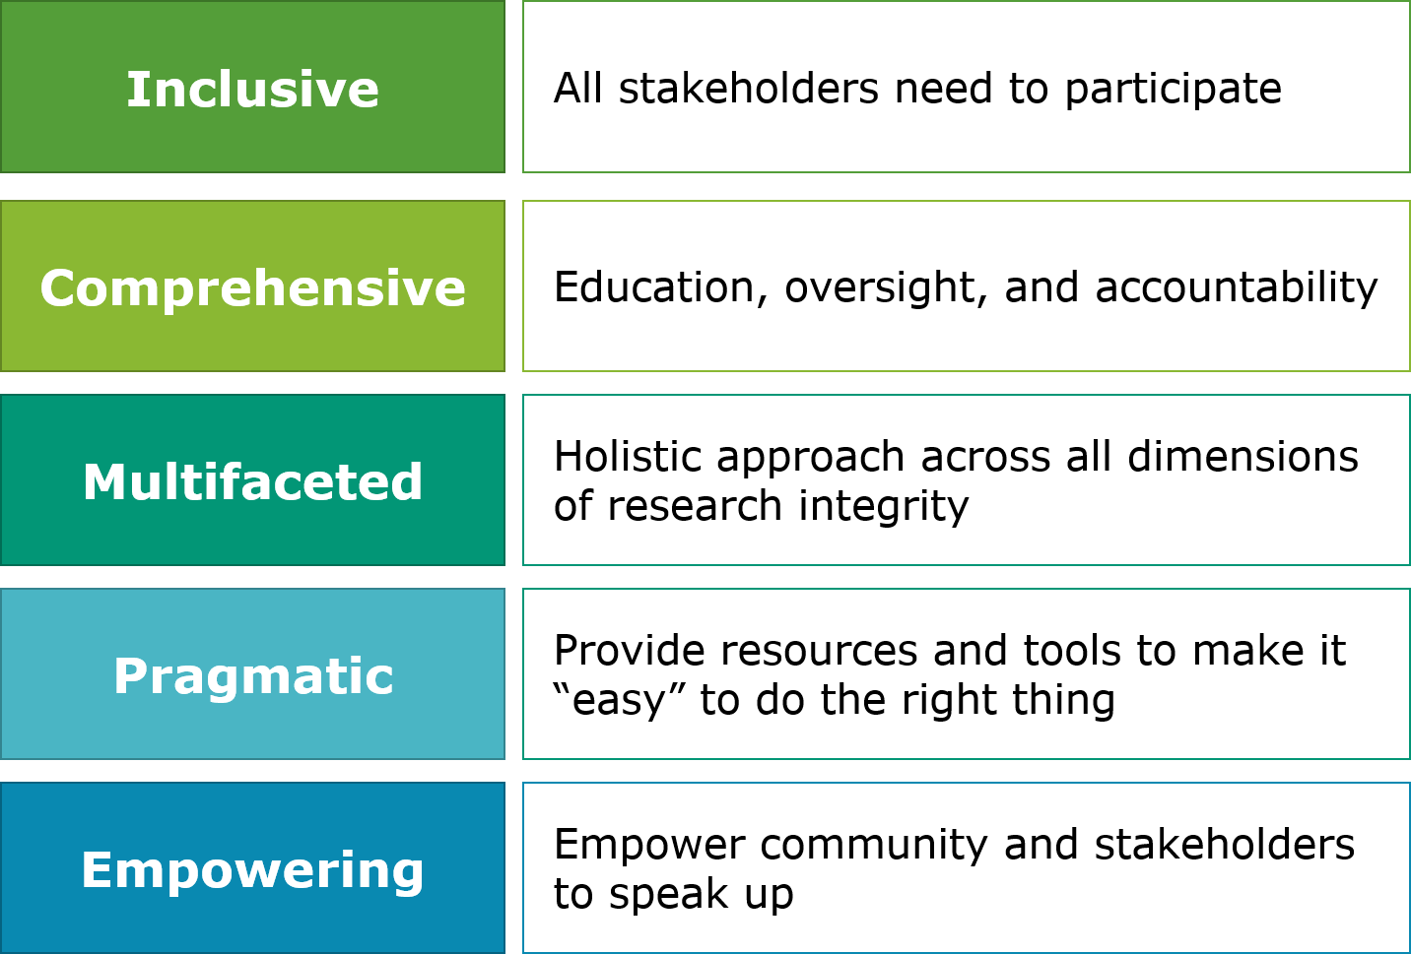
Key Principles: Building a culture of research integrity
Excerpted from Geeta Swamy’s Keynote at the AAU/APLU Summit on Public Access to Research Data, February 2020

Slide 22
language of data governance
language of research data stewardship
Notes:
In particular, the language used in data governance processes is very technical and oriented on data security
Caveat - The ways in which researchers talk about data management, sharing, and stewardship varies widely by discipline

Slide 23
Research Lifecycle
Preservation
Provocation
Dissemination
Ideation
Validation
Knowledge Generation
Notes:
Building a culture of research integrity centers the researcher in the discussion and strategy
In contrast, data governance often centers the data, specifically the security of the data
Sometimes this is to the detriment of the researcher/user experience...which is one reason there is a lot of shadow IT in higher education

Slide 24
The challenges reveal opportunities
Institutional governance of research data is not aligned with stewardship of data by research communities
Researchers are minimally aware of and engaged with institutional data governance policies and processes
Data about research is not connected to research data and project documentation (unlike other data domains)
Universal training on research data management is not required
Individual data management practices are reactive, shaped by compliance requirements & limitations of infrastructure
Institutional policies do not provide practical guidance on RDM

Slide 25
Decouple data security from data sharing
Balance data security with feasible workflows for researchers
Cultivate and encourage a workflow perspective on security
Practices, standards, and infrastructure for data dissemination, publication & sharing, are multifaceted and still emerging
Use specific and distinctive language for access during the active phase of the project as compared to decisions about sharing data as part of the scholarly record
Foster a space to allow the data security and research experts to find common ground and discuss issues

Slide 26
Research data management is about the people
Training
Clarify institutional and investigator responsibilities
Policies, procedures, and process related to research data management
Support available
Guidance
Practical strategies for research data management
Recommended tools, templates, practices
Be responsive to changing needs
Notes:
Steneck, 2004
Data ownership
Data collection
Data storage
Data protection
Data retention
Data analysis
Data sharing
Data reporting
Provide training on foundational practices that can be applied to any platform or system: articulating roles & responsibilities, record-keeping and documentation, file organization & management,

Slide 27
Key tool: operational Data Management Plans
Project personnel
Roles & responsibilities
Onboarding & exit procedures
Funder/Sponsor Data Requirements
Publisher Data Availability & Sharing Requirements
Intellectual Property
Ethical & legal obligations pertaining to data
Data description
Data types & formats
Data storage & organization
Documentation & metadata
QA/QC
Dissemination & sharing
Retention, Archiving, Preservation

Slide 28
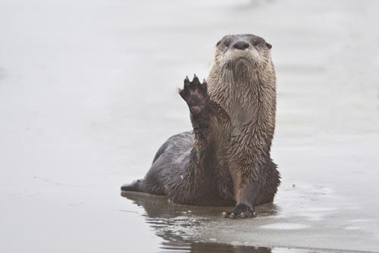
Any questions?
You can find me at:
https://datamanagement.iu.edu/governance/ data-stewards/Research-data.php
hcoates@iupui.edu

Slide 29
CREDITS
Special thanks to all the people who made and released these awesome resources for free:
Presentation template by SlidesCarnival
Photographs by Unsplash

Slide 30
PRESENTATION DESIGN
This presentation uses the following typographies:
Titles: Poppins
Body copy: Montserrat
Download for free at:
https://www.fontsquirrel.com/fonts/poppins
https://www.fontsquirrel.com/fonts/montserrat
You don’t need to keep this slide in your presentation. It’s only here to serve you as a design guide if you need to create new slides or download the fonts to edit the presentation in PowerPoint®

Slide 31
SlidesCarnival icons are editable shapes. This means that you can:
Resize them without losing quality.
Change fill color and opacity.
Change line color, width and style.
Isn’t that nice? :) Examples:

Slide 32
Diagrams and infographics

Slide 33
😉
You can also use any emoji as an icon! And of course it resizes without losing quality. How? Follow Google instructions https://twitter.com/googledocs/status/730087240156643328
✋👆👉👍👤👦👧👨👩👪💃🏃💑❤😂😉😋😒😭👶😸🐟🍒🍔💣📌📖🔨🎃🎈🎨🏈🏰🌏🔌🔑 and many more...

Slide 34

Free templates for all your presentation needs
For PowerPoint and Google Slides
100% free for personal or commercial use
Ready to use, professional and customizable
Blow your audience away with attractive visuals

