Slide 1

Intro to contracts
and licensing
Scarlet Galvan
ONEAL Project
2024
Notes:
Hi everyone this is the ONEAL Project’s Intro to contracts and Licensing. I’m Scarlet Galvan and as of this recording I'm the collection strategist librarian for Grand Valley State University Libraries in Allendale Michigan and for the last 5 years I've been building a values-driven negotiation program, collaborating with our collections team, our systems and Discovery team and our Liaisons to make progress in this way.
We're relatively new members of the Carnegie doctoral professional classification which is like M1 in that we're in the band of schools where users have higher expectations generally because of where we tend to hire faculty from and libraries generally in this band have fewer resources smaller endowments and less institutional power to meet those demands which can make doing the work of contracts and licensing especially challenging.

Slide 2
Agenda
  Introduction
  Goals
  Anatomy of a contract
  To-do
  Overview of terms
  To-do
  Community
Notes:
So, briefly the agenda on this recording is as follows:
we'll do an introduction
we'll go over goals for the lesson
we'll cover the anatomy of a contract
and do a brief overview of terms to look for as a starting place for discussion with uh folks like our office of general counsel or your University's procurement office depending on who you might be working with. You'll have some reading and materials review to do,
and you'll apply what you've learned from this video and those readings in two scenarios based on real discussions between academic libraries and vendors
and finally, we’ll wrap up with next steps and where to find community of other practitioners doing this work.

Slide 3
A brief disclaimer:
This module is not legal advice, but an overview of how members of the ONEAL Project team and others working for academic libraries in the United States read contracts and license agreements.
Notes:
This module is not legal advice, but an overview of how members of the ONEAL Project team and others working for academic libraries in the United States read contracts and license agreements. Even the people affiliated with the project who attended law schools, while those people might be trained as lawyers, they are not your lawyer.
When possible, we've included materials on model licenses in Canadian contexts, but this will be quite centered on the experience of our project team, we're all in the United States, and we're funded by a federal grant from the Institute of Museum and Library Services. So, while we want to include more resources for our colleagues outside the US, we have to be very deliberate about how we do that.

Slide 4
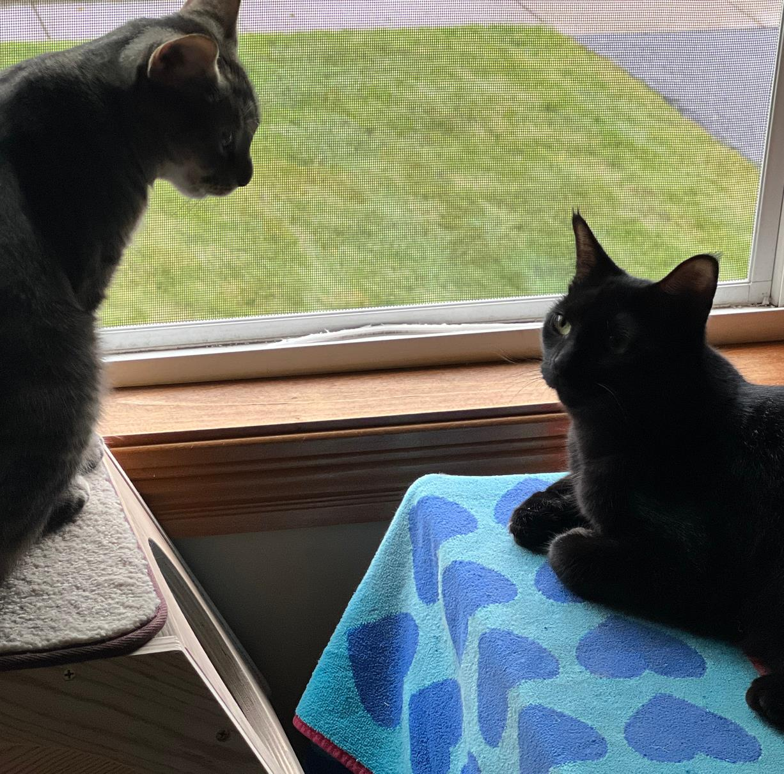
Notes:
You might hear my cats in the background during this section so I figured I might as well introduce them since they can have moments of goblin-like joy. The tabby on the left is Meep and the black cat on the right is Pekoe and they are about one and a half years old.

Slide 5

Notes:
So, I was telling my colleagues that this work can sometimes feel a lot like the scene in Apollo 13 where a Thing has Happened and the engineering group in Mission Control needs to do the equivalent of putting a square peg in a round hole to save the astronauts, and they introduced the problem by saying “Okay people listen up, the people upstairs have handed us this one and we got to come through. We got to find a way to make this [the square peg] fit into the hole for this [the round hole] using nothing but that [anything available on the spacecraft],” which is now dumped in a pile on the worktable.
And so often collections work, trying to negotiate for resources, reading through a contract, trying to balance all the needs of the constituents can feel a little like that moment but there's also something energizing about the work and the kind of impact that a license can have.

Slide 6
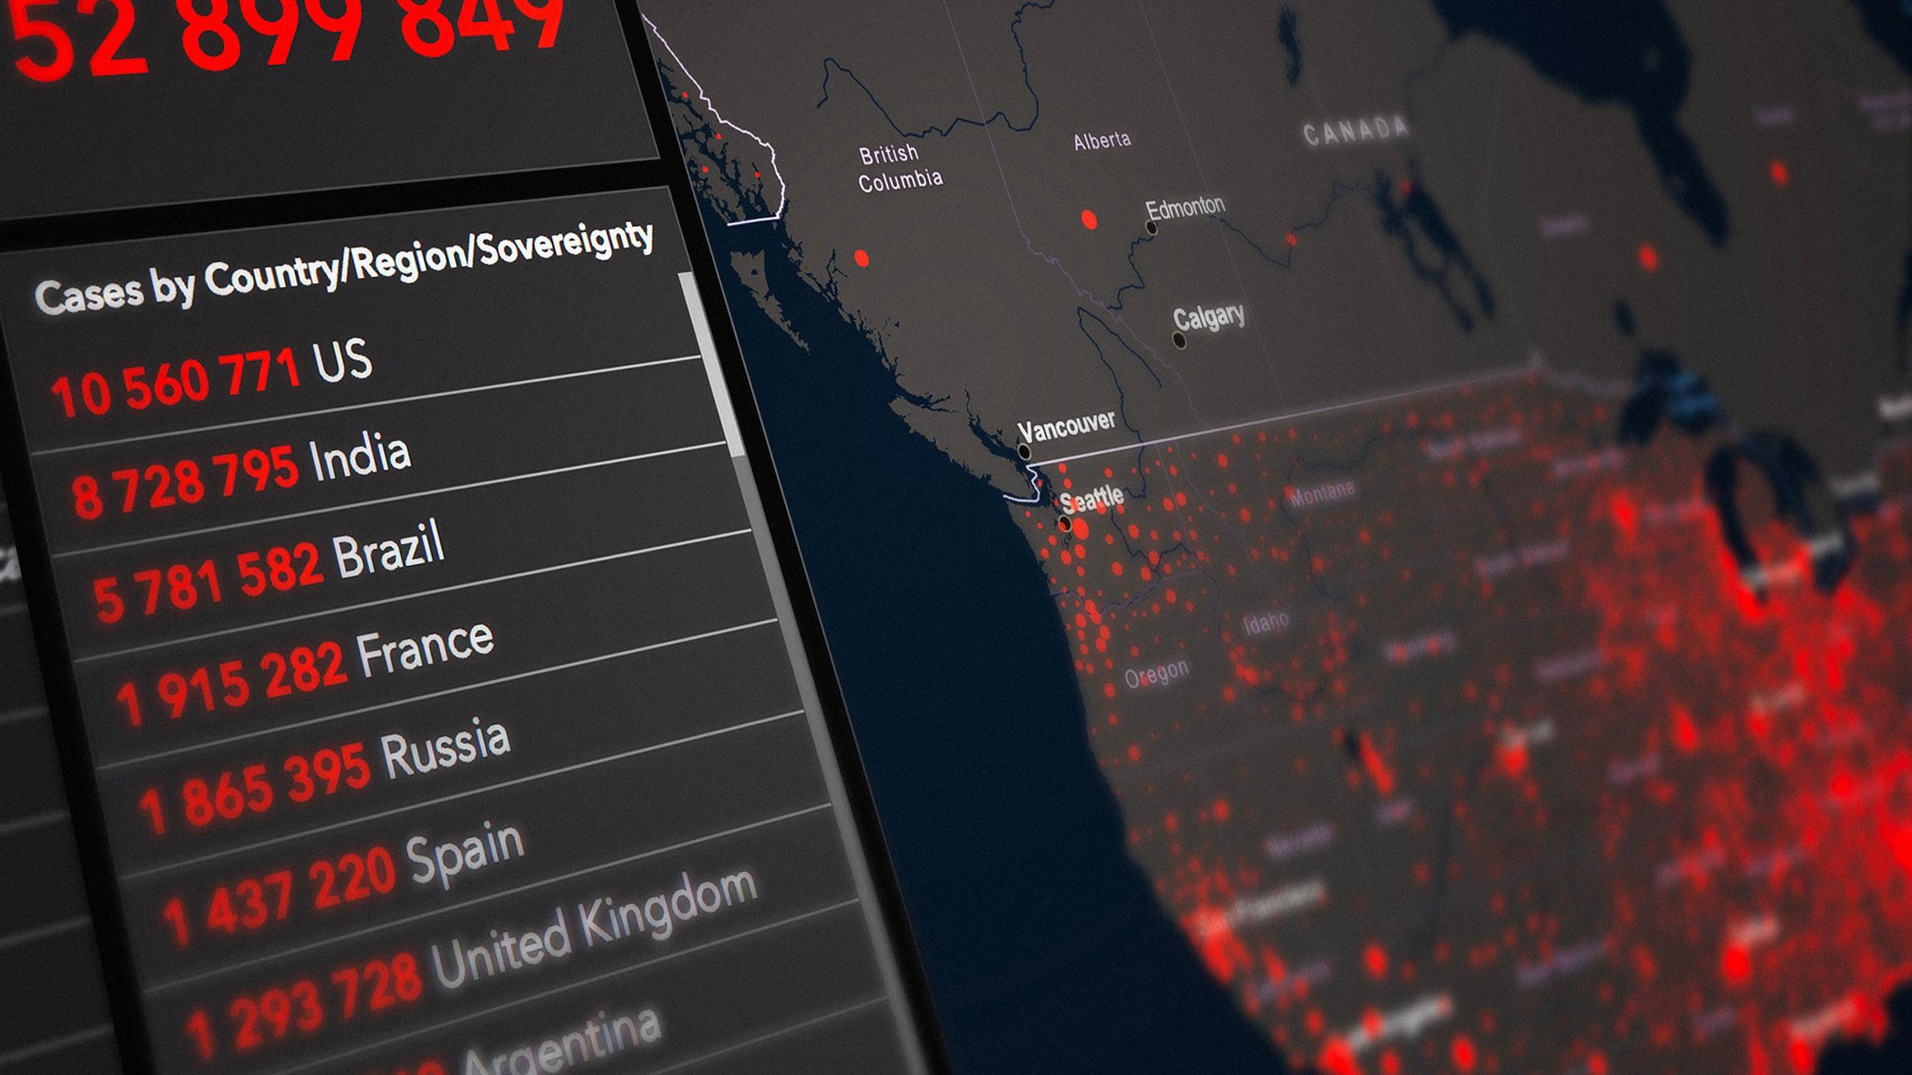
Notes:
I started this work in 2019 and had about six months of pre pandemic work time which I think makes this extra weird if only because that experience means that I functionally work at a different library than many of the people who've been here for years do. My formative experience of the libraries’ culture has been shaped by the pandemic and you might hear that over the course of this module. And while the situation now isn't as immediate as Apollo 13 or early Covid shutdowns, effective contracts and licensing does require that same kind of team teamwork, that “all hands” sense, all of us with different kinds of experience and expertise working together on a solution.

Slide 7
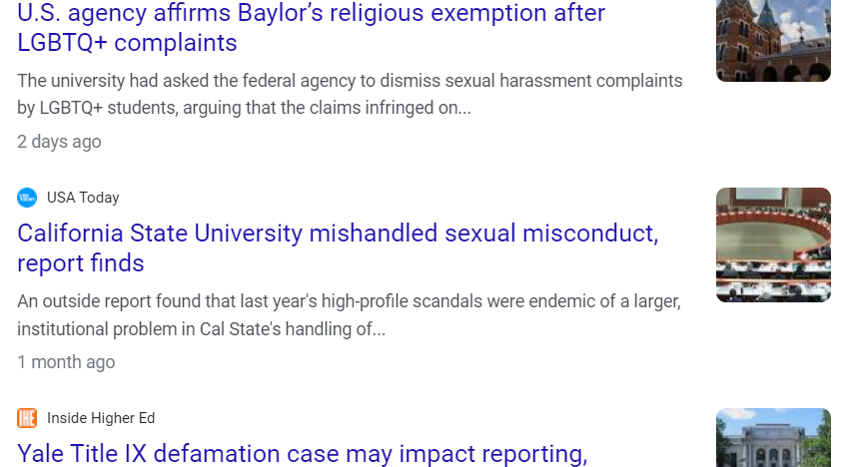
Notes:
And, to be frank, the current climate is one where your University's general counsel is very busy, you'll want to be sure when they see a meeting with the library that it's because you want to get on the same page about your goals and you're working to minimize institutional risk, but we'll get to the management of that relationship later in the module. This can be a dense module, so we've broken this up with breaks because a lot of how you'll apply your understanding of contracts has to do with your local environment and institutional needs.

Slide 8

Goals
  Read and evaluate a license to determine how well it meets basic criteria and goals
  Understand how licensing decisions impacts library services, research, teaching, and learning
  Approach colleagues in other departments to build relationships and support
Notes:
Our goals for introducing contracts and licensing are in three broad areas:
first, we want to be able to read and evaluate a license to determine how well it meets basic criteria and the various goals, and the only way to get
better at reading contracts and licensing is to read them, to have the experience of working through the language and the genre.
another goal is to understand how licensing decisions impact library services, research, teaching, and learning because they do
and then finally we want to be able to give you the tools to approach colleagues in other departments, whether that's in the library or um external to the library in the greater university environment to build relationships and support for what your goals are.

Slide 9


Take a break
Notes:
So, before we dive in feel free to take a break stretch a little grab the things you need to study effectively go ahead and pause this recording and we'll start with the anatomy of a contract and structure of it when you come back

Slide 10

Anatomy of a contract
Notes:
First we'll go over what a contract and what a license is and what kind of structural elements they contain.

Slide 11



A note on language
A contract is an agreement which stablishes roles, responsibilities, obligations and what happens when one party breaches or violates them.
A license agreement describes permitted uses that might otherwise infringe a 3rd party’s rights--usually copyrights. A license is a type of contract.
Notes:
Before we get into the main content, a note on language. You might hear or see me use the words contract and license interchangeably--this isn't totally right, but in academic libraries the majority of the contracts we'll be analyzing are in fact license agreements.
A contract is an agreement between parties which stablishes roles, responsibilities, obligations and what happens when one party breaches or violates them.
A license agreement describes permitted uses that might otherwise infringe a 3rd party’s rights--usually copyrights. A license is a type of contract.

Slide 12



What is a contract?
They’re everywhere!
Rental or lease agreements; mortgage terms
Prenuptial or divorce agreements
Master Promissory Notes for student loans
Certain types of employment
End user license agreements (EULAs)
Memorandums of Understanding (MOUs)
Notes:
A contract is a document that describes the relationship between the library and whatever vendor is providing the content or the service so it's an important relationship management tool.

Slide 13
Rental agreement
As the renter, I agree to: maintain renter’s insurance, report when something needs repair or replacement, not smoke inside the building, give 90 days notice to end my lease agreement, to not sublet my apartment using services like Airbnb.
As the landlord, they agree to: give at least 24 hours of notice before entry, address maintenance requests quickly, provide alternative housing if my apartment or building is uninhabitable, not lock out tenants while eviction proceedings are in process.
Notes:
For example: I checked out my rental agreement because it was updated, and these are the kinds of things I and my landlord agree to.

Slide 14
Employment contract
As a new employee, you usually agree to: job title, pay, start date, location.
You might also agree to: define what in your work constitutes work for hire, professional development funding, relocation expense coverage, academic rank or time off your the tenure clock, oath of office in certain jurisdictions, or you might have a non-compete clause as a condition of employment.
Notes:
Like rental agreements and mortgages, employment contracts and agreements

Slide 15

Offer: What goods and/or services are being sold?
Structure of a contract
Consideration: What have the parties agreed to do? What are the terms?
Acceptance: Who agreed to this and when from each party?
Notes:
In order for a contract to be binding, it has to have an offer, acceptance, and consideration at minimum.
You’ll find a number of different structures for contracts, but this is the absolute, bare bones minimum required.
We’re not going to touch issues of capacity because for our purposes that’s hopefully not going to come up, what's more likely to come up is authority, so in our case who is authorized to sign an agreement. We might have the legal capacity to enter into a contract, but our institution might limit who has the authority to do so.
Most of the time we’re dealing with offers and consideration.
An offer is the part of the contract that details what goods and/or services are being sold.
Consideration is what have the parties agreed to do? So, the terms that define what we can and cannot do with those goods and services.
Acceptance: essentially, the date and signature lines from the parties authorized to enter into the contract on behalf of the vendor and the library.

Slide 16


Common components
Schedules
Addendums
Amendments
Definitions
Notes:
You’ll also see schedules, which are common in the kinds of contracts you’ll see in academic libraries. These can be content lists and individual pricing that is separate from the contract terms. You can think of a “schedule” as an information source that provides necessary information for the understanding and execution of the contract. So, if I am negotiating for a database of historical newspaper, I might get a schedule that includes which newspapers, and what the years of coverage are. It’s not something we have to sign, but it’s something I’d want to reference.
Addendums which can alter the terms of the contract or goes into greater detail.
Addendums can have interesting use cases, and some institutions manage their contracts entirely through addendums, so that would mean I'd get a contract from a vendor, and all the changes we negotiated would be in the addendum.
I think would be useful to tuck things into addendums when there’s a lot of resistance to putting information in the contract terms themselves. So, if I wanted to document something as it existed at the time I signed the contract, and wanted to preserve it as part of the agreement to reflect the parties’ understanding, I could see addendums being used in very creative ways.
You’ll see amendments too—these make changes to an existing agreement, or are an update to a master license so neither party is required to rehash all the terms. You’ll see these often, pages and pages of renewal amendments on higher cost resources that libraries have maintained for a long time. Most of the time when I get a contract that’s a tome it’s because there’s 20 pages of amendments that are changing the dates of the agreements, and updating the parties who entered into the agreement.
You’ll also see definitions, depending on the contract. Lots of places that are just breaking into the academic market, that provide highly specialized resources will occasionally not do a great job of this, or they will combine multiple things under one blanket term, we'll get into this more when we review specific terms and clauses.

Slide 17

Relationship management tool
Notes:
So again, a contract is a pretty dry sort of document, but it's a relationship management tool.
Before they are about specific terms, obligations, and clauses, contracts are about business relationships.
Vendor representatives are people too. That our jobs incentivize us differently is an effect of our workplaces and not a reflection of our individual priorities.
Early in the Covid-19 pandemic, a vendor rep and I got our wires crossed over email in a “We’ve discussed this clause already” sort of way. The vendor rep apologized, and I explained “It's fine, we're all experiencing a weird crisis fog right now.” I got a paragraph in response about how this person felt distressed about a partner returning to work on-site, and they were grateful that someone offered them a little bit of humanity.
This reminded me about our shared futures with content providers and publishers. We've had years to build a better future. However, providers persist with serious usability problems, discovery issues, and use of extractive terms around user privacy, even when we engage in good faith. But there are customer-facing workers on either side of these problems who can't solve them alone. Collectively and collaboratively, we can do better. Many of our colleagues and friends will go to work for vendors. The people whose job it is to submit or respond to tickets are doing the best they can with the resources they have, and they're not the problem just because the organization they work for has different incentives.

Slide 18

Notes:
Understanding contracts is much more than the overall cost of a product or service although that might be the thing that draws our attention first when we're looking at negotiations. The contract is the board we negotiate from, it's our field of play. For academic libraries, this ultimately means what the library values and how the library works are defined by those agreements.
What parties have which rights? How can our users work with the collection? Who holds the power to innovate?
Now, there's a number of external influences on that field of play: financial situation, various sorts of leverage, perception, and the goals of all parties to the contract. All those things influence how we read these documents and what we'll ask for, including how we're feeling about that business relationship.
I have a vivid memory of overhearing a group of lawyers discussing how they handled certain clients who were engaging quite emotionally with their contract disputes, and one of them said "Do you want this to be done, or do you want to be right? Because being right will cost more." He was talking about money, but there are time and capacity costs as well.
And so many people picked being right. It makes sense, it's deeply satisfying to be right on a human level, but it's one of the ways we're bringing ourselves to the work.

Slide 19
To do!
Read Chapter 4 of Managing Licensed E-Resources: Techniques, Tips, and Practical Advice, “The Joy of Licensing and Contracting for E-Resource Acquisition” by Joan Emmet.
If you’re in Canada, read the Canadian Research Knowledge Network’s model license for language comparisons.
Review the Syracuse University Libraries Licensing Principles and the ASERL Eleven.
Notes:
Before we click over to our next break slide, you have a couple of to-do items.
First, you'll want to do a close reading of Chapter 4 in Managing Licensed E-Resources: Techniques, Tips, and Practical Advice, it's called “The Joy of Licensing and Contracting for E-Resource Acquisition” by Joan Emmet. This chapter covers contract terms in depth and includes appendices for your reference.
You'll also want to review the Syracuse University Libraries Licensing Principles and the Association of Southeastern Research Libraries Eleven documents, which are linked in the curriculum.
If you’re in Canada, read the Canadian Research Knowledge Network’s model license for language comparisons from this chapter.

Slide 20

Take a break
Notes:
All right, let's finish up the to-dos, take a break, and when we come back we'll do an overview of some starter terms for values-driven contracts to discuss with your Office of General Counsel or your procurement office, depending on who does this work on your campus.

Slide 21

Overview of terms
Notes:
It is a fool’s errand to comprehensively teach contracts and licensing in a single module. Like metadata or cataloging, contract law is its own specialization in law schools that is constantly adapting to new case law, president, and emerging professional standards. So our goal is going to be understanding how to start thinking about these documents, and how you might go about conversations with other people on campus and in your library about what the contract represents and what that means for your institution. Even if you are the only person doing this work, your college or university likely has a General Counsel whose job it is to understand and implement the standards they believe will best protect the institution. In this way, the university’s lawyers serve a similar function as human resources in that the job is mitigating risk and protecting the university from litigation. Sometimes this is handled by a procurement office, but regardless of who does this at the university, this module will help you engage with them and set priorities.
Reading contracts is a skill, if it feels challenging right now, know that you will get better at it with practice, and extend yourself the grace if you're a beginner. Law evolves, we are all learning all the time, we're all situating that learning in new contexts. It's okay to be new, you have my permission.
If I knew nothing else about my institution's priorities or my library's, these terms are what I would take to those people in Counsel's Office or procurement, or both to get on the same page.

Slide 22

Non-disclosure and confidentiality agreements
These keep us from sharing information, working together, and discourage competition.
Notes:
So let's talk about libraries and non-disclosure agreements, or NDAs.
In very limited cases, there's information I would want covered in an NDA or confidentiality agreement, but my employer isn't in a space where we're often negotiating the kind of research or work that rises to the level of something requiring protection of intellectual property.
For academic library contracts from content providers, NDAs keep us from being good community stewards of our resources when all they're really doing is attempting to protect a price list. Every time we remove an NDA and share our contracts out with others, we're weakening the case that a price list from a sole source provider can be a trade secret. It might be our consortia doing this work, or if we work as a group to FOIA and send things to the SPARC contracts library, or if we have a public facing website for our collections and we're interested in modeling transparency for campus, no matter how we're doing it, sunlight is the best disinfectant. Again, the point here is stewardship of resources, and this should resonate with General Counsel.

Slide 23
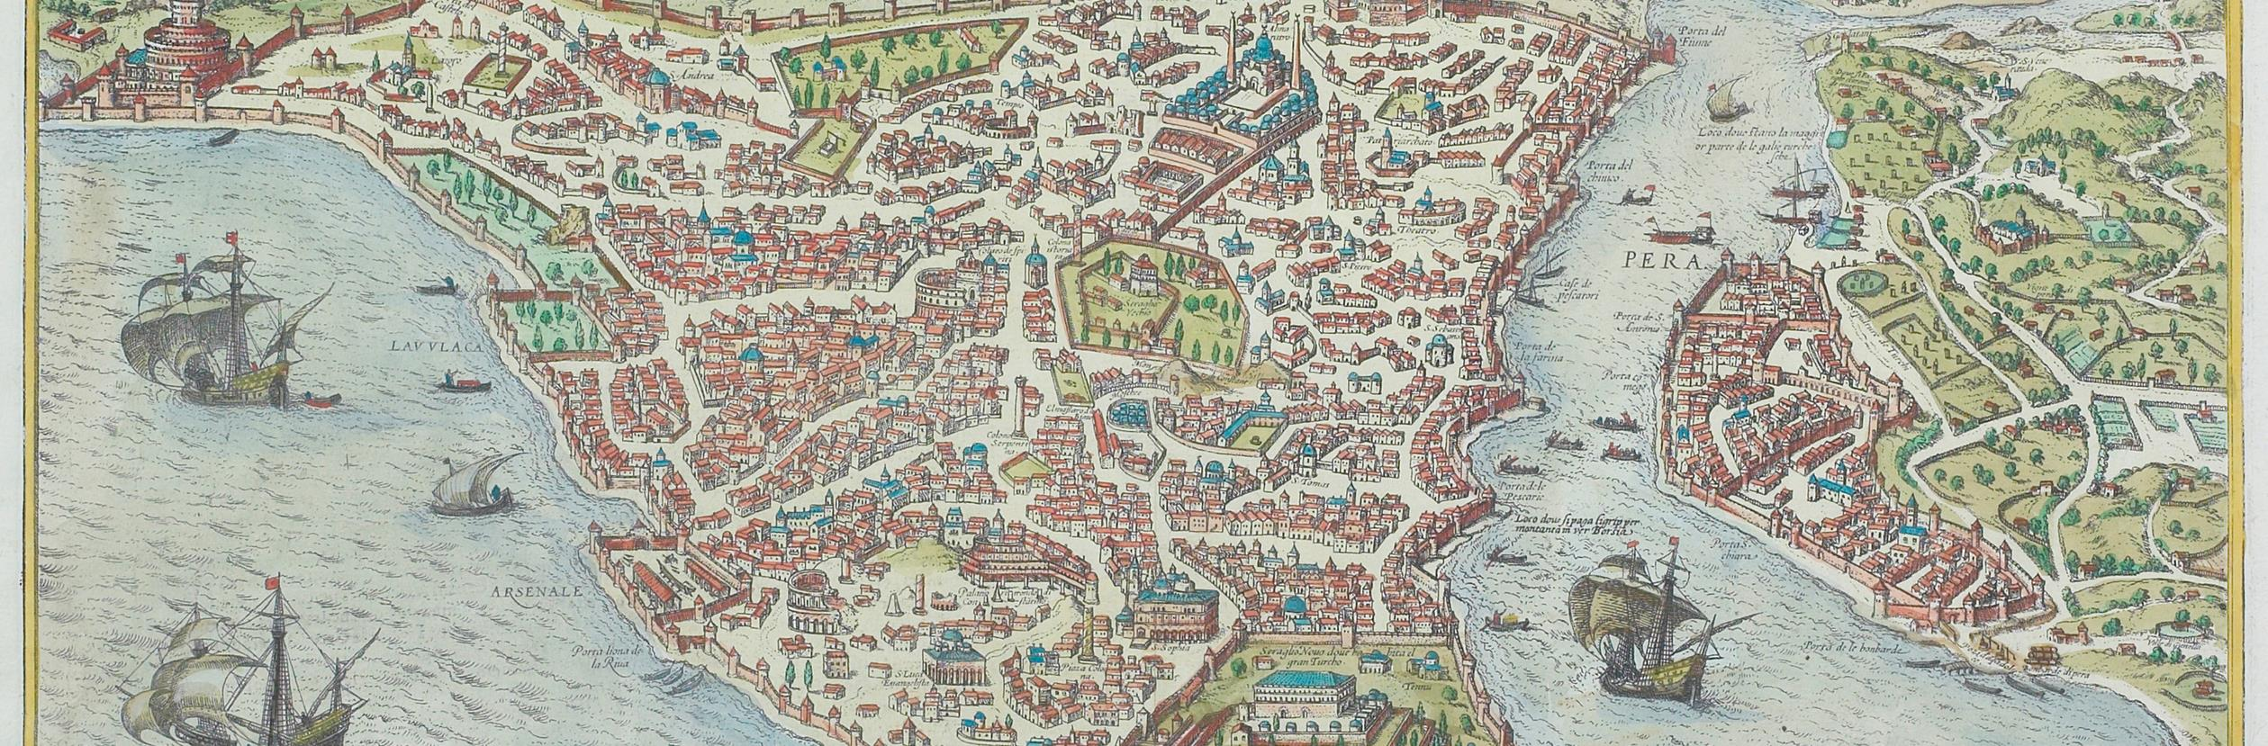
Jurisdiction and governing law
Notes:
If a dispute needs resolution, jurisdiction is an agreement between the parties about where that resolution takes place. This is sometimes called governing law or venue in a contract.
And this makes sense, right? You want the contract to declare the jurisdiction you're in, so if there is a dispute all parties understand which laws apply.
This matters because lawyers are licensed to practice in a particular state and will have expertise in that state’s laws, precedent, and knowledge of the local political environment. For some states it’s built into a part of the bar exam.
Practically: it’s more difficult to resolve a dispute in another state. Zoom may have resolved some of this, but wouldn’t mitigate the need for expertise in a specific jurisdiction.

Slide 24

Venue; Governing Law
Travis County, Texas, will be the proper place of venue for suit on or in respect of this Agreement. This Agreement and all of the rights and obligations of the parties hereto and all of the terms and conditions hereof will be construed, interpreted and applied in accordance with and governed by and enforced under the laws of the State of Texas.
Notes:
This example is from the default language used in contracts at University of Texas, Austin. If you're entering into an agreement with this institution, it makes sense the jurisdiction is Texas, and specifically Travis County where Austin is located.

Slide 25

Dispute resolution
Notes:
Dispute resolution explains how the parties to a contract will resolve disputes when they arise. So, if we can't work out something on our own through informal discussions, what are the processes we've agreed to invoke.
There are a variety of ways to manage contract disputes. Some lawyers want to go to court, that's the kind of resolution they're trained for, they are good at litigation and having the budget and staff to support it.
Others want arbitration, which is where a neutral party makes a binding decision to resolve the dispute, and all parties have to agree to it.

Slide 26

Notes:
Some contracts will include the right to review or audit use of the licensed resource. This can include:
physical spaces on campus such as classes, labs, and offices, university network activity, data, notes, and research on someone’s computer.
Some contracts will make audits a condition to use specific features such as an API, or insist on reviewing any data or research generated using those features.
Terms like this will probably run afoul of most faculty’s understanding of academic freedom. Libraries should avoid agreeing to audits in contracts whenever possible.
If you absolutely must agree to this sort of language:
Limit the scope of the audit
Add friction to the process of the audit

Slide 27

Indemnification
Notes:
Chapter 4 of the to-do list covers indemnification in greater detail, but briefly, indemnification is where I see the need for the most clarity around definitions.
When contracts conflate licensee (that's usually the library or institution) with authorized user, we're assuming responsibility for the actions of those authorized users, which means we're taking on quite a bit of risk. The library cannot be responsible for the actions of its users, just like if we cancel a resource, we cannot agree to things like making users destroy their data. Some of us have tens of thousands of users, we can't assume the liability and risk here.

Slide 28

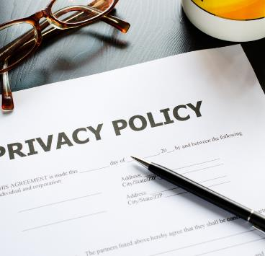

Mention of generative intelligence services, or use of scholarship to train a model.
Other terms to look for
Terms that account for user privacy.
Accessibility, because the VPAT is not good enough
Notes:
Mention of generative intelligence use, especially for dissertations and thesis deposits. As we expand our graduate programs, there should be the ability to opt in to having your dissertation train a model
Terms that account for user privacy. These are challenging to do well, and it can be difficult to push back against the debunked idea that students don't care about privacy. If this is something you hear frequently at your institution, there is peer-reviewed ammo available that centers student voices, courtesy of our friends at the Data Doubles project.
Finally, I look for terms around accessibility, because the VPAT is usually quite aspirational, and you'll learn more about that in our section on accessibility.

Slide 29
To do!
Respond to the questions in each exercise scenario. Apply your understanding so far.
Exercise: The Audit
Exercise: Nondisclosure agreements and the law
Notes:
Before we finish up, you have a couple of to-do items.
I've got two scenarios that are based on real discussions and exchanges with content providers and academic libraries.
Respond to the questions in each scenario. Apply your understanding so far, based on the videos, readings, and any experiences you've had to develop your answers.

Slide 30

Join your colleagues at
oneal-project.org
newsletter
discord server
events
Notes:
Finally, we know this work can be gratifying, it can be isolating, more often than not we're the only person doing the work or we're part of a limited number of people who understand how contracts and licensing deeply influence what's possible for research and teaching. Over and over as the ONEAL project team conducted forums and individual interviews to build the initial OER, we heard this need for community. To that end, please join us at oneal-dash project dot org, we've got a newsletter, a discord server, and post about our events and findings on the site. Come be with your colleagues, we'd love to see you.

