Slide 1
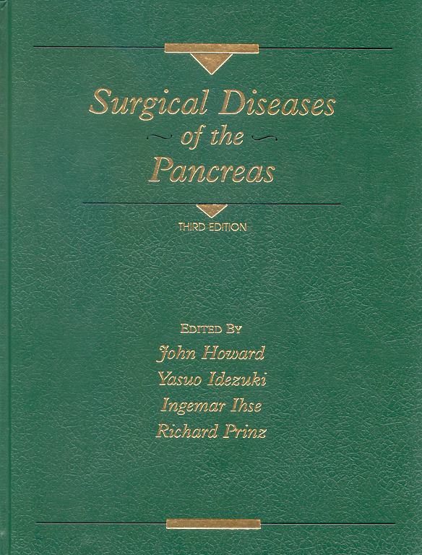
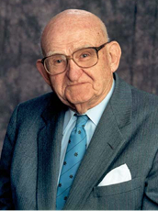
ONE DEGREE OF SEPARATION:
JOHN MALONE HOWARD, MD
FATHER OF PANCREATOLOGY
Nicholas J. Zyromski, MD FACS
Indiana University
History of Medicine/SIG
April 19, 2021

Slide 2
ONE DEGREE OF SEPARATION:
Zyromski – JM Howard, Sarr, Lillemoe, Pitt, TJ Howard
Hayward – Sabiston
Nakeeb – Cameron
House – Blumgardt, Brennan
Feliciano – Oliver Behrs
Dunnington - DeMeester

Slide 3
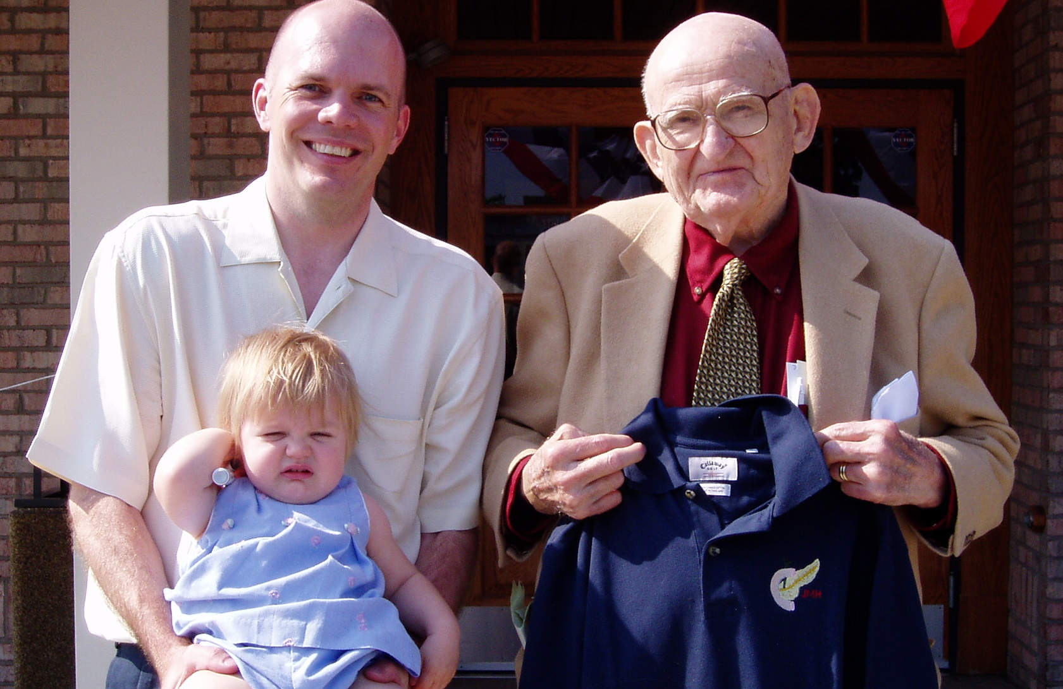
JM Howard: mentor, friend

Slide 4
John M. Howard, 1919-2011:
Training
Korean Conflict
Trauma System Development
Pancreatitis Observations
Pancreatic Surgery
Lifetime Scholarship
Life Lessons

Slide 5
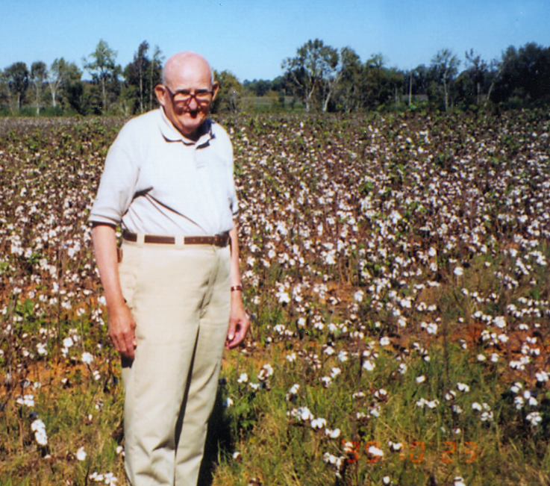
Early Life
Birmingham Southern
1941 BS, Cum Laude
  Phi Beta Kappa
  President of Students
  Sarah Shepard Rice

Slide 6
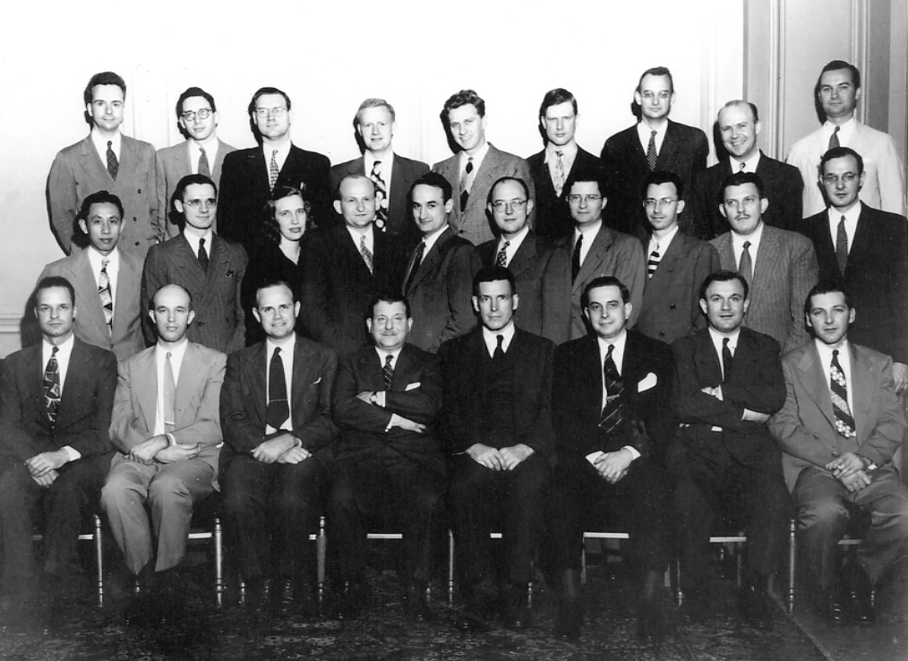
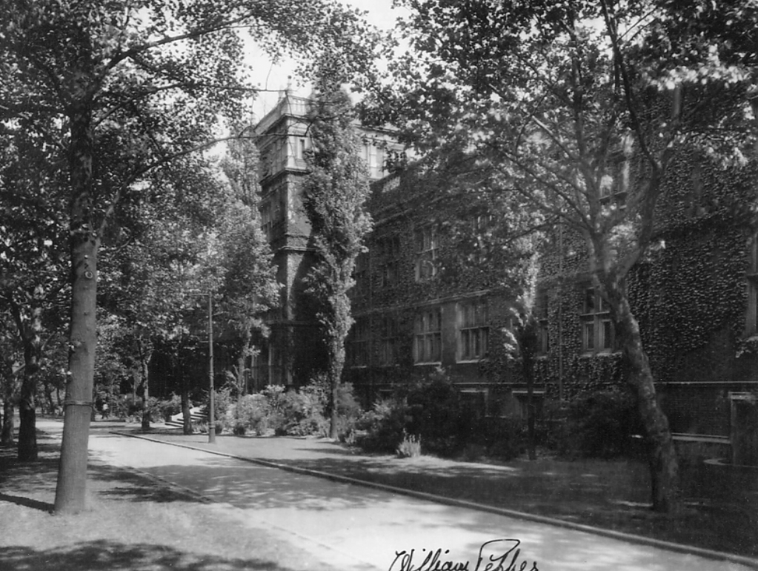
Training
University of Pennsylvania
  1944 MD, AOA
  Student Research Award (Pancreatitis Etiology)
  1944-50 General and Thoracic Surgery (I.S. Ravdin)

Slide 7
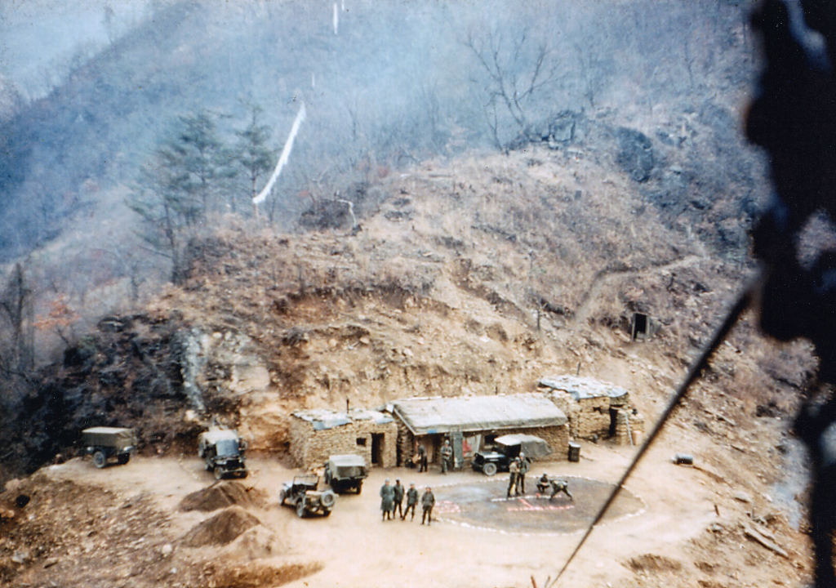
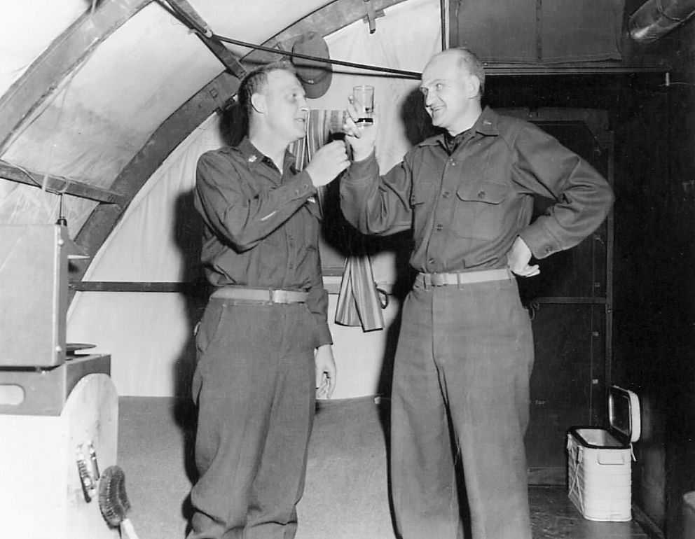
Korea
Korean Conflict
Director – USA Surgical Research Team
“Trapper John”
Renal replacement, “shock lung” (ARDS), arterial repair Ann Surg 1998 (5): 716-8.

Slide 8
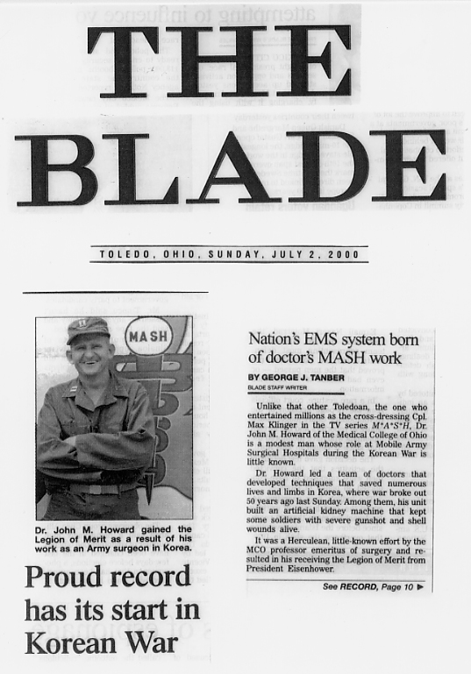
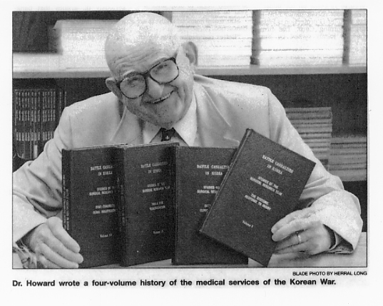
Korea & beyond
Legion of Merit (DDE)
EMS development
American Trauma Society

Slide 9
Korea & Beyond
Legion of Merit (DDE) – “Providing the vision for what has become our nation’s emergency medical services”
Chairman, Committee on Shock
Chairman, Committee on EMS
Founder, American Trauma Society (president 1968-70)
CV including > 460 publications; 43% on pancreas (!)

Slide 10
Academic Positions
1950-1954 – Baylor University (Michael Debakey)
1955-1957 – Emory University, Professor and Chairman of Surgery
1958-1974 – Hahnemann Medical College, Professor of Surgery
1974-2011 – Medical College of Ohio, Professor of Surgery; Professor Emeritus

Slide 11
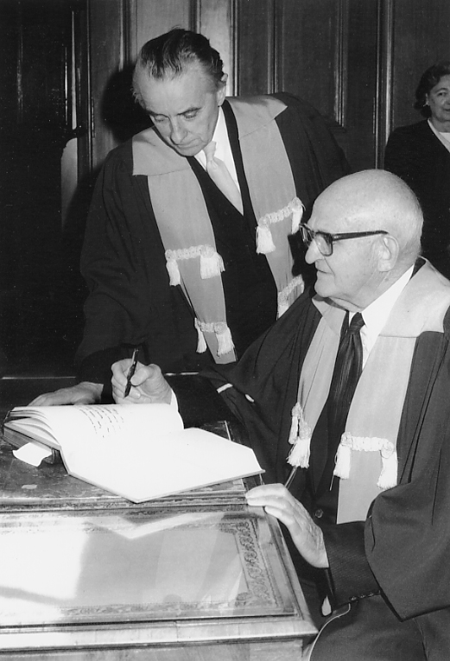
Academic Honors
  Royal College of Surgeons Edinburgh
  Brazilian College of Surgeons
  Japan Surgical Society
  European Surgical Association

Slide 12
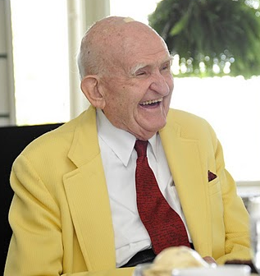
RECURRENT PANCREATITS
Raker (1953)
Howard and Ehrlich (1956, 1962)
  N=251; 90 (36%) had recurrent attack
Raker JW, Bartlett MK 1953 Acute pancreatitis: the fate of the patient surviving one or
more attacks. NEJM 249:751
Howard JM, Jordan GL Jr. 1956 Relapsing pancreatitis secondary to choledocholithiasis
Arch Surg 73:960
Howard JM, Ehrlich EW 1962 Gallstone pancreatitis: a clinical entity. Surgery 51: 177

Slide 13
RECURRENT PANCREATITIS
Author | Year | N | Recurrent AP
Howard and Ehrlich | 1962 | 251 | 90 (36%)
Paloyan et al. | 1975 | 64 | 31 (48%)
Trapnell and Duncan | 1975 | 232 | 88 (38%)
Elfstrom | 1978 | 63 | 16 (25%)
Sharon et al. | 1979 | 90 | 30 (33%)
Ranson | 1979 | 21 | 7 (33%)
Berlinski et al. | 1979 | 39 | 8 (20%)
Kelly | 1980 | 14 | 5 (36%)
Osborne et al. | 1981 | 100 | 26 (26%)
Welch and White | 1982 | 25 | 6 (24%)
Mayer et al. | 1984 | 37 | 4 (11%)
Burch et al. | 1990 | 102 | 23 (23%)
Total |  | 1038 | 334 (32%)
Notes:
Also IR, Diagnostic Radiology

Slide 14
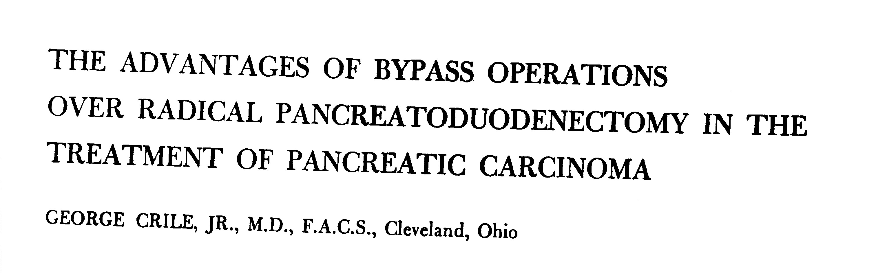
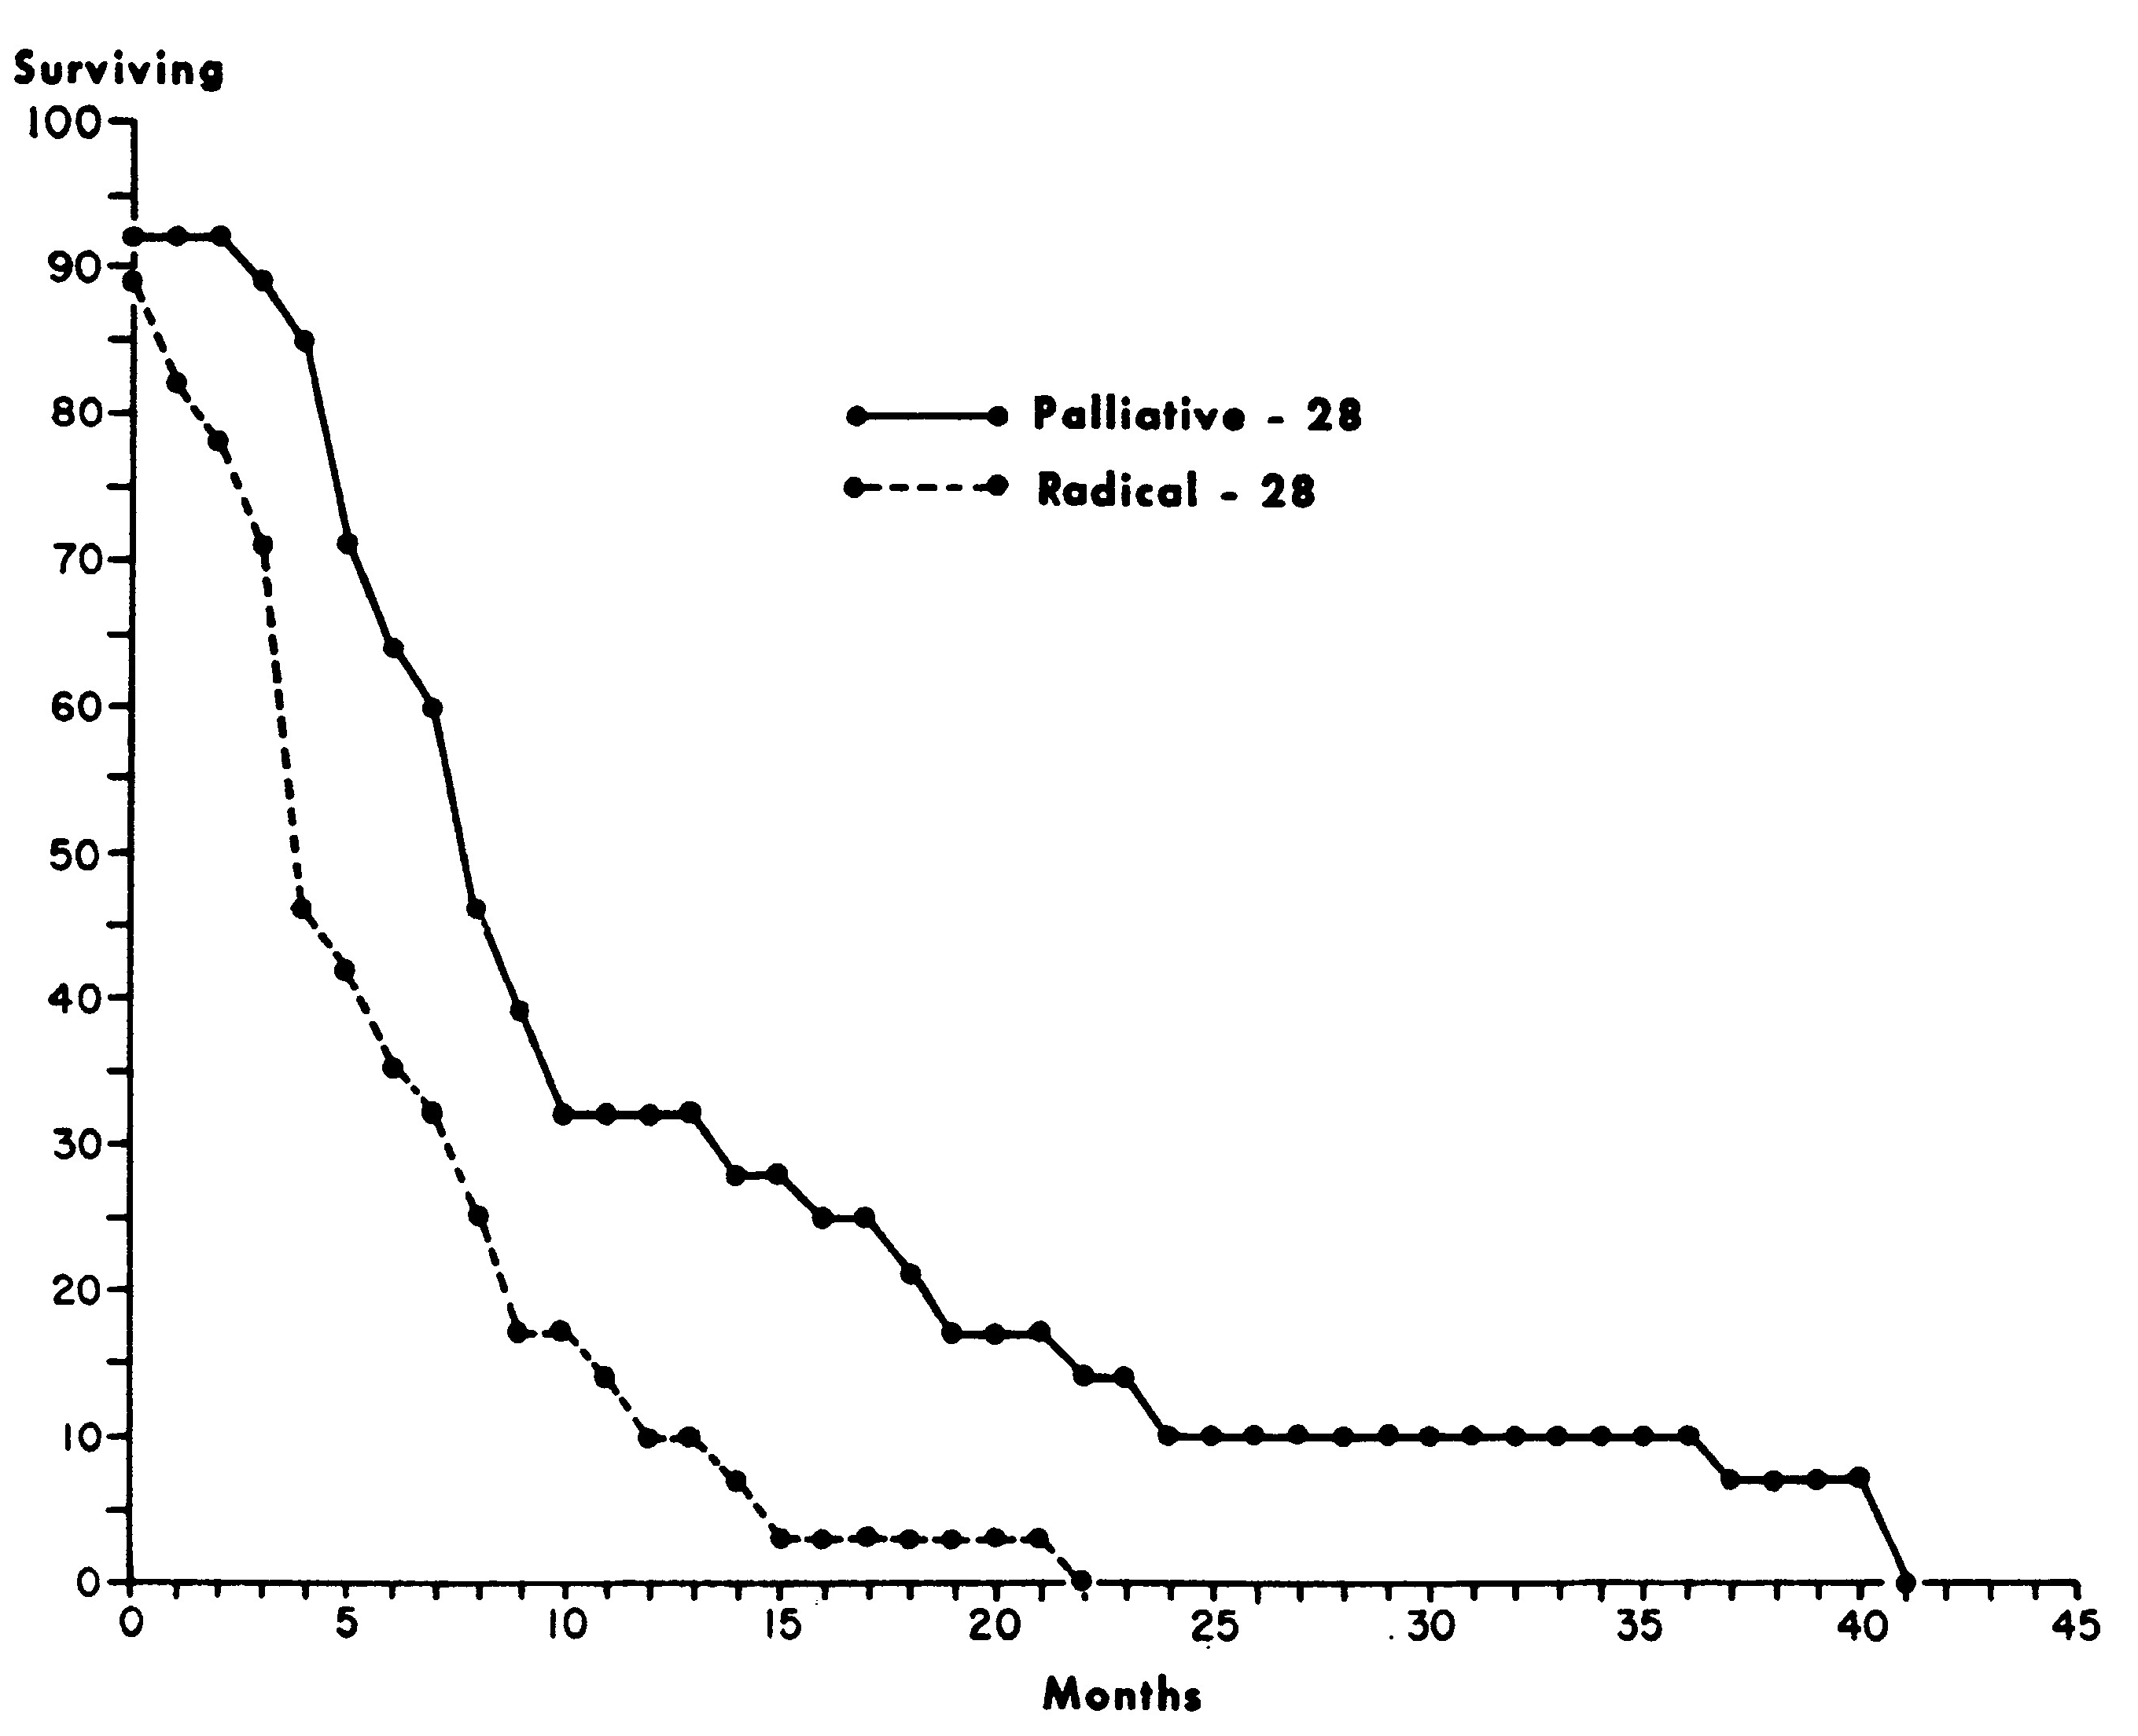
PANCREATODUODENECTOMY
Surgery Gyn Obstet 1970;130:1049-53
Notes:
Also IR, Diagnostic Radiology

Slide 15
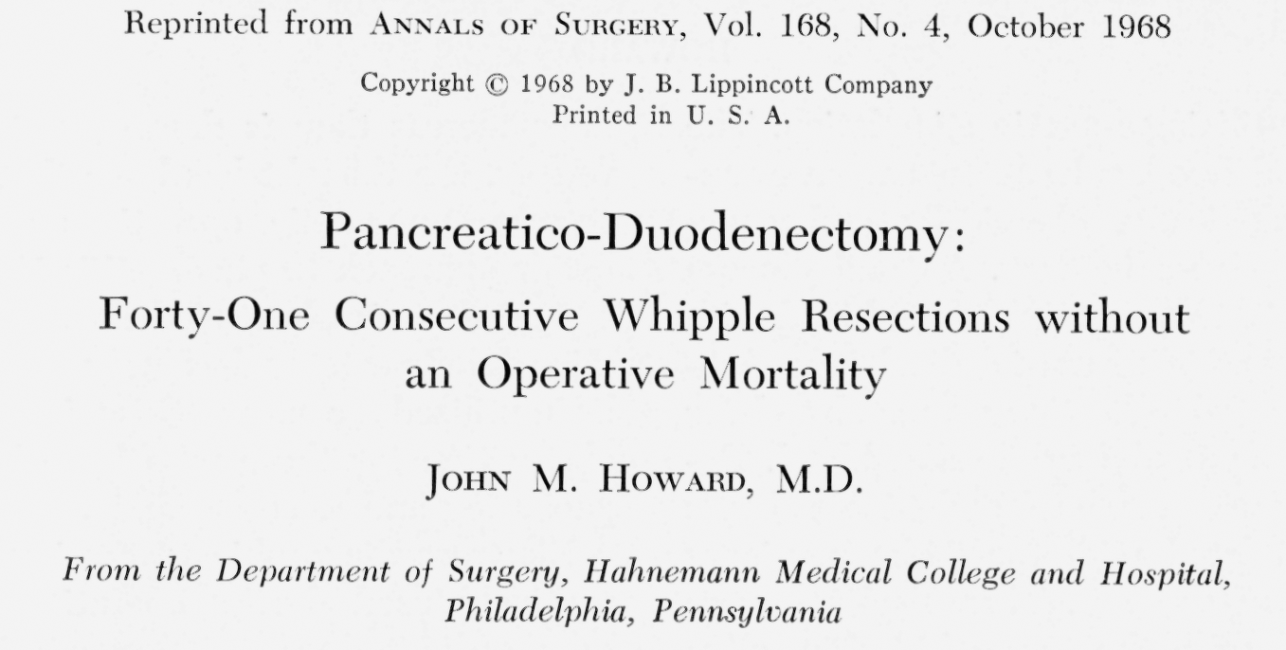
PANCREATODUODENECTOMY
Notes:
Also IR, Diagnostic Radiology

Slide 16
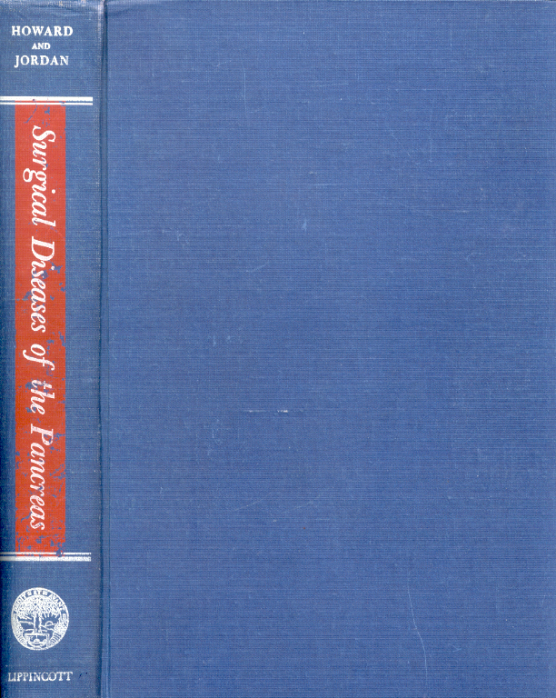
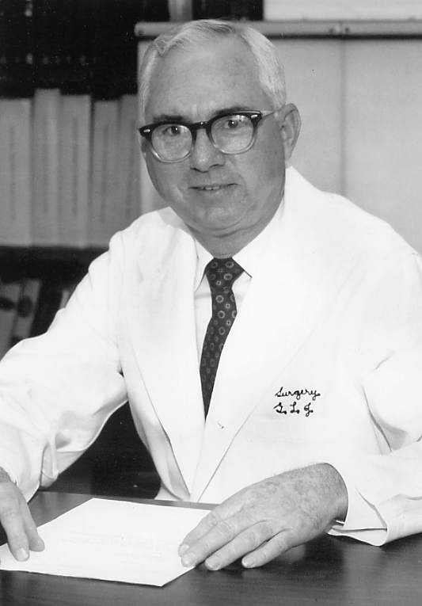
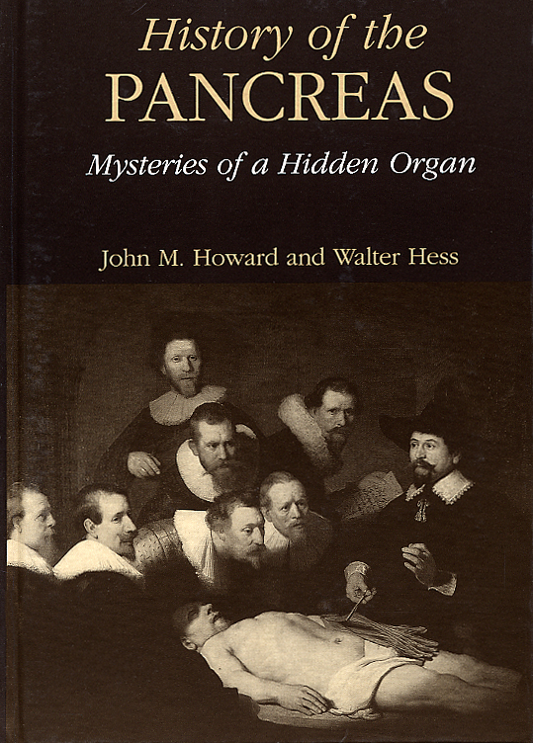
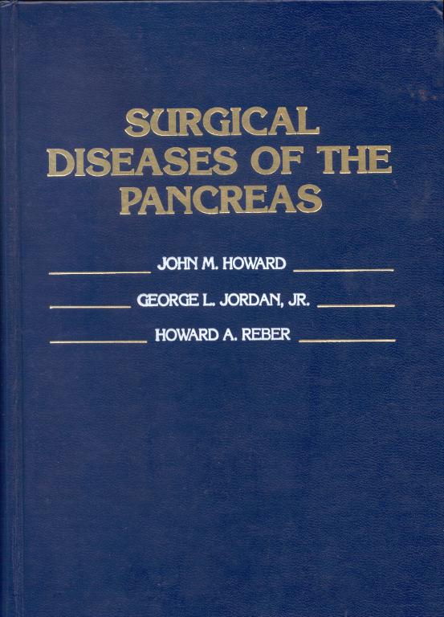
ACADEMIC
LEGACY
1960
1986
1998
Notes:
Also IR, Diagnostic Radiology

Slide 17
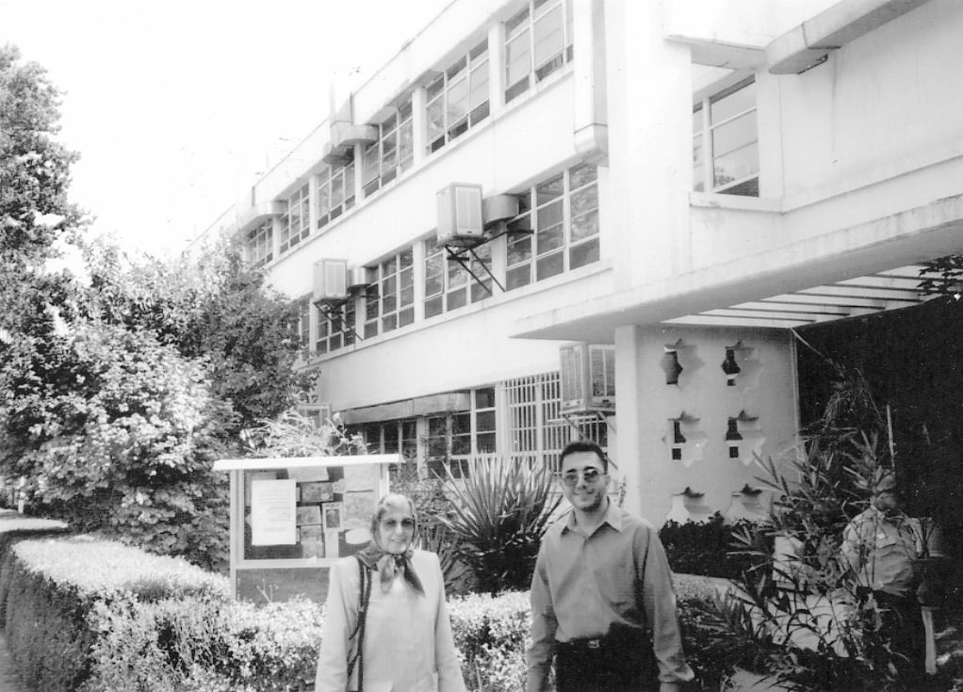
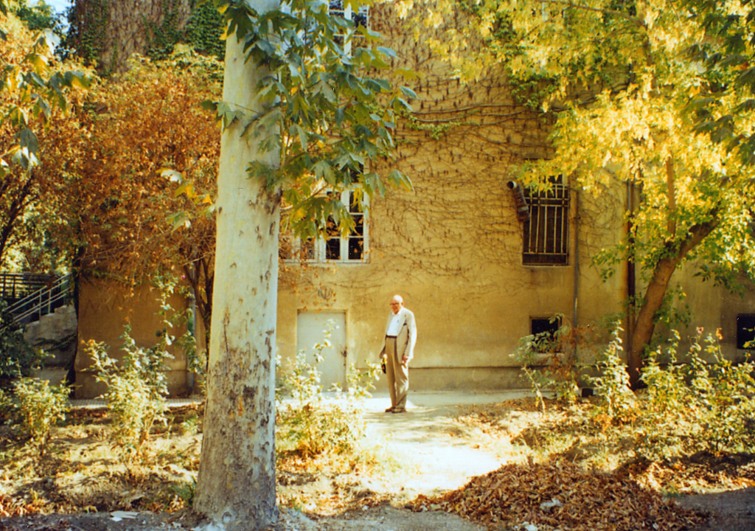
ACADEMIC
LEGACY
Notes:
Also IR, Diagnostic Radiology

Slide 18
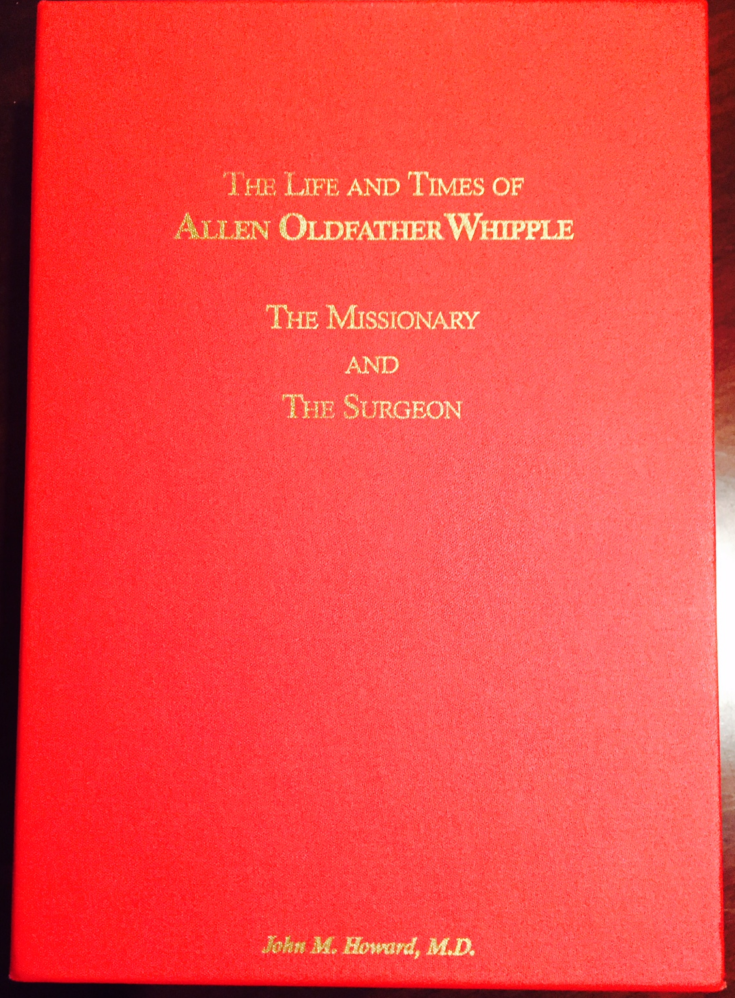
ACADEMIC LEGACY
Notes:
Also IR, Diagnostic Radiology

Slide 19
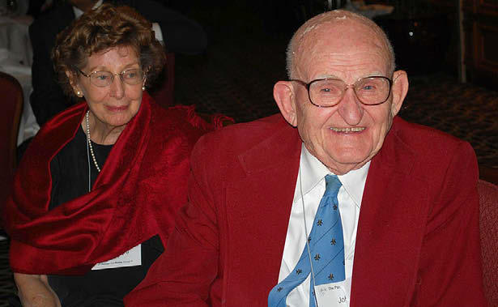
John M. Howard, 1919-2011
Professionalism
International Collegiality
Marriage
Enthusiasm for Life
“Perseverance is my forte”

