Slide 1


Slide 2


Slide 3



Slide 4


Slide 5


Slide 6


Slide 7


Slide 8


Slide 9


Slide 10
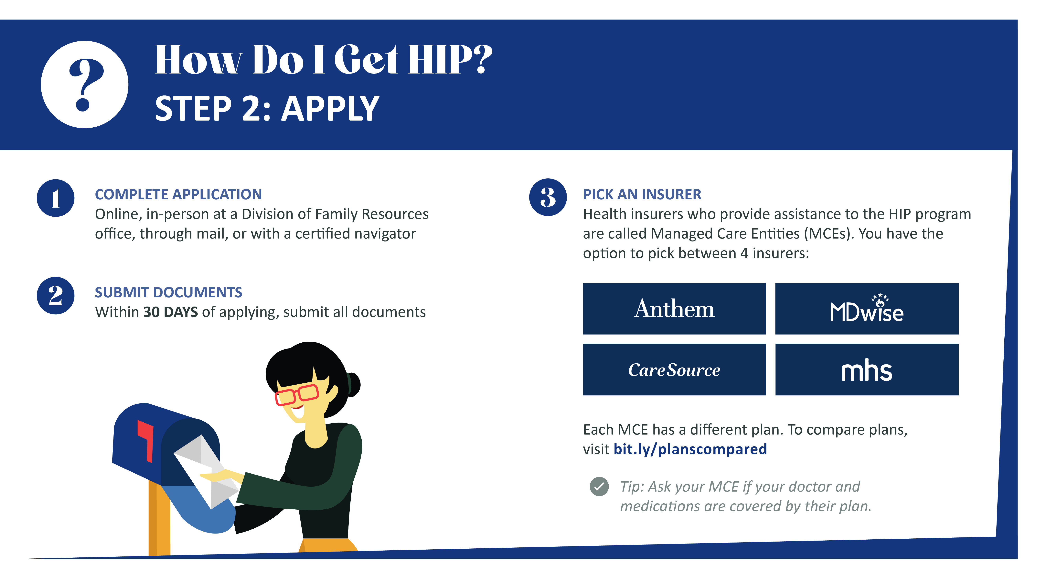

Slide 11


Slide 12


Slide 13


Slide 14


Slide 15

Full Organization Name
websitehere.com, email@goes.here
Full Organization Name
websitehere.com, email@goes.here
Full Organization Name
websitehere.com, email@goes.here

