Slide 1
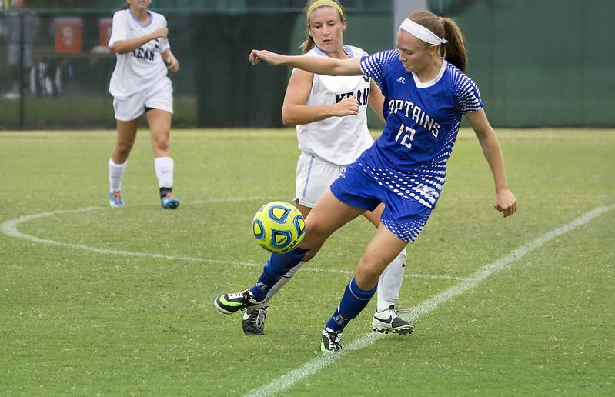
Open Playing Fields:
Addressing Scale and Access in Negotiation Education through OER
AITL23
May 20-23, 2023
Notes:
Permalink to slide deck will be included on handouts - handouts will describe project to date and outline curriculum

Slide 2
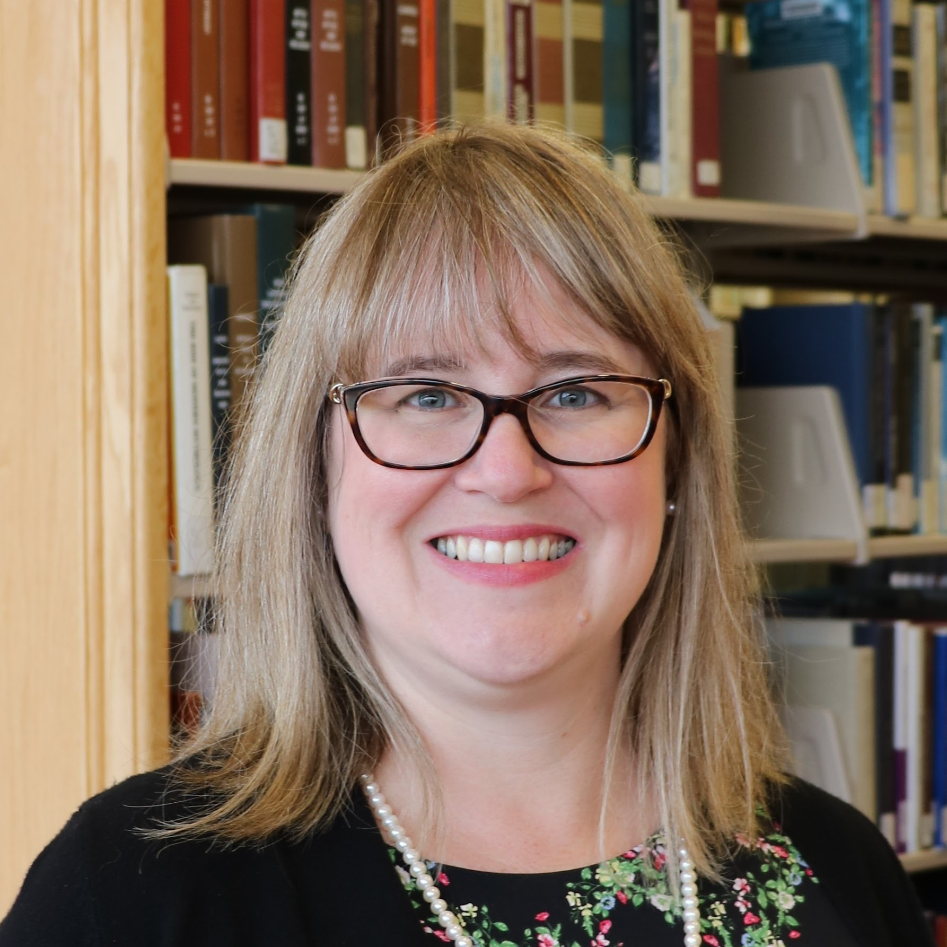
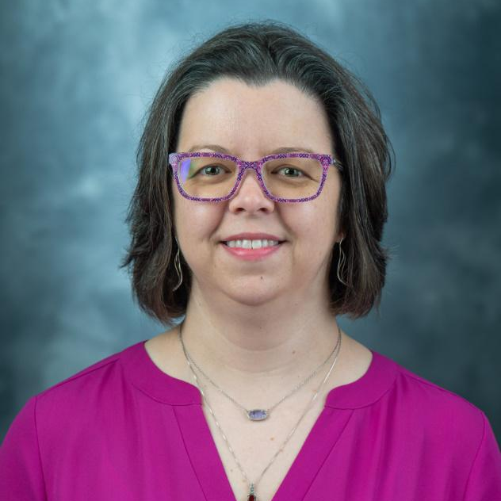


Project Team
Katharine Macy
IUPUI
Scarlet Galvan
Grand Valley State University
Courtney Fuson
Belmont University
Brandy Roldan
IUPUI

Slide 3
the ONEAL project
Open Negotiation Education for Academic Libraries
Notes:
More jobs asking for skills in negotiation, resource management strategies, and understanding how licensing terms impact research, teaching, and learning. Meanwhile our exposure to developing these skills often happens on the job. It’s maybe a paragraph or a sidenote of a lecture in library school. There are formalized programs around but they can be expensive. Training may happen at conferences but also that requires resources and is difficult to scale.
We want to make this training widely available to any librarian who is interested in learning this skill set. Developing negotiation skills benefit all types of librarians. This project is focused on academic libraries while the curriculum is framed around negotiating with vendors, significant portions of the curriculum will be useful in other areas of library work and in our personal lives. The skills and strategies developed through completing the curriculum will be useful for negotiating salaries, relocation allowance, start dates, tenure clocks, and much more. It can help you organize your workplace!
As all of us are aware, many of us are dealing with slow growing, flat, and and often declining budgets. E-resource prices remained stagnant during the Covid-19 pandemic but in many cases vendors are trying to make up for lost growth during that period. This is after decades of averaging 6% annual price growth while budgets have not kept up (5-year annual growth rate of masters and doctoral granting institutions was 2% in 2019). Libraries can negotiate and must negotiate in order to become sustainable. Even small incremental changes at individual institutions can create the ripple that is the start of a tsunami.
Some of you may be wondering - but what If I need to get started today - I need to negotiate something next week and I can’t wait for the curriculum next year. On the handout, which is available electronically through my IR as well as through the conference website has resources to help you get started today.

Slide 4
Asynchronous
Synchronous
Case Studies
Self-directed & hands on learning online learning
Activities & guides to support groups
Fictionalized negotiation scenarios for practice!
Notes:
Asynchronous
Online learning modules teaching concepts and application.
Synchronous
Activities and discussion guides that can help groups learn together.
Case Studies
Fictionalized case studies that reflect academic library experiences that enable practicing negotiations. 3 parts:
Library POV
Vendor POV
Teaching note

Slide 5

Module Creation
Content delivery
Resources
Active Learning
Application
Assessment
Source: https://www.flickr.com/photos/11155746@N00/3903032710
Notes:
In November based on the forums we held a curriculum planning workshop with the project advisory board and 12 academic librarians active in negotiating for resources. Courtney will review an outline of the curriculum. Currently we are actively involved in building the curriculum including doing an interview study which we will analyze for key themes to create fictionalized case studies.
Each learning module will include:
Content Delivery (Video, text, etc)
Resources
Assignment (Active Learning)
Application (Case Studies, Interviews, Panel Discussions)
Assessment (Formative)
Now Scarlet is going to take you through community involvement and our forums.

Slide 6
Nothing about the community without the community!

Slide 7
Key Insights
Community Forums

Slide 8
Curriculum Drafting
Learning Objectives
Notes:
CF
The current draft of our curriculum outline is in your handout and is available within the institutional repository with the slide deck.
After the forums, Brandy transcribed the information from the jamboard, padlets, and forum chats so that we could then go through and look for categories and topics that appeared frequently.
Based on this, we mapped out three broad areas to be the overarching modules for the curriculum. Those areas are Foundations, Strategies, and Issues. We have seven learning objectives for the curriculum, and these are available on your handout for your reference. Those learning objectives map to the three modules.
Each of these modules will have a varying number of topics in them. This curriculum is designed to work either as an independent training (done by an individual) or as part of a course (either in a library school or offered by another group such as a consortium). As Katharine mentioned, there will be asynchronous instruction learning objects as well as support materials for synchronous instruction. There will also be case studies included in the curriculum, to provide some low-stakes practice and experience in negotiating that doesn’t cost the library actual money. The content will be delivered in a variety of modalities - some text, some video, etc - and will include active learning assignments to help the participants use the OER to apply this information to their own situations and negotiations.
One of the deliverables we hope to provide is a workbook or set of worksheets that guides the participant through determining local/institutional information as they work through the modules and their assignments. This is designed to keep participants engaged while also providing them with a concrete application of the content to their work and a record of the information they’ve learned about their institution.

Slide 9
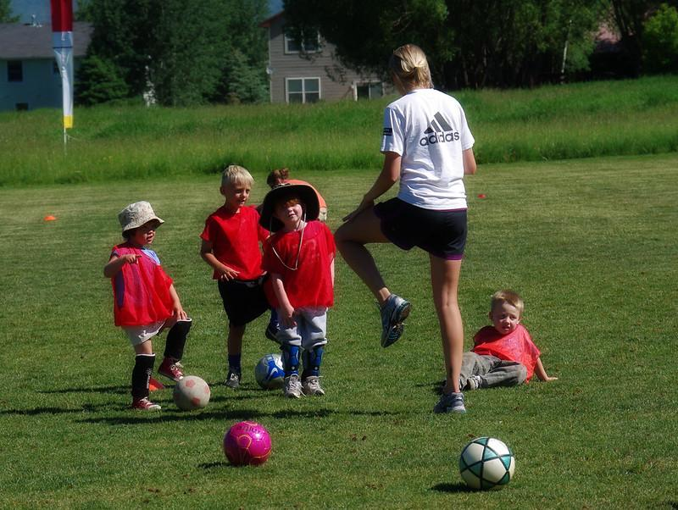
Foundations
Source: https://www.flickr.com/photos/20571120@N08/4759282303
Notes:
CF
The Foundations module will include the introductory materials such as the glossary, the historical context of library negotiations, an overview of the course, and examples of different pricing models as well as the topics seen here.
Contracts & licensing will introduce participants to the anatomy of a license, how to navigate the contract review process, learning about and understanding their local context, and negotiating sticky terms. Understanding local context will help participants to determine who is involved in the decisions and processes locally and provide a chance to document that information.
Intro to Negotiations will look at business relationships between vendors and buyers (and how that differs from other types of relationships); principled negotiations; and how to empower yourself to negotiate and ask for what your library wants and needs.
The last topic in the foundations module will focus on Negotiation Planning – understanding your BATNA (Best Alternative to a Negotiated Agreement), determining your ZOPA (Zone of Possible Agreement), how to research vendors, preparing for no, and more.
We also hope that this module will have a section where practicing library workers talk about their favorite negotiation resource. If you have one (or more), please let us know! Katharine will talk more about how to participate near the end of our presentation.

Slide 10
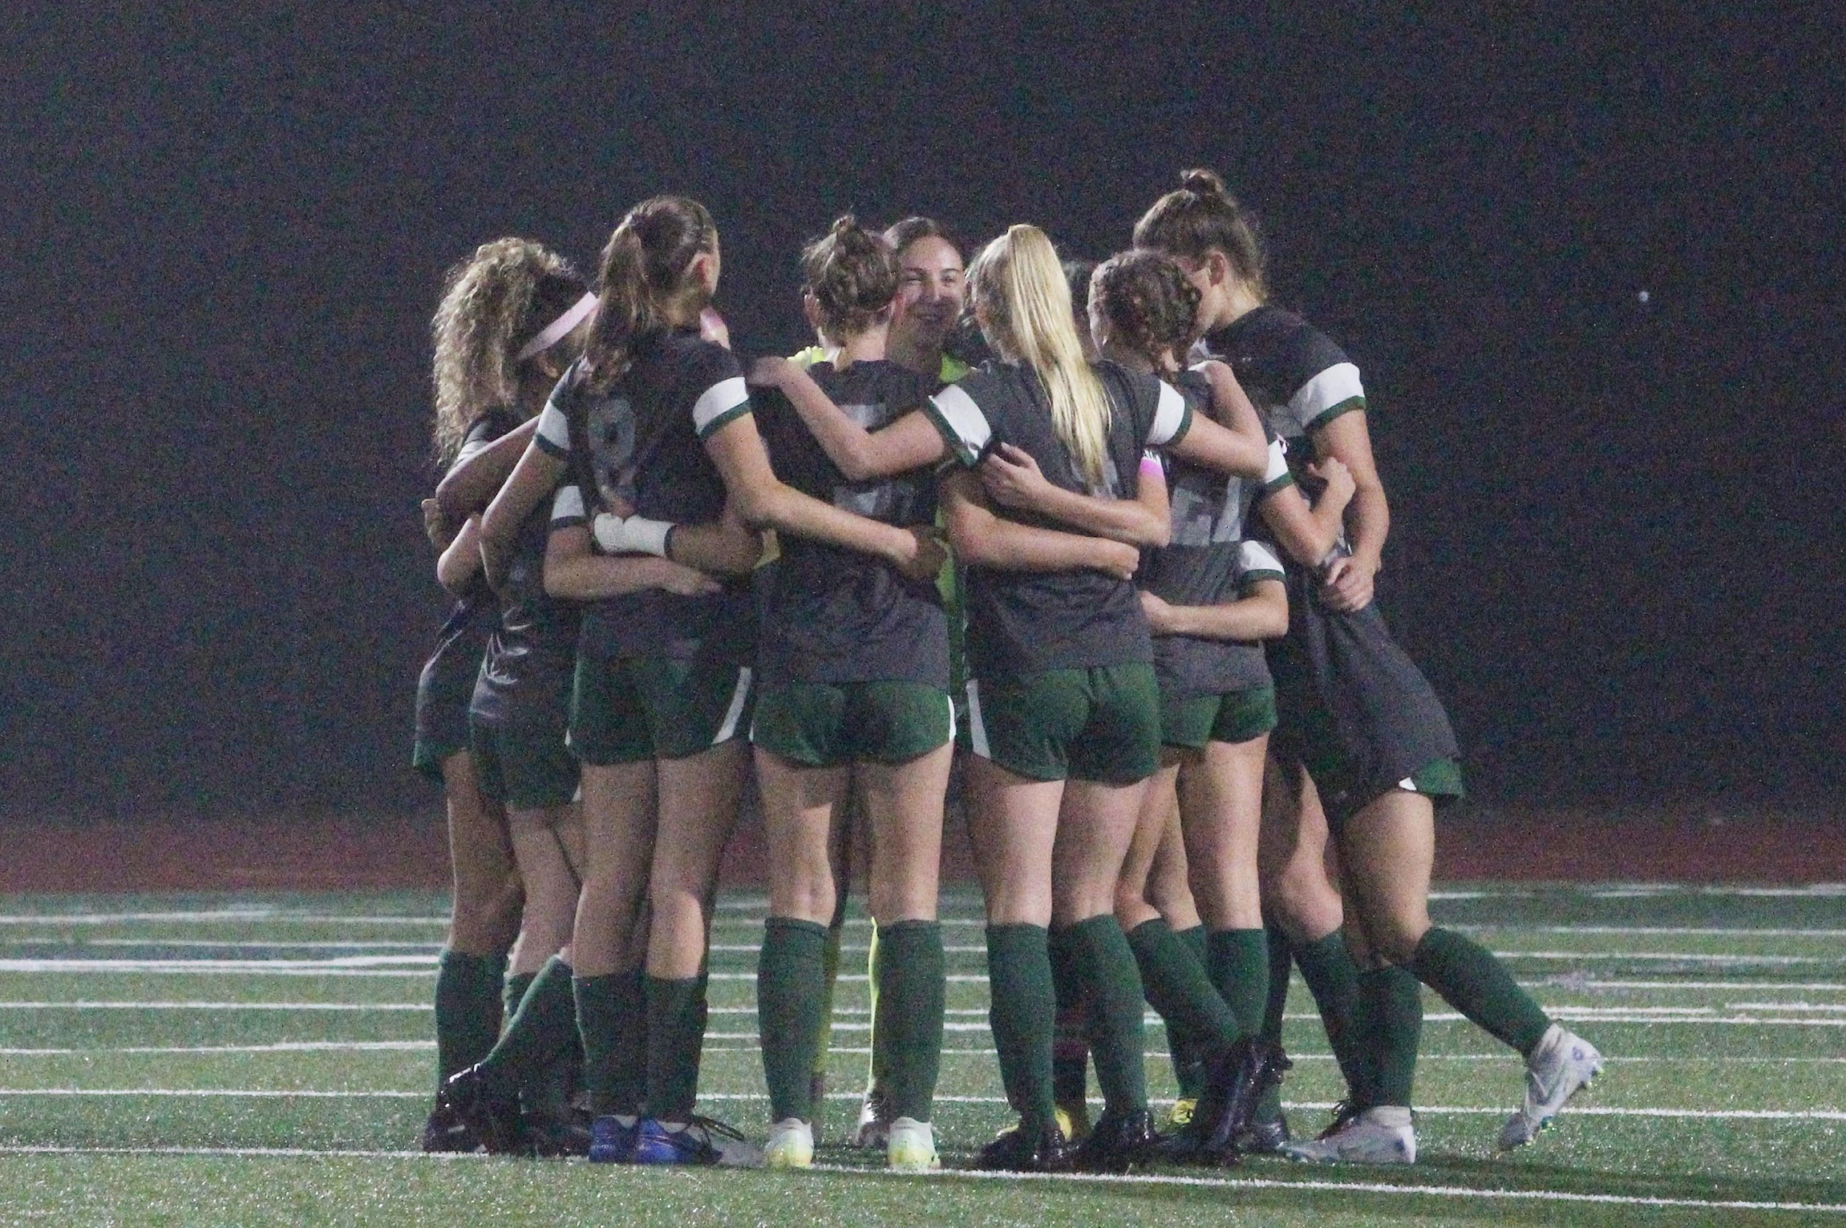
Strategies
Source: "Soccer huddle 2022-10-24" by Bob Park is licensed under CC BY-SA 2.0.
Notes:
CF
The strategies module is focused on providing structure for negotiations.
Providing structure for negotiations includes Setting Priorities - Using Pareto Analysis (the 80/20 rule) when you can’t negotiate every deal; basing your priorities on your library’s values (and how to live in the gap between your values and the actions of your library), and how to create value in the deal
This module will also help participants manage engagement before and during negotiations – this includes whether a negotiation should be a solo or team effort, how to engage with other librarians, administration, faculty, students, the procurement office, and general counsel at your institution. Engagement is also where we’ll talk about consortia and other relationships that the library might have that can benefit negotiations.
We’ll also talk about managing vendor relationships – building on the foundation of the business relationship and how it differs from other relationships. How to facilitate good working relationships with vendors, how and when to tell vendors about library and institutional context, and managing vendor behaviors will all be covered in this part of the strategies module.
Tying in with the vendor relationships discussions will also be power dynamics – how to understand price sensitivity and how that impacts your buying power and strategies for negotiating when you have little power.

Slide 11

Issues
Source: https://www.flickr.com/photos/gattine/with/3886378419/
Notes:
CF
The final module we’ve drafted is the issues module. This module is the one that should change more than any of the others going forward. We’ve tried to account for current issues and newer issues, but of course we can’t see the future to predict what might need to be addressed going forward. Because this will be an OER, the community will be able to step in and provide resources and information about the latest issues.
The issues that we’ve defined for this module are in two broad categories.
Acquisitions Models includes Traditional access models, Point of need models, Evidence-based acquisition, Open Access, and Transformative agreements
And the Intersection of Technology & Licensing includes things like Text and Data Mining (TDM), Privacy & Surveillance, Authentication, and Accessibility
Again, a full draft of the curriculum is available in the repository, with the slides and other additional information. I’ll turn it back over to Katharine now, to talk about how you can get involved and what we anticipate happening next!

Slide 12
Credits
Special thanks to all the people who made and released these awesome resources for free:
Presentation template by SlidesCarnival
Photographs
  Title Slide: Christopher Newport University Sports: https://www.flickr.com/photos/cnu_sports/14929638014/in/photostream/

