Slide 1
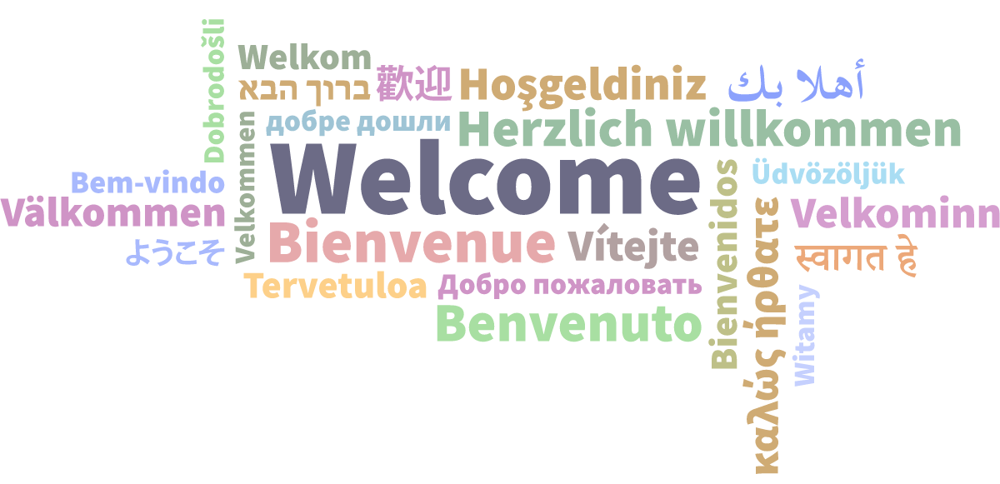


Learn How to Negotiate for a More Sustainable Future
Katharine V. Macy, Scarlet Galvan, & Courtney Fuson
the ONEAL project
Notes:
Opening Slides 1 & 2 - Welcome to the Core program on Learn How to Negotiate for a Sustainable Future. Your presenters are Katharine V. Macy, Scarlet Galvan, & Courtney Fuson from the ONEAL project.

Slide 2




Core thanks our 2024 Annual Events Sponsors
Diamond Sponsor
Platinum Sponsor
Gold Sponsors
Notes:
Core thanks our Annual Conference event sponsors.

Slide 3

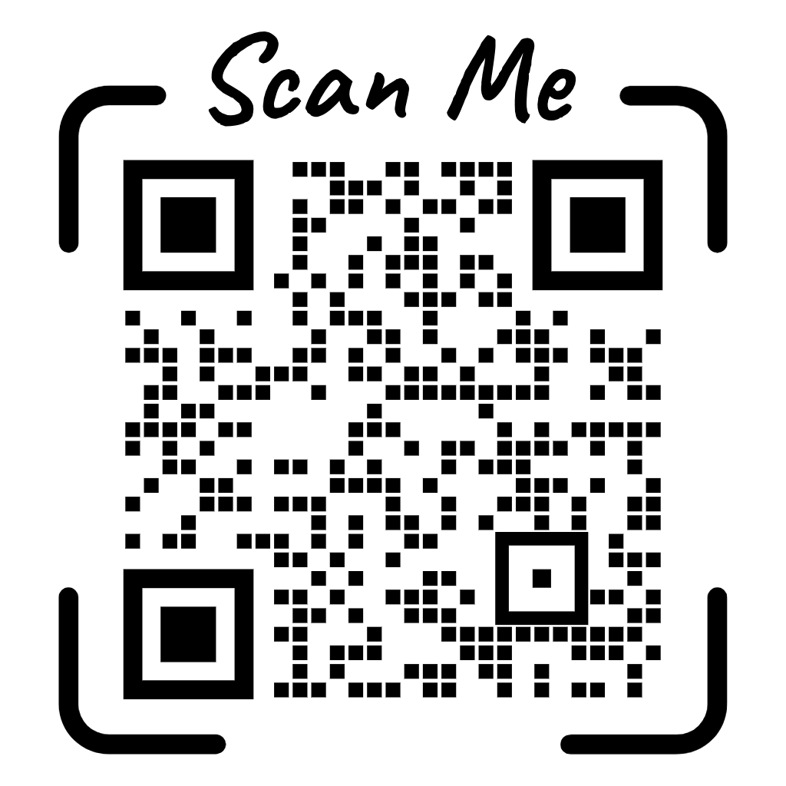
Educational & Practical
Networking & Fun
40+ thought-provoking sessions
Poster sessions
Preconferences, tours, and workshops
Opening reception
Dine-arounds
Game night
Informal, unconference discussions
coreforum.org
Notes:
Before I turn the mic over to them, I'd like to say a quick plug for the Core Forum in Minneapolis (show slide). Registration is now open for the 2-day event that consists of over 40 program sessions. We'd love to see you there! Now it is my pleasure to turn the floor over to Katharine to begin the program.

Slide 4
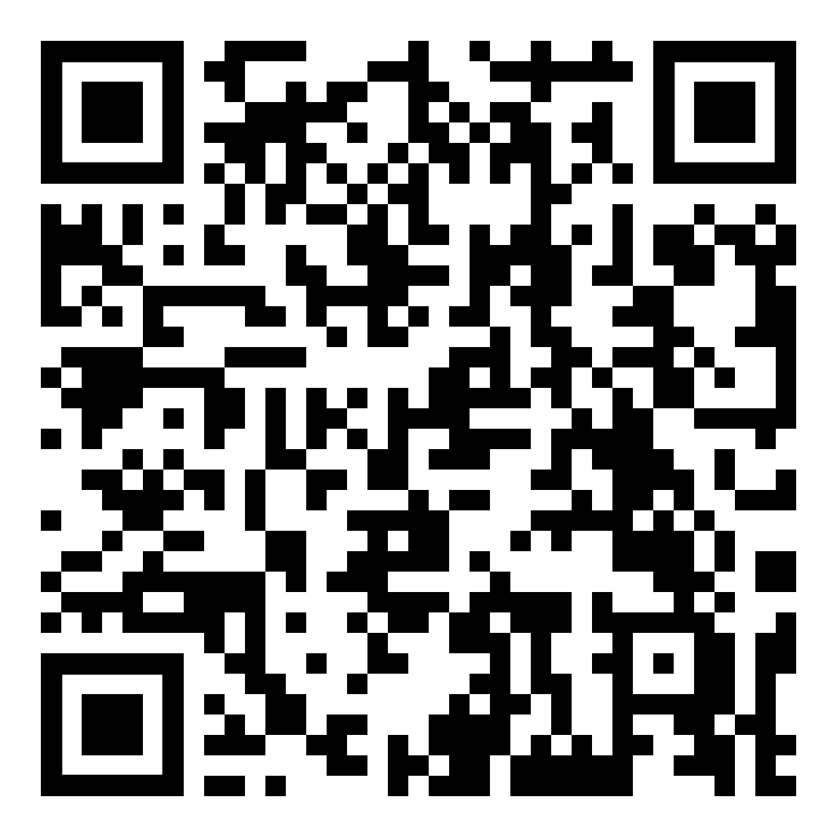

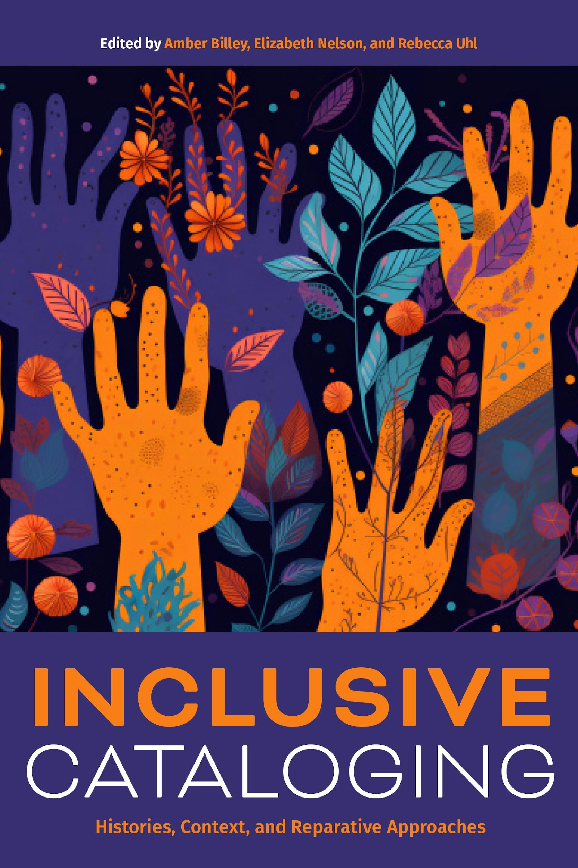




New titles available at alastore.ala.org
Coming Soon!
Notes:
Core New & Upcoming Publications now available at the ALA Store

Slide 5
the ONEAL project
Learn How to Negotiate for a More Sustainable Future

Slide 6
—David Oliver,
How to Negotiate Effectively
“Negotiation is in some ways like chess. You are prepared to sacrifice particular pieces in the interest of winning the game. In chess you know the pieces but you can't see into the other person's mind. In negotiation you don't necessarily know the "pieces". You have to discover and develop your own pieces and find ways of uncovering your counterpart's.”

Slide 7


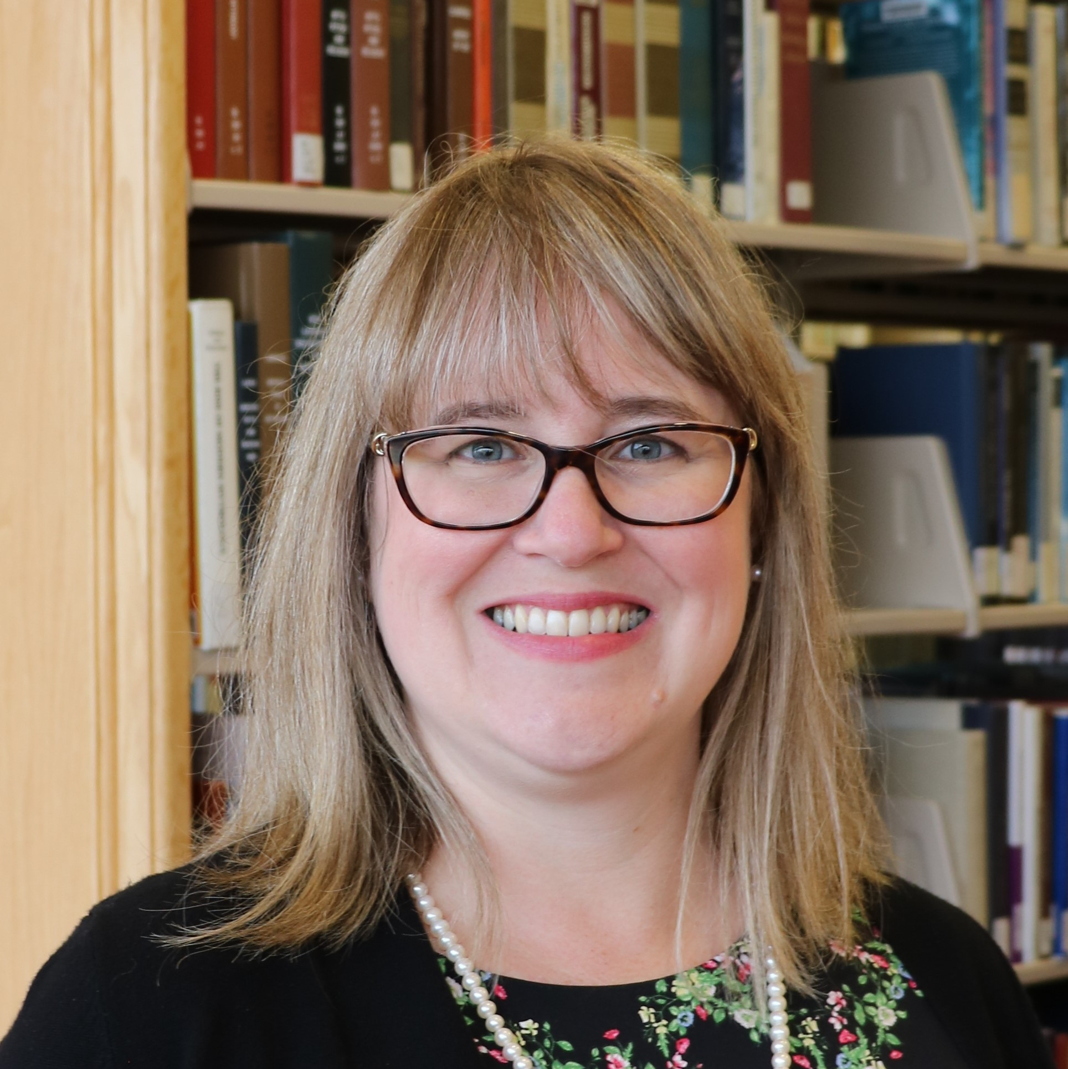
Project Team
Katharine V. Macy
Scarlet Galvan
Courtney Fuson
Founding project director of ONEAL, Interim Associate Dean of Scholarly Communications & Content Strategy IU-Indianpolis
macyk@iu.edu
Co-Principal Investigator and new project director (Aug 2024), Collection Strategist, Grand Valley State University
galvansc@gvsu.edu
Co-Principal Investigator, Asset Management Librarian, Belmont University, courtney.fuson@belmont.edu

Slide 8

the ONEAL project
ONEAL = Open Negotiation Education for Academic Libraries
An IMLS funded project to teach negotiation skills to academic library workers who work with vendors
However, there are lessons within the curriculum that all library workers at any type of institution can use in their professional and person lives!
Notes:
We will point out the lessons that are widely applicable to all library workers. While direct examples are oriented toward buying resources, the strategies learned have been used by colleagues to purchase cars, homes, and negotiate salaries.

Slide 9
Project Timeline
Aug-Dec ‘22
Jan-Aug‘23
Sep ‘23 – Mar ‘24
Community forums & curriculum planning
Interview study, curriculum drafting
Pilot study & revisions
Mar–Aug ‘24
Sep – Dec ‘24
2025 & Beyond
Launch foundations module curriculum & outreach
Development of strategies module and expand issues module
Ongoing curriculum development based on community needs, outreach, assessment

Slide 10
Agenda
01
03
02
04
Issues
Key issues facing library professionals as they negotiate and why negotiation skills is important for everyone
Community
How to join the community for support and how to get involved.
Access
ONEAL curriculum content
Discussion (Q & A)
Ask questions, share your experiences!

Slide 11
01
Issues
Key issues facing library professionals as they negotiate and why negotiation skills is important for everyone
Notes:
We want to provide some context as to why we think negotiation education is important by first looking at some key issues library professionals are facing, as well as explain why we think developing these skills can be important for all library workers.

Slide 12
Why do we need a negotiation OER?
The 5-year compound annual growth rate of collections budgets of doctoral and masters granting institutions was 0.6% (IPEDS FY2022 vs FY2017), and anecdotally the situation with budgets is not improving, many are facing a flat or decreasing budget.

Slide 13
Why do we need a negotiation OER?
Prior to the Covid-19 pandemic, the average annual periodical price increase ranged from 5-6%. (Library Journal Periodical Price Survey)
In recent years the price slowed to 3-4%, but are expected to increase to 5-5.5% in 2024, back to pre-pandemic rates. (Library Journal Periodical Price Survey 2023)

Slide 14
Why do we need a negotiation OER?
Licensing is becoming increasingly complex dealing with issues such as:
  Accessibility
  Privacy and surveillance
  Artificial intelligence (AI)

Slide 15

Negotiation skill development should be a strategic priority
Notes:
Negotiation skill development should be a strategic priority for all libraries. It will allow us to assertively ask for what we need to build better and more sustainable relationships with vendors. Negotiation research shows that people who have negotiation training improve their feelings of self-efficacy which results in better negotiation outcomes than those who have never had training. While this curriculum was centered around negotiating for library resources, there are lessons that are broadly applicable to all library workers, which is to the benefit of everyone.
Why is it a benefit?
Developing negotiation skills = better communication skills. We negotiate all the time – anyone who has ever tried to negotiate with their 4 year old to get them to eat or go to bed understand this. We negotiate daily with our teams at work to get task done.
The skills learned can be used in work and at home. I’ve had colleagues that I’ve put through this training, and they have used it to buy cars, houses -- happier home life impacts all areas of life including work.
Yes, everyone will get better at negotiating salaries – this is a good thing – more open and candid conversations of what is possible, and the potential of wasting less time if you can’t come to agreement. Supervisors and workers should both have these skills.
Negotiations skills help folks learn how to advocate for themselves and their institution.
When working with vendors we can foster a better relationship or more quickly determine if that isn’t possible after putting using strategies to manage unsustainable business terms and/or bad behavior and work toward different alternatives for access (an example is moving away from signing big deals to a more on demand model).

Slide 16
Key Insights from Interviews
35 interviews with library workers who negotiate for library resources. Analyzed for qualititive themes in Dedoose.
Notes:
As part of the ONEAL project we conducted an interview study to learn from a variety of academic library workers their overall experience with negotiations. This included asking them to describe a negotiation that went well as well as one that was particularly difficult. We also asked about the challenges they faced when negotiating and their desired training and support. We sent out an invitation for people to apply to participate in the study and the project team carefully reviewed each candidate’s institutional and demographic background so we could ensure we included as many diverse voices as possible within this study. We selected 40 people and ended up with 35 recorded semi-structured interviews that we were able to analyze. We then qualitative coded using Dedoose to find key themes. In addition to the preliminary results from the analysis we are about to share we are going to use the interviews to create more fictionalized case studies rooted in actual experiences of library workers.

Slide 17

Negotiation Challenges
Notes:
97.1% commented on negative behaviors they had experienced when negotiating with the three largest issues being not understanding academic context, lack of responsiveness and sales representative lacks knowledge (in general – can be about the product, aspects of the license, or the institution). 25.7% mentioned that vendor turnover was a problem. I will add that 62.9% of subjects mentioned positive vendor behaviors including working to maintain the relationship, clear communication & transparency, and high responsiveness.
94.3% of those interviewed mentioned that they had experienced issues with internal stakeholders. The most frequent issues mentioned were around working with folks in the library and other faculty. 62.9% of participants who mentioned experiencing issues within their own library with the most frequently mentioned issues were colleagues not being on the same page, working proactively when approaching negotiations, and lateral decision making and creating agreement. 54.3% mentioned faculty issues with creating faculty buy-in being the largest specifically mentioned issue at 34.3%.
77% of participants mentioned business deal issues, with pricing being the most frequently mentioned issue being negotiated (66% of subjects mentioned). Other issues mentioned include the length of agreement, service problems, and payment terms.
57.1% of participants mentioned difficult licensing terms. The three terms most mentioned were accessibility, NDAs or confidentiality, and indemnity.

Slide 18

Personal Challenges
Notes:
68.6% of respondents noted at least one personal challenge when negotiating. The largest personal challenge was lack of experience or training for negotiations, followed closely by finding it difficult to say no especially considering the service profession expectations.

Slide 19

Desired Training & Support
Notes:
71.4% of respondents mention desired training and support. Licensing and Negotiation strategy training are the two most desired things, followed by community.

Slide 20
Problems with Existing Training
Scalability
Too General
Cost
In person and online options limit the amount of people who can participate
Many negotiation training not associated with library conferences are too general in context.
Negotiation workshops can be out of reach of current budgets.
Notes:
The ONEAL Project attempts to solve this issue.

Slide 21
02
Access
ONEAL Curriculum Content

Slide 22
Curriculum Content
Lesson Plans
Recorded Lectures
Hands-on Exercises
Carefully constructed to maximize learning
Over 5 hours of recorded videos with accessible alt.
Using best pedagogical practice
Case Studies
Workbook
Group Activities
Best way to improve is to practice!
All lessons are available for individual download or in workbook.
To support classes and larger group learning
Notes:
Each lesson consists of three parts – a Watch/Read/Listen section that provides the introductory materials necessary for the lesson, a Review section that provides additional resources , and a Do section that allows the learner to apply what they have learned in a hands-on way. All the hands-on activities are available either all together as a workbook that can be completed alongside the curriculum, or as individual downloads that allow the learner to focus on specific lessons. One of the key activities that runs through the curriculum is a negotiation journal, which encourages the learner to reflect on their planning for negotiations, the vendor’s reaction, and the results of negotiation. Learners are also encouraged to journal throughout the lessons in structured and unstructured ways.
Case studies and group activities are also available as part of the curriculum, providing opportunities to enhance and deepen learning.

Slide 23
Foundations Launch
Foundations | Introduction to the Curriculum
 | Contracts & Licensing
 | Introduction to Negotiations*
 | Negotiation Planning Part 1: Strategy*
 | Negotiation Planning Part 2: Internal Review
 | Negotiation Planning Part 3: Vendor Research
Issues | Accessibility
*Broadly applicable to all library workers
Notes:
The Foundations module launched in April, which included one section of the Issues module on Accessibility. The lessons within the Foundations module are designed for all skill levels, from beginner to more advanced. These introductory lessons lay the groundwork for the future curriculum and provide learners with the skills they need to get started. The contracts and licensing lesson covers over basic terminology and structure of a license, including some terms or clauses to look out for. The Negotiations lessons introduce principled negotiations and walk the learner through the basics of planning a negotiation.
The accessibility lesson is from the Issues module and introduces common accessibility issues that are encountered in library resources and how to advocate for accessibility during negotiations.

Slide 24
Designed to Support Individual & Group Learning

Slide 25
MLS/MLIS Instructors
Lesson plans, quizzes, and assignments will be available to download in a .docx file so you can easily copy and paste content into learning management systems
Notes:
This curriculum is an open educational resource, so it was designed not only with individual learners and small groups in mind, but also to have potential applications in library schools. All the lesson plans, quizzes, and assignments will be available for download so that instructors can easily incorporate them into their learning management systems. The ONEAL project was started on the idea that all library workers should know more about the foundations of negotiation, and one of the best ways to do that is to incorporate it into the relevant courses in the library school curriculum!

Slide 26
Lessons Useful for All Library Workers
Introduction to Negotiations
Negotiation Planning Part 1
Notes:
All library workers can benefit from developing negotiation skills. There are two lessons that are broadly applicable.
Introduction to Negotiations provides brief lectures that cover why negotiation may feel uncomfortable and why we should ask for what we need, what it means to be in a business relationship, the concept of principled negotiations, and the structure of the negotiation process. This lesson includes an exercise where learners practice writing their own script in regard to their own careers and goals, as well as writing a script for their organization.
Negotiation Planning Part 1 includes lessons that describe negotiation strategy and best practices. It introduces concepts like BATNA, ZOPA, reservation price, and concessions and strategies like framing, first offers, and negotiating several issues simultaneously. It provides best practices for negotiating in person, over zoom, and by email, and advice for what to do when you encounter bad behavior.

Slide 27
https://sparcopen.org/our-work/negotiation-resources/oneal/
Notes:
Show & Tell!
Home Page
Curriculum
Workbook
Group activity Guide
Assessment

Slide 28
03
Community
How to join the community for support and how to get involved.

Slide 29
93 attendees
20 library workers
35 interviewees
Average attendance to three community forums in Fall 2022
Participated in Curriculum Planning Workshop in November 2022
Qualitative research study in Spring 2023
26 pilot testers
Completed the Foundations curriculum in Fall 2023
Notes:
Nothing for the community without the community

Slide 30
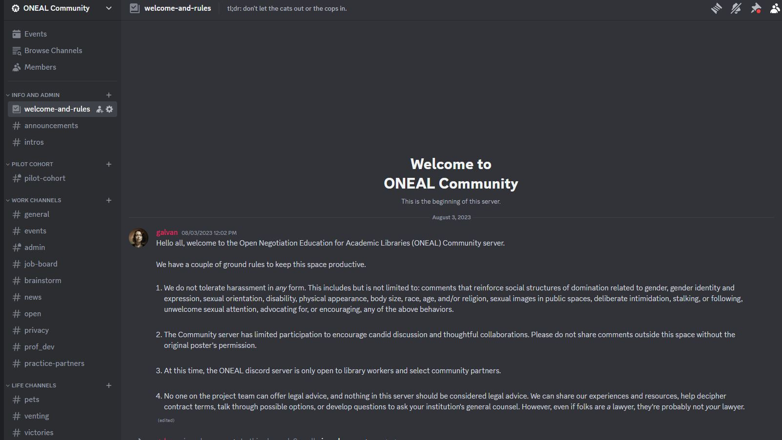
ONEAL Discord
https://oneal-project.org/discord/
Notes:
In addition to the curriculum, and in support of it, we are also working to create a community. One of the things that we heard over an over when we were planning the curriculum was the need for a space for librarians who do this work to talk to one another. So we’ve started a Discord for the users of the curriculum, for them to use when they are working through the curriculum and have questions, comments, or need a partner. We are using Discord for this community and would like to invite you to join us! You can visit the URL on the screen to request access.
Note that we are moderating this community, and it is only for current library workers. At some point there may be additional community opportunities for other groups.

Slide 31
Get involved https://oneal-project.org/contact/

Slide 32
THANKS!
Questions?
Please keep this slide for attribution

Slide 33



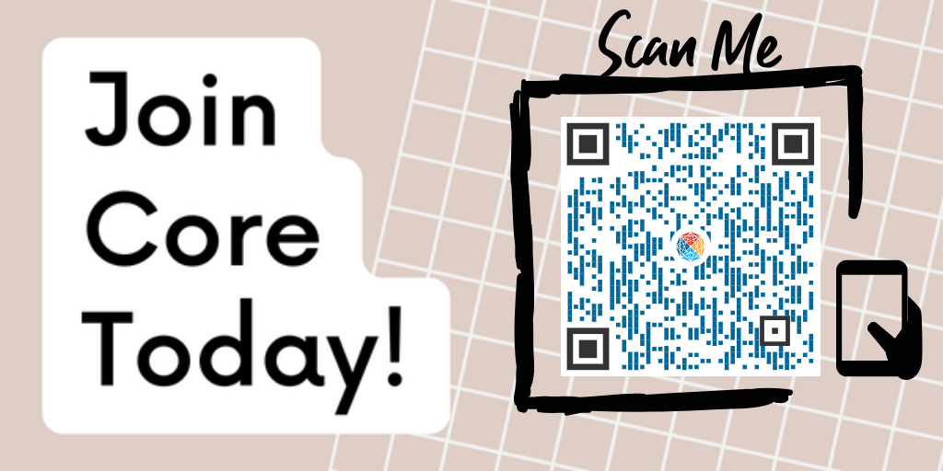
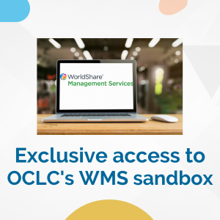
Exclusive
Core Member Benefits
Notes:
(Closing Slides 3&4) - Thank you for attending today's Core program. Thank you to OCLC for sponsoring Core’s Annual Conference programming. We'd love to encourage you to join Core and become involved in an Interest Group or Committee. You can learn about Core on our website at www.ala.org/core.

Slide 34
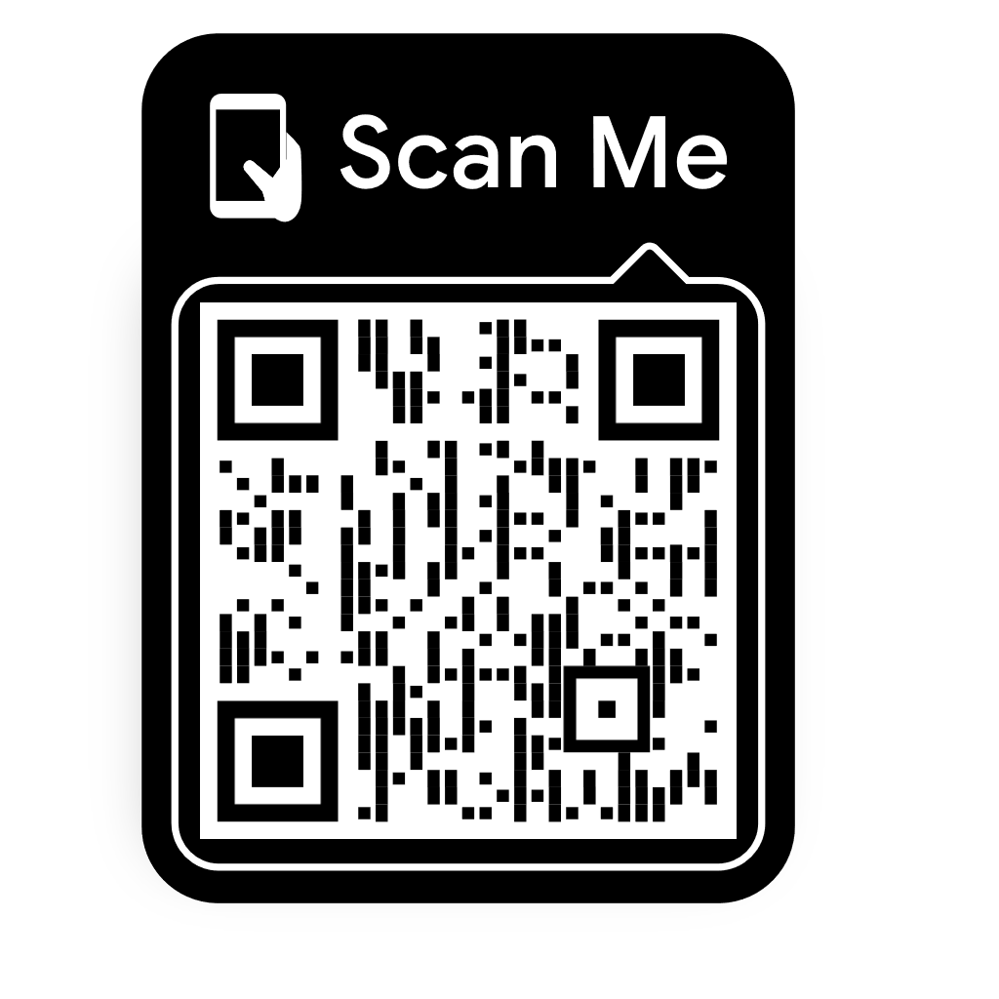

Please take a moment to evaluate this program
ala.org/core
alacore.org/go/to/alaac24-survey
Notes:
(Closing Slide 3 & 4)Finally, please take a few minutes to complete the evaluation form. You can use the QR code shown here or you can click the link to the evaluation form on the program page in the conference site.

