Slide 1
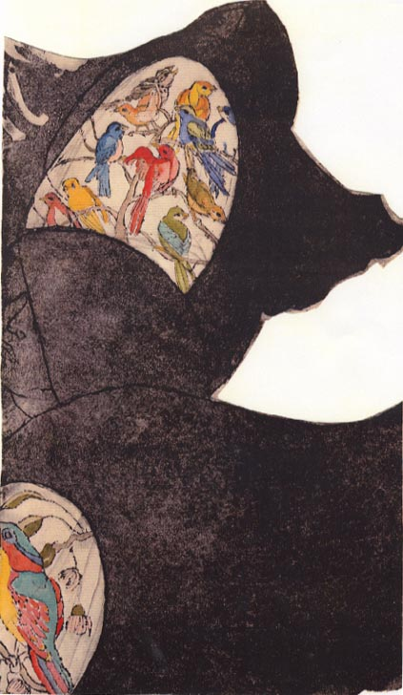
The Conscience Project
1982
2008
Indiana University School of Medicine

Slide 2
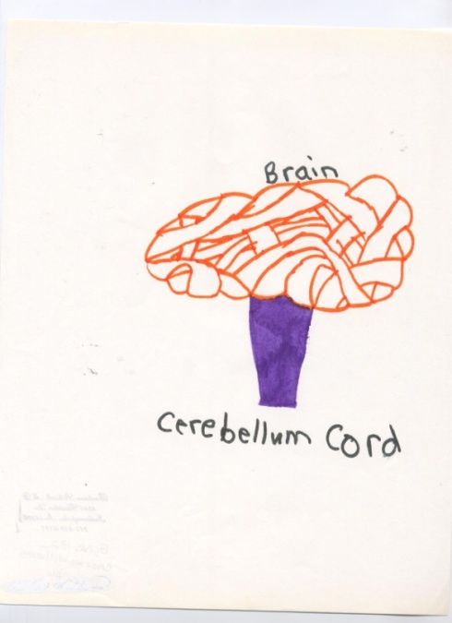
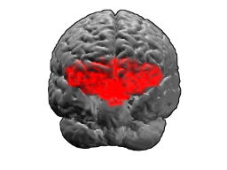
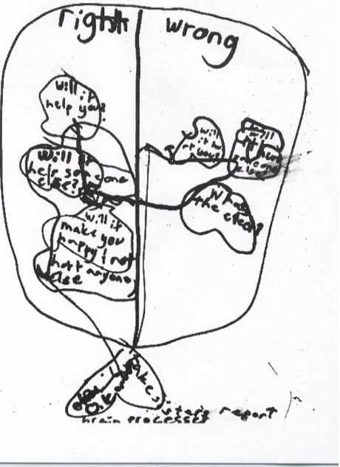
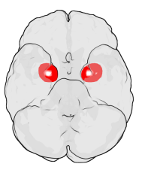
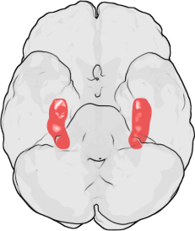
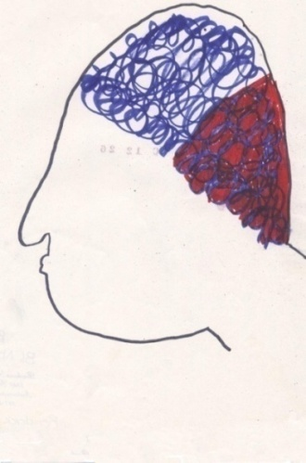
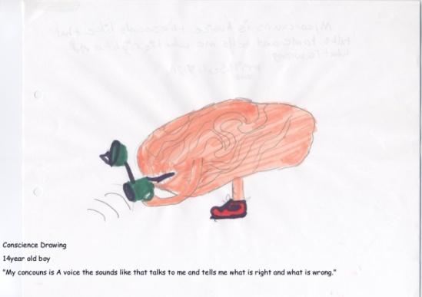
THE PSYCHOBIOLOGY OF CONSCIENCE
Copyright © IU Conscience Project, 2009
Signatures
in
Brain Regions of Interest
with special reference to ‘A Lady’
Notes:
Frontispiece: Images of Conscience and Images of the Brain.
In this presentation, we rely upon imagery from the IU Conscience Project∗ and upon images available in the public domain∗∗ to assist in showing approximate locations interpreted from texts and tabulated data within the articles under review. Some of the articles contain visual representations of findings localized with much more specificity within the brain regions of interest than will be shown in our presentation.
Lateral Images:
Drawings of conscience by children and adolescents.∗
Central Images from top to bottom∗∗:
Brodmann area (BA)11
The brain is viewed from the front and below. BA11 is on the underside (or ventral surface) of the anterior frontal lobe.
On left: Location of the Amygdalae in the Human Brain℘
The figure shows the ventral view of a semi-transparent human brain, with the front of the brain at the top. The darker areas show the approximate location of the amygdalae in the temporal lobes. Note: the amygdalae are covered by the ventral temporal cortices (i.e., they are inside the transparent brain).
On right : Hippocampi℘
This figure also shows the ventral view of a semi-transparent human brain. The darker areas show the approximate location of the hippocampi in the temporal lobes. Note: these bodies are also entirely covered by the ventral temporal cortices.
Courtesy IU Conscience Project
∗∗Courtesy contributors to Wikipedia Commons
℘These particular figures were generated using MATLAB and Blender. They are based on MRI imaging data from the Wellcome Department of Imaging Neuroscience, UCL and on coordinates from the Talairach brain atlas.

Slide 3
ABOUT NEUROIMAGING
Notes:
ABOUT NEUROIMAGING.
As recently explicated by Gerber and Peterson (2008), an image is simply a two dimensional, physical array of much smaller, two dimensional squares or rectangles, which are elemental units of the picture called pixels. Each pixel corresponds to a three dimensional square or rectangular chunk of brain tissue called a volume element or voxel. Each pixel of the image is typically assigned either a level of visual grayness ranging from black to white or an arbitrary color that represents a numerical value. In the case of a functional Magnetic Resonance Imaging (fMRI) map, what is captured in each pixel is the variation across time in the level of deoxygenated hemoglobin, which in turn indexes the level of neural activity, in the corresponding brain voxel. The degree to which that temporal variation in deoxyhemoglobin in each voxel correlates with the temporal variation in behavior or sensory experience of the person being imaged is assessed statistically and that statistical index is assigned to the corresponding pixel of the image. That statistic is color encoded and literally painted on the brain image, usually by being superimposed on a corresponding grayscale representation of brain structure to help locate where the brain activity is located.

Slide 4
APA Headlines September 10, 2008
EXPERTS URGE CAUTION IN INTERPRETING
fMRI STUDY RESULTS
Neurophysiologist Nikos Logothetis, PhD, of Germany's Max Planck Institute, explained that many studies that claim to have found a brain 'center' for some activity assume that these areas of high blood flow are where the particular activity occurs in the brain that corresponds to the task at hand. But, due to the brain's complexity, Logothetis warns THAT WE ARE SEEING SOMETHING THAT MAY HAVE 10 OTHER EXPLANATIONS. And, according to neuroscientist and philosopher Adina Roskies, PhD of Dartmouth University, BECAUSE fMRI DELIVERS IMAGES AS WELL AS DATA ABOUT BRAIN ACTIVITY, THE TECHNOLOGY IS PARTICULARLY SUSCEPTIBLE TO OVER-INTERPRETATION.
Notes:
A Black Box Warning
Abstracted for American Psychiatric Association Headlines from USA Today 9/10 /2008:
“A revolution in 'functional' magnetic resonance imaging (fMRI)...is being used by researchers to
pinpoint the pieces of the brain that people rely on to think and feel. In order to produce brain images,
the magnetic pulses are tuned to resonate with oxygen molecules in blood. Volunteers are given a task
or asked questions, and the scanners show where oxygen-heavy blood flows are headed, causing certain
parts of the brain to light up in fMRI images.” FYI the technique referred to is called Blood Oxygen
Level Dependent (BOLD).
[[Optional Note: Wolf Singer (2005)∗ credits Logothetis et al (2001) for studying the correlation
between neuronal activity and hemodynamic responses which suggested that the (BOLD) signal that
serves as the basis of fMRI investigations does not depend only on the discharge rate of neurons but, to
a crucial extent, also on the coherence of neuronal firing.
[Logothetis N, Pauls J, Augath M, Trianth T, Oeltermann A (2001): Neurophysiological investigation of
the basis of the fMRI signal. Nature 412: 150-157.]
∗Singer W. (2005): How does the brain know when it is right? In Changeux et al (eds) Neurobiology
of Human Values, Springer Verlag, pp. 125-135.]]
For purposes of our presentation we will neither need nor use explanations of neuroimaging with any
more detail than that contained in what you have just heard (we will have troubles enough keeping
straight the myriad neuro-anatomical locations).
As we readily acknowledge the subject to be beyond the scope of our expertise, we will also leave in
abeyance the issue of how available technology has produced findings that may well be encumbered
with overzealous interpretation. However …

Slide 5
THE PSYCHOBIOLOGY OF CONSCIENCE
On the technical point contained in this Black Box Warning
Notes:
[READ SLIDE]

Slide 6
THE PSYCHOBIOLOGY OF CONSCIENCE
On the technical point contained in this Black Box Warning
but also, on the basis of compelling philosophical considerations,
Notes:
[READ SLIDE]
To these considerations, the nature of which may be classified as meta-psychological as well, Elliot Turiel (2008)∗, a moral psychology researcher known for the social interaction theory has devoted a thoughtful essay. He is critical of Neuroscientist Antonio Damasio (regarding the somatic marker hypothesis applied to moral consciousness) for reliance upon “ a hodgepodge of emotions presumably associated with morality” while making “[no] effort [to distinguish] these very different types of emotions, some of which are positive and some aversive, or to specify which play what role in moral acquisition or moral decisions. Similarly, undifferentiated definitions are provided, which fail to account for the types of domain distinctions evident in the judgment of children and adults….” Turiel is skeptical of neuroimaging studies as well. “The apparent strategy is to use tasks or moral problems that clearly seem to have moral relevance and that can be approached from a utilitarian-philosophic perspective. The tasks have clear moral relevance because they pertain to the question of saving lives. However the tasks are anything but straight forward regarding the issues of the value of life and decisions on acting to save lives. The way I would characterize it is that participants in these studies are essentially posed with the problem of whether it is permissible for them to act as executioners.…”
∗Turiel E (2008): The development of children’s orientations toward moral, social, and personal orders: more than a sequence in development. Human Development. 51: 21-39.
We will turn later to other philosophical considerations.

Slide 7
THE PSYCHOBIOLOGY OF CONSCIENCE
On the technical point contained in this Black Box Warning but also, on the basis of
compelling philosophical considerations (to which we will return later),
we recommend there be NO HASTY REMOVAL of the
qualifier,
Notes:
[READ SLIDE]

Slide 8
THE PSYCHOBIOLOGY OF CONSCIENCE
PUTATIVE
On the technical point contained in this Black Box Warning but also, on the basis of
compelling philosophical considerations (to which we will return later),
we recommend there be NO HASTY REMOVAL of the qualifier,
Notes:
[READ SLIDE]
8

Slide 9
THE PSYCHOBIOLOGY OF CONSCIENCE
On the technical point contained in this Black Box Warning but also, on the
basis of compelling philosophical considerations (to which we will return
later) we recommend there be no hasty removal of the qualifier,
putative,
doubly applied:
Notes:
[READ SLIDE]
9

Slide 10
THE PSYCHOBIOLOGY OF CONSCIENCE
On the technical point contained in this Black Box Warning but also, on the
basis of compelling philosophical considerations (to which we will return
later) we recommend there be no hasty removal of the qualifier,
putative,
doubly applied:
first, to any attribution of signatures detected by functional neuroimaging to brain regions of interest
Notes:
[READ SLIDE]

Slide 11
THE PSYCHOBIOLOGY OF CONSCIENCE
On the technical point contained in this Black Box Warning but also, on the
basis of compelling philosophical considerations (to which we will return
later) we recommend there be no hasty removal of the qualifier,
putative, doubly applied:
first, to any attribution of signatures detected by functional neuroimaging to brain regions of interest
and, second, to any proposed correlation of mental states to such findings.
Notes:
[READ SLIDE]

Slide 12
THE PSYCHOBIOLOGY OF CONSCIENCE
On the technical point contained in this Black Box Warning but also, on
the basis of compelling philosophical considerations (to which we will
return later) we recommend there be no hasty removal of the
qualifier, putative, doubly applied:
first, to any attribution of signatures detected by functional neuroimaging to brain regions of interest
and, second, to any proposed correlation of mental states to such findings.
Participants of the IU Conscience Project

Slide 13
THE PSYCHOBIOLOGY OF CONSCIENCE
Copyright © IU Conscience Project, 2009
Signatures
in
Brain Regions of Interest
with special reference to ‘A Lady’
Notes:
The Psychobiology of Conscience.
Our last overview of the field was in 2001℘. At that time we were quite free with our opinion that conceptions of
“… [C]onscience functioning not [be] confined to behavioral inhibition.”
Among our because’s for holding this opinion we adduced [READ NEXT THREE SLIDES]:

Slide 14
THE PSYCHOBIOLOGY OF CONSCIENCE
Moral‑emotional responsiveness requires behavioral action and commitment in the processes of reparation and healing as well as prosocial behavior.

Slide 15
THE PSYCHOBIOLOGY OF CONSCIENCE
Moral‑emotional responsiveness requires behavioral action and commitment in the processes of reparation and healing as well as prosocial behavior.
The domains of moral self valuation and moral volition are related to the maintenance of self‑esteem and the developmental progression from autonomy to moral agency.

Slide 16
THE PSYCHOBIOLOGY OF CONSCIENCE
Moral‑emotional responsiveness requires behavioral action and commitment in the processes of reparation and healing as well as prosocial behavior.
The domains of moral self valuation and moral volition are related to the maintenance of self‑esteem and the developmental progression from autonomy to moral agency. And,
[Such] conscience functions will likely be found to depend upon neuromodulation different from that involved in behavioral inhibition.
Galvin M, Stilwell B, Adinamis A and Kohn A (2001): Conscience sensitive psychiatric diagnosis of maltreated children and adolescents Conscience Works: Theory and Research.1: 1-54
Notes:
We mused: “It would be surprising indeed if the complexities of conscience were not matched in complexity by its psychobiological basis….” And we speculated: “There will likely be additional implications of the study of maltreatment for a more general psychobiology of conscience as neuroimaging and assessment of conscience functions in health and psychopathology become more refined.”
℘Galvin M, Stilwell B , Adinamis A and Kohn A (2001):Conscience sensitive psychiatric diagnosis of maltreated children and adolescents Conscience Works: Theory and Research.1:1-54
So much for opining, musing and speculating. However much we may wish to credit our former mental activities with prescience, we are resolved not to rest on our laurels but instead to work with diligence and keep abreast of new research. At the 2005 Annual Meeting of the American Psychiatric Association (APA), Peter Bandettini, PhD Chief of the Functional Magnetic Resonance Imaging Methods Unit for the National Institute of Mental Health∗, opened his presentation by remarking that there had been nearly exponential growth in the number of papers published on the subject of fMR-neuroimaging between 1992 (at which point there were very few) and 2004 (at which point there were more than 1700). He noted as well an ever enlarging proportion of papers dealing with higher order cognition and emotion.
∗Bandettini P (2005): FMRI Basics and Beyond In Neuroscience for the Psychiatrist Part I: Neuroimaging from Genomics to Therapy, The Annual Meeting APA.

Slide 17
THE PSYCHOBIOLOGY OF CONSCIENCE
Psychology has suffered long enough from a reduction of inner states
to just two respectable ones:
cognitions
Notes:
There was a time when many researchers, even in developmental moral psychology, would scrupulously avoid conscience language in interpreting their findings. In a presentation in 1997∗, we bemoaned the conditions of scholarship which then obtained, declaring that:
“… [P]sychology [had] suffered long enough from a reduction of inner states to just two respectable ones: cognitions...

Slide 18
THE PSYCHOBIOLOGY OF CONSCIENCE
Psychology has suffered long enough from a reduction of inner states
to just two respectable ones:
cognitions and
affects
Notes:
… and affects.”

Slide 19
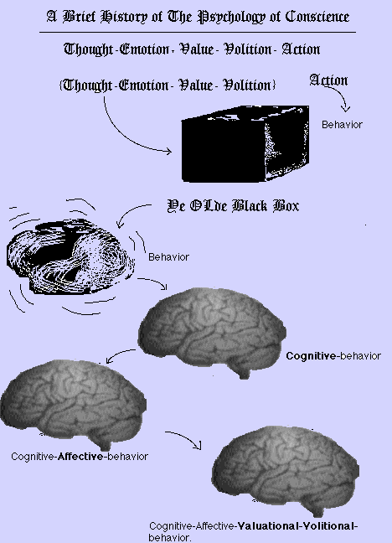
A Different Black Box, in Transformation
Notes:
A Different Black Box, One in Transformation
Counting our blessings, we nonetheless allowed that we should be grateful insofar as
“…any inner states had [had] their respectability restored after what [had] happened to them historically….”
A process depicted in this slide we showed in 1997.

Slide 20
THE PSYCHOBIOLOGY OF CONSCIENCE
THINKING
Notes:
In the context of moral development, we then made a plea:
“…. [T]hat we would do better to accept the irreducibility of at least the following inner states….
[READ THIS AND Next Three SLIDES]

Slide 21
THE PSYCHOBIOLOGY OF CONSCIENCE
Thinking
Feeling

Slide 22
THE PSYCHOBIOLOGY OF CONSCIENCE
Thinking
Feeling
valuing

Slide 23
THE PSYCHOBIOLOGY OF CONSCIENCE
Thinking
Feeling
Valuing
willing
Notes:
“… Each [we averred should be treated] as irreducible to the others. None [should be treated] as existing independently from the others.”
∗Galvin M and Stilwell B (1997/2003): Conscience in the mental health professional, Edited by: M Galvin and M Gaffney for CONSCIENCE WORKS, Conscience and Ethics. 2 (1): 1- 104.

Slide 24
THE PSYCHOBIOLOGY OF CONSCIENCE
Thinking
Feeling
Valuing
Willing
Connecting
Notes:
We would correct an error of omission and today add CONNECTING to these inner states especially when we are speaking of the internal representations of principal attachment relationships.
Then reorganize the terms for heuristic purposes, as follows:
24

Slide 25
THE PSYCHOBIOLOGY OF CONSCIENCE
Valuing
Connecting
Feeling
Willing
Thinking
Notes:
Valuing. Connecting. Feeling. Willing. Thinking.
These inner states correspond, respectively, to the domains of conscience characterized in empirical research: moral valuation (Stilwell et al, 1996), moral attachment (Stilwell et al, 1997), moral emotional responsiveness (Stilwell et al, 1994) moral volition (Stilwell et al, 1998) and conceptualization of conscience (Stilwell, et al, 1985, 1991).
Since 1997, conscience language has become respectable in at least some quarters of neuroscience and even, it may be observed with some irony, is finding its way back into ethical discourse. This felicitous (albeit belated) state of affairs has allowed a literature search using keywords pertaining, on the one hand, to the name (if not the core concept) of each domain of conscience identified in conscience theory and, on the other hand, to functional magnetic resonance (neuro)imaging, thereby providing the basis for today’s overview.
Nevertheless, it must be stressed that, while neuroimaging has become ever more refined and ever more widespread, the same cannot truly be said for assessment of conscience in health and psychopathology. As will be seen, for all the conscience language that has been employed within reports of new research, the driving hypotheses have rested upon an impoverished conceptualization of conscience in each of its domains, thus casting serious doubt upon both face and construct validity of the studies. We have some remedies to propose.
25

Slide 26
OBJECTIVES
to highlight studies in the last eight years in which fMRI or other neuroimaging techniques have been employed in the study of brain activity correlating with conscience functions,
Notes:
Our objectives for this presentation are:
to highlight studies in the last eight years in which Functional Magnetic Resonance Imaging
(fMRI) or other neuroimaging techniques have been employed in the study of brain activity correlating
with conscience functions,
While doing so we wish to keep in mind the question:
How, given available technology, can current methodology be improved to more fully
capture signals of brain activity correlating with moralization of cognitive, affective,
valuational and volitional mental states?

Slide 27
OBJECTIVES
to highlight studies in the last eight years in which fMRI or other neuroimaging techniques have been employed in the study of brain activity correlating with conscience functions,
to propose how neuroimaging studies of conscience functions might be provided more depth and meaning, and
Notes:
2) to propose how neuroimaging studies of conscience functions might be provided more depth and
meaning,

Slide 28
OBJECTIVES
to highlight studies in the last eight years in which fMRI or other neuroimaging techniques have been employed in the study of brain activity correlating with conscience functions,
to propose how neuroimaging studies of conscience functions might be provided more depth and meaning, and
to consider how neuroimaging studies of conscience functioning might be misapplied.
Notes:
And
3) to consider how fMRI and other forms of neuroimaging studies of
conscience functioning are already being or might soon be misapplied.

Slide 29
A Glossary of Terms
Executive functions
Notes:
To assist in meeting the first of our objectives, it may be helpful to present a brief glossary of terms deriving from cognitive sciences including neuropsychology and developmental psychology. These terms, all of which have currency in their respective literatures, may be seen to relate to the domains of conscience, each of which has been described elsewhere in detail but will be briefly reviewed as we proceed.
Executive functions is used to describe a loosely defined collection of brain processes the role of which is to guide thought and behavior in accordance with internally generated goals or plans.
{Reference: Posner M & Snyder C (1975). Attention and cognitive control. In R Solso (ed.), Information Processing and Cognition: The Loyola Symposium. Hillsdale, N.J.: Lawrence Erlbaum Associates.}
Citing Brown (2006), Gemelli (2008)∗ identifies the following executive ego functions:
Activation—organizing, prioritizing, and getting to work
Focus—tuning in, sustaining focus, and shifting attention when appropriate
Effort—regulating alertness, sustaining effort and adjusting processing speed
Emotions– managing frustration and modulating emotion
Memory—holding on to and working with information; retrieving memories
Action—monitoring and regulating one’s actions
[Brown TE (2006): Inside the ADD mind. Additude Attention Deficit 6: 34-38.]
∗Gemelli R (2008): Normal child and adolescent development. In R Hales, S Yudofsky, G Gabbard (eds.), The Textbook of Psychiatry Fifth Edition American Psychiatric Publishing, pp. 245-300.

Slide 30
A Glossary of Terms
Executive functions
Explicit and Implicit Memory
Notes:
Explicit and Implicit Memory
According to Daniel Siegel (2001)∗ the forms of memory are:
Early, non-declarative, procedural, implicit, and
Late, declarative, episodic/semantic, explicit.
The developmental biology of memory involves:
Implicit processing systems, present at birth, and
Explicit processing systems, of which there are two:
Semantic: developing by 1-2 years of age, and
Autobiographical: showing progressive development with onset after the second year of life.
Implicit Memory
A form of memory devoid of the subjective internal experience of “recalling,” of self, or of time.
Involves mental models and “priming”
Includes behavioral, emotional, perceptual, and perhaps somatosensory memory.
Focal attention is not required for encoding
Is mediated via brain circuits involved in the initial encoding and independent of the medial temporal lobe / hippocampus
Explicit Memory
Requires conscious awareness for encoding and having the subjective sense of recollection (and, if autobiographical, of self and time).
Includes semantic (factual) and episodic (autobiographical) memory.
Focal attention IS needed for encoding.
Hippocampal processing IS required for storage.
Cortical consolidation makes selected events part of permanent memory.
∗Siegel, D(2001): Memory: an overview, with emphasis on developmental, interpersonal, and neurobiological aspects. J Am Acad Child Adolesc Psychiatry 40(9): 997-1011.

Slide 31
A Glossary of Terms
Executive functions
Explicit and Implicit Memory
Dual Process Theories: Intuitive and Reflective Systems
Notes:
Dual Process Theories
System I (Intuitive)
Automatic,
Effortless,
Associative,
Rapid,
Opaque process, and
Skilled
System II (Reflective)
Controlled,
Effortful,
Deductive,
Slow,
Self-aware,
Rule-Following
{Reference: Kahneman D & Sunstein C (2006): Cognitive psychology of moral intuitions. In J-P Changeux, A Damasio, W Singer and Y Christen (eds.) Neurobiology of Human Values. Germany: Springer Verlag, pp. 92-95. }

Slide 32
A Glossary of Terms
Executive functions
Explicit and Implicit Memory
Dual Process Theories: Intuitive and Reflective Systems
Valence [cf: Approach/Avoidance]
Notes:
Valence, especially in discussing emotions, means the intrinsic attractiveness (positive valence) or aversiveness (negative valence) of an event, object, or situation.
{Reference: Frijda N (1986):The Emotions. Cambridge(UK): Cambridge University Press, p. 207.}
Citing Bargh (1997), Zajonc (1998) and LeDoux (2000), Kahneman and Sunstein (2006) ∗ write that the assessment of whether objects are good (and should be approached) or bad (should be avoided) is carried out quickly and efficiently by specialized neural circuitry.
[Bargh JA (1997): The automaticity of everyday life. In: Wyer Jr, RS (ed) the automaticity of everyday life: advances in social cognition. Vol. 10 Mahwah, NJ: Erlbau, pp. 1-61.]
[Cf: A morning in the life of Dr. Every Person in CONSCIENCE IN THE MENTAL HEALTH PROFESSIONAL, Conscience Works, Conscience and Ethics, 2 (1): 15- 21, 2003.]
[Zajonc RB (1998): Emotions. In: Gilbert DT, Fiske ST, Lindzey G (eds) Handbook of Social Psychology. 4th Ed., Vol. 1. New York: Oxford University press, pp. 591-632.]
[LeDoux JE (2000) Emotion circuits in the brain. Ann Rev Neurosci 23: 155-184.]
∗Kahneman D & Sunstein C (2006): Cognitive psychology of moral intuitions. In J-P Changeux, A Damasio, W Singer and Y Christen (eds.) Neurobiology of Human Values. Germany: Springer Verlag, pp. 91-105.

Slide 33
A Glossary of Terms
Executive functions
Explicit and Implicit Memory
Dual Process Theories: Intuitive and Reflective Systems
Valence [cf: Approach/Avoidance]
Mutually Responsive Orientation (MRO) [cf. Attachment]
Notes:
MRO, a term introduced by Kochanska (1997)∗, which she clearly relates to attachment scholarship, is a positive, close, mutually binding, cooperative relationship that emerges in some parent–child dyads, and promotes many positive socialization outcomes, including children’s conscience.
∗Kochanska G, Forman D, Askan N and Dunbar S (2005): Pathways to conscience; early mother-child mutually responsive orientation and children’s moral emotion, conduct and cognition. Journal of Child Psychology and Psychiatry 46 (1): pp 19-34.
Bowlby conceptualized attachment as a biological system with the proximal aim of providing a secure base from which the young may safely explore the world and a distal aim of preserving the species. Deficiencies and deviancies in caregiver attachment abilities have been causally linked to insecurity, social avoidance, social resistance and emotional/cognitive disorganization, as well as behavior outside the realm of societal acceptability (Magid and McKelvey, 1987).
[Magid, K. & McKelvey, C.A. (1987): High Risk. New York: Bantam Books.] ℘
℘Galvin M, Stilwell B, Adinamis A and Kohn A (2001):Conscience sensitive psychiatric diagnosis of maltreated children and adolescents Conscience Works: Theory and Research. 1:1-54

Slide 34
A Glossary of Terms
Executive functions
Explicit and Implicit Memory
Dual Process Theories: Intuitive and Reflective Systems
Valence [cf: Approach/Avoidance]
Mutually Responsive Orientation (MRO) [cf. Attachment]
Affective Style
Notes:
Affective Style refers to the individual differences in reactions to emotional incentives and in dispositional mood.
{Reference: Davidson R (2006): Neural substrates of affective style and value. In J-P Changeux et al (eds) Neurobiology of Human Values. Germany: Springer–Verlag. pp 67-90.}

Slide 35
A Glossary of Terms
Executive functions
Explicit and Implicit Memory
Dual Process Theories: Intuitive and Reflective Systems
Valence [cf: Approach/Avoidance]
Mutually Responsive Orientation (MRO) [cf. Attachment]
Affective Style
Effortful Control
Notes:
Effortful Control
Quoting Posner and Rothbart (2000), we noted in 2001∗ :
“Self-regulation involves complex questions about the nature of volition (effortful control) and its relation to our genetic endowment and to social experience. Within cognitive psychology, the mechanisms thought to be involved in self-control are collectively called attention. Attention allows rapid changes in neural activity in local brain areas. Priority is produced, in the timeframe of milliseconds, by amplifying the amount of neural activity within the area performing the skill. When this is done voluntarily it is called effortful attention. Priming, in the timeframe of seconds or minutes, involves efficiently tuning the process in which automatic pathways are established, over minutes to days, by practice. Learning further involves the establishment of new connections stimulated by new associations over weeks, which eventuate, over additional weeks, in rule learning mediated by new structures, and, over years, development dependent upon more complex networks. Executive control is a second form of attention that emerges in the second year of life and is thought to involve the frontal midline….”
[Posner, M.I. and Rothbart, M.K. (2000): Developing mechanisms of self-regulation. Development and Psychopathology, 12: 427-441.]
∗Galvin M, Stilwell B , Adinamis A and Kohn A (2001):Conscience sensitive psychiatric diagnosis of maltreated children and adolescents Conscience Works: Theory and Research. 1:1-54

Slide 36
A Glossary of Terms
Executive functions
Explicit and Implicit Memory
Dual Process Theories: Intuitive and Reflective Systems
Valence [cf: Approach/Avoidance]
Mutually Responsive Orientation (MRO) [cf. Attachment]
Affective Style
Effortful Control
Mirror Neurons
Notes:
Mirror Neurons or Mirror Mechanisms
As discussed by Giacomo Rizzolatti and Laila Craighera (2005)∗ are:
General neural mechanisms that enable individuals to understand the meaning of actions done by others[i.e. action understanding], their intentions[i.e. intention understanding] and their emotions [emotion understanding], through activation of internal representations coding motorically observed actions and emotions…. [I]t is very likely that the faculty for imitation developed on the top of the mirror system. However, its initial basic function was not imitation in the proper sense but enabling an individual to understand actions by others….
… Brain imaging studies have allowed the localization of the cortical areas forming the human mirror neuron system: the observation of others activates, besides the visual areas, two cortical regions whose function is classically considered to be (fundamentally or predominantly) a motor one: the inferior parietal lobule … the lower part of the precentral frontal gyrus plus the posterior part of the inferior frontal gyrus….
… The issue of whether intention comprehension (the ‘why’ of an observed act) could be mediated by the mirror neurons… [has also been] addressed in a study in which motor and visual properties of mirror neurons of the inferior parietal lobule (IPL) were investigated….
… The observing individual may re-enact internally the observed action and thus predict the goal of the observed action… “reading” the intention of the observed individual….
[I]n addition to mirror neurons that fire during the execution and observation of the same motor act … there should be neurons that are visually triggered by a given motor act but discharge during the execution not of the same motor act, but of another one that is functionally related to the former and is part of the same action chain…referred to as “logically related” mirror neurons….
…The hypothesis that we perceive emotion in others by activating the same emotion in ourselves has been advanced by various authors…. Particularly influential in this respect has been the work of Damasio and his coworkers. According to these authors, the neural basis of empathy is the activation of an “as--if--loop,” the core structure of which is the insula, [with a role attributed to] somatosensory areas like SI and SII, conceiving the basis of empathy to be in the activation in the observer of those cortical areas where the body is represented….”
∗Rizzolatti G and Craighera L ( 2005) : Mirror neurons: a neurological approach to empathy. In Changeux et al (eds) Neurobiology of Human Values. pp 107-121.

Slide 37
A Glossary of Terms
Executive functions
Explicit and Implicit Memory
Dual Process Theories: Intuitive and Reflective Systems
Valence [cf: Approach/Avoidance]
Mutually Responsive Orientation (MRO) [cf. Attachment]
Affective Style
Effortful Control
Mirror Neurons
Theory Of Mind (ToM) [cf: Mentalizing; Perspective Taking]
Notes:
Theory of Mind (ToM) is not any formal epistemological theory of mind but rather the ability anyone has to theorize both about others, and, as we believe essential for study of conscience, ABOUT ONESELF,
to attribute mental states—beliefs, intents, desires, pretending, knowledge, etc.—to oneself and others and
to understand that others have beliefs, desires and intentions that are different from one's own.
Psychologist Baron-Cohen is often cited in the literature on autism for proposing an inability to develop THEORY OF MIND as the essential problem in the developmental psychopathology of autism.
{Reference: Baron-Cohen S (1995) Mindblindness: an essay on autism and theory of mind . Cambridge, MA: MIT Press.}
[There are many thoughtful references to the subject to be found in :
Autism and Blindness, Research and Reflections ed. L Pring , London: Whurr Publishers, 2005. ]
Many developmental psychologists identify the emergence of this ability in the child at around 4 years of age.
The Mentalizing function, according to Gemelli (2008)∗ is the capacity to use self reflection to become aware of possessing a mind and to gradually understand one’s own mind and the minds of others as being complex, with different emotions, beliefs and conflicts.
∗ Op cit. Gemelli (2008)

Slide 38
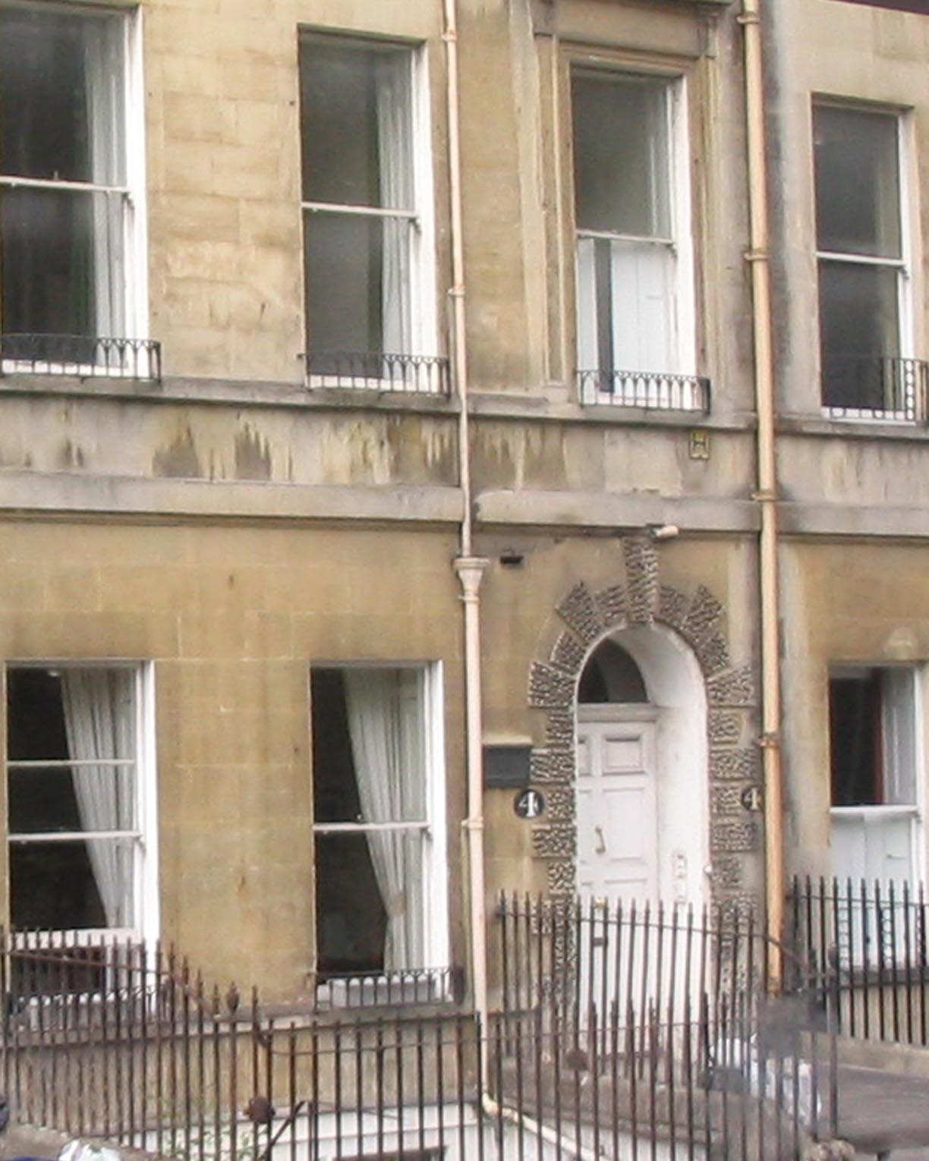
4 Sydney, Bath, England
Notes:
To meet the second and third of our objectives, the one pertaining to enrichment and deepening in matters of how we understand conscience and the other pertaining to how we use that understanding, we felt obliged to seek some help from an expert in the study of character whose literary contributions have continued currency. There were many possibilities, we were all agreed; as much– if not the entirety— of what constitutes good literature has to do with achieving or retrieving goodness in life. One of our party, Dr. Meg Gaffney has these many years been engaged in conscience sensitive study of works by the author who once lived at this address. While we await what will be her more definitive work on the use of this author’s literature in conscience sensitive moral education, Dr Gaffney has allowed us in the meantime to knock and be introduced….

Slide 39
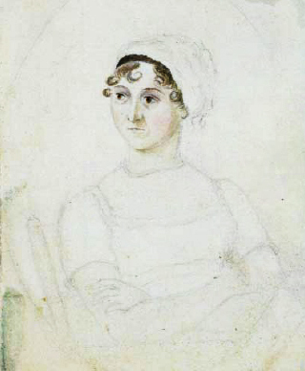
1775-1817
Notes:
….to Jane Austen
Besides Jane, we shall need help from others as well.
Portrait of Jane Austen in watercolor and pencil. c. 1810
by Cassandra Austen (1773-1845)

Slide 40
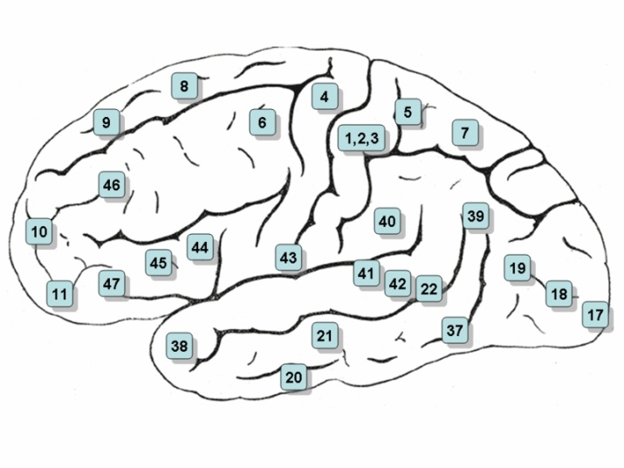
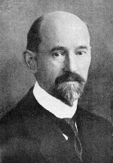
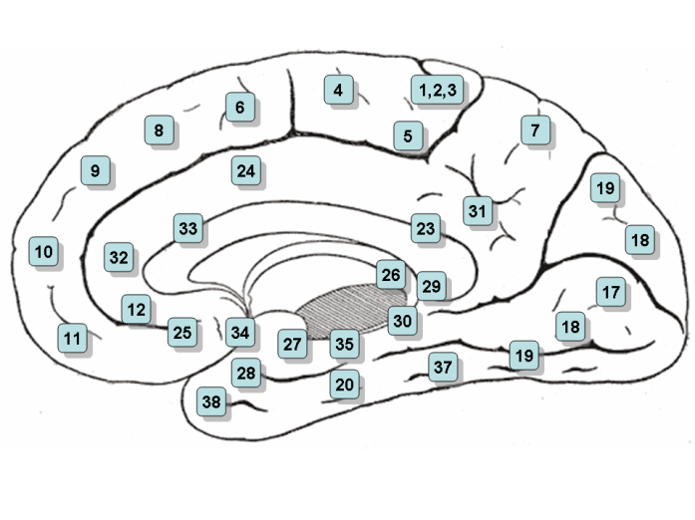
Notes:
Korbinian Brodmann (November 17, 1868 - August 22, 1918) was a German neurologist who became famous for his definition of the cerebral cortex into 52 distinct regions from their cytoarchitectonic (histological) characteristics. These areas are now usually referred to as Brodmann areas. Some of these areas were later associated to nervous functions, such as areas 41 and 42 in the temporal lobe (related to hearing), areas 1, 2 and 3 in the postcentral gyrus of the parietal lobe (the somatosensory region), and the areas 17 and 18 in the occipital lobe (the primary visual areas)*
*Courtesy Wikipedia
40

Slide 41
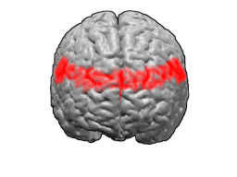
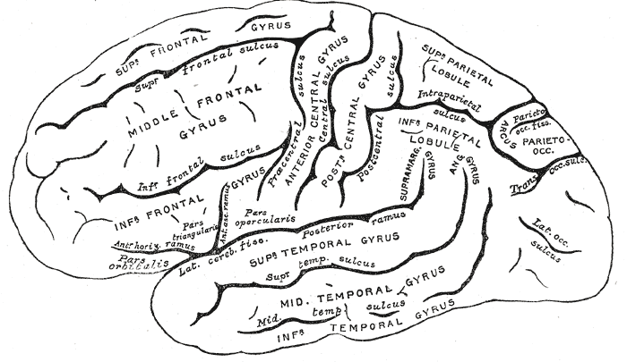
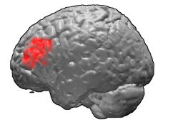
Notes:
BA 9 and BA46: each contributing to the Dorsolateral Prefrontal Cortex (DLPFC)
41

Slide 42
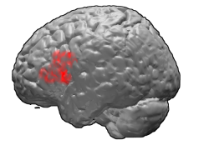
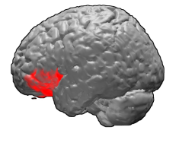
Notes:
The ventrolateral prefrontal cortex (VLPFC) consists of the inferior frontal gyrus: BA 47, 45 is coming to be understood as a crucial region modulating affective responses in subcortical structures, in addition to its role in attentional control and response inhibition (Pavuluri and Sweeney, 2008)
Pavuluri M and Sweeney J (2008): Integrating functional brain neuroimaging and developmental cognitive neuroscience in child psychiatry research. Journal American Academy Child and Adolescent Psychiatry, 47(11): 1273-1288.
42

Slide 43
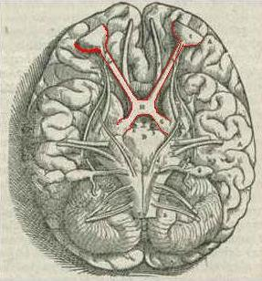
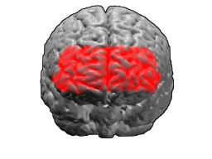
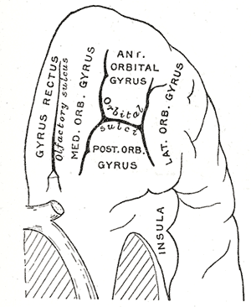
Notes:
Images here are; on the left: the left frontal lobe seen from below; on the right: top BA 10, bottom BA 11.
According to Wikipedia:
The ventromedial prefrontal cortex (VMPFC) is another part of the prefrontal cortex in the human brain. Its function has not been fully determined, but experiments suggest that it may have a role in the processing of risk and fear. The VMPFC has three subregions (dorsal anterior cingulate, prelimbic, and infralimbic). Note that different researchers use the term ‘VMPFC' differently. Sometimes, the term is saved for the area above the medial orbitofrontal cortex, while by others, ‘VMPFC' is used to describe a broad area in the lower (ventral) central (medial) region of the prefrontal cortex, of which the medial orbitofrontal cortex constitutes the lower-most part. One particularly notable theory of VMPFC function is the somatic marker hypothesis, accredited to Antonio Damasio. By this hypothesis, the VMPFC has a central role in adapting somatic markers–-emotional associations, or associations between mental objects and visceral (bodily) feedback—for use in natural decision making. This account also gives the VMPFC a role in moderating emotions and emotional reactions.∗
∗Courtesy Wikipedia.

Slide 44
Notes:
According to Hannah Damasio(2005)∗:
The VMPFC is likely to play multiple roles in normals and its damage is thus likely to cause several defects. In all likelihood, the VMPFC region is necessary for triggering most of the salient social emotions, its functional role in this regard being akin to the amygdala regarding fear....
But the VMPFC is likely to play another role, that of a learned repository of the link between situations calling for a decision and the outcome of decisions, on the one hand, and on the other, the emotional state associated with the situations or with the result of the decisions. The VMPFC would house the record of the linkage between “situation–and–associated-emotion” or “outcome–and–resulting-emotion.” When a situation of the same category as one previously experienced would present itself, the VMPFC would generate the emotion previously associated with that category of situation and with the outcome of the decision it prompted. In this role, the VMPFC is, once again, a trigger region for emotions , except that here the trigger is not an evolutionarily established, emotionally competent stimulus, such as the suffering of another, which triggers compassion. Rather, the trigger is a stimulus learned by the subject, in his or her past experience, and the triggered emotion may or may not be a social emotion….
It should be noted that the normal VMPFC would operate by acting on other brain structures, namely, the DLPFC where we suspect signaling from the VMPFC plays a role in reasoning and decision–making, directly or via the intermediary action of subcortical regions , e.g. amygdala. In other words, the “somatic marker” signal evoked in VMPFC would depend on contributions from subcortical structures and exert its role in the guidance of behavior via the regions on which reasoning is likely to depend the most given their role in higher cognition : the DLPFC….
∗Damasio H (2005): Disorders of social conduct following damage to prefrontal cortices. In Changeux et al (eds.) Neurobiology of Human Values, Germany: Springer Verlag pp. 37-46.

Slide 45
Moral Cognition

Slide 46
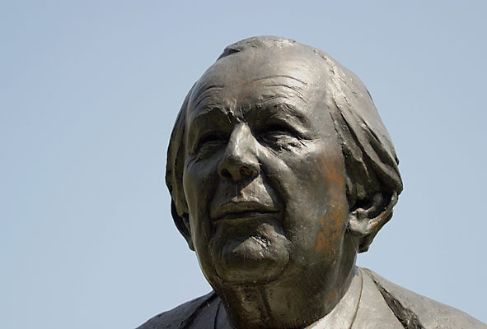
Moral Cognition
“ Intelligence is what you use when you don't know what to do.”
Moral Reasoning
Notes:
During Department of Psychiatry Grand Rounds 1997, we critically reviewed this aspect, which, early on, dominated moral developmental psychology:
Piaget (1965, 1976) began posing some dilemmas with moral characteristics to children of different ages to see how they reasoned morally, for example, about intentionality. He proposed two stages of moral development, the heteronomous and the autonomous. In the heteronomous stage, rules are explained as having authorship in some ultimate authority; in the autonomous stage, rules are explained as having been derived from mutual agreement and are amenable to change. Kohlberg extended the use of moral dilemmas, the most famous of which is The Heinz Dilemma. Kohlberg (1981) combined the concepts of cognitive development and moral philosophy into a stage theory of moral reasoning.
[Piaget J (1965): The Moral Judgement of the Child. New York: Free Press.
Piaget J (1976): Piaget’s Theory. In: P Neubauer (ed) The Process of Child Development. Jason Aronson, New York. pp 164-212.
Kohlberg L (1981): The Philosophy of Moral Development. San Francisco: Harper & Row.] ∗
∗ Op cit. Galvin M and Stilwell B (1997/ 2003).
46

Slide 47
Moral Cognition
Moral Reasoning
Moral Judgment
Notes:
Moral Judgment may appear to be a concept closely related to – and in common parlance used in a manner difficult to distinguish from—moral reasoning. Still, even within the realm of common parlance, the former might be contradistinguished from the latter in that moral judgment conveys a component of valuation that at least some instrumental forms of reasoning need not possess, such as consequential, means-end and alternative forms of thinking, even when applied to moral matters.

Slide 48
Moral Cognition
Moral Reasoning
Moral Judgment
Notes:
To appreciate how nuanced the terms moral reasoning and moral judgment can be outside common parlance, consider Antonio Damasio’s remarks (2005)∗ on how we produce moral judgments:
Two main traditions are usually identified. One claims that, when we are faced with a situation, we use reasoning to detect a violation or an observance of the established norm, we use further reasoning to weigh and classify the violation or observance, and still more reasoning to pronounce a judgment and a sentence. This is the tradition identified with Kant, whose roots go back to Plato and whose modern exponent is the philosopher John Rawls. The psychologists Piaget and Kohlberg are also identified with this tradition.
The other tradition, which is identified with David Hume and Adam Smith, claims that we react to the social situation emotionally and automatically. We instantly produce moral sentiments and intuitions that guide us towards our response to the situation. In this tradition, much of the ‘moral reasoning’ occurs after the moral intuitions have given us a first response. This late, after–the–intuition reasoning often takes the form of rationalization, the post-hoc construction of a case for a certain intuition rather than the deduction that led into it. Using Haidt’s account (2002), we can say that moral intuitions are the judges but those judges are not against having attorneys construct a justification for their pronouncements. Moral reasonings, on the other hand, handle the whole judicial process. The kinder and gentler tradition of moral practice provided by moral intuition has some roots in Aristotle and, in a roundabout way, in Spinoza. Darwin and Freud were early adopters and Jonathan Haidt has argued this view persuasively
[Haidt J (2002): Moral emotions. In: Davidson RJ, Scherer K, Goldsmith HH (eds) Handbook of Affective Sciences. Oxford University Press. pp 852-870 ]
∗Damasio A (2005): The neurobiological grounding of human values. In JP Changeux et al (eds) Neurobiology of Human Values. Springer Verlag. pp 47-55.
[Further Reading: Hauser M (2006): Moral Minds: How Nature Designed Our Universal Sense of Right and Wrong. New York: HarperCollins. pp 1-55.]
48

Slide 49
Zysset et al (2002)
Notes:
In an early study conducted by Zysset et al (2002), judgments were defined as the assessment of an external or internal stimulus on an internal scale and fundamental for decision making and other cognitive processes. Evaluative judgments (e.g. ‘I like George W. Bush: yes/no’) were seen as a special type of judgment, in which the internal scale is related to the person’s value system. The investigators used fMRI to examine brain activation during the performance of evaluative judgments as opposed to episodic and semantic memory retrieval. Evaluative judgment produced significant activation in the anterior frontomedian cortex (BA 10/9), the inferior precuneus (BA23/31), and the left inferior prefrontal cortex (BA 45/47). The results showed a functional dissociation between the activations in the anterior frontomedian cortex and in the inferior precuneus. The latter was mainly activated by episodic retrieval processes, supporting its function as a multimodal association area that integrates the different aspects of retrieval and newly presented information. In contrast, the anterior frontomedian cortex was mainly involved in evaluative judgments, supporting its role in self-referential processes and in the self initiation of cognitive processes.

Slide 50
PHILLIPA FOOT’S TROLLEY DILEMMA
A runaway trolley is headed for five people
who will be killed if it proceeds on its present course.
Notes:
Foot P (1978): The problem of abortion and the doctrine of double effect. In: Virtues and Vices. Oxford: Blackwell.

Slide 51
PHILLIPA FOOT’S TROLLEY DILEMMA
A runaway trolley is headed for five people
who will be killed if it proceeds on its present course.
The only way to save these people is to hit a switch that will turn the trolley onto a side track where it will run over and kill one person instead of five.
Notes:
Foot P (1978): The problem of abortion and the doctrine of double effect. In: Virtues and Vices. Oxford: Blackwell.
51

Slide 52
Phillipa Foot’s Trolley Dilemma
Is it okay
to turn the trolley
in order to save the five people
at the expense of one ?
Notes:
Foot P (1978): The problem of abortion and the doctrine of double effect. In: Virtues and Vices. Oxford: Blackwell.
52

Slide 53
The Footbridge ‘Dilemma’
As before, a runaway trolley threatens to kill five
people , but this time you are standing next to a
large stranger on a footbridge spanning the
tracks, in between the oncoming trolley and the
five people. The only way to save the five
people is to push this stranger off the bridge and
onto the tracks below. He will die as a result, but his
body will stop the trolley from reaching the others. Is it okay
to save five people by pushing this stranger to his death?
Notes:
{Reference :Thomson JI (1986): Rights, restitution, and risk : essays in moral theory. Cambridge, Mass: Harvard University Press.}
This footbridge ‘dilemma’ and the preceding trolley dilemma can also be found in an article (2005) by Joshua Greene∗ entitled “Emotion and cognition in moral judgment: evidence from brain imaging” and in Mark Hauser’s book (2006)℘ Moral Minds.
∗Greene J (2005): Emotion and cognition in moral judgment: evidence from neural imaging. In Neurobiology of Values, eds J-P Changeux, AR Damasio, W. Singer & Y Christen, Berlin, Germany: Springer-Verlag, pp. 57-66.
℘Hauser M (2006): Moral Minds: How Nature Designed Our Universal Sense of Right and Wrong. New York: HarperCollins.

Slide 54
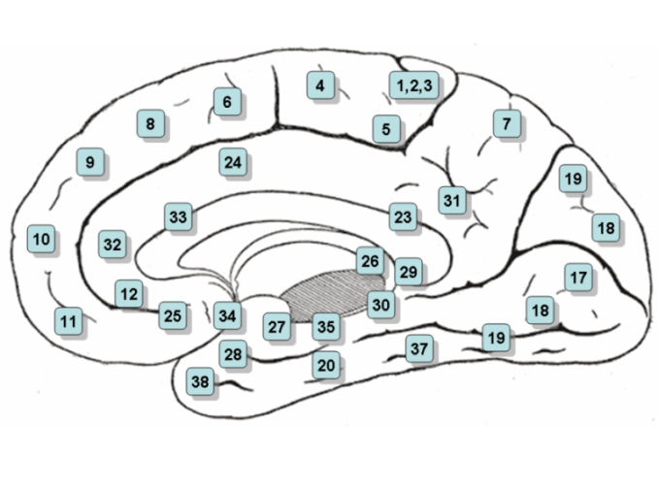
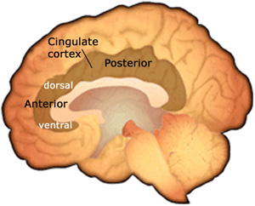
Brain Regions of Interest in Personal vs Impersonal
Moral Dilemmas
Lateral surface of the (left) cerebral hemisphere.
Region of interest
Areas with Greater Activity in Personal Dilemmas
Brodmann Areas
Medial Pre-Frontal Cortex 10,11,12
(Phan et al, 2002)
Posterior Cingulate
(Maddock, 1999)
Ventral 23,
Dorsal 31
Notes:
Citing the studies that follow, Greene (2005) ∗ reports differential brain activity according to whether a so-called personal or impersonal moral dilemma is under consideration (N.B. both personal and impersonal dilemmas are hypothetical in character):
Contemplation of personal moral dilemmas produced greater activity in three emotion–related areas: the posterior cingulate cortex (Maddock 1999), the medial prefrontal cortex (Phan et al, 2002) and the amygdala (Adolphs 2003; Phan et al, 2002).
[Adolphs R (2003): Cognitive neuroscience of human social behaviour. Nat Rev Neurosci 4: 165-178.
Maddock RJ (1999): The retrosplenial cortex and emotion: new insights from functional neuroimaging of the human brain.Trends Neurosci 22:310-316.
Phan KL, Wager T, Taylor SF, Liberzon I (2002) Functional neuroanatomy of emotion: a meta-analysis of emotion activation studies in PET and fMRI. Neuroimage 16:331-348.]
∗Greene J (2005): Emotion and cognition in moral judgment: evidence from neural imaging. In Changeux et al (eds.) Neurobiology of Human Values. Germany: Springer Verlag pp 57-66.

Slide 55
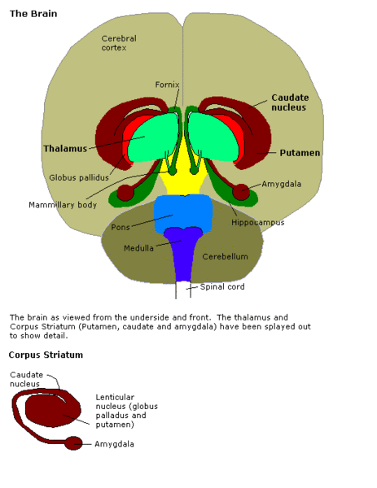
Amygdala
(Adolphs,2003; Phan et al, 2002)
Notes:
Amygdalae

Slide 56
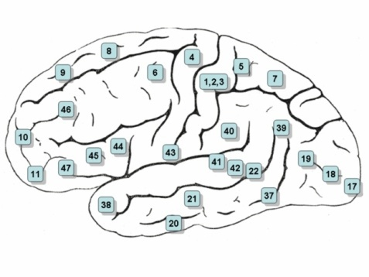
Brain Regions of Interest in Personal vs Impersonal
Moral Dilemmas
Lateral surface of the (left) cerebral hemisphere .
Viewed from the side
cerebral hemisphere region of interest
Areas with Greater Activity in Personal Dilemmas
Brodmann Areas
Superior Temporal Sulcus 22
Temporal Pole 38
(Allison et al, 2000; Saxe et al, 2004)
Notes:
Citing other studies of colleagues, Greene (2005)∗ also reports:
The effect was also observed in the superior temporal sulcus and the temporal pole, regions associated with various kinds of social cognition (Allison et al, 2000; Saxe et al, 2004).
[Allison T, Puce A, McCarthy G (2000) Social perception from visual cues: role of the STS region, Trends Cogn Sci 4: 267-278 .
Saxe R, Carey S, Kandwisher N (2004) Understanding other minds: linking developmental psychology and functional neuroimaging. Ann Rev Psychol 55: 87-124.]
∗Ibid.

Slide 57
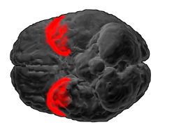
Notes:
BA38 as seen from the underside of the brain.

Slide 58
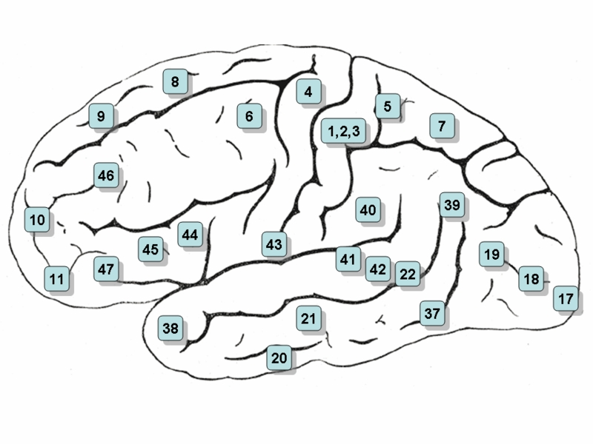
Brain Regions of Interest in Personal vs Impersonal
Moral Dilemmas
Lateral surface of the (left) cerebral hemisphere
Viewed from the side
cerebral hemisphere region of interest
Areas with Greater Activity in Impersonal Dilemmas
Brodmann Areas
Dorsolateral Prefrontal Cortex 9, 46
Inferior Parietal Lobe
Notes:
∗J Greene (2005):
At the same time, contemplation of impersonal moral dilemmas, produced relatively greater neural activity in two classically ‘cognitive’ brain areas, the dorsolateral prefrontal cortex and inferior parietal lobes.
∗ Ibid.

Slide 59
Phillipa Foot’s Trolley Dilemma
Is it okay
to turn the trolley
in order to save the five people
at the expense of one ?
Notes:
The essay by Turiel (2008)∗, cited earlier calls into consideration “several serious problems with these methods of study and interpretation of findings,” namely in:
Treating trolley car tasks as representative examples of moral problems involving utilitarian calculations, and
Presuming that rationality entails utilitarian calculations only.
“… [T]hese types of scenarios pose particular types of emotionally laden problems with multiple considerations that are difficult to reconcile without violating serious moral precepts in order to achieve serious moral goals. In this sense, the scenarios used in the neuroscience studies have affinities with the types of moral situations used by Kohlberg in his research. In both cases there has been a lack of attention to how individuals think and feel about the various components, and their coordination, in these types of situations. In the neuroscience research, gross generalizations are made from these unusual situations to moral functioning in general. The seeming inconsistencies in response to the supposedly same situations (i.e. utilitarian calculations) have been taken to mean that morality is due to evolutionarily determined, emotionally based intuitions and that reasoning is merely rationalization of and justification for subconscious decisions. These approaches to moral acquisition and functioning entail one-dimensional, causal explanations rather than ones that attempt to integrate biology, individual-environmental interactions , thought and emotions ….”
∗Op cit, Turiel (2008), p. 34.
59

Slide 60
THE CRYING BABY DILEMMA
It is wartime, and you and some of your fellow villagers are hiding from enemy soldiers in a basement. Your baby starts to cry, and you cover your baby’s mouth to block the sound.
Notes:
J Greene (2005)∗:

Slide 61
THE CRYING BABY DILEMMA
It is wartime, and you and some of your fellow villagers are hiding from enemy soldiers in a basement. Your baby starts to cry, and you cover your baby’s mouth to block the sound.
If you remove your hand, your baby will cry loudly, the soldiers will hear, and they will find you and the others and kill everyone they find, including you and your baby.
Notes:
61

Slide 62
THE CRYING BABY DILEMMA
It is wartime, and you and some of your fellow villagers are hiding from enemy soldiers in a basement. Your baby starts to cry, and you cover your baby’s mouth to block the sound.
If you remove your hand, your baby will cry loudly, the soldiers will hear, and they will find you and the others and kill everyone they find, including you and your baby.
If you do not remove your hand, your baby will smother to death.
Notes:
62

Slide 63
The Crying Baby Dilemma
Is it okay
to smother your baby to death
in order to save yourself
and the other villagers?
Notes:
“This is a very difficult question. Different people give different answers, and nearly everyone takes a relatively long time. This response is in contrast to other personal moral dilemmas, such as the Infanticide dilemma, in which a teenage girl must decide whether to kill her unwanted newborn. In response to this case, people [we tested] quickly and unanimously say that this action is wrong.”
On the investigator’s analysis of the two dilemmas they identified a ‘response conflict’ present in the crying baby dilemma but not in the infanticide scenario. This response conflict, it was hypothesized, would be correlated with increased activity in the anterior cingulate cortex. In addition ,the crying baby dilemma but not the infanticide scenario was hypothesized to evoke a strong cognitive response that would compete with a prepotent, emotional response, which would be correlated with activation in ‘classically cognitive’ brain areas .
∗Ibid.
63

Slide 64
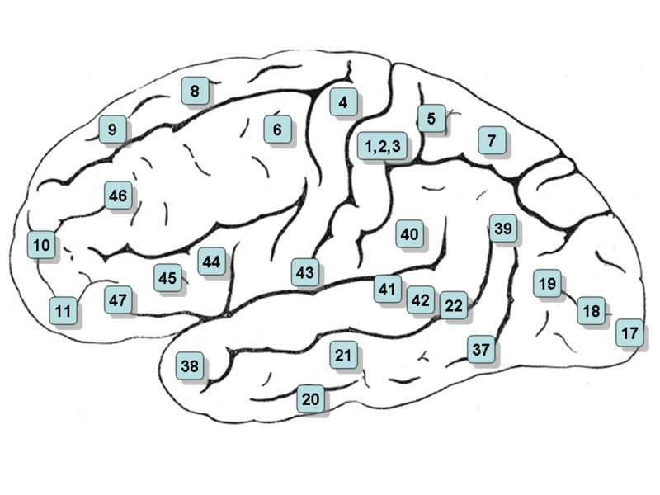
Notes:
Citing earlier work, J Greene (2005)∗:
“These two predictions have held (Greene et al, 2004). Comparing high-reaction time personal moral dilemmas like the crying baby to low reaction time personal moral dilemmas like infanticide revealed increased activity in the anterior cingulate cortex (conflict) as well as the anterior dorsolateral prefrontal cortex and the inferior parietal lobes, both classically ‘cognitive’ brain regions.”
[Greene J, Nystrom L, Engell A, Darley J, Cohen J (2004): the neural bases of cognitive conflict and control in moral judgment. Neuron 44: 389-400.]
These investigators also looked at what they classified as utilitarian versus deontological responses to the crying baby dilemma and found increased activity in bilateral anterior DLPFC the brain regions associated with cognitive control when subjects judged in accordance with utilitarianism.
Note: the theory of dual processing systems is invoked as an explanation.
∗Ibid.

Slide 65
Moll et al (2001)
Old people are useless
Every human being has the right to live
We break the law when necessary
Stones are made of water
Telephones never ring
Every text has words
Notes:
In a study by Moll et al (2001) ∗ ten adults (six men and four women) engaged in silently judging propositions (given via auditory presentation) as right or wrong. Half the sentences were said to have explicit moral content while the other half were said to be true or false matters of fact.
∗Moll J, Eslinger P, de Oliveira-Souza R (2001): Frontopolar and anterior temporal cortex activation in a moral judgment task, preliminary functional MRI results in normal subjects. Arquivos de Neuro-Psiquiatria, 59 (3B), accessed http://www.scielo.br on 5/24/2008.

Slide 66
Brain Regions of Interest in
Moral Judgment Tasks
Lateral surface of the (left) cerebral hemisphere .
Viewed from the side
left cerebral hemisphere region of interest
corresponding region right hemisphere
bilateral activity
Frontopolar and anterior Temporal Cortex
Brodmann Areas
Left hemisphere
Frontopolar cortex (FPC) 10*
Orbital division of inferior frontal gyrus 46*
Precuneus 7*
Posterior external Globus Pallidus not shown
Right hemisphere
Frontopolar cortex 10*
Temporal pole and cortex 21, 22, 38
Posterior superior temporal sulcus 22,39
Bilateral
Medial frontal gyrus 9,10
Cerebellum
Right dorsolateral cerebellar cortex not shown
* Areas in which activities were unchanged when adjustments were made for emotional valence.
Notes:
This is a surface mapping of brain regions of interest, according to Brodmann areas, in which BOLD functional magnetic imaging (fMRI) in the study by ∗Moll et al (2001) demonstrated activity during moral judgment tasks. The mapping indicates any areas in any of the subjects that demonstrated specific activity while judging moral as opposed to factual content. Adjusting for the effects of emotional valence, activations in frontopolar and medial frontal regions remained unchanged but were reduced in anterior temporal regions and the pallidum was no longer activated. The investigators concluded:
“So far, complex social actions requiring moral evaluations, empathy, theory of mind, and stable social bonds were conceived to rely on two main streams of processing: one more cognitively oriented and dependent on the dorsolateral prefrontal system and the other more emotion-oriented and mediated by anterior temporal, limbic and orbito-ventromedial frontal systems. We believe that the FPC which has been largely overlooked in current models of the brain mechanisms of social control, provides further regulation of social conduct… our results favor the view that the prefrontal cortex needs further functional fractionation, with polar, orbital, and dorsolateral sectors mediating distinct but complementary roles in the regulation of social cognition and behavior.”
∗ Ibid.

Slide 67
Prototypes in Moral Deliberations
Represent experientially basic types of situations
Carry with them the affective dimensions of the concrete situations in which they arise
Are malleable and flexible
Have meaning, point, and force that depend on the various narrative contexts in which they are embedded
Will be the basis for whatever moral principals we have
In their imaginative use play a central part of our moral development
Mark Johnson (1993): Moral Imagination, University of Chicago Press, Chicago.
Notes:
67

Slide 68
The Allure of Value:
Valence
irreducible to-
but inextricable from-
emotion
Notes:
If Mark Johnson is right about our moral deliberations, then they are characterized by affective dimensions which are inseparable from but not reducible to cognitive dimensions. As we have noted Valence often tends in modern psychology to be subsumed by the category of affective dimensions, but one may wonder with reason why valence should not be accorded status sui generis.
The study of the affective circumplex (Posner, 2008), mentioned earlier, follows custom in categorizing valence as affective but nonetheless produces support that the psychobiology of valence is different from that of the (indisputably) affective condition of arousal.
In this study of 10 subjects there was correlation of BOLD signal ratings with ratings of valence and arousal during the presentation of emotion-denoting words. Valence ratings correlated positively with neural activity in the left insular cortex and inversely with neural activity in the right DLPFC and precuneus cortices . The absolute value of valence (reflecting positive and negative extremes of valence) correlated positively with neural activity in the left DLPFC and MPFC , dorsal ACC, PCC and right DPFC; and inversely with neural activity in the left medial temporal cortex and right amygdale. Arousal ratings were and neural activity correlated in the left parahippocampus and dorsal ACC, and inversely in the left DLPFC and dorsal cerebellum.
68

Slide 69
Pride and Prejudice
Elizabeth and Jane in conversation, pursuant to Mr. Darcy’s disclosures regarding Mr. Wickham.
“…. There is one point on which I want your advice. I want to be told whether I ought, or ought not, to make our acquaintances in general understand Wickham’s character.”
Miss Bennet paused a little, and then replied, “ Surely there can be no occasion for exposing him so dreadfully. What is your own opinion?”
“ That it ought not be attempted. Mr. Darcy has not authorized me to make his communication public. On the contrary, every particular relative to his sister was meant to be kept as much as possible to myself; and if I endeavor to undeceive people as to the rest of his conduct, who will believe me? The general prejudice against Mr. Darcy is so violent that it would be the death of half the good people in Meryton to attempt to place him in an amiable light. I am not equal to it. Wickham will soon be gone; and therefore it will not signify to anybody here what he really is. Some time hence it will be all found out, and then we may laugh at their stupidity in not knowing it before. At present I will say nothing about it.”
“ You are quite right. To have his errors made public might ruin him forever. He is now, perhaps, sorry for what he has done , and anxious to re-establish a character. We must not make him desperate.”
Notes:
Austen J (1813): Pride and Prejudice, Walter J Black: New York.

Slide 70
Moral Valuation
Stilwell Conscience Interview and IU Conscience Autobiography
QUESTION 12:
MANDATE LISTS
Now, I want you to make a list of the main principles
(rules) (do's and don'ts) in your conscience.
QUESTION 12A:
MANDATE LISTS
List the main rules {principles}
in your conscience.
QUESTION 12B: UNDERLYING VALUES
Beside each main rule {principle}
you and your conscience have
adopted, identify the main value you
believe to underlie that rule
{principle}.
Notes:
Moral valuation (Stilwell et al, 1996)∗ measures developmental changes in the way a child justifies compliance or non‑compliance with rules of conscience based on both reasoning and psychological defenses. This domain has three subdomains based on how the child categorizes rules of conscience as authority‑ derived, self‑ derived and peer‑derived.
∗Stilwell B, Galvin M, Kopta S, and Padjett R (1996): Moral valuation: a third domain of conscience functioning. Journal American Academy Child and Adolescent Psychiatry, 35, 2: 230‑239.
Stilwell Conscience Interview (SCI) additional probes:
If the rules are concrete (i.e. don't knock down mailboxes) ask for a generalization (i.e.
don't damage property). Younger subjects won't be able to generalize.
If a lot of rules seem to get at the same thing, ask for a generalization.

Slide 71
Moral Valuation
Stilwell Conscience Interview and IU Conscience Autobiography
QUESTION 14: VALUATION AND DEFENSES:
Sometimes there are good reasons for OBEYING
rules; sometimes there are good reasons for NOT
OBEYING rules. Let's look at your rules and see
what you think about them.
What are your best reasons for ---- ?
What are your best reasons for not---- ?
QUESTION 14A: VALUATION AND DEFENSES
Sometimes there are reasons for living in
accordance with rules; sometimes there are
reasons for not doing so. Reflecting upon the
main rules {principles} you have listed, select one
and answer the following questions about it:
1. What are your best reasons for ______________?
2. What are your best reasons for not ___________?
3. What are your strongest motives for __________?
4. What are your strongest motives for not_______?
Notes:
SCI Note: If the subject has an extremely long or repetitive list, select just a few mandates
for discussion. Include ones that cover the three categories: obligations to authority,
obligations to self, and obligations to others (egalitarian issues).
SCI Note: When the subject gives a reason, keep asking for a reason for the reason until
the very root value is reached.

Slide 72
Moral Valuation
Stilwell Conscience Interview and IU Conscience Autobiography
Additional probes:
When would it be a good idea to "forget" to follow that rule?
Is that rule ever just too hard to follow?
Are there times when that rule just does not make sense?
Do you have rules in your head that are confusing?
Are there any exceptions to that rule?
Can you follow all those rules all the time?
QUESTION 14B: MORAL DILEMMAS
Give an example of a moral dilemma (a right vs. right
issue) with which you have wrestled since entering
professional/vocational school. Give as full an
account as possible.

Slide 73
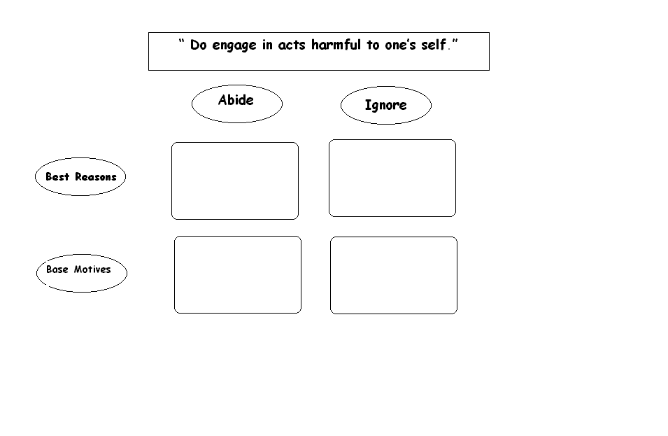
Moral Valuation Matrix
Notes:
The Value Matrix is an organizational schema to represent the dynamic process in which the interviewer facilitates the person of conscience’s self- examination of the valuational contents of her conscience.
Operationally defined, for any ‘don’t’ (or ‘do’) x, base motives are usually the first (i.e. baseline) responses a person makes to an inquiry in the form:
If you (a person) went along with x , it would be because ---- ( fill in the blank).
The facilitator records* this ‘because’ as a starting point for the dialogue but then stretches the person’s moral imagination by hypothetically blocking the motivational power of whatever was put in the blank in order to assist the person of conscience in eliciting another because. The person of conscience adduces another ‘because’ and then is asked to evaluate the first ‘because’ with respect to the second ‘because’ in terms of which is better (the interviewer makes clear that what is meant by ‘better’ is not ‘stronger’). This may turn out to be an iterative process, the end result of which will be the person of conscience’s best reason(s). The person may then be asked to judge the relative strengths of all the ‘becauses’ she has differentiated into best reasons and base motives.
*Dry erase boards are most helpful in that what first appears as an only --and by default best—reason can be placed lower in the matrix as the examination proceeds.
Example: x is ‘ Don’t make myself die.’
The initial inquiry takes the form: “ How do you fill in the blank: ‘ I will not make myself die because-----’?”
The patient responds: “ I will not kill myself because I don’t want to experience the pain.”
The psychiatrist hypothetically blocks the motivational power of the baseline ‘because’ by saying:
“What if you could be very sure you would not endure any pain, then what would be your best reason not to make yourself die?”
The patient responds: “ I don’t know. I’m worried about being condemned to Hell for taking my own life. I heard a minister tell me that suicide is the only unforgivable sin.”
The psychiatrist hypothetically blocks the motivational power of this ‘because’ by saying:
“And what if you were very sure of God’s forgiveness, what would be your ‘because’ then?”
The patient responds: “ Because it would hurt my mother terribly—for all the rest of her life.”
To actually complete the matrix the patient would also need to address the ‘becauses’ for making herself die, again in terms of base motives and best reasons. Patient and psychiatrist would then proceed to sort these ‘becauses’ according to which the patient thought was best and then again according to which the patient considered strongest. In so doing the patient becomes aware of the value-motive gap.∗
∗IU Conscience Project (2003): The IU Conscience Project 1982-2003 a power point presentation, Conscience Works, Theory Research and Clinical Applications .

Slide 74
Moral Valuation
IU Conscience Autobiography
In approaching, grappling with and/or resolving the moral dilemma
To what extent did you rely upon:
not at all-------------extremely
moral intuition
_____________________________ 0 1 2 3 4
reflection and moral reasoning
_____________________________ 0 1 2 3 4
guidance from a respected authority
within your profession
_____________________________ 0 1 2 3 4
guidance from a respected authority
outside your profession (specify_______________)
_____________________________ 0 1 2 3 4
guidance from a peer within your
profession
_____________________________ 0 1 2 3 4
guidance from a peer or significant other
outside your profession (specify_______________)
_____________________________ 0 1 2 3 4
your understanding of conventional practice
_____________________________ 0 1 2 3 4
your understanding of medico-legal requirements
_____________________________ 0 1 2 3 4
How did you settle the matter?
QUESTION 14C: RELATIVE STRENGTH OF VALUES For each of the following values, check the most
Appropriate description of its strength in your conscience
Absent Weak Present Strong Dominant
Active engagement (meeting challenges)
_____________________________________________ 0 1 2 3 4
Attachment in relationships/Connectedness in community
______________________________________________ 0 1 2 3 4
Knowledge
acquisition of knowledge
______________________________________________ 0 1 2 3 4
contributing to knowledge
______________________________________________ 0 1 2 3 4
transmitting knowledge
______________________________________________ 0 1 2 3 4
Beneficence/ Helping
______________________________________________ 0 1 2 3 4
Compassion/Empathy
______________________________________________ 0 1 2 3 4
Non-maleficence (Do no harm)
______________________________________________ 0 1 2 3 4
Individuality/ Autonomy/Liberty
______________________________________________ 0 1 2 3 4
Authority/Tradition
______________________________________________ 0 1 2 3 4
Self-interest/Authenticity
______________________________________________ 0 1 2 3 4
Justice/Fairness
______________________________________________ 0 1 2 3 4
Balance/Harmony
______________________________________________ 0 1 2 3 4
Notes:
Note: In the IU Conscience Autobiography the questions proceed to consideration of traditional bioethical principles a la the ‘Georgetown Mantra’ supplemented by the professionalized intrinsic values of conscience.

Slide 75
Moral Valuation
“In The Think Tank”
A Proposed Neuro-imaging Study
Priming
The subject has responded to SCI Questions or
IU Conscience Autobiography Questions 12 through 14
Following the Value Matrix method previously described,
the subject is assisted in identifying the because’s regarding the pro’s and con’s
for a moral mandate or dilemma of personal concern
Neuro-imaging (e.g. fMRI)
During the first run, the subject is provided a visual representation of the personalized value matrix
and is asked to mentally sort the because’s into best reasons and base motives
During the next run the subject is asked to order the list of the because’s according to relative goodness
During the last run the subject is asked to order the list of the because’s, according to relative strength

Slide 76
Decety et al, 2004, 2007

Slide 77
Empathy
Three Basic Macro- Components
Affective sharing between the self and the other, based on perception–action coupling that lead to shared representations
Notes:
Decety and Jackson (2004)∗ :
Automatic mapping between self and other is supported by considerable empirical literature in the domain of perception and action, which has been marshaled under the common-coding theory (Prinz, 1997). This theory claims parity between perception and action. Its core assumption is that actions are coded in terms of the perceivable effects…they should generate…. This theory also states that perception of an action should activate action representations to the degree that the perceived and the represented action are similar.
[Prinz, W (1997): Perception and action planning. European Journal of Cognitive Psychology. 9, 129-154]
∗Decety J and Jackson P (2004) The functional architecture of human empathy. Behavioral and Cognitive Neuroscience Reviews. 3 (2): 71-100.

Slide 78
Empathy: Emotion Sharing
Premotor and Supplementary Motor Cortex
Posterior Parietal Lobule
Notes:
…[F]unctional neuroimaging experiments in humans…demonstrate that the neural circuit involved in action execution overlaps with that activated when actions are observed….this neural network includes the premotor cortex, the parietal lobule, the supplemental motor area, and the cerebellum… In addition, several studies have shown that similar brain areas, pertaining to the same network in the premotor and posterior parietal cortex are activated during imagining one’s own action and imitating actions performed by a model….
Emotion Sharing, Some Developmental Landmarks
Discrimination of three facial expressions (happy, sad, surprised): 36 hours
Affective synchrony in mother-infant play: 2-3 months
Social referencing: 10 months
Prosocial behaviors: 2nd year of life
Emergent awareness of the subjectivity of other people’s emotions: 18 months
∗Ibid

Slide 79
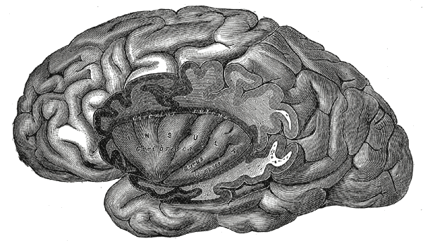
Empathy: Emotion Sharing
Premotor Cortex
Superior Temporal Sulcus
Anterior Insula
Notes:
The authors report an fMRI study: when subjects are required to observe or to imitate facial expressions of various emotions, increased neurodynamic activity is detected in the superior temporal sulcus, the anterior insula, and the amygdala as well as the premotor cortex corresponding to the facial representation (Carr, Iacoboni, Dubeau, Mazziotta and Lenzi, 2003)
[Carr L, Iacoboni M, Dubeau M, Mazziotta J and Lenzi G (2003): Neural mechanisms of empathy in humans: a relay from neural systems for imitation to limbic areas. Proceedings of National Academy of Science USA, 100. 5497-5502]
In another neuroimaging study conducted by Decety and Chaminade (2003), subjects were presented with a series of videoclips showing individuals telling sad and neutral stories, as if they had personally experienced them. Stories were told with either congruent or incongruent motor expressions of emotion. Watching sad stories versus neutral stories was associated with increased activity in emotion processing related structures (including the amygdala and parieto –frontal areas) predominantly on the right side. This network was not activated when subjects watched incongruent social behavior; instead there was strong hemodynamic increase in the VMPFC and Superior Frontal Gyrus.
[Decety J and Charminade T (2003): Neural correlates of feeling sympathy. Neuropsychologia 41, 127-138]
The authors conclude the section on share representation thus:
There is no specific cortical site for shared representations; their neural underpinnings are widely distributed , and the pattern of activation (and also presumably deactivation) varies according to the processing domain, the particular emotion , and the stored information.
∗Ibid.

Slide 80
Empathy: Self Other Awareness
Three Major Components
Affective sharing between the self and the other, based on perception –action coupling that lead to shared representations
Self-other awareness. Even when there is some temporary identification, there is no confusion between self and other
Notes:
Decety and Jackson (2004)∗ continue:
There is increasingly clear evidence of a specific developmental link between ToM and improved self control at around the age of 4…. [E]xecutive functions, especially inhibitory control, play a crucial enabling role in both the emergence and expression of children’s mental state attribution. Furthermore, it has been demonstrated that the development of cognitive control is related to the maturation of the prefrontal cortex….Bunge, Dudukovic, Thomason, Vaidya and Gabrieli (2002) investigated with fMRI in children (ages 8 to 12) and adults. They found that children were more susceptible to interference and less able to inhibit inappropriate responses than were adults and that different brain regions were recruited between the two groups. Notably the response inhibition in children was not associated with the right ventrolateral prefrontal cortex as it was in adults….
…There is evidence that a region around the paracingulate sulcus in the medial PFC plays a specific role in attribution of intention. This region contains spindle cells…which are thought to be involved in coordinating widely distributed neural activity involving emotion and cognition…. This region has been found to be reliably activated by mentalizing tasks of various cognitive difficulty ranging from:
Judging the emotion in another person’s gaze
Detecting the intention in simple dynamic animations
Attributing intention to cartoon characters, comprehending stories
Detecting social transgression and appreciating humor.
∗Ibid.

Slide 81
Empathy: Self Other Awareness
Three Major Components
Affective sharing between the self and the other, based on perception –action coupling that lead to shared representations
Self-other awareness. Even when there is some temporary identification, there is no confusion between self and other
Notes:
Using fMRI, Fink et al (1996) found activation of a right hemispheric network of temporomesial (including the amygdala and hippocampus) posterior cingulate, prefrontal right insula and prefrontal regions during presentation of personal autobiographical memories versus impersonal statements. Two functional imaging studies have reported specific increase in activity in the MPFC and posterior cingulate during tasks that involved self reflection (Gusnard, Akbudak, Shulman & Raichle, 2001; Johnson et al, 2002).
[Gusnard D, Akbudak E, Shulman G, Raichle M (2001): Medial prefrontal cortex and self-referential mental activity: relationship to a default mode of brain function. Proceedings of the National Academy of Sciences, USA. 98, 4259-4264;
Johnson S, Baxter L, Wilder L, Pipe J, Heiserman J, and Prigatano G (2002): Neural correlates of self reflection. Brain. 125, 1808-1814.]
An fMRI experiment demonstrated that the neurodynamic activity starts earlier in a number of cortical regions involved in motor control when the participants made judgments about their own actions versus those of others (Grezes , Frith and Passingham, 2004)
[ Grezes J Frith C, and Passinghan R (2004): Infering false beliefs from the actions of oneself and others: an fMRI study . Neuroimage. 21, 744-750.]
∗Ibid.
Elsewhere, Decety and Moriguchi(2007) emphasize the importance of the right inferior parietal cortex , in conjunction with prefrontatl areas and the insula as critical in distinguishing self from others.
{Reference: Decety J and Moriguchi Y (2007): The empathic brain and its dysfunction in psychiatric populations: implications for intervention across different clinical conditions. BioPsychoSocial Medicine 1;22}

Slide 82
Empathy: Mental Flexibility and Self Regulation
Three Basic Macro-Components
Affective sharing between the self and the other, based on perception –action coupling that lead to shared representations
Self-other awareness. Even when there is some temporary identification, there is no confusion between self and other
Mental Flexibility to adopt the subjective perspective of the other and also regulatory processes that modulate the subjective feelings associated with emotion.
Notes:
Decety and Jackson (2004)∗ summarize:
A series of three neuroimaging studies of healthy volunteers investigating the neural under-pinning of perspective taking in three different modalities (i.e. motoric, conceptual, and emotional) of self-other representations. In a first study, participants were scanned while they were asked to either imagine themselves performing a variety of everyday actions (e.g. winding up a watch) or imaging the experimenter doing similar actions (Ruby and Decety, 2001). Both conditions were associated with common activation in the SMA, premotor cortex and occipito-temporal region. This network corresponds to the shared motor representations between the self and the other. Taking the perspective of the other to simulate his or her behavior resulted in selective activation of the frontopolar cortex and right IPL.
In a second study, medical students were shown a series of affirmative health-related sentences (e.g. taking an antibiotic drugs causes general fatigue) and were asked to judge their truth either according to their own perspective (i.e. as experts in medical knowledge) or according to the perspective of a layperson (Ruby and Decety, 2003). Although not statistically significant there was a tendency for response times to be slightly greater when the participants answered the question with the perspective of a layperson. The set of activated regions recruited when the participants put themselves in the shoes of a layperson included the medial PFC, the frontopolar and right IPL.
In a third study, the participants were presented with short written sentences that depicted real –life situations (e.g. someone opens the toilet door that you have forgotten to lock), which are likely to induce social emotions (e.g. shame, guilt, pride) or other situations that are emotionally neutral (Ruby and Decety, 2004). They were asked to imagine how they would feel if they were in those situations , and how their mother would feel in those situations, The mother was chosen as the target of empathy because she was the participants’ best known person. Like in the previous experiment, a slight increase in the response times was observed when participants imagined the reaction of their mother elicited by neutral situations as compared to their own reactions. Reaction times were statistically greater when the subjects imagined emotion-laden situations, both from their own perspective and the perspective of their mothers. Activation was detected in the frontopolar cortex, the VMPFC the MPFC anfd the Right IPL. When the participants adopted the perspective of their mother, regardless of the affective content of the situation depicted. Cortical regions involved in emotion processing were found activated in the conditions that integrated emotion laden situations, including the amygdala and the temporal poles.
∗Ibid.

Slide 83
Empathy: Mental Flexibility and Self Regulation
Three Basic Macro-Components
Affective sharing between the self and the other, based on perception –action coupling that lead to shared representations
Self-other awareness. Even when there is some temporary identification, there is no confusion between self and other
Mental Flexibility to adopt the subjective perspective of the other and also regulatory processes that modulate the subjective feelings associated with emotion.
Notes:
Decety and Moriguchi (2007) ∗ add commentary about another fMRI study℘ which investigated whether observation of distress in others leads to empathic concern and altruistic motivation. In this experiment behavioral measures and event related functional MRI were used to explore the effect of perspective taking and emotion regulation on empathy processing while participants watched video-clips of patients expressing pain resulting from medical treatment. Video –clips were presented either with instruction to imagine the feelings of the patient (“imagine other” ) or to imagine oneself to be in the patient’s situation ( “imagine self”). Need for emotional regulation was manipulated by providing information that the medical treatment had or had not been successful. Behavioral measures clearly demonstrated that the imagery and reappraisal instructions were effective, neuroimaging data showed consistent activity in the insular cortex and anterior medial cingulate cortex (aMCC). Graded responses related to the imagery instructions were observed in dorsal insula, aMCC, and left and right parietal cortex. Emotional regulation resulted in hemodynamic changes in anterior paracingulate cortex, subgenual ACC, orbitofrontal, and right temporal cortex. These findings support the view that the response to the pain of others can be modulated by the cognitive and motivational processes. These processes influence whether observing a conspecific in need of help will result in empathic concern, an important prerequisite for helping behavior.
[℘ Lamm C, Batson C, Decety J (2007): The neural substrate of human empathy: effects of perspective taking and cognitive appraisal. J Cogn Neuroscience 19 (1): 42-58.
∗Decety J and Moriguchi Y (2007): The empathic brain and its dysfunction in psychiatric populations: implications for intervention across different clinical conditions. BioPsychoSocial Medicine 1;22

Slide 84
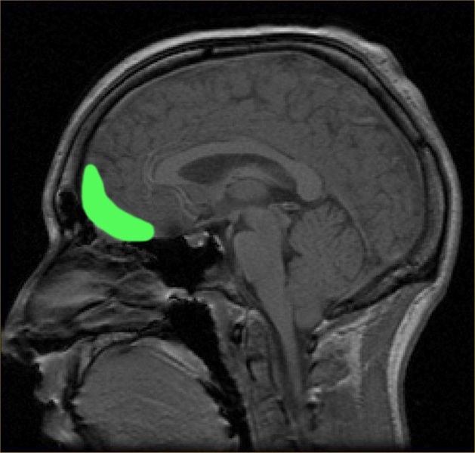
Empathy: Mental Flexibility and Self Regulation
Notes:
Ruby and Decety (2001, 2003, 2004) found differential activations within each of the brain regions depicted here (frontopolar, medial prefrontal /anterior paracingulate and posterior cingulate cortices) when subjects overtly adopt the perspective of another individual versus self perspective. Hemodynamic changes were more pronounced in the right hemisphere.
[Ruby P and Decety J (2001): Effect of subjective perspective taking during simulation of action: a PET investigation of agency. Nature Neuroscience. 4, 546-550;
Ruby P and Decety (2003): What you believe versus what you think they believe: a neuroimaging study of conceptual perspective taking. European Journal of Neuroscience. 17, 2475-2480;
Ruby P and Decety J (2004): How would you feel versus how do you think she would feel? A neuroimaging study of perspective taking with social emotions. Journal of Cognitive Neuroscience.16, 988-999.]
One of the most striking findings [in studies] that investigated self-versus other-perspective is the systematic involvement of the frontopolar cortex, medial PFC and posterior cingulate when participants adopt the perspective of another….
….We argue that [an] inhibitory component is required to regulate and tone down the self perspective to allow the evaluations of the other-perspective. This is necessary because the prepotent self-perspective, driven by the automatic link between perception and action, is the default mode, and this regulation allows cognitive and affective flexibility…. ∗
∗Ibid.
Also see: Decety J and Moriguchi Y (2007): The empathic brain and its dysfunction in psychiatric populations: implications for intervention across different clinical conditions. BioPsychoSocial Medicine 1;22

Slide 85
Empathy: Key Structures
Notes:
The following set of slides serves as a summary of brain regions of interest in the experience of empathy according to Decety et al (2004).

Slide 86
Empathy: Key Structures
Essential for regulating emotion
Notes:
[Read Slide]

Slide 87
Empathy: Key Structures
ESSENTIAL FOR REGULATING EMOTION
(ORBITOFRONTAL AND VENTROMEDIAL PFC)
RECIPROCALLY CONNECTED WITH BRAIN REGIONS INVOLVED
IN
Notes:
[Read Slide]

Slide 88
Empathy: Key Structures
EMOTIONAL PROCESSING,
Notes:
[Read Slide]

Slide 89
Empathy: Key Structures
Emotional processing
(Amygdala ),
Notes:
[Read Slide]

Slide 90
Empathy: Key Structures
MEMORY,
Notes:
[Read Slide]

Slide 91
Empathy: Key Structures
Memory
(Hippocampus),
AND
Notes:
[Read Slide]

Slide 92
Empathy: Key Structures
executive functioning
Notes:
[Read Slide]

Slide 93
Empathy: Key Structures
EXECUTIVE FUNCTIONING
(DORSOLATERAL PFC)
AS WELL AS
Notes:
[Read Slide]

Slide 94
Empathy: Key Structures
A FORM OF ATTENTION
that serves to regulate both cognitive and emotional processing
Notes:
[Read Slide]

Slide 95
Empathy: Key Structures
A FORM OF ATTENTION
that serves to regulate both cognitive and emotional processing
(ANTERIOR CINGULATE CORTEX)
Notes:
[Read Slide]
In addition, Decety et al (2004) brings into the account of the biology of empathy, neural correlates of emotional reappraisal in the lateral PFC and medial PFC accompanied by decreased activity in the medial orbitofrontal cortex and the amygdala (Oschner, Bunge, Gross and Gabrieli, 2002) noting similar findings in voluntary suppression of sadness by Levesque et al in 2003.
[Oschner K, Bunge S, Gross J, and Gabrieli J (2002): Rethinking feelings: an fMRI study of the cognitive regulation of emotion. Journal of Cognitive Neuroscience 14, 1215-1229.
Levesque J, Eugene F, Joanette Y, Paquette, V, Mensour B, Beaudoin G and Beauregard M (2003): Neural circuitry underlying voluntary suppression of sadness. Biological Psychiatry, 53, 502-510.]

Slide 96
Sense and Sensibility
Marianne and Elinore in conversation, following public disclosure of Edward’s engagement to Lucy.
“How long has this been known to you, Elinor? Has he written to you?”
“ I have known it these four months. When Lucy first came to Barton Park last November, she told me in confidence of her engagement.”
“At these words, Marianne’s eyes expressed the astonishment which her lips could not utter. After a pause of wonder, she exclaimed:
“Four months! Have you known of this four months?”
Elinor confirmed it.
“ What! While attending me in all my misery, has this been on your heart? And I have reproached you for being happy!”
….
“Oh! Elinor,” she cried, ‘you have made me hate myself forever. How barbarous have I been to you! You, who have been my only comfort, who have borne with me in all my misery, who have seemed to be only suffering for me! Is this my gratitude? Is this the only return I can make you? Because your merit cries out upon myself, I have been trying to do it away.”
Notes:
Austen J (1811/2004): Sense and Sensibility, Ann Arbor, MI: Borders Classics
In the much longer exchange that occurs between the two sisters, Elinor and Marianne, from which this is excerpted, we are able to discern activity in various domains of Elinor’s conscience. For example, she is explicit in endorsing deontological values: confidentiality for instance and, in accordance with non-maleficence, regulation of self disclosure for the sake of sparing family and friends what she perceives would present them with much distress without any apparent remedy. However, the selection especially highlights the depth and duration of Elinor’s empathic responsiveness as apprised not by herself but by her sister. Empathy finds its home within the domain of conscience called moralized attachment and its place of work within the domain called moral emotional
responsiveness.

Slide 97
Moralized Attachment
Stilwell Conscience Interview and IU Conscience Autobiography
QUESTION 9: WHO CARES ABOUT
YOUR GOODNESS?
Other than yourself, who is most PROUD
When you have done something good?
Has this been true all your life? How do
these person(s) show they care about your
goodness?
QUESTION 10: WHO CARES ABOUT
YOUR BADNESS?
Other than yourself, who is most
ASHAMED when you have done
something bad?Has that been true all your
life? How do these person(s) show they
care when you haven't been good?
QUESTION 9: WHO CARES ABOUT YOUR GOODNESS?
Other than yourself, who in your life has been most pleased
When you have done something good? Has this been true all
your life?How do these persons show they care about your
goodness? Of these persons, whose good opinion do you
most want to have or keep? What about since entering
professional/vocational school- have you added new people to
your list of those who care when you've done something
good? How did they get to be on your list? Of these
persons, whose good opinion do you most want to have or
keep? How come?
QUESTION 10: WHO CARES WHEN YOU'RE BAD?
Other than yourself, who in your life has been most displeased
when you have done something bad? Has this been true all
your life? How do these persons show they care when you're
bad? Of these persons, whose bad opinion do you most want
to avoid? What about since entering professional/vocational
school- have you added new people to your list of those who
care when you've done whose bad opinion do you most want
to avoid? How come?
Notes:
Moralization of attachment (Stilwell et al, 1997)∗ measures developmental transitions in the youngster's response to parental prohibitions and demands based upon how s/he links feelings of security, empathy and oughtness to child‑ parent and other child‑authority figure relationships.
∗Stilwell B, Galvin M, Kopta M, Padgett R, and Holt J (1997): Moralization of attachment: a fourth domain of conscience functioning. Journal American Academy Child and Adolescent Psychiatry, 36(8): 1140-1147.
SCI additional probes for Question 9:
Who most wants you to be a good person?
How do they get that idea across to you?
Does it get across?
SCI additional probes for Question 10:
Who gets most upset with you when you're done something wrong?
With whom do you get in trouble? What is "trouble"?
How do you feel about it when they (ground, punish, give you a timeout) etc.,
Is it for your own good?
What are they trying to teach you? Does it work?

Slide 98
Moralized Attachment
Stilwell Conscience Interview and IU Conscience Autobiography
QUESTION 13: MANDATE AUTHORS
Beside the rules [ identified in response to
Question 12] write the name of the person(s)
who have helped the most in putting that rule in
your conscience.
QUESTION 13: MANDATE AUTHORS
Beside the main rules {principles) and values
you have listed, write the name of the person(s)
who has helped you and your conscience the
most in adopting that rule {principle} / embracing
that value.
Circle which of the main rules {principles} /
values are new since you entered professional
school.
Underline which of the main
rules{principles}/values, although present before,
have become more important since you entered
professional school.

Slide 99
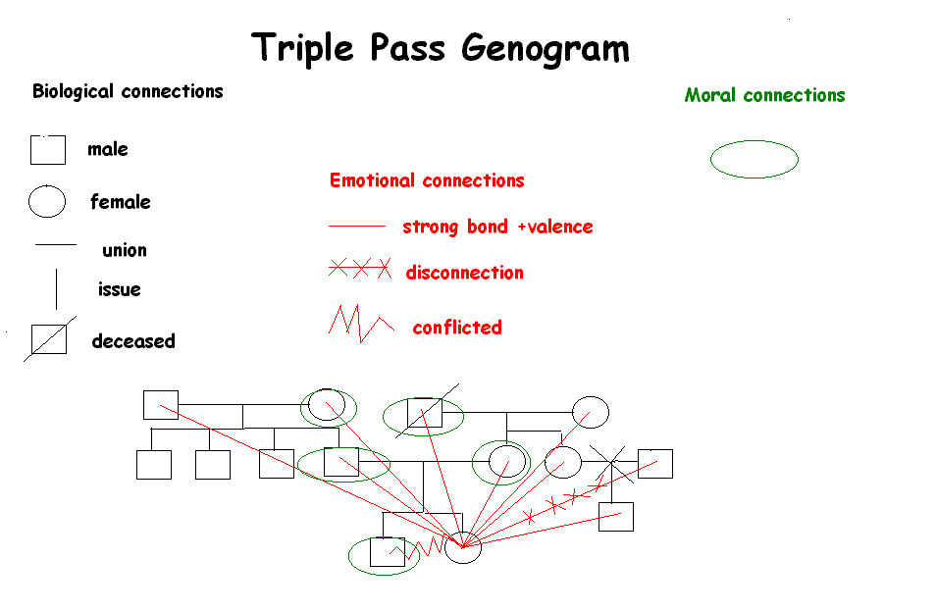
Moralized Genogram
Notes:
IU Conscience Project (2003): The IU Conscience Project 1982-2003 a power point presentation, Conscience Works, Theory Research and Clinical Applications.

Slide 100
Pride and Prejudice
Notes:
Austen J (18--): Pride and Prejudice, Walter J Black: New York.

Slide 101
Moralized Attachment
“ In the Think Tank”
A Proposed Neuro-imaging Study
Priming
The subject has responded to SCI Questions or
IU Conscience Autobiography Questions 9, 10, 13
The subject has completed parts one and two of the Moralized Genogram
Neuro-imaging (e.g. fMRI)
During the run, the subject is provided a visual representation of the incomplete genogram
and is asked to mentally encircle those symbols on the genogram representing moral attachment figures
Following the run the subject is asked to record how the designated moral attachment figures show they care and/or what values those persons have transmitted across or within generations

Slide 102
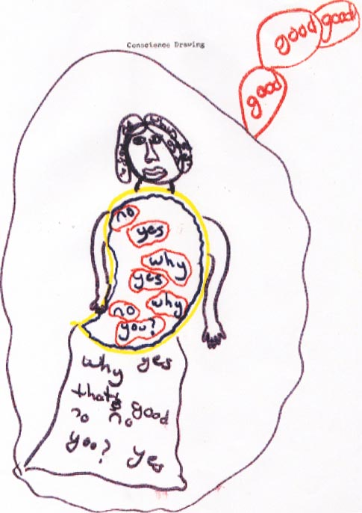
Notes:
One of our favorite drawings of conscience. By a twelve year old girl.
Cf: J Austen∗ describing reactions to a drawing of Miss Harriet Smith done by Emma:
Mrs. Weston: “The expression of the eyes is most correct, but Miss Smith has not those eyebrows and eyelashes. It is the fault of her face that she has them not.”
Mr. Elton: “Do you think so? , replied he . “ I cannot agree with you. It appears to me a most perfect resemblance in every feature. I never saw such a likeness in my life. We must allow for the effect of shade, however.”
Mr. Knightley: “You have made her too tall, Emma.”
∗Austen J (1816/1981): Emma. New York: Bantam Books. p 43.

Slide 103
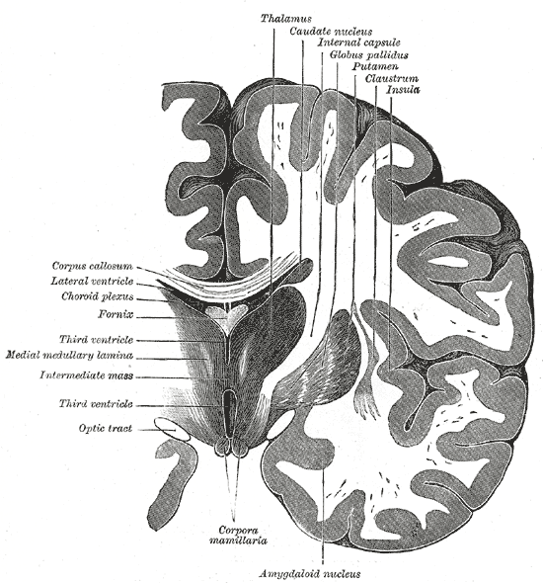
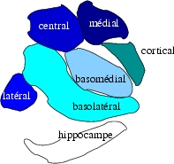
Notes:
Brain imaging studies have been conducted on various emotions. For example, as reviewed by Giacomo Rizzolatti and Laila Craighero (2005)∗, in the emotional experience of disgust, intense activation can be found in the amygdala and insula:
“ The amygdala is a heterogeneous structure formed by several subnuclei. Functionally, these subnuclei form two major groups: the corticomedial group and the basolateral group. The former, phylogenetically more ancient, is related to the olfactory modality. It is likely that it is the signal increase in the corticomedial group that is responsible for the amygdala activation in response to disgusting stimuli.
“ Similarly to the amygdala, the insula is a heterogeneous structure. Anatomical connections revealed two main functional subdivisions in it: an anterior ‘visceral’ sector and a multimodal posterior sector…. The anterior sector receives a rich input from olfactory and gustatory centers. In addition the anterior insula receives an important input from the inferotemporal lobe, where in the monkey, neurons have been found that respond to the sight of faces…. Recent data demonstrated that the insula is the main cortical target of interoceptive afferents…. Thus, the insula is not only the primary cortical area for chemical exteroception (e.g. taste and olfaction) but also for the interoceptive state of the body (‘ body state representation’)….
“… As for the premotor cortex, it is plausible that in the insula there is a specific type of mirror neurons that match the visual aspect of disgust with its viscero –motor aspects. The activation of these (hypothetical) viscero-motor mirror neurons should underlie the first person knowledge of what it means to be disgusted. The activation of these insular neurons should not necessarily produce the overt viscero-motor response….”
∗Op cit. Rizzolarri and Craighero (2005) p. 119.

Slide 104
Takahashi et al, 2004
Notes:
In a study by investigators at Tokyo Medical and Dental University (2004)∗, nineteen healthy volunteers read sentences carrying neutral , guilty or embarrassing conditions during the scans.

Slide 105
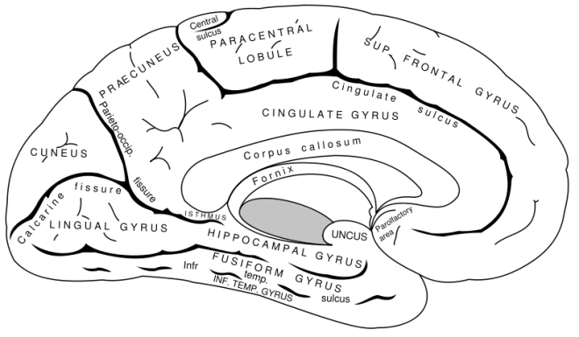
Brain Regions of Interest in
Evaluative processes of
Guilt and Embarrassment
left cerebral hemisphere region of interest
corresponding region right hemisphere
bilateral activity
not specified
Left Posterior Superior Temporal Sulcus
Visual Cortex
MPFC
Notes:
Both guilt and embarrassment conditions commonly activated the MPFC, left posterior superior temporal sulcus and visual cortex.

Slide 106
Brain Regions of Interest in
Evaluative processes of
Guilt and Embarrassment
left cerebral hemisphere region of interest
corresponding region right hemisphere
bilateral activity
not specified
Embarrassment > Guilt
Bilateral Hippocampus
Visual cortex
Right Anterior Temporal Cortex
Notes:
Compared to guilt condition, embarrassment condition produced greater activation in the right anterior temporal cortex, bilateral hippocampus and visual cortex.
The investigators comment that most of these regions have been implicated in the neural substrate of ToM and conclude:
Our results support the idea that both [guilt and embarrassment ] are self conscious emotions which are social emotions requiring the ability to represent the mental states of others. At the same time, our functional MRI data are in favor of the notion that evaluative process of embarrassment might be a more complex process than that of guilt.
∗Takahashi H, Yahata N, Koeda M, Matsuda T, Asai K , Okubo Y (2004): Brain activation associated with evaluative processes of guilt and embarrassment: an fMRI study. Neuroimage 23 (3): 967-74.

Slide 107
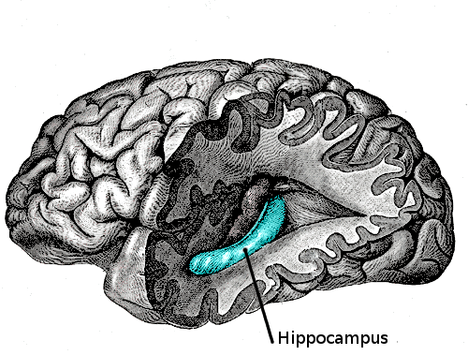
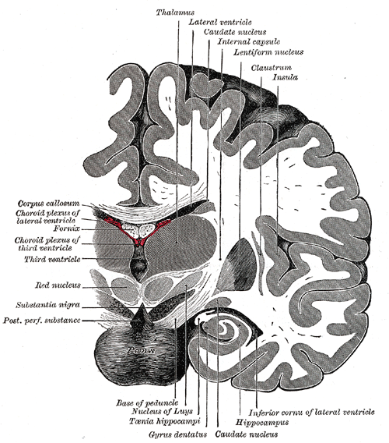
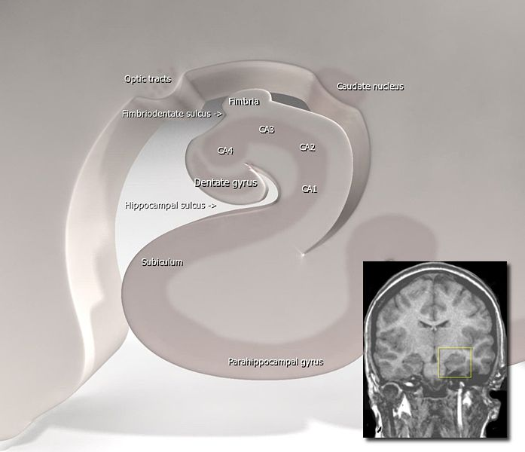
Notes:
Views of the Hippocampus

Slide 108
Berthoz et al, 2006

Slide 109
social behavior stories
Self accidental (SA) violation
beginning: ‘ You are invited to a Japanese dinner at a friend’s house’
end: ‘You have a bite of the first course , you choke and spit out the food while you are coughing.’
Other accidental (OA) violation
beginning: ‘Joanna is invited to a Japanese
dinner at her friend’s house’
end: “She has bite of the first course, chokes and spits out the food while she is coughing.’
Self intentional (SI) violation
beginning: ‘You are invited to a Japanese dinner at a friend’s house’
end: ‘You have a bite of the first course , but do not like it and spit the food back into your plate.’
Other intentional (OI) violation
beginning: ‘Joanna is invited to a Japanese dinner at a friend’s house.’
end : ‘She has a bite of the first course, but does not like it and spits the food back into her plate.”
Notes:
In this study by Berthoz et al (2006)∗, 12 subjects, all adult males, were asked to make evaluations regarding the degree of inappropriateness of social behaviors described in stories in which they themselves, or someone else transgressed social norms intentionally or accidentally. The example the investigators chose is presented in this slide.
Here we will provide details of the methods employed as these seem to us fairly readily adapted to the “Think Tank” studies we are proposing for each conscience domain.
Stories were presented twice, once with second personal reference and once with third personal reference. Stimuli were displayed on a monitor and presented to the subject via a 45 degree angled mirror positioned above the head coil. Beginning of the story was presented for 8 seconds and then replaced by the end of the story for 10 seconds. Participants were instructed to read the text silently, and to click the response key when they finished reading the second part of the story. They were instructed to imagine what they or the story protagonist would feel in the situation described. After the scanning session, half of the participants rated the stories in which the protagonist was imagined to be the subject himself, the other half rated the stories in which the protagonist was someone other than the subject. Ratings requested were i) how embarrassing they thought the situation would be, ii) how inappropriate they thought the behaviour to be and iii) how funny they thought the story to be.
∗ Berthoz S, Grezes J, Armony J, Passingham R and Dolan R (2006): affective response to one’s own moral violation. NeuroImage 31, 2: 945-950.

Slide 110


Brain Regions of Interest in
Affective Responses to Violations
Lateral surface of the (left) cerebral hemisphere .
Viewed from the side
left cerebral hemisphere region of interest
corresponding region right hemisphere
bilateral activity
Intentional > Accidental
(SI plus OI) versus (SA plus OA)
Left
Dorsolateral, Superior Frontal Cortex
Anterior Cingulate Gyrus
Inferior Parietal Cortex
Superior Occipital Gyrus
Amygdala
Bilaterally
Precuneus
Right
Cerebellum (not shown)
Notes:
Their equipment was a whole body MRI system with a head coil. As in the previously described study, BOLD contrast was utilized. They first analyzed the main effect of Intentionality [(SI plus OI) versus (SA plus OA)]. Significant differential activation was seen in the left dorsolateral, superior frontal cortex, anterior cingulate gyrus, left inferior parietal cortex, left superior occipital cortex, left amygdala, right cerebellum and bilaterally in the precuneus. In the inverse contrast Accidental > Intentional only the right inferior temporal sulcus showed more activation.∗
∗Ibid.

Slide 111

Brain Regions of Interest in
Affective Responses to Violations
Lateral surface of the (left) cerebral hemisphere .
Viewed from the side
left cerebral hemisphere region of interest
corresponding region right hemisphere
bilateral activity
Self versus Other
(SI plus SA) versus (OI plus OA)
Left
Precuneus
Right
Cerebellum (not shown)
Notes:
Next they analyzed the main effect of Agency [(SI plus SA) versus (OI plus OA)]. Significant differential activation was seen in the left precuneus and right cerebellum In the inverse contrast, Other>Self, there were no significant differences in activation.∗
∗Ibid.

Slide 112

Brain Regions of Interest in
Affective Responses to Violations
Lateral surface of the (left) cerebral hemisphere . Viewed from the side
left cerebral hemisphere region of interest
corresponding region right hemisphere
bilateral activity
Self Involvement in Intentional Violation
(SI minus OI)---(SA minus OA)
Left
Amygdala
Right
Amygdala
DLPFC
Notes:
In order to identify brain areas specifically activated when evaluating self involvement in intentional violation of social norms, the following contrast [(SI-OI)-(SA-OA)] was calculated. This interaction revealed significant bilateral amygdala activation . A post hoc exploration of the parameter estimates showed that this effect was driven by a response to Self Intentional violation as compared to all other conditions. The only region that showed greater activation was the Right DLPFC.∗
∗Ibid.

Slide 113

Brain Regions of Interest in
Affective Responses to Violations
Lateral surface of the (left) cerebral hemisphere .
Viewed from the side
left cerebral hemisphere region of interest
corresponding region right hemisphere
bilateral activity
Self Involvement in Intentional Violation
(SA minus OA)---(SI minus OI)
Left
Parieto-Occipital Fissure
Cerebellum (not shown)
Notes:
To identify brain areas specifically activated when evaluating self involvement in accidental violation of social norms, the following contrast [(SA-OA)-(SI-OI)] was calculated.This interaction revealed significant increased activation in the left parieto-occipital fissure and the left cerebellum. A post hoc exploration of the parameter estimates showed that this effect was driven by a response to Self Intentional violation as compared to all other conditions. The only region that showed greater activation was the Right DLPFC.
In Discussion the investigators make the following points:
Their critical finding was enhanced activity in the amygdala when participants narrated their own intentional violation of social norms.
The amygdala is a crucial part of the neural circuitry by which stimuli trigger emotional responses that reflect an appraisal of value.∗
∗Ibid.

Slide 114
Brain Regions of Interest in
Affective Responses to Violations
Lateral surface of the (left) cerebral hemisphere .
Viewed from the side
left cerebral hemisphere region of interest
corresponding region right hemisphere
bilateral activity
Self Involvement in Intentional Violation
(SA minus OA)---(SI minus OI)
Left
Parieto-Occipital Fissure
Cerebellum (not shown)
Notes:
The fact the amygdala was activated for intentional violation by the self alone, is consistent with the view that this structure is involved in emotional processing important for personal welfare, as in the perception of emotionally salient stimuli and stimulus-affect contingencies (Adolphs, 2003; Dolan, 2002). Thus, the present results further emphasize the role of the amygdala in weighing the consequence of one’s own intentional action for the sake of one’s own wellbeing. The previous neuroimaging studies on the neural correlates of morality did not address the influence of intentionality and agency, which are two core aspects in moral judgment (e.g., Greene et al., 2001; Moll et al., 2002a,b). For example, in Moll et al. (2002b) study, the subjects were instructed to read emotional unpleasant moral and non moral statements and to covertly judge them as being either right or wrong. However, these instructions did not require reference to the subject’s own behaviour. This may explain why the amygdala was not activated in the moral judgement condition, even though the stimuli were rated as emotionally evocative. More recently, these authors (Moll et al., 2005) found amygdala activation when comparing statements evocative of pure disgust (e.g., ‘One night you were walking on the street. You saw a cat eating its own excrement’) to indignation (e.g., ‘You went with a friend to a restaurant. When you passed the kitchen, you saw rats in the pans’). Although the statements had a personal perspective (‘You’), the participants were passive observers rather than being the agent of intentional social transgressions.∗
[Adolphs R (2003): Is the human amygdala specialized for processing social information? Ann NY Acad Sci 985, 326-340.
Dolan R (2002): Emotion, cognition and behavior. Science 298, 1191-1194.
Greene J , Sommerville R, Nystrom L, Darley J and Cohen J (2001): An fMRI investigation of emotional engagement in moral judgment. Science 293, 2105-2108
Greene J , Nystrom L, Engell A, Darley J and Cohen J (2004): The neural bases of cognitive control in moral judgment. Neuron 14, 389-400
Moll et al. (2002a): the neural correlates of moral sensitivity: A functional magnetic resonance imaging investigation of basic and moral emotions. J Neurosci 22, 2730-2736
Moll J, de Oliveira-Souza R, Eslinger P, Graffman J (2002b): Functional networks in emotional moral and nonmoral social judgments. NeuroImage 16, 696-703
Moll J, de Oliveira-Souza R, Moll F, Ignacio F, Bramati I, Caparelli –Daquer E, Eslinger P (2005): The moral affiliation of disgust: a functional MRI study. Cogn. Behav. Neurol. 18, 68-78.]
∗Ibid.

Slide 115
Emma
Miss Woodhouse and Mr. Knightley at Box Hill
While they talked they were advancing towards the carriage; it was ready; and, before she could speak again, he had handed her in. He had misinterpreted the feelings which had kept her face averted, and her tongue motionless. They were combined only of anger against herself, mortification, and deep concern. She had not been able to speak; and on entering the carriage, sunk back for a moment overcome; then reproaching herself for having taken no leave, making no acknowledgment, parting in apparent sullenness, she looked out with voice and hand eager to show a difference; but it was just too late. He had turned away, and the horses were in motion. She continued to look back, but in vain; and soon, with what appeared unusual speed, they were half-way down the hill, and everything left far behind. She was vexed beyond what could have been expressed—almost beyond what she could conceal. Never had she felt so agitated, so mortified, grieved, at any circumstance in her life. She was most forcibly struck. The truth of his representation there was no denying. She felt it at her heart. How could she have been so brutal, so cruel to Miss Bates! How could she have exposed herself to such ill opinion in any one she valued! And how suffer him to leave her without saying one word of gratitude, of concurrence, of common kindness!
Notes:
Austen J (1816/1981): Emma. New York: Bantam Books.

Slide 116
Moral Emotional Responsiveness
Stilwell Conscience Interview and IU Conscience Autobiography
QUESTION 3A: PLEASING THE
CONSCIENCE
When you have pleased your conscience and done something morally right/good, what happens on the inside of you?
Do you feel it in any particular place(s) in your body?
What happens on the outside of you? How does it show?
If I were to look at you, how would I know what is happening inside of you?
What is the reaction of other people around you? What do other people do when they find out?
[GET EXAMPLES]
QUESTION 3A: PLEASING THE
CONSCIENCE
When you have pleased your conscience by doing something good, do you discern any change or changes in your inner state? Describe the change or changes.
Do you experience these changes in any particular place or places in your body?
What happens externally? Is the change discernible to others {how does it show}?
If someone were to look at you, how would s/he know what is happening inside you?
What are the reactions in others around you?
{Give examples}
Notes:
Moral emotional responsiveness (Stilwell et al, 1994)∗measures developmental transitions in the way a child uses 1) anxiety and mood to regulate moral behavior and 2) processes of reparation and healing after wrongdoing to regain the physiological state normally experienced when feeling like a good person.
∗Stilwell B, Galvin M, Kopta S & Norton J(1994): Moral‑ emotional responsiveness: two domains of conscience functioning. Journal of the American Academy of Child and Adolescent Psychiatry, 33, 1: 130‑139.
SCI additional probes for eliciting feelings and psychophysiological responses:
What is it like when you feel happy (sad, scared, mad, embarrassed, ashamed, etc).
For every person it's a little different. How do you experience that feeling physically or physiologically?
Do your feelings show in your face, or any other part of your body?
Do you put on a face when you feel that way?
How long does that feeling last? What do you do about it (if its negative)?
How do other people know your feelings about right/wrong, good/bad?
What feelings do you have that don't show?
Is it easy for other people to "read" your feelings?
SCI additional probes for "other people's reactions":
How do other people feel when you have.....?
Do other people put on a face? What does it look like?
Do they treat you differently?

Slide 117
Moral Emotional Responsiveness
Stilwell Conscience Interview and IU Conscience Autobiography
QUESTION 3B: PLEASING...IF NO ONE
KNOWS
Would you tell me of a time when you did something good/right and nobody knew
about it....a time when you did a secret good deed.
What happened on the inside of you in that situation?
Did you feel it any special place in your body?
What happened on the outside of you?
If I just came into the room and looked at you....would I be able to tell that you had just done something good?
Do other people figure it out? How do they do it?
QUESTION 3B: PLEASING THE
CONSCIENCE...IF NO ONE KNOWS
Write about a time when you did something good / right and nobody knew about it.
Did you discern any change or changes in your inner state? Describe the change or changes. Were these changes experienced in any particular place or places in your body?
What happened externally? Was the change discernible to others {how did it show}?
Had someone been there to look at you, would s/he have been able to tell you had done something good?
Did other people suspect or figure it out?
{Give examples}
Notes:
SCI additional probes for secret goodness:
For a small child a secret may be associated with lying or badness. Try the word, surprise.
Let's say, you've done a secret good deed....what happens ...?
Let's pretend that there is no possible way for your parents (teacher, friend, etc) to find out.
Would that change how you felt about it?

Slide 118
Moral Emotional Responsiveness
Stilwell Conscience Interview and IU Conscience Autobiography
QUESTION 4A: DISPLEASING THE
CONSCIENCE
When you have gone against your conscience and done something morally bad/wrong, what happens on the inside of you?
Do you feel it any special place in your body?
What happens on the outside of you?
If I were looking at you, how would I know something was wrong?
What is the reaction of other people around you?
QUESTION 4A: DISPLEASING THE
CONSCIENCE
When you have gone against your conscience and done something morally wrong (bad), do you discern any change or changes in your inner state?
Describe the change or changes. Do you experience these changes in any particular place or places in your body?
What happens externally? Is the change discernible to others {how does it show}?
If someone were to look at you, how would s/he know what is happening inside you?
What are the reactions in others around you?
{Give examples}.
Notes:
SCI notes:
When moral feelings are elicited, the objective is to learn how they are used in behalf of
moral growth.
SCI additional probes:
How long does the feeling bad (angry, guilty) last?
What do you do to get a good feeling? (This will repeat in Q5).
How does that feeling show itself in your body? Does it take a toll on you physically,
physiologically? Does it affect your health?
SCI additional probes for other people's reactions:
How upset do other people get with you? What do they do? Do they treat you differently?

Slide 119
Moral Emotional Responsiveness
Stilwell Conscience Interview and IU Conscience Autobiography
QUESTION 4B: DISPLEASING
...IF NO ONE KNOWS
Tell me about a time when you did something wrong and no one found out.
What happened on the inside of you?
Did you feel it in any special place in your body?
What happens on the outside of you?
If I were looking at you, how would I know you had done something wrong?
What is the reaction of other people around you?
QUESTION 4B: DISPLEASING THE
CONSCIENCE...IF NO ONE KNOWS
Write about a time when you did something wrong and no one found out.
Did you discern any changes in your inner state? Describe the change or changes. Were these changes experienced in any particular place or places in your body?
What happened externally? Was the change discernible to others {how did it show}?
Had someone been there to look at you, would s/he have been able to tell you had done something wrong?
Did other people suspect or figure it out?
{Give examples}
Notes:
SCI additional probes:
Let's pretend there is absolutely no way your parents (teachers, the police, your friends,
etc. can find out)....
Let's pretend I'm a little (bug, mouse, etc.) hidden in the corner of your bedroom? Would I
be able to tell you had done something wrong? Would there be any clues?
Have you ever done anything so bad/wrong that you couldn't tell anybody for a long, long time?

Slide 120
Moralized Emotional Responsiveness
“ In the Think Tank”
A Proposed Neuro-imaging Study: “Activating Moral Emotional Mirror Neurons”
Priming
The subject has responded to SCI Questions or
IU Conscience Autobiography Questions 3 and 4.
Neuro-imaging (e.g. fMRI)
During one run, the subject is instructed keep in mind a specific memory of right doing
with special consideration of how the experience elicited anxiety, altered mood and/or produced psychophysiologial responses
Following the run the subject is asked record the memory and considerations
During another run, the subject is instructed keep in mind a specific memory of wrong doing
with special consideration of how the experience elicited anxiety, altered mood and/or produced psychophysiological responses
Following the run the subject is asked record the memory and considerations

Slide 121
Emma
Miss Woodhouse Resolves to Make Amends
A whole evening of backgammon with her father was felicity to it. There, indeed, lay real pleasure, for there she was giving up the sweetest hours of the twenty–four to his comfort; and feeling that, unmerited as might be the degree of his fond affection and confiding esteem, she could not, in her general conduct , be open to any severe reproach. As a daughter, she hoped she was not without heart. She hoped no one would have said to her, “ How could you be so unfeeling to your father? I must, I will tell you truths while I can.” Miss Bates should never again—no never! If attention in future could do away the past she might hope to be forgiven. She had been often remiss, her conscience told her so, remiss, perhaps, more in thought than fact; scornful, ungracious. But it should be no more. In the warmth of true condition she would call upon her the very next morning, and it should be the beginning, on her side, of a regular, equal, kindly intercourse.
Notes:
Austen J (1816/1981): Emma. New York: Bantam Books.

Slide 122
Moral Emotional Responsiveness
Stilwell Conscience Interview and IU Conscience Autobiography
QUESTION 5:
REPARATION AND HEALING
A. When you have gone against your conscience and you do something wrong or bad, what do you do to make things right?
B. What do you do to feel better?
QUESTION 5:
REPARATION AND HEALING
When you have gone against your conscience by doing something wrong or bad, what do you do to make things right? Repair the damage?
What do you do to feel better, to soothe you conscience?
Notes:
SCI additional probes for “making things right”:
And what else? And what else? And what else?
What do you do to make it fair, to make up for......, to make things turn out right?
Are there times when nothing makes things right? What do you do then?
SCI additional probes for feeling responses:
Okay, you've done [quote the subject] such and such to make up for [quote subject], now how do you feel?
What else do you do to make yourself feel better?
What else do you do to get back to feeling like your normal self? How long does it take?

Slide 123
Moralized Emotional Responsiveness
“ In the Think Tank”
A Proposed Neuro-imaging Study: “Letters of Apology and Gratitude”
Priming
The subject has responded to SCI Question or
IU Conscience Autobiography Question 5
Neuro-imaging (e.g. fMRI)
During one run, the subject is instructed to mentally compose a letter of apology
as an exercise in moral imagination (i.e. the maleficence may not actually have occurred)
Following the run the subject is asked to draft the letter
During another run, the subject is instructed to mentally compose a letter of gratitude
as an exercise in moral imagination (i.e. the beneficence may not actually have occurred)
Following the run the subject is asked to draft the letter

Slide 124
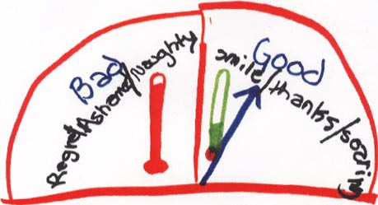
Notes:
A moral emotional conscience by another twelve year old girl.

Slide 125
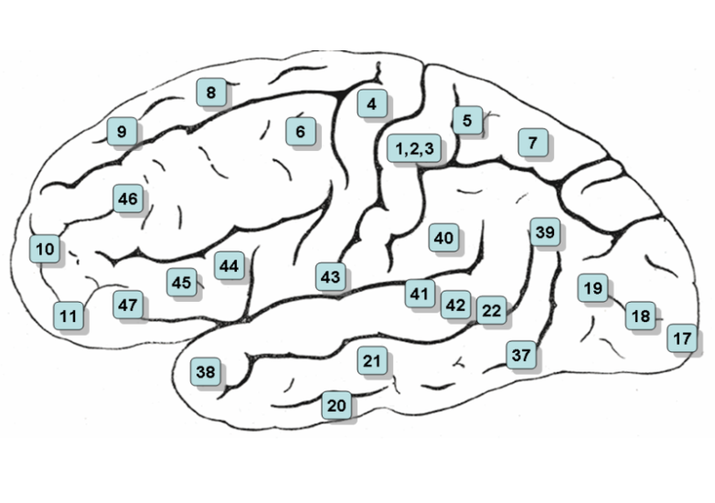

Lateral surface of the (left) cerebral hemisphere. Viewed from the side
left cerebral hemisphere region of interest
corresponding region right hemisphere
bilateral activity
Brain Regions of Interest
in
Attempted Inhibition Conditions
Brodmann Areas
A priori Search
Right hemisphere
Superior frontal gyrus 10
Anterior cingulate gyrus 32
Whole-brain post hoc analysis
Left hemisphere
Middle Occipital Gyrus 19
Inferior Frontal Gyrus 47
Right Hemisphere
Inferior Occipital Gyrus 19
Bilateral
Superior Occipital Gyrus 19
superior parietal lobule 7
Notes:
In a study by Beauregard et al (2001)∗ 10 men viewed emotionally neutral and erotic films while fMRI studies were conducted. One functional run was conducted while subjects were instructed to attempt inhibition to the arousal from the erotic films. For both sexual arousal and attempted inhibition conditions, a conventional subtraction method was used to contrast brain activity associated with the viewing of the erotic film excerpts and that associated with viewing the emotionally neutral film excerpts. In viewing erotic film excerpts allowing arousal, BOLD signal increases were found in the R amygdala, R anterior temporal pole [Brodmann area (BA) 38] and hypothalamus. In the attempted inhibition condition, significant loci of activation were noted in the R superior frontal gyrus (BA10) and R anterior cingulate gyrus (BA 32). No significant loci of activation were detected in the amygdalas, the anterior temporal polar region and the hypothalamus
∗Beauregard M, Levesque J, Bourgouin, P (2001): Neural correlates of conscious self regulation of emotion. The Journal of Neuroscience 21: RC165:1-6.

Slide 126
Notes:
Austen J

Slide 127
Moral Volition
QUESTION 15: SELF EVALUATION AND
VOLITION
Does your conscience change as you grow? How?
Do you think about your conscience (or morality) differently now than when you were younger?
Are there changes going on in you now? Tell me about them.
Is your conscience your friend or your
enemy?
Is it in charge of you or are you in charge of it? Do you work together or are you enemies?
How much willpower do you have?
How do you use your willpower to stay out of trouble, to please your conscience, to follow through on what you believe?
When does your willpower fail for you?
Are there ways that your feelings get in the way of following right and wrong?
Do you sometimes think one way and behave another?
QUESTION 15A: SENSE OF CHANGE AND
VOLITION
At what age did you become aware of making moral choices?
What is your earliest memory of moral choosing?
How often do the choices you make affect/involve relations with authorities?
During what period(s) of your life have you been most aware of changes in your conscience?
Describe the changes associated with these
periods.
Have certain life events triggered, accelerated or modified changes in your conscience? Which events? How did they affect your conscience?
Which changes have unfolded without obvious association to life events?
Which changes have been deliberately directed by yourself?
How has professional/vocational school
contributed to changes in your conscience?
Notes:
Moral volition (Stilwell et al, 1998)∗ measures developmental transitions in how a child uses his/her sense of autonomy in responding to and redefining rules of conscience.
∗Stilwell, B., Galvin, M., Kopta, M., and Padgett, R. (1998): Moral volition: the fifth and final domain leading to an integrated theory of conscience understanding. Journal American Academy Child and Adolescent Psychiatry, 37 (2): 202-210.
SCI Additional probes:
What does your conscience know now that it didn't know when you were younger?
How much will power do you have? How often to you follow your own conscience? How
hard or easy is it to follow your conscience?
Are there times you don't know what the right or good action is? What if there are two
rights or two wrongs? Which action do you take?
Have you been in unusual situations that interfered with you doing the right thing or being
a good person? Are there some situations you try to avoid? Are there some situations that
are too tempting?
Do you have a different attitude than you used to have about things having to do with
conscience? Are you trying to get a different attitude? How?
What developmental events--things that happened while you were growing up--changed your conscience? Directed the development of your conscience? Shaped how you think about right and wrong? Good and bad?

Slide 128
Moral Volition
15C: ENVISIONING FUTURE
CONSCIENCE DEVELOPMENTS.
Since starting professional/vocational school, do
you have a different attitude than you used to
have regarding conscience? Are you trying to
change your conscience? Do you envision future
changes in your conscience?
What do you envision as helping most in the in
the further development of your conscience in
your chosen profession/vocation?
What do you envision as the greatest threat to
your professional conscience development?

Slide 129
Moral Volition
“ In the Think Tank”
A Proposed Neuro-imaging Study: “ The New Year’s Resolution”
Priming
The subject has responded to SCI Question 15
IU Conscience Autobiography Question 15 a and 15c
Neuro-imaging (e.g. fMRI)
During the run, the subject is asked to consider one rule or value which he or she had considered to be outside of the self (i.e. authority or peer derived ) but which he or she predicted he or she would adopt (internalize) in the next year.
Following the run the subject is asked record the rule or value and considerations .

Slide 130
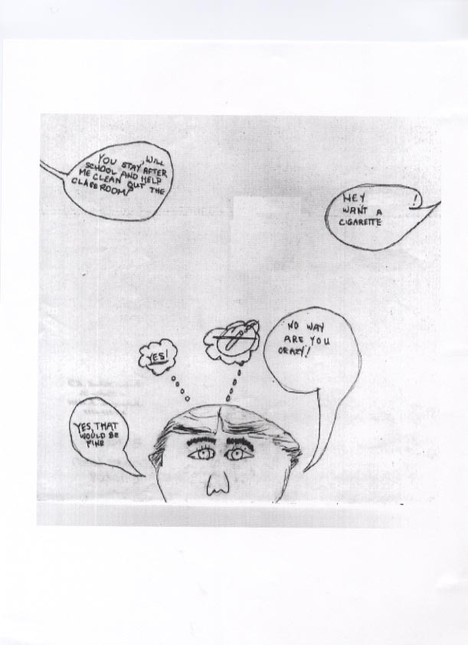
Notes:
A volitional conscience by a twelve year old boy.

Slide 131
Moral Imagination and Cognitive Science
Prototypes in Moral Deliberations
Represent experientially basic types of situations
Carry with them the affective dimensions of the concrete situations in which they arise
Are malleable and flexible
Have meaning, point, and force that depend on the various narrative contexts in which they are embedded
Will be the basis for whatever moral principals we have
In their imaginative use play a central part of our moral development
Mark Johnson (1993): Moral Imagination, University of Chicago Press, Chicago.
Notes:
Note both Eliot Turiel (2008)∗, cited twice earlier, and Mark Johnson, cited here acknowledge the insights of Philosopher Martha Nussbaum.
Turiel: “As some philosophers have stressed ,’human beings are above all reasoning beings’ (Nussbaum,1999, p.71), and as reasoning beings ‘all, just by being human, are of equal dignity and worth, no matter where they are situated in society, and that the primary source of this worth is a power of moral choice within them, a power that consists in the ability to plan a life in accordance with one’s own evaluation of ends (Nussbaum,1999, p.57)….”
[Nussbaum M (1999): Sex and social justice. New York: Oxford University Press]
Johnston: “Arguing for the importance of extended narratives as a basis for moral philosophy , Nussbaum makes the case that ‘ a whole tragic drama, unlike a schematic philosophical example making use of a similar story, is capable of tracing the history of a complex pattern of deliberation , showing its roots in a way of life and looking forward to its consequences in that life. As it does all of this , it lays open to view the complexity, the indeterminacy, the sheer difficulty of actual human deliberation …. A tragedy does not display the dilemmas of its characters as pre-articulated; it shows them searching for the morally salient; and it forces us , as interpreters , to be similarly active.’” ℘
[Nussbaum M (1986): The fragility of goodness: luck and ethics in greek tragedy and philosophy. Cambridge: Cambridge University Press. p 14]
Op cit. Turiel (2008).
℘Mark Johnson (1993): Moral Imagination, Implications of Cognitive Science for Ethics, University of Chicago Press, Chicago, pp.185-216.

Slide 132
Pride and Prejudice
Miss Bennet and Mr. Darcy. At the Ball at Netherfield .
“May I ask to what these questions tend?”
“ Merely to the illustration of your character,” said she, endeavoring to shake off her gravity. “I am trying to make it out.”
“And what is your success?”
She shook her head, “I do not get on at all. I hear such different accounts of you as puzzle me exceedingly.”
“ I can readily believe,” answered he gravely, “ that reports may vary greatly with respect to me; and I could wish, Miss Bennet, that you would not to sketch my character at the present moment, as there is reason to fear that the performance would reflect no credit on either.”
“But if I do not take your likeness now, I may never have another opportunity.”
Notes:
Austen J (1813): Pride and Prejudice. Published for the Classics Club by Walter J. Black, New York.

Slide 133
Conceptualization of Conscience and Moral Imagination
Stilwell Conscience Interview and IU Conscience Autobiography
QUESTION 1: GENERAL DEFINITION
Have you heard of the word, conscience? What
is it? How does it work? It's alright to guess.
(1st Alternate) Is there a part of a person that
knows about right and wrong? good and bad?
What is it? How does it work?
(2nd Alternate) How does a person (boy/girl)
know when s/he is being good? How does a
Person (boy/girl) know when s/he is being bad?
Would you give me an example of what you
mean?
QUESTION 1: GENERAL DEFINITION
To begin, write about how you conceive of
conscience. It's all right to speculate, draw
analogies or use metaphors. What is it? How
does it work?
Notes:
Conceptualization of conscience (Stilwell, et al., 1985, 1991)∗ measures the degree of inclusiveness and abstractness a person utilizes when providing a personal definition of conscience. Five transformations in conceptualization of conscience occur between the ages of 5 and 17. The most salient feature of each has been incorporated into the names of the stages: External Conscience (age 6 and under), Brain or Heart Conscience (ages 7- 11), Heart/Mind or Personified Conscience (ages12-13), Confused Conscience (ages 14- 15), and Integrated Conscience (ages 16- 17). Stage transitions in the other domains are anchored in the domain of conceptualization of conscience.
∗Stilwell, B. & Galvin, M. (1985): Conceptualization of conscience in 11-12 year olds. Journal of American Academy Child Psychiatry, 24: 630-636.
∗Stilwell, B., Galvin, M. & Kopta, S. M. (1991): Conceptualization of conscience in normal children and adolescents ages 5 to 17. Journal of the American Academy of Child and Adolescent Psychiatry, 30: 16-21.

Slide 134
Conceptualization of Conscience and Moral Imagination
Stilwell Conscience Interview and IU Conscience Autobiography
QUESTION 2: PERSONAL DEFINITION
Describe your own conscience and how it works
Can you give another personal example?
QUESTION 2: PERSONAL DEFINITION
Circle the numeral corresponding to what best describes you.
How comfortable are you responding to questions about your conscience?
1 2 3 4 5
Very Uncomfortable -----------------------------------------------Very Comfortable
How often do you think about the nature of your conscience?
1 2 3 4 5
Not at all Seldom Sometimes Often Very Often
What about compared to your peers (other health professional students)?
1 2 3 4 5 Much less Less As often More Much more
How often do you become concerned with matters of conscience in the form
right vs. wrong ?
1 2 3 4 5
Not at all Seldom Sometimes Often Very Often
What about compared to your peers?
1 2 3 4 5 Much less Less As often More Much more
How often do you become concerned with matters of conscience in the form
of right vs. right (moral dilemmas)?
1 2 3 4 5
Not at all Seldom Sometimes Often Very Often
What about compared to your peers?
1 2 3 4 5 Much less Less As often More Much more
Notes:
SCI Additional Probes for "how does it work?":
What does your brain think about right/wrong, good/bad? What kind of things does it tell
you?
What does your mind know about right/wrong, good/bad? How did it get to know those
things?
What kinds of ideas are stored in your mind (conscience) about right and wrong?
How is a conscience formed? How does it get in your mind in the first place?

Slide 135
Conceptualization of Conscience and Moral Imagination
Stilwell Conscience Interview and IU Conscience Autobiography
QUESTION 2: PERSONAL DEFINITION
QUESTION 2: PERSONAL DEFINITION
Describe your own conscience.
Do you think of it as located in a particular part or
parts of your body? Which part(s)?
How does your own conscience work? Give one
ormore specific examples.
Notes:
SCI Note:
A word about examples:
Examples that are stories involve a situation, characters, conflict, feelings, exchange of
words, actions, resolutions and lessons learned. Stories are the best kind of examples
because they tell so much. However, an example can be any of these components...in that
case there may not be a resolution or a lesson.
SCI Additional Probes to get examples:
Can you give me a "for instance"?
Can you tell me a story about how your brain (mind) got to know about right and wrong?
Can you tell me about a situation (or a time) that your conscience really worked well...
or forgot to work? Who did what? Who said what? What needed to be done? How did it turn
out? Who learned what?
If examples are hard to get:
What would be an example of right/wrong, good/bad for any boy (girl) about your age?
If examples are all hypothetical:
Can you give me an example from your own life that really happened to you?

Slide 136
Conceptualization of Conscience and Moral Imagination
Stilwell Conscience Interview and IU Conscience Autobiography
QUESTION 11: CONSCIENCE DRAWING
Now...I want you to use your imagination and
draw a picture of your conscience (or the part of
you that knows about right and wrong) (or a
picture about being good and being bad).
Now... would you tell me about your drawing?
QUESTION 11: CONSCIENCE DRAWING
Use your imagination and put on paper
your image of your conscience.
This could be a pictorial drawing or perhaps a
schematic diagram or some other two
dimensional rendering.
Notes:
SCI Additional probes:
Do the colors mean anything in particular?
Ask about any details that the subject doesn't spontaneously describe.
How does the "person" feel in the drawing? What is s/he thinking?

Slide 137
Moral Imagination
“In the Think Tank”
A Proposed Neuro-imaging Study
Priming
The subject has responded to SCI Questions or
IU Conscience Autobiography Questions 1 and 2
Neuro-imaging (e.g. fMRI)
During the run, the subject is asked to imagine how he or she would depict his or her conscience
Following the run the subject is asked to actually render the image in a drawing and to describe it
Hypotheses
One hypothesis of interest regarding children and adolescents is that there will be increased functional
connectivity between ventromedial PFC and amygdala correlating with advancement through stages of
conscience development as discerned in SCI
Another hypothesis of interest regarding adults is that activity will be more pronounced in some
brain regions of interest more than others depending upon the subject’s conscience contours as discerned in the conscience autobiography

Slide 138
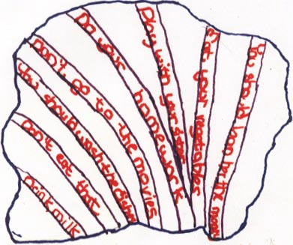
Notes:
A dutiful conscience by another twelve year old boy.
So far we have provided an overview of intriguing studies which highlight some brain regions of interest in putative conscience functions such as moral judgment, moral valuing, and moral emotions. We have suggested that new studies be designed to explore activations of brain regions that correlate with questions and tasks that we believe come even closer to the personal conscience, the heart of the personality.
If we are to be guided by the image of conscience depicted in this slide, we can be assured there are many, many bodies, convolutions and gyri in the brain yet to be explored that contribute in some way to conscience functioning.
In the final section we will be concerned with boundary issues both philosophical and (neuro)ethical.

Slide 139
PHILOSOPHICAL CONSIDERATIONS
MIND BODY
FREEDOM and DETERMINISM
ETHICS

Slide 140
MIND BODY
Epiphenomenalism
Notes:
Epiphenomenalism
A theory about the relation between matter and mind, according to which there is some physical basis for every mental occurrence. Mental phenomena are seen as by-products, as it were, of a closed system of physical causes and effects, and they have no causal power of their own.
A DICTIONARY OF PHILOSOPHY, T. Mautner (ed.) Blackwell Publishers Inc.; Cambridge, Mass., 1996.
“The mind exists, like a rainbow shimmering over the falls. Yes it’s there, but it doesn’t do anything. You know it’s there because some experiences are unique to yourself…. Merely a product of brain –body processes, the mind sometimes facilitates for itself the illusion that it affects those processes, much as if the rainbow thought it affected the falls in some way.”
Beauregard M & O’Leary (2007): The Spiritual Brain. New York: Harper Collins. p.106.

Slide 141
MIND BODY
Epiphenomenalism
Eliminative Materialism
Notes:
Eliminativism is a type of theory that combines two basic tenets: (1) the entities and properties to which a certain vocabulary or discourse supposedly refers do not exist; (2) the vocabulary or discourse in question ought to be eliminated….
The word is used mainly in the philosophy of mind, where it designates the view that mentalistic concepts, e.g. belief, intention and thought, can have no place in an adequate theory, and that our ordinary common sense view of the mind is fundamentally flawed because it uses such concepts. This thesis is often linked with a materialist thesis, that human behavior which common–sense psychology tries but fails to explain can only be accounted for by the concepts and theories of neurophysiology, cognitive science and other empirical sciences.
A DICTIONARY OF PHILOSOPHY, T. Mautner (ed.) Blackwell Publishers Inc.; Cambridge, Mass., 1996.

Slide 142
MIND BODY
Epiphenomenalism
Eliminative Materialism
Psychophysical Identity Theory
Notes:
The identity theory of mind is the theory that mental states and events … are identical with certain states or processes in the central nervous system. Statements about mental states and statements about brain states while having different meanings refer to the same phenomena.
A DICTIONARY OF PHILOSOPHY, T. Mautner (ed.) Blackwell Publishers Inc.; Cambridge, Mass., 1996.
We apprehend our own consciousness and mental processes in the first person, that is, in a subjective and experiential manner. Brain events, however, are measured in the third person, that is, from the outside in an objective manner. Brain events and mental events are completely parallel, like the two sides of the same medal….The underlying assumption is that brain states create the mind states, not the other way around.
Beauregard M & O’Leary (2007): The Spiritual Brain. New York: Harper Collins. p.107.

Slide 143
MIND BODY
Epiphenomenalism
Eliminative Materialism
Psychophysical Identity Theory
Mentalism

Slide 144
MIND BODY
Epiphenomenalism
Eliminative Materialism
Psychophysical Identity Theory
Mentalism
Substance Dualism

Slide 145
MIND BODY
Epiphenomenalism
Eliminative Materialism
Psychophysical Identity Theory
Mentalism
Substance Dualism
Dualistic Interactionism

Slide 146
MIND BODY
Epiphenomenalism Neurologist CJ Herrick
Eliminative Materialism Philosopher Daniel Dennett
Psychophysical Identity Theory Neuroscientist Jean-Pierre Changeux
Mentalism Neuroscientist Roger Sperry
Substance Dualism Descartes
Dualistic Interactionism Neuroscientist John Eccles
Mario Beauregard & Denyse O’Leary (2007): The Spiritual Brain. New York: Harper-Collins.
Notes:
Note that we have not called this slide the “Mind Body Problem”, as is traditional in modern philosophy. Arguably, something is not really a problem if it’s not, in principle, susceptible of a solution. Some, following ∗ Robert Nozick’s suggestion in approaching another traditional philosophical ‘problem’, freedom and determinism may enjoy treating mind body more as a koan, to be visited every once in a while, on each occasion striking a deeper aporia, finding a more profound appreciation of ongoing mystery. And, just as arguably, science need not suffer should we take such an approach.
∗ Nozick R (1981) Philosophical Explanations. Cambridge MA: Belknap Press Harvard University.

Slide 147
Freedom and Determinism
IU Conscience Autobiography
QUESTION 15B: ATTITUDE TOWARDS AGENCY
1) Which of the following best describes your philosophical attitude or
intuitions about choices?

Slide 148
Freedom and Determinism
One Option:
i)The actions of human beings are completely determined
by causal lines (interactive strings of causes and events) which,
in principle, have no interruptions. If ever one could know all
the laws governing the universe, and one could specify the
state of the universe at any particular time, one could predict
the state of the universe at any other time. I believe there is
no room for free will in such a universe. To say I make a choice
or that I am responsible for choosing is simply to express the
fact that certain processes in my brain exist at the point of
convergence of these uninterrupted causal lines.

Slide 149
Freedom and Determinism
Other Options:
ii) I agree with the principle of determinism expressed above,
however I also believe that free will in the sense of making
choices is compatible with the principle.
iii) I believe in free will and can not reconcile this belief
with a completely determined universe.
iv) I believe in neither free will nor determinism. There are
interruptions in the lines of cause and effect because the
universe is probabilistic and chance plays its part. But there is
no free will, chance is not choice.
v) I have not formed an opinion on this subject.
vi) I do not think about this subject.
vii) I have given this subject some thought but have decided the
question is not meaningful or susceptible of an answer.

Slide 150
Freedom and Determinism
IU Conscience Autobiography
QUESTION 15B: ATTITUDE TOWARDS AGENCY
2) Designate the truth value ℘ of each of these statements for you as a clinician:
Notes:
℘DEFINITELY NOT TRUE… DOUBTFUL… SOMEWHAT TRUE… TRUE … VERY TRUE
1 2 3 4 5

Slide 151
Freedom and Determinism
i) It is easier for me to empathically respond to a patient whose illness or condition has not come about because of poor lifestyle choices.
ii) I find it especially difficult to empathize with patients who lack empathy for others.
iii) I find it especially difficult to treat patients who are only partially compliant or non compliant with my best recommendations.
iv) My task is to make a diagnosis, present my findings and recommendations. I respect my patient's choice whether or not to accept my findings and recommendations and am willing to work further with a patient who does not.
v) I counsel patients who do not accept my recommendations to seek help from someone else.
vi) Irrespective of the circumstances that have shaped their lives, patients should be encouraged to take responsibility for themselves with respect to their illness/ condition, especially if lifestyle or psychological change will contribute to better health.
vii) There are definite constraints that genetic endowment and adverse life experiences place upon patients in their capacity to take responsibility for themselves. In order for healing to occur, these constraints must be acknowledged empathically by the clinician.

Slide 152
ETHICS:
INTUITIONISM
Theories of moral knowledge according to which we have immediate knowledge of the rightness and
wrongness of certain actions or the intrinsic goodness of certain kinds of things, states or affairs.¹
SOME TYPES:
Initially intuitionism was defined in contrast to Mills’ utilitarianism and was associated with pluralism, the view that there are a large number of moral principles that cannot be put in any general order of importance in a way that would help resolve conflicts between them.
Later intuitionism was associated with the position that concepts about right and wrong are un-analyzable, whether there is more than one principle or not.
In subsequent historical developments, even some utilitarians (e.g. Sidgwick) relied upon intuitionism.
Intuitionism in the newer sense and pluralism in the older sense were reunited in the work of Ross and Prichard in the 1930s.² Ross’s ethic of prima facie duties, is pluralistic, deontological and intuitionistic.
Notes:
1. A DICTIONARY OF PHILOSOPHY, T. Mautner (ed.) Blackwell Publishers Inc.; Cambridge, Mass., 1996.
2. Dancy, J. (1993): Intuitionism. In: A COMPANION TO ETHICS, P. Singer (ed.) Blackwell Publishers Inc., pp.411--420.

Slide 153
ETHICS:
INTUITIONISM
In A THEORY OF JUSTICE, Rawls discounted the sense of intuitionism
as a way of knowing and reverted to identifying it with pluralism.
According to Rawls, there are two features to intuitionist theories:
1) they consist of a plurality of first principles which may conflict.
2) they include no explicit method, no priority rules, for weighing these principles against one another.³
Notes:
3. Rawls, J. (1971): A THEORY OF JUSTICE. Belknap Press of Harvard University Press; Cambridge, Mass.pp. 34-35.

Slide 154
ETHICS:
NATURALISM
A cognitivist family of doctrines stating that :
* Moral judgments are propositions, capable of truth and falsity.
* Some moral judgments are true .
* There are no irreducible moral facts or properties.
Some Types:
Hedonistic naturalists reduce ‘facts’ about goodness to facts about pleasure and pain.
Aristotelian naturalists prefer ‘facts’ about human nature and human flourishing,
but preferred ‘facts’ may be :
sociological,
psychological,
scientific,
metaphysical, or
theological.

Slide 155
ETHICS:
NATURALISM
Contemporary example: Mary Midgley ...drawing on ethological literature, she
suggests given our natures, there are constraints on the kinds of lives humans will find
fulfilling, and hence human action.¹
She cites this passage from Darwin’s Descent of Man:
...[A]ny animal whatever , endowed with well-marked social instincts, would inevitably acquire a moral sense or conscience, as soon as its intellectual powers had become as well-developed....the social instincts...with the aid of active intellectual powers and the effects of habit, naturally lead to the Golden Rule, “As ye would that men do unto you, do ye to them likewise” and this lies at the foundation of morality.... ²
Notes:
1. Pidgen, C.R. (1993) Naturalism. In: P.Singer (ed.) A COMPANION TO ETHICS, Cambridge, Mass:
Blackwell Publishers. pp. 421-431.
2. Midgley, M. (1993) The origin of ethics. In: P. Singer (ed.) A COMPANION TO ETHICS Cambridge, Mass: Blackwell Publishers. pp. 3-13.

Slide 156
ETHICS
THE NATURALISTIC FALLACY
According to G. E. Moore, the fallacy committed by all ethical naturalists.¹
Sometimes put in terms of ‘Hume’s Law’:
NO ‘IS’ to ‘OUGHT’
or, positively, as :
THE AUTONOMY of ETHICS.
There are three forms of autonomy of ethics:
1) logical autonomy : moral judgments differ fundamentally from factual propositions
2) semantic autonomy: moral words don’t mean the same as other words and cannot be paraphrased in a non-moral idiom
3) ontological autonomy : moral judgments to be true must answer to a realm of sui generis (‘of its own kind’) moral facts and properties.
Logical and semantic autonomy are not threats to naturalism. ²
Notes:
1. A DICTIONARY OF PHILOSOPHY, T. Mautner (ed.) Blackwell Publishers Inc.; Cambridge, Mass.,1996.
2. Pidgen, C.R. (1993) Naturalism. In: P. Singer (ed.) A COMPANION TO ETHICS, Cambridge, Mass:
Blackwell Publishers. pp. 421-431.

Slide 157
Emma
Miss Woodhouse and Mr. Knightley at Donwell Abbey
Upon my word, Emma, to hear you abusing the reason you have, is almost enough to make me think so too. Better to be without sense than misapply it as you do.
Notes:
Austen J (1816/1981): Emma. New York: Bantam Books.

Slide 158
NEURO-ETHICAL CONSIDERATIONS

Slide 159
New Brain–Study Technology Raises Ethical Questions
fMRI and brain fingerprinting are being developed to detect lying– and are being touted by some as superior to polygraphs, whose evidence is banned in most legal jurisdictions.
The use of fMRI for lie detection is rooted in the observation that lying is an active process that engages areas of the brain not involved when a person responds truthfully.
Uses for brain fingerprinting are based upon the supposition that brain waves spike when persons recognize a familiar scene or piece of information (already used in one case and admitted into evidence in an Iowa Court).
Reporting the APA Annual Meeting session “Neuroethics : Ethical Challenges at the
Cutting Edge of Neuroscience,” Arehart-Treichel J(2008): Psychiatric News , 43 (11), 29.
Notes:
Possible (ab)uses:
Screening for pedophilic tendencies in prospective clergy and teachers ???

Slide 160
An Alternative to Torture?
The issue of torture raises a fundamental question about the American
character: Can we be inhumane in the defense of our humanity?
FMRI represents a quintessentially American solution to this problem –
namely , the application of technology to avoid the issue.
Thompson S(2005): The legality of the use of psychiatric neuroimaging in intelligence
interrogation. Cornell Law Review, 90: 1601-1637.

Slide 161
Neurobiological Profiling
In the future it may be possible to calculate a child’s risk of becoming severely violent by adding up the child’s gene profile, brain deficits caused by maternal smoking, low cortisol responsivity, and underactive prefrontal cortex– or by scanning the child’s genes. Could such a person be forced into some kind of treatment program when this risk reaches a certain limit?
If a juvenile in a psychiatric or justice facility has such a risk profile, does this profile influence decisions as to whether the child can return to society?
Popma A and Raine A (2006): Will future forensic assessment be neurobiologic? Child Adolesc
Psychiatric Clin N Am. 15: 429-444.
Notes:
Possible (ab)uses:
Admission interviews augmented with functional neuroimaging for medical and other professional schools ???
In our lifetime or that of our children---
We are happy to be wrong.

Slide 162
The Conscience Project
Conscience Project: Current Participants
Ethna Verkamp
John Sullivan
Barb Stilwell
Sister Mary Satala
Jason Mensah
Sue London
Leslie Hulvershorn
Matt, Deb, Beulah Galvin
Meg Gaffney
Joe and Susan DiMicco
Conscience Project: Advisors
Charlie Shelton, SJ
Ted Petti
Conscience Project Friends and Guests
Patrick Wagner
Linda Stephan
Katie Pedersen
Sandy Laramore
Tamara Hamilton
Patricia Garcia
Linda Cantor
Jill Abram

Slide 163
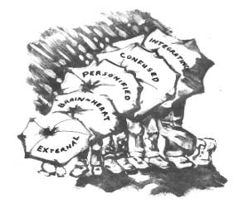
CONSCIENCE WORKS
http://shaw.medlib.iupui.edu/conscience/
THEORY, RESEARCH AND CLINICAL APPLICATIONS
CONSCIENCE SENSITIVE MORAL EDUCATION
CONSCIENCE AND ETHICS
This project has been funded in whole or in part with federal funds from the National Library of Medicine, National Institutes of Health, under Contract No. NO1-LM-1-3513.
Additional support for this and other work by the I.U. Conscience Project has been generously provided by Mr. and Mrs. Jim Irsay and The Indianapolis Colts, the Moore Foundation and other individual anonymous donors.
Meg Gaffney, M.D. Editor in Chief
C/O Department of Medicine
1001 W. 10th St., Suite M200
Indianapolis, IN 46202-5124
e-mail: mgaffney@iupui.edu
Sue London,
Web Master
e-mail: slondon@iupui.edu

