Slide 1
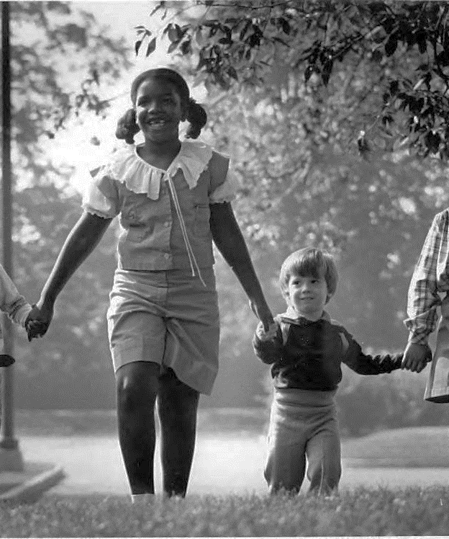
Archival Internships:
High Impact or High Barrier?
Denise Rayman & Lydia Spotts
Indiana University Indianapolis
Notes:
Photo from: https://iuidigital.contentdm.oclc.org/digital/collection/IUPUIphotos/id/9831/rec/2

Slide 2
Do archives internships completed during graduate school correlate with greater career success after graduation?
“Career success” is defined as likelihood to be full-time permanently employed in archives 0-12 years after graduation

Slide 3
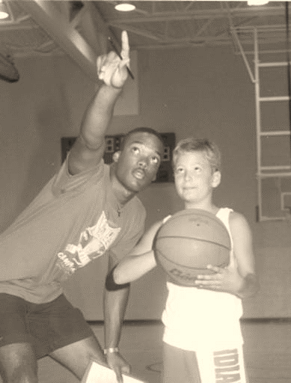
About
Study grant-funded by Society of American Archivists Foundation in May 2023
  Research participants were paid
  Mixed methods research approach
Survey of recent graduates in LIS programs conducted July – Aug 2023
  Survey invitation & open-access link distributed on SNAP listserv, SAA Annual Meeting 2023 digital platform, and seven MLIS alumni lists
  We had a spam problem that required data cleanup
  273 valid responses
Interviews of 10 select participants completed May 2024 (qualitative analysis ongoing)
Notes:
We do not have a response rate due to the nature of open-access links (i.e., no direct emails, no way of knowing number of people who say survey and chose not to respond).
Many thanks to the programs who distributed our survey
Photo from: https://iuidigital.contentdm.oclc.org/digital/collection/IUPUIphotos/id/8931/rec/20

Slide 4
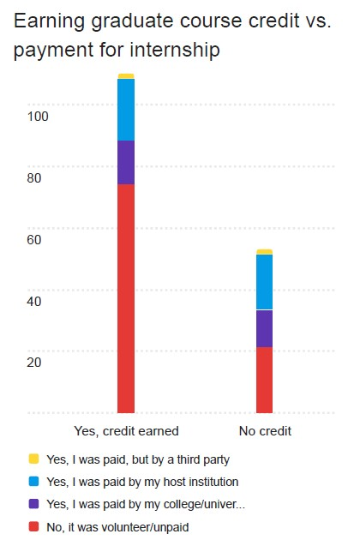
State of internships
n=273
Majority of survey respondents reported an internship was not required by their graduate program (60.5%, 147)
Majority of survey respondents completed an internship (71.2%, 173) and of those, a majority:
  completed internship for credit (67.6%, 117)
  were not paid for internship (54.9%, 95)
  found host independently, not through school (51.3%, 59)
Most common work completed during an internship was Arrangement and Description of Physical Records, Physical Preservation Tasks, and Digitization (scanning or metadata creation)
Notes:
This Stacked bar chart is showing the majority of respondents who completed an internship for credit (117) were not paid)- that’s the red in this first column (a little under 80). But if you look at the yellow, light blue, and dark blue together (paid by different methods), pmt is gaining ground
Those who completed the internship for no credit were more likely to be paid.

Slide 5
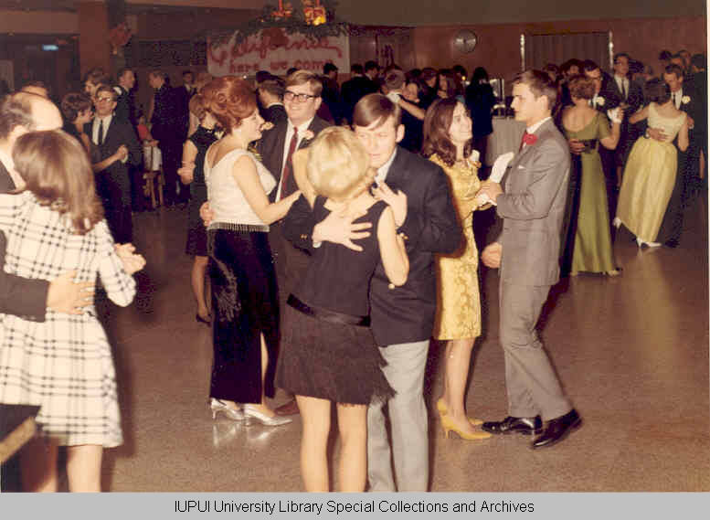
MIXED EVIDENCE
Notes:
Photo from: https://iuidigital.contentdm.oclc.org/digital/collection/IUPUIphotos/id/3364/rec/8

Slide 6
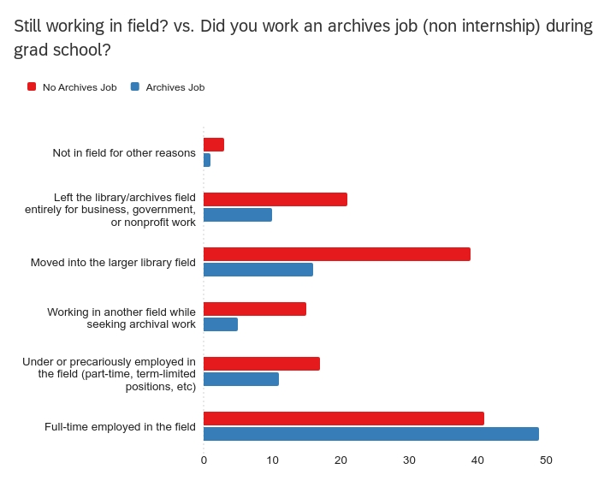
Correlations with statistical significance!
Students who worked at a job in an archives before AND/OR during their graduate school program were more likely to employed in the field
Students who completed an internship for credit vs ad-hoc were more likely to still be employed in field

Slide 7
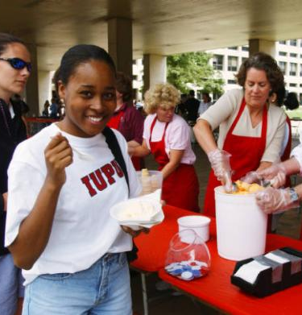
Correlations without statistical significance
Students who completed an internship are more likely to still be employed in the field at time of survey
Students who completed an internship spent less time job hunting
Students who were paid in their internship are more likely to still be employed in the field
Notes:
Photo from: https://iuidigital.contentdm.oclc.org/digital/collection/IUPUIphotos/id/10903/rec/43

Slide 8
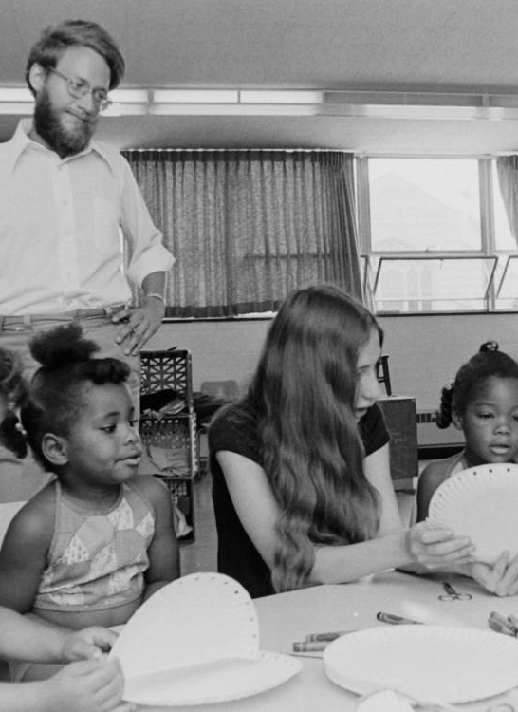
How do we interpret and use this data?
Notes:
Photo from: https://iuidigital.contentdm.oclc.org/digital/collection/IUPUIphotos/id/9500/rec/6

Slide 9
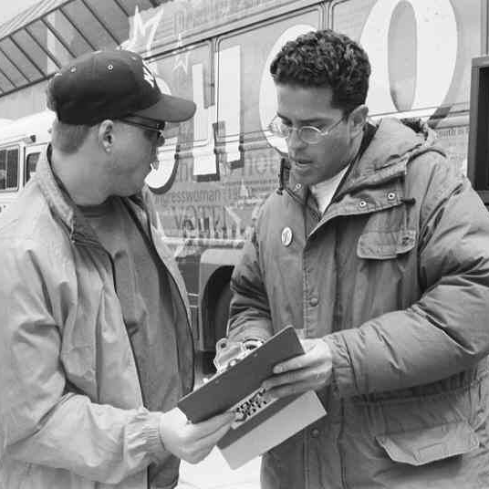
Don’t count out internships yet
More research is needed!
  Many correlations without statistical significance indicates something is happening here, but we did not capture it with our sample
  Limitations
Strong and significant correlation between jobs but not for internships – what makes a student job different (better?) than an internship for future employment?
What makes a for-credit internship more impactful than an ad-hoc one?
What is the impact of quality mentorship within or outside of internships?
Notes:
Sample limitations:
Participant recruitment strategy impacted sample: people who are members of SAA SNAP section checking their notifications for SAAConnect, people attending SAA 2023 & monitoring digital platform, people still in touch with their programs (on listserv), impacted by whether or not a graduate program agreed to distribute our survey (only 7/36 we contacted distributed); whether or not someone outside of the profession was keeping up with their grad school co-hort & was sent the survey...
Attempted to correct these limitations with follow up interviews: Purposive sampling, Maximum variation sampling, attempted to cover key profiles, but often selected participants who declined or were not available; scheduling limitations, timezones
Data collection methods: Internet-delivered questionnaire, excluding participants with no access to a computer (only delivered in electronic format via email or limited social media distribution)
https://iuidigital.contentdm.oclc.org/digital/collection/IUPUIphotos/id/4403/rec/5

Slide 10
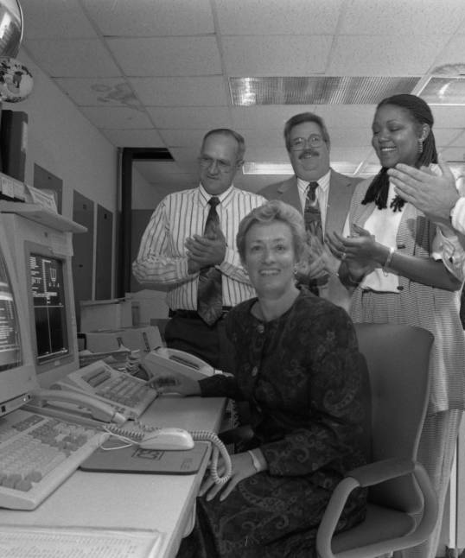
What do you want a new archivist to know?
Train the profession you want to see!

Slide 11
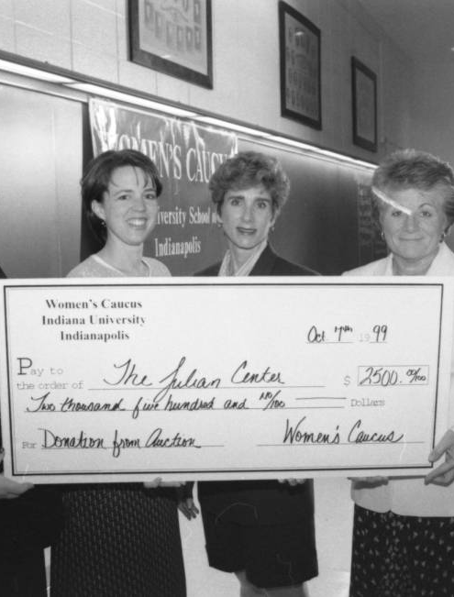
Lowering Barriers to internships
Move away from volunteer as the default!
An intern working 180 hours for $15/hr costs you just $2,890 (including taxes)
  This flat-dollar ask goes down smoother with upper administrators
  Looking for a grant? Write an internship into it!
  Library/Archives Friends groups have sponsored interns
How to make an unpaid internship tolerable:
  Be flexible! Respect their paid work schedule
  Free parking
  Random perks – send them to SAA & other annual meetings or workshops!
  Offer remote work!
Notes:
Photo from: https://iuidigital.contentdm.oclc.org/digital/collection/IUPUIphotos/id/14916/rec/6

Slide 12
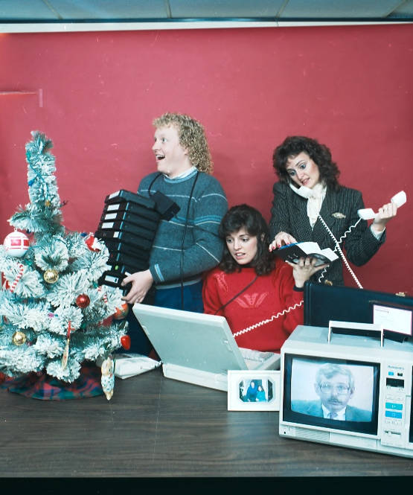
Feed an intern today!
Denise Rayman
drayman@iu.edu
Lydia Spotts
lcspotts@iu.edu
All photographs are from IUPUI Image Collections:
https://iuidigital.contentdm.oclc.org/digital/collection/IUPUIphotos/
Notes:
Photo from: https://iuidigital.contentdm.oclc.org/digital/collection/IUPUIphotos/id/10519/rec/22

