Slide 1
ONEAL’s Gambit
Improving Library Advantage During the Game

Slide 2

Planning and executing negotiations is very similar to chess

Slide 3
—David Oliver,
How to Negotiate Effectively
“Negotiation is in some ways like chess. You are prepared to sacrifice particular pieces in the interest of winning the game. In chess you know the pieces but you can't see into the other person's mind. In negotiation you don't necessarily know the "pieces". You have to discover and develop your own pieces and find ways of uncovering your counterpart's.”
Notes:
Nothing for the community without the community

Slide 4

the ONEAL project
ONEAL = Open Negotiation Education for Academic Libraries
An IMLS funded project to teach negotiation skills to academic library workers who work with vendors

Slide 5


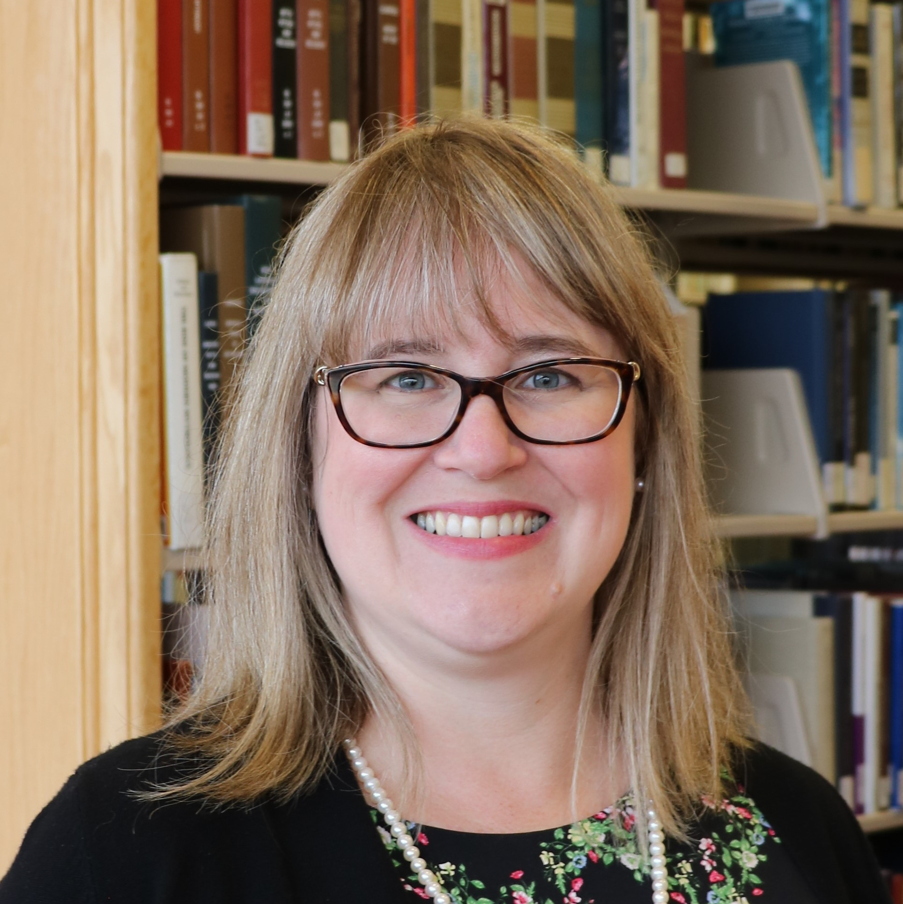
Project Team
Katharine V. Macy
Scarlet Galvan
Courtney Fuson
Founding project director of ONEAL, Collection Assessment Librarian at IU-Indianpolis
macyk@iu.edu
Co-Principal Investigator and new project director (Aug 2024), Collection Strategist, Grand Valley State University
galvansc@gvsu.edu
Co-Principal Investigator, Asset Management Librarian, Belmont University, courtney.fuson@belmont.edu

Slide 6
93 attendees
20 library workers
35 interviewees
Average attendance to three community forums in Fall 2022
Participated in Curriculum Planning Workshop in November 2022
Qualitative research study in Spring 2023
25 pilot testers
Completed the Foundations curriculum in Fall 2023
Notes:
Nothing for the community without the community

Slide 7
Key Insights from Interviews
35 interviews with library workers who negotiate for library resources. Analyzed for qualititive themes in Dedoose.
Notes:
As part of the ONEAL project we conducted an interview study to learn from a variety of academic library workers their overall experience with negotiations. This included asking them to describe a negotiation that went well as well as one that was particularly difficult. We also asked about the challenges they faced when negotiating and their desired training and support. We sent out an invitation for people to apply to participate in the study and the project team carefully reviewed each candidate’s institutional and demographic background so we could ensure we included as many diverse voices as possible within this study. We selected 40 people and ended up with 35 recorded semi-structured interviews that we were able to analyze. We then qualitative coded using Dedoose to find key themes. In addition to the preliminary results from the analysis we are about to share we are going to use the interviews to create more fictionalized case studies rooted in actual experiences of library workers to publish later in 2024.

Slide 8

Negotiation Challenges
Notes:
97.1% commented on negative behaviors they had experienced when negotiating with the three largest issues being not understanding academic context, lack of responsiveness and sales representative lacks knowledge (in general – can be about the product, aspects of the license, or the institution). 25.7% mentioned that vendor turnover was a problem. I will add that 62.9% of subjects mentioned positive vendor behaviors including working to maintain the relationship, clear communication & transparency, and high responsiveness.
94.3% of those interviewed mentioned that they had experienced issues with internal stakeholders. The most frequent issues mentioned were around working with folks in the library and other faculty. 62.9% of participants who mentioned experiencing issues within their own library with the most frequently mentioned issues were colleagues not being on the same page, working proactively when approaching negotiations, and lateral decision making and creating agreement. 54.3% mentioned faculty issues with creating faculty buy-in being the largest specifically mentioned issue at 34.3%.
77% of participants mentioned business deal issues, with pricing being the most frequently mentioned issue being negotiated (66% of subjects mentioned). Other issues mentioned include the length of agreement, service problems, and payment terms.
57.1% of participants mentioned difficult licensing terms. The three terms most mentioned were accessibility, NDAs or confidentiality, and Indemnity.

Slide 9

Personal Challenges
Notes:
The largest personal challenge was lack of experience or training for negotiations, followed closely by finding it difficult to say no especially considering the service profession expectations.

Slide 10

Desired Training & Support

Slide 11
Project Timeline
Aug-Dec ‘22
Jan-Aug‘23
Sep ‘23 – Mar ‘24
Community forums & curriculum planning
Interview study, curriculum drafting
Pilot study & revisions
Mar–Aug ‘24
Sep – Dec ‘24
2025 & Beyond
Launch foundations module curriculum & outreach
Development of strategies module and expand issues module
Ongoing curriculum development based on community needs, outreach, assessment

Slide 12
Foundations Launch
Foundations | Introduction to the Curriculum
 | Contracts & Licensing
 | Introduction to Negotiations
 | Negotiation Planning Part 1: Strategy
 | Negotiation Planning Part 2: Internal Review
 | Negotiation Planning Part 3: Vendor Research
Issues | Neptune is the farthest planet from the Sun
Notes:
The curriculum will launch soon with the Foundations module. We’ll also have one section of the Issues module on Accessibility. The lessons within the Foundations module are designed for all skill levels, from beginner to more advanced. These introductory lessons lay the groundwork for the future curriculum and provide learners with the skills they need to get started. The contracts and licensing lesson covers over basic terminology and structure of a license, including some terms or clauses to look out for. The Negotiations lessons introduce principled negotiations and walk the learner through the basics of planning a negotiation.
The accessibility lesson is from the Issues module and introduces common accessibility issues that are encountered in library resources and how to advocate for accessibility during negotiations.

Slide 13
Curriculum Content
Lesson Plans
Recorded Lectures
Hands-on Exercises
Carefully constructed to maximize learning
Over 5 hours of recorded videos with accessible alt.
Using best pedagogical practice
Case Studies
Workbook
Group Activities
Best way to improve is to practice!
All lessons are available for individual download or in workbook.
To support classes and larger group learning
Notes:
Each lesson consists of three parts – a Watch/Read/Listen section that provides the introductory materials necessary for the lesson, a Review section that provides additional resources , and a Do section that allows the learner to apply what they have learned in a hands-on way. All the hands-on activities are available either all together as a workbook that can be completed alongside the curriculum, or as individual downloads that allow the learner to focus on specific lessons. One of the key activities that runs through the curriculum is a negotiation journal, which encourages the learner to reflect on their planning for negotiations, the vendor’s reaction, and the results of negotiation. Learners are also encouraged to journal throughout the lessons in structured and unstructured ways.
Case studies and group activities are also available as part of the curriculum, providing opportunities to enhance and deepen learning.

Slide 14
MLS/MLIS Instructors
Lesson plans, quizzes, and assignments will be available to download in a .docx file so you can easily copy and paste content into learning management systems
Notes:
This curriculum is an open educational resource, so it was designed not only with individual learners and small groups in mind, but also to have potential applications in library schools. All the lesson plans, quizzes, and assignments will be available for download so that instructors can easily incorporate them into their learning management systems. The ONEAL project was started on the idea that all library workers should know more about the foundations of negotiation, and one of the best ways to do that is to incorporate it into the relevant courses in the library school curriculum!

Slide 15
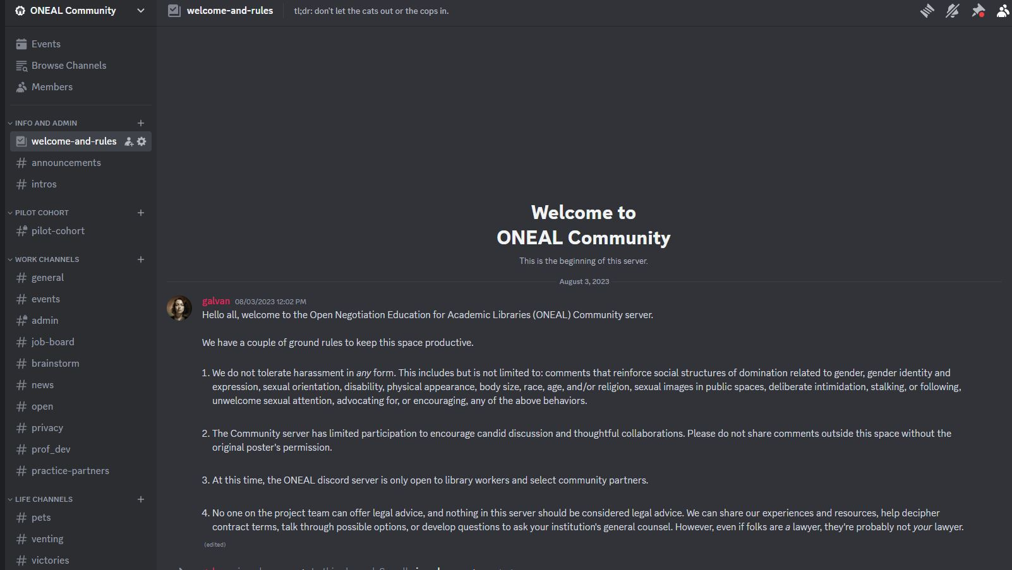
ONEAL Discord
https://oneal-project.org/discord/
Notes:
In addition to the curriculum, and in support of it, we are also working to create a community. One of the things that we heard over an over when we were planning the curriculum was the need for a space for librarians who do this work to talk to one another. So we’ve started a Discord for the users of the curriculum, for them to use when they are working through the curriculum and have questions, comments, or need a partner. We are using Discord for this community and would like to invite you to join us! You can visit the URL on the screen to request access.
Note that we are moderating this community, and it is only for current library workers. At some point there may be additional community opportunities for other groups.

Slide 16
Join our mailing list!
Notes:
I or someone at this conference will email a link so you can easily join!

Slide 17
THANKS!
https://oneal-project.org/

