Slide 1
Take the Data: Leave the CD-ROMS
Olivia Sipocz & Denise Rayman: IU Indianapolis Ruth Lilly Special Collections and Archives
Rescuing information from legacy databases
IUPUI

Slide 2
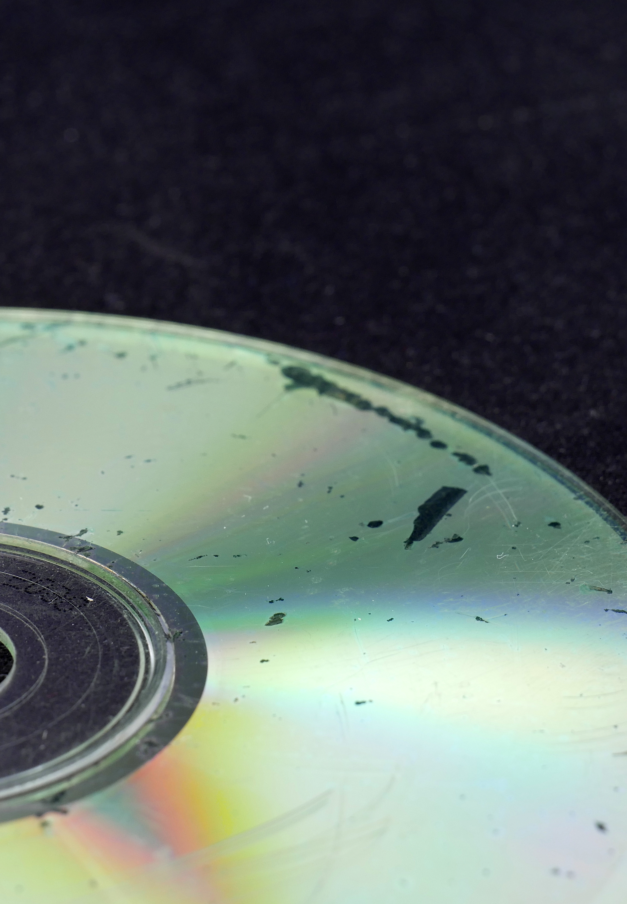
Digital media: the rotting apples in the backlog
Digital media have a short lifespan:
  CD-R/DVD-R (home-burned) have a life span of 25+ years
We are completing 2-year grant project sponsored by the Indianapolis Foundation Library Fund to transfer all data off our digital media (now complete!) and then process it for public access (current work)
Damaged CD by Santeri Viinamäki, via Wikimedia Commons
Notes:
Transferred over 6000 items, about 70% of these were optical media
Media Stability Ratings: Museum of Obsolete Media. https://obsoletemedia.org/media-preservation/media-stability-ratings/

Slide 3
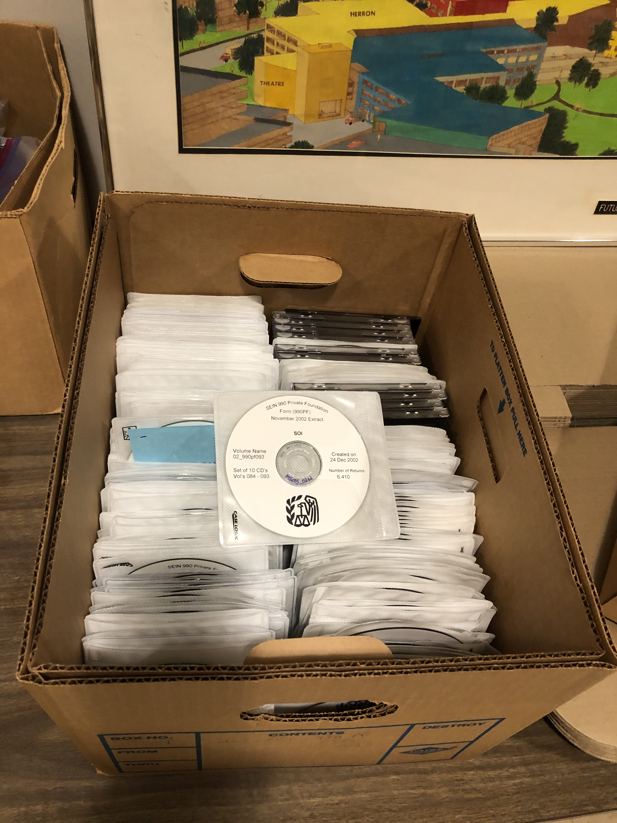
A grisly discovery in the stacks
Over 700 CD-ROMs with 990-PF tax forms
  Contain sensitive data (SSNs)
  Only usable in Compatibility Mode for Windows 95
  No easy export function within software (only one page at a time)
Notes:
We hold a set of microfiche with 990-PFs covering the 1970s to 1997
While inventorying our stx for digital media, we found two boxes with lots of CD-ROMs, ah!

Slide 4
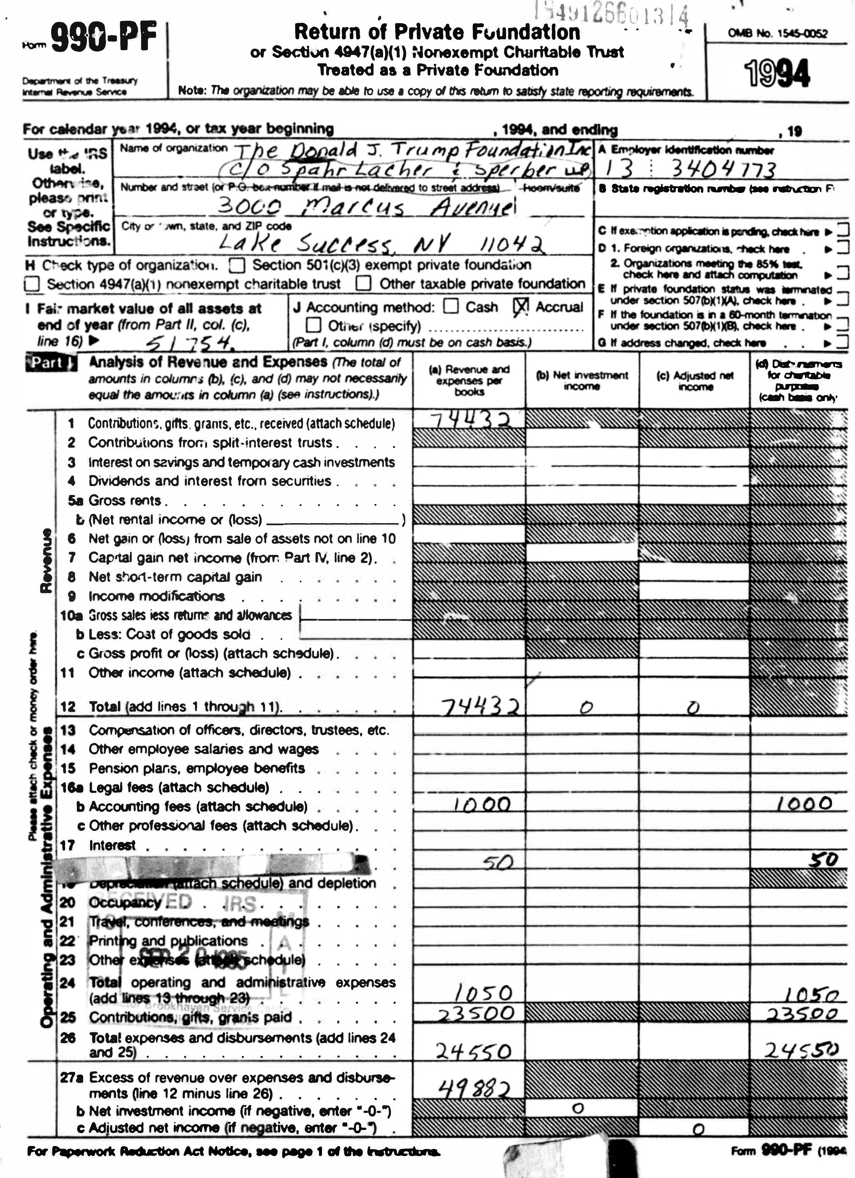
What are 990-PFs and why save them?
Mandatory yearly disclosure for Private Foundations in the US (a special type of 501c3)
Often the only public list of grants with dollar amounts for smaller (or secretive) foundations
Rich source of data on the history of philanthropy in the US, used by historians, social scientists, and journalists
Notes:
Largest dataset is paywalled and only goes back to 1998 (Guidestar)
Public domain so no concerns about copyright
Use cases – Donald Trump and Jeffery Epstein for journalists

Slide 5
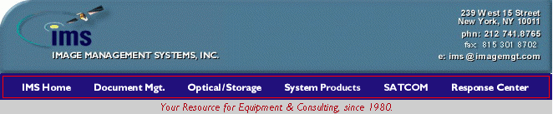

What is this software?
A solution for businesses to build databases consisting of documents or other file types
Proprietary and abandoned
Each CD-ROM contains:
  Database viewing program (legacy)
  Metadata (in binary format)
  A gigantic file made of hundreds of TIFF files concatenated together

Slide 6
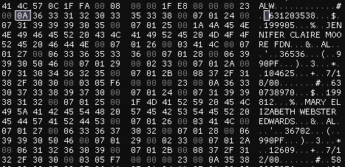
Adventures in Hex
The same data as ASCII text
The data as hex numbers
For the file made up of images - look for TIFF file headers (always [49 49 2A 00])
Write a program to separate all the TIFF files
For the metadata file - look for patterns and readable text, then write a program to extract it
Run it on ALL 700 CD-ROMS and hope the structure is consistent!
How the above data is structured:
Header:
The text "ALW" and one unknown number
The location of the end of the file
The location of the first record in the file minus 1
More unknown values
Data:
[07 01 XX 00] [YY "text that's YY characters long" 00]

Slide 7
Next Steps
Opportunity to create the first large free collection of 990-PFs. Potential for datamining projects, AI training set; public domain means the sky’s the limit!
  Challenge: Forms contain SSNs and need to be hand redacted before release
  Challenge: Many numbers are hand-written and not easily OCR-ed, hard to turn into a usable data set
Low-risk, low-cost opportunity: We will take the harvested metadata for the forms and use it to make a simple database, forms available by request

Slide 8
Take Aways
Prioritize ripping your optical media! It’s dying fast
Legacy files and databases were created by people, and can be reverse-engineered by people
However, every database or archaic filetype is laid out differently – each one is a new puzzle requiring hard work to figure out
Olivia's code for this project is open source on GitHub:
https://github.com/livvy94/alchemy-archival-tools

Slide 9
Olivia Sipocz
osipoczo@iu.edu / oliviasipocz@gmail.com
Denise Rayman
drayman@iu.edu
Ruth Lilly Special Collections and Archives
http://ulib.iupui.edu/special

