Slide 1


Development and Administration of Needs Assessment of Endocrine Surgery Curriculum for General Surgery Residents
ASSOCIATION OF PROGRAM DIRECTORS IN SURGERY
2023 ANNUAL MEETING
Signe Braafladt, MD¹; Madeline Blackwell, MD¹; Hadley Ritter, MD^{1,2}; E. Matthew Ritter, MD^{1,3}; Alexandria McDow, MD^{1,2}
¹Indiana University School of Medicine Department of Surgery, Indianapolis Indiana, ²Division of Surgical Oncology, ³Divistion of General Surgery
INDIANA UNIVERSITY SCHOOL OF MEDICINE DEPARTMENT OF SURGERY

Slide 2
DISCLOSURES
Nothing To Disclose

Slide 3




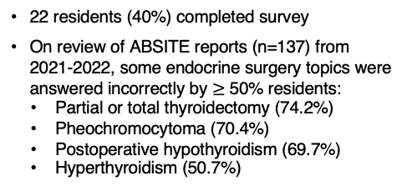
Development and Administration of Needs Assessment of Endocrine Surgery Curriculum for General Surgery Residents
SCHOOL OF MEDICINE
DEPARTMENT OF SURGERY
Signe Braafladt, MD¹; Madeline Blackwell, MD¹; Hadley Ritter, MD^{1,2}; E. Matthew Ritter, MD^{1,3}; Alexandria McDow, MD^{1,2}
¹Indiana University School of Medicine Department of Surgery, Indianapolis Indiana, ²Division of Surgical Oncology, ³Divistion of General Surgery
BACKGROUND
RESULTS
RESULTS
CONCLUSION
American Board of Surgery established Entrustable Professional Activities (EPAs) to formalize Competency-Based Education (CBE) for General Surgery Residency
Thyroid and Parathyroid disease management is one of 18 core EPAs
We conducted a mixed-methods Endocrine Surgery needs assessment for general surgery residents and endocrine surgeons at a single institution to inform the development of a CBE curriculum
22 residents (40%) completed survey
On review of ABSITE reports (n=137) from 2021-2022, some endocrine surgery topics were answered incorrectly by $≥$ 50% residents:
  Partial or total thyroidectomy (74.2%)
  Pheochromocytoma (70.4%)
  Postoperative hypothyroidism (69.7%)
  Hyperthyroidism (50.7%)
Qualitative interviews of endocrine surgeons:
  Consistent exposure to endocrine operations identified as largest gap
  Dashboard of resident competencies may improve autonomy when transitioning between surgeons/rotations
  Current rotations limit chief exposure which contributes to lack of autonomy and resident competence at graduation
ABSITE results identified subject areas for improvement
Most residents perceived little to no autonomy during endocrine procedures
Need for multiple spaced exposures to enhance endocrine knowledge and increase autonomy
Results support the need for CBE in endocrine surgery for general surgery residents
Next steps:
  establish objectives of the curriculum by competency level in medical knowledge and operative skill
  develop endocrine surgery competency dashboard
METHODS
Developed needs assessment with Likert scale and administered to general surgery residents
  5 = competent
  3 = neither competent or incompetent
  1 = incompetent
Analyzed resident American Board of Surgery In-Training Exam (ABSITE) performance on endocrine surgery topics over 2021-2022
Performed qualitative interview with all departmental Endocrine Surgeons
ACKNOWLEDGEMENTS
Thank you to the Department of Surgery administration and to our endocrine surgeons.
@SigneBraafladt @AllieMcDowMD
INDIANA UNIVERSITY SCHOOL OF MEDICINE DEPARTMENT OF SURGERY

