Slide 1
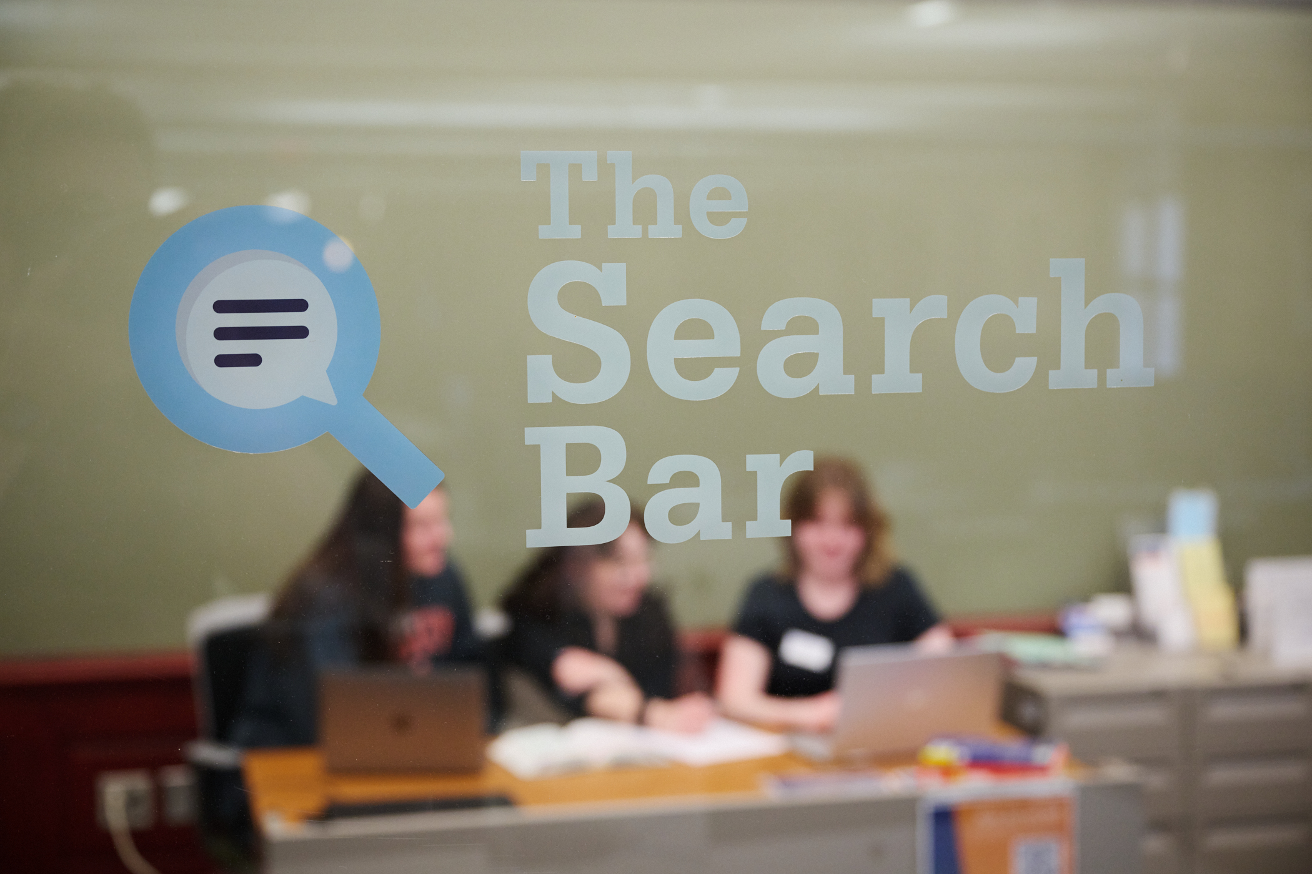
Checking In: Slowing Down and Doing Less to Empower Students
Monica Gingerich
Coordinator for Student Experience & Engagement Penn State University Libraries

Slide 2

overview
Peer Research Consultants and the Search Bar at Penn State
Training
Check-ins
Building a program based on student need and input
Reflections

Slide 3
The Search Bar at Penn State
The Search Bar offers a suite of peer-to-peer undergraduate student services in Sidewater Commons, located on the first floor of Pattee Library. These services are designed for peers to assist their fellow students toward academic success. The Search Bar is a collaboration between the University Libraries and Penn State Learning.
Writing Tutors
Peer Research Consultants
EPPIC (English for Professional Purposes Intercultural Center) Tutors
https://libraries.psu.edu/services/search-bar-services
Walk in and appointment based (Starfish)

Slide 4
Peer Research Consultants (PRCs)
Peer Research Consultants help other Penn State students conduct research and use library resources. Students can receive assistance with:
  Choosing or narrowing down a topic
  Writing a research question
  Finding and evaluating information sources
  Learning more about navigating the Libraries’ website, databases, and resources
  If needed, students may be referred to the appropriate library subject specialist or service for more advanced assistance.

Slide 5
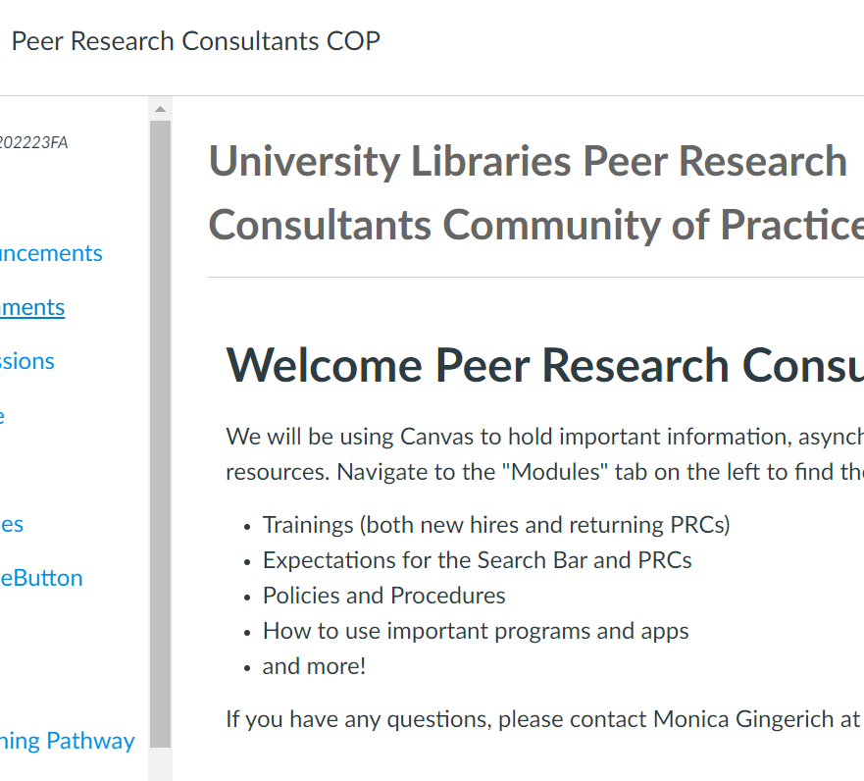
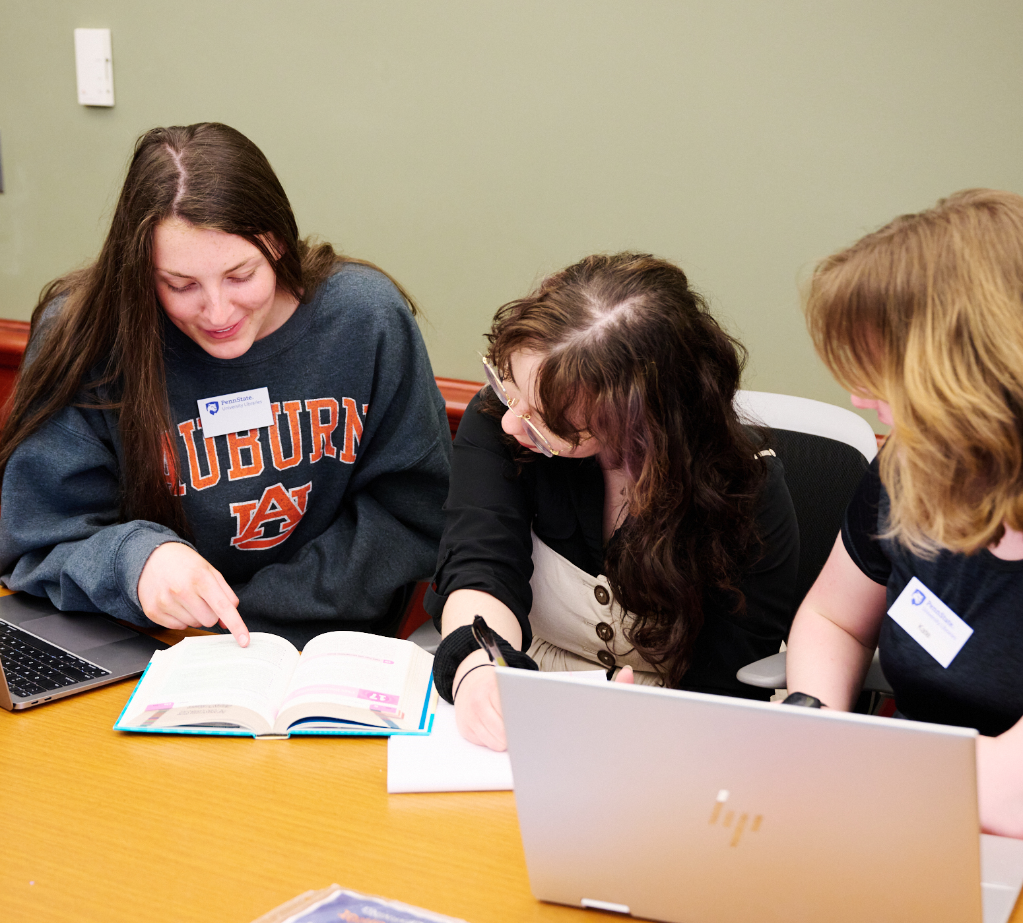
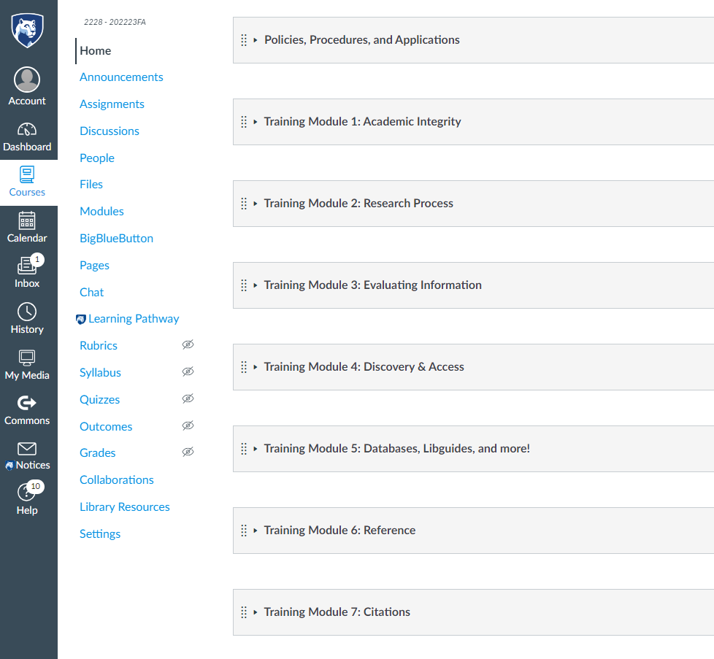
Training
Asynchronous
Bi-weekly Meetings
Joint training with Writing Center Tutors
Additional training and projects as time allows

Slide 6

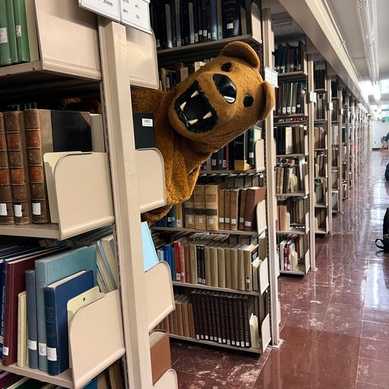


Check-ins
"Share a win from the past two weeks"

Slide 7
Building a program based on student need and input
Ask
Consider
What are you interested in learning more about?
What skills would you like to develop to help you in your work?
Survey/questionnaire on training program, with room for open-ended suggestions
What training or information do students NEED for their position?
What skills are being developed through a training or completion of a project?
How do trainings/projects align with Library and University mission/vision/goals?

Slide 8
Reflection
Moving forward
Moving Forward
In what ways can I gather information?
How am I creating an engaged learning experience for my student employees?
How am I supporting a climate of care for my student employees?
How can I share my work with colleagues in my organization?
Contributing to student growth holistically
Strengthening community among student employees
Knowing the value of time and capacity

Slide 9
Questions?
Thank you!

