Slide 1
Expanding the Table:
The Role of Library Data Professionals in Data Governance
@RDAP22
Abigail Goben (Data Librarian & Policy Advisor, UIC)
Heather Coates (Data Librarian & Data Steward, IUPUI)
Kristin Briney (Biology Librarian, Caltech)
Notes:
Kristin

Slide 2
Goals for Today
Intro to Data Governance
Models at Our Institutions
Mind the Gap
Notes:
Kristin

Slide 3
The Role of Data Governance in Higher Ed
LONG TERM STEWARDSHIP
MINIMIZE RISK
PROTECT IP & LICENSE
ENABLE COLLABORATION
COMPLIANCE
FUNDER AND COMMUNITY RIGHTS
IDENTIFY PARTNERS
ADD DATA VALUE
Notes:
Abigail
Ensure that compliance requirements are met
Minimize risk of data breach or unauthorized access
Protecting Intellectual Property, data as an asset, data licensing
Enable collaboration
Increase the value of data
Enable effective long-term stewardship of research data
Balance the rights of the researcher, community partners, and funders
Identifying the partners and boundaries at the university and beyond
Heather
Data governance needs a purpose, ideally one that comes from within the organization and with input from all the stakeholders. Some common goals or priorities we see in higher ed are related to security, compliance, and protecting IP.
For data governance efforts to be successful and survive, the purpose needs to agreed upon, clearly communicated, and periodically reassessed. If data governance gets in the way of people being able to use the data, data governance won’t happen; people will find ways to circumvent the processes put in place, which puts an organization in the mode of policy enforcement and penalties.
A key challenge for research data governance in higher education is the conflict between the underlying culture of commercialization created by the Bayh-Dole Act and the less immediate benefits of curating and sharing research data more broadly. There is an important opportunity for research data governance programs to more clearly communicate the possible options related to data sharing and to help researchers navigate this space. At most institutions, a small percentage of researchers are likely to purse patents and commercialization, while many more would benefit from sharing data, openly or in controlled ways.

Slide 4
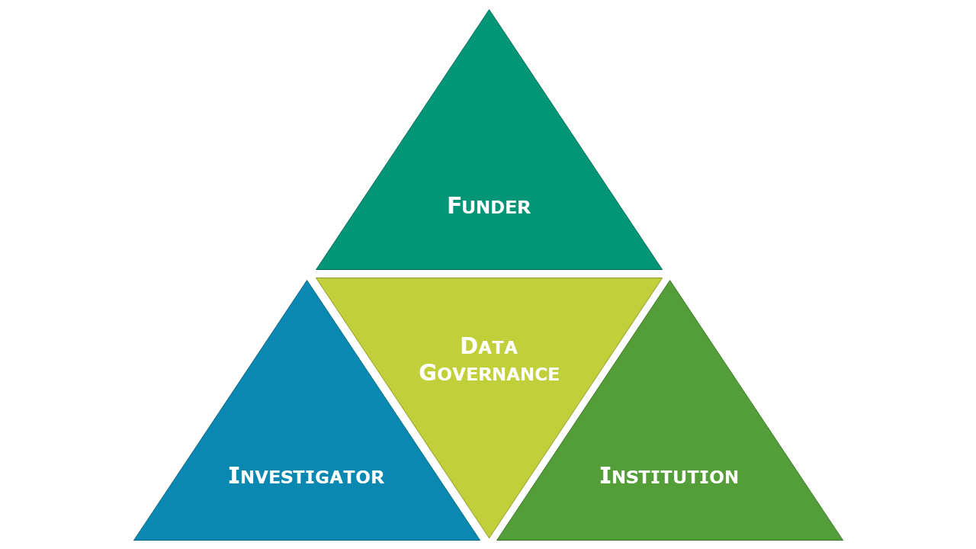
Data governance is a shared responsibility
Notes:
Heather -
Data governance generally tends to be described and operationalized at the level of individual organizations. But governing research data requires that we balance institutional priorities with those of funders, investigators, and others across any given research community. Governing research data is truly a community effort. You’ve probably encountered obstacles or friction when you try to help researchers share data. In some cases, those may be related to data governance decisions or gaps in policy and process. The boundaries of research data governance are often unclear, in part because data governance can be many things. When we do the daily work of data governance, we begin to see how different perspectives, values, priorities, and assumptions play out.

Slide 5
Models at Our Institutions
 | IUPUI/IU | UIC | Caltech
Timing | Began in 1991, research added 2017 | Started in 2011 Pending: Specific Data Governance Committee | Started in 2019
Scope | All institutional data | Committees on Research, Education, Infrastructure | Stewardship of research information
Ownership/ Reporting Structure | Board of Trustees, Executive Management, UDMC | Oversight Committee that reports to CIO | Office of the Provost
Roles | Data Stewards, Data Managers, Data Custodians | IT and Faculty Representatives | Not yet defined
Notes:
Heather intro - We wanted to give you a sense of where each of is positioned in data governance at our institutions. In 2017, I was appointed the first data steward for research data and stepped into a mature data governance program that had not yet grappled with the wonderful world of research data. Our data governance program sits primarily within IT, with connections to our Information Policy and Information Security Offices, as well as Executive Leadership (think VP level).
Each take 1 minute to speak to our institutional models

Slide 6
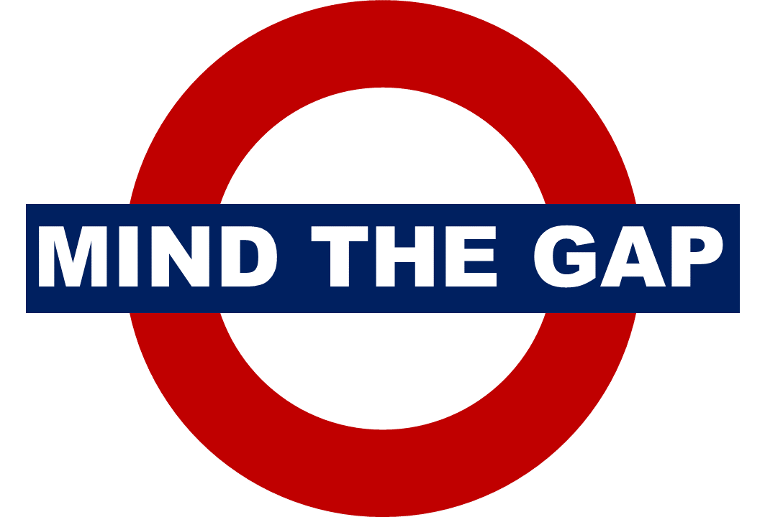
Who is responsible?
Dominance of IT perspective
Differentiating governance by data domains
Rapidly changing external policies & pressures
Local bureaucracy (or lack thereof)
Local training & documentation
Local policy
Issues emerging from the intersections of research, compliance, & IT
Many unknown unknowns
Notes:
Unknowns - What data do we have? Where is it? How long should we keep it? Who should have access?

Slide 7
Who is Responsible?
Bureaucracy (or lack thereof) matters
Lots of people need to be involved but who is leading?
Notes:
Kristin

Slide 8
Dominance of IT
Potential conflict of risk management vs. sharing
Providing many of the central tools
Different perspective and understanding from researchers
Notes:
Abigail

Slide 9
Differentiating Governance by Data Domains
Develop a shared understanding of terminology (i.e., access vs. sharing)
Processes for vetting third-party systems and vendors do not always raise pertinent issues for research or speak the language of researchers
Timing of data governance processes does not always align with the pace and time frame of research
Issues emerging from overlapping regulatory requirements and policies present obstacles to formalizing institutional processes and ensuring consistency in executing these processes (high touch, time intensive)
Notes:
Heather
Over time, the requirements for differentiating research data governance from administrative or operational data governance have become more clear.
First, a shared understanding of key terms - like access and data sharing - is crucial for good communication.
Second, existing processes for ensuring the security of institutional data on third-party systems often focus on areas of risk that are not relevant to researchers, or assume knowledge that researchers do not have.
Third, the timing of our most common data governance processes can conflict with the timing of research projects; so researchers are often encountering these processes during project startup, when the clock for their funding has already begun. We are piloting some strategies to reach them further upstream, ideally during the project development phase.
Finally, there are emerging issues in research that result from overlapping and/or conflicting regulatory requirements. These issues often demand a high touch and time-intensive approach to accurately identify and resolve the issues. However, once people with the appropriate expertise are convened, we can often resolve questions in a brief meeting.
In part, these challenges result from how data governance was established and grew up at IU - it has traditionally fallen under the authority of VPIT, with emphases on risk assessment and information security. However, that has begun to change over the past several years. I've been trying to connect the dots between the why of research data governance and existing policies, processes, and guidance.

Slide 10
Thank you
WHAT NEXT?
Investigate your institution
Connect with someone new
Have a conversation
Abigail Goben: agoben@uic.edu
Heather Coates: hcoates@iupui.edu
Kristin Briney: briney@caltech.edu

