Slide 1
Monitoring and Assessing Community-Engaged Activities Across Campus
Assessment Institute 2016 | Indianapolis
Heather Mack
Kristin Medlin
Kristin Norris
Anne Weiss
Amanda Wittman
Notes:
ADD FRUIT ICONS AND FORMATTING

Slide 2
Facilitator Introductions - “What we do”
Kristin Norris (IUPUI)
Anne Weiss (Indiana Campus Compact & IUPUI)
Heather Mack (Heather Mack Consulting, LLC)
Kristin Medlin (TreeTop Commons)
Amanda Wittman (Cornell University)
© Norris, Weiss, Mack, Medlin, & Wittman, 2016
Notes:
10 MINUTES
Hi Dan,
I'm disappointed I won't be able to join the class on Thursday, but so excited to see this project unfold.
I have my M. A. in International Peace and Conflict Resolution from The School of International Service at American University, Washington, D. C. where I concentrated on design, monitoring and evaluation.
From 2005-2010, I worked as an evaluation consultant for an international conflict resolution NGO both in DC and in multiple countries in West and sub-Saharan Africa, for national and regional philanthropic foundations in the US, and for several local-level non-profits involved in Hurricane Katrina disaster recovery and other social issues. Since 2010, I've also worked with universities to improve the impact of their community engagement efforts through planning, tracking and assessment.
Disasters and violent conflicts, as well as chronic social issues, call for programmatic interventions. But through my work, I've seen that without data those interventions can actually inflict damage, worsen conditions, and literally cost the lives of the people they set out to help. My work is to equip organizations with the evidence-based insights they need to make decisions that will get them closer to their laudable goals.
If you think it would be valuable, feel free to share with the class that I'm a NSSE cynic. I would advise universities to triangulate NSSE findings with other data before basing any decisions on them. But, as I said Friday, with as many resources as our institutions invest in this instrument, I'm eager to find ways for it to be of real value to them and to the field.
Thanks so much and good luck on Thursday!
Heather
On Mon, Aug 29, 2016 at 9:30 AM, Kristin Medlin <kmedlin@treetopcommons.com> wrote:
Hi Dan and all,
Thanks for including us in this project! Unfortunately I will not be able to make the call on Thursday, so I am sending a few bullet points, as requested.
Kristin Medlin, Assistant Director for Postsecondary Initiatives, Treetop Commons
Dual masters in educational research methods (focus on mixed methods and program evaluation) and public affairs (focus on nonprofit management and leadership).
Worked at the University of North Carolina at Greensboro for 5 years, where I led the collection, analysis, and dissemination of community-university engagement metrics. In collaboration with colleagues, invented the Collaboratory to centralize and track this data in a shareable way.
Currently work for Treetop Commons, a software company committed to building the Collaboratory on a shareable platform that other universities can use. Focus on data integrity, product development, and am currently leading plans for the development of a national research program utilizing Collaboratory data.

Slide 3

Participant Introductions
© Norris, Weiss, Mack, Medlin, & Wittman, 2016
Notes:
10 MINUTES | AMANDA
Do you have systems? Do you need to improve a system? Or are you starting from scratch?

Slide 4

Session Info
Call to Action
Framing Our Work
Logic Modeling/ToC
Data Framework Activity
Lunch
Reflections & Recommendations
Lessons from Evaluation Theory
Allies & Next Steps

Slide 5
What Story Do We NEED to Tell?
Address Tensions:
Quantity over quality
More community engagement is better
Continual increases in the numbers equates to greater impact
CE as a strategy, not an output:
Primarily a curricular activity/tied to teaching
Value the role of practitioners
Advocate for and demonstrate the value of SL/CE:
Demonstrate the value and importance of public scholarship, community-engaged research methods, and outreach programs in the overall success of the institution
Institutional Change
Community engagement has the capacity to fundamentally transform how we do teaching, learning, and research in the academy
Community Capacity
Higher ed institutions are an asset in their communities
Community solutions and impact require all institutions to step up
© Norris, Weiss, Mack, Medlin, & Wittman, 2016
Notes:
Each of us has 2 sentences that speak to why we are here.
Norris
Medlin
Anne
Heather
Amanda
Regardless of quality, the target is wrong.
There has been some good surveys/work. But the focus is too narrow, snapshot in time. Not done in ways that inform quality and decisionmaking (aka UTILITY)
Provide space for those not yet here in this thinking to get in the right head space.
These are at a FIELD level. Part of deliverables we’ve promised = institution-level strategies.
These slides help people reflect on the broader context as they consider their institutional contexts

Slide 6
So How Do We Get There?: A Call to Action
Identify ‘good’ questions that inform strategies for monitoring, measuring, assessing, and evaluating community engagement and ultimately telling YOUR story.
© Norris, Weiss, Mack, Medlin, & Wittman, 2016
Notes:
Norris’s rant - will SHORTEN :)
New narrative in HE through data: Develop a strategy for changing the narrative in higher education that shifts the focus away from the fabulous five and toward a broader understanding of community engaged activities and how it impacts students, faculty, staff, community, and the institution.
Telling a Story/Reporting: Identify the ways in which data should be used for research, assessment, and informed decision making
EXPANDING THE TENT - MOVING BEYOND TRADITIONALLY ACCEPTED FORMS OF CE
GETTING BEYOND DOING GOOD

Slide 7
Framing Our Work
Come Play in Our Sandbox!
© Norris, Weiss, Mack, Medlin, & Wittman, 2016

Slide 8
Terms
Measuring/Tracking
(Key) Performance Indicators
Assessment
Evaluation
Research
NOTE: There are no clear or “singular” definitions for these terms as to how they are utilized across community engagement (CE), which makes it even more important for us to have a clear understanding of what we mean when we are talking about these topics.
© Norris, Weiss, Mack, Medlin, & Wittman, 2016

Slide 9
Measure/Metrics/Tracking
… it’s about the outputs; how can CE be counted or quantified?
Main Example in Higher Education:
numbers or “measurements” surrounding
“performance indicators”
Examples:
# and % of faculty/staff/students/community partners involved in CE
# of internship
$$ economic impact of CE
© Norris, Weiss, Mack, Medlin, & Wittman, 2016

Slide 10
(Key) Performance Indicators
… it’s about the benchmarking, goal-setting;
how can CE be strategic to reach __(end goal)___?
Main Example in Higher Education:
Strategic Plans WITH Indicators
Examples:
25% of enrolled students are from local schools (Enrollment Management)
10% of faculty are using a CB/E pedagogy (Building Critical Mass)
2/10 new hires have utilized community based research (Recruitment)
50% of scholarships include elements of CB/E (Student Retention)
© Norris, Weiss, Mack, Medlin, & Wittman, 2016
Notes:
Resource on metrics
https://www.luminafoundation.org/files/resources/a-better-higher-education-data.pdf
Jeffery Seybert - KPIs - Metrics
http://www.hartnell.edu/sites/default/files/u770/intro_to_dashboards_in_higher_ed.pdf

Slide 11
Assessment
…it’s about the outcomes; what are we trying to change or impact through CE?
Main Example in Higher Education:
student learning outcomes
Examples:
What do students learn through CE experiences?
How does CE influence students’ development?
How does CE bridge “us v. them” with the community?
What skills are developed through CE experiences?
© Norris, Weiss, Mack, Medlin, & Wittman, 2016
Notes:
Resource on metrics
https://www.luminafoundation.org/files/resources/a-better-higher-education-data.pdf
Jeffery Seybert - KPIs - Metrics
http://www.hartnell.edu/sites/default/files/u770/intro_to_dashboards_in_higher_ed.pdf

Slide 12
Tracking AND Assessment
We need both in order to better understand what is going on to what ends.
© Norris, Weiss, Mack, Medlin, & Wittman, 2016
Notes:
Resource on metrics
https://www.luminafoundation.org/files/resources/a-better-higher-education-data.pdf
Jeffery Seybert - KPIs - Metrics
http://www.hartnell.edu/sites/default/files/u770/intro_to_dashboards_in_higher_ed.pdf

Slide 13
Evaluation
…it’s about the practice itself; is CE effective, efficient, of a certain quality, etc.? Summative (continual evaluation to improve practices) & Formative (evaluation to see if objectives were achieved)
Main Example in Higher Education:
program and/or teacher evaluation
Examples:
What is a high quality CE experience?
Are your programs cost-effective?
How do your programs meet their objectives (i.e. outcomes and outputs)?
© Norris, Weiss, Mack, Medlin, & Wittman, 2016
Notes:
Resource on metrics
https://www.luminafoundation.org/files/resources/a-better-higher-education-data.pdf
Jeffery Seybert - KPIs - Metrics
http://www.hartnell.edu/sites/default/files/u770/intro_to_dashboards_in_higher_ed.pdf

Slide 14
Tracking AND Assessment AND Evaluation
We need all three in order to better understand what is going on, how, and to what ends.
© Norris, Weiss, Mack, Medlin, & Wittman, 2016
Notes:
Resource on metrics
https://www.luminafoundation.org/files/resources/a-better-higher-education-data.pdf
Jeffery Seybert - KPIs - Metrics
http://www.hartnell.edu/sites/default/files/u770/intro_to_dashboards_in_higher_ed.pdf

Slide 15
Research
…it’s about being more generalizable, per se
  Institutional Research
  Higher Education Research
  Disciplinary Research
  Community-Engaged Research (CER)
  Community-Based Research (CBR)
© Norris, Weiss, Mack, Medlin, & Wittman, 2016
Notes:
Resource on metrics
https://www.luminafoundation.org/files/resources/a-better-higher-education-data.pdf
Jeffery Seybert - KPIs - Metrics
http://www.hartnell.edu/sites/default/files/u770/intro_to_dashboards_in_higher_ed.pdf

Slide 16
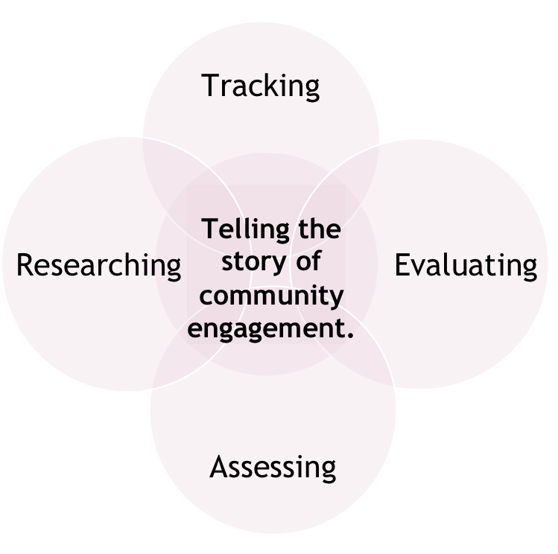
A Lot of Gray
While we want to provide a framework from which we can all rely on when talking about our work…
These areas SHOULD overlap or inform each other.
© Norris, Weiss, Mack, Medlin, & Wittman, 2016
Notes:
DOUBLECHECK GRAPHIC APPEARS
Resource on metrics
https://www.luminafoundation.org/files/resources/a-better-higher-education-data.pdf
Jeffery Seybert - KPIs - Metrics
http://www.hartnell.edu/sites/default/files/u770/intro_to_dashboards_in_higher_ed.pdf

Slide 17
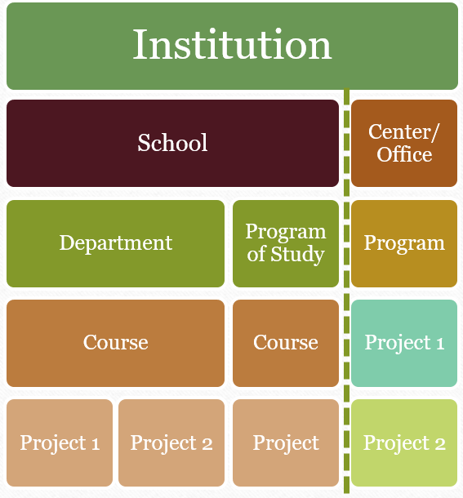
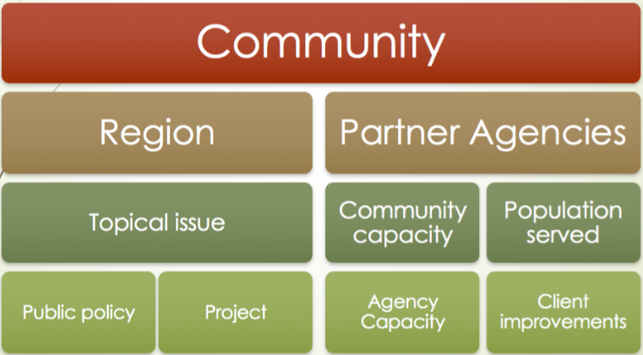
At What Level?
© Norris, Weiss, Mack, Medlin, & Wittman, 2016
Notes:
HEATHER WILL RESIZE COMM IMAGE

Slide 18
Where to Start
© Norris, Weiss, Mack, Medlin, & Wittman, 2016
Notes:
HEATHER

Slide 19
Common Assessment Complaints
“We don’t know where to start”
“How do we even begin to prioritize”
“We have all this data, but don’t know what to do with it”
© Norris, Weiss, Mack, Medlin, & Wittman, 2016

Slide 20
3 Warm Up Steps
© Norris, Weiss, Mack, Medlin, & Wittman, 2016

Slide 21

Step 1: Hands Off that Survey!
© Norris, Weiss, Mack, Medlin, & Wittman, 2016

Slide 22
Step 2: Define Success
What does success mean for your CE program?
How would you know?
© Norris, Weiss, Mack, Medlin, & Wittman, 2016

Slide 23
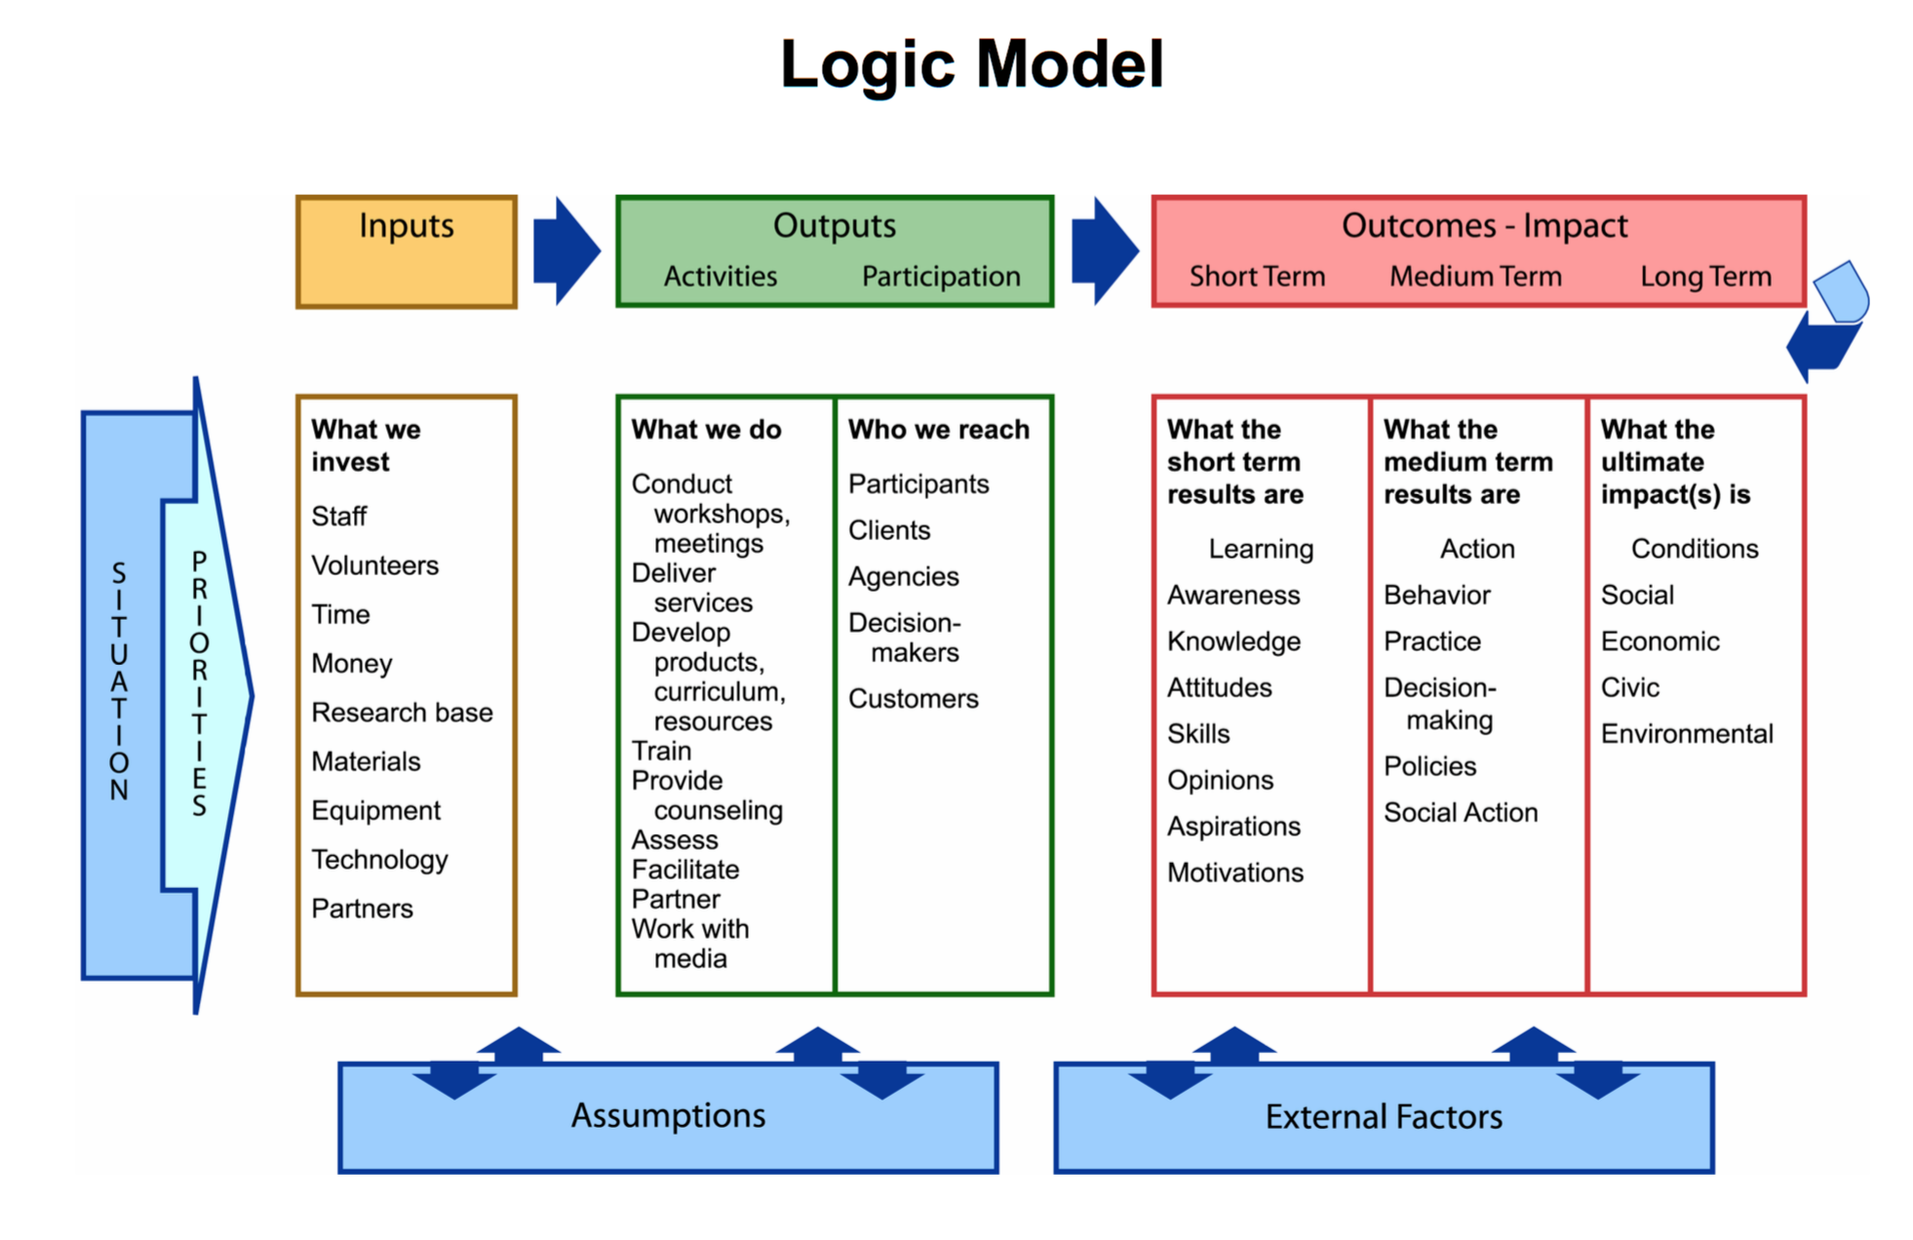
Define Success
Introducing
The logic model
University of Wisconsin Extension - Enhancing Program Performance with Logic Models
© Norris, Weiss, Mack, Medlin, & Wittman, 2016
Notes:
Focus on Flow and major labels

Slide 24
What is a logic model?
Logic Model:
  Planning tool – backwards engineer for assessment purposes
  Both process and product
Process:
  Articulates relationships between the intervention and its intended results
Product:
  A visual depiction showing what the program will do and what it is to accomplish
© Norris, Weiss, Mack, Medlin, & Wittman, 2016

Slide 25
Simplest Form of Logic Model:
Chronological
Activities
Outputs
Outcomes
What we do
What happens
What results
= If, then
© Norris, Weiss, Mack, Medlin, & Wittman, 2016
Notes:
In its simplest form, a logic model is a graphic representation that shows the logical relationships between:
The resources that go into the program – INPUTS
The activities the program undertakes – OUTPUTS
The changes or benefits that result – OUTCOMES

Slide 26
Logic Models for Beginners
C
O
N
D
I
T
I
O
N
Activities
Outputs
Outcomes
Goal
Direct Control
© Norris, Weiss, Mack, Medlin, & Wittman, 2016
Notes:
Our focus is usually on activities – where it needs to be.
Logic models are the opportunity to ground yourself in the outcome so the activity will manifest out of the desired outcome.

Slide 27
What’s so special about logic models?
C
O
N
D
I
T
I
O
N
Activities
Outputs
Outcomes
Goal
Design order: BACKWARDS
Look at our work from a new perspective
© Norris, Weiss, Mack, Medlin, & Wittman, 2016
Notes:
Our focus is usually on activities – where it needs to be.
Logic models are the opportunity to ground yourself in the outcome so the activity will manifest out of the desired outcome.

Slide 28
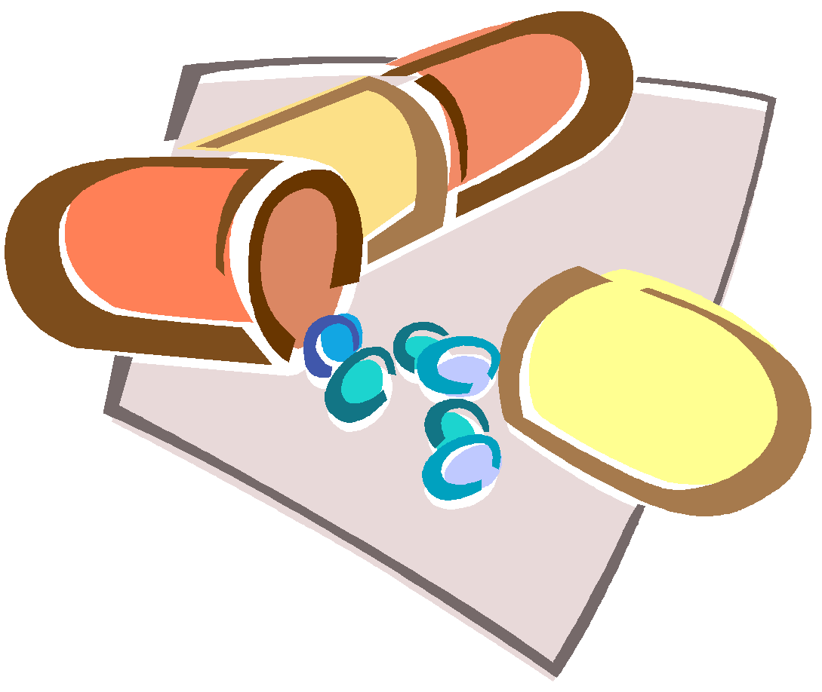
Everyday Example
H
E
A
D
A
C
H
E
Take aspirin
Increase aspirin in blood stream
Decrease pain in head
Feel better!
Condition
Activities
Outputs
Outcomes
Goal
What we seek to improve
What we do
What happens
The Whole Point
What results
© Norris, Weiss, Mack, Medlin, & Wittman, 2016
Notes:
How many of us have had a headache at one time or another? (headache – SITUATION)
What do we do? Our experience may be that certain pills help
So, we need to get the pills (INPUTS),
Then we take the pills (OUTPUTS)
As a consequence, our headache goes away and we feel better. (OUTCOME)
Number of embedded assumption: assumes that we can find/get the needed pills; that we take the pills as prescribed; that the pills lead to improvement – not a stomach ache or other negative side effect. All programs have such assumptions – often the basis for failure or less than expected results
But, you can see the logic of the diagram and the end results – the impact that is expected. What really matters isn’t whether we get the pills and take the pills, but whether we feel better as a result

Slide 29
Everyday Example
H
E
A
D
A
C
H
E
Take
an
aspirin
Increase aspirin in blood stream
Decrease pain in head
Feel better!
Activities
Outputs
Outcomes
Condition
Goal
What we seek to improve
What we do
What results
The Whole Point
What happens
© Norris, Weiss, Mack, Medlin, & Wittman, 2016
Notes:
Try hunger, cold, in a rut
How many of us have had a headache at one time or another? (headache – SITUATION)
What do we do? Our experience may be that certain pills help
So, we need to get the pills (INPUTS),
Then we take the pills (OUTPUTS)
As a consequence, our headache goes away and we feel better. (OUTCOME)
Number of embedded assumption: assumes that we can find/get the needed pills; that we take the pills as prescribed; that the pills lead to improvement – not a stomach ache or other negative side effect. All programs have such assumptions – often the basis for failure or less than expected results
But, you can see the logic of the diagram and the end results – the impact that is expected. What really matters isn’t whether we get the pills and take the pills, but whether we feel better as a result

Slide 30
Zooming in on the Logic Model
Outcomes
and
Goals
© Norris, Weiss, Mack, Medlin, & Wittman, 2016

Slide 31
Your Logic Model
 | Desired results What is success? | Logic Check If all goes well…
Goal The most significant change |  | Are the outcomes enough to create this goal?
Outcomes 3 components necessary for the goal |  | Are the outputs enough to create these outcomes?
Outputs Direct results from activities |  | Does each output directly contribute to an outcome?
Activities What the program does |  | Will these activities create all the necessary outputs?
© Norris, Weiss, Mack, Medlin, & Wittman, 2016

Slide 32
Your Logic Model
 | Desired results What is success? | Logic Check If all goes well…
Goal The most significant change |  | Are the outcomes enough to create this goal?
Outcomes 3 components necessary for the goal |  | Are the outputs enough to create these outcomes?
Outputs Direct results from activities |  | Does each output directly contribute to an outcome?
Activities What the program does |  | Will these activities create all the necessary outputs?
Assessment
Tracking
© Norris, Weiss, Mack, Medlin, & Wittman, 2016

Slide 33
Step 3: Why assess?
What are you hoping to achieve through assessment?
AKA: Assessment Goal
What do you hope will be different as a result of the assessment?
What would make you satisfied that the assessment was a success?
© Norris, Weiss, Mack, Medlin, & Wittman, 2016

Slide 34
Why does it matter?
Assessment goal informs ALL assessment decisions
Use your assessment goal to work backwards in designing your assessment
© Norris, Weiss, Mack, Medlin, & Wittman, 2016

Slide 35
Recap – 3 Warm Up Steps
To survey or not to survey
Logic model approach → Define & articulate program success
Assessment goal dictates assessment design
© Norris, Weiss, Mack, Medlin, & Wittman, 2016

Slide 36
A Data Framework
© Norris, Weiss, Mack, Medlin, & Wittman, 2016

Slide 37



Importance of Models/Frameworks
Answers the “to what ends” question; provides more concrete goals
Guides the process (data collection, method of analysis, reporting)
Results in more useful information and recommendations for action
© Norris, Weiss, Mack, Medlin, & Wittman, 2016

Slide 38
Importance of Models/Frameworks (cont.)
Help balance the constraints and purposes of existing data collection mechanisms
Determine how you will communicate findings to key stakeholders
Identify opportunities for growth & priority areas
Advocate for what data you need and why
Identify what activities you are currently tracking, but gaps in data that are preventing you from conducting further inquiry or telling a more compelling story
© Norris, Weiss, Mack, Medlin, & Wittman, 2016

Slide 39
Activity: Walking Through an Example
Type of Activity | How this data could be used to inform decisions, continuous improvement, telling a story | Data points | Source of the data | Metric | Use & Reporting (Who needs to know? Why? How do they best receive information?)
Community-Based Learning Courses
Inclusion Criteria:
Students making a significant contribution (time, talent, resources) in a community setting. (e.g., service-learning, internships, field study, practicum, community-based research)
Pervasiveness of SL throughout curriculum---to what ends
Evidence of SL as a HIP
Creation of KPI’s and identification of institutional priorities (Seybert)
Do we need to offer more faculty development for taking CBL to CEL?
Incentives needed? Or barriers that need to be removed?
Course designations
Required within the curriculum?
Every program of study has a required SL component
At least one SL course sequence is scaffolded in every program of study (100, 200, 300, 400; foundational/core curriculum and advanced)
25% of all courses offered have a community-based component
10% of all courses offered have a community-engaged component
Stakeholders:
Other offices on campus - (un)usual suspects
Community partners
General public
Board of Trustees (etc.)
Avenues:
Annual Reports
Media/Op-Eds
Publications
Newsletters
Award applications
Technical reports
© Norris, Weiss, Mack, Medlin, & Wittman, 2016
Notes:
Add animation to each cell
Here is our activity - we’ve talked about at IUPUI; good process for you to think about w/our campuses when you leave today. Let’s take the example of CBL.
Q1: how do you determine what’s in and what’s out as it relates to CBL courses?
Raise dialogue about SVL, other designations, grey area in internships, etc. (continuum); address definitional challenges
Q2: What story do you need to tell about CBL courses?
Prompt: Who is doing the work (e.g., adjuncts, lecturers, tenured faculty) and begin to ask why/why not?
Q3: If you need to know where SL is throughout your curriculum, what data points do you need?
Prompt: You need categories and classifications (rank/status of instructors of record - decide which are important (it’s not that easy!); connections to demographic information about them)
If you need to if SL is a HIP, what how would you determine the fidelity (”good”, consistent, standardized, objective ---measurable) of SL as a HIP (Taxonomy; identify and embed common indicators across all SL classes that reflect your key questions/priorities)? [challenge we typically face now, in the absence of a data framework, is being proactive rather than reactive]
Skipping over the source of this data right now - we’ll assume that you don’t have access to it right now. It’s likely that you don’t know what you need to know or WHY you need to know it. If you can understand these, then you can go back later and find out WHERE that data lives.
Q4: Metrics/performance indicators
You have to be careful about how they get framed and how they get used. Is $$ tied to this? If you can’t demonstrate ‘good’ or improvement
Who sets the priorities? Are they longterm? Good for the institution/ your department?
Does it matter??? Often statements that live outside of context and therefore hard to interpret. They aren’t meant to be interpreted --- just a goal/motivational
Often times is the REACTIVE...if you waste all of your time on gather data to suffice a metric, you won’t get to the usefulness of assessment for improving practice
Q5: this column could and should technically be one of the first 2 columns.
Distinctiveness between column 2 and 6---
We want to show evidence of something in column 2. -- internally, what do I care about
What do others care about/need to know? Being a good steward/partner in data collection

Slide 40
LUNCH
© Norris, Weiss, Mack, Medlin, & Wittman, 2016

Slide 41
Reflections
& Recommendations
for Mobilization
Or…
HOW DO I GET YOU TO GIVE ME THE DATA?
© Norris, Weiss, Mack, Medlin, & Wittman, 2016
Notes:
Over the last two hours, we’ve discussed how to understand our campus contexts, and we’ve thought about what data would be useful to our various assessment needs. To close out the precon, we want to share some strategies to mobilize successful assessment initiatives. Or, in short, everyone’s favorite question… “HOW DO I GET YOU TO GIVE ME THE DATA?”

Slide 42
Reflections on a Full Stomach
How is this different than the way you’ve been thinking about CE data?
  (have you been thinking about CE data before this??)
What challenges do you anticipate arising as you begin a process to track/monitor/assess/evaluate CE work?
How can we support each other?
© Norris, Weiss, Mack, Medlin, & Wittman, 2016
Notes:
10 MINUTES? Let participants speak out in large group.
What did you think about over lunch?? :) What did you EAT for lunch? :-)
how is this different than the way you have been thinking about data? Any anticipated challenges? How can we support each other?
What I love about all the people present in the room right now is that we are half community engagement people, half assessment people. How can we be learning from each other? How can we be sharing, helping increase understanding?

Slide 43
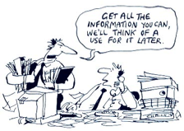
Best Practices: Use
Shift away from reactive
  Annual recognitions, surveys, annual reports
  Episodic accreditations
  Unique requests from legislature, general public, referral inquiries, media, etc.
To proactive
  Systematic and intentional
  Planning and improvement purposes
  Convene and catalyze
  Minimizes the administrative and political costs to collect data
  Capitalizes on motivations for collecting data and inspires use
  Anticipate needs and produce iterative reports
Data Matters PDF
© Norris, Weiss, Mack, Medlin, & Wittman, 2016
Notes:
For me, the takeaway of this work over the last few years has been a shift in how to approach data collection and the process.
Utilization-Focused Evaluation (UFE):
developed by Michael Quinn Patton, is an approach based on the principle that an evaluation should be judged on its usefulness to its intended users. Therefore evaluations should be planned and conducted in ways that enhance the likely utilization of both the findings and of the process itself to inform decisions and improve performance. How many of us feel like our data collection initiatives meet this criterion??
The evaluator’s job is not to make decisions independently of the intended users, but rather to facilitate decision making amongst the people who will use the findings of the evaluation.
It is a shift from reactive uses to proactive uses. How are we using our data needs as a carrot, instead of as a stick? At UNCG, even though we needed data for reactive requests/demands/decrees, it was always the proactive uses of data that helped people commit to willingly sharing such data. We used data matters when we spoke with stakeholders across the institution about why this data was valuable. How we would share it back with them - reports on our website, etc.
Consider image and identity - how these reinforce (or do not reinforce) each other. How are strategic communications and initiatives framed to encourage an engaged campus vibe?
Do not bury data - make it public. Determine how you might make that data publicly available/useable
University press releases, websites – news and events
Newsletters – online or paper
Publications/Reports – online or paper
Elective and Mandatory: Accreditation, Carnegie, PHR, system-wide metrics (in the case of the UNC System), etc.
HAND OUT DATA MATTERS SHEET.
basis for rewards and recognition in various forms
clarifying the institution's goals for and concepts of engagement
reinforcing best practices
facilitating interdisciplinary cooperation and research
encouraging more faculty to adopt engagement practices
collect immediately accessible and real stories to assist development and advancement officers in raising funds and for teaching, research, and service - as well as other partners to advocate on behalf of you.
Recruit and retain potential faculty and students to come to your institution and greater community.
Strengthen capacity and reputation as a member at the table in your community
MENTION REFERRAL DESK

Slide 44

Best Practices: Process
See Janke and Medlin, 2015
How often do you collect data?
  Snapshot or continual
How much data do you collect at once?
  All of it at once, or different slices at different times?
What data is important to collect?
  WHY ARE YOU COLLECTING THE DATA??
  Just course data? Student data? Faculty data? Community data?
  What stakeholders need to be involved in the process? Who needs what data?
  Focus on activities as unit of analysis
What data do you already have?
  Is it already being collected somewhere else by you or someone else?
What is your rollout/communications strategy?
  Both top-down and bottom-up
© Norris, Weiss, Mack, Medlin, & Wittman, 2016
Notes:
So how do you go about doing this?
Before lunch we walked through a data framework. We won’t repeat that exercise here, but let’s summarize some of the key takeaways.
How often do you collect data?
Tell story of different offices going to faculty for different slices of the same data multiple times within any given semester, plus the additional requests from external arbiters
Additional offices that might be unknowingly requesting similar data at the same time: leadership and service learning, institutional research, research and economic development, undergraduate research, office of assessment and accreditation, registrar, etc.
How much data do you collect at once?
What data is to be reported? One of the most common questions we received is “what data are you asking us for?” As we saw earlier today, the options are endless. SO - be able to share with them what data and WHY. and more importantly, why other data points may not be included.
UNCG’s approach was to create a single, unified “ask” for data
We convinced faculty/staff that this level of detail was necessary and that this one ask will actually reduce redundancies in the longterm.
Define the scope of your data collection and your constructs
Acknowledge that these terms are value-laden across different constituencies
Data collection and constructs – at UNCG we cast a wide net to include both CE and PS – and used specific definitions and criteria for each to help faculty determine what was “in” and what was “out”. Much of this documentation is available at UNCG’s website, communityengagement.uncg.edu. Collecting both CE and PS allowed us to tell the full scope of our engagement with the community, from camps, clinics, and services to athletic and cultural events, as well as the more reciprocal, long-term partnership activities that community engagement scholars aspire to. By casting the net and defining the terms, we are able to collect it all, but also distinguish between the two (to/for/on vs. with/by)
Review all past, present, and likely future reporting needs
Talk with offices across campus responsible for collecting/reporting various pieces of information
Review existing data collection mechanisms to determine adaptability and to minimize redundancy
What data is important to collect?
Our mantra was always “is the juice worth the squeeze?” - if it wasn’t worth doing, we tried not to do it. What’s the payoff to me? Or is it to the institution more generally? Requests for data are interpreted as indicators of what they ought to be doing. Pay attention to how messages are sent, how they are received, and how they are interpreted.
Interest in basic descriptive indicators that form the basis for measurement - mention Collaboratory we developed
who is doing what, where, and with whom?
how can we leverage that data?
Community and economic engagement, collective impact
Additional data sources/needs: as we’ve seen from the data framework activity, different data lives in a lot of different places!
Community-based learning courses
Student participation in service events
Students enrolled in CBL courses
Community partners and information about them
Others??
Already collected by someone else (already happening) - how can you plug into these? What stakeholders need what data?:
Alumni survey
Annual reports (based on the Strategic Plan)
Faculty survey
Staff survey
Student surveys (Entering Student, Continuing Student, NSSE)
Faculty Annual Reports (FAR)
Registrar
Student organizations
Campus climate survey
What is your rollout/communications strategy?
From the top: worked through our provost
Invited us to dean’s council meeting to share request – build awareness and share uses
Sent formal request (authored by our office) for data through the deans to all department chairs. Shared requirements AND requested working meetings with key contacts
From Middle out:
Purpose of these meetings was to share why the data was needed, what data was to be reported, and how to report data into the online mechanism.
Essential for recruiting participation. We learned the message from the Provost in most cases did not filter down through the academic dissemination structures as planned. Support from deans/department chairs varies widely from unit to unit
Critical to answering questions and allowing contacts to vent frustrations related to other political contexts on campus
Be sure to communicate!
Establish and articulate timelines, collection mechanisms, points of contact, support materials
Agree on what level of data/detail is “sufficient” but allow flexibility
There’s a lot of this spelling out in an article last fall of the Metropolitan Universities Journal.

Slide 45
Best Practices: Values
Be collaborative with others (internal to the campus)
Attentive to community partners needs, interests, involvement
Data is publicly available/accessible to others
Systems/processes that let you be responsive to campus needs & community needs (real-time)
Trustworthy - looking out for the best interests of many
Creativity - you have data...what can you/can’t you answer
© Norris, Weiss, Mack, Medlin, & Wittman, 2016

Slide 46
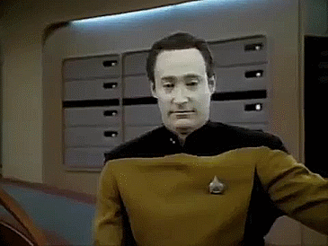

Costs to Collecting Data
Administrative
Political
© Norris, Weiss, Mack, Medlin, & Wittman, 2016
Notes:
So, why can’t we get our faculty and staff to give us data?? Lots of reasons!
Faculty/staff time to communicate, record, review, synthesize, and formally report information
The expense (both time and money) of adapting, creating, or licensing software systems to facilitate the collection, storage, and analysis of data.
political costs associated: the cost-benefit analysis of asking faculty and staff to provide pieces of information not previously collected for what is often perceived as “administrative purposes.”
Given the increased demands for counting, accounting, and reporting on activities across nearly all areas of faculty work, which have increased the administrative portion of faculty workloads, administrators are asking “How am I to add this to their load? What will be the cost in asking for this data?”

Slide 47
Are You Ready?
Culture of
  Community engagement - marginalized or mainstream?
  Assessment - accepted as routine? Rejected, necessary evil, or seen as beneficial?
Foundations & Buy-In
  Definitions and language?
  Complementary/competing conversations on campus?
  Integration into strategic initiatives?
  Leadership support? Top down and bottom up
  Allies and champions? “Unusual suspects”?
Evaluability Assessment (Wholey 1979, Trevisan and Walser 2014)
© Norris, Weiss, Mack, Medlin, & Wittman, 2016
Notes:
Data collection NEVER happens in a vacuum. There is critical planning work that must be conducted prior to starting the process. Takes TIME. Takes LONG-TERM THINKING. At UNCG we began this process in 2010, with the revision of university-wide P&T guidelines. Hosted multiple speakers, created publications, lots of bush beating across campus, etc.
Culture -
Of CE - marginalized or mainstream? What would it take to shift this perception
Of assessment - accepted as routine? Standardized processes in place? necessary evil? Or seen as beneficial?
At UNCG, a lot of culture building was required to lay the groundwork for valuing public service and community engagement. They are not either/or, better or less, but two sides of a distinct coin that can be articulated, defined, and distinguished. Faculty and staff should feel confident when reporting their public service work that it will be valued by their department and executive leadership.
Foundations - e.g., definitions, other conversations on your campus
What can you do to improve understanding and acceptance of engagement/service on your campus?
Leadership support? Top down is just as important as bottom up in some cases
Allies and champions, but also the “unusual suspects”
EVALUABILITY ASSESSMENT: AN ENTIRE OTHER PRESENTATION. IN A NUTSHELL...
What is EA?
Developed at the Urban Institute in the late 1970s in response to government complaints that no useful information was derived from evaluation (Wholey, 1979)
Difficult to evaluate programs that were poorly designed in the first place, which inevitably led to conclusions of deficient programs (Smith, 1990)
A pre-evaluation to see if a program is ready for outcome evaluation (Trevisan and Walser, 2014)
In reality, this entire day has been assessing the evaluability of our abilities to track CE at an institutional level.
Common Problems Prevented by EA:
Lack of definition of the problem addressed, the program intervention, the expected outcome of the program, or the expected impact on the problem addressed
Lack of a clear logic of testable assumptions linking expenditure of program resources, the implementation of the program, the outcomes to be caused by that program, and the resulting impact
Lack of agreement on evaluation priorities and intended uses of evaluation
Inability or unwillingness to act on the basis of evaluation information

Slide 48
Evidence of a New Narrative –
How would we know?
developing and delivering community‐based instruction, such as service‐learning experiences, on‐site courses, clinical experiences, professional internships, and collaborative programs
developing and delivering instruction to communities and other constituencies
creating exhibits in educational and cultural institutions
Disseminating community engaged research through public programs and events
Conducting and reporting program evaluation research or public policy analyses for other institutions and agencies
Developing innovative solutions that address social, economic, or environmental challenges (e.g., inventions, patents, products, services, clinical procedures and practices
Consulting and providing technical assistance and/or services to public and private organizations
Writing position papers for the general public
Collaborating with schools, businesses, advocacy groups, community groups, and civic agencies to develop policies
Providing leadership in or making significant contributions to economic and community development activities
(UNCG University-Wide Promotion and Tenure Policies, 2010)
© Norris, Weiss, Mack, Medlin, & Wittman, 2016
Notes:
THESE MIGHT BELONG SOMEWHERE ELSE - parking lot
Part of framework activity?

Slide 49
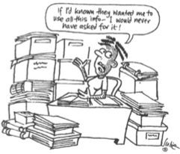
Lessons Learned
A survey is not sufficient
Never underestimate the power of middle-range leadership
Create support for data collection – FAQs, student assistance curating and following up on requests, combing media outlets
Requires continual clarification, awareness, and re-evaluation of the process
Data is critical to enhancing the institution’s image and identity as community-engaged
Virtuous cycle - faculty and staff are seeing their data used, and they are becoming better, more compliant, participants and partners in the data collection initiative
© Norris, Weiss, Mack, Medlin, & Wittman, 2016

Slide 50
Lessons from Evaluation Theory
© Norris, Weiss, Mack, Medlin, & Wittman, 2016

Slide 51
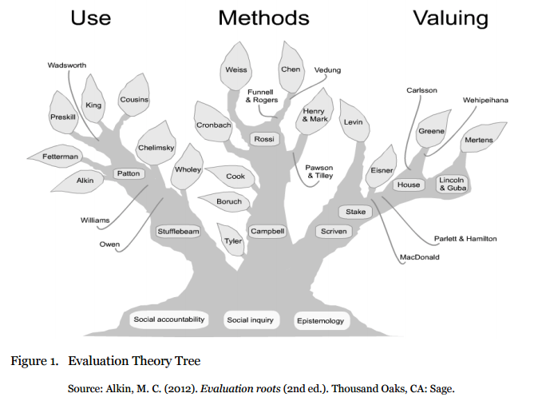
Evaluation Theory Tree
© Norris, Weiss, Mack, Medlin, & Wittman, 2016
Notes:
PRINT HANDOUT

Slide 52
Allies & Next Steps
© Norris, Weiss, Mack, Medlin, & Wittman, 2016
Notes:
TAKE A 15 MINUTE BREAK BEFORE BEGINNING THIS SECTION

Slide 53
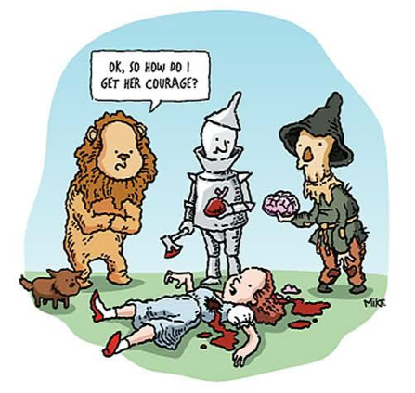
Getting to Know your Inner Oz
© Norris, Weiss, Mack, Medlin, & Wittman, 2016

Slide 54
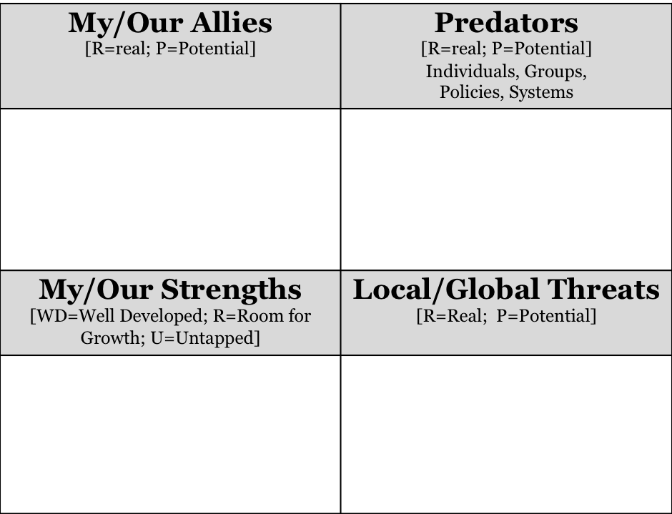
Getting in Character
© Norris, Weiss, Mack, Medlin, & Wittman, 2016
Notes:
NEED TO PRINT OUT OZ WORKSHEET HERE

Slide 55
Wrapping Up
© Norris, Weiss, Mack, Medlin, & Wittman, 2016

Slide 56
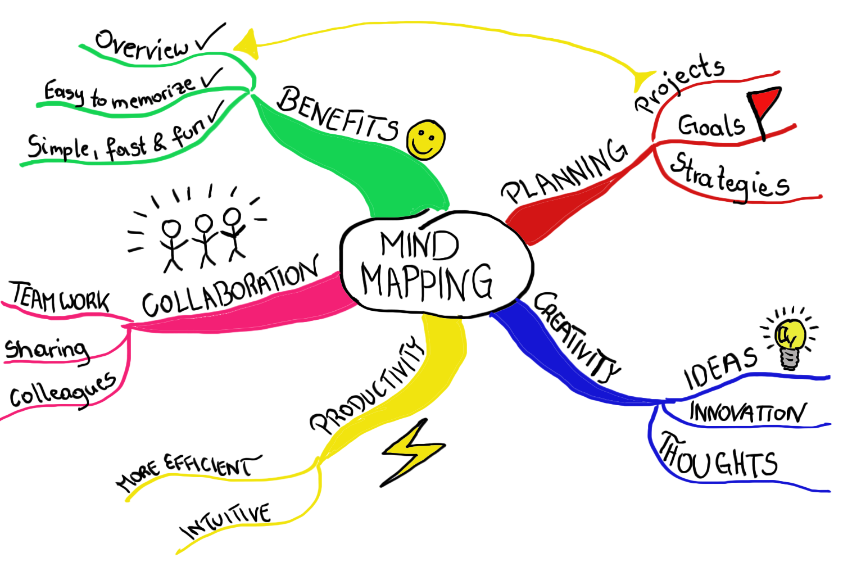
Coffee dates
Team mates
Who do you know? Who do you want to know?
© Norris, Weiss, Mack, Medlin, & Wittman, 2016

Slide 57
Don’t Miss Out!
Opening Reception & Presenters Recognition
  Sunday, 5-6:30pm, Marriott 7-10
Community Engagement Reception (Invitation Only, but bring friends!)
  Monday, 6:30-8:00pm, Tavern on South Restaurant (2nd floor)
Featured Keynote – Robert Reason
  Tuesday, 9:00-10:15am, Marriott 5
© Norris, Weiss, Mack, Medlin, & Wittman, 2016

