Slide 1
Mixed Bag
Denise Rayman: IUPUI Ruth Lilly Special Collections and Archives
Describing and Publishing a Collection of Open and Restricted Born-Digital Records using Digital Objects
IUPUI

Slide 2
How do we represent mixed access collections?
Arranging and describing collections with mixed open and restricted content can be tricky, and especially tricky when working with born-digital records. We must balance the need for giving a basic description of restricted content to researchers, while providing privacy to the donor’s materials.
This presentation will show a method of representing both the openly accessible and restricted born-digital material within a single collection, using folder-level description combined with the published/unpublished feature in ArchivesSpace’s digital objects.

Slide 3
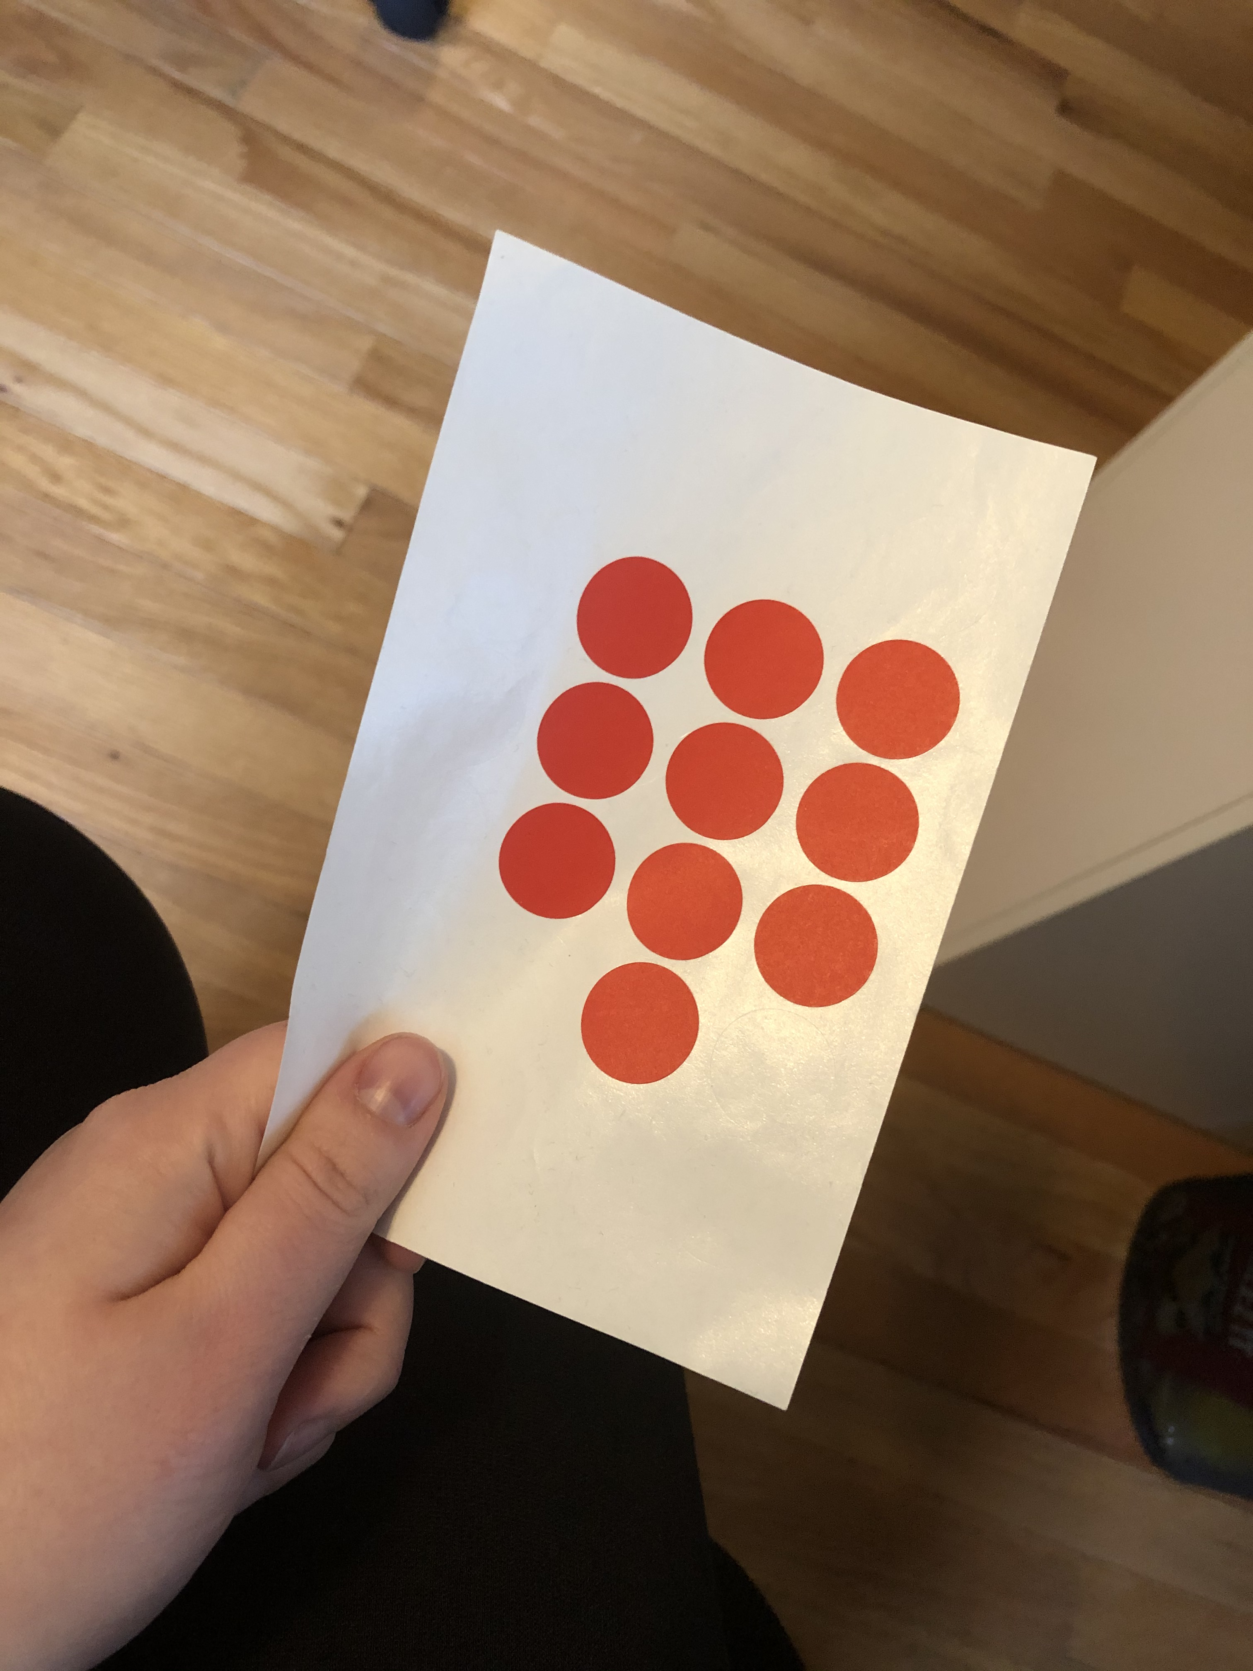
The Restricted Sticker
Archivists have a time-honored and economical way of clearly marking restricted material – bright stickers
Typically restricted files are pulled and segregated to one box for simplicity, and the sticker alerts anyone who pulls the box
How do we translate the “sticker” to born-digital materials?

Slide 4
Digital Material: What level of description?
When representing digitized traditional archival objects we, as a profession, have defaulted to item-level cataloging, which is useful for items like photos, videos, or discrete publications
However, with the size, scope, and interrelated nature of born-digital material, item-level is not practical for most collections
Restricting at the item level is also impractical

Slide 5
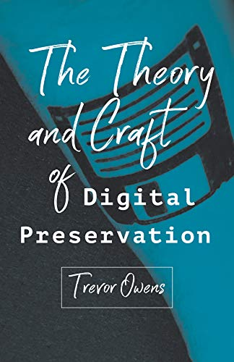
MPLP is for digital
If we took [MPLP] seriously for working with digital content, we would have very different approaches to working with born digital materials than what most cultural heritage organizations are doing now. You would acquire content, create a short collection level description, then produce a container list (which as digital files and folders provide the instantaneous ability to provide a list this is rather trivial) and then go ahead and make the collection as broadly accessible as possible.
[…] However sophisticated some collection of digital material is, at the most basic level, it’s possible to create a record for it and make that record available.

Slide 6
Digital Objects
In ArchivesSpace, digital objects are simple and flexible – which makes them intimidating to start using
Digital objects can represent material at the item-level, folder-level, or collection level - whatever level of processing you want

Slide 7

Overview of our mixed collection:
Manuscript collection of social-science researcher David Reingold
Mixed collection of physical papers (2.5 cbft) as well as born-digital material (2.5 GB, transferred to us on ZipDisks)
Digital material has publications, reports, and other grey literature, which we wanted openly available online
Also contains email and original research data sets containing human subjects, which we wanted to collect but not put online
Collection processed by Hannah Vaughn

Slide 8
Restricting at scale example: Emails
FILE Check out this job at jobsearch usajobs opm gov.msg
FILE Community is published!.msg
FILE Faculty Summary Report and Vita.msg
FILE FW CONFIDENTIAL Return from Leave.msg
FILE FW David Reingold.msg
FILE FW Draft welfare to work and DWD.msg
FILE FW Special Issue.msg
FILE FW The Rossi paper.msg
FILE Graduate School Application Time.msg
FILE IU web page draft.msg
FILE Lilly Proposal.msg
FILE Olzak riot data.msg
FILE P&T Timeline.msg
FILE Picture of Grandpa Haim's parents.msg
FILE Promotion and Tenure.msg
FILE Proposals.msg
FILE RE Assistance.msg
FILE RE FSSA Article.msg
FILE RE My fax number.msg
FILE RE Office.msg
FILE RE Olzak riot data.msg
FILE RE .msg
FILE Revised Hypotheses.msg
FILE Thanks.msg
FILE Untitled.msg
FILE Yuseok Moon's dissertation proposal.msg
TOTAL 26 Emails

Slide 9
Finding Aid
http://findingaids.ulib.iupui.edu/repositories/6/archival_objects/129038
  Digital records have an Archival Object at the file level, just like the paper records, with attached Digital Object

Slide 10
Public view of open and closed digital records
Open records: http://findingaids.ulib.iupui.edu/repositories/6/archival_objects/129074
  Archival object visible, digital object record visible, directs patron to corresponding records in DSpace
  Most records are available in bags at the folder level, zipped, with a directory printout and corresponding preservation metadata
Closed records: http://findingaids.ulib.iupui.edu/repositories/6/archival_objects/129110
  Archival object visible, has digital object, but not visible to user

Slide 11
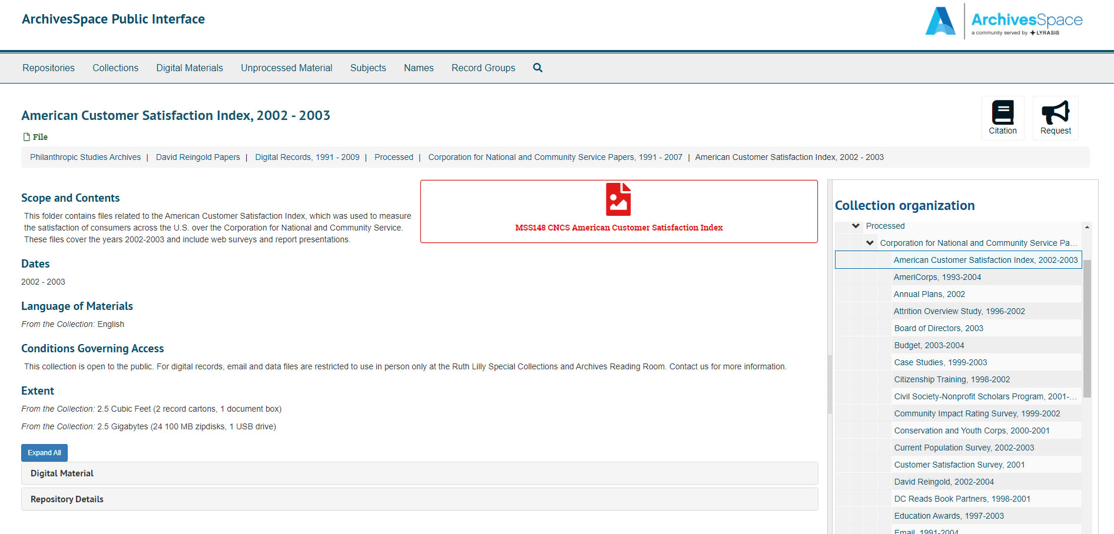
Archival Object with Accessible Digital Object

Slide 12
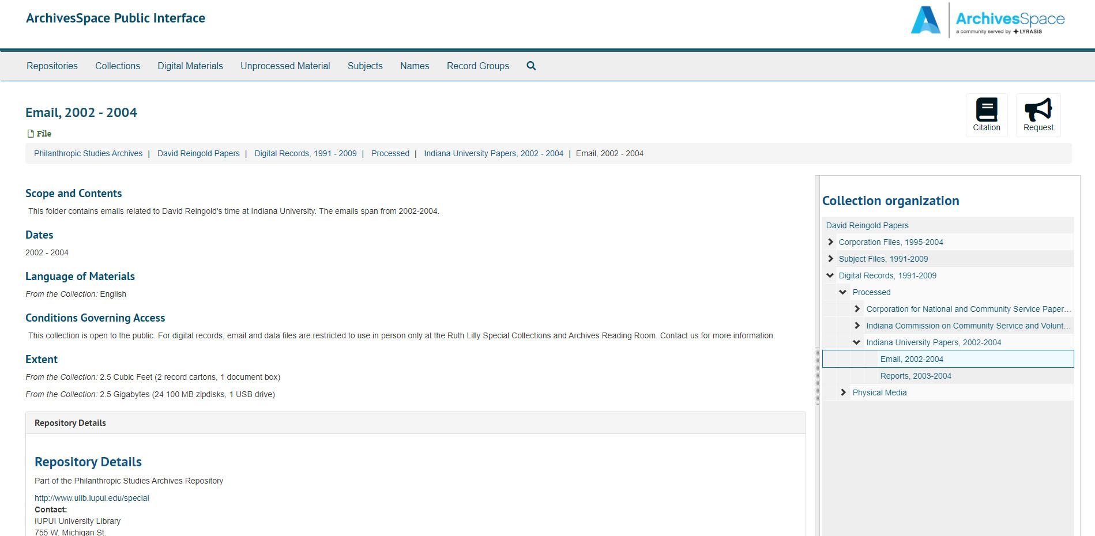
Archival Object with Closed Digital Object

Slide 13
Archivist View of Closed digital records
Archival Object: https://archivists.ulib.iupui.edu/resources/227#tree::archival_object_129110
  Publish: true
Digital Object: https://archivists.ulib.iupui.edu/digital_objects/9695#tree::digital_object_9695
  Publish: false
  Link available to DSpace here, for archivist use only
  DSpace record also locked

Slide 14
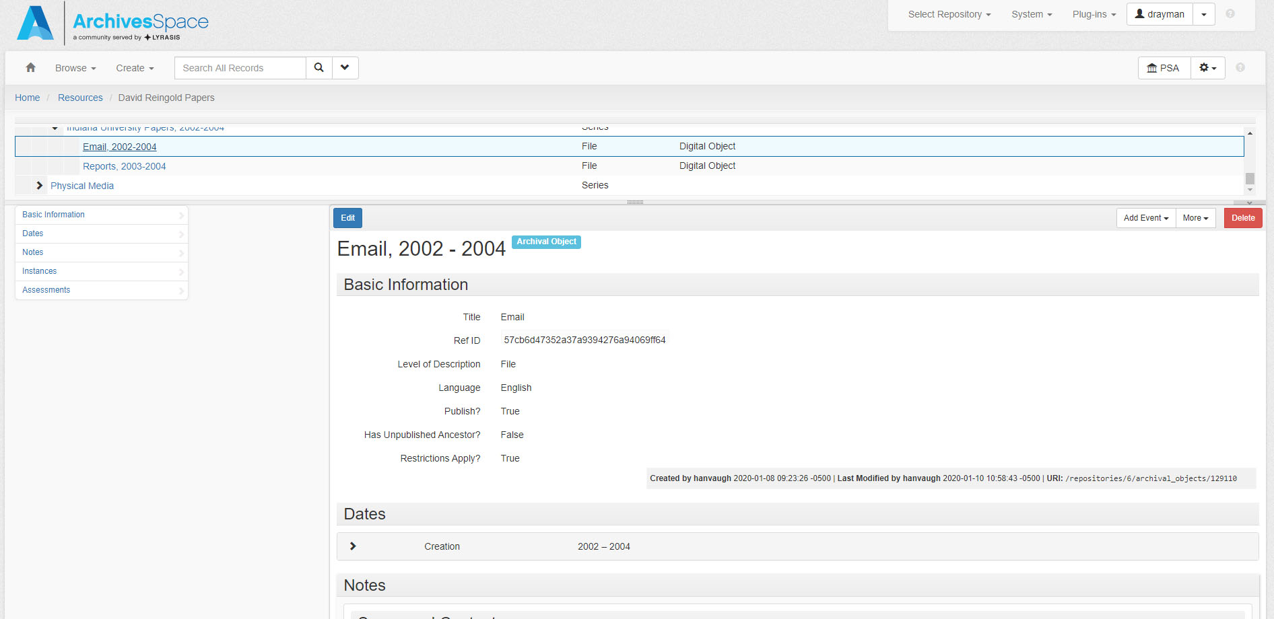
Closed Archival Object, Archivist Side

Slide 15
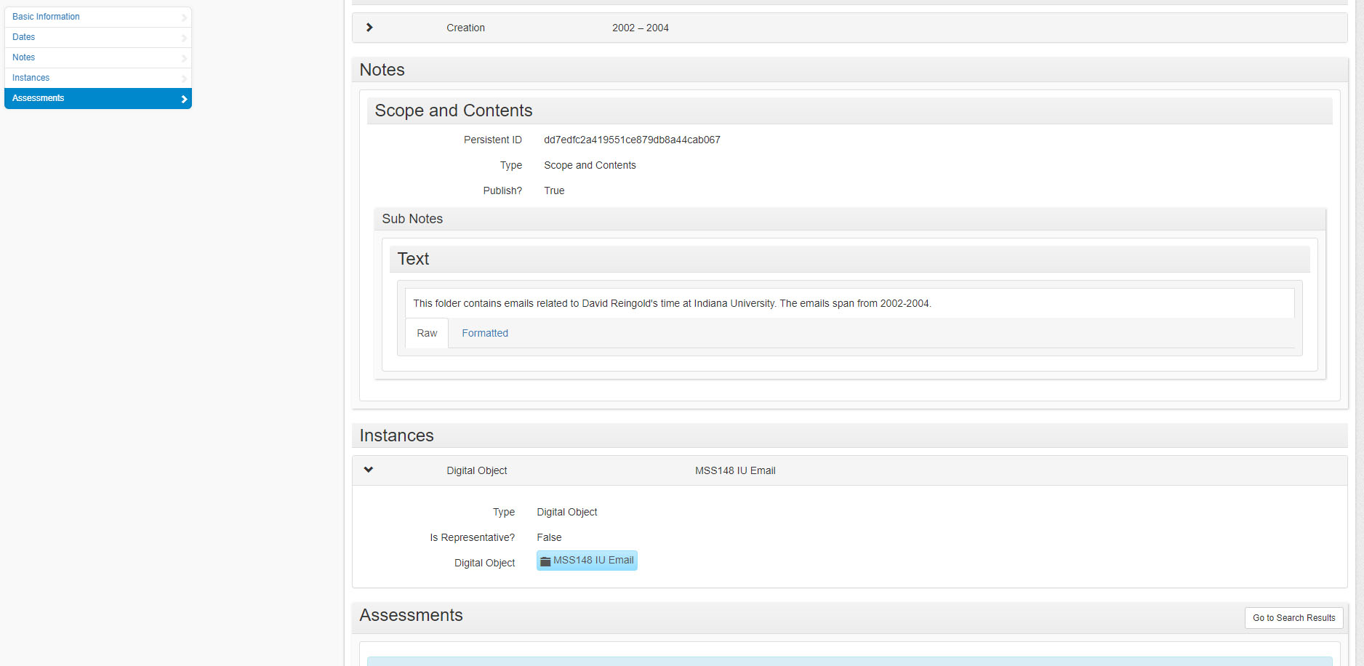
Closed Archival Object, Archivist Side, cont.

Slide 16
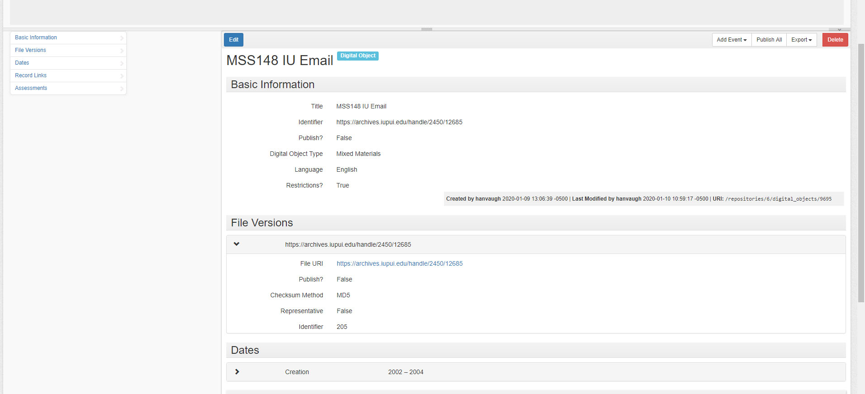
Closed Digital Object, Archivist Side

Slide 17
Conclusion
Digital objects and minimal processing are compatible!
ArchivesSpace has a “restricted sticker” for digital objects – it’s the published/unpublished check box
A published archival object linked with an unpublished digital object can be used to inform patrons that materials exist, and help archivists quickly find restricted records in your institutional repository

Slide 18
Denise Rayman
drayman@iupui.edu
http://ulib.iupui.edu/special

