Slide 1
How to Write a Library Cover Letter
Rachel Molina and Gary Maixner
University Library, IU Indianapolis

Slide 2
Overview
Common Misconceptions
Example Job Posting
Resume vs CV
Additional Suggestions
Time for Questions

Slide 3
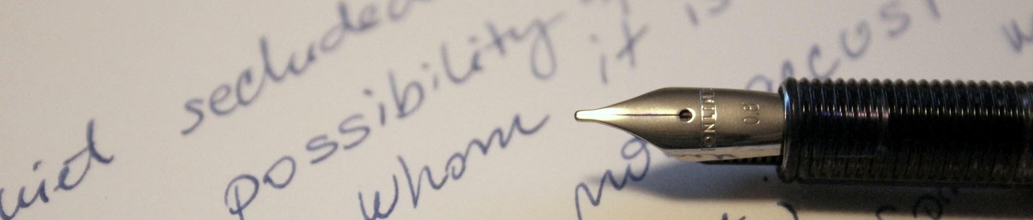
Common Misconceptions
One Page Max
Reusing Letters
Qualifications are ranked
More than one page is acceptable and even preferred for library job postings
Do not use the same cover letter for every job application
You will not be able to speak to the job well enough when reusing
While there may be some reason that things are ordered, don’t assume that one qualification is more important than the others
Notes:
Rachel’s notes: I was shocked when I was told by my now supervisor that one page cover letters are actually preferred. Everything I’d been told in undergrad and even our mlis program said that you shouldn’t go over one page, which is why so many of my cover letters didn’t work. It’s hard to speak to everything you need to in essentially two paragraphs.

Slide 4
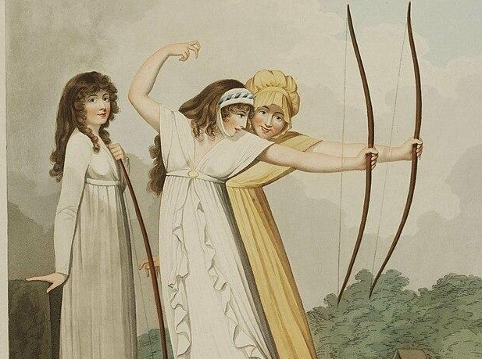
Write with Purpose
Don’t be Humble in your Cover Letter
Use strong language throughout
  Avoid wording like “contributed,” instead speak to what you actually did
Never sell your accomplishments short
Outright state that you are an ideal candidate for the position
Use active voice
  Makes it easier to read and parse
Notes:
Rachel’s notes: it’s always been hard for me to brag on myself, because it feels unprofessional or like imposter syndrome. Even though it may feel wrong, being confident, not humble, about yourself in a cover letter will get you much farther than being humble.

Slide 5
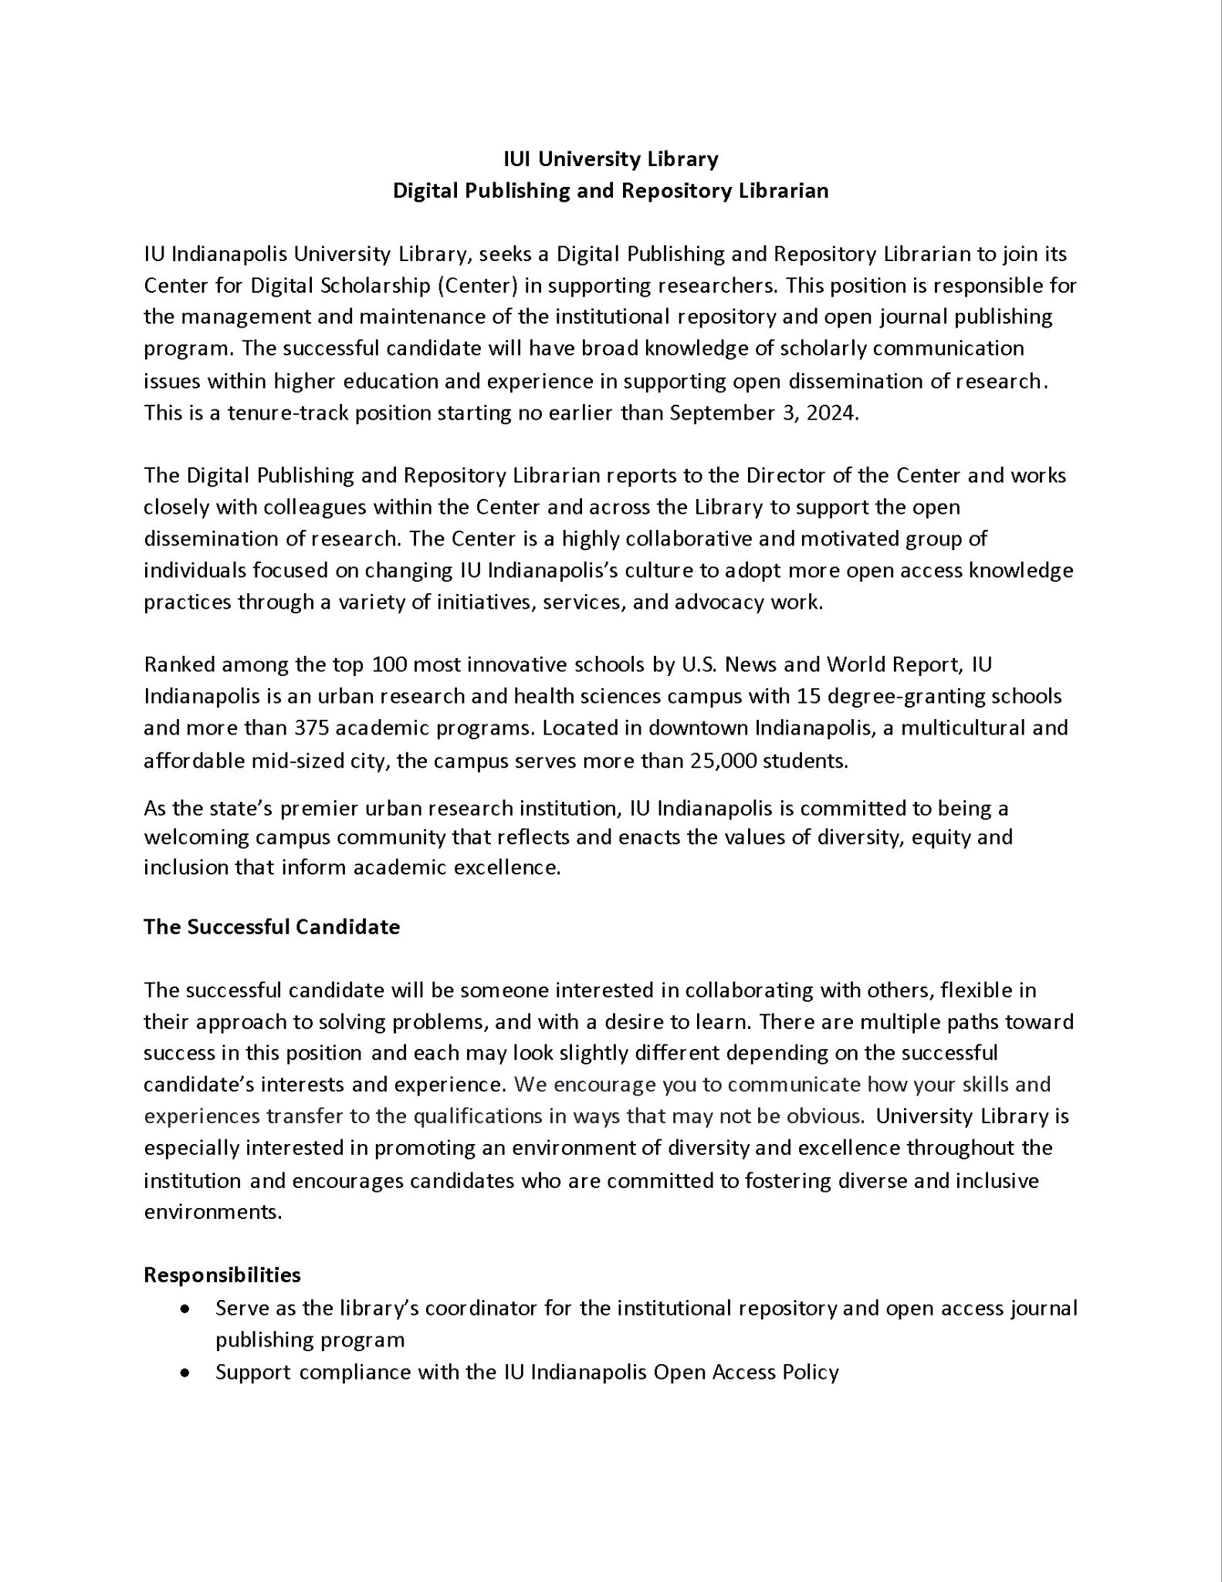
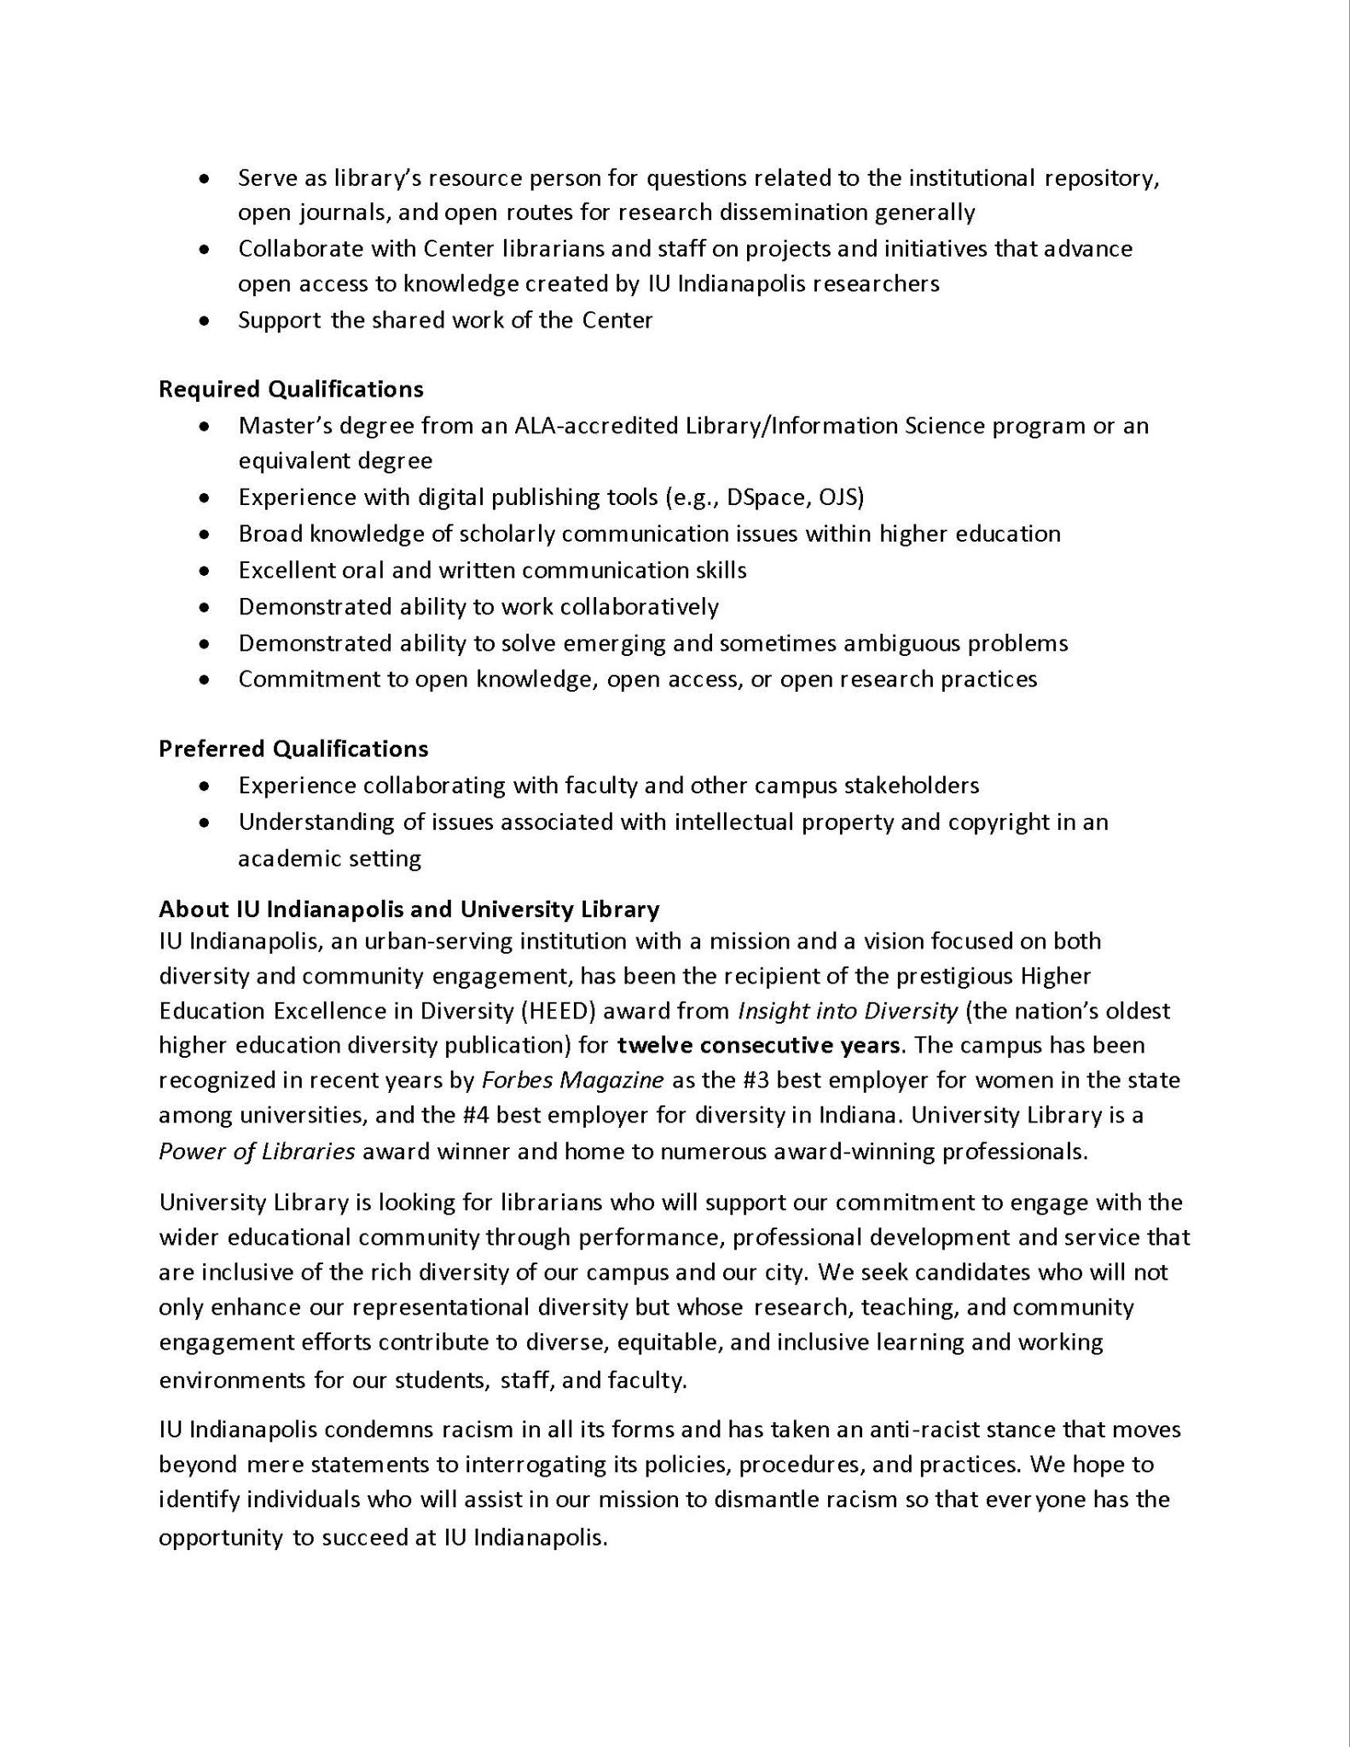
Example Job Posting:
Digital Publishing and Repository Librarian
Notes:
Rachel’s notes: This is the job posting for my current position. You can see how a typical academic library position will be posted here. It starts with a general overview of both the position and the campus before moving on to more specific details. They do explain what will make a successful candidate before listing the responsibilities and qualifications. Remember what we said on the common misconception slide- just because these qualifications are in a list doesn’t mean they’re necessarily ranked by importance.

Slide 6

Example Job Posting
How to Read
Focus on the bullet points
  Responsibilities
  Required Qualifications
  Preferred Qualifications
Remember that you should be excited by the job - read any information about the institution and the environment
Ask yourself how this job will serve your career. Sometimes that answer is just getting a foot in the door of the profession
Notes:
Rachel’s notes: While the background information on the job and the campus is good to know, the responsibilities and qualifications are the most important part of the job posting. They tell you exactly what the hiring committee is looking for and what the job will be like. While you are trying to sell yourself and why you’re the perfect candidate for this position, remember that showing excitement for the campus environment and for the future of the job’s responsibilities will also play into how the committee perceives you. If you have the qualifications but lack excitement or interest in the environment, that’s going to leave a negative impression.

Slide 7
Example Job Posting
Mapping Experiences to Requirements
Requirements:
Experience with digital publishing tools (e.g., DSpace, OJS)
Broad knowledge of scholarly communication issues within higher education
Excellent oral and written communication skills
Demonstrated ability to work collaboratively
Demonstrated ability to solve emerging and sometimes ambiguous problems
Commitment to open knowledge, open access, or open research practices
Experience:
Using ScholarWorks in current position, experience with digital publishing platforms during graduate program
Knowledge of scholarly communication from graduate program (i.e. benefiting from OA as a student)
Shown through letter as well current position communication with large numbers of people
Collaborative work across campus with various departments including faculty and staff
See #4
See #1
Notes:
Rachel’s notes: Here’s how I mapped my own experiences to the required qualifications of my job. I didn’t include having my MLIS in this list because it’s on my CV, but you will want to include it in your introductory statement. Starting with the experience with digital publishing tools, I made sure to speak to my previous use of ScholarWorks, something that was also listed as a responsibility of the position. Being able to link requirements to the responsibilities is also a good thing to do, when you can. While I didn’t have other professional experience with digital publishing tools I would use in my position, I made sure to explain that I had some learning experience through my degree program. Experience in school is important to highlight, too! Moving on to broad knowledge of scholarly communication issues, I also linked this back to my graduate degree program- specifically how I benefited from open access research as a student, again- something this position deals with every day. Every job posting will have the excellent oral and written communication skills as a requirement. This is where making sure your letter is checked for grammatical errors will come into play, as you can take your letter as evidence of your skills. Additionally, you can include examples from your professional life in how you communicate with others. For me, I highlighted how I was the point of contact for a large number of people across various levels of our campus organization. Some of these requirements will overlap with your experiences, as you can see with the final three. The ability to work collaboratively and solve emerging problems can kind of be lumped together. Similarly, showing a commitment to open knowledge can be linked back to the first and second requirements, where I spoke to my experience with digital publishing tools and personal benefits gotten from open access research as a student.

Slide 8
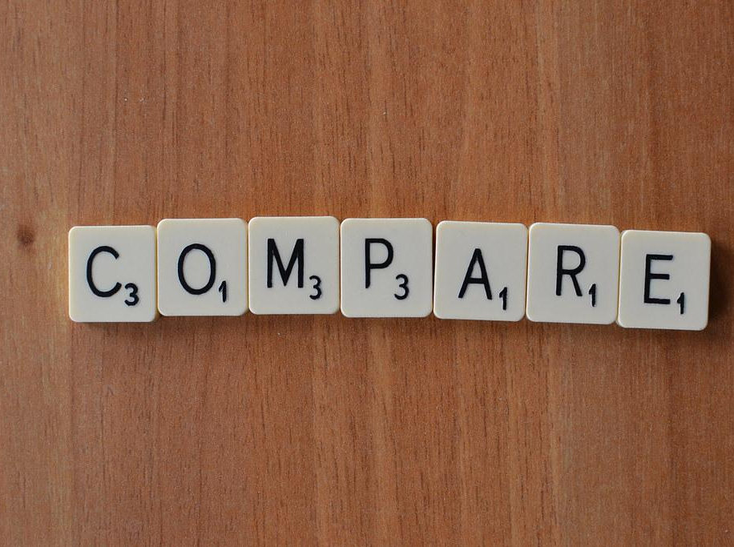
Reviewing Example Cover Letters
Activity Time
Compare Rachel’s original cover letter with the one that led to an interview
Review Gary’s cover letter
Review Corey Barber’s cover letter
Notes:
10-15 minutes in break out groups to review materials, get back together to go through them together and ask for comments(?)

Slide 9
Resume vs CV
What’s the difference?
Resume qualities:
Used for business, non-profit, government, and similar positions
Provides concise, action-oriented statements regarding your professional background focusing on relevant skills and experiences
1-2 pages preferred
Does not include references
CV qualities:
Used for academic and research-based positions
Provides a full, detailed history of your academic background including research, teaching, publications, honors, and service
No maximum length requirement*
Includes references

Slide 10
Resume/CV Do and Don’ts
What’s the difference?
DO:
Keep a consistent style for your publications/posters/etc
Use proper headings
Keep it up to date, even after you land a job
DON’T:
Make it “cute” to be memorable
  Can have the opposite effect and be cheesy
  This includes fonts
Lie or over exaggerate skillset
Include GPA (this is a maybe)
Notes:
Rachel’s notes: as someone who has served on a hiring committee, and I’m sure Gary can relate, I have actually cringed at some resumes and CVs I’ve had to review because of their page design. Simple is effective in this instance. You don’t need borders, color blocks, or multiple columns. Please, for the sake of those reading it, don’t do columns.

Slide 11
Additional Suggestions
Getting good feedback on your cover letter:
Ask a library friend to check your cover letter for a content review (e.g. mapping between experience and requirements)
Ask someone in your life that is good at copy editing to help with typos, grammar, and voice
Reaching out to better understand the job:
There’s nothing wrong with contacting the person that will be your boss to ask about the job. In particular, if it helps you understand how it will fit into your career
  It is not desperate unless you are only talking to plead
This process is also about you deciding if the job is a good fit for you
Notes:
Rachel’s notes: I was lucky enough to be connected with Gary before my job search, and he was gracious enough to agree to help review my cover letter and give me some pointers before I submitted my application for my current position. Especially in the world of increasing use of AI for checking and writing things… please make sure to use an actual human to double check your grammar and voice. If you know someone in the library field, that’s great! But even having friends or family read over it for you is beneficial. Reaching out to someone connected to the job- I had a meeting with my now supervisor, Jere, before submitting my application for my position where he and I chatted about what he was looking for. He was kind enough to also give me pointers on what to include in my cover letter to make sure it got noticed by the committee. Many of the suggestions in this presentation came directly from his advice. It’s important to remember that the people hiring for a position are wanting someone who is engaged and excited about the job- reaching out to better understand it is something that most will appreciate. My meeting with Jere also showed me that we would be able to get along and made me feel better about the potential office environment I would be in, should I get the position. And of course, putting a face to the name is a bonus.

Slide 12
Interview Process
Bonus slide!
Phone Interview
Different places will do different things
Review the job beforehand
If you are nervous about interviewing, write out some answers to the most common questions that you will be asked
Look up structure of the library (department names, reporting lines, etc.)
Find the library’s mission statement and strategic priorities
On Campus Interview
Remember that the search committee is also nervous - they don’t want to waste time and resources on bad candidates and they don’t want to hire the wrong person
Practice your presentation at least once - this is the only contact you will have with most of the organization
  Pull in colors/logos/branding of school
Dress one step up is a good rule of thumb
Use every interaction as a way to sell yourself
Remember - you are also interviewing the place!
Don’t ask about salary - you will be able to negotiate afterwards
  Other benefits are fine
Send a thank you note - email is fine, but physical are also nice (also relieves some stress)
I’ve always thought of it this way: If you get a phone interview that means that the committee thinks you can do the job on paper. On-campus means that they believe you are capable and are looking for fit.

Slide 13
Any Questions?

Slide 14
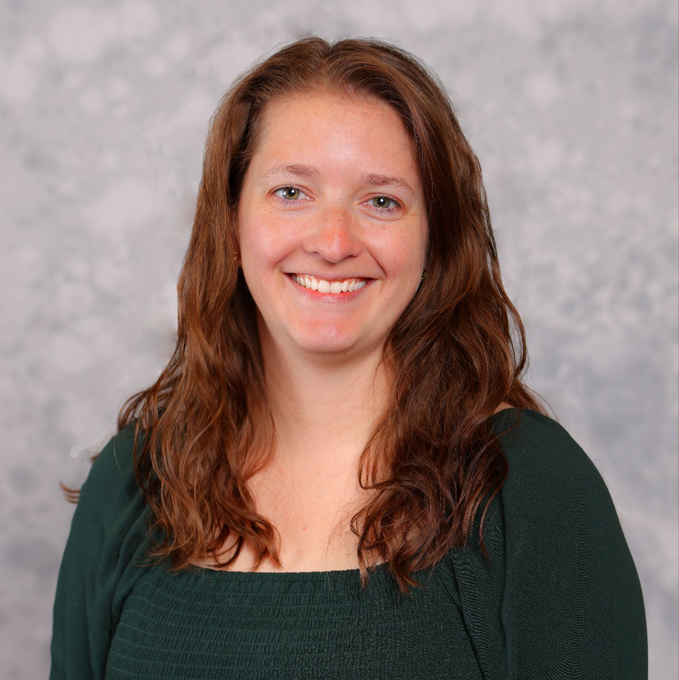
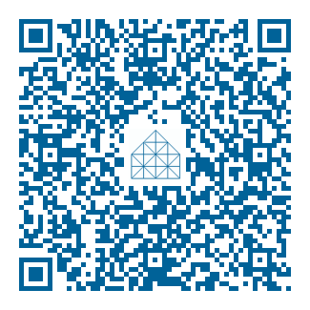
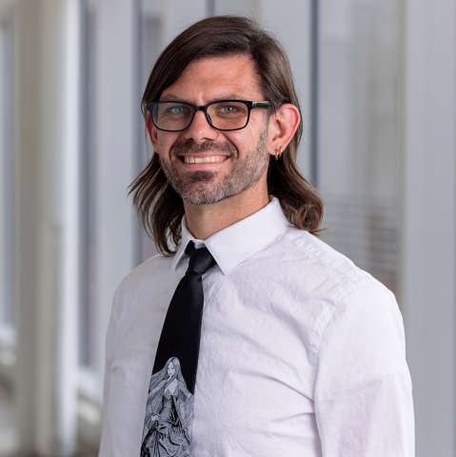
Contact us
Rachel Molina
Digital Publishing and Repository Librarian
ramolin@iu.edu
Gary Maixner
User Experience Librarian and Liaison to Communication Studies
gmaixner@iu.edu
Link to Slides and Materials
https://go.iu.edu/8t0u

