Slide 1

Indiana University School of Medicine The Conscience Project
AMERICAN SOCIETY OF ADOLESCENT PSYCHIATRY
MORAL DEVELOPMENT COMMITTEE
A CONSCIENCE SENSITIVE PSYCHIATRIC APPROACH TO MORAL INJURY
PREMIERE PRESENTATION
BROOKDALE HOSPITAL AND MEDICAL CENTER
BROOKLYN, NEW YORK
PSYCHIATRY GRAND ROUNDS
FEBRUARY 3, 2021
Notes:
Frontispiece
BASILICA SAN GIOVANNI IN FONTE; Naples, Italy; Visit 9-21-19
Western Euope’s oldest baptistry; Mosaic fourth century.
Heart shapes and brain convolutions are frequently embedded in young persons’ depictions of conscience.

Slide 2
The Conscience-IN-Adversity Data Collection
For The further Study of moral injury
Curator: Matthew Galvin^{1*}
Indiana University Conscience Project
Director: Margaret Gaffney^{2**}
contributing expert Consultation and/or commentary: Barbara Stilwell³, Theodore Petti⁴, Leslie Hulvershorn⁵
contributing models for case formulation: Matthew Galvin¹, Margaret Gaffney², Mary Lou Gramelspacher⁶
conscience works webmaster: Jere Odell⁷
¹Clinical Associate Professor, voluntary faculty Indiana University School of Medicine Department of Psychiatry; ²Clinical Associate Professor, Emerita Indiana University School of Medicine Center for Bioethics; ³Clinical Associate Professor, Emerita Indiana University School of Medicine Department of Psychiatry; ⁴Professor, Rutgers Robert Wood Johnson School of Medicine Division of Child Adolescent Psychiatry; ⁵Associate Professor, Indiana University Department of Psychiatry, Division Child Adolescent Psychiatry ⁶ ; ⁷ Scholarly Communication Librarian, Indiana University-Purdue University Indianapolis Library Center for Digital Scholarship
conscience works: https://conscienceworks.iu.edu/
indiana university-purdue university indianapolis (IUPUI) scholarworks: https://scholarworks.iupui.edu/handle/1805/37
*Address Correspondence to the Curator of the Conscience-In-Adversity Data Collection: Matthew R. Galvin, 2113 W 42nd Street Indianapolis In. 46228
Email: mattanamcara@aol.com
**Address Correspondence to the Director of the Indiana University Conscience Project:
Margaret M. Gaffney, 2113 W 42nd Street Indianapolis In. 46228
Email: mgaffney@iu.edu
Notes:
The original presentation was by invitation to present at Psychiatry Grand Rounds Brookdale Hospital and Medical Center, Brooklyn New York on February 3, 2021.
I have no disclosures to make regarding conflicts of interest.
This slide formally introduces The Conscience In Adversity Data Teaching Collection and contains the address for the Conscience Works website.
There you will find, freely available to you, the front matter including the case index for this teaching collection and the user’s agreement form which, upon signing and returning to us, will allow us to send to you the cases you select from the index for further study.
At the Conscience Works website you will also discover other relevant enduring materials, again all freely available, as well as our contact information.
I will show this slide again at the end of the presentation.

Slide 3
OBJECTIVES for use of the teaching collection
Identify the domains of conscience in moral psychological development in conditions of relative advantage
Appreciate age-expected stage-attainments in conscience in conditions of relative advantage
Appreciate the continuum of conscience casualty in moral injury
Be able to incorporate conscience sensitive inquiries in routine psychiatric assessments
Be able to discern, in particular persons, their particular strengths and weaknesses with respect to conscience
Be able to address in case formulations: delays in conscience formation and psychopathological interferences in conscience functioning

Slide 4
OBJECTIVES by the end of this presentation, participants will be familiar with:
the key concepts
Conscience relevance and sensitivity
Conscience development: the process of moralization in psychological realms
Conscience domains
Conscience stage-attainment
Conscience in advantage and adversity
Delay in conscience formation
Psychopathological interference in conscience functioning
Continuum of conscience casualty in the process of de-moralization and moral injury

Slide 5
Conscience
key concept: deferring general definition
Notes:
CONSCIENCE:
Well, well…. Let’s start with this word. Some call it ‘that still small voice inside’…. If you only hear it in your home, that is not conscience. It’s Alexa; if you only hear it in your car, that isn’t conscience either. That’s Siri.
The word itself might be rendered literally as: ‘to come to know together’.
It is fundamental to our work that we do not presuppose or impose any particular definition of the term but simply ask others to provide their personal definitions.
Our task has been to study these personal definitions and, informed by developmental theories and findings, to discern patterns.
Operationally, the definition of conscience is given in narrative or image when a person is asked to describe or draw a personal conscience or the part of (or process in) the person that helps that person figure our right from wrong or good from bad.
Personal definitions we have heard are shaped by many factors, level of maturity being especially important, but also characterological features and environmental circumstances.
Hence, we refer to:
contours-of-conscience,
conscience-in-relative advantage,
conscience-in-adversity,
conscience-in-catastrophe,
conscience-in-recovery,
and conscience-in-objection.

Slide 6
key concept: conscience relevant
CONSCIENCE RELEVANT___:
An explicit assessment or evaluative comment by some one other than the person whose conscience is of interest or items endorsed by some one other than the person whose conscience is of interest: for example, a psychologist whose evaluation includes summary remarks regarding conscience. More broadly, the term denotes any inferences about conscience that are or can be drawn from knowledge of general psychological domains, psychopathological conditions and their neurobiological underpinnings.
Notes:
This key concept becomes important in the context of obtaining secondary historical data from aggregated referral information to complete the history of present illness and past psychiatric history or in integrating new data obtained from psychological or psychoeducational testing into a treatment review or final summary.

Slide 7
key concept: conscience relevant
psychological evaluation (conducted by a PsyD):
“ She has a strong ability to avoid blame and shows remarkably poor insight.”
MMPI-A and thematic apperception test were the tests specified.
Notes:
Conscience in Adversity Data Collection (CIA): Case PRC017 (age deleted for heuristic purposes)

Slide 8
key concept: conscience sensitive
CONSCIENCE SENSITIVE____:
An interrogatory given orally or in writing or an activity proposed in which there is explicit reference made to the person’s own conscience in age appropriate terms.
Examples are: CONSCIENCE SENSITIVE INQUIRY and CONSCIENCE SENSITIVE TASK.
It also denotes an overall approach informed by conscience development that incorporates specifiable conscience sensitive interrogatories or tasks, as in:
CONSCIENCE SENSITIVE PSYCHIATRY CONSCIENCE SENSITIVE GROUP THERAPY CONSCIENCE SENSITIVE MEDICAL EDUCATION CONSCIENCE SENSITIVE MORAL EDUCATION CONSCIENCE SENSITIVE SPECIAL EDUCATION
Notes:
This is my only abjuration to you, implicit in the term ‘conscience sensitivity’, the most key of all the key concepts that I wish to convey today:
Be curious and inquisitive about conscience in others. Not in a judgmental way, not in the way of the confessional, but, without preconception, in the open-ended way of understanding how conscience has been formed and become part of a particular person’s lived experience.

Slide 9
key concepts:
PSYCHOLOGICAL REALMS SUSCEPTIBLE OF MORALIZATION
AGE-EXPECTED STAGE-ATTAINMENT AND DEVELOPMENTAL DELAY
Notes:
Moralization is a more specific term.
Socialization is the more general term with which we are familiar.
The domains of conscience are formed in stages of moralization from:
•the realm of cognition: thoughts, memories, and the imaginary;
•the realm of attachment experiences;
•the emotional realm including modulation, regulation or management of affect;
•the realm of temperamental traits and characterological facets;
•the realm of valuation including value keeping, seeking and making; and
•the realm of volition including, agency, self-efficacy and personal responsibility.

Slide 10
key concepts:
STRESSORS AND OPPRESSORS
Notes:
Stressors trigger individual stress responses that are managed with coping strategies, some less conscious than others, some more adaptive than others, and some more heteronomous than others.
These strategies, such as problem solving, affective regulation and help-seeking, when honed as skills, expand competencies essential to learning and advancing from a secure base.
Traumatic Stress Related Disorders comprise a DSM category but do not fully capture the enduring psychobiological legacy of adverse childhood experiences. Natural disaster, acute or enduring and systemic or structural oppressions according to how persons are sexed, gendered, and/or colored must always be considered among potential stressors.

Slide 11
key concepts:
PSYCHOPATHOLOGICAL INTERFERENCE
Notes:
In this presentation, psychopathological interferences should be understood, in a reductionistic way, to be neuro-psycho-biological roadblocks to effective use of coping skills and to access of life affirming and healing values.
Values are considered to have not only motivational power but their own allure.

Slide 12
key concepts:
DEMORALIZATION
TENDENCIES TO HARM
Notes:
In this presentation, de-moralization is used in a more technical sense than in common parlance.
As will hopefully become clear, it is an undoing of moralization in one or more domains of conscience at any stage of conscience formation.
It is also, paradoxically enough, an invitation to consider possible worlds of re-moralization.

Slide 13

turnaround
no entry
Notes:
Some simple signage.

Slide 14
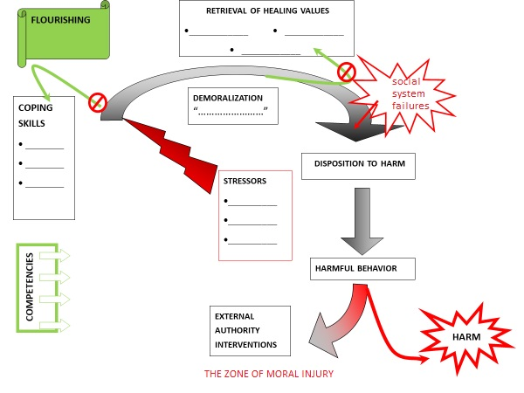
key concepts: ZONE OF MORAL INJURY
ZONE OF MORAL INJURY
Notes:
Stilwell B. and Galvin M. (in press): Moral development and conscience: moral Injury, psychopathological syndromes, psychopathological interference to conscience functioning. How are they related? In A. Goenjian et al Editors: the spitak earthquake and beyond, lessons learned in disaster mental health. Cambridge Press:
[R]ecently, scientific methods have been designed to define and study the suffering of combat veterans from the wars in Vietnam, Iraq, and Afghanistan. Shay (1995) defined moral injury as “transgressive harms and the outcomes from those experiences.” Since transgressive harms do not always result in serious moral injury, Litz proposed the concept, potentially morally injurious events (PMIEs) as ones in which “a person perpetrates, fails to prevent, bears witness to, or learns about acts that transgress deeply held moral beliefs and expectations.” Currier et al (2019) divided the moral injury concept into self-directed or other-directed categories ….”
“... [And] designed an Expressions of Moral Injury Scale - Military Version Quoting him:
(1) Self-directed moral injury occurs when the person feels directly responsible for perpetrating transgressive acts on others. Self-directed moral injury is characterized by painful feelings of pervasive shame and guilt; beliefs/attitudes about being unlovable, unforgivable, or incapable of moral decision-making.
(2) In cases of betrayal or bearing witness to others’ acts of moral wrongdoing for which an individual does not feel personally responsible, other-directed moral injury produces feelings of anger and moral disgust, beliefs/ attitudes related to mistrust of haters, and revenge fantasies for the responsible person(s).”
Shay; Litz et al: Currier et al: moral injury
references: Shay, J. (1995): achilles in vietnam: combat trauma and the undoing of character. New York, NY: Touchstone.
Litz, B. T., Stein, N., Delaney, E., Leibowitz, L., Nash, W. P., Silva, C., & Maguen, S. (2009). Moral injury and moral repair in
war veterans: A preliminary model and intervention strategy. Clinical Psychology Review, 29, 695-706. https://doi.org/10.1016/j.cpr.2009.07.003.
Currier, J.M., McDermott, R. C., Farnsworth, J. K., Borges, L. M. (2019): Temporal Associations Between Moral Injury and Posttraumatic Stress Disorder Symptom Clusters in Military Veterans. Journal of Traumatic Stress 32(6): 382-392.
“Anticipating recent research, Verkamp (1993) studied moral injury in war from medieval to modern times, noting that, in addition to trauma related stress, soldiers might also experience moral pain, deserving of our healing effort.…”
Bernard Verkamp: moral wounding
reference:
Verkamp, B (1993): moral treatment of returning warriors in early medieval and modern Times. Chicago: University Chicago Press.

Slide 15
key concepts: ZONE OF MORAL INJURY
ZONE OF MORAL INJURY
Notes:
ZONE OF MORAL INJURY
The zone in which moral injury is apt to occur begins with demoralization which, because of pathological interferences abetted by social system failures, begins the trajectory towards harmful behavior. Harm has the potential for becoming or compounding stressors and oppressors.
Adapted with permission from a slide in IU Conscience Project (2011) Demoralization and Harm Prevention, power point presentation. Conscience Works https://scholarworks.iupui.edu/handle/1805/16478

Slide 16
HUMAN flourishing
retrieval of healing values
____________ • ____________
• ____________
survival strategy
________
________
________
SOCIAL SYSTEM FAILURE
demoralization “……………………”
coping skills
• ________
• ________
• ________
disposition to harm
stressors
•__________
•__________
•__________
competencies
harmful behavior
secure base
external authority interventions
harm
personalized demoralization and harm prevention plan
Notes:
This is a fuller image of conscience functioning that I would like you to develop in your minds today.
Instead of an image of climbing ladders, scala instrumental to attain the heights of human flourishing—for which, as we will soon see, we have examples from antiquity onwards—
Conjure up from your memories: the children’s game of Chutes and Ladders, depicting road-blocks, set-backs, and effortful turnarounds.
Consider storing this image among the organizational schemes appropriate to healing professions called upon to address moral injury in a conscience sensitive manner.

Slide 17
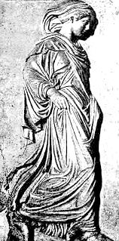

MORAL DOMAINS IN ANTIQUITY
AESARA OF LUCANIA
flourished sometime between
Three hundred and one hundred BCE.
Waithe & Harper,1987
Notes:
IMAGES OF AESARA, public domain.
Reference:
Waithe M and Harper V (1987): Late Pythagoreans: Aesara of Lucania, Phintys of Sparta, and Perictione I. IN a history of women philosophers Vol. I 600BC-500AD, pp.19-39

Slide 18
MORAL DOMAINS IN ANTIQUITY
In the fragment left to us of her Book on Human Nature, Aesara is said to present “… a familiar and intuitive natural law theory.”
Waithe & Harper,1987
WP, 2019
Notes:
references for slide
Waithe M and Harper V (1987): Late Pythagoreans: Aesara of Lucania, Phintys of Sparta, and Perictione I. IN a history of women philosophers Vol. I 600BC-500AD, pp.19-39.
Women in Philosophy (WP) readings, 8-15-19 and 10-10-19
additional note
natural law theories, whether classical or modern, in the sense used by historians of philosophy, are prescriptive and not descriptive as we think of the scientific laws of nature. Rather, natural laws are embedded in our nature. They apply universally. They issue into rules of conduct, commands, permissions or prohibitions, and general statements assigning rights or obligations. Their essential feature is that they do not depend for validity upon the will of any legislator. While their origins in classical forms have often been attributed to divine creation (as opposed to divine legislation) there are modern forms of natural law theory that make no religious assumptions. (Mautner, 1996). As we shall see, Aesara’s remarkable anticipation of moral psychology intersects at many points with current conscience theory, the latter theory, however, maintaining circumspection on the subject of just how one attempts to justify bridging the gap between ascertained facts about specifically moral aspects of human nature and making recommendations for nurturing a set of intrinsic values aligned with just those facts.
reference:
Mautner, T. (Ed.). (1996). A dictionary of philosophy. Oxford: Blackwell Reference. Buckle S (1994) Natural law. In a companion to ethics (Ed. P Singer}, Oxford Blackwell pp.161-174.
additional note
For the aforementioned descriptor of “intuitive” applied to Aesara’s philosophy we might also read “introspective” because Aesara calls for engagement in self-examination and reflection, a discernment process by which one arrives at an orderly and functional arrangement of the soul.

Slide 19
MORAL DOMAINS IN ANTIQUITY
Aesara distinguishes but connects three aspects of moral philosophy:
Waithe & Harper,1987
Notes:
Reference:
Waithe M and Harper V (1987): Late Pythagoreans: Aesara of Lucania, Phintys of Sparta, and Perictione I. IN a history of women philosophers Vol. I 600BC-500AD, pp.19-39

Slide 20
MORAL DOMAINS IN ANTIQUITY
Aesara distinguishes but connects three aspects of moral philosophy:
• Individual or private morality
Waithe & Harper,1987
Notes:
Reference:
Waithe M and Harper V (1987): Late Pythagoreans: Aesara of Lucania, Phintys of Sparta, and Perictione I. IN a history of women philosophers Vol. I 600BC-500AD, pp.19-39

Slide 21
MORAL DOMAINS IN ANTIQUITY
Aesara distinguishes but connects three aspects of moral philosophy:
• Individual or private morality
• The moral basis of the institution of the family
Waithe & Harper,1987
Notes:
Reference:
Waithe M and Harper V (1987): Late Pythagoreans: Aesara of Lucania, Phintys of Sparta, and Perictione I. IN a history of women philosophers Vol. I 600BC-500AD, pp.19-39

Slide 22
MORAL DOMAINS IN ANTIQUITY
Aesara distinguishes but connects three aspects of moral philosophy:
• Individual or private morality
• The moral basis of the institution of the family
• The moral foundations of social institutions.
Waithe & Harper,1987
Waithe & Harper,1987
WP, 2019
Notes:
References:
Waithe M and Harper V (1987): Late Pythagoreans: Aesara of Lucania, Phintys of Sparta, and Perictione I. IN a history of women philosophers Vol. I 600BC-500AD, pp.19-39
Conscience Project special interest group: Women in Philosophy (WP) proceedings , 8-15-19 and 10-10-19.

Slide 23
MORAL DOMAINS IN ANTIQUITY
discernment yields an awareness of the essential aspects of the tripartite soul. In ENGLISH these are:
MIND,
HIGH SPIRIT,
and DESIRE, LOVE AND KINDLINESS.
Waithe & Harper,1987
Notes:
Waithe M and Harper V (1987): Late Pythagoreans: Aesara of Lucania, Phintys of Sparta, and Perictione I. IN a history of women philosophers Vol. I 600BC-500AD, pp.19-39
additional notes
“Nous” is translated “mind” more specifically: judgment and thoughtfulness.
“Thumos” is translated “high spirit” more specifically: strength and ability or perhaps efficacy
“Apsos organa chai”, literally organs of the sense, is used analogically for epithumia which is rendered as: desire, love and kindliness.

Slide 24
MORAL DOMAINS IN ANTIQUITY
no one of the essential aspects of the tripartite soul is privileged absolutely over the others but comes to the fore, contextually, according to the ‘task at hand.
Waithe & Harper,1987
Notes:
Waithe M and Harper V (1987): Late Pythagoreans: Aesara of Lucania, Phintys of Sparta, and Perictione I. IN a history of women philosophers Vol. I 600BC-500AD, pp.19-39

Slide 25
MORAL DOMAINS IN ANTIQUITY
the goddess Hera was assigned to protect adolescents and emerging adults. This would have been familiar to Aesara. one may speculate that Aesara would share with her contemporaries some sense of human development that included some sensitive or even critical periods, but the surviving fragment of her book does not inform us further that she identified particular stages of conscience an individual would traverse.
WP, 2019
Notes:
reference: Conscience Project special interest group: Women in Philosophy proceedings, 8-15-19 and 10-10-19
additional notes:
Another conscience concept, not unlike what the youth in the Stilwell Conscience Study taught us, also calls from across both space and time. It is derived from the classic Chinese philosopher Mencius:
.... [H]eaven’s guidance comes as inborn feelings or inclinations to behavior. These are neither merely inclinations to egoistic preservation nor even a general inclination for altruistic benefit. Heaven’s endowment is a fully instinctive morality in seed form. Each of us is born with genetic inclinations to behavior. As we mature these inclinations grow in strength and sensitivity to the moral setting. Barring deprivation or distortion from external influences, they will eventually yield sage-like Confucian moral character. The heart can be thought of as similar to conscience in Western theories except that the moral discrimination capacity postulated by Mencius grows in accuracy throughout life.
The inclinations to behavior make up the xin (‘heart-mind’)-the ruler of the body.... four seeds or hearts develop into the four primary virtues...the first seed is... sympathy for other humans. That fully developed becomes the virtue of humanity. The second is our penchant to feel shame, which motivates the development of i (‘morality’). The third is our disposition to show respect and deference toward social superiors. This motivates conformity to li [previously defined as ‘a positive cultural way’ or ‘conventions’]. Finally we have a congenital tendency to discern shi-fei [previously discussed in making a shi (‘this : right’) or a fei (‘this : wrong’) assignment]. We distinguish in action and attitude between something approved in the context ...and something not approved. This tendency to have pro-con action guiding attitudes grows into practical wisdom, zhi (‘knowledge’).... Fully ripened, the heart’s organic constitution puts us in harmony with a cosmic moral force-- the flood-like qi (‘breath’). We simultaneously use it and are used by it....
Reference: Hansen, C. (1993): Classical Chinese ethics. In: A COMPANION TO ETHICS (ed. P. Singer). Blackwell Publishers Ltd., Oxford, UK. pp. 74-75.
For an excellent comparison and contrast of Western and early Buddhist moral philosophical traditions see: Kalupahana, D.J. (1995): ETHICS IN EARLY BUDDHISM. University of Hawaii Press, Honolulu.

Slide 26

MORAL STAGES IN ANTIQUITY
DIOTIMA TEACHER OF SOCRATES
flourished AROUND Four hundred FORTY BCE.
Notes:
Image: Jadwiga Łuszczewska, a poet in Warsaw used the pen name Diotima, posing as the ancient seer in a painting by Józef Simmler, 1855.

Slide 27
MORAL STAGES IN ANTIQUITY
DIOTIMA TEACHER OF SOCRATES
flourished AROUND Four hundred FORTY BCE.
Diotima’s ladder
Notes:
Chosen In honor of Valentine’s Day, we turn now to a metaphorical scala, a stage like conceptualization, known as DIOTIMA’S LADDER.
Reference for slides 27-33: adapted from Wikipedia, public domain.
Other References
Plato: Symposium (1961). In the collected dialogues of plato. Ed. E. Hamilton and H. Cairns. Princeton University Press. pp. 526-574
Waithe, ME (1987): Diotima of Mantinea, In a history of women philosophers Vol. I 600BC-500AD Martinus Nijhoff Publishers: Boston pp. 83-116
D’Angour, A (2019): socrates in love, the making of a philosopher. Bloomsbury: London.

Slide 28
MORAL STAGES IN ANTIQUITY
Love for a particular body
Diotima’s ladder
Notes:
First: love for a particular body. Love is a desire for physical features.
Individuals tend to get attracted to what is missing from their own bodies.
Different particular bodies trigger different individuals.

Slide 29
MORAL STAGES IN ANTIQUITY
Love for all bodies
Love for a particular body
Diotima’s ladder
Notes:
Second: love for all bodies. Attained when individuals recognize the physical features that they are attract them.
They understand that many bodies can have beauty. Love is then expressed towards all beautiful bodies in the lover's view, not just a particular body.
They then see beauty in all bodies and learn to love the differences.

Slide 30
MORAL STAGES IN ANTIQUITY
Love for souls
Love for all bodies
Love for a particular body
Diotima’s ladder
Notes:
Third: love for souls. This stage is attained when physical features are put aside and spiritual and moral beauty trigger love.
Taking this rung of the ladder, one will fall in love with beautiful minds.

Slide 31
MORAL STAGES IN ANTIQUITY
Love for laws and institutions
Love for souls
Love for all bodies
Love for a particular body
Diotima’s ladder
Notes:
.
Fourth: love for laws and institutions. Love for the practices, customs or foundations derived from people with beautiful souls.

Slide 32
MORAL STAGES IN ANTIQUITY
Love for knowledge
Love for laws and institutions
Love for souls
Love for all bodies
Love for a particular body
Diotima’s ladder
Notes:
Fifth: love for knowledge. When individuals turn their attention to all kinds of knowledge.
They love [it] that there is knowledge to acquire everywhere.

Slide 33
MORAL STAGES IN ANTIQUITY
Love for love itself
Love for knowledge
Love for laws and institutions
Love for souls
Love for all bodies
Love for a particular body
Diotima’s ladder
Notes:
Sixth: love for love itself. When individuals see the beauty in its Form and love the beauty of Love as it is.
Every particular beautiful thing is beautiful because of its connection to this Form.
Many Plato scholars argue this Form is identical to the Form of the Good.
The lover who has ascended the ladder apprehends the Form of Beauty/Good in a kind of vision-- not through words or in the way that other sorts of more ordinary knowledge becomes known.

Slide 34
modern moral developmental theories
psychodynamic
social interaction theory
social communication theory
social learning theory
social cognitive theory
Notes:
ADDITIONAL NOTES
Turiel, Nucci and Smetana’s social interaction theory proposes that the development of the idea of moral obligation is related to social experiences with a restricted class of events that have objective or intrinsic implications for justice, rights, harm and the welfare of others. Moral obligation and the idea of conventional obligation are both present universally and differentiated from each other in early childhood.
REFERENCE:
Turiel E (2008): The development of children’s orientations toward moral, social, and personal orders: more than a sequence in development. human development. 51: 21-39.

Slide 35
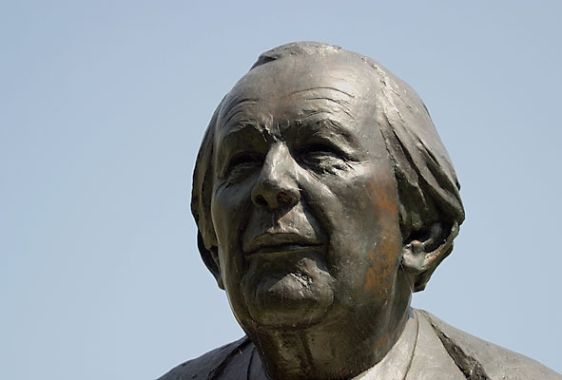
jean piaget
cognitive developmental moral theories
1896 – 1980
“ Intelligence is what you use when you don't know what to do.”
Notes:
Reference: Image of Jean Piaget in the public domain
Piaget is known for his cognitive developmental psychology in which he saw intelligence as a biological adaptation with a logical substructure that unfolds in a series of epigenetic stages.
By ‘epigenesis’ Piaget meant that growth and development are not preformed but rather, are sequentially created. At each stage in development the preceding structure writes the program for the next succeeding structure.
However there is also an emergent character to the next stage.
additional notes
Piaget was very attracted to philosophy, in particular to Bergson and to Aristotle, but the similarity of his structuralism to that of Kant is especially noteworthy (Elkind,1980).
Piaget identified the processes of assimilation and accommodation as the means by which the child advances through cognitive stages from sensorimotor to formal operations (Piaget,1976)
His ideas are really not so strange to us who have been reared with physical theories that tell us that matter tells space how to be shaped and space tells matter how to move, or that observation itself alters the probabilistic character of observable phenomena. However the concept of developmental emergence of organic wholes greater than the sum of their parts transforming without loss of identity and having the capacity for self regulation (homeostasis) still vie with mechanistic and reductionistic explanations (Overton & Horowitz, 1991).
References
Elkind, D. (1980) Developmental Structuralism of Jean Piaget. In: THE COMPREHENSIVE TEXTBOOK OF PSYCHIATRY III (H. Kaplan, A. Freedman & B. Sadock, eds). Williams and Wilkins, Baltimore, p. 374.
Piaget, J. (1976): Piaget’s Theory. In: THE PROCESS OF CHILD DEVELOPMENT (P. Neubauer, ed.) Jason Aronson, New York, pp 164-212 and Elkind, op cit.
For an overview of these issues see: Overton, W. & Horowitz, H. (1991): Developmental psychopathology: integrations and differentiations. In: ROCHESTER SYMPOSIUM ON DEVELOPMENTAL PSYCHOPATHOLOGY-MODELS OF INTEGRATION (ed. D. Cicchetti & S. Toth), University of Rochester Press. pp. 1-42.

Slide 36
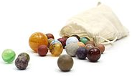
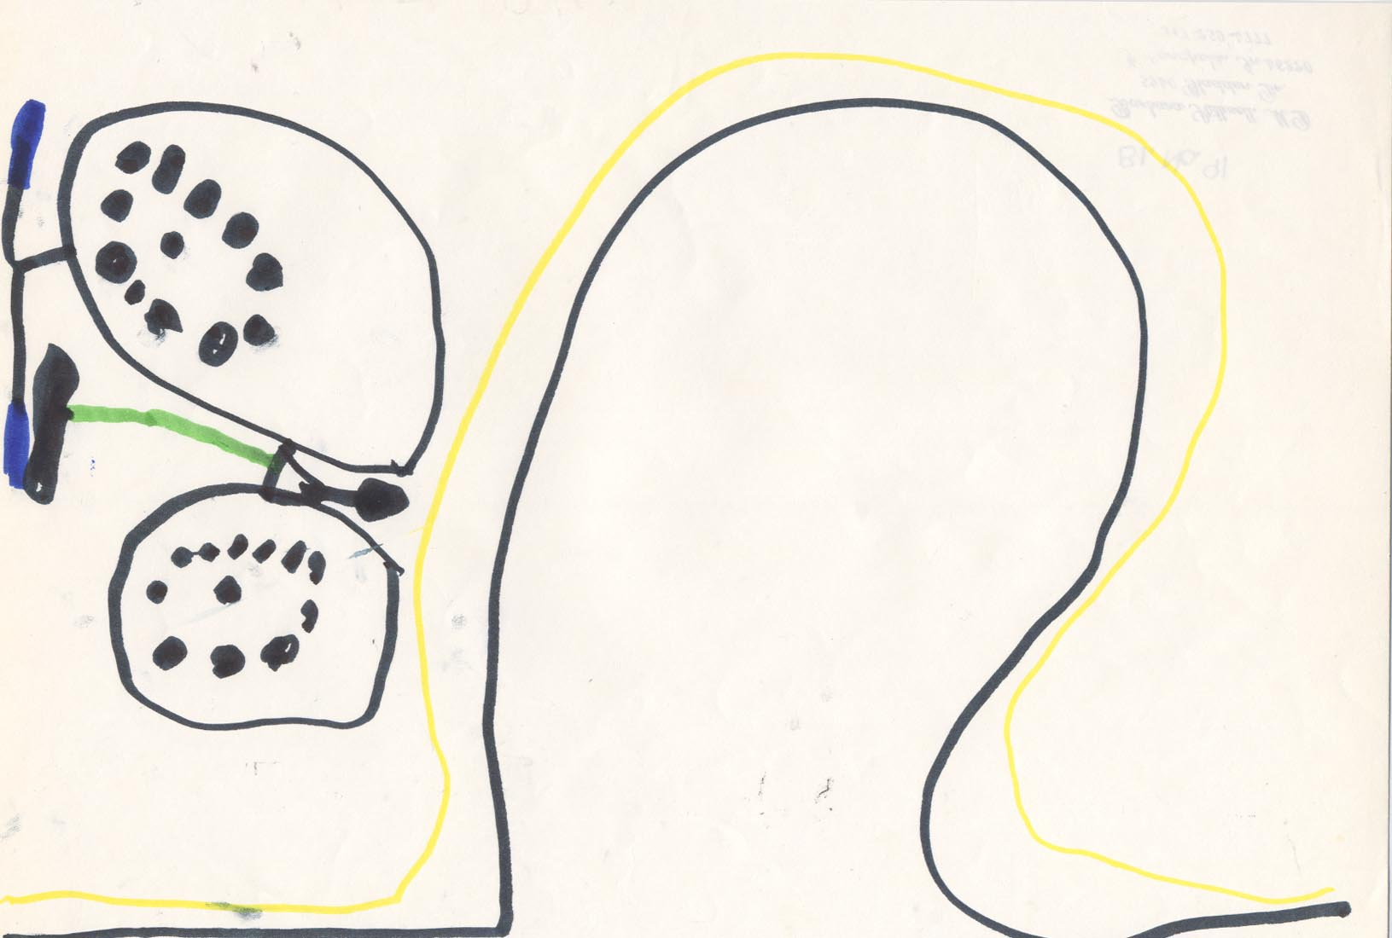
moral cognition
cognitive developmental moral theories
Age 6 and Under
Notes:
Naturalistically, enough,
Piaget went off to the mountains to see how Swiss children in Neuchatel played marbles together.
We don’t really know if he used a bicycle to get there or not.
Reference: The bicycle image is from the Archives of the Indiana University Conscience Project.

Slide 37
moral cognition
cognitive developmental moral theories
practice of rules
first stage
individualistic motor use
Lapsley, 1996
Notes:
first stage: [handling marbles] in accordance with motor habits
Reference for Slides 32- 36:
Lapsley D (1996): moral psychology. Boulder Co: Westview Press. pp. 16-40.
37

Slide 38
moral cognition
cognitive developmental moral theories
practice of rules
first stage
second stage
individualistic motor use
egocentric (2 -5 years old)
Lapsley, 1996
Notes:
second stage: egocentric
The child is exposed to codified rules.
The child attempts to follow the rules.
The child is convinced she is following the rules with fidelity.
The child is actually practicing the rules in highly individualistic ways.
38

Slide 39
moral cognition
cognitive developmental moral theories
practice of rules
first stage
second stage
third stage
individualistic motor use
egocentric (2 -5 years old)
incipient cooperation (7-10 years old)
Lapsley, 1996
Notes:
Third stage; incipient cooperation
Children genuinely try to win.
There must be some concern for seeking agreement about rules.
Cooperative agreements are unstable, rarely lasting longer than the duration of a single game.
39

Slide 40
moral cognition
cognitive developmental moral theories
practice of rules
first stage
second stage
third stage
fourth stage
individualistic motor use
egocentric (2 -5 years old)
incipient cooperation (7-10 years old)
codification of rules (11-12 years old)
Lapsley, 1996
Notes:
fourth stage: codification of rules
Every detail is fixed.
Rules are widely known and shared
40

Slide 41
moral cognition
cognitive developmental moral theories
consciousness of rules
first stage
second stage
third stage
a notion that rules must apply
rules are sacred and immutable
rules are collaborative and subject to mutual consent
Lapsley, 1996
Notes:
Consciousness of rules in social games:
motor rule traced to habitual action schemes
coercive rule traced to unilateral respect
rational rule traced to mutual respect
Additional Comment:
There are similarities in playing games like marbles and learning moral rules but there are also differences, important ones, which cannot be captured by game-theoretic suggestions that morality is reducible to rational self-interest (egoism).
41

Slide 42
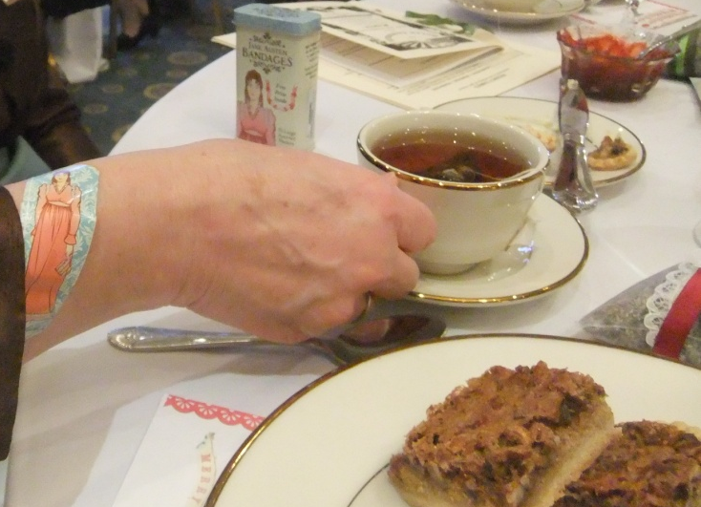
moral cognition
cognitive developmental moral theories
moral judgment tasks
Piaget, 1965,1976
Notes:
Piaget (1965, 1976) began posing some dilemmas with moral characteristics to children of different ages to see how they reasoned morally, for example, about intentionality. He proposed two stages of moral development,
the heteronomous and the autonomous.
In the heteronomous stage, rules are explained as having authorship in some ultimate authority; in the autonomous stage, rules are explained as having been derived from mutual agreement and are amenable to change.
Some of Piaget’s dilemmas about different circumstances in which teacups might get smashed aimed at discernment of how much of another’s intentionality did children take into consideration in making moral judgements.
Billy, might in one scenario be bent on reaching the jar on a high shelf in order to purloin a forbidden cookie and send one teacup toppling. Bobbie, might in another scenario, open the porch door he usually uses but this time unaware that a tray of a dozen cups has been temporarily placed there whilst a table for a dinner party is being laid. The damages are different but so are the intentions.
References
Piaget J (1965): the moral judgement of the child. New York: Free Press.
Piaget J (1976): Piaget’s Theory. In: P Neubauer (ed) the process of child development. Jason Aronson, New York. pp 164-212.
42

Slide 43
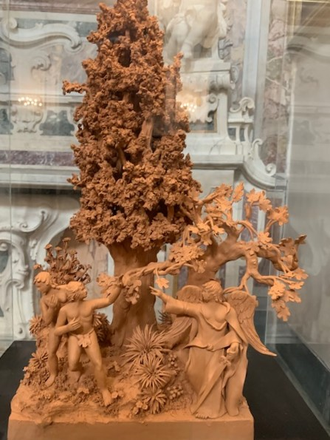
moral judgment tasks
morality of constraint
moral realism
  duty is heteronomous
  obedience to an adult is good
  what is obeyed is the letter not the spirit of the law
  acts are judged according to objective consequences not intentions
belief in immanent justice
Lapsley, 1996
Notes:
Components of the morality of constraint: moral realism and belief in immanent justice
Reference to Piaget in slide:
Lapsley D (1996): moral psychology. Boulder Co: Westview Press. pp. 16-25.
immanent justice:
Casting out from Eden depicted in a Neapolitan terra cotta sculpture
additional comment
conscience sensitive character analyses
See: Conscience Project Meeting 5-21-16, p. 5: “Segue to: Steinbeck’s conceptualization of conscience in east of eden” presented by Joe DiMicco.
43

Slide 44

moral judgment tasks
morality of cooperation
equality
mutual respect
peer solidarity
Lapsley, 1996
Piazza garibaldi
NEAPOLITAN YOUTH ASSEMBLING FOR CLIMATE CHANGE PROTEST
Notes:
morality of cooperation
Reference to Piaget in slide:
Lapsley D (1996): moral psychology. Boulder Co: Westview Press. pp. 16-25.
PIAZZA GARIBALDI MIRROR IMAGE; Visit 9-27-19 (pre-pandemic)
Relevance to Conscience Project topics: Conscience in catastrophe and climate change.
44

Slide 45
THE HEINZ DILEMMA
cognitive developmental moral theories
lawrence kohlberg (1927 - 1987)
Notes:
From marbles and teacups to precious medications (or tests, or vaccines or scarce PPE equipment?): moral dilemmas.
Kohlberg extended Piaget’s use of moral dilemmas, the most famous of which is the heinz dilemma.

Slide 46
THE HEINZ DILEMMA
cognitive developmental moral theories
HEINZ’S WIFE IS DYING OF CANCER AND NEEDS A DRUG THAT AN ENTERPRISING DRUGGIST HAS INVENTED.
kohlberg, 1981
Notes:
Reference:
Kohlberg L. (1981): the philosophy of moral development. San Francisco: Harper & Row.

Slide 47
THE HEINZ DILEMMA
cognitive developmental moral theories
HEINZ’S WIFE IS DYING OF CANCER AND NEEDS A DRUG THAT AN ENTERPRISING DRUGGIST HAS INVENTED.
THE DRUGGIST DEMANDS SUCH A HIGH PRICE THAT HEINZ CANNOT RAISE THE MONEY.
kohlberg, 1981

Slide 48
THE HEINZ DILEMMA
cognitive developmental moral theories
HEINZ’S WIFE IS DYING OF CANCER AND NEEDS A DRUG THAT AN ENTERPRISING DRUGGIST HAS INVENTED.
THE DRUGGIST DEMANDS SUCH A HIGH PRICE THAT HEINZ CANNOT RAISE THE MONEY.
HEINZ’S DILEMMA, THEN, IS WHETHER OR NOT TO STEAL THE DRUG TO SAVE HIS DYING WIFE.
kohlberg, 1981

Slide 49
cognitive developmental moral theories
[Stage 6] [universal ethical principles]
Stage 5 (young adulthood) principled conscience
[prior rights & social contract]
Stage 4 (high school) responsibility to the system
[social system & /conscience]
Stage 3 (early to mid teens) interpersonal conformity
[mutual interpersonal relationships & conformity]
Stage 2 (early elementary) “what's in it for me?"
[individual/instrumental]
Stage 1 (kg) obedience [punishment and obedience]
Stage 0 (preschool) egocentric
Notes:
Reference:
Kohlberg L (1981): the philosophy of moral development. San Francisco: Harper & Row.
ADDITIONAL NOTES
post- and neo-kohlbergian developments in moral psychology.
Carol Gilligan
psychological theory and women’s development 1982
Reference:
gilligan, carol (1982). in a different voice. harvard university press.
james rest: four component theory: moral sensitivity, moral judgment, moral motivation, moral character
Reference:
rest, James (1979). development in judging moral issues. minneapolis, mn: university of minnesota press.
Profile
James Rest refined Kohlberg’s model, adding components. He died in 1999 at 58 years old of a neurodegenerative disease.
Along with colleagues Narvaez, Bebeau, and Thoma, Rest was responsible for the defining issues test (DIT).
The DIT uses a Likert-type scale to give quantitative ratings and rankings to issues surrounding different moral dilemmas, or stories.
One of the DIT’s original purposes was to assess the transition of moral development from adolescence to adulthood. In 1999 the test was revised in the DIT-2 for brevity, clarity and more powerful validity criteria.
The Center for the Study of Ethical Development University of Alabama: http://www.ethicaldevelopment.ua.edu/
darcia narváez: triune ethic theory: security ethic imagination ethic engagement ethic
triune ethics theory (Narvaez, 2008) describes the effects of early experience on neurobiology and moral functioning. When children do not get what they need, they develop a more self-protective orientation (Security Ethic) because their prosocial emotion circuitry was inadequately developed and because extensive distress wires the brain for stress reactivity (incongruent with compassion) so they rely on suboptimal emotional circuitry or even more primitive brain systems for social interaction. They have a minimized or absent Engagement Ethic (relational attunement) and subverted Imagination Ethic (reflective abstraction). As a result of our declining emotional and moral intelligence from the increasingly poor childrearing, standards for what is “normal” keep dropping (e.g., self-regulation, concern for others). Thus, modern societies increase immoral exemplarity and make moral exemplarity more impossible to cultivate or find. An overlapping Venn diagrammatic area between the imagination ethic and engagement ethic is the theater for mindful morality, which includes communal imagination and harmony morality.
References:
narvaez, D. (2008). triune ethics: the neurobiological roots of our multiple moralities. New Ideas in Psychology, 26, 95-119.
Narvaez. D. (2014). neurobiology and the development of human morality. W.W. Norton, New York.
Profile
Dr. Narvaez’ research explores questions of moral cognition and moral development over the lifespan in multiple contexts (e.g., family, school). She examines how early life experience influences moral functioning and moral character in children and adults. She integrates neurobiological, clinical, developmental and education sciences in her theories and research about moral development. Questions that interest her include: How do moral development and moral identity influence understanding of information and life events? What is a moral personality? What is mature moral functioning and how do we cultivate it? How can educators and parents foster moral character? She has developed several integrative theories: Adaptive Ethical Expertise, Integrative Ethical Education, Triune Ethics Theory.
http://psychology.nd.edu/people/faculty/narvaez-darcia/

Slide 50
prosocial development
investigator:
  nancy eisenberg
  harriet rheingold
  daniel bar-tal
  robert selman
  diana baumrind
area of concentration:
  levels of prosocial reasoning
  helping behaviors
  altruism may show stage-like development
  perspective –taking
  parenting styles
Notes:
additional notes
Levels of prosocial reasoning (Eisenberg, 1986):
1. Hedonistic, self focused orientation (preschoolers and younger elementary school children)
2. Needs oriented orientation (many preschoolers and grade school children)
3. Approval and interpersonal orientation and/or stereotypic orientation (some elementary and high school students)
4a. Self-reflective empathic orientation (some older elementary and many high school youth)
4b. Transitional level (a minority of high school youth and late adolescents)
5. Strongly internalized stage (minority of high school youth)
Reference:
For further discussion and references see: Lapsley, 1996, pp. 148-195.

Slide 51
grazyna kochanska
empirical Investigations in early conscience development
moral emotions
moral conduct
mutually responsive orientation
Kochanska et al. , 1991,1993,1996,1997,2005
Notes:
With respect to temperament and conscience, a basic knowledge of Grazyna Kochanska and her colleagues’ work is essential. In early work, Kochanska identifies two developmental processes important in conscience formation: the development of the tendency to experience affective discomfort, guilt and anxiety associated with wrong-doing and the development of behavioral control, the ability to inhibit a prohibited action.
In articulations of a theory of conscience developed by Kochanska and her colleagues based upon their longitudinal studies covering the first six years in the lifespan, the two major components of conscience are termed moral emotions and moral conduct compatible with rules and standards. An early discernible development is the child’s eager, willing stance towards parental socialization (also termed committed compliance). Development is seen as influenced
by biologically based temperament (in particular, fearfulness and effortful control) and features of socialization, including style of discipline and quality of the parent-child relationship (specifically, early security).
mutually responsive orientation (mro)
A term introduced by Kochanska (1997), which she clearly relates to attachment scholarship, is a positive, close, mutually binding, cooperative relationship that emerges in some parent–child dyads, and promotes many positive
socialization outcomes, including children’s conscience.
References:
Some of Kochanska and her colleagues' studies we have found important to the psychobiology of conscience are:
Kochanska G (1991): Socialization and temperament in the development of guilt and conscience. Child Development. 62, 1379‑1392.
Kochanska G (1993): Toward a synthesis of parental socialization and child temperament in early development of conscience, Child Development, 64, 325‑347.
Kochanska G, Padavich D, Koenig A (1996): Children's narratives about hypothetical moral dilemmas and objective measures of their conscience: mutual relations and socialization antecedents. Child Development, 67, 1420‑1436.
Kochanska G, Forman D, Askan N and Dunbar S (2005): Pathways to conscience; early mother-child mutually responsive orientation and children’s moral emotion, conduct and cognition. Journal of Child Psychology and Psychiatry 46
(1): pp 19-34.
Kochanska G, Askan N (2006): Children’s conscience and self-regulation. J Pers, 74, 1587-617.

Slide 52
neuroimaging: early study on evaluative judgment
old people are useless
every human being has the right to live
we break the law when necessary
stones are made of water
telephones never ring
every text has words
Moll et al (2001)
Notes:
In a study by Moll et al (2001) ten adults (six men and four women) engaged in silently judging propositions (given via auditory presentation) as right or wrong. Half the sentences were said to have explicit moral content while the other half were said to be true or false matters of fact.
Reference:
Moll J, Eslinger P, de Oliveira-Souza R (2001): Frontopolar and anterior temporal cortex activation in a moral judgment task, preliminary functional MRI results in normal subjects. Arquivos de Neuro-Psiquiatria, 59 (3B), accessed http://www.scielo.br on 5/24/2008.

Slide 53
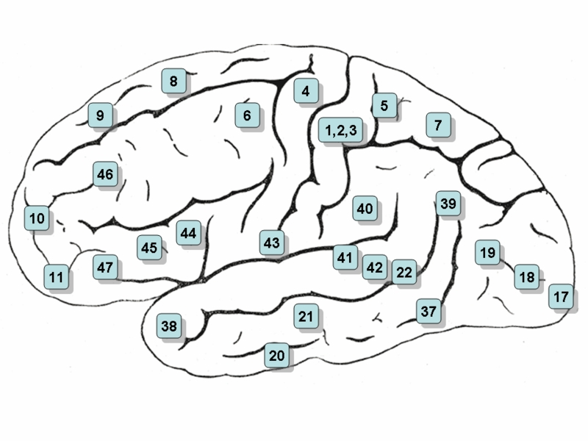
brain regions of interest in moral judgment tasks
left cerebral hemisphere region of interest
corresponding region right hemisphere
bilateral activity
Lateral surface of the (left) cerebral hemisphere
Notes:
In the decades following Moll’s neuroimaging study there have been a slew of others seeking signals from brain regions of interest while the subject is tasked with a moral dilemma, such as the Prisoner’s dilemma or the Trolley dilemma.
ADDITIONAL NOTES
Interpreting the study by Moll et al (2001), this is a surface mapping of brain regions of interest, according to brodmann areas (BA), in which BOLD functional magnetic imaging (fMRI) demonstrated activity during moral judgment tasks. The mapping indicates any areas in any of the subjects that demonstrated specific activity while judging moral as opposed to factual content. Adjusting for the effects of emotional valence, activations in frontopolar and medial frontal regions remained unchanged but were reduced in anterior temporal regions and the pallidum was no longer activated. The investigators concluded:
“So far, complex social actions requiring moral evaluations, empathy, theory of mind, and stable social bonds were conceived to rely on two main streams of processing: one more cognitively oriented and dependent on the dorsolateral prefrontal system and the other more emotion-oriented and mediated by anterior temporal, limbic and orbito-ventromedial frontal systems. We believe that the FPC which has been largely overlooked in current models of the brain mechanisms of social control, provides further regulation of social conduct… our results favor the view that the prefrontal cortex needs further functional fractionation, with polar, orbital, and dorsolateral sectors mediating distinct but complementary roles in the regulation of social cognition and behavior.”
Reference
Ibid.
For additional review of functional neuroimaging relevant to conscience 2001-2009: Galvin M, Stilwell B, Gaffney M, Hulvershorn L (2009): The psychobiology of conscience: signatures in brain regions of interest. Conscience Works: Theory, Research and Clinical Applications
https://scholarworks.iupui.edu/handle/1805/16300

Slide 54
dual process theories
System I (intuitive) automatic, effortless, associative, rapid, opaque process, and skilled
System II (reflective) controlled, effortful, deductive, slow, self-aware, rule-following
Kahneman & Sunstein , 2006
Notes:
Comments
Moral Judgment may appear to be a concept closely related to – and in common parlance used in a manner difficult to distinguish from—moral reasoning.
Still, even within the realm of common parlance, the former might be contradistinguished from the latter in that moral judgment conveys a component of valuation that at least some instrumental forms of reasoning need not possess, such as consequential, means-end and alternative forms of thinking, even when applied to moral matters.
More recently, the theory of dual processing systems is invoked as an explanation.
Kahneman D & Sunstein C (2006): Cognitive psychology of moral intuitions. In J-P Changeux, A Damasio, W Singer and Y Christen (eds.) Neurobiology of Human Values. Germany: Springer Verlag, pp. 92-95.
Additional Notes
To appreciate how nuanced the terms moral reasoning and moral judgment can be outside common parlance, consider Antonio Damasio’s remarks (2005)∗ on how we produce moral judgments:
Two main traditions are usually identified. One claims that, when we are faced with a situation, we use reasoning to detect a violation or an observance of the established norm, we use further reasoning to weigh and classify the violation or observance, and still more reasoning to pronounce a judgment and a sentence. This is the tradition identified with Kant, whose roots go back to Plato and whose modern exponent is the philosopher John Rawls. The psychologists Piaget and Kohlberg are also identified with this tradition.
The other tradition, which is identified with David Hume and Adam Smith, claims that we react to the social situation emotionally and automatically. We instantly produce moral sentiments and intuitions that guide us towards our response to the situation. In this tradition, much of the ‘moral reasoning’ occurs after the moral intuitions have given us a first response. This late, after–the–intuition reasoning often takes the form of rationalization, the post-hoc construction of a case for a certain intuition rather than the deduction that led into it. Using Haidt’s account (2002), we can say that moral intuitions are the judges but those judges are not against having attorneys construct a justification for their pronouncements. moral reasonings, on the other hand, handle the whole judicial process. The kinder and gentler tradition of moral practice provided by moral intuition has some roots in Aristotle and, in a roundabout way, in Spinoza. Darwin and Freud were early adopters and Jonathan Haidt has argued this view persuasively.
References:
[Haidt J (2002): Moral emotions. In: Davidson RJ, Scherer K, Goldsmith HH (eds) handbook of affective sciences. Oxford University Press. pp 852-870 ]
Damasio A (2005): The neurobiological grounding of human values. In JP Changeux et al (eds) neurobiology of human values. Springer Verlag. pp 47-55.

Slide 55
indiana university conscience project
a brief history
conscience in advantage
research
1980
1982
1985
1985
1987

Slide 56
conscience in advantage
indiana university conscience project
a brief history
subjects: 125* children and adolescents
  ages 5-17
  early and middle 1980’s
  cross-sectional study
  screened for psychopathology
measure: stilwell conscience interview (SCI)
outcomes
  developmental stages scored and analyzed
  domains characterized
    five in all, one with three sub-domains
  evolution of conscience theory
    including concept of bedrock (intrinsic) values
See Domains, slides 54-58, for references
Notes:
* Number of subjects in the earliest report o this age range, the number of subjects was expanded to 132 in subsequent reports.

Slide 57
indiana university conscience project
a brief history
conscience theory
domains
intrinsic values
stages
interdependent developmental domains
invariant hierarchical stages*
intrinsic values
Notes:
* When rearing occurs in conditions of relative advantage.

Slide 58
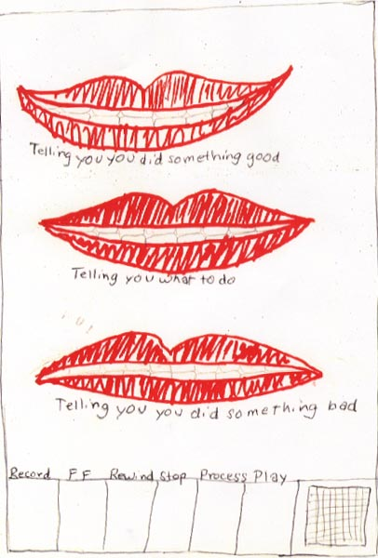
domain: conscience conceptualization
[moral imagination]
conceptualization of conscience
Measure is made of the degree of inclusiveness and abstractness a person utilizes when providing a personal definition of conscience.
Stilwell, et al, 1991
intrinsic value : meaning
Notes:
conceptualization of conscience (Stilwell, et al., 1991)
For the next domains,
I am going to ask you to read the slides while I add comments on the core concepts.
Reference:
Stilwell, B., Galvin, M. & Kopta, S. M. (1991): Conceptualization of conscience in normal children and adolescents ages 5 to 17. journal american academy child and adolescent psychiatry, 30: 16‑21.

Slide 59
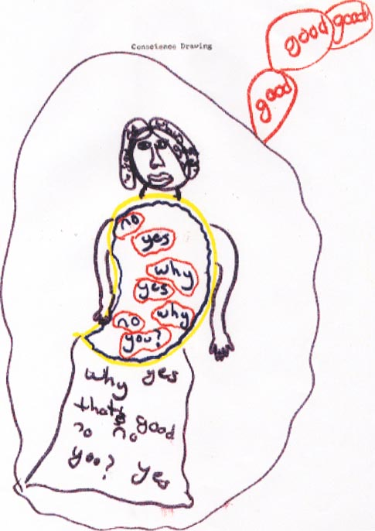
domain: moralized attachment
moralized attachment
Measure is made of developmental transitions in persons’ responses to parental prohibitions and demands based upon how they link feelings of security, empathy and ought-ness to child‑parent and other child‑authority figure relationships.
Stilwell, et al, 1997
intrinsic value : connectedness
Notes:
moralization of attachment (Stilwell, et al, 1997)
In this domain, measure is taken of developmental transitions in young persons’ responses to parental prohibitions and demands based upon how they link feelings of security, empathy and ought-ness to child‑parent and other child‑authority figure relationships.
core concept: the attachment‑empathy‑ought-ness link
In early childhood, a person develops a sense of ought-ness out of their needs for physical and psychological security. As children learn emotional cues as well as identifying those emotions in themselves, they gradually learn that compliance/noncompliance with parental prohibitions and demands is followed by parent pleasure/displeasure. Mutual pleasure is the desirable state because it satisfies the bedrock value of connectedness. The link is formed.
Reference
Stilwell, B., Galvin, M., Kopta, M., Padgett, R., and Holt, J. (1997): Moralization of Attachment: a fourth domain of conscience functioning. journal american academy child and adolescent psychiatry, 36(8): 1140-1147.

Slide 60
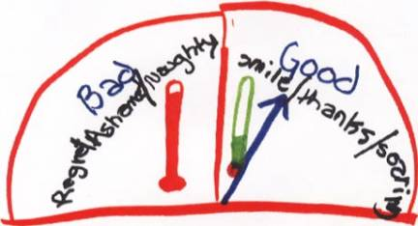
domain: moral emotional responsiveness
moral‑emotional responsiveness
Measure is made of developmental transitions in the way a person uses:
1) anxiety and mood to regulate moral behavior and
2) processes of reparation and healing after wrongdoing to regain the physiological state normally experienced when feeling like a good person.
Stilwell et al, 1994
intrinsic value : balance
Notes:
moral‑emotional responsiveness (Stilwell et al., 1994)
In this domain, measure is made of developmental transitions in the way a child uses:
1) anxiety and mood to regulate moral behavior and
2) processes of reparation and healing after wrongdoing to regain the physiological state normally experienced when feeling like a good person.
core concept: Moral emotional responsiveness is the barometer of the conscience. The barometer is established when the early ought-ness experiences are linked to regulation of emotions and their physiological manifestations. Awareness of an am good‑do good‑feel good state becomes the set point of moral emotional harmony on the barometer.
Reference:
Stilwell, B., Galvin, M., Kopta, S.M. & Norton, J.A. (1994): Moral‑ emotional responsiveness: two domains of conscience functioning. journal american academy child and adolescent psychiatry, 33, 1: 130‑139.

Slide 61
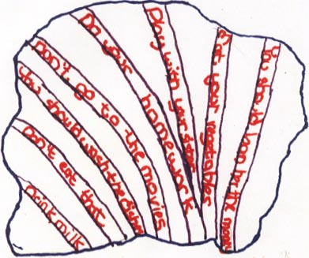
domain: moral valuation
moral valuation
Measure is made of developmental changes in the way a person justifies compliance or non‑compliance with rules of conscience based on both reasoning and psychological defenses. This domain has three sub-domains based on how the child categorizes rules of conscience as:
Authority‑derived
Self‑derived
Peer‑derived.
Stilwell, et al, 1996
intrinsic value : worth
Notes:
moral valuation (Stilwell, et al., 1996)
In this domain, measure is made of developmental changes in the way a person justifies compliance or non‑compliance with rules of conscience based on both reasoning and psychological defenses. This domain has three sub-domains based on how the person categorizes rules of conscience as: authority‑derived, self‑derived and peer‑derived.
core concept: Basic psychological needs constitute bedrock values. The child learns that she ought to behave in certain ways for these bedrock values to be met. As the brain matures, learned ought-ness/behaviors become rules which in time, generalize to abstract values (e.g. trust, loyalty, justice, caring, tolerance). The Valuation Triangle resonates with dynamic interactions among authority, peer and self moral mandates.
Reference:
Stilwell, B., Galvin, M., Kopta, S., and Padjett, R. (1996): Moral valuation: a third domain of conscience functioning. journal american academy child and adolescent psychiatry, 35, 2: 230‑239.

Slide 62
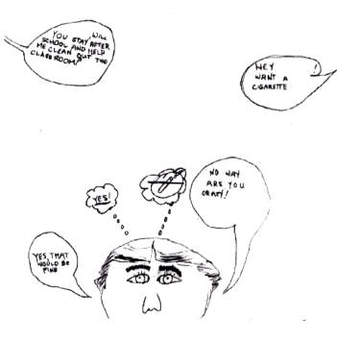
domain: moral volition
moral volition Measure is made of developmental transitions in how young persons uses their sense of autonomy in responding to and redefining rules of conscience.
Stilwell et al, 1998
intrinsic value : freedom
Notes:
moral volition (Stilwell et al, 1998)
In this domain measure is taken of developmental transitions in how young persons use their sense of autonomy in responding to and redefining rules of conscience.
core concept: autonomy and will allow a child to value being and doing as an individual. Autonomy and will become moralized as moral volition. Young persons gradually learns to make increasingly sophisticated judgment‑derived choices about what they believe to be right or good. They combine what they have learned from others with their own moral intuitions, reasoning, defenses and risk‑taking. Hard choices and courage are closely coordinated.
Reference:
Stilwell, B., Galvin, M., Kopta, M., and Padgett, R. (1998): Moral volition: the fifth and final domain leading to an integrated theory of conscience understanding. journal american academy child and adolescent psychiatry,
37 (2): 202-210.

Slide 63
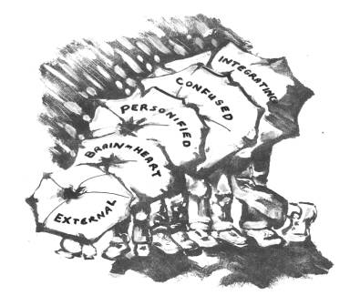
conscience stages
Laramore, circa 2000
Notes:
Frontispiece for Stages
By Sandra Laramore Ferraro (1947-2015)
These are the rungs of the ladder in our conscience theory.

Slide 64
stage i: externalized conscience
age six and under
Notes:
This young child knew he was being good ‘when the teacher didn’t tell me to sit down.’
In this drawing, he shows what happened while riding bikes with his cousin. The hill was straight down, his cousin
told him to stop but he didn’t, and when he got toward the bottom he had to drag his feet in the mud. His cousin
told him that was bad and he would never ride bikes with him again.
ADDITIONAL NOTES
• The picture also describes another bike adventure with his cousin who told him to pull over. He didn’t and ‘flipped
over the handlebars.’
• Modal age Six and under.
• Characteristics
Specific:
The child labels her own behavior good or bad.
Knowledge for the labeling is ascribed to authority outside the self.
General:
Conscience resides ‘outside’ the child, in parents, teachers, other adults or older children.
Reference: An image from the Archives of the Indiana University Conscience Project.

Slide 65
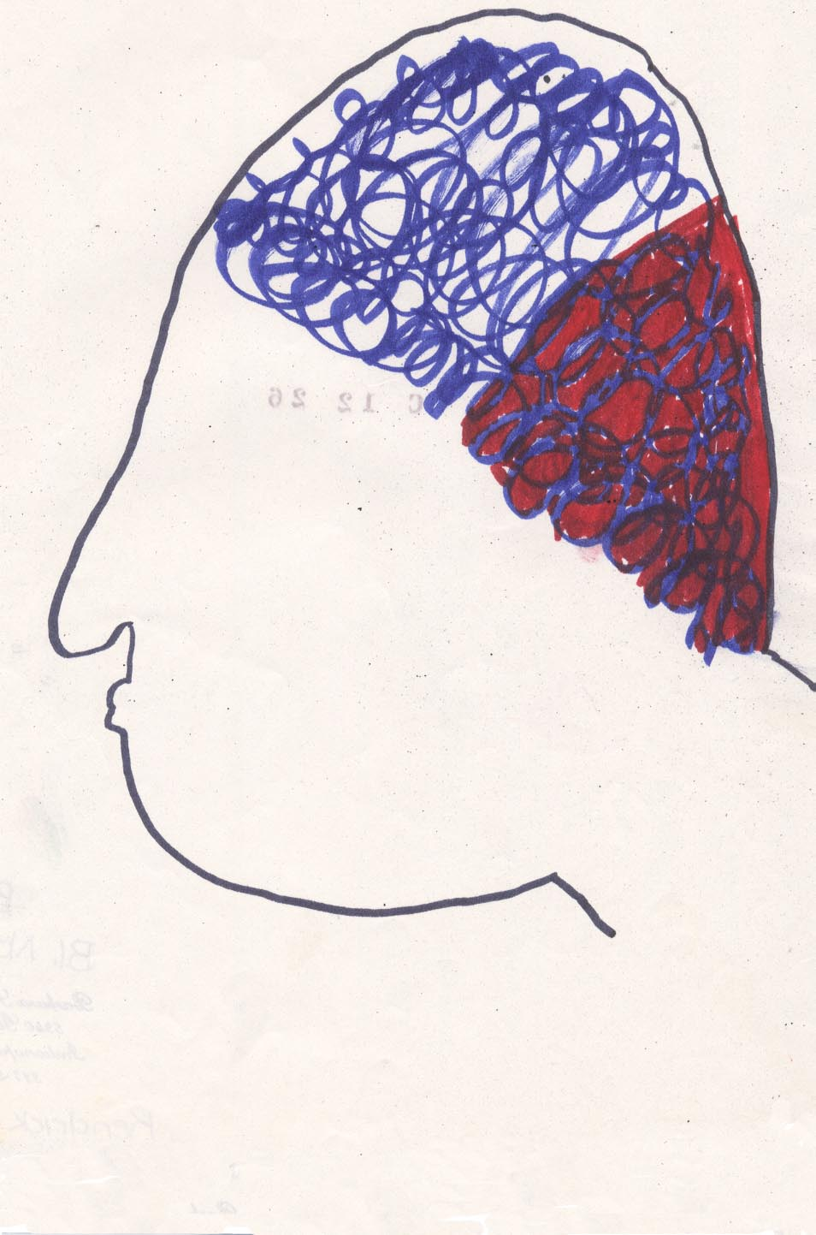
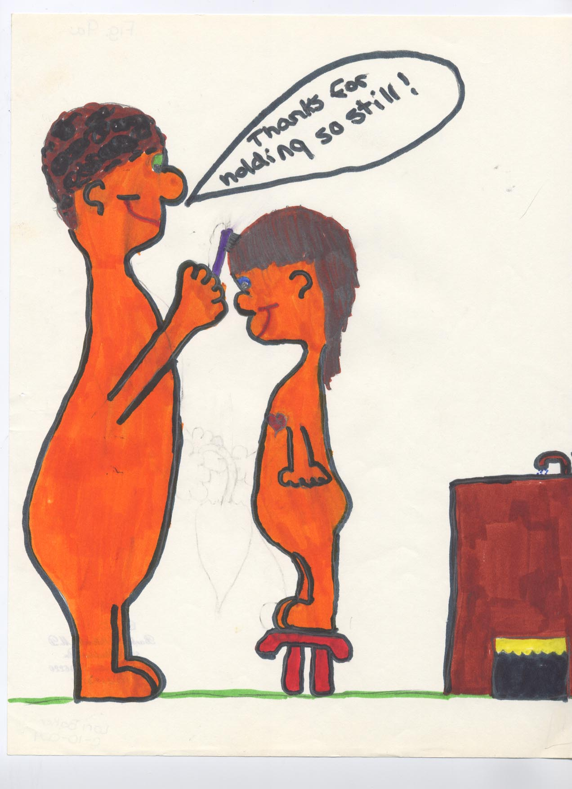
stage ii: brain or heart conscience
modal age seven
Notes:
• Modal age: Seven
• Characteristics
Specific:
Behavioral experiences are morally labeled.
The child has stored rules about moral behavior based on cognitive-behavioral or affective-behavioral experiences.
General:
A particular body site stores rules for easy retrieval.
Reference: An image from the Archives of the Indiana University Conscience Project.

Slide 66
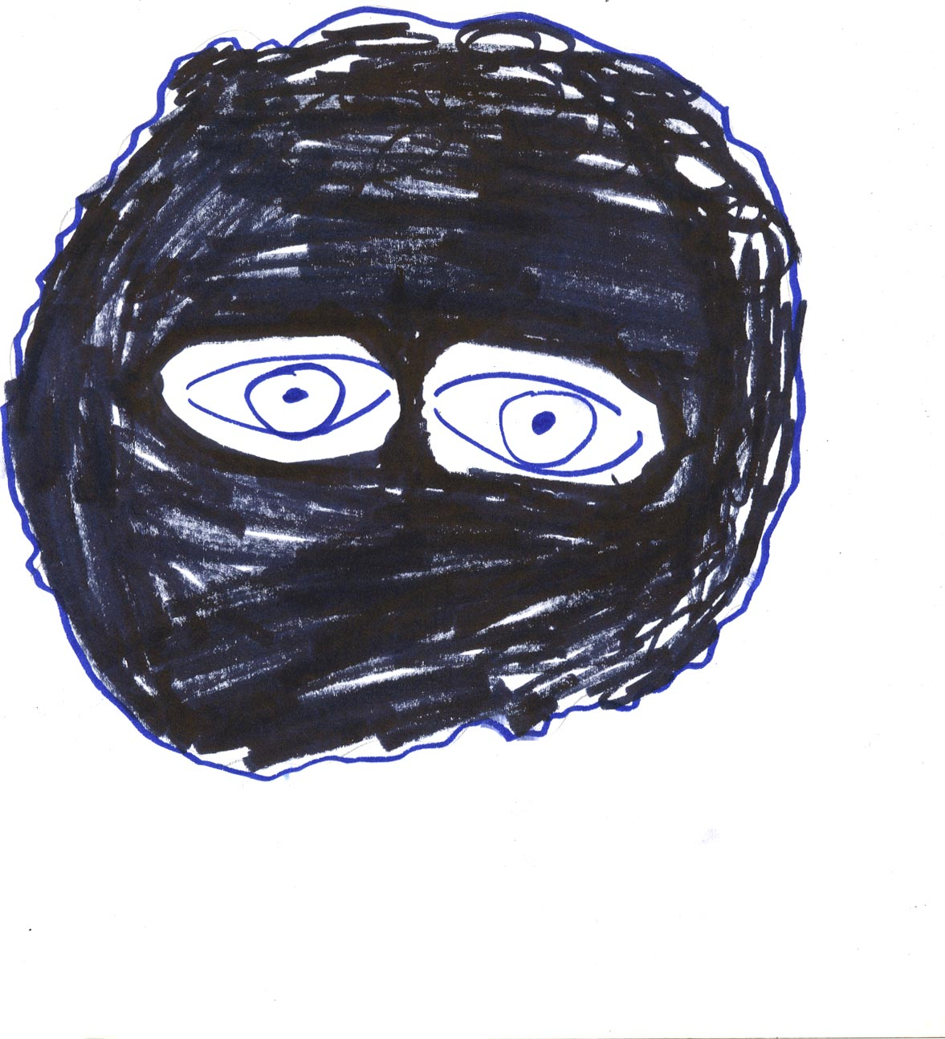
stage iii: personified conscience
modal age twelve
Notes:
• This boy defines his conscience as a thing inside his brain that tells him what to do - what’s right and wrong. It is being ‘aware of the outer layer of your soul.’
• But in describing his drawing he says that there is no mouth, no voice – he doesn’t hear anything. Unconsciously he asks the back part of the brain, like a reflex, like ‘checking first with the boss.’
• This is “Blob,” an abstract shape to reflect his abstract thinking. The eyes watch over him and make him think.
ADDITIONAL NOTES:
• Modal age: Twelve
• Characteristics
Specific:
1) Morally labeled behavioral experiences.
2) External authority is still the ultimate source of moral knowledge.
3) Evidence of conjoined affective/cognitive derivatives from moral experience.
4) Affective/cognitive derivatives are projected onto an internal personification.
5) The conscience is taking on a life of its own within the self.
General:
Interchangeable use of terms for feeling and thinking
Reference: An image from the Archives of the Indiana University Conscience Project.

Slide 67
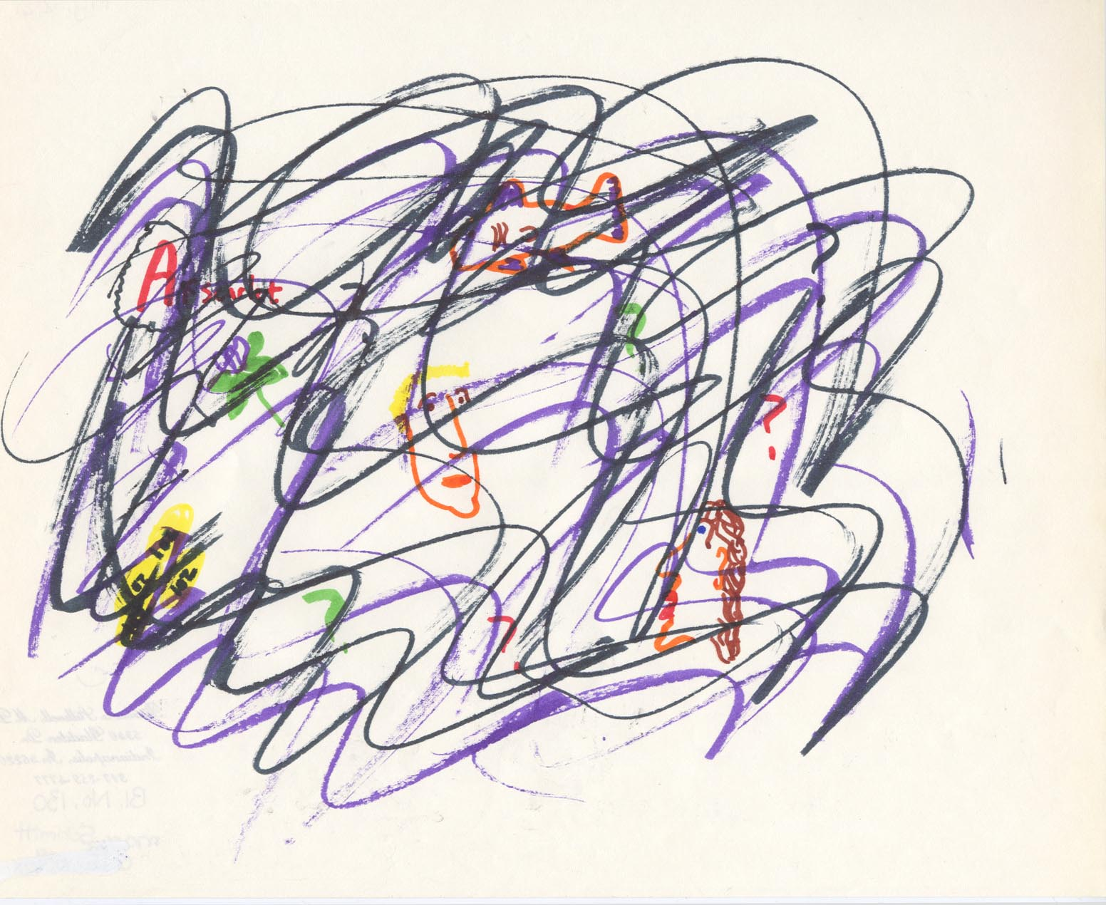
stage iv: confused conscience
modal age fifteen
Notes:
• This 15 year old male tells us that he first heard about conscience on Donahue and Oprah, talk shows of his time. He thinks his conscience consists of his thoughts and the questions he thinks of.
• His drawing represents his thoughts and questions – he says he doesn’t ‘mix stuff up with my thoughts’ – he just thinks about things and ‘it’ makes decisions.
• Things are jumbled up inside and it all comes out at once.
(Look closely – there are multiple images embedded within the squiggle lines…)
ADDITIONAL NOTES:
• Modal age: Fifteen
• Characteristics
Specific:
Morally labeled behavioral experiences.
Cognitive and affective derivatives handled simultaneously.
Confusion about the ultimate source of moral knowledge.
General:
‘Confusion’ ‘ Turmoil’ and ‘Indecision’ are useful descriptors.
Reference: An image from the Archives of the Indiana University Conscience Project.

Slide 68
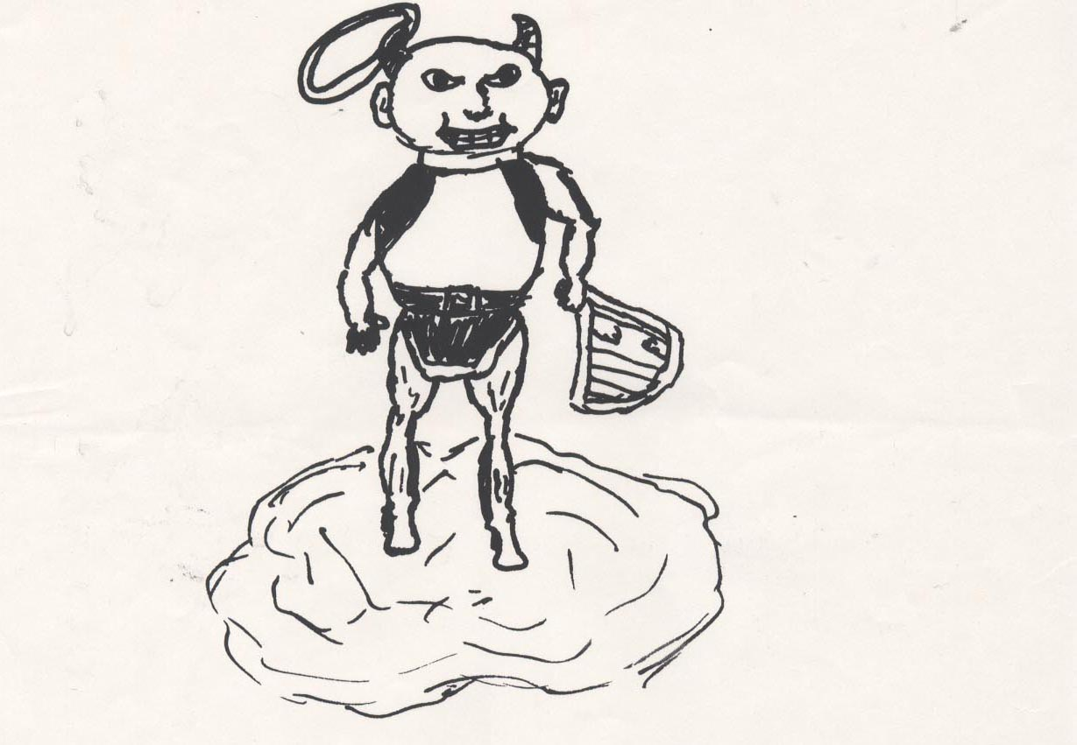
stage v: integrated conscience
modal age seventeen
Notes:
• This young artist represents his conscience as an angel-type figure. He says, “Angels are supposed to be short round little guys with wings.” His angel has devil horns, as well as a crooked halo to show a mix of good and bad. He has a
crooked tail, ‘to show neutral.’
• He has a harp – to show good – with a broken string to show the mix of good and bad.
ADDITIONAL NOTES
• The example he gave of his own conscience at work – he goes hunting which makes him feel badly, especially when he actually shoots something. He makes it harder on himself by using only bows, not guns.
• Modal age: Seventeen
• Characteristics:
Specific:
Morally labeled behavioral experiences.
Authorship of moral knowledge is multiple and ultimately self chosen.
Affective and cognitive derivatives are well integrated.
Tolerance for ‘gray areas’ of behavior in self and others.
Goodness may exist within bad and badness within good.
General:
‘Flexibility’ and ‘Tolerance’ are useful descriptors.
Reference: An image from the Archives of the Indiana University Conscience Project.

Slide 69
indiana university conscience project
a brief history
conscience in advantage
research
conscience in adversity
collaboration with biopsychosocial sequelae of maltreatment
1980
1982
1985
1989
1992
1996

Slide 70
conscience in adversity
indiana university conscience project
a brief history
subjects: nineteen male youth inpatients age matched with counterparts from conscience in advantage studies
  psychiatric hospital stays typically six to nine months
  late 1980’s
measures:
  stilwell conscience interview (SCI)
  dsm diagnoses from interdisciplinary diagnostic conferences
  maltreatment experiences characterized
  putative neurobiological correlate
outcomes
  psychopathological interference as well as developmental delay scored
Galvin et al, 1997
Notes:
Reference:
Galvin M, et al (1997): Maltreatment, conscience functioning and dopamine beta hydroxylase in emotionally disturbed boys.
child abuse and neglect, the international journal. 21(1): 83-92.

Slide 71
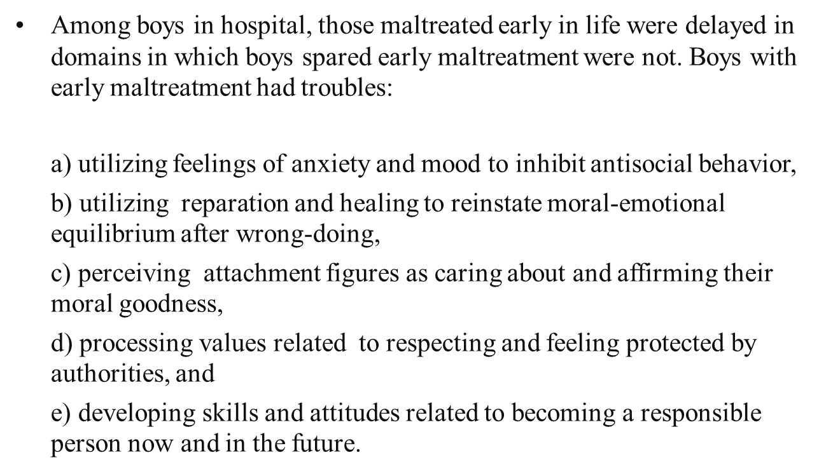
conscience in adversity
indiana university conscience project
a brief history
Galvin et al, 1997
Notes:
Reference:
Galvin M, et al (1997): Maltreatment, conscience functioning and dopamine beta hydroxylase in emotionally disturbed boys.
child abuse and neglect, the international journal. 21(1): 83-92.

Slide 72
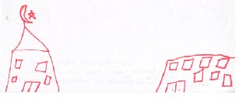
THE PRISONER’S DILEMMA
conscience in adversity
AGE 15
Notes:
The 15 year old boy who rendered this image of his conscience probably never heard of Princeton mathematician Albert Tucker’s prisoner’s dilemma.
THERE ARE TWO PRISONERS ACCUSED OF CONSPIRING AGAINST THE STATE.
THE JUDGE GIVES EACH TWO ALTERNATIVES: TO CONFESS OR NOT TO CONFESS.
IN A PLEA BARGAINING ARRANGEMENT, THE JUDGE OFFERS A DEAL:
IF ONE PRISONER CONFESSES AND THE OTHER DOES NOT, THE CONFESSOR WILL BE RELEASED AND THE OTHER WILL GO TO PRISON FOR TEN YEARS.
IF BOTH CONFESS, BOTH GO TO PRISON FOR FIVE YEARS.
IF NEITHER CONFESSES, BOTH GO TO PRISON FOR A YEAR.
It’s not a game to some.
Particularly poignant is how our youth imagines himself between a detention center and a mosque.
REFERENCES:
Attributed to the Princeton mathematician, Albert Tucker in a 1950 lecture on game theory.
The version cited here appears in Kidder (1995).
Kidder, R.M. (1995): HOW GOOD PEOPLE MAKE TOUGH CHOICES. William Morrow & Co., New York.
An alternative version with references to the literature on game theory appears in Nozick (1981).
Nozick, R.(1981): PHILOSOPHICAL EXPLANATIONS, The Belknap Press of Harvard University Press, Cambridge, Mass.

Slide 73
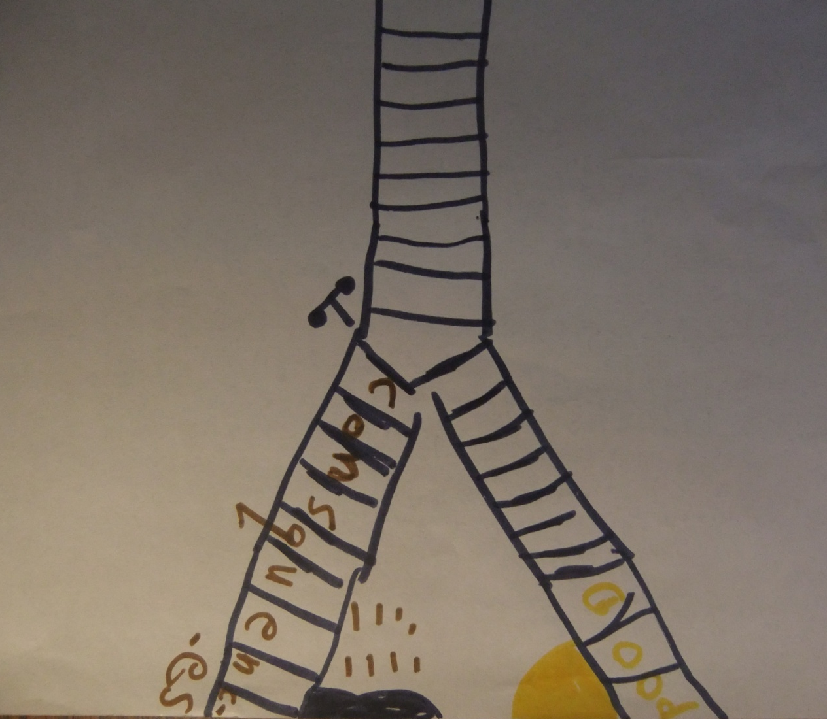
THE TROLLEY DILEMMA
conscience in adversity
AGE 12
Notes:
The twelve year old artist who created this image of his conscience probably never heard of Phillipa Foot’s trolley dilemma*
Our youth readily identified his ‘conscience’ as something that told him when he was behaving in a good way or a bad way. He said it was part of his brain. A bad conscience was related “to hittin’, yellin’, aggravatin’ and antagonizin’” while a good conscience was related to “being happy, sharing and giving and being thankful, showing manners –stuff like that.” He subsequently elaborated that sometimes he had to pick one side or the other and “turn a switch to get back on track.” He seemed aware of rewards and consequences incorporating that notion along with the image of railroad tracks in his conscience drawing. In his depiction, the tracks forked, one was the way of consequences; the other was the way of rewards. On the way to rewards, there were neither rain nor mud puddles as might be encountered on the way to consequences. He perceived himself forced to choose which way. Asked if he could ever switch tracks once chosen, he said “No.” If he had taken the wrong track, he would have to back-up, conveying that he would need to rectify matters before proceeding on the right track.
REFERENCE:
Foot P (1978): The problem of abortion and the doctrine of double effect. In: virtues and vices. Oxford: Blackwell.
ADDITIONAL NOTES
*a runaway trolley is headed for five people who will be killed if it proceeds on its present course.
The only way to save these people is to hit a switch that will turn the trolley onto a side track where it will run over and kill one person instead of five.
is it okay to turn the trolley in order to save the five people at the expense of one?

Slide 74
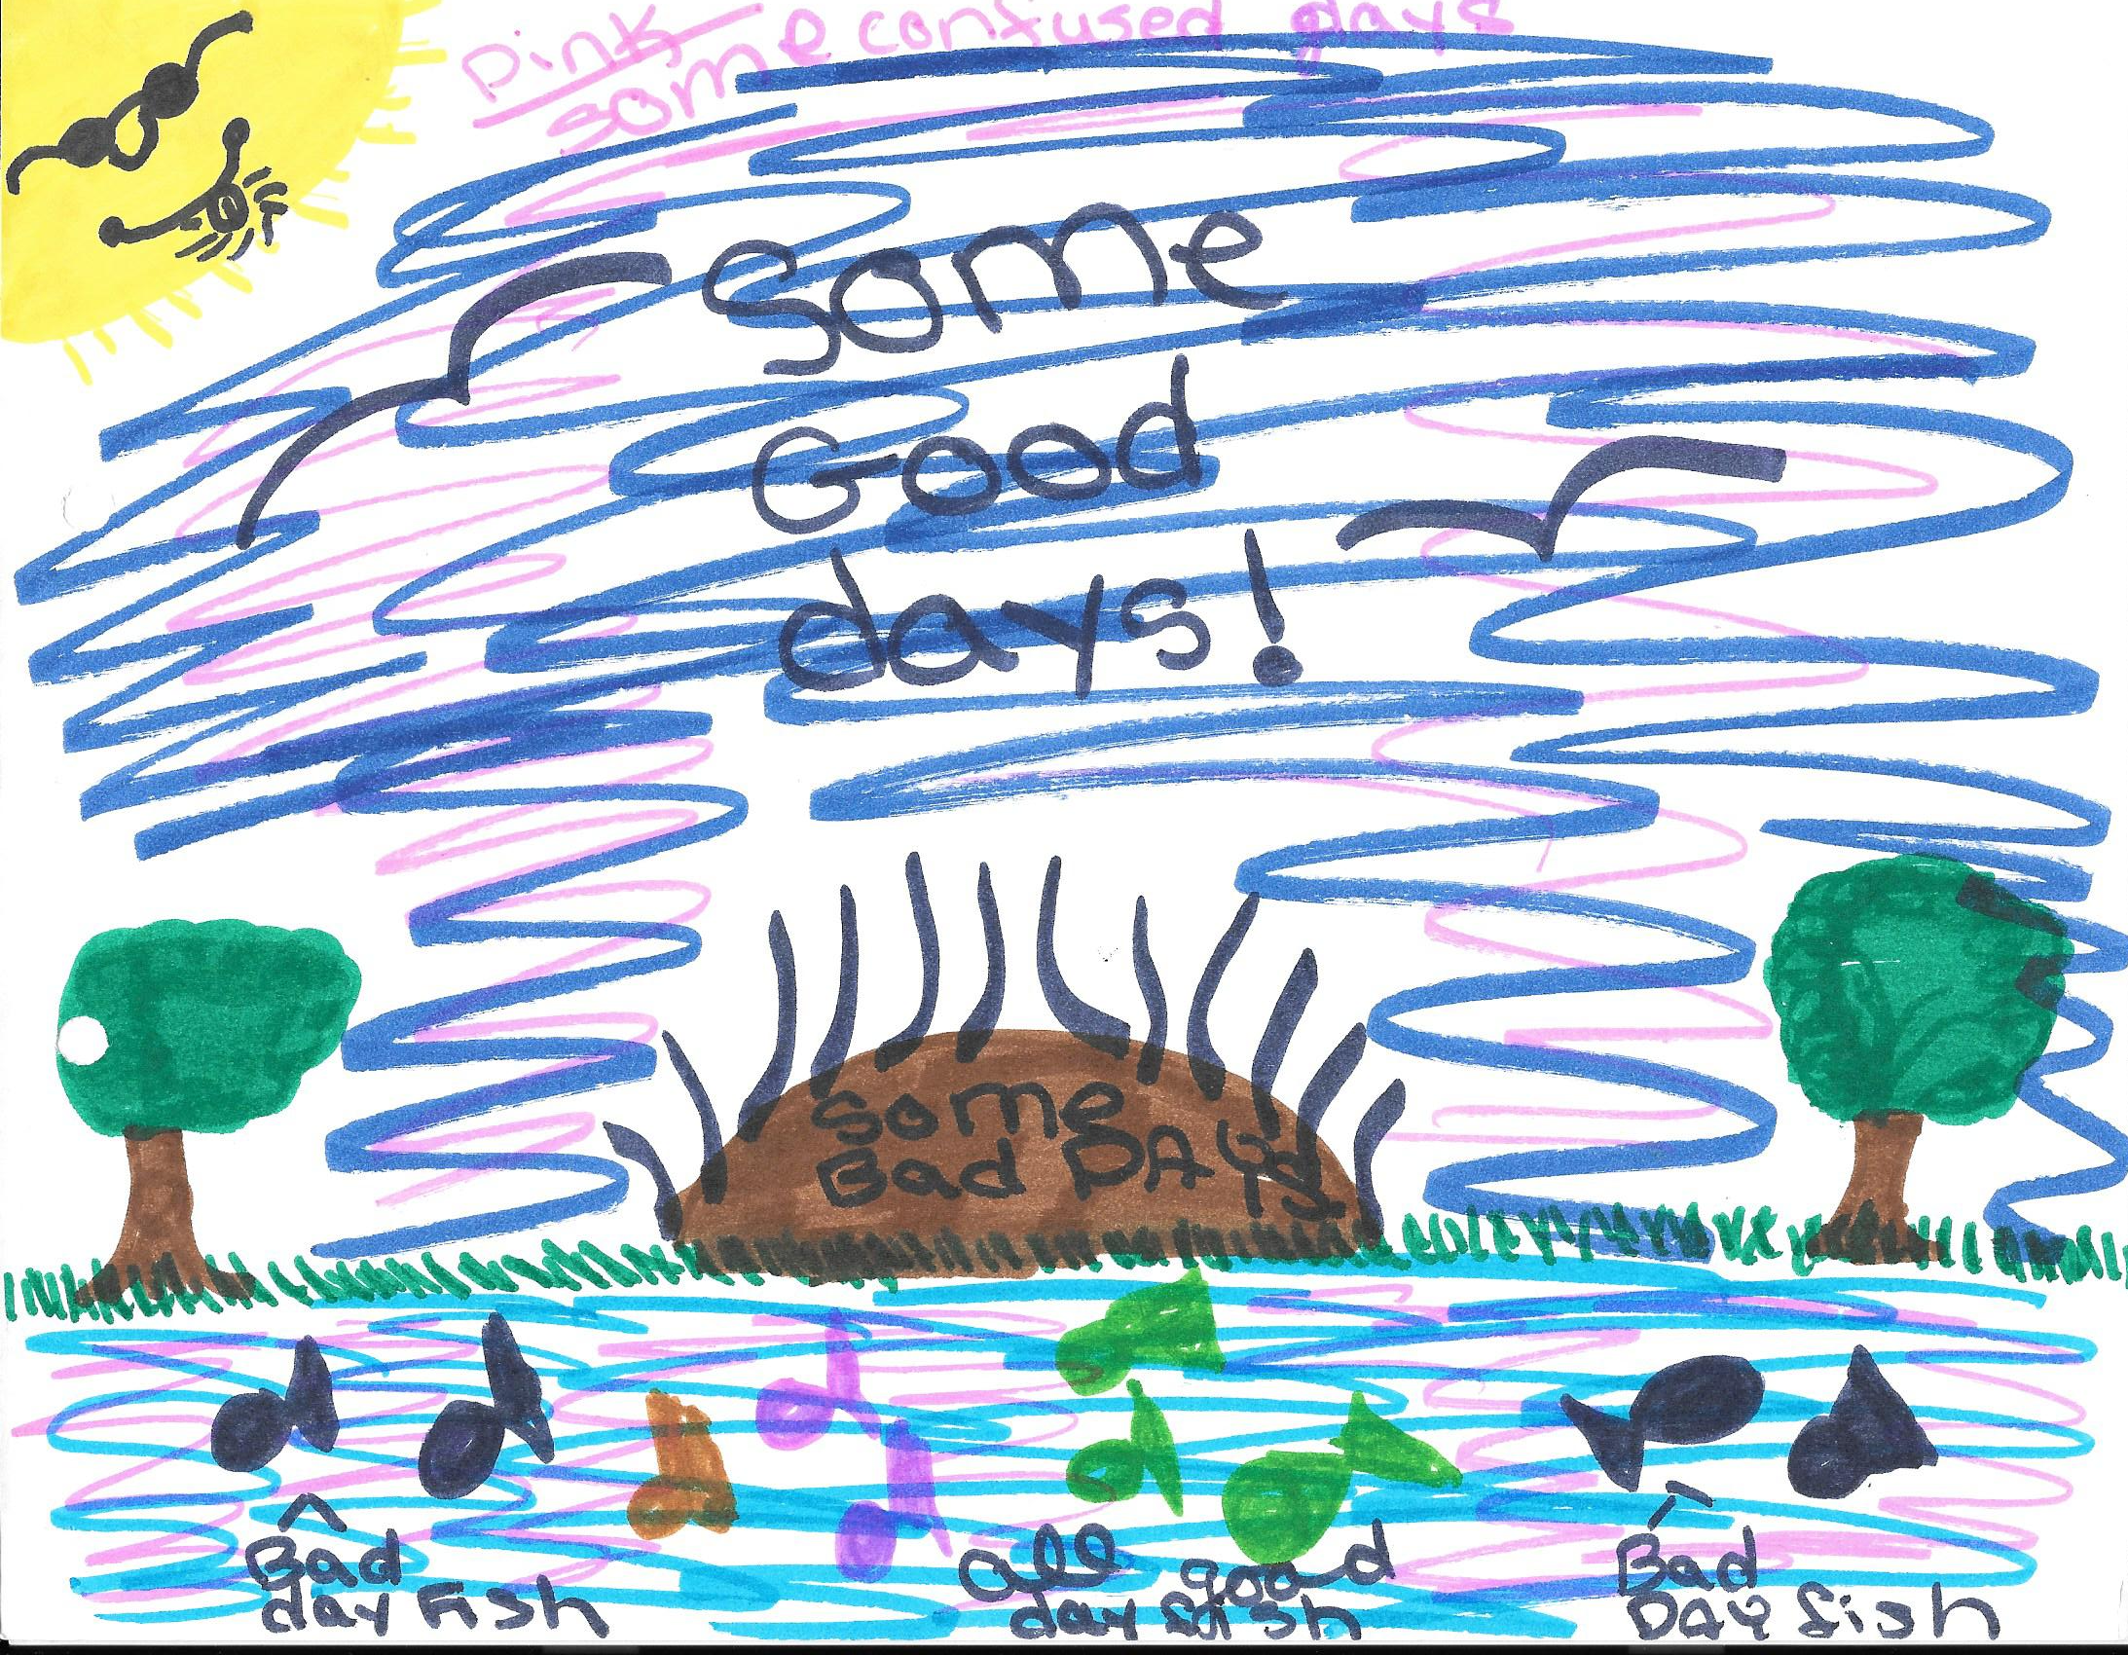
conscience in adversity
AGE 16
Notes:
Age 16.
In the center of her conscience drawing, our youth depicted a brown mound with black emanations flanked on either side by grass and trees with full green foliage. She said the brown mound represented the way she felt about herself. She inscribed on the mound: “Some bad days.” Above the mound, pink color and blue color were used profusely and intermixed. She captioned that pink represented “some confused days” and blue “some good days.” There was a pond full of “bad fishes” on the periphery around a core of “good fishes.” She said these represented bad and good experiences in her life.
ADDITIONAL NOTES
CONSCIENCE CONCEPTUALIZATION (CC): “Yes,” she said she had heard the word ‘conscience’: “It’s a person.” Then she said she wasn’t sure. When the alternative inquiry was posed, she said “Well, my brain.” She elaborated, “I usually know what’s right and wrong but I don’t do it unless I know the consequences; and sometimes I don’t follow the consequences.” She laughed [in a self-derisive way]. MORALIZATION OF ATTACHMENT (MA): The person who she thought cared most about whether she was good or not was her birth mother: “She is there for me. She talks to me about it.” She had only recently re-established contact with her after nearly nine years. “She’s really nice. We have a mother–daughter relationship.” Of her biological father she said: “I would kill him if he comes near me, though I forgive him for most of the things he’s done.” Asked whether or not she thought herself a good person, she said she saw herself as “evil—pure evil: being mean to practically everyone in front of me.”
MORAL EMOTIONAL RESPONSIVENESS (MER): She said she was not aware of any changes in her inner states when she had done something that she thought good or bad, right or wrong. Under the latter conditions she said if no one found her out, she would persist in whatever it was until they did.
MORAL VALUATION (MVAL): Laughing again, she ticked off her ‘values’, which were: “Don’t listen to your parents. Don’t follow the rules.” Earlier in the interview when the context was harm to others, she had said: “I tried to kill my [adoptive] parents. I didn’t like them. I spent lots of time thinking of ways to kill them. I will never do that again.”
•Earlier in the interview when the context was her history of suicidality, she had been able to retrieve some life affirming experiences such as enjoyment of her friendships. However, her strongest ‘because’ for staying alive appeared related to having had a friend who completed suicide by self-strangulation: “That freaked the living crap out of me. That could have been me.” She said she realized how much it hurt other people and determined then not to take her own life. She denied suicide attempts in the last two years since. • [Although psychological testing revealed a predisposition to substance abuse and she thought she had been given cocaine while quite young], she said: “Drugs freak me out. There is a fifty –fifty chance that I would be addicted or die.”
MORAL VOLITION (M VOL): Whatever change that might eventually occur in her self-valuation she did not think it would be deliberately motivated by her but rather, if it occurred, “it would change on its own” or as she worked on problems with her therapist. On the other hand, she said she would like to change from being “pure evil” to being “sometimes evil.”

Slide 75
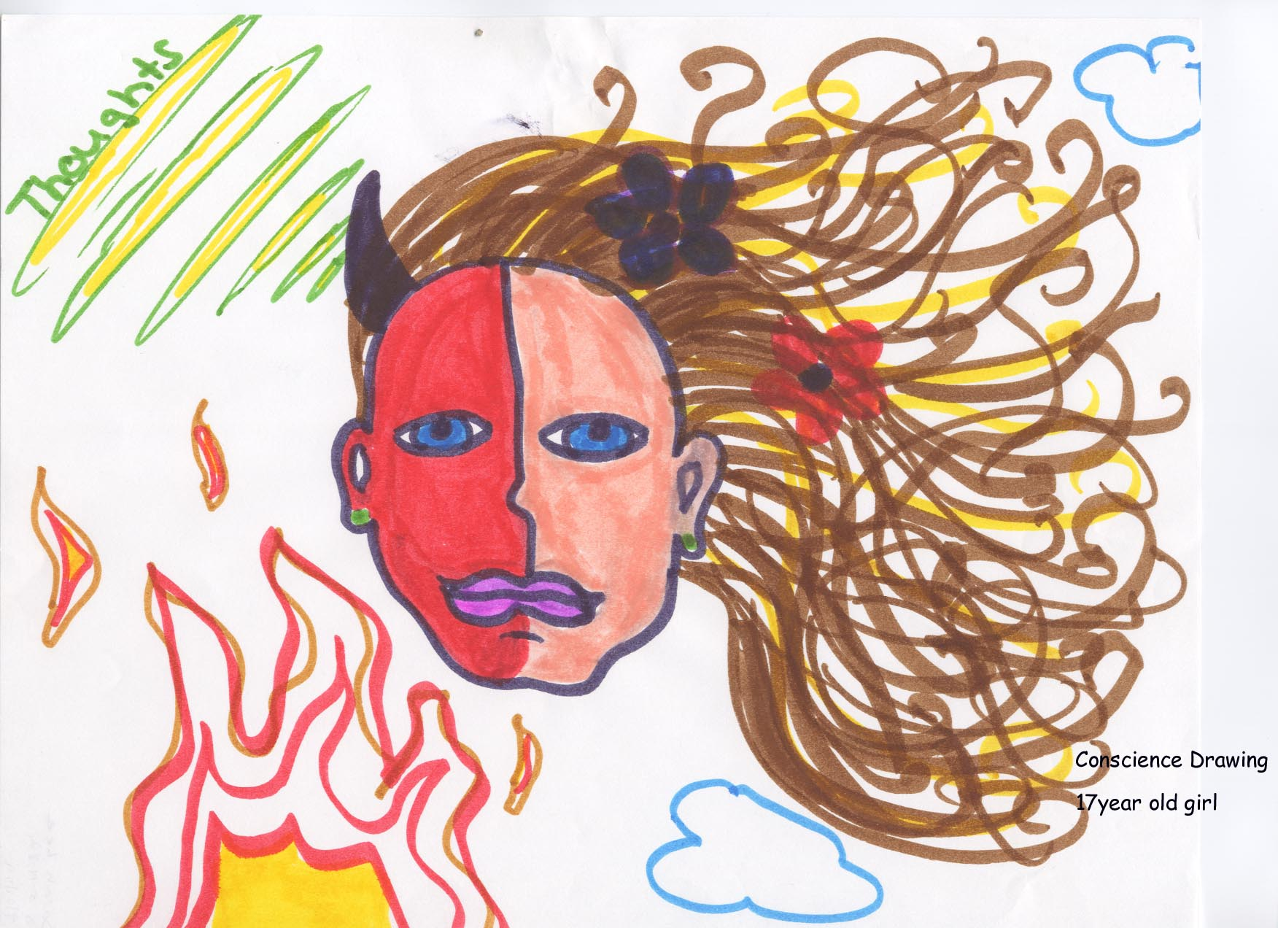
conscience in adversity
AGE 17
Notes:
Age 17
CONSCIENCE CONCEPTUALIZATION (CC): She conceptualized conscience as “a little voice you hear in your head. Sometimes it says ‘Go ahead! Do it! You’re not going to get out of here anyway. Sometimes it tells me how nice I am.”
ADDITIONAL NOTES
MORALIZATION OF ATTACHMENT (MA): The earliest memory of doing something good was retrieved from her sixth-grade year in school. She had been running track and her coach praised her. She was not sure what age to assign her earliest memory of doing something bad. However, the memory itself was stealing from a candy store. She declared it was wrong to steal “because you must pay for what you have.” Her parents divorced when our youth was age 4. She said that she and her mother had become close but there was a time when she prayed her mother would die. She conveyed that her mother took a downturn into substance abuse and depression when her mother’s boyfriend died. Her mother had requested our youth be placed when she was unable to handle our youth any longer. Our youth declared: “I don’t really know [my father] that well.” She called him a “workaholic” and added that she did not get on well with her stepmother.
MORAL EMOTIONAL RESPONSIVENESS (MER): When she had done something that she regarded as good but no one else noticed she said: “It is frustrating if people don’t know.” In the event she had done something she deemed bad but the deed was not detected by anyone else, she said she felt “guilt” nonetheless. She was not sure that she could localize the feeling to anywhere in her body but said it was accompanied by “anger followed by depression.” She considered one of her strengths being a forgiving person. She thought in terms of having sinned [examples given further on] and practiced confession before going to sleep. She said she talked to herself and her stuffed animals because she didn’t have friends. An exception was when she was in sixth grade: she became a cheerleader and experienced being popular. She used the term “independent” when she referred to her social isolation.
MORAL VALUATION (M VAL): She stated: “Before I came here, I didn’t have any do’s or don’ts.” Yet she also reported she had been subject to compulsions to do things such as stay up all night and paint.
• She had engaged in self-injurious behavior in the form of burning her skin. She attributed this behavior to her low self-esteem. She had been subject to suicidal ideation since age 13 and had made at least three suicide attempts.
• She had begun smoking tobacco when she was in seventh grade reaching a peak consumption of two packs per day. She reported use of alcohol, favoring beer over other forms, on a daily basis. She had used street drugs among which she mentioned: ‘weed’, ‘crack’ and ‘LSD’ She professed to have become more circumspect about using street drugs: “They sap your motivation.”
• She had become sexually active in the preceding year. She believed, since the onset of sexual activity to which she assented, she had had seven partners. She said she always insisted that her partner wear a condom but she also stated that she had engaged in sexual activities when she was “drunk” and could not [on her own] retrieve memory of the encounters.
• “Sins” for her included hurting her mother, others, herself and not visiting her father. She also said, in this context, that she told lies.
MORAL VOLITION (M VOL): Our youth had declared straightaway that she was in our Residential Treatment Center (RTC): “because I beat my mother, I was out of control and I ran away.” She did not make an explicit reference to changes going on in her conscience. However, her acknowledgements of violating behaviors went well beyond the reason for referral, which indicated only defiance and runaways. Her remark about not having any rules of her own to live by might well be construed to mean that she implicitly assumed her need for authoritative scaffolding in order to mitigate the damages of her personal irresponsibility.

Slide 76
indiana university conscience project
a brief history
conscience in advantage
research
international collaboration conscience in catastrophe
conscience in adversity
collaboration with biopsychosocial sequelae of maltreatment
1980
1982
1985
1989
1992
1996
1997
1998
2001

Slide 77
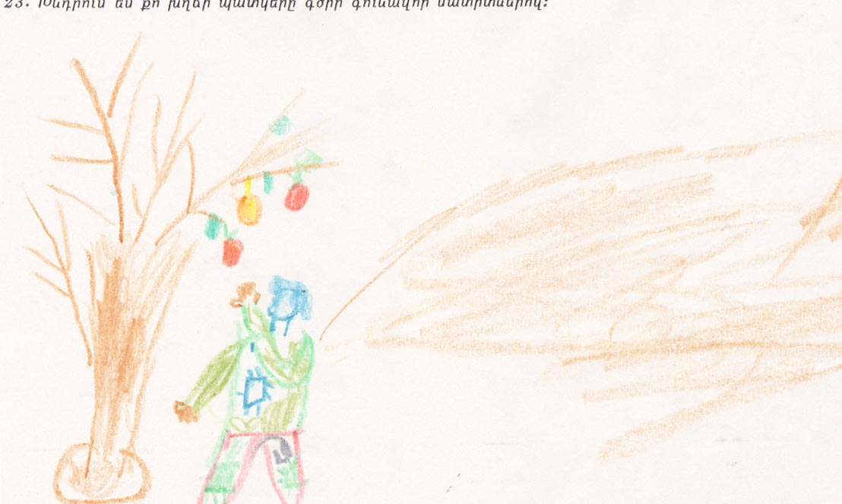
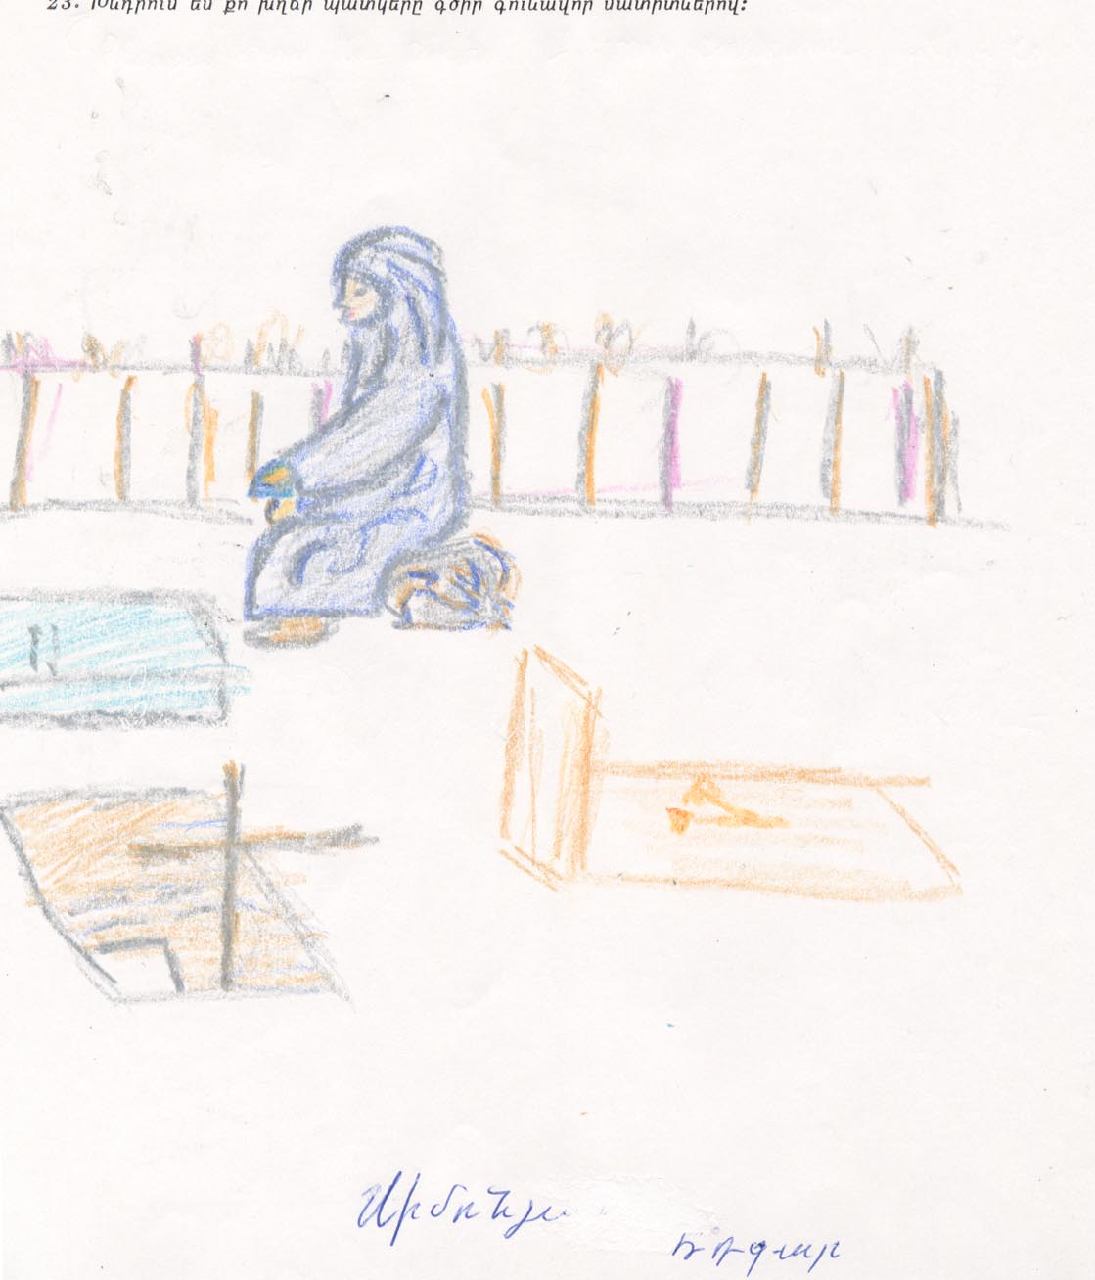
conscience in catastrophe
Spitak, Armenia
Notes:
On 12/7/88 an earthquake, 6.9 on the Richter Scale, struck northern Armenia. Yerevan the capital, 47 miles from the epicenter sustained mild damage and no significant loss of life.
Spitak, the city nearest the epicenter was almost totally destroyed.
On the left: A poor person’s conscience. Colorfully dressed male with patches on his clothing, taking fruit from a tree. Only one branch has fruit; others are brown and barren.
We made an assignment of Stage IV.
On the right: Female figure fully enshrouded, sitting in graveyard looking at grave marker. Three graves: One with cross; the other two have symbols.
We made an assignment of Stage III.
ADDITIONAL NOTES
Those residing in Spitak experienced extreme life-threat, witnessed mutilating injuries and grotesque deaths, heard agonizing screams for help and cries of distress from victims trapped in the rubble during the earthquake and for several days thereafter. Because of pervasive post-earthquake adversities, children took on greater responsibilities, either on their own or at the behest of adults. These included care of siblings, other dependent, disabled and elderly family members, finding wood to burn for cooking and heat, having to sell things on the street to earn extra money for the family. There was diminished parental supervision and guidance. The children were also very likely aware of exploitation by individuals who sold basic necessities at exorbitant prices and lack of accountability for the poor workmanship which contributed to the destruction and loss of life. There was a widespread perception of unfair distribution of food and housing. Being exposed to the complexities of moral decision-making, these children may have had greater opportunity to learn that moral dilemmas are not always readily resolvable based upon a set of inclusive moral rules (Stage II conscience) and that they had to devise their own solutions.
Reference
Goenjian, A., Stilwell, B.M., Steinberg, A.M., Fairbanks, L.A., Galvin, M., Karayan, I., Pynoos, R.S. (1999): “Moral development and psychopathological interference in conscience functioning among adolescents after trauma” journal american academy child & adolescent psychiatry (JAACAP). 38 (4): 376-384.

Slide 78
conscience in catastrophe
subjects: youth victims of natural catastrophe
  study of survivors of 1988 earthquake in armenia
  comparison of youth in spitak (epicenter) and yerevan (remote)
measures: stilwell structured conscience interview (SSCI)translated into armenian
outcomes:
  adolescents in spitak showed:
    advanced development of conceptualization of conscience
    many had marked psychopathological interference
Goenjian et al. 1999
Notes:
Goenjian et al. (1999): Moral development and psychopathological interference in conscience functioning among adolescents after trauma. journal american academy child and adolescent psychiatry, 38(4): 376-384.

Slide 79
indiana university conscience project
a brief history
research
conscience sensitive approaches to diagnosis
clinical applications
damar
CTS
PRCH
SVSC
ISBVI
CBI
conscience sensitive approaches to treatment
1980
1982
1985
1989
1992
1996
2020
1997
1998
2001
2006
2009
2011
2013
2014
2025

Slide 80
indiana university conscience project
a brief history
conscience in adversity teaching collection
research
clinical applications
conscience sensitive approaches to diagnosis
conscience sensitive approaches to treatment
1980
1982
1985
1989
1992
1996
2020
1997
1998
2001
2006
2009
2011
2013
2014
2025

Slide 81
INDIANA UNIVERSITY CONSCIENCE PROJECT
CONSCIENCE IN ADVERSITY TEACHING COLLECTION
conscience in adversity
OBJECTIVE: To enable further studies of the continuum of casualty in personal conscience that will enlarge and transmit the fund of knowledge in our healing professions.
METHOD: Presentation of a data collection comprised of 125 identity-protected cases, developed from conscience sensitive psychiatric interviews conducted, consecutively, over a three-year period in a residential treatment center which was dedicated to youth who had been reared in adverse life circumstances.
Learners are invited to systematically progress through them.
Notes:
Background. In matters of conscience, we are always learning. When conscience becomes a casualty of adverse life experiences, we are called upon in our healing professions to bind the moral wounds and attend the moral injuries we encounter in the light of whatever knowledge of moral nature and nurture we have acquired, meager as it may be.
Objective. To enable further studies of the continuum of casualty in personal conscience that will enlarge and transmit the fund of knowledge in our healing professions.
Method. Presentation of a data collection comprised of 125 identity-protected cases, developed from conscience sensitive psychiatric interviews conducted, consecutively, over a three-year period in a residential treatment center which was dedicated to youth who had been reared in adverse life circumstances. The presentation of these cases departs from the format of traditional psychiatric case presentations by first introducing the youth through their representations of personal conscience in narrative and imagery. Each case is then organized according to: religious or spiritual information; the particulars of adverse life experiences; dimensional ratings of psychopathology; conscience relevant as well as any conscience sensitive findings culled from close reading of aggregated referral information; academic and legal histories; and, finally, psychiatric diagnoses. Exercises in discernment have been strategically laid out.
Learners are invited to systematically progress through them, as follows:
• Learners identify and justify relative weaknesses and strengths in the five domains of conscience surveyed in the selected case.
• Learners use tables of age-expected conscience stage-attainment in conditions of relative advantage, in order to form a global impression and arrive at an estimate of stage- attainment from their survey of the five domains of conscience in the selected case.
• Learners note the moral psychological developmental gap between youth reared in relative advantage and the youth selected for study.
• Learners proceed through the youth’s histories, dimensional ratings, endorsed items specific to conscience, conscience findings in the aggregated referral information, and psychiatric diagnoses.
• Learners then use the proposed taxonomy, to consider the type and estimate the severity of psychopathological interference in conscience functioning. An index of the data collection has been organized according to: adverse life experiences; psychiatric diagnoses; findings in five domains of conscience and tendencies to harm.
• Learners use the index to summarize their discernments and then formulate the case with an eye to conscience sensitive treatment planning.
For learners who are or who aspire to be clinician researchers, a few study questions using the data collection in the aggregate are suggested. Cases may be more formally scored, interrater reliability for scoring established, the scores entered into a data base, and may be further interrogated using research designs with statistical analyses.
Results. Learners, whether in educational or clinical research endeavors, who wish to engage in the further study of the continuum of casualty in personal conscience are invited to complete the user agreement, appended, and return it to the curator of the data collection in order to access cases.
Conclusion. Agreed upon users will then have before them cases from the conscience in adversity data collection with which to teach to conduct research or to study in the aggregate.

Slide 82
conscience in adversity
OUR 125 CASES WERE:
• YOUNG MILLENIALS
• MEAN AGE: 170 MONTHS (14 YEARS) S.D. 26 MONTHS
• AGE RANGE: 81 MONTHS (7 YEARS) TO 208 MONTHS (17 YEARS)
• 45 WERE OVER 180 MONTHS (FIFTEEN YEARS) OLD
• MALE: 55%
Notes:
Designations made by the intake worker of race and ethnicity have been deliberately omitted because they were not reliably self-affirmed by our youth. Any references to race or ethnicity introduced into the narrative by our youth have, however, been carefully preserved.

Slide 83
conscience in adversity
MALTREATMENT/CAREGIVER CASUALTY/TRAUMA DATA
1. NEGLECT
2. PHYSICAL ABUSE
3. SEXUAL ABUSE
4. PSYCHOLOGICAL/EMOTIONAL ABUSE
5. EXPOSURE TO DOMESTIC VIOLENCE
6. THREAT OR VIOLENCE OUTSIDE HOME
7. HARSH AND OR INCONSISTENT PARENTING
8. BULLYING
9. RAPE/COERCED OR INVOLUNTARY SEXUAL ACTIVITY
INDIANA UNIVERSITY CONSCIENCE PROJECT
CONSCIENCE IN ADVERSITY TEACHING COLLECTION
Notes:
MALTREATMENT/CAREGIVER CASUALTY/TRAUMA [now called Adverse Childhood Experiences (ACE’s)] DATA
Informed by research work in the field of biopsychosocial sequelae of maltreatment endured during developmentally sensitive periods, the attending had incorporated in the clinical routine the practice of approximating from history and/or from documentation the earliest age at onset of maltreatment. The attending had also routinely paid attention to and followed up on any leads regarding the FORMS OF MALTREATMENT (enumerated in the Data Collection as 1 through 7 and also 9).
ADDITIONAL NOTES
These were the forms most often encountered in the then-current and expanding literature on the continuum of caretaking casualty (a phrase owed to Sameroff and Chandler,1975). The phrase ‘continua of caregiving casualty’ has been substituted in preference by the undersigned curator:
1. NEGLECT
2. PHYSICAL ABUSE
3. SEXUAL ABUSE
4. PSYCHOLOGICAL/EMOTIONAL ABUSE
5. EXPOSURE TO DOMESTIC VIOLENCE
6. THREAT OR VIOLENCE OUTSIDE HOME
7. HARSH AND OR INCONSISTENT PARENTING
8. BULLYING
9. RAPE/COERCED OR INVOLUNTARY SEXUAL ACTIVITY
In one of the continua of caregiving casualty, #4 PSYCHOLOGICAL/EMOTIONAL ABUSE and #7 HARSH AND/OR INCONSISTENT PARENTING and #5 EXPOSURE TO DOMESTIC VIOLENCE can reasonably be considered likely to have occurred whenever #2 PHYSICAL ABUSE has been cited.
In another of the continua of caregiving casualty, #4 PSYCHOLOGICAL/EMOTIONAL ABUSE and #9 INVOLUNTARY SEXUAL ACTIVITY can reasonably be considered to have occurred whenever #3 SEXUAL ABUSE has been cited.
#8 BULLYING was gradually given more specificity during the time the interviews were conducted. So called ‘cyber-bullying’ had yet to emerge as a recognized form of maltreatment perpetrated via social media on the internet.
Reference:
Sameroff A, and Chandler M (1975): Reproductive risk and the continuum of caretaking casualty. In Review of Child Development Research (vol 4) Ed: F Horowitz. Chicago: University of Chicago Press.

Slide 84
conscience in adversity
CHARACTERIZATION OF THE COLLECTION ACCORDING TO ACE’S.
cumulative ACE’s enumerated #1-9; per centages given in round numbers:
6% (n=8): None.
6% (n=7): One kind only.
30% (n=37): Two kinds.
22% (n=28): Three kinds.
36% (n=45): Four or more kinds.
INDIANA UNIVERSITY CONSCIENCE PROJECT
CONSCIENCE IN ADVERSITY TEACHING COLLECTION

Slide 85
conscience in adversity
CHARACTERIZATION OF THE COLLECTION ACCORDING TO ACE’S.
age at onset for ACE’s enumerated #1-9; percentages given in round numbers:
18% (n=23) between 0-3 years old when they endured their first ACE.
29% (n=36) between 3-6 years old when they endured their first ACE.
40% (n=50) between 6-12 years old when they endured their first ACE.
8% (n=10) in early or mid-adolescence when they endured their first ACE.
INDIANA UNIVERSITY CONSCIENCE PROJECT
CONSCIENCE IN ADVERSITY TEACHING COLLECTION

Slide 86
conscience in adversity
100% (n=125) simply by virtue of being in our RTC, had some experience with habilitative insecurity, i.e. had at least one out-of-home placement.
57% (n=71) had at least one other out-of-home placement prior to coming to our RTC.
12% (n=15) had five or more out-of-home placements.
71% (n=89) had personal experience with law enforcement in the form of arrest, detention and/or incarceration. 18% (n= 23) had knowledge of one or more parents having had these experiences with the legal system.
46% (n= 58) had experienced hospitalizations that were-with few exceptions- psychiatric.
21% (n=26) had experienced three or more hospitalizations.
32% (n=40) had experience in or encounters with security threat groups, neighborhood or community violence.
30% (n=37) reported loss of life among family and/or friends.
22% (n=27) had personal experience with gun violence; two cited police gun violence or threat.
9% (n= 11) related or had documented experience with food insecurity.
8% (n=10) reported being involved in motor vehicle accidents.
7% (n=9) had endured torture or confinement by adults.
INDIANA UNIVERSITY CONSCIENCE PROJECT
CONSCIENCE IN ADVERSITY TEACHING COLLECTION
Notes:
SYSTEMIC ACE’S
The attending also routinely made inquiry into LOSSES, EXPERIENCES OF SUSPENSIONS AND EXPULSIONS FROM SCHOOL and ENCOUNTERS WITH POLICE AND THE LEGAL SYSTEM.
ADDITIONAL NOTES
Working within systems of care, we must be keenly aware of the harms we do in our efforts to help. This is no less true in consideration of risks/benefits of resorting to out-of-home placements than in consideration of other interventions. However, only after ‘data mining’ had commenced and several of the original records had been destroyed after de-identified versions were completed and transcribed into the Data Collection, did the undersigned curator make the decision to expand the retrospective by routinely including out-of-home placements and psychiatric hospitalization among the ACE’s. Regrettably, about twenty original records were destroyed before that decision was made.
Experiences of sexism, biases against gender nonconformity and what is now called ‘structural or systemic racism’ were, regrettably, not subject to routine inquiry. Nonetheless, when our youth spontaneously brought racism or other biases into the account, it was recorded by the attending. Indicators, even in those days, can be discerned retrospectively in a few of these accounts relating experiences of threat or violence from police.

Slide 87

conscience in adversity
Notes:
ZONE OF MORAL INJURY Adapted with permission from a slide in IU Conscience Project (2011) Demoralization and Harm Prevention, power point presentation. conscience works
https://scholarworks.iupui.edu/handle/1805/16478

Slide 88
conscience in adversity
ZONE OF MORAL INJURY
Notes:
ZONE OF MORAL INJURY Adapted with permission from a slide in IU Conscience Project (2011) Demoralization and Harm Prevention, power point presentation. Conscience Works
https://scholarworks.iupui.edu/handle/1805/16478

Slide 89
CHARACTERIZATION OF THE COLLECTION ACCORDING TO FINDINGS IN THE DOMAINS OF CONSCIENCE
CONCEPTUALIZATION (CC)
68% (n=85) were aware of conscience or a functionally equivalent part or process.
15% (n=19) were unaware of any conscience activity.
11% (n=14) disavowed personal conscience.
9% (n=7) were aware of deliberately ignoring conscience activity.
9% (n=7) showed atypicality/eccentricity in their responses or misalliance of part or whole of conscience with a disposition to harm self or others.
INDIANA UNIVERSITY CONSCIENCE PROJECT
CONSCIENCE IN ADVERSITY TEACHING COLLECTION

Slide 90
CHARACTERIZATION OF THE COLLECTION ACCORDING TO FINDINGS IN THE DOMAINS OF CONSCIENCE
MORAL IMAGINATION (MI)
58% (n=73) rendered images of conscience that were either preserved or described.
6% (n=8) declined to draw and/or describe conscience when asked.
INDIANA UNIVERSITY CONSCIENCE PROJECT
CONSCIENCE IN ADVERSITY TEACHING COLLECTION

Slide 91
CHARACTERIZATION OF THE COLLECTION ACCORDING TO FINDINGS IN THE DOMAINS OF CONSCIENCE
MORALIZED ATTACHMENT (MA)
MORAL MEMORIES
80% (n=100) were able to effectively retrieve some moral memories
32% (n=40) had impaired retrieval of self-ascribed good deeds or approbation from others.
20% (n=25) had absent, buried or impoverished early moral memories of any kind.
INDIANA UNIVERSITY CONSCIENCE PROJECT
CONSCIENCE IN ADVERSITY TEACHING COLLECTION

Slide 92
CHARACTERIZATION OF THE COLLECTION ACCORDING TO FINDINGS IN THE DOMAINS OF CONSCIENCE
MA cont’d
PRINCIPAL MORAL ATTACHMENT (PMA) FIGURES
33% (n=41) nominated a biological parent as their PMA figure.
9% (n=11) nominated an adoptive, foster or step parent.
8% (n=10) nominated a grandparent.
7% (n=9) nominated family members not otherwise specified
10% (n=13) nominated another adult, outside the family
5% (n=6) nominated their deity or higher power
9% (n=11) nominated themselves.
24% (n=34) perceived no one as their PMA figure.
INDIANA UNIVERSITY CONSCIENCE PROJECT
CONSCIENCE IN ADVERSITY TEACHING COLLECTION

Slide 93
CHARACTERIZATION OF THE COLLECTION ACCORDING TO FINDINGS IN THE DOMAINS OF CONSCIENCE
moral emotional responsiveness (mer)
49% (n=61) described congruity of MER with the valence they assigned to their deeds.
37% (n=46) somatically localized their MER in their bodies.
26% (n=32) had awareness of evincive behavioral signals associated with MER.
18% (n=22) experienced guilt or empathic responses to those our youth had harmed.
16% (n=20) engaged in forgiveness seeking and/or granting or making apologies.
12% (n=15) had MER contingent upon other’s approval or censure.
10% (n=13) described fear of- or worry over- discovery, punishment and/or retribution.
26% (n=32) were seen by at least one authority figure as lacking guilt.
18% (n=23) described MER as absent, or not a lively experience, in response to self-ascribed good deeds.
18% (n=23) described MER as absent, or not a lively experience, in response to self-ascribed bad deeds.
12% (n=15) described incongruity of MER with the valence they assigned to their deeds.
11% (n=14) ascribed to themselves a paucity of guilt.
INDIANA UNIVERSITY CONSCIENCE PROJECT
CONSCIENCE IN ADVERSITY TEACHING COLLECTION

Slide 94
CHARACTERIZATION OF THE COLLECTION ACCORDING TO FINDINGS IN THE DOMAINS OF CONSCIENCE
moral valuation (m val)
27% (n=34) expressed an absence of self-ascribed rules for living.
6% (n=7) embraced dysvalues contrary to the rights of others and/or major age appropriate norms with respect to sexual experiences.
22% (n=27) made explicit their abstinence sustaining values or values of restraint with respect to substances.
10% (n=12) made explicit their abstinence sustaining values or values of restraint with respect to sexual experiences.
INDIANA UNIVERSITY CONSCIENCE PROJECT
CONSCIENCE IN ADVERSITY TEACHING COLLECTION

Slide 95
CHARACTERIZATION OF THE COLLECTION ACCORDING TO FINDINGS IN THE DOMAINS OF CONSCIENCE
moral valuation (m val)
rarities
• Representations of ambits of conscience expanding beyond self and family/home
to a subcommunity/identity group or community-at-large were rare. * •There were no representations of ambits of conscience expanding to a world- view or universal-view or principled positions taken regarding society or commonwealth.
• There was a single representation of obligation to preserve or assume stewardship of the environment.
• Professions of altruism as well as balance/ equanimity were rare.
• Prima facie endorsements of some version of the golden rule were rare.
• Express prohibitions against lying or cheating were rare.
• Express sensitivities to biases against others were rare.
• Professions of non-maleficence (do no harm) were rare.
* rare = less than 5%
INDIANA UNIVERSITY CONSCIENCE PROJECT
CONSCIENCE IN ADVERSITY TEACHING COLLECTION
Notes:
• Representations of ambits of conscience expanding beyond self and family/home to a subcommunity/identity group or community-at-large were rare.
• There were no representations of ambits of conscience expanding to a world-view or universal-view or principled positions taken regarding society or commonwealth.
• There was a single representation of obligation to preserve or assume stewardship of the environment.
MOREOVER:
¹ Professions of altruism as well as balance/equanimity were rare.
² Prima facie endorsements of some version of the golden rule were rare.
³ Express prohibitions against lying or cheating were rare.
⁴ Express sensitivities to such biases against others were rare.
⁵ Professions of non-maleficence (do no harm) were rare.

Slide 96
CHARACTERIZATION OF THE COLLECTION ACCORDING TO FINDINGS IN THE DOMAINS OF CONSCIENCE
m val cont’d
45% (n=56) implicated beneficence in the form of a disposition to help others.¹
27% (n=34) ascribed to themselves a sense of justice in the form of a disposition to be fair to others.²
25% (n=31) ascribed to themselves honesty, integrity or openness in self-disclosure.³
15% (n=19) endorsed some version of the intrinsic value of connectedness.
7% (n=9) expressed prohibitions against stealing.
10% (n=12) expressed sensitivities to racial injustice/prejudice/tension involving self.⁴
7% (n=9) expressly endorsed egoistic values for personal or material success in the acquisition of external goods.
17% (n=21) were described by at least one authority figure as habitually lying or cheating.
10% (n=12) ascribed to themselves a disposition towards lying and cheating.
12% (n=15) were described by at least one authority figure as habitually stealing.
10% (n= 12) ascribed to themselves a disposition towards stealing.
6% (n=7) expressed outright hostility to authority/rules.
INDIANA UNIVERSITY CONSCIENCE PROJECT
CONSCIENCE IN ADVERSITY TEACHING COLLECTION

Slide 97
CHARACTERIZATION OF THE COLLECTION ACCORDING TO FINDINGS IN THE DOMAINS OF CONSCIENCE
m val cont’d
42% (n=52) had experienced suicidality or engaged in self-injury.
18% (n=23) were subject to low self-esteem or expressed self-loathing.
12% (n=15) of those with suicidal tendencies reflected that life affirming values were absent, weak or repudiated.
5% (n=6) made explicit or implicated tendencies towards survivalism or being reduced to their survival values.
25% (n=31) endorsed upholding their rights or preserving, restoring, or obtaining autonomy.
18% (n=22) made explicit their life affirming values or prohibitions against suicide.
12% (n=15) expressly prohibited killing, aggressive or violent behavior.¹
10% (n=12) expressed values favoring personal educational empowerment.
10% (n=12) expressed values favoring participation in sports.
9% (n=11) expressly valued respect.
INDIANA UNIVERSITY CONSCIENCE PROJECT
CONSCIENCE IN ADVERSITY TEACHING COLLECTION

Slide 98
CHARACTERIZATION OF THE COLLECTION ACCORDING TO FINDINGS IN THE DOMAINS OF CONSCIENCE
moral volition (m vol)
26% were either unaware, not desirous of or else repudiated changes occurring in conscience.
18% had absent or impoverished experiences making moral choices.
14% demonstrated weakness or absence of personal responsibility according to at least one adult authority.
10% reported they were secretive.
18% welcomed maturational changes in conscience.
13% were at least sometimes able to resist urges and dispositions to harm.
11% acknowledged or affirmed reliance upon authoritative scaffolding for right conduct.
8% were self-disclosive either as a general trait or as strategy to seek approval or relieve anxiety about eventual detection or to make amends.
7% expressed desires to address lapses in conscience, reconcile themselves with conscience or to (re)activate conscience
INDIANA UNIVERSITY CONSCIENCE PROJECT
CONSCIENCE IN ADVERSITY TEACHING COLLECTION
Notes:
Moreover:
• Expressed recognition was rare that some coping skills might be problematic or maladaptive.
• Declarations of determination to advocate for others were rare.
• Declarations of dispositions to engage in help-seeking as a heteronomous coping skill were rare.
• Declarations of resistance to/rejection of help were rare.

Slide 99
CHARACTERIZATION OF THE COLLECTION ACCORDING TO FINDINGS IN THE DOMAINS OF CONSCIENCE
m vol cont’d
29% reported making prayer petitions for divine protection/safeguarding/healing of loved ones.
17% reported making prayer petitions for divine help in personal healing or
improvement.
9% reported making prayer petitions for divine forgiveness and/or a closer relationship with God.
INDIANA UNIVERSITY CONSCIENCE PROJECT
CONSCIENCE IN ADVERSITY TEACHING COLLECTION
Notes:
However:
• Reports of making prayer petitions for others besides love ones were rare.
• Reports of making prayer petitions for external goods were rare.

Slide 100
conscience sensitive
She registered her chief concern as “ I make bad mistakes: doing drugs, smoking— which I still want to do—having sex at a young age. Just choices and decisions.”
CONSCIENCE SENSITIVE DATA
embedded within the CHIEF CONCERN
Notes:
Reference:
Conscience in Adversity Data Collection (CIA): Case PRC017 (age deleted for heuristic purposes)

Slide 101
conscience sensitive
She affirmed a desire to teach other persons about enuresis, the condition that had afflicted her most of her life and which had led to her being ridiculed by peers. She said that her desire to teach about enuresis numbered among the life affirming values she was able to retrieve to counteract suicidal urges. Other life affirming values were family and her creativity.
CONSCIENCE SENSITIVE DATA
embedded within the history
Notes:
Conscience in Adversity Data Collection (CIA): Case PRC017 (age deleted for heuristic purposes)

Slide 102
conscience sensitive
CHIEF CONCERN
HISTORY OF PRESENT ILLNESS
PERSONAL HISTORY
REVIEW OF SYSTEMS
example with respect to:
SEXUALITY
a conscience sensitive inquiry might be crafted in the form of:
‘You’ve told me that you first became sexually active at age x years and that you’ve had y sexual partners and that you usually practice safe sex by using condoms. Are there some do’s and don’ts you think are important about your sex life? What are some of the values you have come to realize about being sexual?’
CONSCIENCE SENSITIVE DATA
embedded within the REVIEW OF SYSTEMS

Slide 103
LEVELS OF CONSCIENCE SENSITIVE INQUIRIES
Aside from making inquiries opportunistically, a psychiatrist may follow the religious/spiritual history taking with formal level one inquiries, one or two for each domain of conscience
Notes:
In the next slides I will read the inquiries aloud while you read, on the right, her responses to yourselves.
Level two inquiries (and tasks) deepen and expand the interview about conscience. they require more time than can generally be allotted for psychiatric evaluation. accordingly, when it is clear that a threshold has been crossed and deeper inquiry is indicated, level two queries and tasks are reserved by this psychiatrist for later clinical encounters.

Slide 104
conceptualization of conscience
conscience sensitive inquiry
Have you heard of the word conscience? How would you describe yours?
alternative forms:
Is there a part of you that helps you figure out right from wrong, good from bad? Tell me how it works.
How do you tell what would be right and what would be wrong, what would be good and what would be bad?
She said that her ‘conscience’ was “a thing that tells you what is right and what is wrong. It is a part of you. It is just connected. It is like a mother. You listen to it and you decide whether to do what it says or not.” She added, however, that her mother was stricter than her conscience.

Slide 105
moralized attachment
conscience sensitive inquiry
Who cares most about whether you turn out to be a good person or not? How does that person show you he or she cares about your being good?
She identified her mother as the person who cared most whether she was good or bad.
Notes:
Conscience in Adversity Data Collection (CIA): Case PRC017 (age deleted for heuristic purposes)

Slide 106
moralized attachment
conscience sensitive inquiry
What is the very first thing you can remember doing that was called ‘good’?
Go back as far as you can. Tell me the whole story of the event.
variant:
Tell me the earliest memory you have of doing something you regarded as good or right.
She retrieved her first memory of doing something good from when she was FOURTEEN years old.
She had helped a girl scout troop with their carnival.
She remembered people smiling at her.
Notes:
Conscience in Adversity Data Collection (CIA): Case PRC017 (age deleted for heuristic purposes)

Slide 107
moralized attachment
conscience sensitive inquiry
What is the very first thing you can remember doing that was called ‘bad’? Go back as far as you can. Tell me the whole story of the event.
variant:
Tell me the earliest memory you have of doing something you regarded as bad or wrong.
She retrieved what amounted to a life-long memory of doing something wrong and positioned it earliest on her moralized time line.
She said, “It happened all the time.” She was referring to enuretic events. She said her grandmother and father disapproved and told her they believed she wet herself just to gain attention.
Notes:
Conscience in Adversity Data Collection (CIA): Case PRC017 (age deleted for heuristic purposes)

Slide 108
MORAL EMOTIONAL RESPONSIVENESS
conscience sensitive inquiry
When you have done something that in your eyes is the right thing to have done-- a good thing--what is that like inside you, body and mind?
follow-up re: autonomy vs heteronomy
What if no one knows about your good deed? Is it the same or different inside you?
Asked what happened inside her when she did something she regarded as good or right, she said she felt happy. She did not locate a particular sensation anywhere in her body.
When asked how it would be if no one knew of her good deed, she laughed and said it was hard for her to keep secret any good deeds for which she might be responsible. She said she was apt to “skip down the sidewalk” when she had done something good seeking out someone to tell.
Notes:
Conscience in Adversity Data Collection (CIA): Case PRC017 (age deleted for heuristic purposes)

Slide 109
moral valuation
conscience sensitive inquiry
What are some do’s and don’ts you have in your life—rules you try to follow?
alternative inquiries:
You’ve told me about what happens inside you when you do something right. What are some right-doings or good deeds that would make you feel that way?
We also talked about what happens inside you when you’ve done something you believe is wrong. What are some wrong-doings or bad deeds that would make you feel like that?
Do’s and don’ts she ascribed to herself were “Don’t be taken advantage of,” “Be strong,” “Be creative,” and “Always have love in your heart and go by your values.”
“Don’t be taken advantage of” pertained to sexuality. She expected respect and did not want to put herself in circumstances in which she might be sexually abused or lied to for sexual favors. She indicated that she would “try not to fall in love with [just] any guy” because she had been so hurt in the past that she was “exhausted.”
The feeling of hurt she associated vaguely to having been thrown downstairs by her father, as well as to what she considered disastrous love relationships.

Slide 110
moral volition
conscience sensitive inquiry
You’ve told me that you thought x was wrong. Have there been times when you had an urge to do x but you succeeded in resisting the urge? How were you able to do that?
[Recall her comments regarding retrieval of life affirming values to counteract suicidal urges]
Notes:
Conscience in Adversity Data Collection (CIA): Case PRC017 (age deleted for heuristic purposes)

Slide 111
pivotal point: clinical discernment developmental delay in conscience
mind the gap
Notes:
The gap to which we refer is between what we might expect of conscience stage-attainment at that age under favorable conditions and what we have actually before us:
developmental delay

Slide 112
pivotal point: clinical discernment developmental delay in conscience
OUR YOUTH
AGE: 203 MOS or 16.9 YRS
STAGE-ATTAINMENT expected for 16.9 YRS: IV OR V (4.5)*
CONSCIENCE DEVELOPMENTAL QUOTIENT: ψ /4.5**
Notes:
* Age-expected stage-attainment for CONSCIENCE IN ADVANTAGE studies.
** Conscience Developmental Quotient is a heuristic device currently without empirical validation

Slide 113
pivotal point: clinical discernment developmental delay in conscience
OUR YOUTH
AGE: 203 MOS or 16.9 YRS
CONSCIENCE STAGE ψ (RANGE 0.5-5): 2.5
STAGE-ATTAINMENT expected for 16.9 YRS*: 4.5
CONSCIENCE DEVELOPMENTAL QUOTIENT**: 2.5/4.5 X 100= 55
Notes:
* Age expected stage attainment for CONSCIENCE IN ADVANTAGE studies.
** Conscience Developmental Quotient is a heuristic device currently without empirical validation

Slide 114
pivotal point:
clinical discernment of psychopathological interference
mind the tendency towards harm
Notes:
The gap to which we refer is between what we might expect of conscience stage-attainment at that age under favorable conditions and what we have actually before us:
developmental delay

Slide 115
pivotal point:
clinical discernment of psychopathological interference
psychiatric diagnostic contexts of psychopathological interference
in
conscience formation and functioning
(pi-in-conscience)

Slide 116
pivotal point:
clinical discernment of pi-in-conscience
pi-in-conscience TAKES INTO ACCOUNT:
the responses to conscience sensitive inquiries and conscience sensitive tasks
PLUS
the diagnostic context which in turn should take into account: MALTREATMENT /CAREGIVER CASUALTY/TRAUMA, PSYCHOMETRIC, ACADEMIC- HISTORICAL and LEGAL-HISTORICAL data
PLUS
the internalizing and/or externalizing signs and symptoms culled from dimensional approaches
PLUS
observations made in the youth-space recorded by caregivers, the counselor or others
Notes:
All of which are weighed for preponderance of evidence to support the evaluator’s designation of type and severity.
Reference:
Galvin M (2015): Psychiatric diagnostic (DSM5) contexts of psychopathological interference in conscience formation and functioning across the youth-span: a guideline. Conscience Works, Theory, Research and Clinical Applications 4(1): 1-40.

Slide 117
pivotal point:
clinical discernment of pi-in-conscience
ZONE OF MORAL INJURY
Notes:
ZONE OF MORAL INJURY Adapted with permission from a slide in IU Conscience Project (2011) Demoralization and Harm Prevention, power point presentation. Conscience Works
https://scholarworks.iupui.edu/handle/1805/16478

Slide 118
pivotal point:
clinical discernment of pi-in-conscience
pi-in-conscience
ZONE OF MORAL INJURY
Notes:
ZONE OF MORAL INJURY Adapted with permission from a slide in IU Conscience Project (2011) Demoralization and Harm Prevention, power point presentation. Conscience Works
https://scholarworks.iupui.edu/handle/1805/16478

Slide 119
pivotal point:
clinical discernment of pi-in-conscience
pi-in-conscience
pi-in-conscience
ZONE OF MORAL INJURY
Notes:
ZONE OF MORAL INJURY Adapted with permission from a slide in IU Conscience Project (2011) Demoralization and Harm Prevention, power point presentation. Conscience Works
https://scholarworks.iupui.edu/handle/1805/16478

Slide 120
a conscience sensitive biopsychosocial formulation
Our youth is almost seventeen years old.

Slide 121
a conscience sensitive biopsychosocial formulation
Her conscience developed in adversities including parenting that was inconsistent and inadequate to her needs, harsh and sometimes abusive, eventually leading to out-of-home placement. She had been subject to ridicule from others and to repeated diagnostic instrumentation for her persistent enuresis. She endured physical and sexual abuse later on.

Slide 122
a conscience sensitive biopsychosocial formulation
Her overall attainment of conscience stage seems to fluctuate between stage 2, an embodied conscience, and stage 3, a more metaphorical conscience. Her stage-attainment is uneven with relative strength in moralized attachment and relative weakness in moral volition, manifesting chiefly in poorly modulated impulsiveness and engagement in high risk behaviors and relationships.

Slide 123
a conscience sensitive biopsychosocial formulation
Psychopathological interference appears to be moderately severe combining two types, one that constricts and thwarts functionality and impedes further formation; the other, dysautonomous. Accordingly, she is prone to run away, to suicidality and to substance abuse.

Slide 124
a conscience sensitive biopsychosocial formulation
Although she is able to retrieve some life affirming values that counteract suicidal ideas and urges, she lacks a coherent demoralization and harm prevention plan. She currently adduces no abstinence sustaining values with respect to substances. At a neurobiological level, connectivity between the prefrontal cortex and the limbic system including amygdala and hippocampus is implicated.

Slide 125
a conscience sensitive biopsychosocial formulation
In therapeutic and adaptive contexts, she will require extensive moral skill building before the moral scaffolding provided by caring adults can be dismantled.
Notes:
A conscience sensitive biopsychosocial formulation. Our patient is almost seventeen years old. Her conscience developed in adversities including parenting that was inconsistent and inadequate to her needs, harsh and sometimes abusive, eventually leading to out-of-home placement. She had been subject to ridicule from others and to repeated diagnostic instrumentation for her persistent enuresis. She endured physical and sexual abuse later on. Her overall attainment of conscience stage seems to fluctuate between Stage 2, an embodied conscience, and Stage 3, a more metaphorical conscience. Her stage-attainment is uneven with relative strength in moralized attachment and relative weakness in moral volition, manifesting chiefly in poorly modulated impulsiveness and engagement in high risk behaviors and relationships. Psychopathological interference appears to be moderately severe combining two types, one that constricts and thwarts functionality and impedes further formation; the other, dysautonomous. Accordingly, she is prone to run away, to suicidality and to substance abuse. Although she is able to retrieve some life affirming values that counteract suicidal ideas and urges, she lacks a coherent demoralization and harm prevention plan. She currently adduces no abstinence sustaining values with respect to substances. At a neurobiological level, connectivity between the prefrontal cortex and the limbic system including amygdala and hippocampus is implicated. In therapeutic and adaptive contexts, she will require extensive moral skill building before the moral scaffolding provided by caring adults in the controlled environment of the RTF can be dismantled.
Galvin M, Hulvershorn L, Gaffney M (2019): Conscience relevance and sensitivity in psychiatric evaluations in the youth span. Adolescent Psychiatry 9(3)167-184.

Slide 126
The Conscience-IN-Adversity Data Collection
For The further Study of moral injury
Curator: Matthew Galvin^{1*}
Indiana University Conscience Project
Director: Margaret Gaffney^{2**}
contributing expert consultation and/or commentary: Barbara Stilwell³, Theodore Petti⁴, Leslie Hulvershorn⁵
contributing models for case formulation: Matthew Galvin¹, Margaret Gaffney², Mary Lou Gramelspacher⁶
conscience works webmaster: Jere Odell⁷
¹Clinical Associate Professor, voluntary faculty Indiana University School of Medicine Department of Psychiatry; ²Clinical Associate Professor, Emerita Indiana University School of Medicine Center for Bioethics; ³Clinical Associate Professor, Emerita Indiana University School of Medicine Department of Psychiatry; ⁴Professor, Rutgers Robert Wood Johnson School of Medicine Division of Child Adolescent Psychiatry; ⁵Associate Professor, Indiana University Department of Psychiatry, Division Child Adolescent Psychiatry ⁶ ; ⁷ Scholarly Communication Librarian, Indiana University-Purdue University Indianapolis Library Center for Digital Scholarship
conscience works: https://conscienceworks.iu.edu/
indiana university-purdue university indianapolis (IUPUI) scholarworks: https://scholarworks.iupui.edu/handle/1805/37
*Address Correspondence to the Curator of the Conscience-In-Adversity Data Collection: Matthew R. Galvin, 2113 W 42nd Street Indianapolis In. 46228
Email: mattanamcara@aol.com
**Address Correspondence to the Director of the Indiana University Conscience Project:
Margaret M. Gaffney, 2113 W 42nd Street Indianapolis In. 46228
Email: mgaffney@iu.edu
Notes:
This is my only abjuration to you, implicit in the term ‘conscience sensitivity’, the most key of all the key concepts that I wish to convey today:
Be curious and inquisitive about conscience in others.
Not in a judgmental way, not in the way of the confessional, but, without preconception, in the open-ended way of understanding how conscience has been formed and become part of a particular person’s lived experience.
Respectfully submitted,
Matthew R. Galvin, MD,
Curator Conscience In Adversity Data Collection

Slide 127

acknowledgements
american society for adolescent psychiatry
est. 1967
moral development committee*
Theodore Petti, ASAP President, 2018-2019
Stephan Carlson, ASAP President, 2019-2020
W. Connor Darby, ASAP President, 2020-2021
*An ad hoc committee called to convene in 2017, chartered annually to continue its mission by the ASAP governing board.
ASAP website: https://www.adolescentpsychiatry.org/

Slide 128
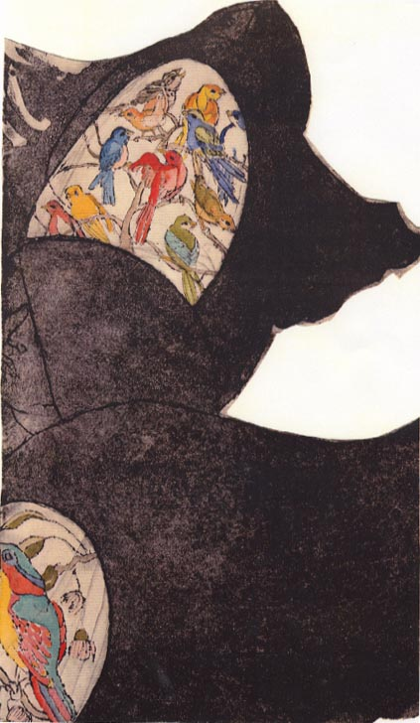
acknowledgements
the indiana university conscience project est. 1982
director: margaret m. gaffney
founding members: barbara m. stilwell, matthew r. galvin, margaret m. gaffney
recent participants: ethna verkamp, kamau sullivan, john sullivan, jere odell, jim and pam lemons, leslie hulvershorn, beulah and deborah galvin, susan and joseph dimicco, sarah bullock, julia bradshaw, mary bargiel, angeline larimer, halima al-khattab.
special thanks to the conscience project study group on women in philosophy
participant: mary lou gramelspacher

