Slide 1

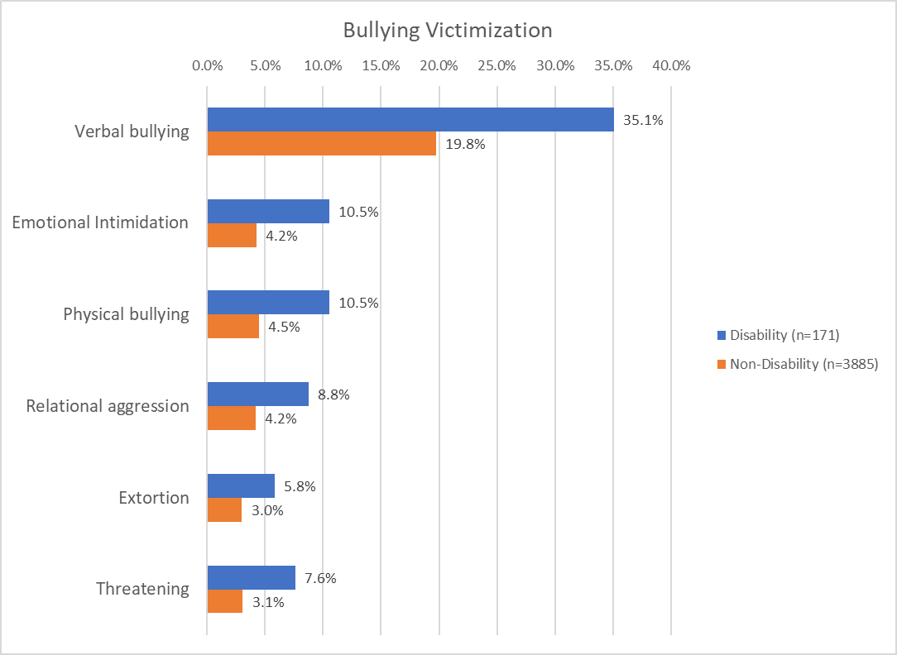

Intersection of Disability, School Climate, and School Violence
in Inclusive Settings
Saahoon Hong
Indiana University School of Social Work
Given that few studies have examined the intersectionality of bullying, disability, and self-efficacy, this study highlighted the intersection of disability, psychosocial characteristics, school violence, friendship, and teacher roles in examining the effect of school violence and school climate on self-efficacy among students with disabilities.
Conclusion
Abstract
Methodology
The study utilized the third year of data collected from the Seoul Education Longitudinal Study (SELS, 2016). The
student sample was of interest and comprised students with/without disabilities who were 9th graders in middle schools (total N=4,056; N of students with disabilities=171). In addition, demographic information and psycho-social characteristics were included to identify intersections of disability, gender, self-efficacy, school violence, friendship, and teacher effectiveness.
Hierarchical linear regression models were implemented to examine the effect of psycho-social characteristics on self-efficacy. This study focused on the interaction term (Disability*Bullying Victimization), including the SELS’s six domains (i.e., school climate, school violence, attitudes toward friends/teachers/parents, self-efficacy), gender, and household income.
Findings presented that students with disabilities were disproportionately involved in bullying. 35% of students with disabilities experienced verbal bullying, 10.5% emotional intimidation, 10.5% physical bullying, 8.8% relational aggression, 5.8% extortion, and 7.6% threatening. They experienced greater rates of bullying victimization than their peers without disabilities.
The significant Interaction term indicated that students with disabilities who experienced bullying had the lowest self-efficacy scores. In this regard, the results highlight that bullying victimization was associated with poor self-efficacy.
The findings present well-posed variables to develop an intervention model to support self-efficacy among students with disabilities (i.e., what areas of need and support we should consider for students with disabilities in inclusive settings. It could eventually be a foundation for another in-depth analysis of the best practice model for successful inclusion, such as effective programs to divert students with disabilities from exclusion, isolation,
and school violence.
Introduction
School violence, including bullying and other forms of aggression, has been a common topic of national concern throughout the last decades across countries. Literature on school violence highlighted the importance of school climate in reducing violence and fostering a safe school environment (Espelage & Hong, 2019). In South Korea, nearly 55 percent of students reported that their friends became victims of school violence at least once during the previous month of the survey (Seoul Education Longitudinal Study, 2016). However, little is known about school violence and its school climate in inclusive settings that students with disabilities experience.
This study was developed through a collaborative
effort by the Seoul Education Longitudinal Study.
Acknowledgement

