Slide 1
Assessing Student Learning in Undergraduate Research Using the Principles of Undergraduate Learning
Dominique M Galli, MS, PhD
IUPUI – Center for Research and Learning
CUR Biennial Conference 2016 – Tampa, FL

Slide 2
Center for Research and Learning
Campus-wide unit within the Office of the VC for Research that directs UG research since 1999
Multiple programs funded by campus, NIH, foundation
Academic year and summer programs
Open to students in all disciplines
One-on-one and interdisciplinary team-based faculty-mentored research
Provides student stipends and project supply funds

Slide 3
Student Learning
Outcome Assessment

Slide 4
IUPUI
Principles of Undergraduate Learning
Adopted in 1997
Define learning outcomes for students’ general education
To be incorporated into courses and co-curricular activities
Should be linked to performance assessment

Slide 5
PUL 1: Core Communication and Quantitative Skills
PUL 2: Critical Thinking
PUL 3: Integration and Application of Knowledge
PUL 4: Intellectual Depth, Breadth, and Adaptiveness
PUL 5: Understanding Society and Culture
PUL 6: Values and Ethics
http://due.iupui.edu/Undergraduate-Curricula/General-Education/Principles-of-Undergraduate-Learning

Slide 6
Objectives
Activities
Assessment

Slide 7
Objectives: meet at least 4 PULs (#1, 2, 3 and 6)
Activities:
submit written research reports (formative and
summative) signed by mentor
complete the Responsible Conduct of Research module
present a research poster
complete a program survey
submit a written personal reflection

Slide 8
Assessment of Learning-Qualitative
Progress and final research reports
skills learned, data collected and analyzed,
problems encountered, problems solved
Personal reflection
identification of 3 PULs that most closely match the
learning experience

Slide 9
Assessment of Learning-Quantitative
Program Survey Sections:
Demographics
Rating of research experience
Rating of mentoring experience
Rating of program experience

Slide 10
Survey Demographics
# of participants: 64
Gender: 32 male, 32 female
Student classification: freshmen (2), sophomore (17), junior (19), senior (26)
Discipline: science (32), engineering (21), liberal arts (3), public health (3), physical ed (3), social work (2)
First research experience: 58%

Slide 11
Quantitative Assessment cont.
Q: I learned much more through my research experiences than in traditional courses.
81% Agreed or Strongly Agreed
Learning was in the areas of methodologies, literature review, data collection and analysis, and understanding of research ethics

Slide 12
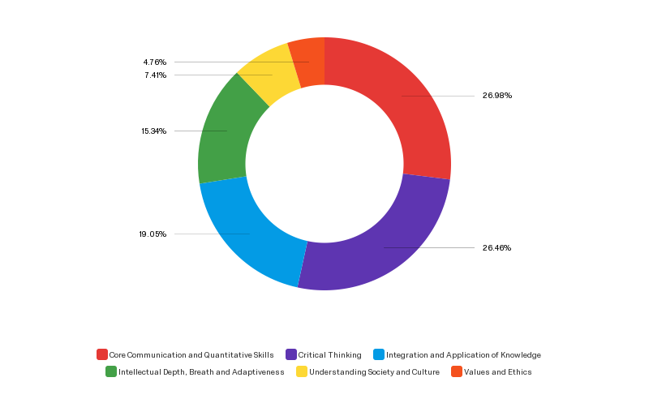
PULs
Identified by students
14.29%
22.22%
80.95%
46.03%
57.14%
79.37%

Slide 13
Quantitative Assessment cont.
Ranking of PULs was similar when filtered for gender, student classification, and prior research experience.
Ranking differed by discipline with liberal arts and social work students placing PUL# 5 (culture and society) in third place.

Slide 14
Support of quantitative data with qualitative data
PUL: Communication and quantitative skills
Summary of student comments:
Improvement of writing skills: writing reports, designing poster
Improvement of oral skills: presenting poster, ability to convey research to peers and supervisors

Slide 15
PUL: Communication Skills cont.
Select student quotes:
In my research team, there are students from different cultural background; during the research period I learned how to communicate effectively and relate with people of different cultures.
It really made me realize how it is possible that a specialist in a field can have trouble communicating important work to the general public or even in a class lecture setting.
I was the youngest student on my team and tempted to not contribute in our group discussions. I soon opened up and got very comfortable. So much so that I insisted on being a presenter at our regional conference, whereas normally I don’t enjoy public speaking.

Slide 16
PUL: Critical Thinking
Ability to first remember and understand and then apply, analyze, evaluate and create knowledge, procedures, and products.
Summary of student comments:
Honing of critical thinking skills via design of experiments, data analysis and interpretation, troubleshooting, rethinking methodological approach, reevaluation of hypothesis.

Slide 17
PUL: Critical Thinking cont.
Select student quotes:
I learned from failing on my own because I could reflect on what went wrong and how I could improve in the future.
Being a part of this research [project] has taught me to question sources and instruments used when gathering data because I caught a glimpse of how difficult it can be to interpret and analyze data.

Slide 18
PUL: Integration and Application of Knowledge
Ability of students to use information and concepts from studies in multiple disciplines in their intellectual, professional, and community lives.
Summary of student comments:
Application of knowledge acquired in class.

Slide 19
Select student quote:
Pulling knowledge from different disciplines has really helped me realize how all these disciplines come together. It is easy to view each discipline as separate when attending lectures; working in research has shown me just how much they collide [coalesce].

Slide 20
PUL: Intellectual depth, breath and adaptiveness
Ability of students to
show substantial knowledge and understanding of at least one field of study;
compare and contrast approaches to knowledge in different disciplines;
modify one's approach to an issue or problem based on the contexts and requirements of particular situations.

Slide 21
Select student quotes:
Early on I found that I needed to prep more, I needed to read more, and I needed to ask more questions. The depth that I was understanding the material wasn’t enough to connect with other scientists (they all do have PhDs) but with a fair bit of work, I could at least approach them for discussion.
In order to really solve your problem you have to actively change and adapt your protocol, find new ways of doing things and figure out how your data fits into the bigger picture of your topic.

Slide 22
PUL: Society and culture
Ability to compare and contrast the range of diversity in human history, societies and ways of life.
Ability to operate with civility in a complex world.
Summary of student comments:
Students referred to the impact their research could make on human life, health and disease

Slide 23
Select student quote:
When I started I realized that lab members were at different points in their lives and academic careers. Despite [these differences], the researchers in a lab must come together to complete a common goal.

Slide 24
PUL: Ethics and Values
Ability to make informed and principled choices and to foresee consequences of these choices.

Slide 25
Select student quotes:
I researched the ethical controversy surrounding embryonic stem cells in order to be prepared in case people inquired.
It is easy to change your data to make it significant. It is better to have honest insignificant data than to have made up data. Once papers are published, people replicate data and if it comes back inconsistent with your data your credibility as a researcher is lost.
Our research had to be fair to all sides regardless of our own political or ideological beliefs.

Slide 26
Summary
Quality of assessment data validate approach
Areas of improvement:
increase awareness of significance of research ethics
collect mentor data on student learning and compare to student self-reported data
provide feedback to select faculty to improve the quality of mentoring and as a result student learning

