Slide 1
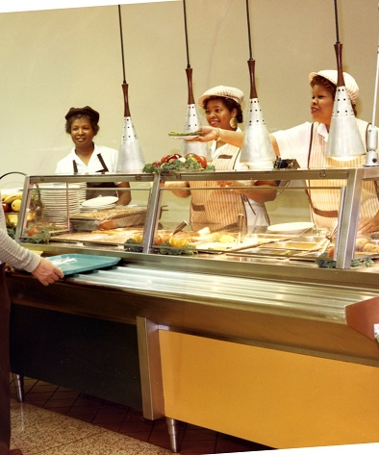
Making Internships
Work!
A Guide to the Care and Feeding of the Profession
for the Working Archivist
By Denise Rayman
Notes:
Here to share the power and the glory of internships
Photo from: https://ulib.iupui.edu/captioncontest/caption_photos/2017/April

Slide 2
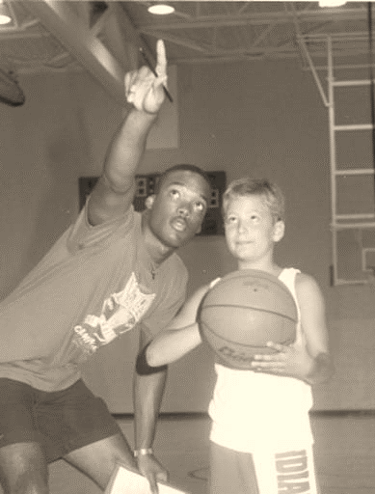
About me – what are your bonafides?
Archivist at IUI University Library
In this semester (Spring 2024) our archives hosted 9 LIS graduate student workers!
Supervise the internship program for Department of Library and Information Science - Archives Management students
  Internships required for Archives Mgmt
  Supervise 1-12 interns every semester
I know a lot about internships as an instructor and a practitioner!
Notes:
Of 9 student workers, 3 were fully remote
Photo from: https://iuidigital.contentdm.oclc.org/digital/collection/IUPUIphotos/id/8931/rec/20

Slide 3
Do internships even help students?
Preliminary results from “Graduate School Archives Internships: Exploring the Efficacy,” a study funded by Society of American Archivists Foundation, by Denise Rayman and Lydia Spotts
Notes:
Crisis of Faith question I have about my work sometimes
Ample evidence for internships in undergraduates and business fields, none for library science or archival science

Slide 4
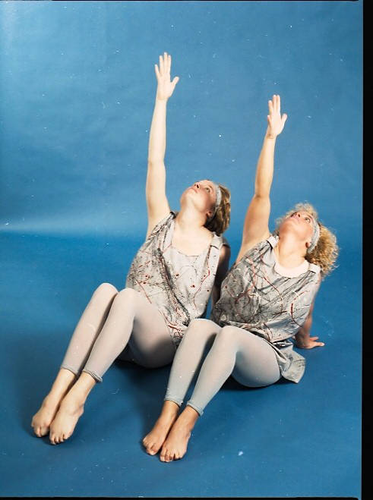
Graduate School Archives Internships: High Impact or High Barrier?
World Premiere of these research results!
Study funded by Society of American Archivists in May 2023
Survey of recent graduates in LIS programs conducted July – Aug 2023
Simple research question – do internships correlate with greater career success in the archives field?
Notes:
Photo from: https://iuidigital.contentdm.oclc.org/digital/collection/IUPUIphotos/id/10903/rec/43

Slide 5
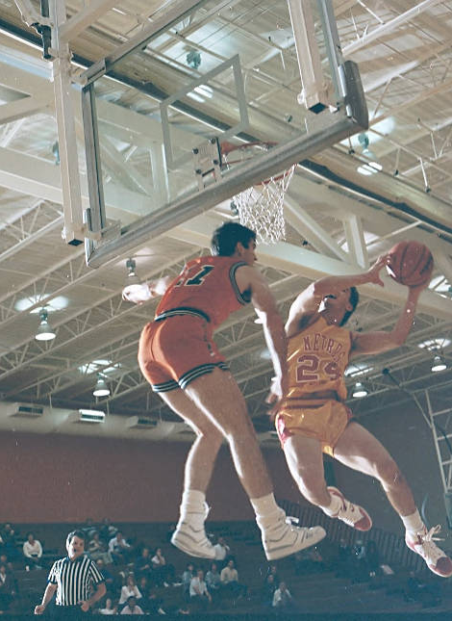
YES, INTERNSHIPS
WORK

Slide 6
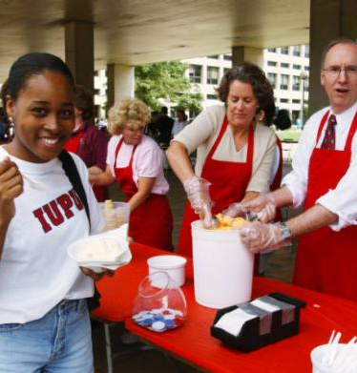
Quick correlations from survey data
Students who completed an internship are more likely to still be employed in the field at time of survey (0-12 years after graduation)
Students who completed an internship spent less time job hunting
Students who were paid in their internship are more likely to still be employed in the field
Students who were mentored in their internship are more likely to still be employed in the field
Notes:
Photo from: https://ulib.iupui.edu/captioncontest/caption_photo/2021/august

Slide 7
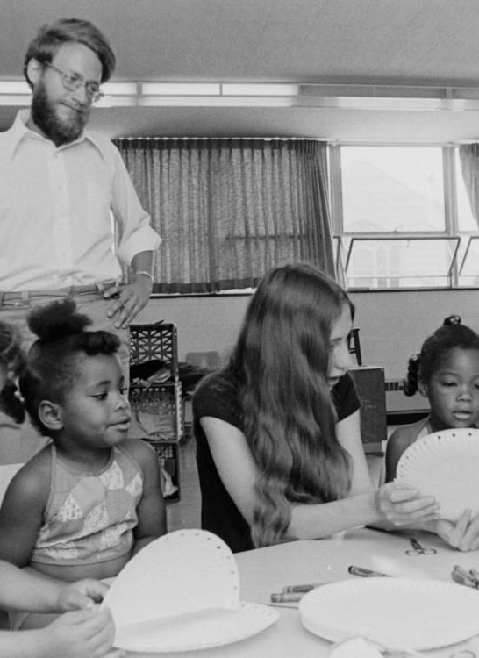
How do we make internships work at our archives?
Notes:
Photo from: https://iuidigital.contentdm.oclc.org/digital/collection/IUPUIphotos/id/9500/rec/6

Slide 8
Frequently asked questions about hosting internships
How many work hours is an internship?
How much time does it take to supervise an intern?
Do I have to pay my intern?
Can I have a remote-work intern?
We aren’t a fancy archives with ASpace and CONTENTdm etc. Can I still host an intern?
What should I have my intern do?
Notes:
How many hours is an internship?
150-200 hours. At IUI DLIS, 180 hours. This works out to about 10-12 hours per week in one semester
How much time does it take to supervise an intern?
This depends on the intern. Interns with previous A&D or Metadata classes probably need lower supervision, interns with less experience will need more. I recommend a weekly check-in of 30 minutes, with a longer time commitment for onboarding and start-up.
Do I have to pay my intern?
I know not all internships can be paid, but you should do everything short of fist-fighting your boss to try to pay your intern. Do not accept unpaid as the default. (Additional slide coming.)
Can I have a remote-work intern?
Yes! I have 3 fully-remote graduate student workers at my archives
We don’t have ASpace and CONTENTdm etc. Can I still host an intern?
Yes. This is the real world. Interns need to learn that many good archives are run on shoestrings.
What should I have my intern do?
See next slide!

Slide 9
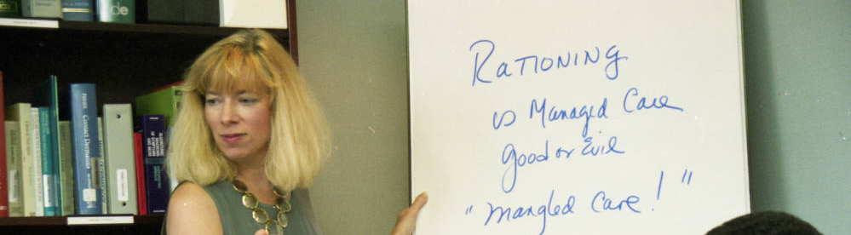
The Ethical Internship:
Who gets more out of it, you or them?
Notes:
Photo from: https://iuidigital.contentdm.oclc.org/digital/collection/IUPUIphotos/id/13814/rec/2

Slide 10
Best practices: Food for interns
GOOD WORK
Processing smaller collections, including writing a finding aid
Processing born-digital collections
Significant interfiling or accrual to existing collection
  Learn how to interpret other people’s processing decisions!
Writing metadata for digitized material (like photographs)
  Experience with CONTENTdm etc. very valued in field
And more!
“BAD” WORK
Scanning photographs and paper
Transferring digital media (ripping CDs and floppies etc)
Staffing the reference desk, watching the reading room, answering the phone
Anything clerical, rote, or requiring simple skills and training
This work is not actually bad, and we all do it, but not appropriate for an internship
Notes:
My longest and most controversial slide

Slide 11
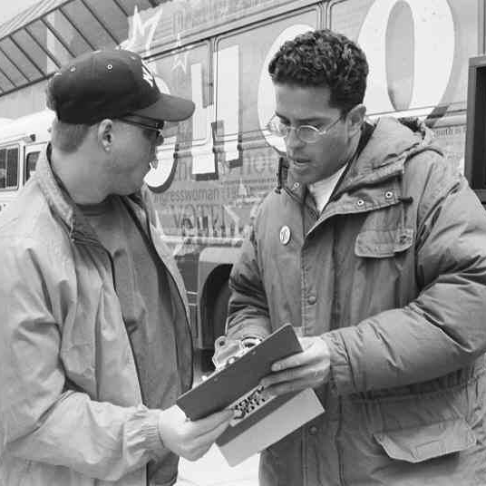
Examples of meaningful work
Library of Congress: metadata work on the US Copyright Office Virtual Card catalog: https://www.copyright.gov/vcc/
Shoah Foundation: metadata work for video testimonials/oral histories of genocide https://vha.usc.edu/home
My archives: intern helped me write a grant to digitize obsolete media

Slide 12
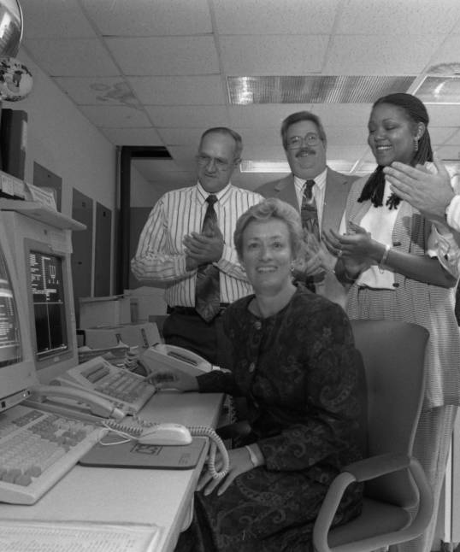
What do you want a new archivist to know?
Train the profession you want to see!

Slide 13
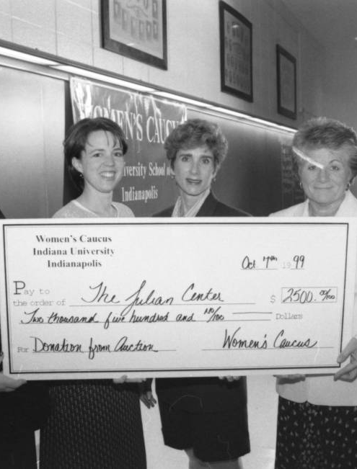
Lowering Barriers to internships
Move away from volunteer as the default!
An intern working 180 hours for $15/hr costs you just $2,890 (including taxes)
  This flat-dollar ask goes down smoother with upper administrators
  Looking for a grant? Write an internship into it!
  Library Friends groups have sponsored interns
How to make an unpaid internship tolerable:
  Be flexible! Respect their paid work schedule
  Free parking
  Random perks – send them to SIA Annual!
  Offer remote work!
Notes:
https://iuidigital.contentdm.oclc.org/digital/collection/IUPUIphotos/id/14916/rec/6

Slide 14
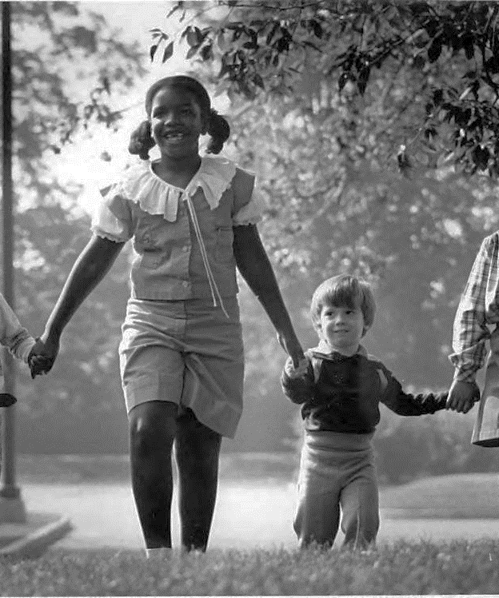
Students are the best part of my job
Everyone remembers their first archives job – be remembered for the right reasons!
Notes:
Many survey respondents reported poor internship experiences – no one talked to them, the work was boring, just punching the clock to meet a requirement – don’t be part of that
Photo from: https://iuidigital.contentdm.oclc.org/digital/collection/IUPUIphotos/id/9831/rec/2

Slide 15
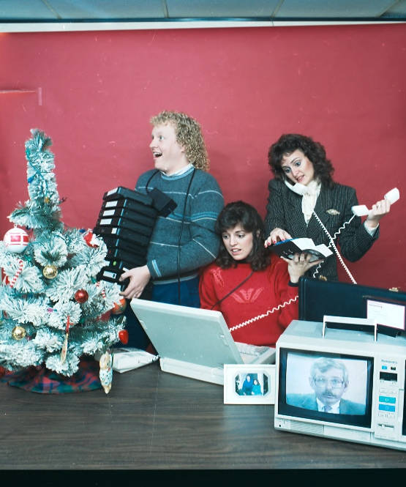
Feed an intern today!
Denise Rayman
drayman@iu.edu
All photographs are from IUPUI Image Collections: https://library.indianapolis.iu.edu/digitalcollections/uarchives/ua024
Notes:
Photo from: https://iuidigital.contentdm.oclc.org/digital/collection/IUPUIphotos/id/10519/rec/22

