Slide 1
The Great Academic Publishing Racket
The Publishing Process, Journals of Ill Repute, and the Importance of Open Access

Slide 2
The Traditional Publishing Model

Slide 3
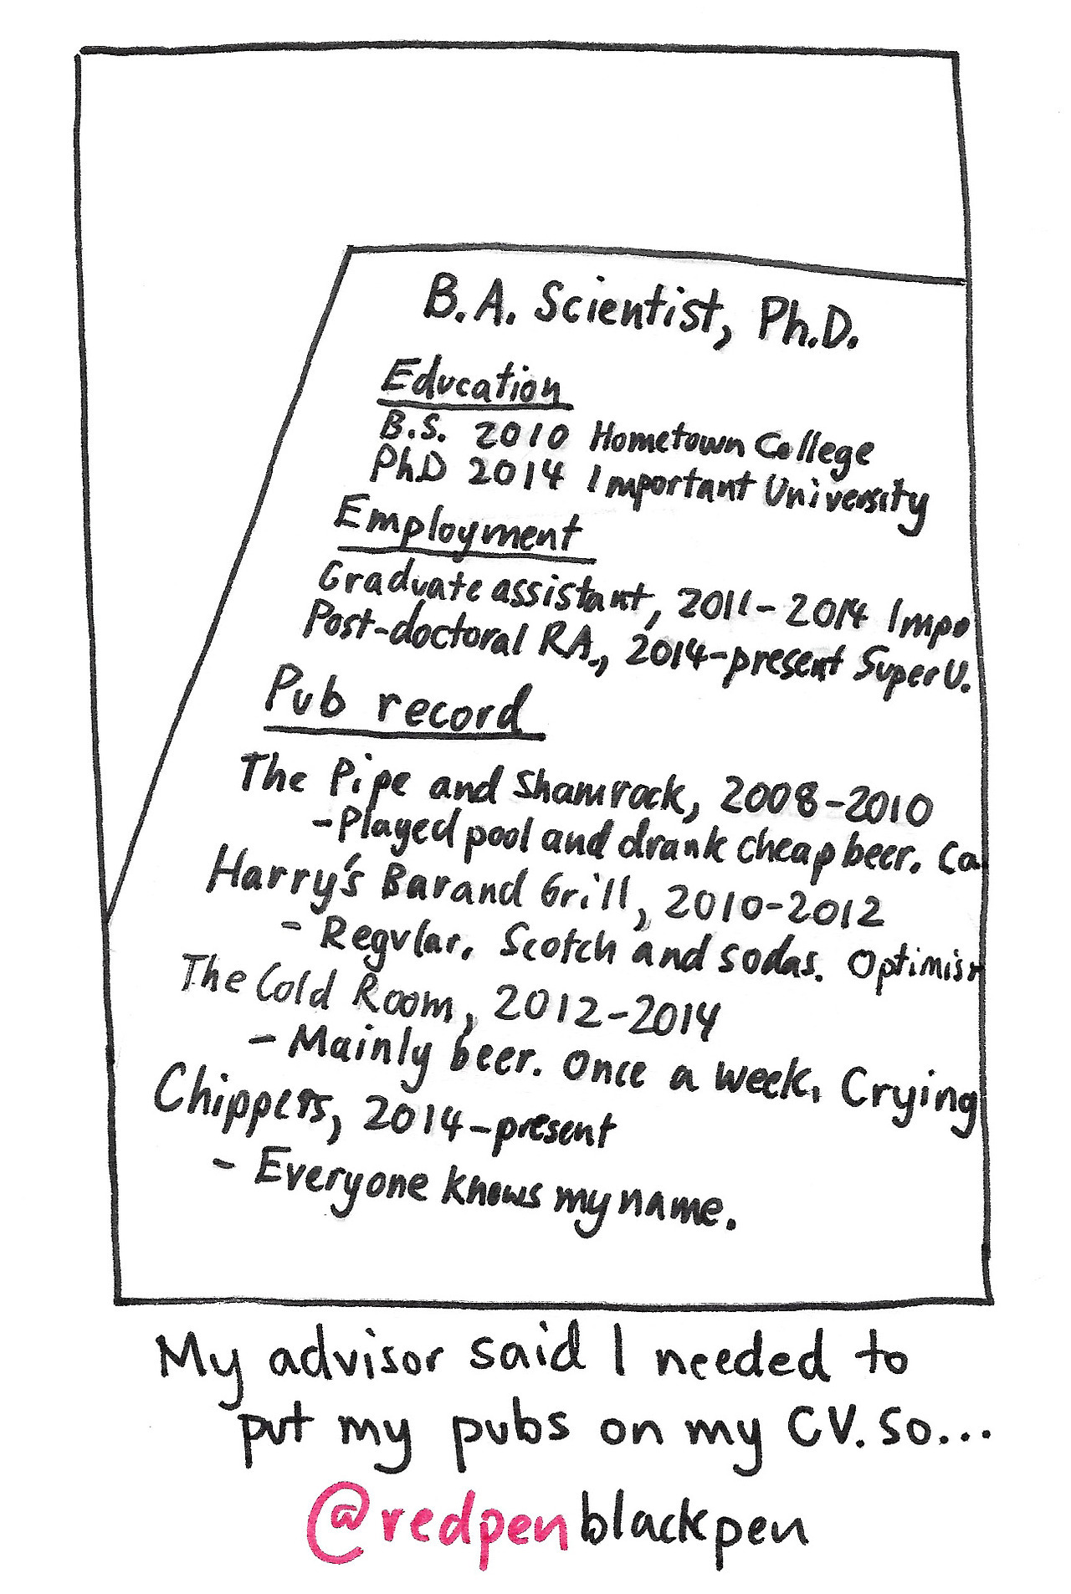
Publishing is important!
Why?
Share and Promote New Ideas
Advance Evidence-Based Practice
Get Cited
Promotion and Tenure

Slide 4






Who are the Key Players?
Author (that’s you!)
Journal
Editor
Peer Reviewers
Publisher
Notes:
The Author writes an article detailing their ground-breaking research results, they choose a journal to submit to based on the recommendation of their faculty advisor, mentor, or peers. An editor receives the submission and makes an initial assessment on whether it is well-suited for the journal. If it is, they will send it out to several peer reviewers (usually 3-4), who will read the work and decide if the research is sound and if it needs major or minimal edits in order to be published. Once reviewed, the work will be sent back to the author with the comments from the reviewers, and the author can choose to continue with the original journal, or try a different one. If they choose to make the edits and re-submit, they will then be notified

Slide 5
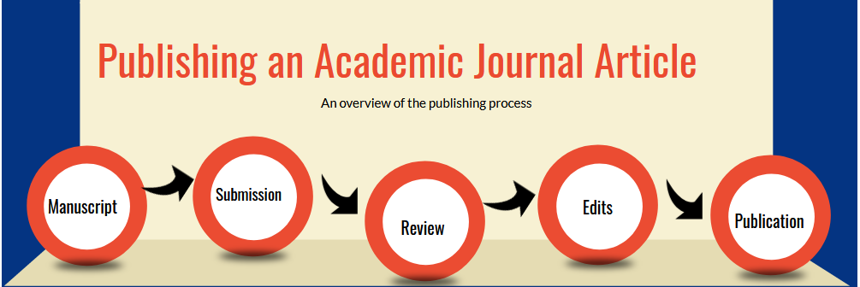

Slide 6
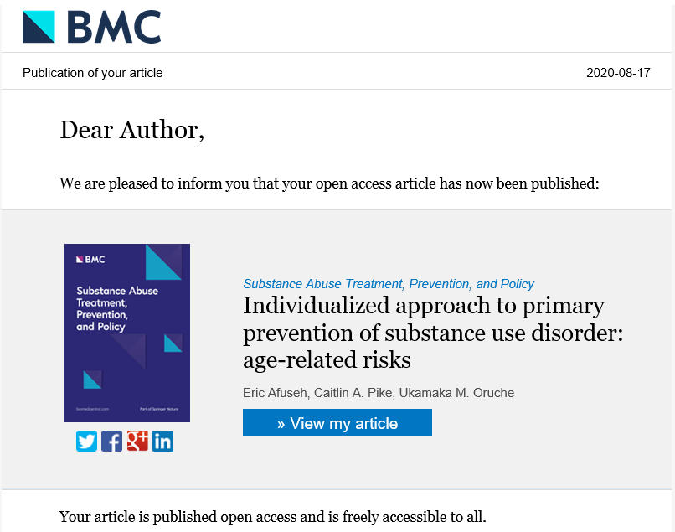
Publication
As an author, you have the ability to negotiate and retain certain rights to your work!
Read the publication agreement carefully…some publishers are open to negotiating terms such as:
  Publishing the final version of your article to your website.
  Republishing the work in a later work of your own.
  Granting permission for others to use your work.

Slide 7
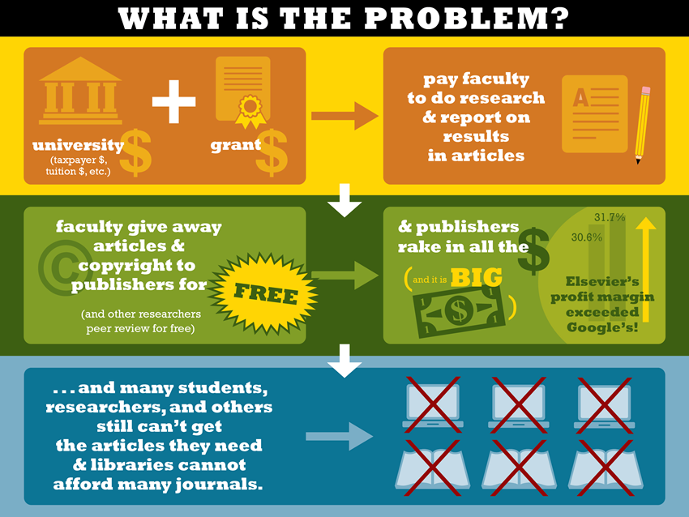
Source: http://justpublics365.commons.gc.cuny.edu/files/2014/10/Problem-infographic3.jpg

Slide 8

Global Production of Articles
~ 2.5 million English language articles per year
~ 3% - 7% annual growth rate
Over 90% of all journals are now online (96% STM; 87% SS & Humanities … in 2008)
~ 12% of all articles published are in legitimate OA journals (2014)
(Ware & Mabe, The STM Report. 2015)

Slide 9

Subscription Journal Market
- 88% of the journal share is subscription-based
Majority owned by 5 very profitable companies
(Elsevier, Springer, Wiley, Taylor & Francis, SAGE …)
Profit margins: 30% - 40%
(in contrast: Apple, 23%; Eli Lilly, 20%; Berkshire Hathaway, 11%)
CEOs of Elsevier, Thomson, Wolters Kluwer: $13+ mil. Salaries
Subscription prices increase by 6% - 7% per year
Larivière, et al. 2015; Sola, 2016.; Tivnan, 2017.
Image: Flaticon

Slide 10
If gasoline prices kept pace with journal prices …
$4,276
Average price for a subscription to a Chemistry or Physics journal in 2015
Odell, 2016. The Lewis …. http://hdl.handle.net/1805/8684

Slide 11
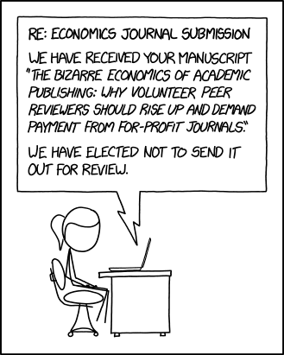
The Catch
Only the publisher is paid for their work…and they, arguably, do the least amount.
Anyone who wants the information in these journals must pay for it.
The same institutions that pay for your time to create the research must also pay to access it.
Source: https://xkcd.com/2025/

Slide 12
Predatory Publishing

Slide 13
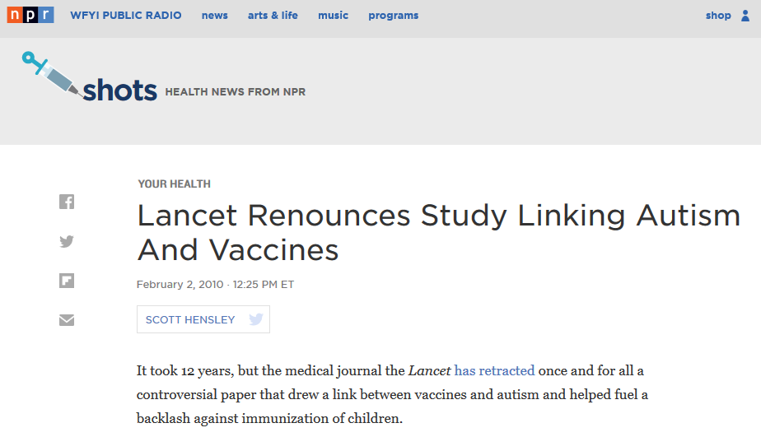
12 years!
(Peer reviewed, paywalled, Elsevier, JIF 47.83)

Slide 14

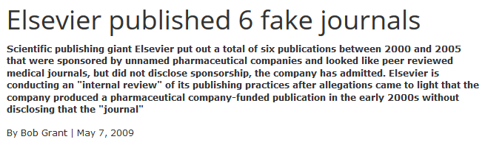

Paywalled, “peer reviewed,” Elsevier journals

Slide 15
What is a predatory journal?
A journal that isn’t clear with their intentions!
They charge a fee, and then they don’t deliver on what they’ve promised.
Things to look out for…
Claims peer review, but offers a short turn-around time
Poorly designed website
Overly broad content
Dubious editorial board
Lies about association memberships and/or database inclusion

Slide 16
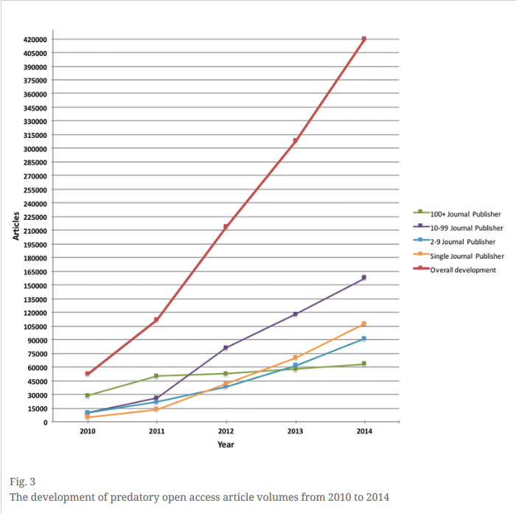
Yes, we have a global problem!
420,000 “articles” in 2014 (Shen and Bjork)?
Shen and Bjork, 2015

Slide 17
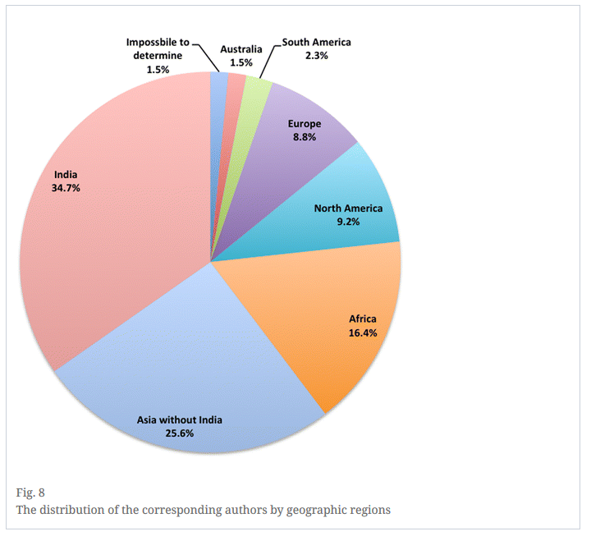
Who writes these articles?
U.S. authors: 6% of sample
Stratified sample: 200 articles from 47 journals
Shen and Bjork, 2015

Slide 18
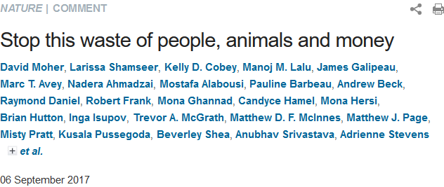
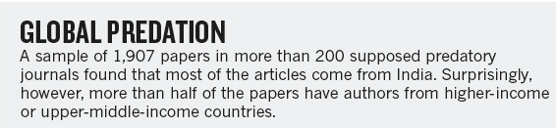
Who writes these articles?
India: 27% of sample (> 10% of national output; Scopus)
USA: 15% of sample (< 1% of national output; Scopus)

Slide 19
Why do authors submit to fraudulent journals?
71% of respondents
unaware that the journal could not be trusted
Sample: 96 authors
(61% published in a journal from their country)
“I sent my paper to that journal because I checked its editorial pages and I found [that its] editors [were] from India. Since I am also from India, I thought this journal would understand my paper more and decide accordingly.”
(Kurt, 2018)

Slide 20
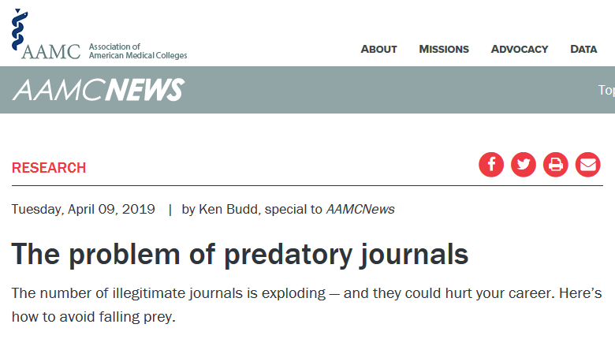
Eroding science
Open access could soon become more prevalent. For example, in September 2018, 11 agencies that award around $8.8 billion in annual research grants announced that they would require the scientists they fund to make their papers free to read upon publication, starting in 2020. The initiative, called Plan S, comes from funders in 11 different European countries.

Slide 21
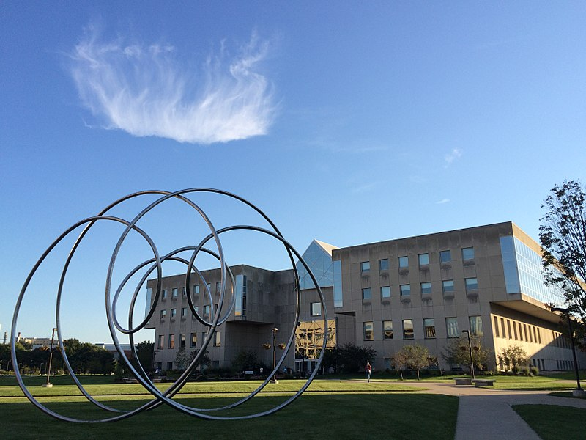
But do we have a problem at IUPUI?
Image: Mlemusrojas, CC BY SA

Slide 22
IUPUI Articles in “Predatory” Journals?
Moher, D., et al. (2017). Stop this waste of people, animals and money. Nature News, 549(7670), 23. https://doi.org/10.1038/549023a
Sample size: 1,907 articles in 200 journals
IUPUI = 0

Slide 23
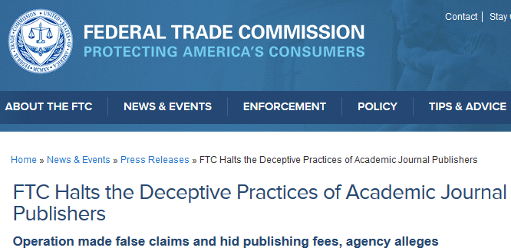

FTC, 2017
IUPUI articles = 6
(about 1 per year)
5 corresponding authors
(4 with tenure at date of publication)

Slide 24
IUPUI OA Fund Requests (2013-present)
Total Requests for Support: 176
Requests Denied for Journal Quality: 3 (2%)
(OA Journal not included in the DOAJ)
  2 = Oncotarget (http://www.oncotarget.com)
  [Indexed in Web of Science 2017; IF 5.8]
  ----
  1 = International Journal of Emerging Technology and Advanced Engineering (http://www.ijetae.com/)

Slide 25
Meanwhile … Is this an “exploding” problem?
IUPUI Articles 2017 (excluding Medicine)
Trusted? | Items
Yes | 1080 (98.3%)
No (appears to be disreputable) | 14 (1.3%)
Maybe | 5 (.5%)
Total | 1099
Journal requires an APC and makes false claims about indexing, etc.
No evidence of dishonesty, but below threshold for “trusted” (e.g., not in the DOAJ)

Slide 26
Leading Indicators that a Journal isn’t Reputable
Not indexed by the DOAJ: https://doaj.org/
Website or email is too general or full of errors.
The journal makes false claims about indexing in PubMed, DOAJ, etc.
The journal makes false claims about location of publication (e.g., title says “American” but it is published in Nigeria)
Articles published by the journal are poorly written by authors you’ve never heard of and … often on topics that are not within scope.
The article fee is not disclosed or is too low ($150.00-$200.00).
The contact email is non-professional: gmail or yahoo.

Slide 27
Questions to Consider…
Is it clear what fees will be charged, if any? What are the fees?
Can you easily identify and contact the editor and/or the publisher?
Who are the editor(s) and what are their institutional affiliations?
Is the journal listed in the Directory of Open Access Journals (DOAJ) or a similar organization? Which ones?
Are the articles in the journal found in databases that you use? Which ones?
Are there grammar and spelling concerns?
Does the website talk about peer-review and what is the turnaround time?
Does the website look legitimate? Why or why not?

Slide 28

Things to Avoid…
Immediately writing off journals published in the developing world
Using pre-determined journal “blacklists”
Ignoring new journals just because they are new
Publishing in any journal that solicits your work AND asks you to pay them
Source: https://anrinfo.org/mistakes-to-avoid-on-facebook/

Slide 29
Things to Explore…
Think. Check. Submit.
  Through a range of tools and practical resources, this international, cross-sector initiative aims to educate researchers, promote integrity, and build trust in credible research and publications.
The Be iNFORMEd Checklist – Duke University Medical Center Library & Archives
  Get a suspicious invitation to publish? Find a new journal and want to know if it meets your quality standards? Duke developed this checklist to help potential authors determine whether a journal or publisher is potentially predatory or of low quality.
Directory of Open Access Journals (DOAJ)
  DOAJ is a community-curated online directory that indexes and provides access to high quality, open access, peer-reviewed journals.
Publishing Process Overview – University of Rochester, River Campus
  Much of the Publishing Process section of this presentation is collected here, along with other great tips!

Slide 30
Open Access

Slide 31
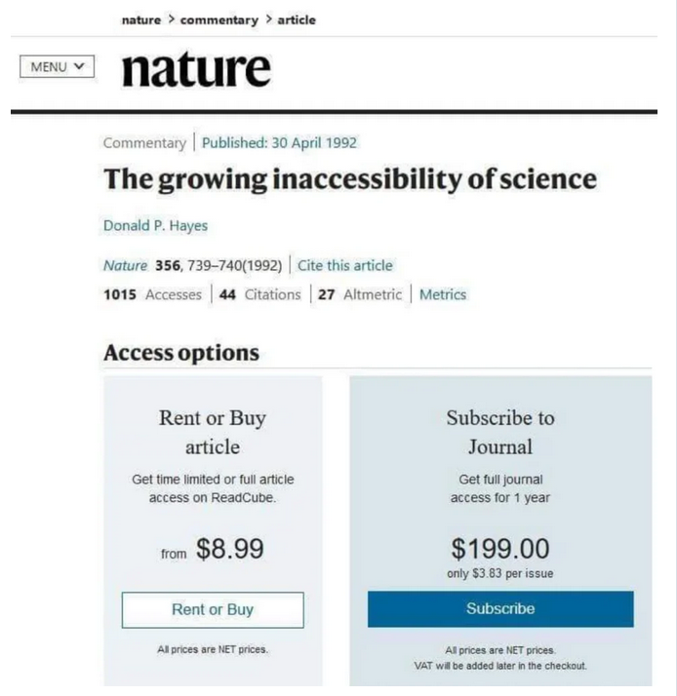
Academic Irony…

Slide 32
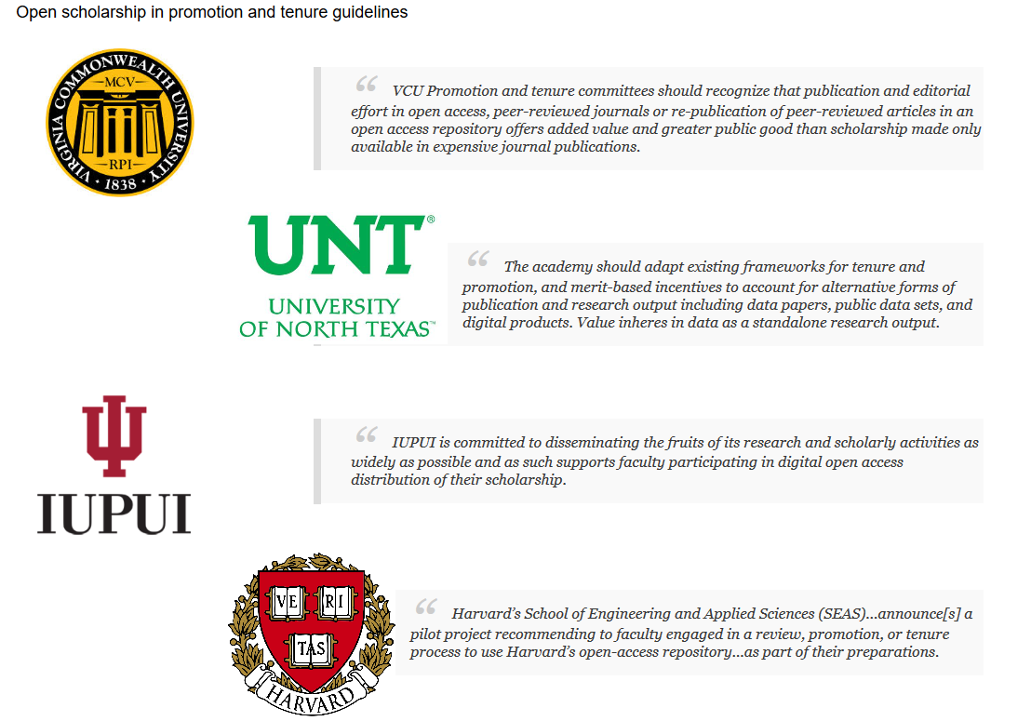
Open Access at IUPUI
IUPUI has a national reputation for best practices in OA dissemination
McKiernan, Get that promotion.

Slide 33
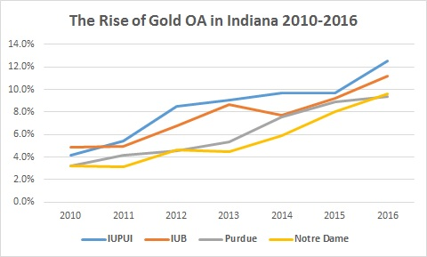
IUPUI Leads Indiana in the Publication of Articles in Legitimate OA journals
Odell, 2016. Gold ….

Slide 34
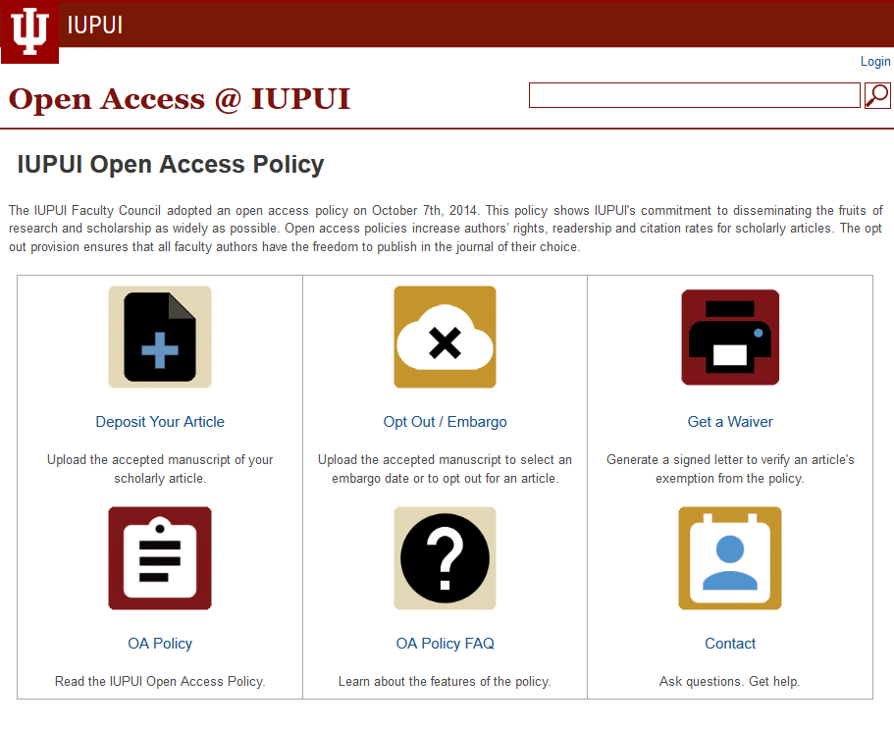
65%-70% of articles (2015-2017) by IUPUI authors are free to read
Center for Digital Scholarship, IUPUI University Library, 2017.

Slide 35


Final Thoughts…
Open access gives anyone with an internet connection access to research.
This access exists regardless of income, education, geographic location, or any other factor.
It also promotes citizen science, and helps to create a more informed public.
Source(s):
http://med.stanford.edu/ourvoice.html
https://commons.wikimedia.org/wiki/File:Open_Access_logo_PLoS_white.svg

Slide 36
Thank you for your attention!
Caitlin A. Pike, MLS, MPH | caiapike@iupui.edu
Research Engagement and Scholarly Services Coordinator
Health Sciences Librarian, IUPUI University Library
Hannah Craven, MLIS | hancrave@iu.edu
Research and Scholarly Communications Librarian, Ruth Lilly Medical Library

