Slide 1
Creating Alignment in a Complex Policy Environment:
The Case of Indiana’s Certified and Reimburseable Community Health Workers
Courtney Randolph, MPH
Hannah Maxey, PhD, MPH
Indiana University Bowen Center for Health Workforce Research & Policy
May 3rd, 2019

Slide 3
Objectives
  Provide a background on Community Health Workers (CHWs)
  Describe methods for occupational regulation/“sunrise” policy
  Discuss findings from policy coordinating process
  Identify lessons learned for creating alignment in the many moving policy parts

Slide 4
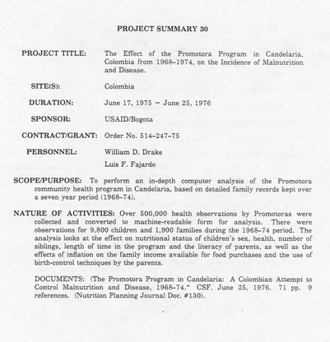
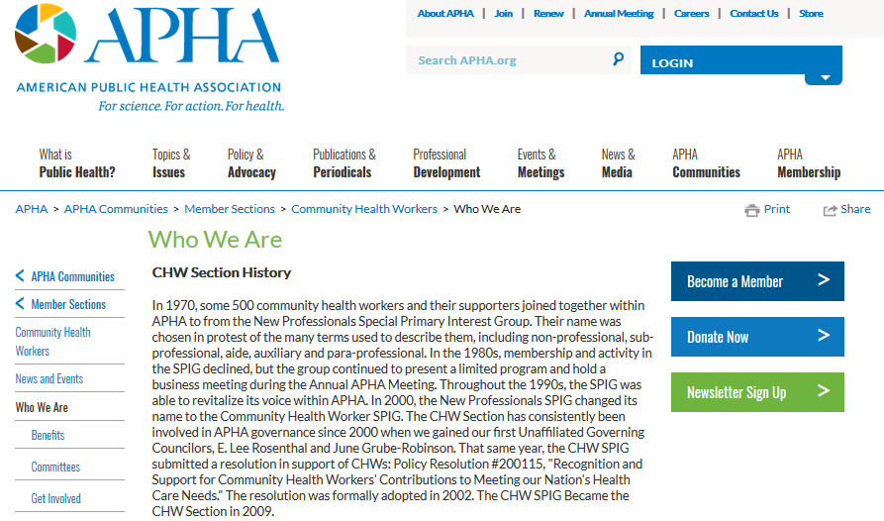
Background
CHWs have a long history of serving their communities
Promotoras arose in Mexico in 1960s & spread to Latin America
United States: formalization began in 1970s
WD, D. (1976). The Promotora Program in Candelaria: a Colombian attempt to control malnutrition and disease 1968-74. Cali Colombia Community Systems Foundation, 72.
American Public Health Association. History of the CHW Section. Available from: https://www.apha.org/apha-communities/member-sections/community-health-workers/who-we-are

Slide 5
Background: CHWs rise to recognition nationally
  HRSA Report on CHWs (2007)¹
  Assignment of a formal occupational code through Department of Labor (2010)²
  CMS allows Medicaid reimbursement of non-licensed health professionals to deliver preventive services³ (2013)
    “States must include in their state plan amendment a summary of practitioner qualifications for practitioners who are not physicians or licensed practitioners. The summary should include any required education, training, experience, credentialing or registration.”
Community Health Worker National Workforce Study. 2007. Health Resources & Services Administration. Available from: https://bhw.hrsa.gov/sites/default/files/bhw/nchwa/projections/communityhealthworkforce.pdf
Full definition of CHWs as defined by the Department of Labor available at: https://www.bls.gov/oes/2017/may/oes211094.htm
Centers for Medicare & Medicaid Services. Informational bulletin: Update on Preventive Services Initiatives. Available at: https://www.medicaid.gov/Federal-Policy-Guidance/Downloads/CIB-11-27-2013-Prevention.pdf

Slide 6
CHWs Rise to Recognition in Indiana – 2017 political environment
Employers need financial incentive for delivery of preventive services
Indiana citizens need gainful employment
We need to improve the health of our communities
Workforce Development
Public health
Reimbursement

Slide 7
Indiana’s 2017 CHW Regulatory Environment
Implications for the State
Various third party associations offered “certification” (no ties to state)
No standardized training or practice of CHWs
CHWs in many roles, under many titles
No reimbursement existed – many CHWs are financed though grant-funding
No state intervention
No state ability to quantify
Employers don’t know what CHWs are trained to do and there is no standard/quality assurance of training
Services provided by CHWs were not financially sustainable
Employers hesitant to hire CHWs

Slide 8
Mechanism for Action: Policy Coordinating Body
Governor’s Health Workforce Council established in 2016 to serve as a policy coordinating body for health workforce issues
Perspectives represented include:
Medicaid
Occupational Regulation/Licensing
Workforce Development
Public Health
Health Employers
K12 and Higher Education
Health Workforce Researchers
Legislative Health Committee Chairs (House & Senate)

Slide 9
Getting the ball rolling: Creating a Forum for Sunrise of CHWs
Established CHW Workgroup (2017)
Workgroup leadership: Public Health Agency & Department of Workforce Development
Workgroup Charge: Create recommendations for sunrise of CHWs in Indiana
Learn more about the CHW Workgroup at: https://www.in.gov/dwd/3202.htm

Slide 10

Defining “Sunrise”
“Sunrise is a process under which an occupation or profession wishing to receive State certification or licensure must propose the components of the legislation, along with cost and benefit estimates of the proposed regulation. The profession must then convince the legislators that consumers will be unduly harmed if the proposed legislation is not adopted.”
No state intervention
Some level of state regulation
Council on Licensure Enforcement and Regulation. Sunrise, Sunset and State Agency Audits. Available at: http://www.clearhq.org/page-486181.

Slide 11
Methods for Sunrise Review of CHWs in Indiana

Slide 12
Methods: Indiana’s Current Sunrise Process
No legislative provisions/process for sunrise reviews exists.
Sunrise for occupational regulation is treated just like any other legislative initiative.
Interested occupations/stakeholders approach legislators for consideration
If legislation is proposed, bill is assigned to committee at discretion of legislative leadership (usually either a health committee or employment/labor committee)
Outcomes:
  No bill is proposed
  Bill defeated
  Summer study committee
  Signed into law

Slide 13
Methods:
Getting the right people at the table
Conduct landscape analysis of CHW regulation
Identify “leading” states; key considerations:
  Regulatory structure (umbrella agency vs. de-centralized regulation)
  Reimbursement
Work in unison with related efforts (reimbursement)
Develop recommendations (legislation, rules, and/or programmatic)

Slide 14
Key Findings

Slide 15
Key Findings:
9 CHW Workgroup meetings were held between October 2017 and August 2018
Workgroup Actions and Findings
Understand current regulatory process for CHWs in Indiana
Reviewed state statute & rules | Reviewed state workforce data | Engaged key stakeholders
No state intervention identified for regulating CHWs
Regulatory Landscape Analysis
Reviewed other states CHW regulatory schema
Identified states with promising practices for Indiana
Generate final recommendations for sunrise of CHWs
National experts assisted with facilitating discussions to achieve consensus
Finalized recommendations for CHW regulation in 7 content areas

Slide 16
Key Findings
Components of recommendation:
Definition
Competencies & Skills
Occupational Regulation: State Certification
Education & Training
Grandfathering
Registry
Regulatory Oversight

Slide 17
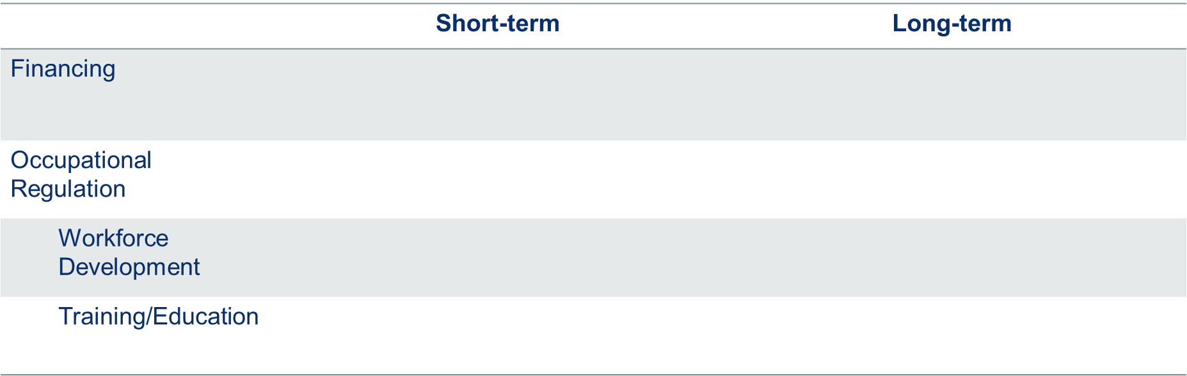
Outcomes: The Current State of CHWs in Indiana
Indiana has both a short-term and a long-term vision for CHWs
Medicaid reimbursement went into effect July 2018
Ongoing, sustainable reimbursement for CCHWs (possibly expanded)
Medicaid recognizes certification from specific training vendors
State-administered certification and registry
CCHW is a marketable credential
Stackable credentials for CCHWs
Medicaid adopted workgroup’s competencies
Process for state-review of curriculum for alignment (de-centralized training for a flexible workforce)

Slide 18
Lessons Learned
  Public Forum: Get the right people to the table and allow all “voices” to be heard
  Have a Mechanism for Action: A feedback mechanism for policy must exist:
    Could be legislative, administrative, or programmatic
  Leverage the Momentum

Slide 19
Thank you!
For additional information or follow-up, contact Bowen Center
bowenctr@iu.edu

