Slide 1
Data Visualization in Collections: Demonstrating Value
KATHARINE MACY, UNIVERSITY LIBRARY
IUPUI

Slide 2
Value is complex

Slide 3
Project Workflows
Exploration
Other Institutions
Best Practices
Stakeholder Analysis
Meetings & Surveys
Thematic Analysis
Dashboard Creation
Learning the Platform
Tool Evaluation
Selection for Dashboard Pilot
Data Cleanup & Structure
Visualization Creation

Slide 4
Exploration
Other Institutions
Best Practices
Tool Evaluation
Data Visualization at other institutions
CARL Data Visualization Toolkit
Google DataStudio

Slide 5
Stakeholder Analysis
Meetings & Surveys
Thematic Analysis
Selection for Dashboard Pilot
Internal Stakeholders | External Stakeholders
Library Administration Library Council Subject Liaison Librarians Collection Working Group | Students Teaching Faculty Research Faculty University Administration Community
Meetings & Surveys focused on the key groups above for the pilot creation of the dashboard.
In May 2022, a library wide survey was distributed to gain additional perspectives on how collection data is used by all library faculty & staff that will inform future development of dashboard visualizations, as well as the work of the the Resources Description & Acquisitions department.

Slide 6
Dashboard Creation
Learning the Platform
Data Cleanup & Structure
Visualization Creation
YouTube has great training.
Determining how to structure the data to create desired visualization was largest challenge.
Show your visualizations to colleagues and let them play – they will figure out what doesn’t work!

Slide 7
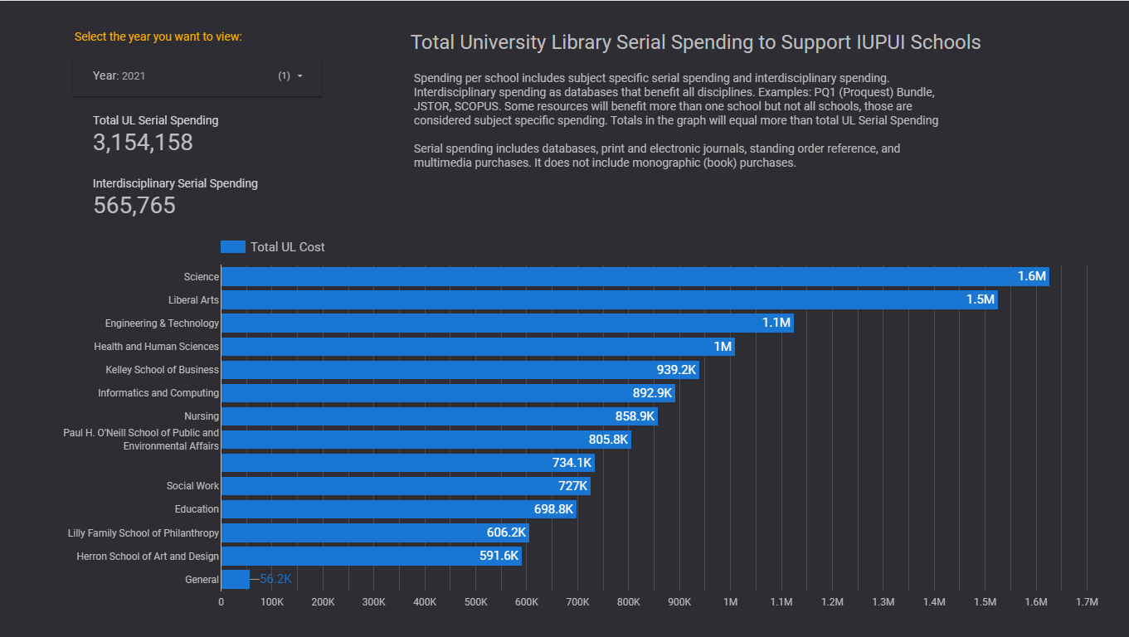

Slide 8
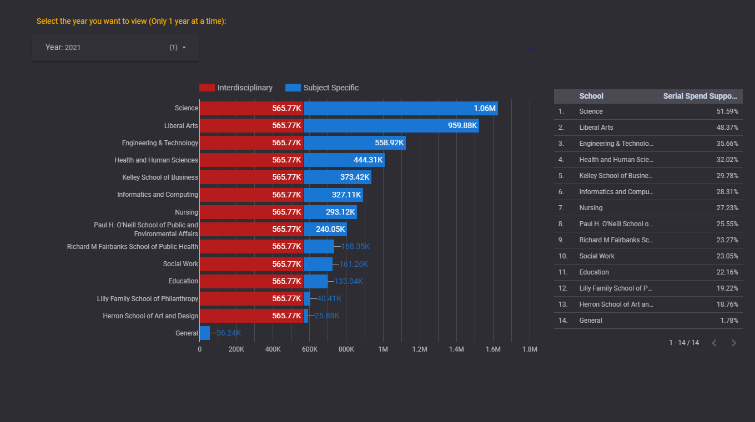

Slide 9
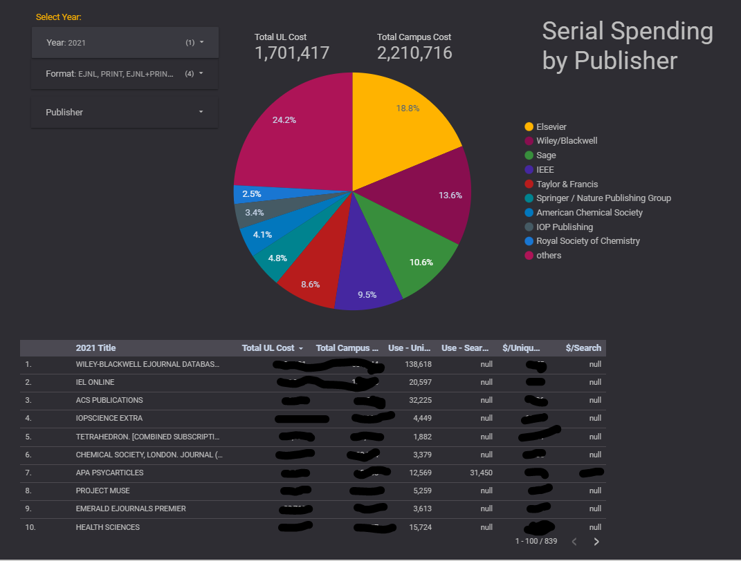

Slide 10
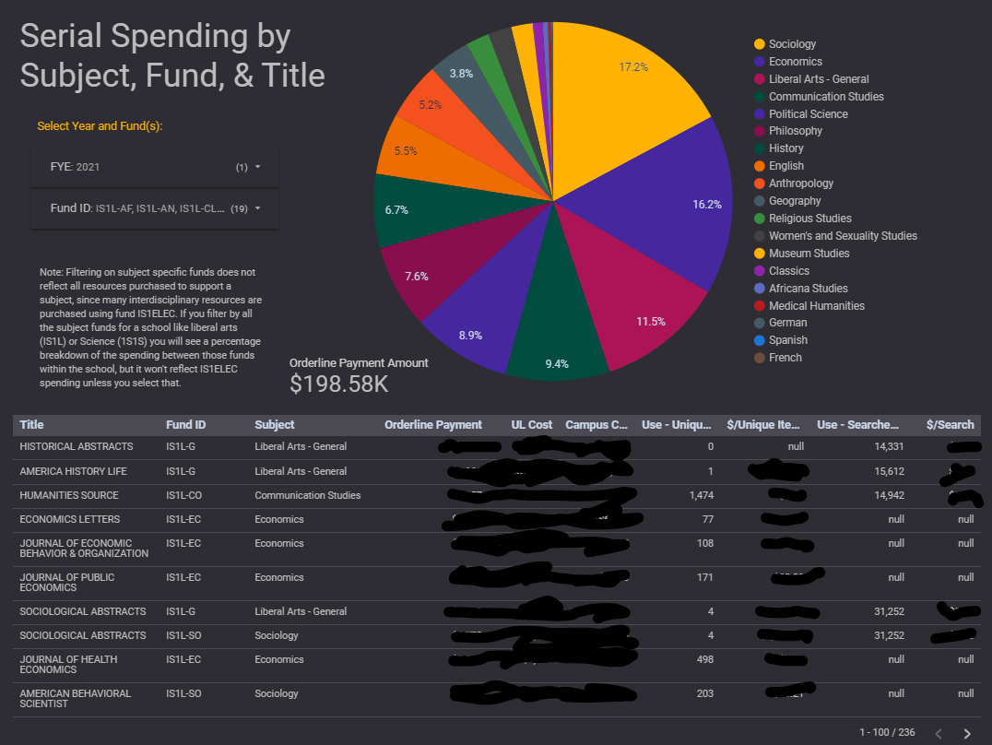

Slide 11
Some Project Lessons from Next Generation 2.0
Considering the changing landscape of higher education and the fiduciary pressures faced, libraries must address value and data visualization may help express that part of our story.
Data visualization can be a tool to strategically address concerns of people with different change styles (comfort with change).
Value alignment is important when leading. The stakeholder analysis was intended to uncover key questions and help discover what our stakeholders find important.
Diversity, Equity, Inclusion, and Antiracism practices is critical as we evaluate practices and processed moving forward. Data visualization can aid it understanding our data around collections and DEIA. One visualization in the queue to be created is evaluating the collecting patterns since the move to patron driven acquisitions for books in 2019.
Data visualization is a way to help break down information silos that lead to organization dysfunction.

Slide 12
Thank you!
Kristi Palmer
Tina Baich
Sara Lowe
Willie Miller
Kevin Petsche
Jere Odell
IFC Library Affairs Committee
UL Educational Services
UL Collection Working Group
Gina Gibau
Kathy Grove
Next Generation 2.0 Staff

