Slide 1


Determining BATNA: Analyzing the Value of Packages &
A La Carte Purchasing
NEGOTIATION 201 SERIES

Slide 2
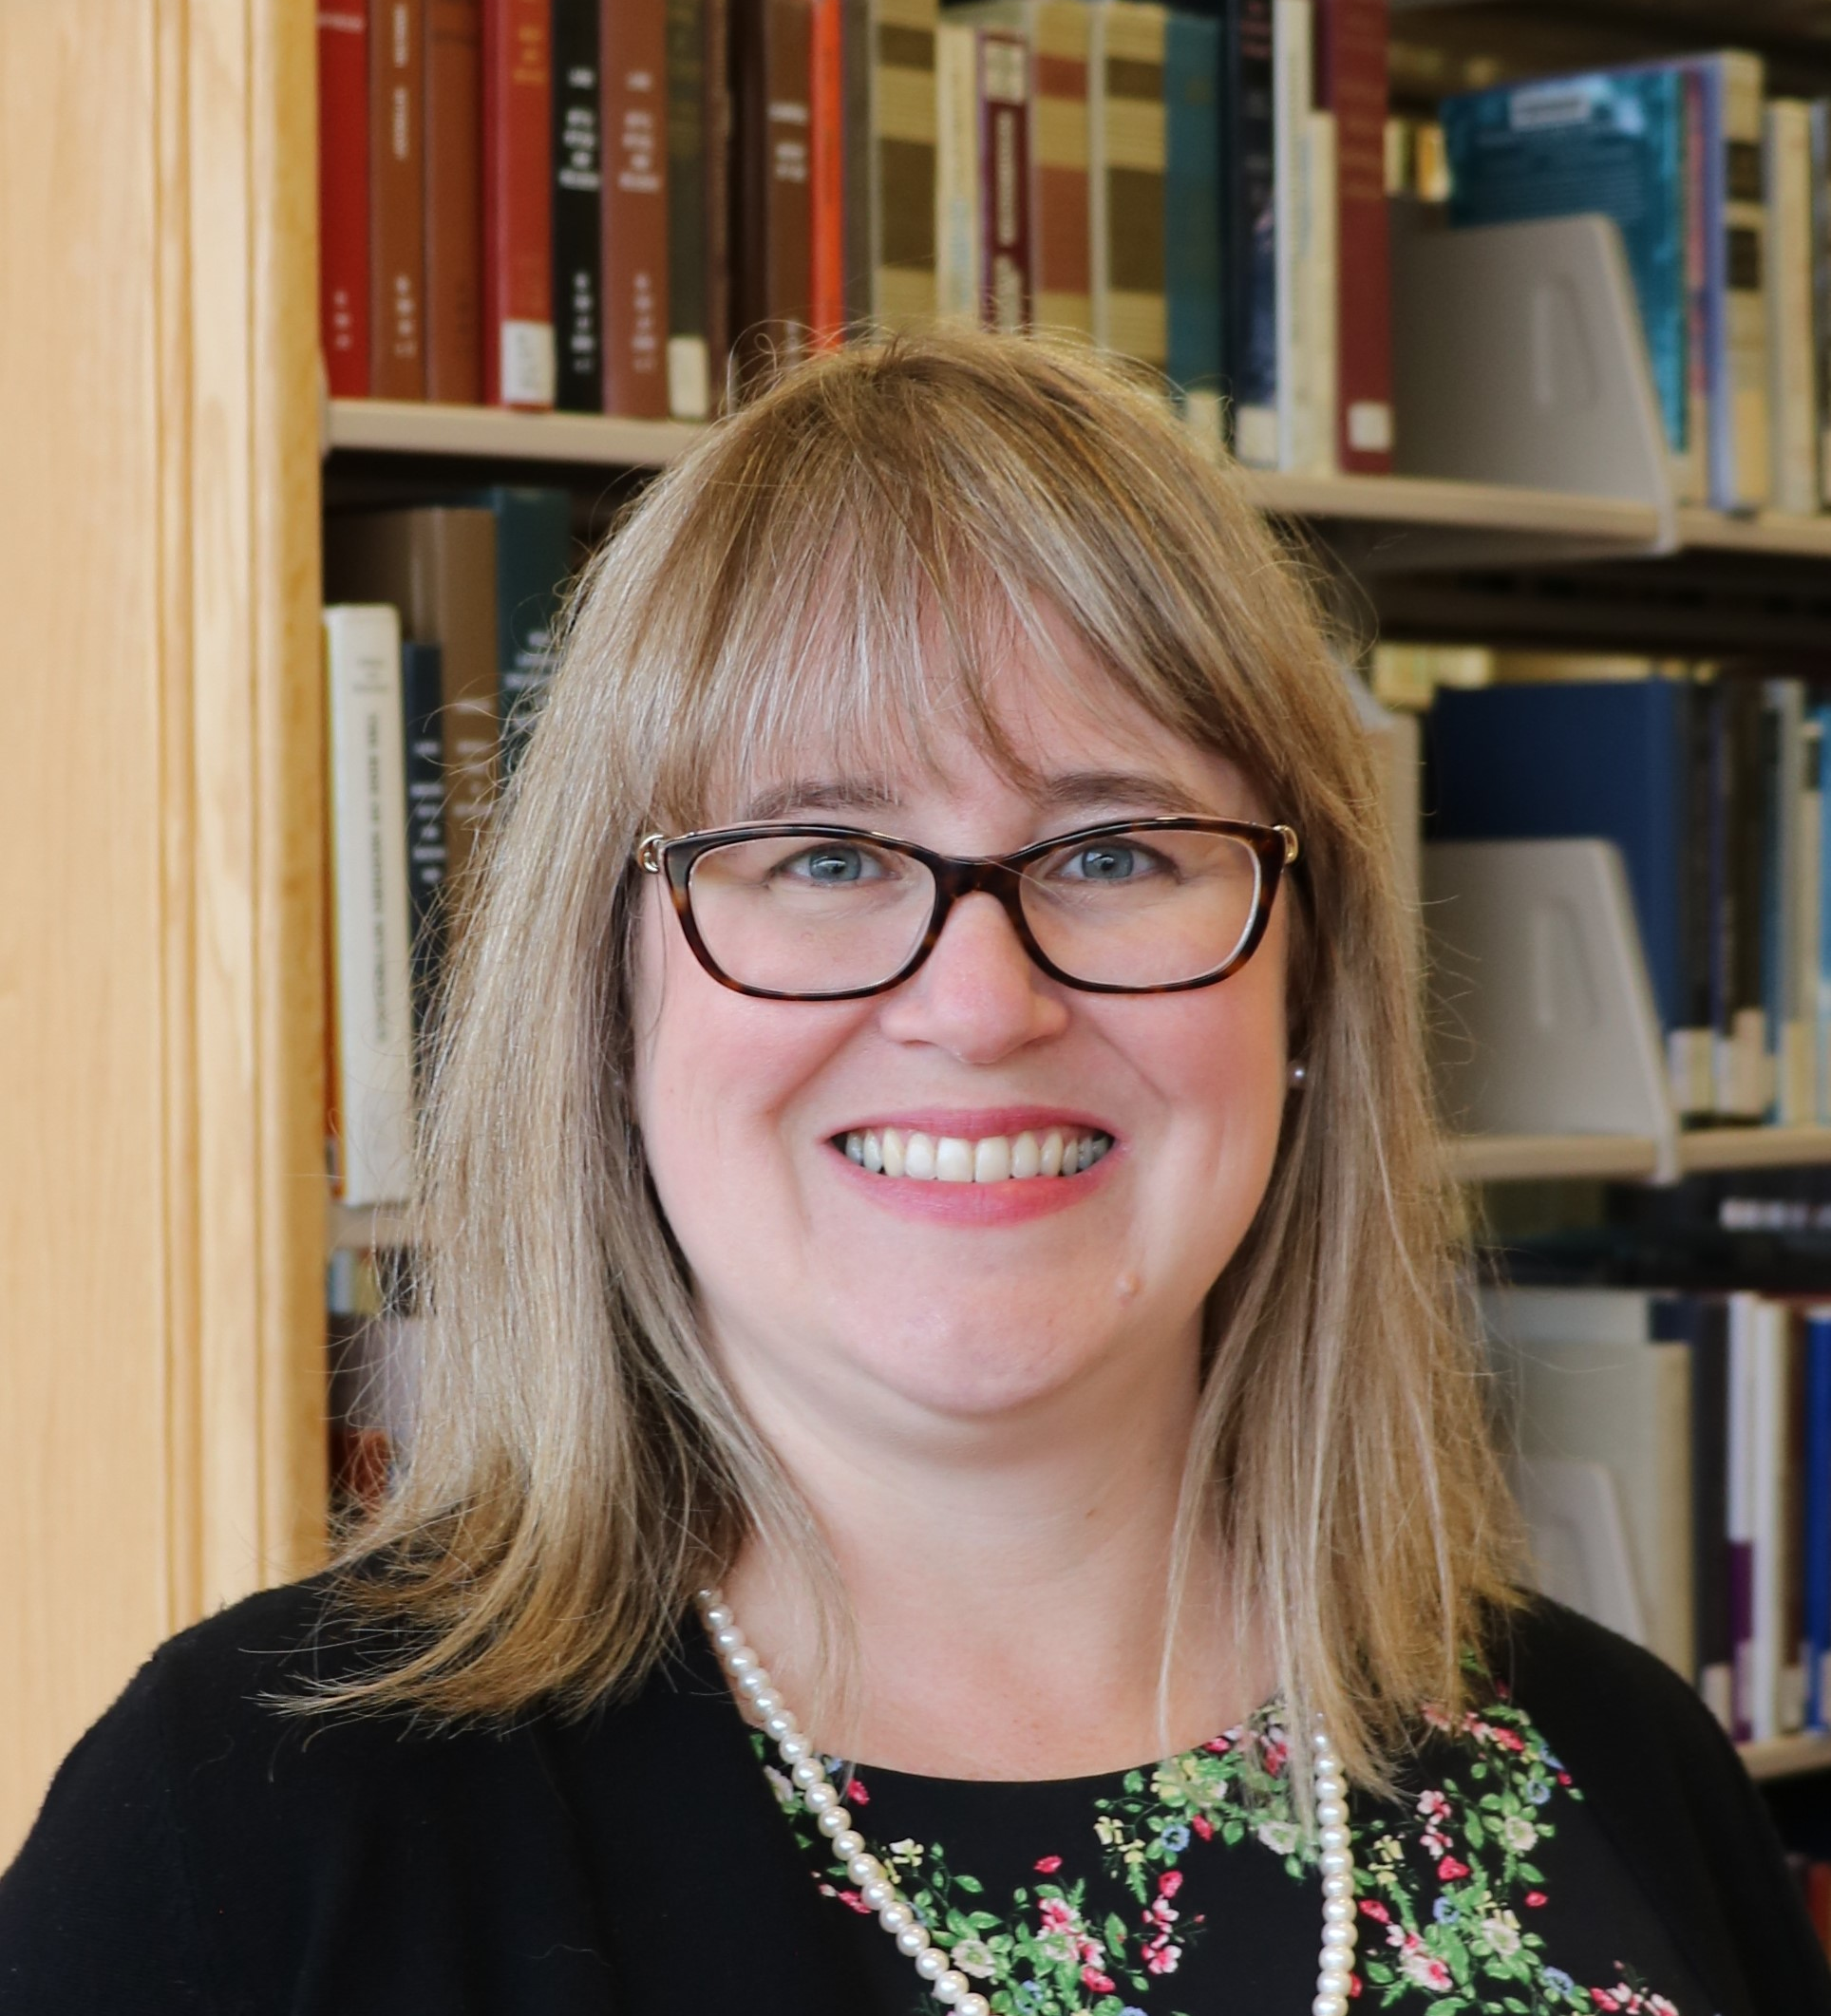
Hello!
Katharine V. Macy, MBA, MLIS​
Collection Assessment Librarian
IUPUI University Library​
macyk@iupui.edu ​
Twitter: @kvmacy​
ORCID https://orcid.org/0000-0002-6283-7143 ​
​

Slide 3
1.
Defining BATNA
Why are we talking about this?

Slide 4
Negotiation 101
Deeper dive into a concept discussed in ACRL/SPARC Negotiation 101
Workshop Materials including presentation, resources, and case studies
Video recording coming soon!

Slide 5
BATNA
Best Alternative to Negotiation Agreement.
It should consider things beyond price including licensing terms.
Notes:
What you would do if you fail to reach a negotiated agreement.​
Cancel​
Resubscribe, but look for later alternatives​
Be careful to not reveal this early, if at all.​
​
During the negotiation you don’t want to reveal your BATNA (unless you have absolutely reached an impass) but you can signal at your BATNA. Don’t lie about your BATNA. I you say you walk away point is X but it is really Z and they talk you down to Z you will have a difficult time in future negotiations. The other party may ask about your walk away point – divert them away from this by emphasizing you are negotiating for the entire value of the package which can include other things such as support, authorized user access, removing NDAs, fixing price increases, etc.​
BATNA can change over time. One year you may choose to resubscribe, but if a deal goes south the vendor has to know you will be looking for alternatives.​ Open Access, PDA, and AOD is allowing libraries to change their BATNAs​
Don’t just determine your own BATNA, research your other party’s. Are subscriptions down, sales flat, are there new competitive products….​

Slide 6
ZOPA
$10,000 Min
Seller
$12,500 Max
Buyer
The minimum the seller is willing to sell and the maximum the buyer is willing to pay.
While traditionally price focused, you can attempt to value other important parts of your agreement such as NDAs, perpetual access, and authorized users.
Notes:
Discuss BATNA in terms of ZOPA. Quick review of ZOPA.

Slide 7
Negotiation 201 Series
BATNA determines the max the buyer is willing to pay in Zone of Possible Agreement.
Negotiation 201 ZOPA Workshop explored ZOPA and researching the vendor side of the negotiation.
  Librarian’s Guide to Scholarly Publisher Financial Data
  Spreadsheet with Publisher Financial Data (RELX, Wiley, ACS)
Notes:
Point back to materials from ZOPA workshop.

Slide 8
Help I have no BATNA!”
Yes, you do, it’s just not favorable. There is always a BATNA. It may be cancelling and taking heat.
If your negotiation fails and you signed anyway, you reached agreement.

Slide 9
Reservation Price
The bottom line, the point in the negotiation where you can go either way. It is the max that buyer is willing to pay and is informed by the BATNA.​
Notes:
The bottom line. The point in the negotiation where you could find agreement or go with your BATNA. It is often determined by your BATNA. Don’t reveal this or your BATNA. Otherwise the seller will only go down as low as your max.​ Only reveal if negotiation is at a standstill and it’s a last resort, or you have such a great alternative you are looking for a match.
Can include non-price related deal requirements.

Slide 10
Reservation Price & ZOPA
ZOPA Exists
$10,000 Min
Seller
$12,500 Max
Buyer (Reservation Price)
ZOPA Doesn’t Exist
$20,000 Max Buyer (Reservation Price)
$25,000 Min Seller

Slide 11
Best Practices in Using BANTA
Don’t reveal it, unless strategic. However, you can signal your BATNA
Don’t lie about it
Constantly work to improve your BATNA
Research the vendor’s BATNA (ZOPA Workshop!)
Notes:
Signaling example:
I understand you are the exclusive publisher many distinguished journals and that always aggregators don’t have the most recent content, but we are exploring our various options for acquiring your content outside of a subscription to the package.
We do have various legal options: Articles on Demand, regular ILL, Open Access copies available in IRs now easily findable with tools like the OpenILL button.

Slide 12
Improving your BATNA
Creating relative bargaining power
  Understand your price sensitivity
    Historical use
    Institutional context
  Are there actions your library can take to change that (i.e. consortia, supporting OA)
Macy, K.V. (2018). Information creates relative bargaining power in vendor negotiations. The Bottom Line, 31(2), 137-149. https://doi.org/10.1108/BL-12-2017-0033

Slide 13
2.
Analysis & Tools
Resources that can help

Slide 14
Helpful Analysis (Not Exhaustive)
Historical use & cost per use
Qualitative data on faculty use in research, teaching, and learning
What content is used? OA, aggregators, perpetual access
Where are faculty publishing? Being cited?
What licensing terms are critical?
What does your library value?

Slide 15
MS Excel
Tools that can be useful:
Pivot Tables – Quickly summarize data
Vlookup – Easily add data to a spreadsheet by looking up a unique value within row data.
Unpivot – Take cross tabulated data such as a Counter report and reformat to enable joining with other data and create Pivot Tables or import into a database.
PowerQuery – Join multiple spreadsheets, such as annual data, into a large pivot table to find longitudinal trends.

Slide 16
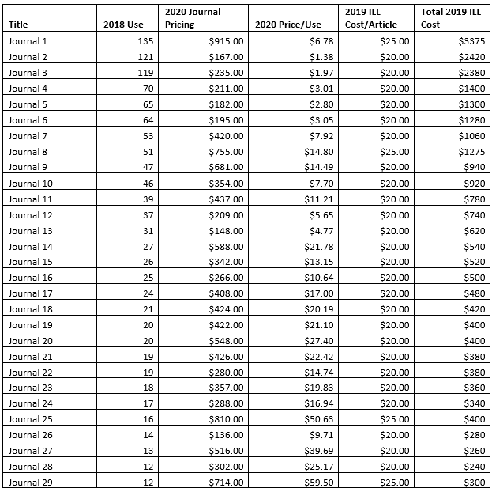
Example: Cap & Mikey Case Study
Gathered data COUNTER (Use), Vendor (Price List, and ILL costs.
Joined using Vlookup to create this table.
Full step-by-step Instructions.

Slide 17
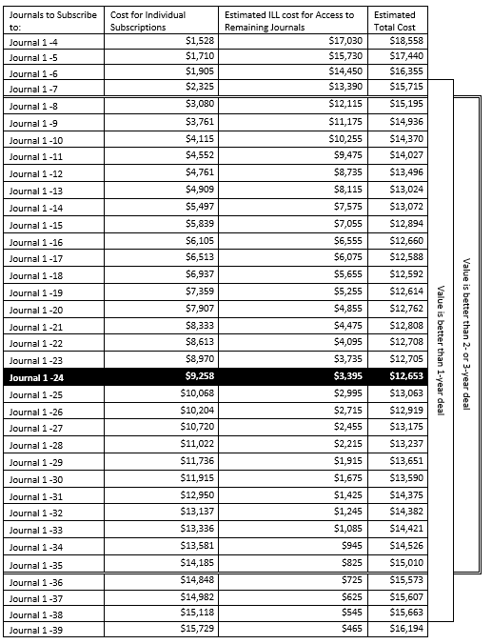
Using collected data determine costs for a la carte
Cost of journals with individual subscriptions + Estimated ILL Costs based on use = Estimated Total Cost
Use this to develop your BATNA

Slide 18
Unsub
Subscription tool with tiered pricing
Allows for a more nuanced look at cost per use that enables weights for faculty publishing and citations, examines back-file, and OA availability.
Current publishers covered: Elsevier, Sage, Taylor & Francis, Wiley-Blackwell, and Springer Nature.

Slide 19
Coming Soon!
The Data Analysis Working Group with the Journal Negotiation Community of Practice has been creating and curating a set of resources that can help! Be on the lookout this fall for resources on:
Usage statistics, Cost per use, COUNTER 4 vs COUNTER 5
Resources to analyze the impact of OA and Factors to consider in OA agreements
Information on serials transparency and conducting overlap analysis
Specialty analysis on turnaways, qualitative data, full-text coverage ratio, and data visualization.

Slide 20
3.
Let’s discuss power
Strategies for even when you feel powerless

Slide 21
Negotiators with stronger alternatives set higher aspirations (Pinkley et al., 1994; Wong, 2014), demand more from their opponent (de Dreu, 1995), and behave more agentically to achieve their goals (Magee et al., 2007). “
Schaerer, M., Schweinsberg, M., & Swaab, R. I. (2018). Imaginary alternatives: The effects of mental simulation on powerless negotiators. Journal of Personality and Social Psychology, 115(1), 96–117. https://doi-org.proxy.ulib.uits.iu.edu/10.1037/pspi0000129.supp (Supplemental)

Slide 22
So BATNA is a source of power.
What do you do when your BATNA is weak?
How do you negotiate from a position of powerlessness?

Slide 23
Strategy #1: Mental Simulation
Imagine if you had a stronger alternative
What would you ask for?
How would you restructure your initial offer or your counter-offer
Center yourself within this place as you begin and conduct your negotiation.
Schaerer, M., Schweinsberg, M., & Swaab, R. I. (2018). Imaginary alternatives: The effects of mental simulation on powerless negotiators. Journal of Personality and Social Psychology, 115(1), 96–117. https://doi-org.proxy.ulib.uits.iu.edu/10.1037/pspi0000129.supp (Supplemental)
Notes:
You may have to come down but this will set your start point higher and result in a more positive outcome than if you started with a weak BATNA anchoring what you feel like you can ask for.

Slide 24
If you need help developing your simulation
Look at deals that others have managed to negotiate:
  Big Deal Knowledge Base
  Transparency Lists
Example: CRKN Licensing Principles leading to CRKN Elsevier Deal
Notes:
Yes CRKN is a large consortia, but don’t let that stop you imagining the type of deal you could structure using their example.

Slide 25
Strategy #2: Use If-Then Scenario Planning
Outline scenarios that could occur and how you will react. This can include reacting to negative behaviors, responding to claims and retorts from the vendor, and knowing how you will adjust based on tactics.
Jäger, A., Loschelder, D. D., & Friese, M. (2017). Using self-regulation to overcome the detrimental effects of anger in negotiations. Journal of Economic Psychology, 58, 31–43. https://doi.org/10.1016/j.joep.2016.09.003

Slide 26
4.
Using to your advantage
How BATNA can be used to shape the negotiation.

Slide 27
Make first offer to set anchor
It should be better than your BATNA. Your ideal offer that outlines
Price / Price Increases
Term
License Terms
Other (Support, Accessibility, Training)
Often vendors make first offer, trying to anchor changes in their favor. Libraries should determine value and derive a counteroffer when this happens. Or, when appropriate, be proactive by submitting a first offer based on determined value to the vendor.
Example: VIVA, Virginia’s Academic Library Consortium
Notes:
First offers anchor your position.
This should be your ideal offer that outlines price including price increases, term, desired licensing terms, and any other import aspect for your agreement. Often vendors make the first offer, trying to anchor changes in their favor. Libraries should determine the value and derive a counteroffer when that happens. But when appropriate, perhaps its time for us to be proactive and submit a first offer based on our determined value to the vendor. One example of this is the work that VIVA has done around planning journal negotiations for their consortia. There is an article about VIVA’s work in the resource list we are providing you with this workshop.

Slide 28
Framing
Plan carefully how you frame
Offers and counter offers
Concessions
Decisions can be framed as a win or a loss.
Remember humans are risk averse.
Opportunity to signal BATNA if appropriate.
Notes:
Think about how you frame what you say around offers and counter offers and concessions. Decisions can be framed as a win or a loss and remember that humans are risk averse.
An example of framing something as a loss:
We need to keep prices flat but are willing to sign a two-year contract, otherwise we will only sign a 1 year agreement and based on our historical use which is declining we may be making the decision to cut this next year.
Now consider how this statement framed as a win. Perhaps:
We can sign a multiyear contract if you can meet us where we need to be for our budget. We are looking to keep price increases to 2%.
Can you hear the difference? Both could be useful depending on the conversations

Slide 29
Always keep BATNA top of mind
Let it hold you steady.
Have a plan and be prepared to say no and stick to it if the deal is worse than your BATNA.
  Vendors will try to convince you to move.
Strategize how you meet a vendor’s no and you may get them to move.
  First no is not always a no.

Slide 30
Negotiation 201 Series:
Preparing for No
August 19th, 3-4pm EDT
Register

Slide 31
Thanks!
Any questions?
You can find me at:
@kvmacy
macyk@iupui.edu

Slide 32
Appendix

Slide 33
Cap & Mikey Analysis How-To
Step 1:
Gather your data:
Pull use data for most recent year by journal.
Pull current price list by journal from publisher.
Find ILL cost/article by journal.
.
Step 2:
Open a workbook.
In the worksheet using Vlookup join data gathered based on ISSN into one spreadsheet with Title, ISSN, Use, List Price, and ILL cost/article.
Sort by use descending.
Step 3:
Add two columns “Price/Use” (List price/Total Use), “Total ILL Cost” (Use*ILL Cost per Article). Insert column before title and lable as journal number. Then number your rows with 1 = most used journal.

Slide 34
Cap & Mikey Analysis How-To
Step 4
Open new worksheet within Excel workbook. This will be your analysis of individual subscriptions & ILL Costs if no package deal is signed purchases are made a la carte.
Step 5
Label 4 columns:
Journals to Subscribe to
Cost for Individual Subscriptions
Estimated ILL cost for Access to Remaining Journals
Estimated Total Cost.
Step 6
Now create your individual subscription options:
Journal 1
Journal 1-2
Journal 1-3
Journal 1-4
….
Journal 1-Last Journal with use data

Slide 35
Cap & Mikey Analysis How-To
Step 7
Sum the individual cost using list price for the journals in the subscription option
Ex: Journal 1-4
Would sum the total list price of journals 1, 2, 3, 4
Step 8
Sum the estimated ILL cost for access for the remaining journals.
Ex: Journal 5 – Last journal with use.
Step 9
Sum the numbers from step 7 and step 8 to get total cost for that option.
Back to Main Presentation

