Slide 1
Open for Health
Open for Health: How Open Access Can Create a More Equitable World © 2021 by Caitlin Pike is licensed under CC BY-NC-SA 4.0
How Open Access Can Create a More Equitable World
Your Name
Your Affiliation
Your Email Address

Slide 2
Agenda
0:00 –Traditional Publishing in Context
0:05 – Overview of Open Access and Social Justice
0:30 – Knowledge Café
1:00 – Share Results with the Group
1:20 – Summary
1:30 – End

Slide 3
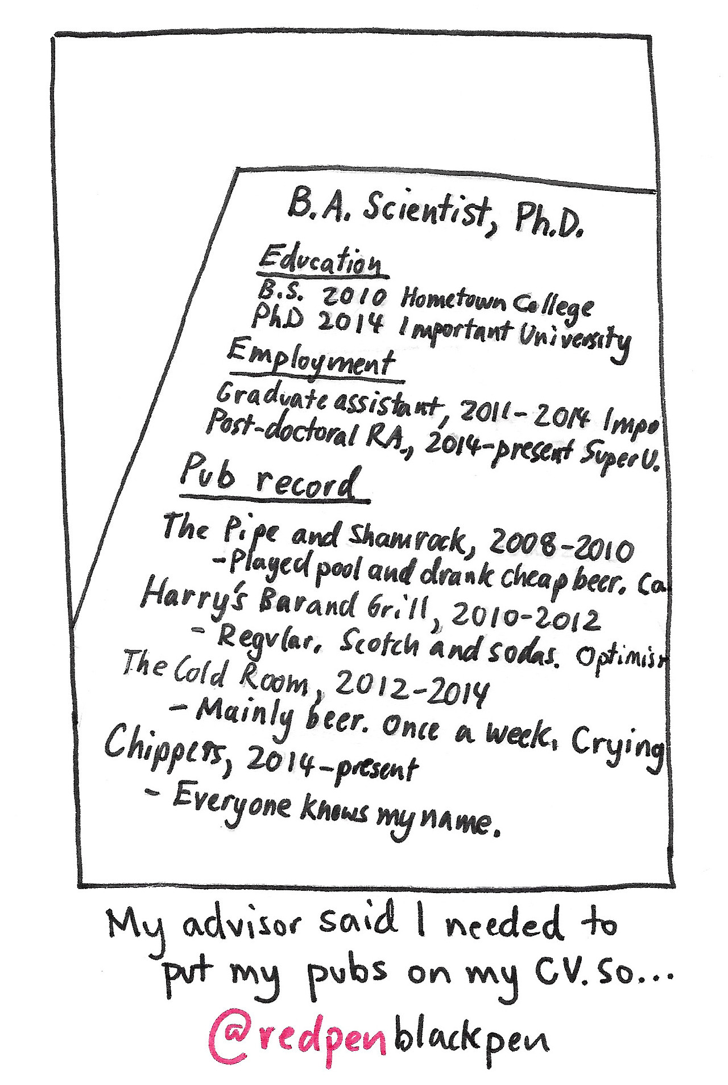
Publishing is important!
Why?
Share and Promote New Ideas
Advance Evidence-Based Practice
Get Cited
Promotion and Tenure

Slide 4




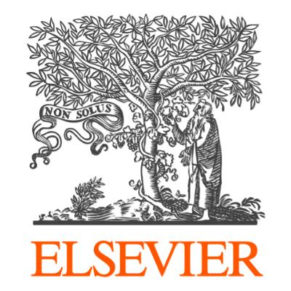

Who are the Key Players?
Author (that’s you!)
Journal
Editor
Peer Reviewers
Publisher
Notes:
The Author writes an article detailing their ground-breaking research results, they choose a journal to submit to based on the recommendation of their faculty advisor, mentor, or peers. An editor receives the submission and makes an initial assessment on whether it is well-suited for the journal. If it is, they will send it out to several peer reviewers (usually 3-4), who will read the work and decide if the research is sound and if it needs major or minimal edits in order to be published. Once reviewed, the work will be sent back to the author with the comments from the reviewers, and the author can choose to continue with the original journal, or try a different one. If they choose to make the edits and re-submit, they will then be notified of their acceptance. Traditionally, libraries pay hundreds of thousands of dollars annually to subscribe to the journals so that their patrons can read the research that was, in many cases, written up by their peers for free. The only people getting paid in this whole process is the publishers (Wiley, Elsevier, etc.), and they are often making incredibly large profit margins (more than Apple or Amazon.)

Slide 5
Defining Our Terms
Social Justice, Open Access, and Health Equity

Slide 6
Poll Question!
Notes:
What does social justice mean to you?

Slide 7

Social Justice The idea of acting with equality, fairness and dignity to all human beings.
“Social justice is the view that everyone deserves equal economic, political and social rights and opportunities.”
– National Association of Social Workers
“Social justice also imposes on each of us a personal responsibility to work with others to design and continually perfect our institutions as tools for personal and social development.”
– Center for Economic and Social Justice
Source: https://bccdcfoundation.org/social-justice-and-public-health/
Notes:
These are a couple of definitions that I felt well-encapsulated social justice as a concept. If we think about the second definition from the Center for Economic and Social Justice in the context of health disparities and access to information, it begins to come clear how these issues relate to one another. In our publishing slides, we discussed the primary players in the information dissemination industry and how it has traditionally been a pay-per-view model built on the free labor of scientists. The average patient or unaffiliated healthcare provider researching a diagnosis or treatment cannot afford to pay the increasing exorbitant costs to access individual articles, which are typically at least $50 a piece. Once we realize that this model is unsustainable and unethical, we must consider changing the way that we access the information that is needed for evidence-based practice and an informed patient population.

Slide 8
Poll Question!
Notes:
What does open access mean to you?

Slide 9
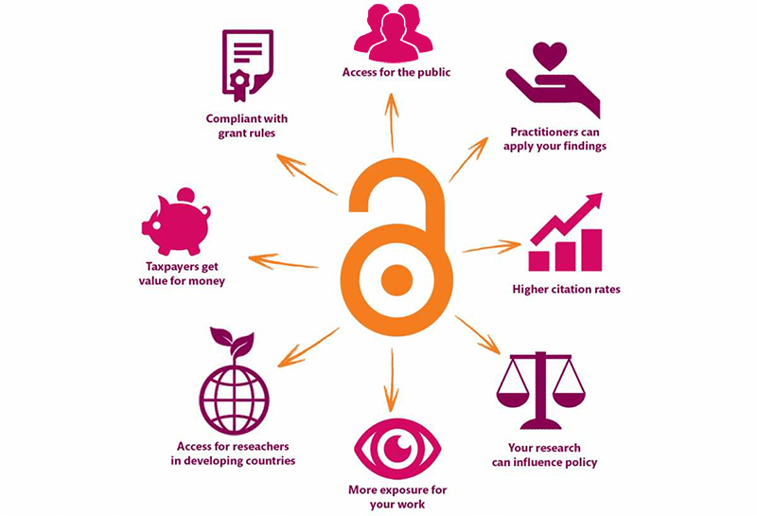
Open Access
According to SPARC:
Open Access is the free, immediate, online availability of research articles coupled with the rights to use these articles fully in the digital environment.
Open Access ensures that anyone can access and use these results—to turn ideas into industries and breakthroughs into better lives.
Source: https://kib.ki.se/en/publish-analyse/open-access
Notes:
Open access is a new model that can be used to breakdown the barriers presented by geographic location and article cost, among others. As we see in this definition from SPARC, open access is all about free and immediate access to information. This goes against the traditional model of publishing from a capitalistic standpoint, but it benefits the producers and consumers of research as a whole. Peer review is not compromised, and as the research isn’t blocked by a paywall, it can be used more quickly by scientific peers and other interested parties to produce new potential breakthroughs. Open access contributes to social justice principles by breaking down the ways that powerful people and industries have historically controlled the way that research is shared. It also contributes to the ideas of patient empowerment and implementing health equity at the provider level.

Slide 10
Poll Question!
Notes:
Do you believe that social determinants, such as income, neighborhood, and education directly affect health outcomes such as life expectancy?
Yes
No
I’m not sure

Slide 11
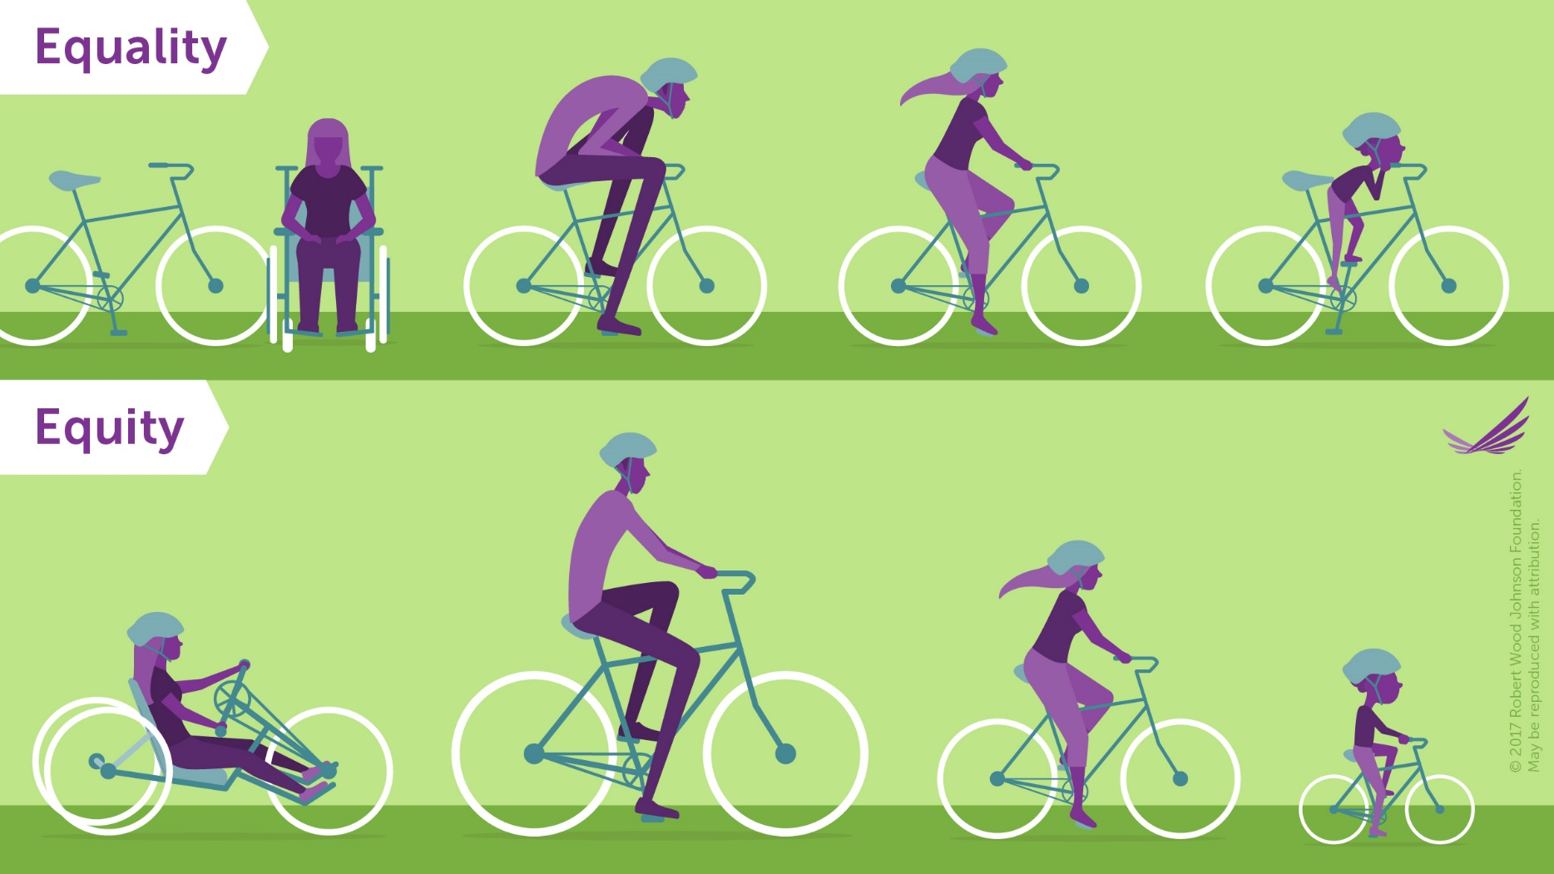
Equality vs. Equity Social Justice should (hopefully) aim to be equitable.
Source: https://www.rwjf.org/en/library/infographics/visualizing-health-equity.html
Notes:
The goal of equality is to make sure that everyone has the same things to be successful. Equity is trying to understand where people are coming from and give them what they need to be successful. You can see with the bikes example here that the top picture provides everyone with the same access, but most of the potential riders are unsuccessful because the bike doesn’t fit their needs. Even though they all have bikes, they are unable to use them to ride, as opposed to the bottom picture where each rider is given a bike that fits their needs, and then they can all ride successfully.

Slide 12
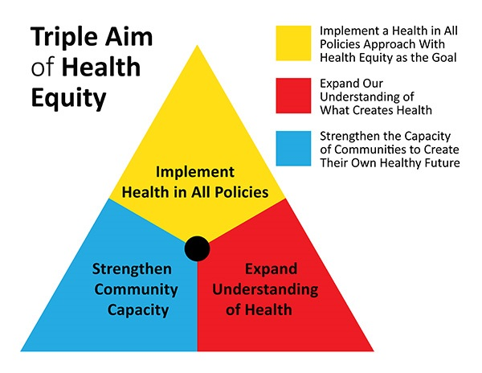
Health Equity
Source: https://www.planning.org/blog/blogpost/9104610/
Notes:
According to the American Public Health Association, health equity means that everyone has the opportunity to attain their highest level of health. We do that by valuing all people equally, and by optimizing the environments that surround individuals. This includes optimizing the conditions in which people are born, grow, live, work, learn and age. It also includes working collaboratively with other sectors to address the factors that influence health, including employment, housing, education, health care, public safety and food access. In focusing on the red and blue blocks, we can start to see why access to health information is an inextricable part of achieving health equity, especially for underserved communities. For example, a community health worker who is working with a group of pregnant women will need access to the most recent research on reducing infant mortality. The health worker can use the information to create a community-based plan to support and empower the women to help them better understand how they can reduce their babies’ risk of health problems. At home, the pregnant women can use openly available research to learn about their specific risk factors based on age, race, and other demographics. If they don’t have the health literacy needed to understand the research themselves, at least they have the ability to access it so that they can take it to their doctor (who may also have trouble getting non-OA research) and discuss the results.

Slide 13
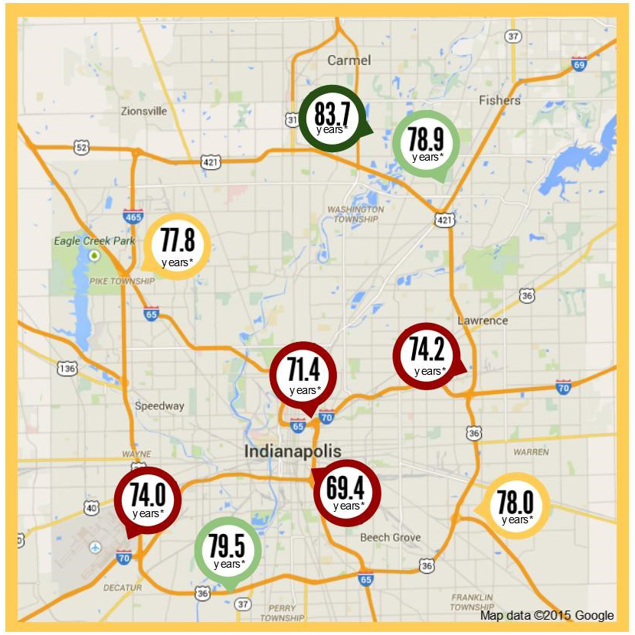
Why Does It Matter?
Life Expectancy in the Indianapolis Metro Area
46033
High School Graduates: 99%
Median Household Income: $124,712
46225
High School Graduates: 69.3%
Median Household Income: $33,688
28 miles and 14 years of life
(Source: 2013-2017 American Community Survey 5-Year Estimates)
Source: Worlds Apart: Gaps in Life Expectancy in the Indianapolis Metro Area
Notes:
Use a site such as this (https://qz.com/1462111/map-what-story-does-your-neighborhoods-life-expectancy-tell/) to find disparities among neighborhoods (census tracks) in your city. You can modify this slide to show how low income areas with poor education outcomes also have lower life expectancy in your region. This problem of lower life expectancy is also related to access to healthcare and health literacy.

Slide 14
Activity: Knowledge Café (30 minutes)
Instructions:
1. Everyone should count off by 6 and break into their group numbers at the tables provided.
2. I will come around and pass out the questions for your discussion.
3. Select a recorder and write your summary thoughts under the questions in the space provided.
- Some of the questions are meant to be difficult or uncomfortable, and that’s okay!
4. I recommend that you choose someone to report out to the larger group (can be the recorder or someone else.)
5. We’ll come back together and discuss your results at the end after 30 minutes.
Notes:
This is the instructions for the in-person version of the lesson plan. If virtual, delete this slide entirely and keep the next slide.

Slide 15
Activity: Knowledge Café (30 minutes)
Instructions:
1. Everyone should open the Google Doc link that can be found in the chat.
2. You will be automatically sorted into breakout groups. Click on the Group number that corresponds to your breakout group number. (Group 1 = Breakout rooms 1 and 6)
3. Each group should answer the questions listed under their breakout group number in the Google Doc. Select a recorder and write your summary thoughts under the questions in the Google Doc.
Some of the questions are meant to be difficult or uncomfortable, and that’s okay!
4. I recommend that you choose someone to report out to the larger group (can be the recorder or someone else.)
5. We’ll come back together and discuss your results at the end after 30 minutes.
Notes:
This is the instructions for the virtual version of the lesson plan. If in-person, delete this slide entirely and keep the previous slide.

Slide 16
Open Discussion
Notes:
Ask the larger group for their initial thoughts, and then call on each group to report their highlights. Make sure they read their questions to the larger group, as not every group will have the same questions.

Slide 17
Final Takeaways

Slide 18
Why Should We Advocate for Open?
Allows patients and their families to better understand a diagnosis
Provides access to current research for healthcare providers.
Makes increasingly more sense, as public and donation dollars fund medical research.
Offers an opportunity to question who is being disenfranchised by paywalls.
Dismantles the traditional model of publishing that perpetuates blind allegiance to impact factors and journal reputation.
Personal responsibility plays a key role in health, but the choices we make depend on the choices we have available to us. (Robert Wood Johnson Foundation)
Notes:
Allowing patients and their families to better understand their diagnosis empowers patients and makes them feel more in control of their health. It also facilitates shared decision-making among providers, patients, and family members.
Healthcare providers need access to the most current research in order to make evidence-based decision, but it is often impossible to financially afford the access required to serve all of your patients if you are working outside of a major hospital system or for the government.
As of 2007, in the United States, research that is funded by taxpayers dollars is required to be made publicly available through open access channels. The idea behind this was simply that the public is paying for the research and they should be able to access it if they need it. Publishers shouldn’t be able to lock the labor and research paid for by the public behind paywalls so that the same people who paid with their tax dollars collectively must pay a second time individually to read the results.
In addition to patients and healthcare providers in our own neighborhoods, consider how many people are disenfranchised across the world due to lack of internet, funding, and lack of access to the tools to search for peer-reviewed articles.
Open access provides us with a unique opportunity to ask why we continue to do things as we have always done them, considering we are now in a 21st century world with the tools and technology to change the status quo. We have the ability to change we way that we value research, as well as how we provide access to it, and I firmly believe that we should use all of those advantages to create a new, more robust model that focuses on connecting people to the information they need instead of driving profits.

Slide 19
How Should We Advocate for Open?
Ethical Appeal
People in developing countries don’t have access to the same research we do, nor do U.S. doctors unaffiliated with large health systems.
Increase in Future Citation Counts
Open access articles can see up to an 18% increase in citation counts when compared to paywalled articles.
Be Discoverable in Google Scholar
Tell peers that adding their pre-prints to your institutional repository will make them discoverable in Google Scholar.
Expanding the Idea of Open
Open access doesn’t just include articles, it can be virtually anything.
Peer-Review isn’t Perfect
People are often quick to judge all open access journals as “predatory” or they say that such journals don’t have a respectable peer-review process. This is simply untrue.

Slide 20
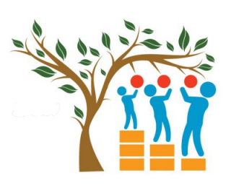

I believe that we shouldn’t be neutral!
Open access gives anyone with an internet connection access to health-related research.
This access exists regardless of income, education, geographic location, or any other factor.
It promotes health equity and citizen science through creating a more informed public.
Source(s):
http://med.stanford.edu/ourvoice.html
https://commons.wikimedia.org/wiki/File:Open_Access_logo_PLoS_white.svg

Slide 21
Resources for Learning More…
Social Justice
Harvard Implicit Bias Tests
Equality vs. Equity
Open Access
Scholarly Publishing and Academic Resources Coalition (SPARC)
OpenCon Diversity and Inclusion Report
Rewarding Open Access in Promotion and Tenure: Driving Institutional Change

Slide 22
Questions?
Open for Health: How Open Access Can Create a More Equitable World © 2021 by Caitlin Pike is licensed under CC BY-NC-SA 4.0
Thank you!
Your Name
Your Email

