Slide 1
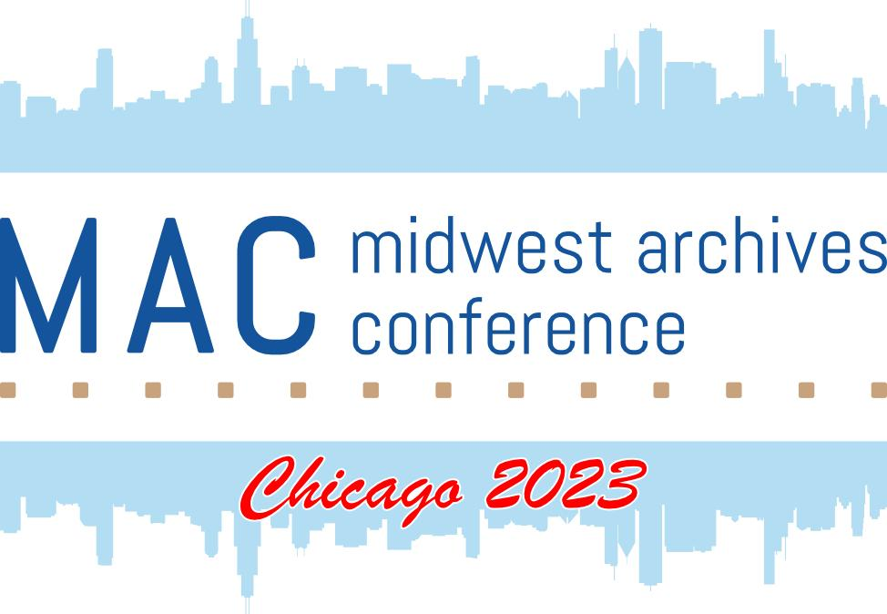
[ s301]
Pop-up: The Purpose of Creation and Beyond
DIG DEEP
Midwest Archives Conference annual meeting

Slide 2
The Purpose of Creation and Beyond
By: Rina Sim, Lauren M. Harris, & Raneem Hijazi
Notes:
Hi everyone. It’s an honor to be here to share our experiences here at MAC. Today, we will talk about the purpose of creation and beyond. We will spend around 20 minutes about our thoughts on archives and we would like to discuss about the topic together.

Slide 3
About the Presenters

Slide 4
Presenters
MLIS Students
at Indiana University - Purdue University Indianapolis (IUPUI)
Rina Sim — Archives Management and Digital Curation Student
Lauren Harris — Digital Curation Student
Raneem Hijazi — Archives Management Student
Notes:
Let me introduce the presenters first. I’m Rina, Lauren and Raneem and we are in the Library and Information Science master’s program at IUPUI.

Slide 5
Cultural Shifts
between South Korea and U.S. Archives
SECTION 1
Notes:
I moved here, the United States from south korea at end of 2020 for my husband who works in Indiana. As I worked at the Korea Comic Museum for 7 years as a librarian and museum storage manager, I decided to study master’s program further in this field. And luckily, I have a great opportunity to work at the university archives as a process assistant.

Slide 6
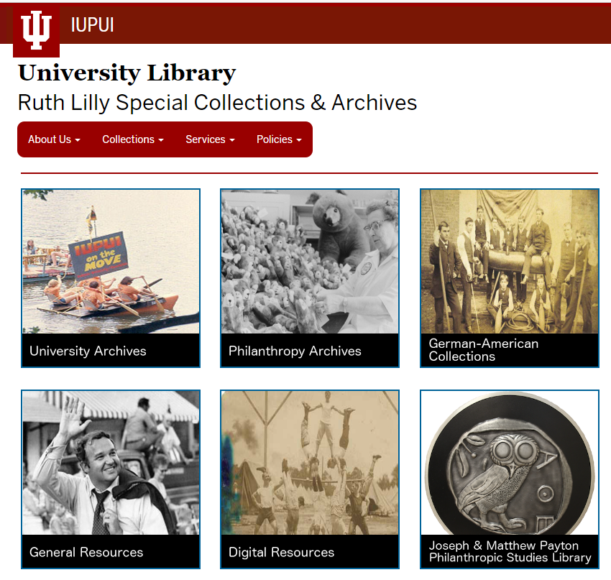
Indiana-University Purdue-University Indianapolis Library Ruth Lilly Special Collections and Archives. (n.d.). Retrieved from https://ulib.iupui.edu/special.
Notes:
At the beginning of working at the archives, what I heard the most was “Rina, you are overthinking.”
Because I asked too many questions about things that don’t really matter, such as a book did not include specific year of publication but there was a letter from a giver at the first page and it said 1877. So, should I put it as “before 1877”? and changed the collection range? I just tried to provide information as much as I can.
But I learned about MPLP, more product less process’ by Mark Greene and Dennis Meissner. I shouldn’t spend too much time on small details to process faster and provide more access.

Slide 7
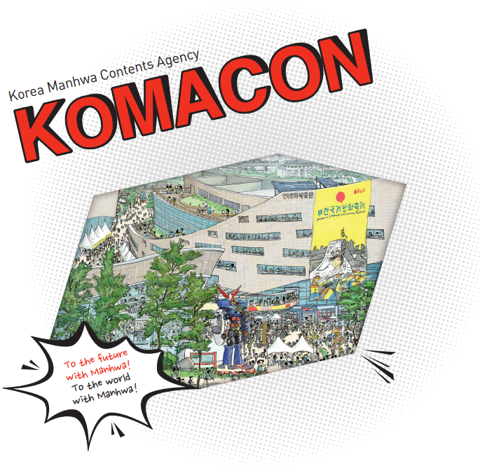
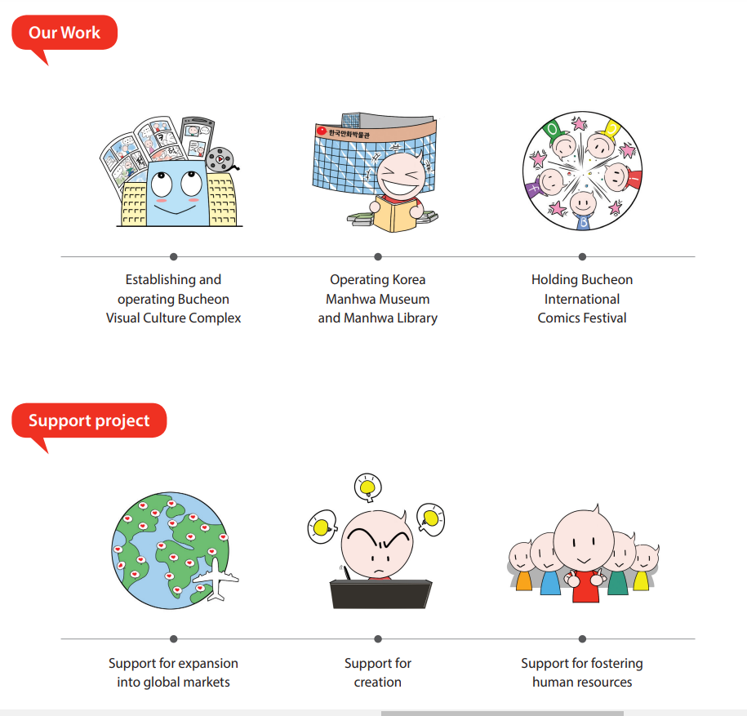
Korea Manhwa Contents Agency. (n.d.). KOMACON Profile. Retrieved from http://www.komacon.kr/komacon_en/file/Komacon%20Profile.pdf.
Notes:
It was very challenging for me after working at the specialized museum. I worked at the Korea Manhwa Contents Agency that operates the Korea Comic Museum aim to promote comic industry. Especially, the institution focuses on collecting every comic book published in Korea as long as we have place and money. We have prioritized list, but there is nothing we don’t want to have. When we get donations from comic writers, we process every single piece because those will represent the comic writer.
Of course, the purposes of the specialized museum and the university archives are different. Here at IUPUI archives, it’s right that I shouldn’t take too long to process the general collections. But I questioned if we are missing any access points from MPLP because I encountered several unexpected requests for reference services.

Slide 8
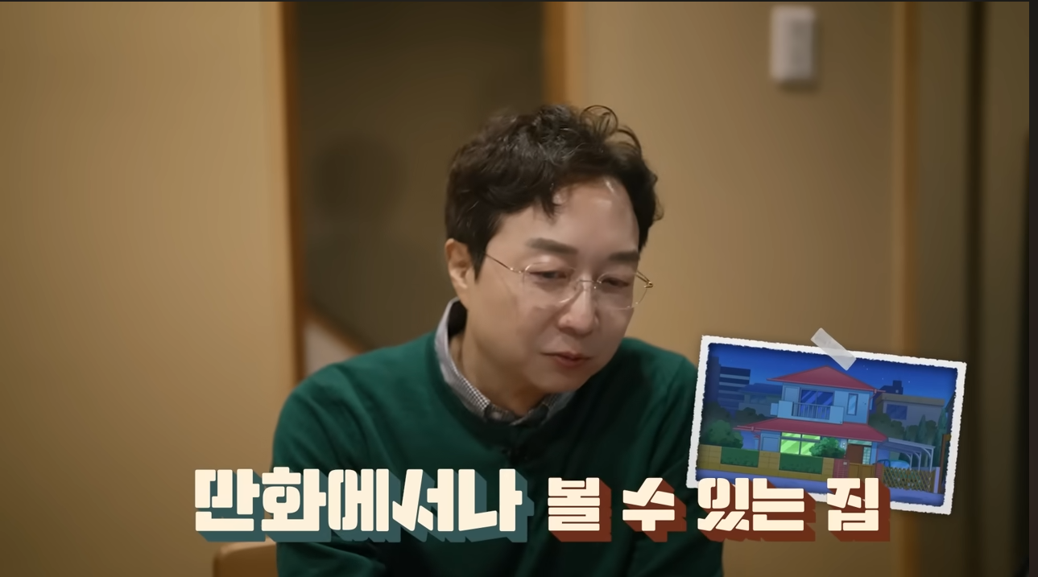
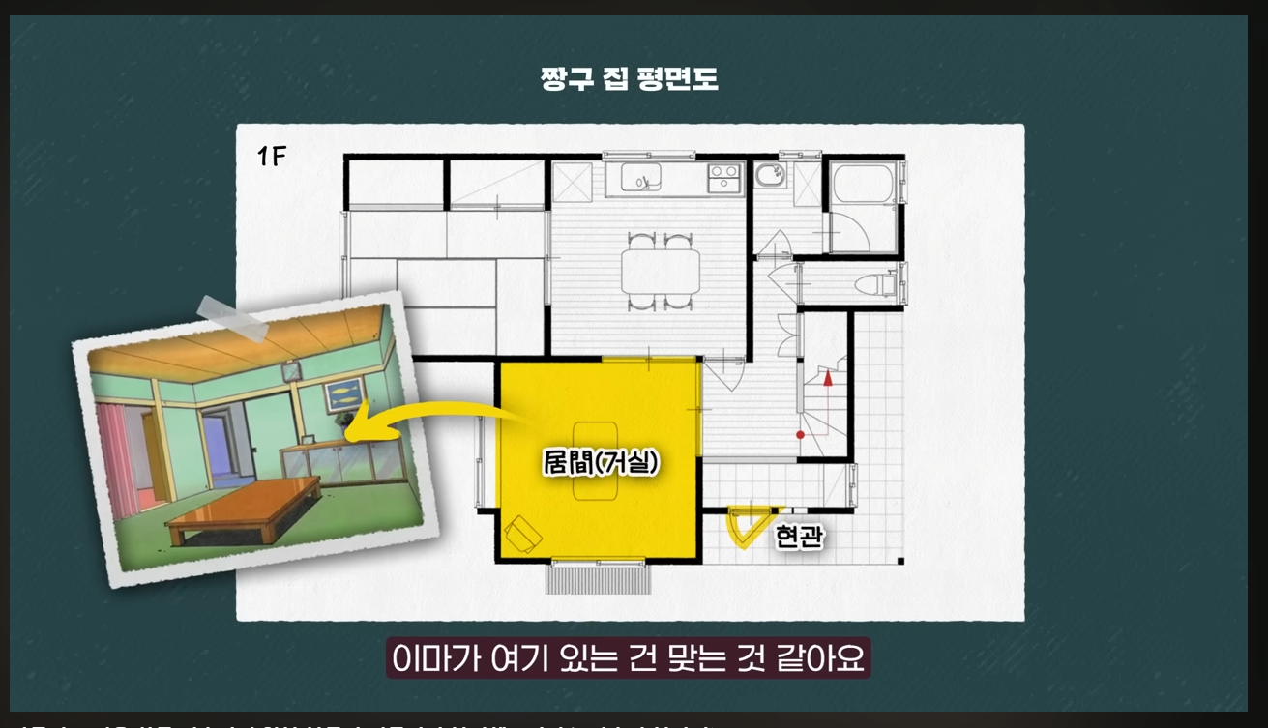
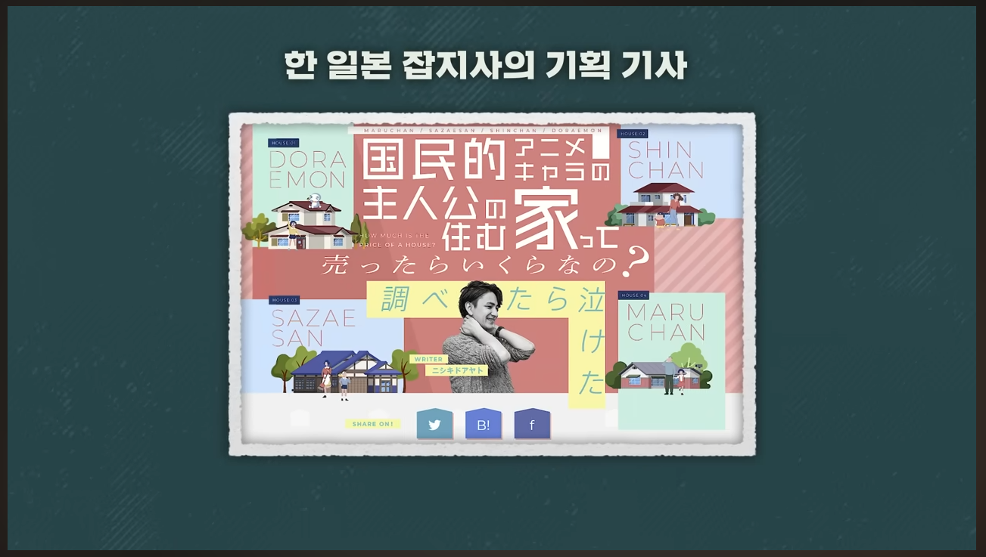
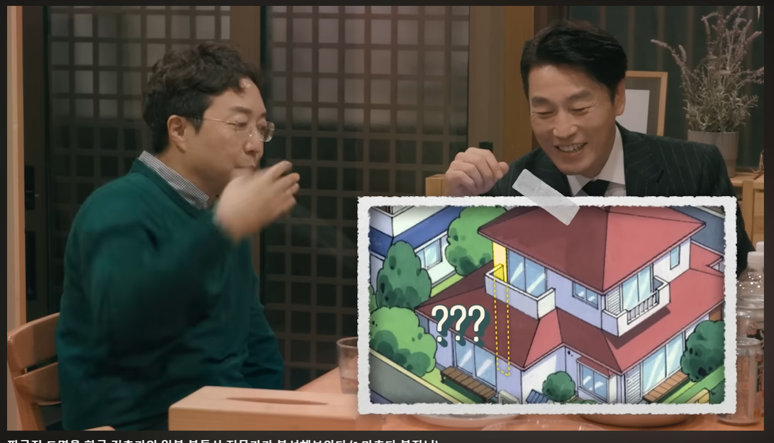
Floor Plan of
Crayon Shin-chan
Featured article from a Japanese magazine
realtor
Architect
Sherlock Hyeonjun. (2023). jjang-gugoljib-eul hangug geonchuggawa ilbon-i jeonmungaga bunseoghae deulibnida. (f. macheuda bujangnim) [A Korean architect and a Japanese real estate expert analyzed the blueprints of Crayon Shin-Chan House. (f. Manager Matsuda)]. YouTube. Retrieved from https://youtu.be/gR3QjJPM1xs.
Notes:
One time, an architect visited the museum for the comic books from 1980’s to see styles of architecture in 1980’s comics because comics can represent people’s sentimental views of the times unlike photos. This screenshots that are recently found are from one of my favorite YouTuber, Sherlock Hyeonjun’s video. An architect and realtor talks about houses from Japanese animation that it’s imaginary houses.

Slide 9
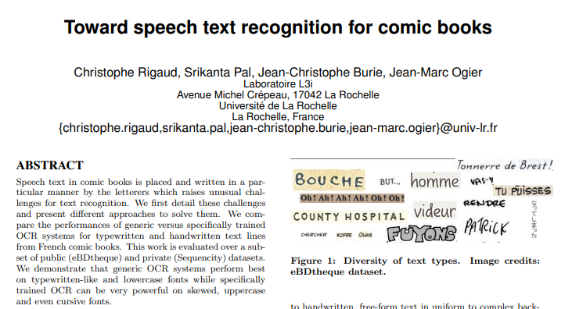
Rigaud, C., Pal, S., Burie, J.-C., & Ogier, J.-M. (2016). Toward speech text recognition for comic books. Proceedings of the 1st International Workshop on CoMics ANalysis, Processing and Understanding. https://doi.org/10.1145/3011549.3011557
Notes:
Other example was shared by an archivist from other comic museum in Angoulême, France when I visited that. They were conducting collaborative work with the Computer Science and Image Interaction Lap of La Rochelle University to develop optical character recognition, OCR, technology with handwriting speech text examples.
Not only technology, when I searched “comics” as a keyword, but comics were used in many ways such as education, sociology, and behavioral psychology.

Slide 10
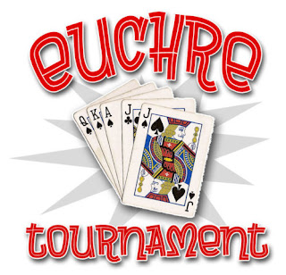
Euchre Fun. (n.d.). Euchre tournament - Madison Hts, MI - canceled. Retrieved from https://www.euchrefun.com/2021/09/euchre-tournament-saturday-september-18.html
Notes:
Even in IUPUI archives, a Euchre researcher visited to find any records in German-American collections. Euchre was definitely not a keyword when an archivist processed in German-American collections. So, he looked all the letters.
Those experiences made question whether we are missing other values from MPLP processing, especially for marginalized communities and lowbrow art and literature. how we can provide access points if we don’t even really know about the collection because of MPLP. Now, Raneem will talk about how U.S. and westernized archives are missing the chance to be used because of quick process.

Slide 11
How misrepresentation of description can hinder access
SECTION 2

Slide 12
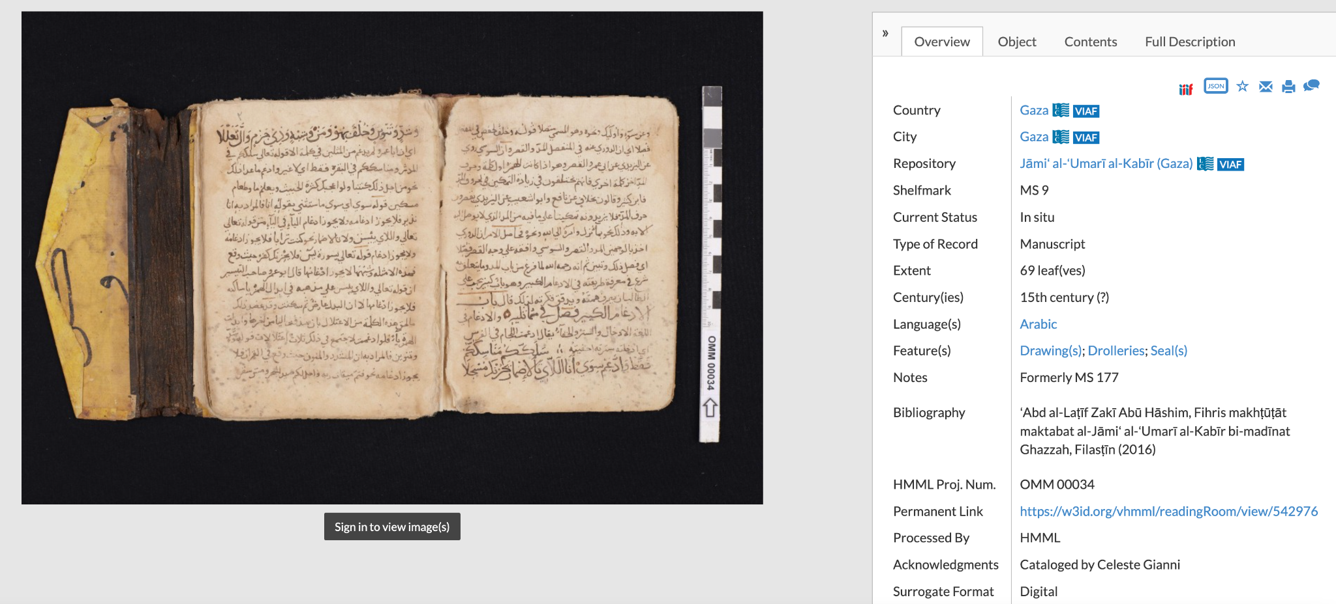
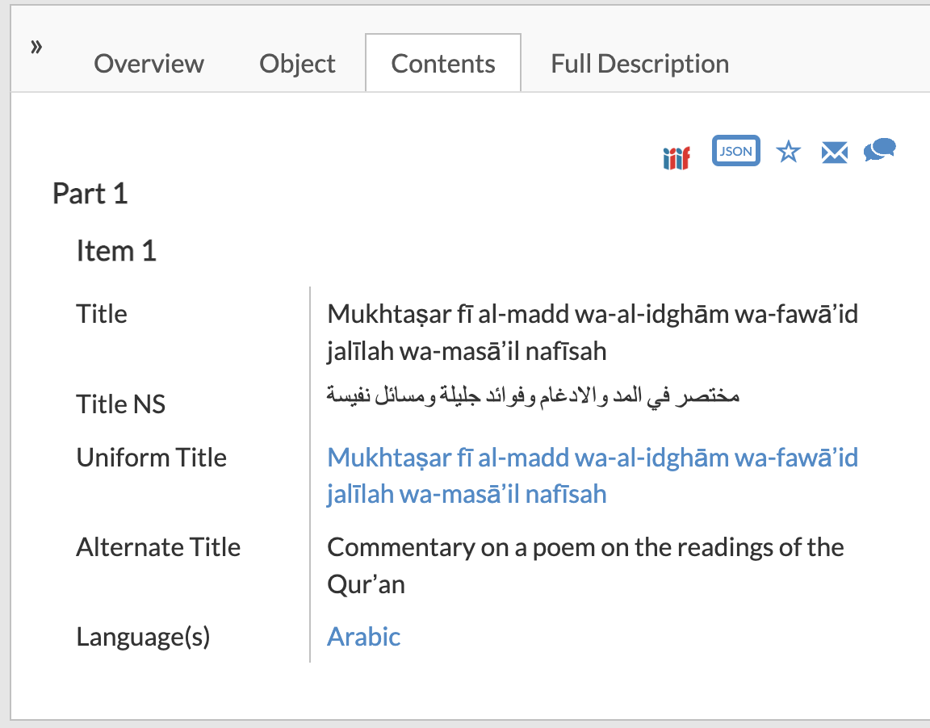
Retrieved March 27th, 2023
https://www.vhmml.org/readingRoom/view/542976#
Notes:
So I actually am Palestinian — and i dedicate a lot of time to looking into different organizations like museums and archives and how they represent Palestinian records. More often than not, I find that a lot of the representation of cultural heritage material are either 1) altered information that misrepresent the culture, or 2) being shared for the sake of dissemination using MPLP without concern for correct or incorrect information. This first example is from the Hill Museum and & Manuscript Library, or HMML. For those of your who are interested in manuscripts, what they focus on in the repository is digitizing manuscripts from their partner repositories from around the world. For this specific manuscript, it’s from Jama’ al-Umari al-Kabir (Gaza). If you notice their location “country” metadata tag being “Gaza” rather than “Palestine.” Now we don’t know whether or not this was intentional for political purposes or this was just lack of awareness, or just how they decided to categorize the content on their website, but the fact that this manuscript is not accurately presented BECAUSE HMML prioritizes dissemination of information by implementing MPLP, may potentially confuse researchers to actual historical fact.
Another thing would be the Title section. Now the title reads (read in arabic), and the alternate title in english just does not represent this at all. The different reading practices of the Quran are mentioned in the title and the word for “poem” is nowhere mentioned in the title. So you’re losing key context about the religious implications of this manuscript, and as a researcher you won’t be able to understand what exactly this manuscript was used for because the title misrepresents it.

Slide 13
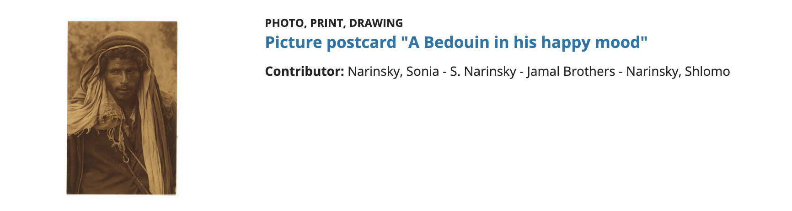
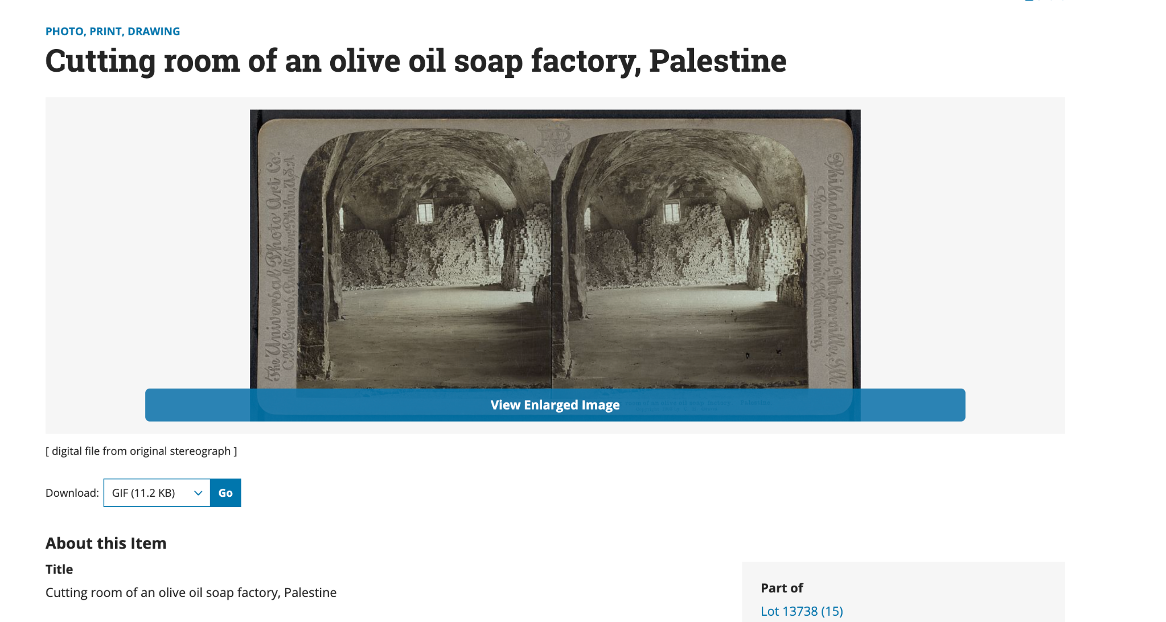
Retrieved April 3rd, 2023 https://www.loc.gov/item/mamcol.044/
Retrieved April 3rd, 2023 https://www.loc.gov/item/2006679684/
Notes:
So these next couple examples are from the Library of Congress in collections that or focus on Palestinian culture and history. This first photo with the… odd name is actually from the digital collection of American Colony in Jerusalem Collection which has a bunch of photos of the American colony back in the early 20th centuries. First thing that really stands out in this photo is the title of the photo. We don’t know if this guy is happy or not, he doesn’t really look like he has much emotion to his expression right now. I don’t know if this was the title of the photograph postcard back in the 20th century and the LOC is conveying to us the title, but when you explore the item further, there is close to no information for researchers to draw conclusions. We don’t know what region this man is from, and we don’t get a definition of what “Bedouin” is, which disrupts introductory researchers into this topic and prevents them from learning more about the collection.
The second photo is from the repository of the Library of Congress Prints and Photographs Division Washington, D.C. 20540 USA. Something that not many people know about Palestinian culture is that Olive Oil soap, as well as glassmaking and even embroidery, is a pretty regional tradition. For Olive Oil soapmaking, in arabic, is called saboona nablusia, or Nablus Soap because how they invented it is so iconic. There are different manufacturers around Palestine, for instance, my great-grandfather used to manufacture this soap but he was nowhere near Nablus. There is historical context missing when this item doesn’t provide regional distinctions which again, is not an accurate representation of the records, limiting introductory researchers’ understanding of Palestinian culture. You can make the argument that they can research further on their own time using google, but there is a lot of misinformation when it comes to Palestinian information. You’d expect the LOC to at least have a more detailed view of historical fact that won’t give way to prejudices that a quick google search will open you up to.
https://www.loc.gov/collections/american-colony-in-jerusalem/about-this-collection/

Slide 14
Politics and Archives
Why is it important to maintain archives of the politically and socially underrepresented?
“STARTING IN THE LATE 1980S, a group of Israeli scholars known as the New Historians published several monographs challenging the Israeli/Zionist narrative of the 1948 war that led to the dispossession and expulsion of three-quarters of a million Palestinians and the destruction of more than five hundred villages and localities in what had been Mandate Palestine. Palestinian historians had already written about the Nakba extensively prior to that, but never before had the narrative been substantiated by declassified archival material….. The documents on which this new historiography was based were housed in several archives, most important among them the Haganah Historical Archives, the Ben-Gurion Archives, the army archive (also known as the Israel Defense Forces [IDF] archive), and the Yad Yaari archive—the last being especially significant for the New Historians’ early work, since the army would not declassify relevant military documents until later in the 1990s.”
Pappé, I. (2020). An indicative archive: Salvaging nakba documents, Journal of Palestine Studies, 49(3), p.22
Notes:
We have to acknowledge the impact that these archives can have on the real world. For instance, a few years ago, amnesty international had officially declared the state of israel an apartheid state… but after 70+ years of Palestinians saying this, why did they only just recently decide this? Well it’s actually due to the declassified archival materials that various scholars had provided that proved an actual concentrated movement that intended to separate the Palestinians from Israelis legally as well as evidence of intentional genocide. Illan pappe, who is a Jewish archivist who participated in this research effort, had actually described what exactly was found and where it came from. So the availability of description of resources as well as the providing of the resources themselves is necessary for our role in social and political activities.
So if researchers can’t… research, because descriptions aren’t available than how can we expect actual social change to occur when people’s understanding is inherently flawed in the topic due to faulty description?

Slide 15
How can we utilize archival materials more than their purpose?
SECTION 3

Slide 16

Assign an archivist
to dig deeper
Own research
Participation of communities
Work with experts
Communicate with faculty
Notes:
Lauren: Thank you, Raneem for highlighting the issues of archival description. One solution of digging deeper into a collection or materials is to have a dedicated staff like outreach archivist, this could be their responsibility rather than all archivists are working in same level. And if the staff is lean, having a division of labor among staff to look finding aids and material description. Looking at finding aids and confirming that it still serves users. This could be surveys and focus groups to increase access points. Another solution is engaging with communities and their materials and allowing them to contribute additional or unconventional context. Archivists can work with subject matter experts for additional description. I don’t want to be unrealistic and mention that this work should or could be done in a year or less than five. It should be a continual process of making sure the materials can still be found by everchanging users and their needs.

Slide 17
Discussion
SECTION 4

Slide 18
Did you have any user request that did not anticipate?
  Examples of archives doing well?
What we can prepare for unexpected reference request?
  What does “digging” look like?
  What types of “digging” exist?
  What is the barriers?
  How can those cases help archivist identify archival materials?
How can we balance between reducing backlog and creating a richer description?
  How do we collaborate with communities?
Notes:
Outstanding examples
Butler University Sigma Gamma Rho Centennial Collection
https://digital.palni.edu/digital/collection/SigmaGammaRho
When Rina worked at High school library as a trainee, the librarian asked me to put all words from contents page to MARC index field
https://shotdeck.com/welcome/home
Canal Area Research Class
https://exhibits.ulib.iupui.edu/CanalCollection/neatline/show/baist-1908

Slide 19
Thank you!
And have a great day!

