Slide 1
A Novel Approach to Point-of-Care Ultrasound (POCUS) Education: One-page Documents with Embedded E-Curriculum
Nathan Markus, DO, Danniel Brenner, MD, PhD, Francesca Duncan MD, MS, Adriano Sanjuan, MD, Eric Osborn, Edwin Jackson DO

Slide 2
Outline
Discuss my experiences as a learner
Challenges in POCUS education
Proposed Solution
Methods, Results, and Discussion
Future Directions

Slide 3


My Experience

Slide 4
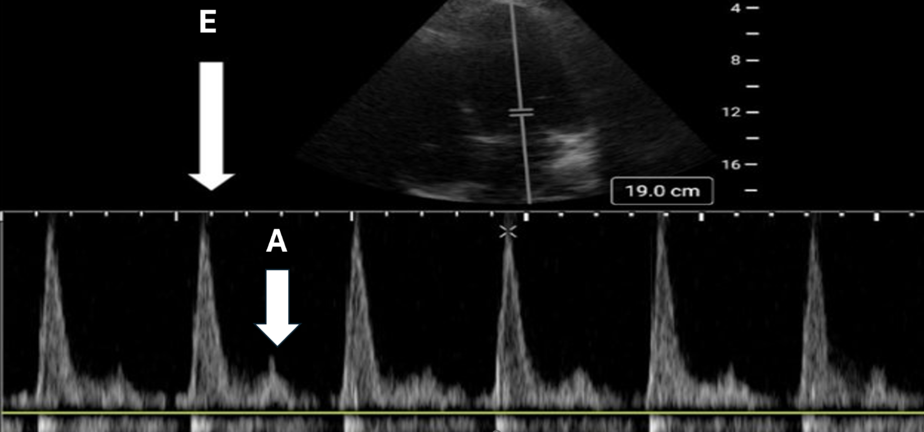
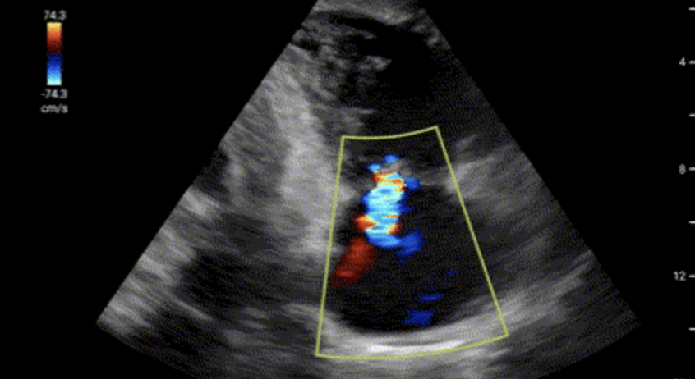
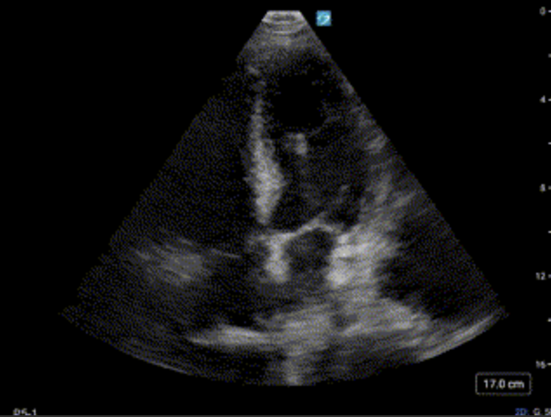
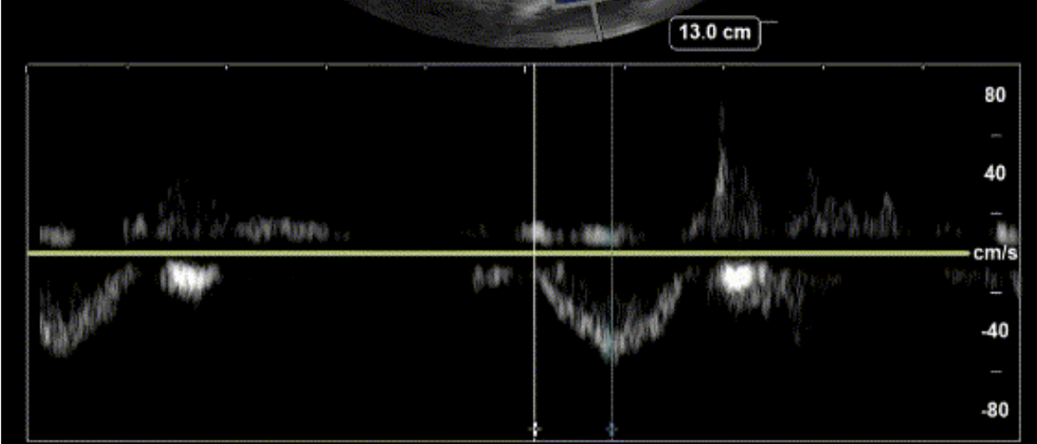
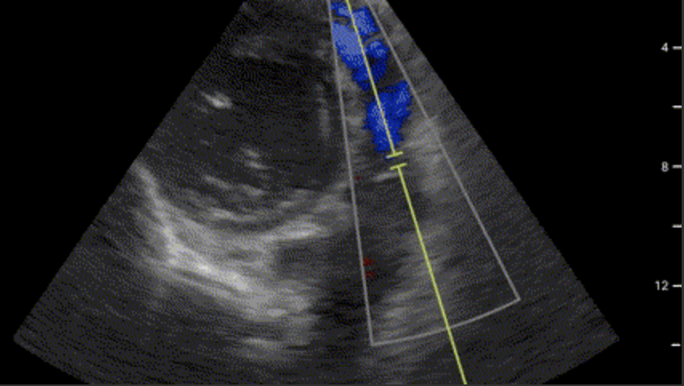
My Experience
Notes:
Had very little exposure to ultrasound in medical school - only for procedural guidance

Slide 5
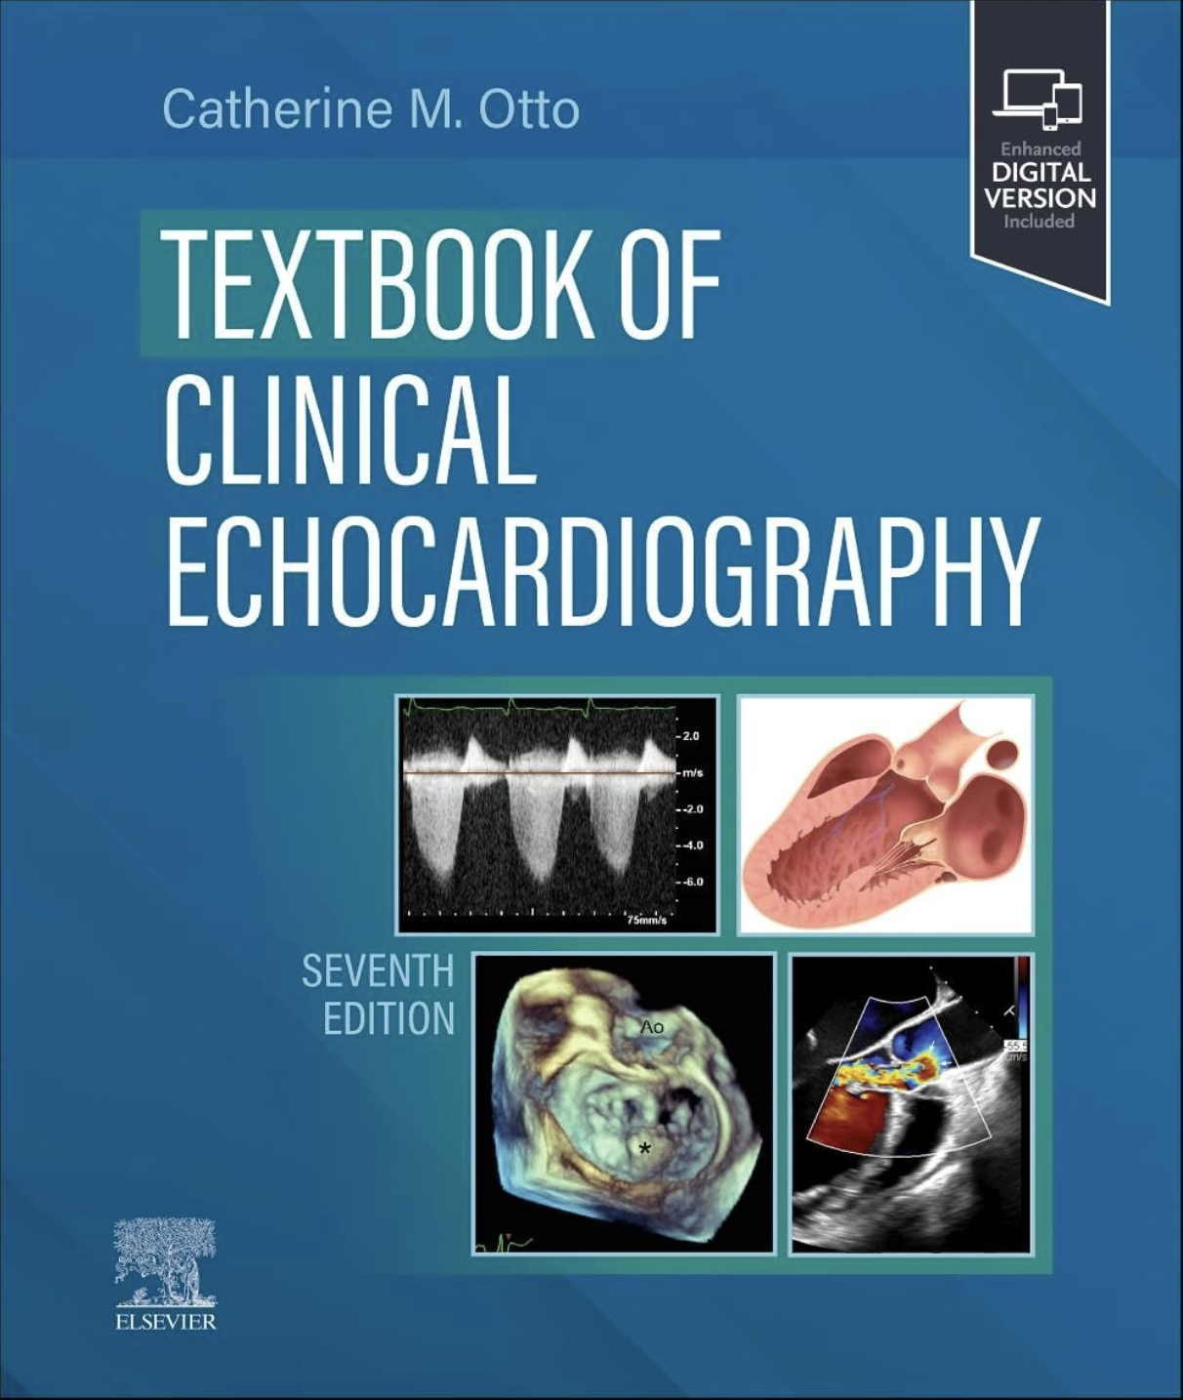



My Experience
Notes:
Had very little exposure to ultrasound in medical school - only for procedural guidance

Slide 6
Challenges in POCUS Education
Resource intensive – requires trained faculty mentors and ultrasound equipment
Ultrasound machine variability
Intimidating to learn new skill without supervision

Slide 7
A Proposed Solution
Simple to use and not overwhelming
Supported by the institution and available at the bedside
Empower beginners to feel comfortable picking up the probe in absence of faculty mentor
Notes:
Need to empower beginners to feel comfortable picking up the probe - the first barrier.

Slide 8
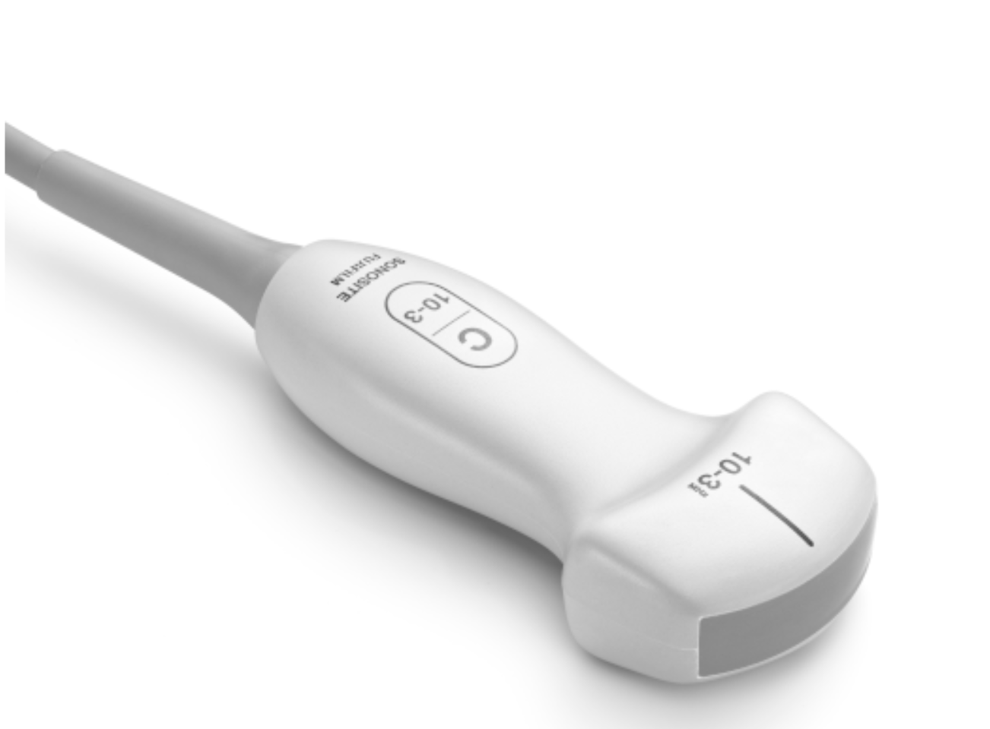
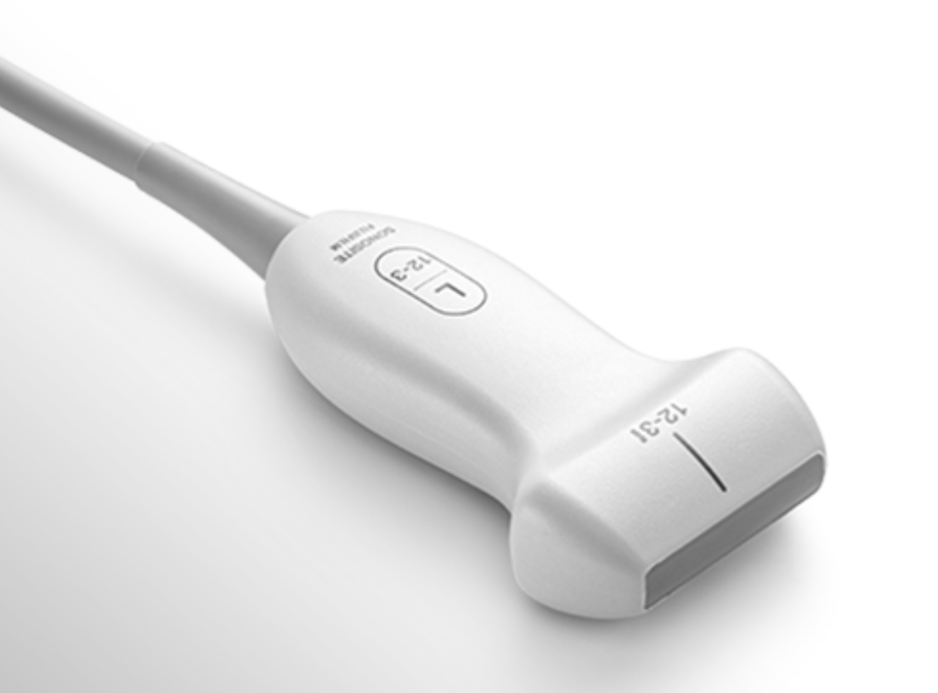
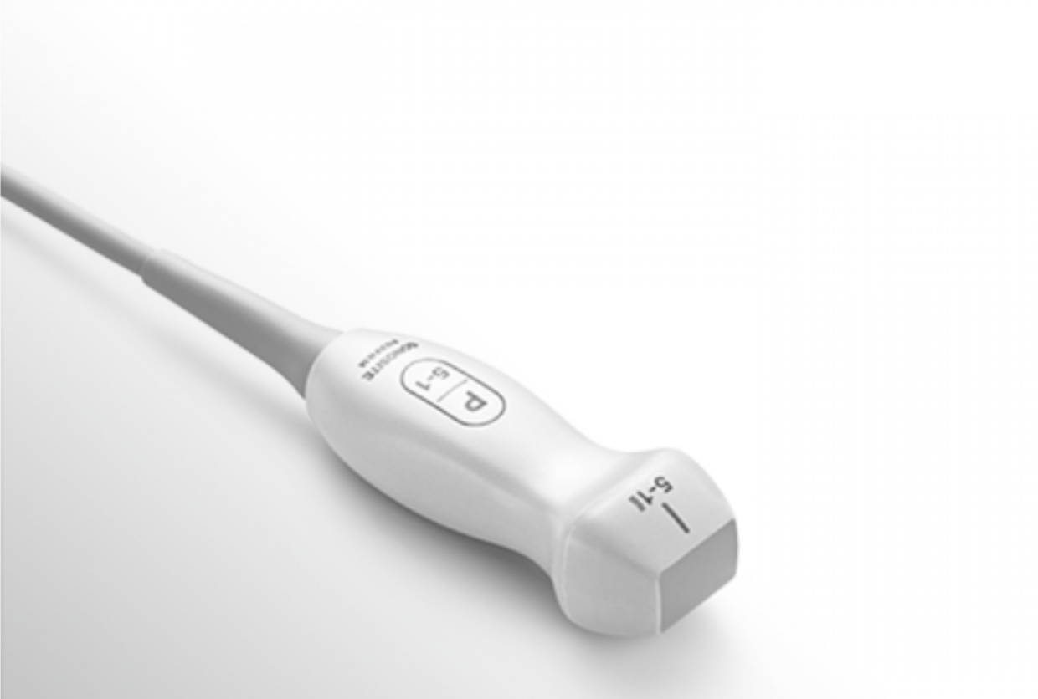
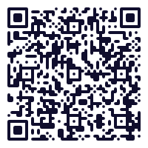
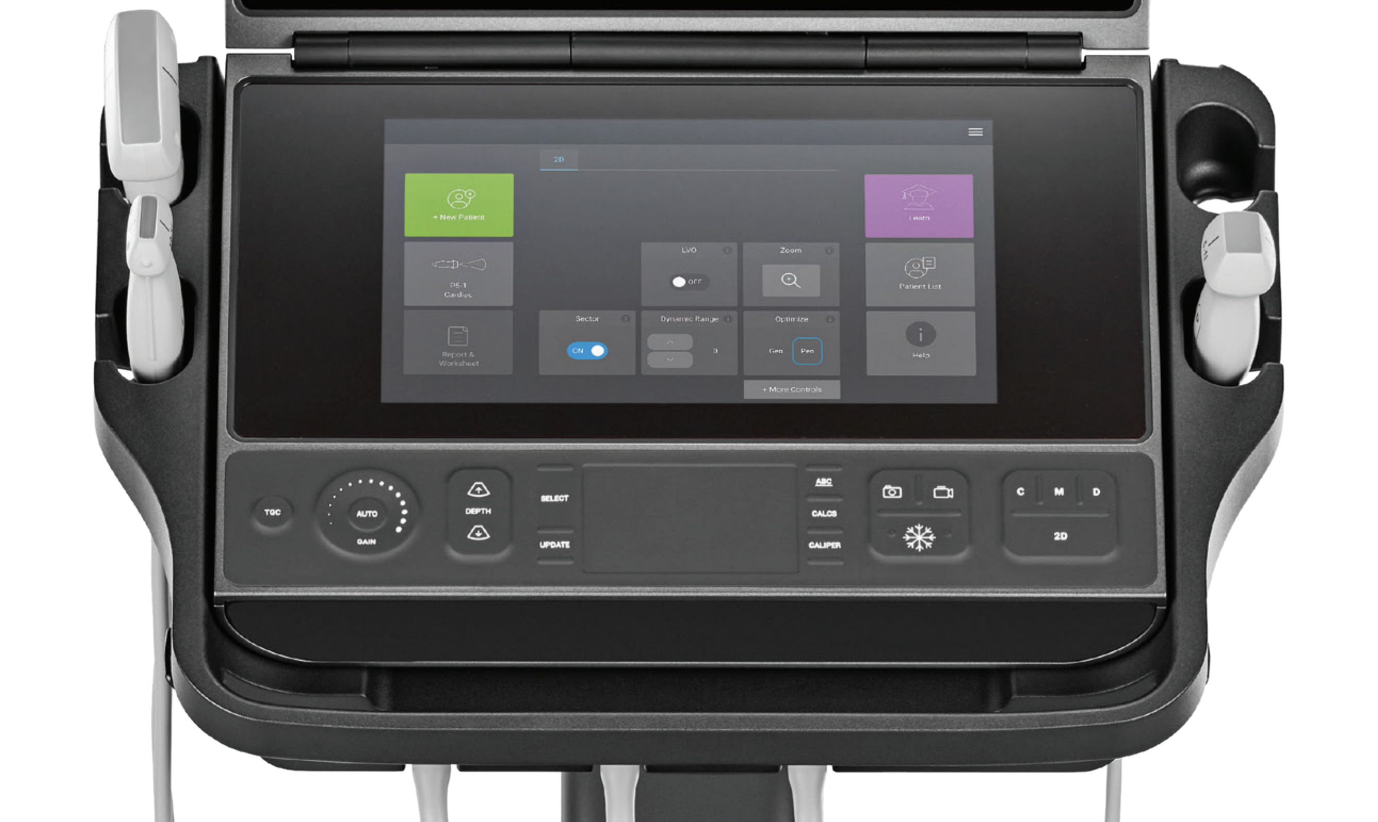
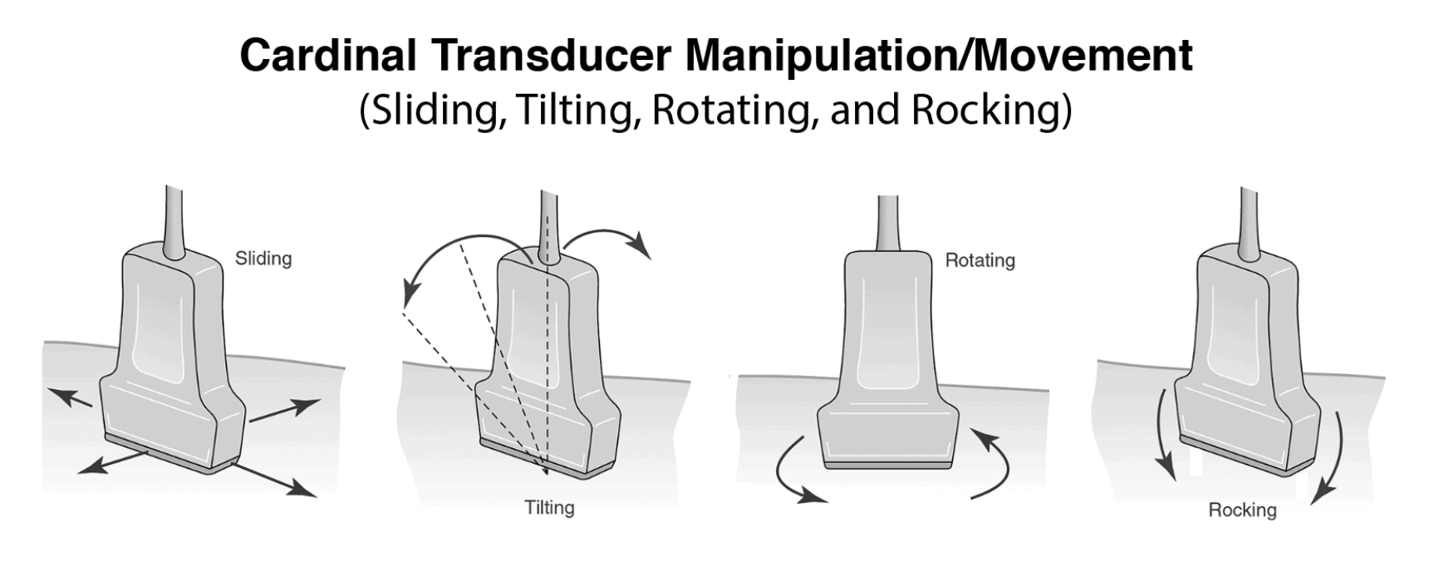
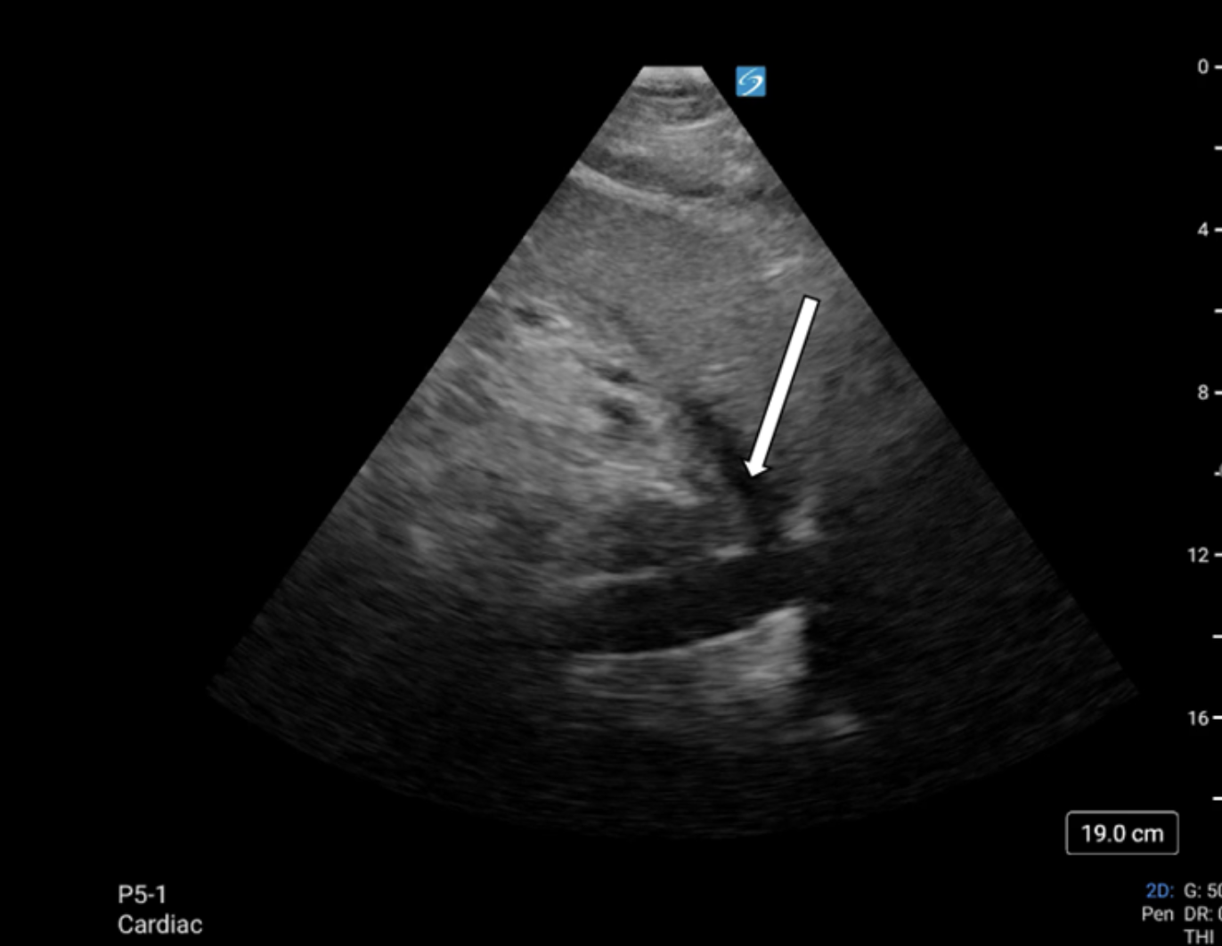
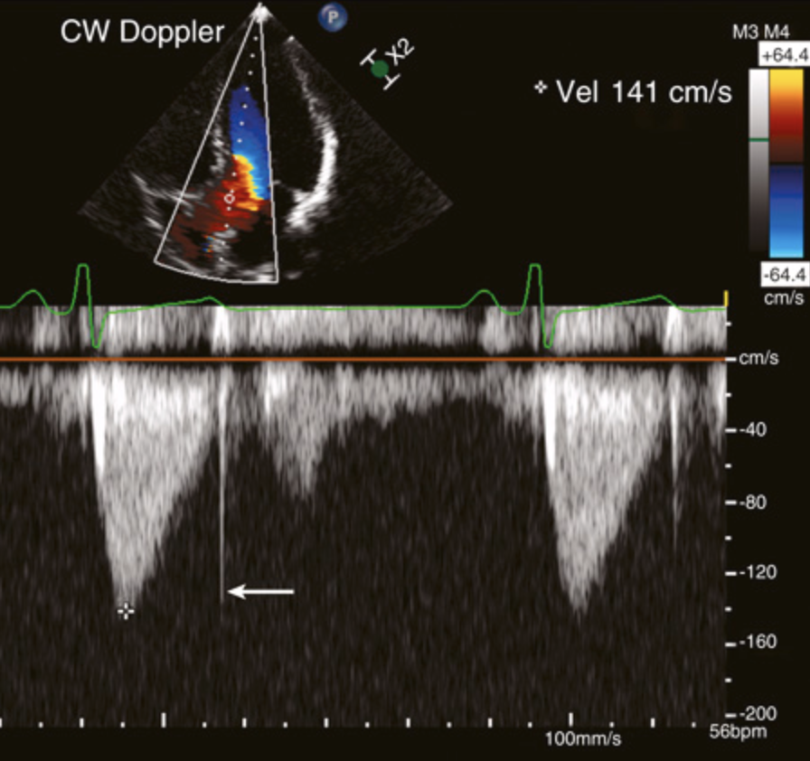
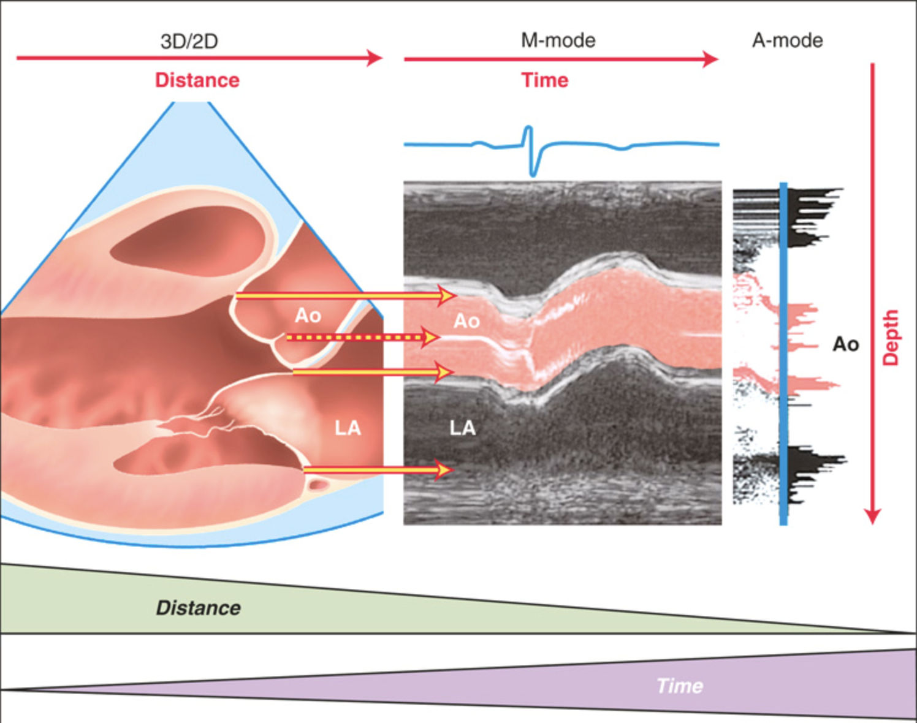
Iterative Design
References: Otto C. M. (2024). Textbook of Clinical Echocardiography. Elsevier.
https://www.pocus101.com/ultrasound-machine-basics-knobology-probes-and-modes/
The Sonosite PX has physical controls as well as a touch screen. To get started, open the screen, press the power button in the back of the machine and select “scan”, then choose your probe and start scanning!
Curvilinear:
Abdominal
OB/GYN
Linear:
Vascular
Superficial
Cardiac/phased array:
Cardiac
Lung
Gain: Alters echogenicity (“brightness”) of structures to help better visualize tissue of interest
Camera: Capture photo
Movie camera: Capture video
Snowflake: Freeze image
Caliper: Take measurements
Fanning
2D: Standard view
Depth
C: Color
D: Doppler
Selecting “C” will create a box for color flow that can be manipulated with the touch pad. Mnemonic: BART (Blue Away, Red Towards). This can be used to assess flow across valves, help differentiate veins and arteries, and check to ensure your procedure site is free of vessels. Selecting “D” can generate the trace on the bottom, quantifying the color doppler. Here, flow velocity (y-axis) is graphed against time (x-axis).
M: Motion (M-mode)
”Footprint”
”Probe indicator”
The standard clinical display will show superficial structures towards the top of the screen and deep structures at screen bottom. The depth in cm is displayed screen right. Pressing down on the depth button will “increase depth” showing deeper structures. The probe indicator (blue dot at top right) should align with the “dot” on the side of the transducer.
M-mode plots time against depth of structures. The primary advantage is temporal resolution. For fast-moving cardiac structure, it offers more precise measurements. It also has clinical utility in assessing for lung sliding in suspected pneumothorax.
Hepatic vein
IVC

Slide 9
Iterative Design

Slide 10
Iterative Design

Slide 11
A Proposed Solution
Displayed on Screen
Simplified Representation
Optional QR Codes for Deeper Dive
Seen on Patient
Text Description
Notes:
Need to empower beginners to feel comfortable picking up the probe - the first barrier.

Slide 12
A Proposed Solution
Optional QR Codes for Deeper Dive
Notes:
Need to empower beginners to feel comfortable picking up the probe - the first barrier.

Slide 13
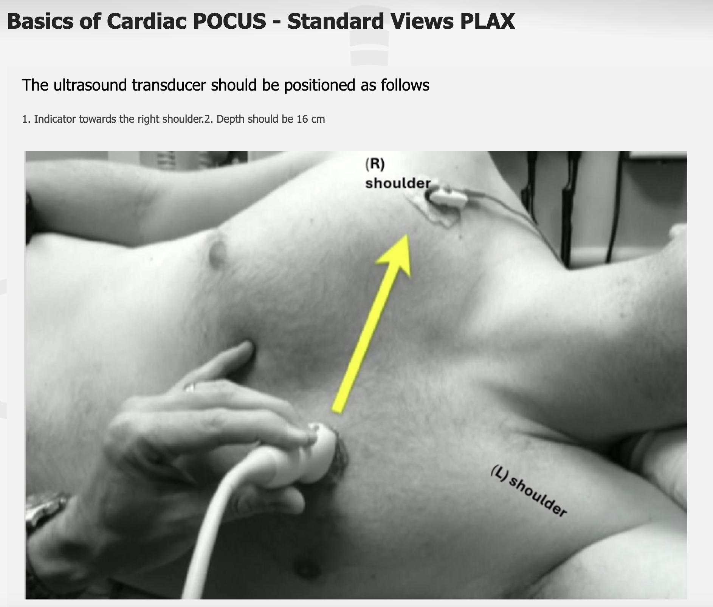

QR Codes
Microsoft Forms
Notes:
Need to empower beginners to feel comfortable picking up the probe - the first barrier.

Slide 14
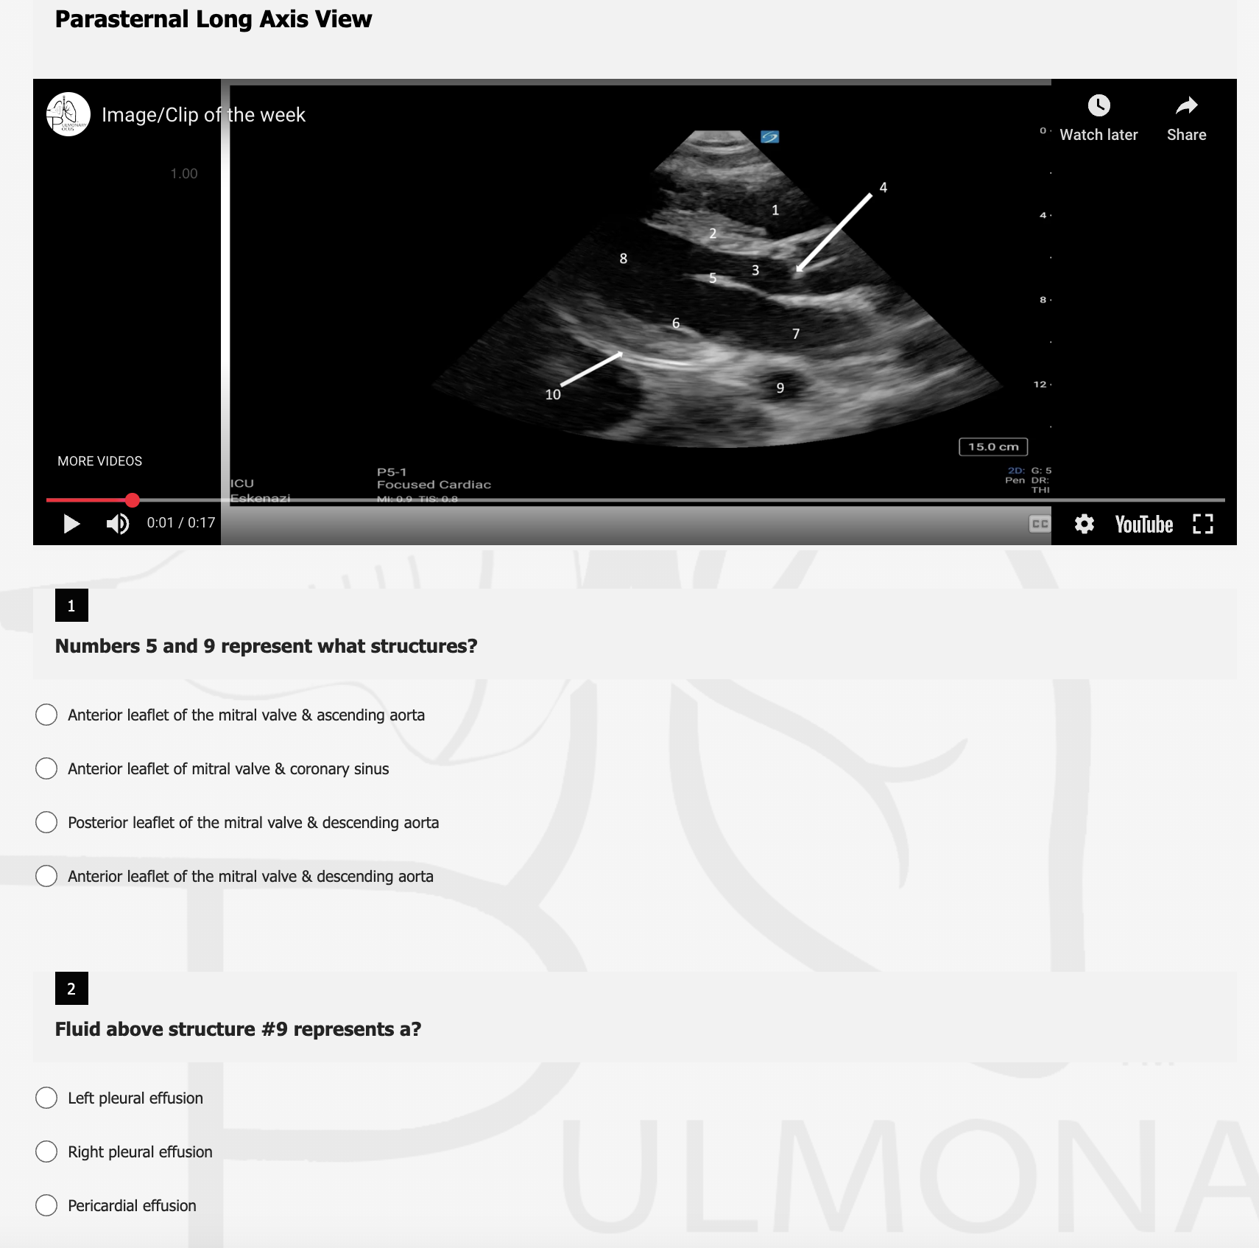
QR Codes
Microsoft Forms
Notes:
Need to empower beginners to feel comfortable picking up the probe - the first barrier.

Slide 15
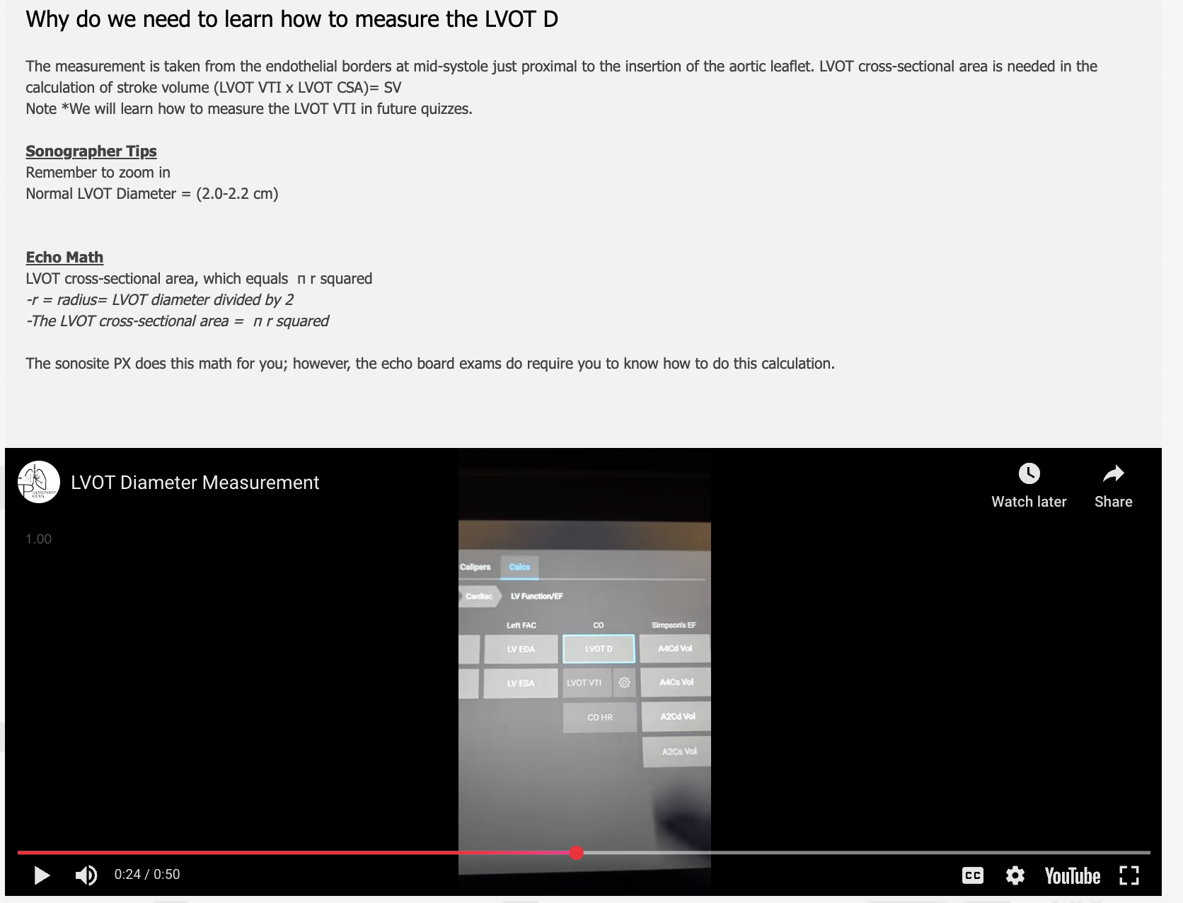
QR Codes
Microsoft Forms
Notes:
Need to empower beginners to feel comfortable picking up the probe - the first barrier.

Slide 16
QR Codes
Microsoft Forms
Notes:
Need to empower beginners to feel comfortable picking up the probe - the first barrier.

Slide 17
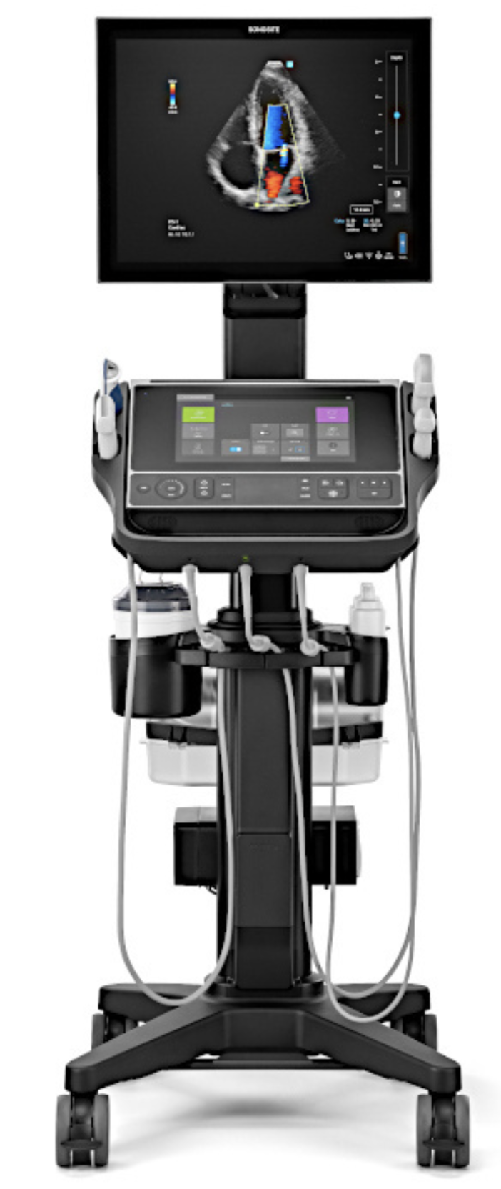
Roll-Out
Coming soon: www.pulmonarypocus.com
Notes:
Need to empower beginners to feel comfortable picking up the probe - the first barrier.

Slide 18
Methods
Pre- and post- 30-day rotation surveys were administered to Eskenazi ICU rotators and collected in Microsoft Forms.
The survey questions comprised several categories including interest in learning POCUS, confidence in image acquisition, and confidence in image interpretation.
Learners were asked to rate their confidence in image acquisition and interpretation on a 5-point scale from “no skill” to “expert skill”.

Slide 19
Methods

Slide 20
Results
Preliminary survey data (n = 14) have been collected.
Interest: 60% of learners were likely/very likely to use POCUS in clinical practice and 40% of learners were unlikely/very unlikely.
All participants felt that they were more confident in identifying cardiac anatomy.
All participants also reported that they would continue to use this resource this to learn POCUS.

Slide 21
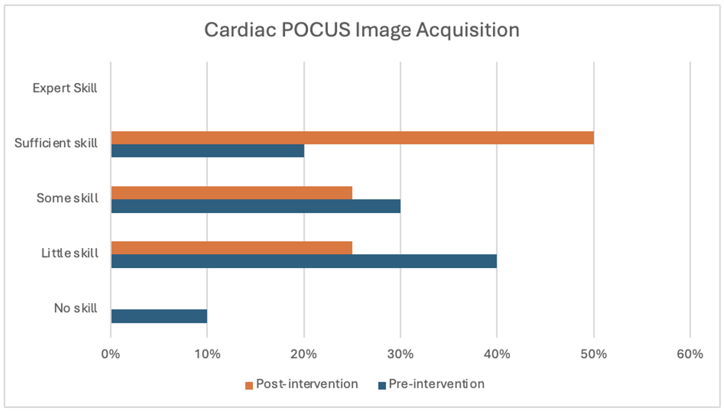
Results
Notes:
“Sufficient skill” increased from 20% pre-intervention to 50% post-intervention.

Slide 22
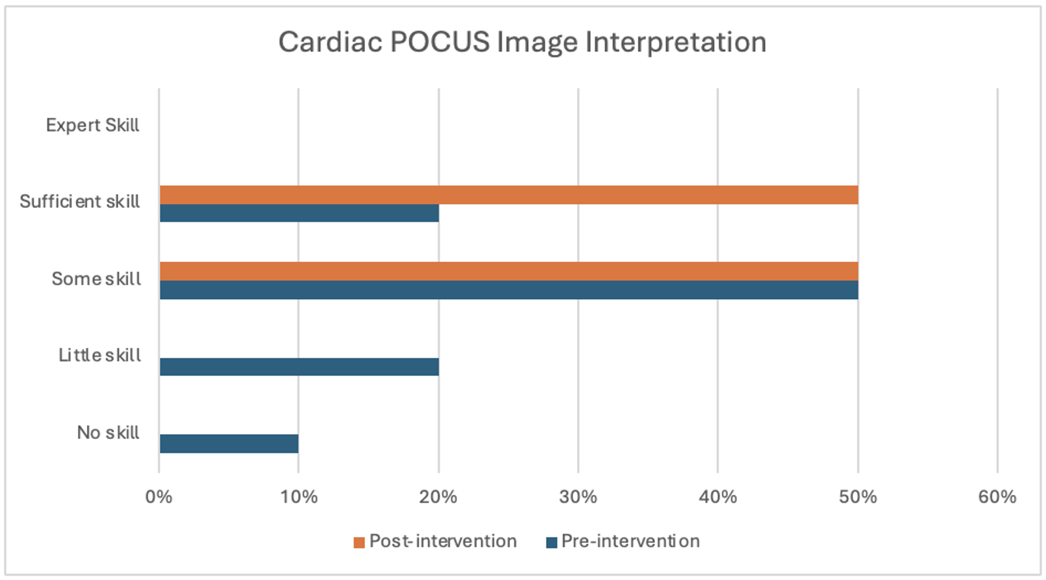
Results
Notes:
30% of learners rated skill in identifying anatomy as “no skill” or “little skill”. After the intervention, these groups decreased to 0%

Slide 23
Discussion
Learners perceived value in this document and had increased confidence after interacting with it
Low sample sizes makes data-interpretation difficult
Learners were subject to different faculty during rotations and may have spent more or less time with POCUS champions, influencing confidence

Slide 24
Future Directions
Further demonstrate effectiveness: ongoing data collection for survey responses
Analyze click-through-rate and engagement
More topics and distribution
Notes:
More one-page references

Slide 25
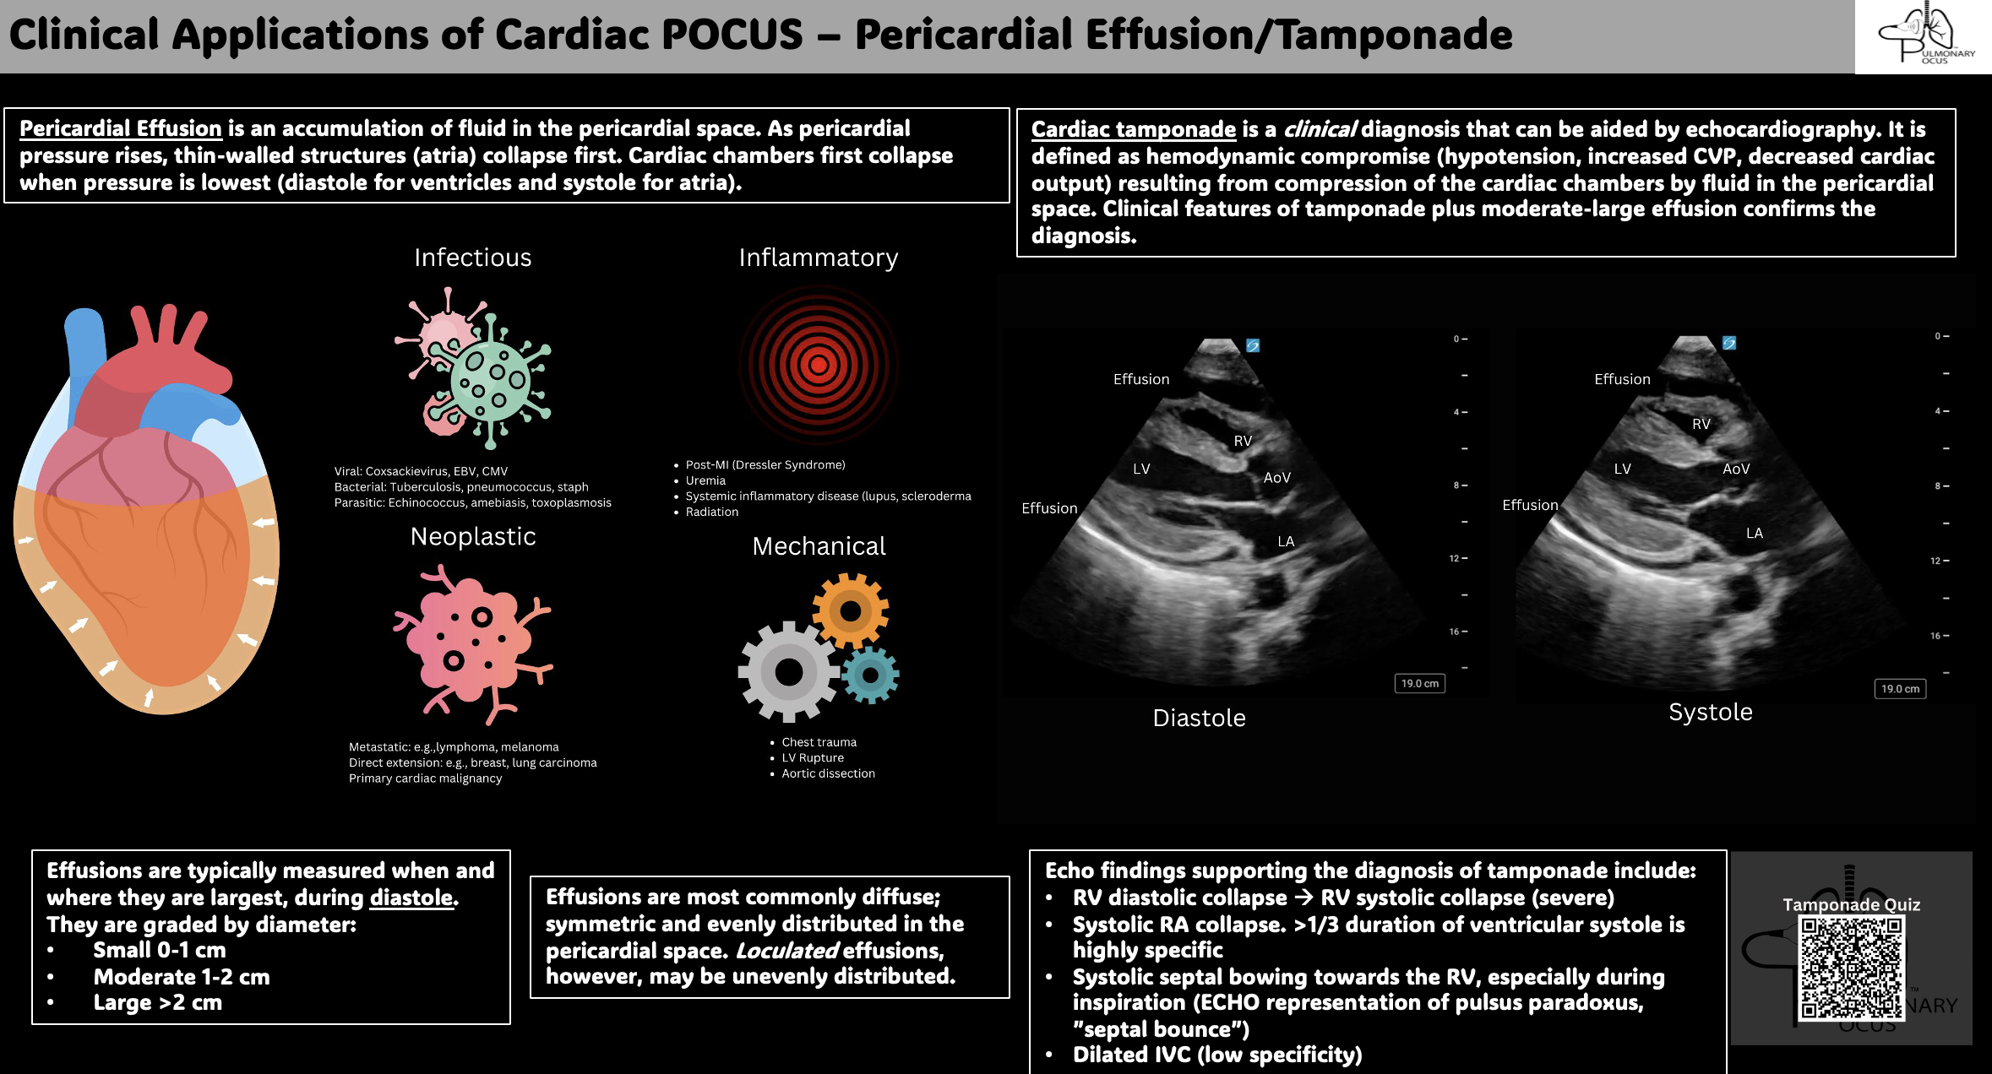
Future Directions
Notes:
More one-page references

Slide 26
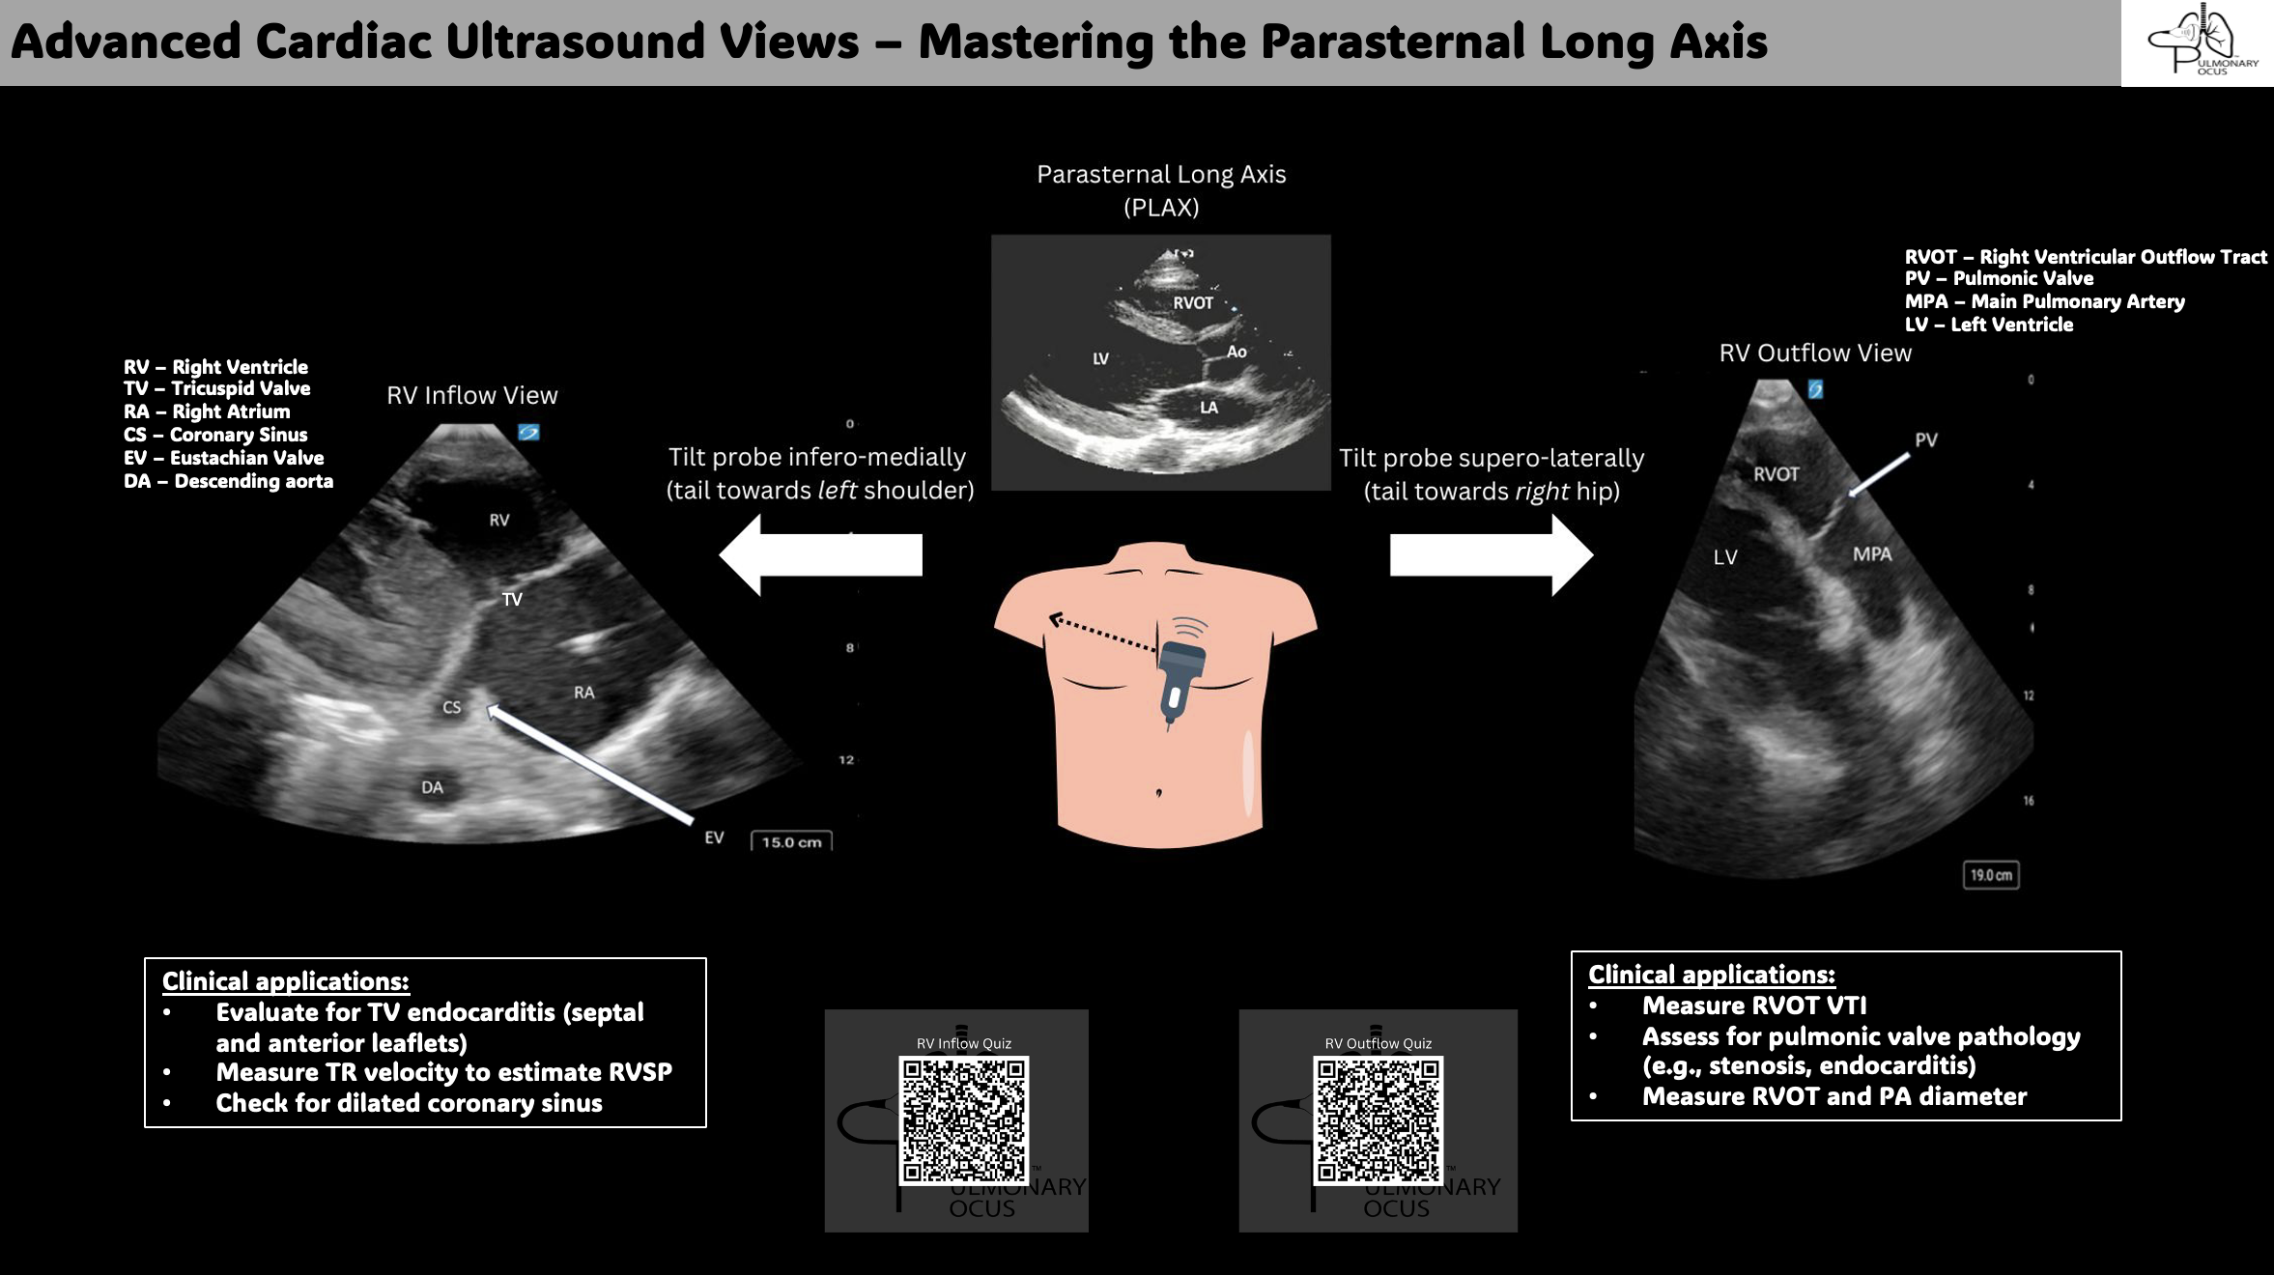
Future Directions
Notes:
More one-page references

Slide 27
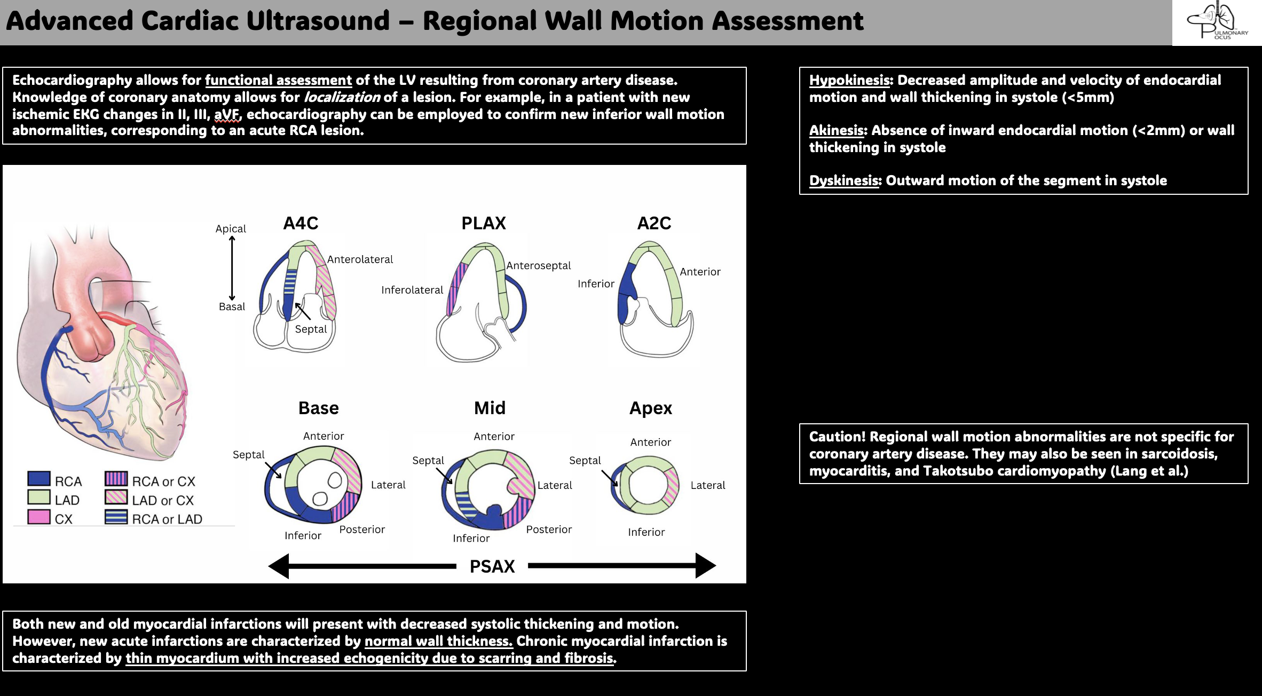
Future Directions
Notes:
More one-page references

Slide 28
Acknowledgements
Thank you to Dr. Edwin Jackson, Dr. Daniel Brenner, Dr. Francesca Duncan, Dr. Grahm Carlos, Dr. Muhammed Rishi, and the rest of the POCUS Writing Group!

Slide 29
References
Williams, J. P. et al. Current use, training, and barriers in point-of-care ultrasound in hospital medicine: A national survey of VA hospitals. Journal of Hospital Medicine 17, 601–608 (2022).
Díaz-Gómez JL, Mayo PH, Koenig SJ. Point-of-Care Ultrasonography. N Engl J Med. 2021;385(17):1593-1602. doi:10.1056/NEJMra1916062
Spencer KT, Kimura BJ, Korcarz CE, Pellikka PA, Rahko PS, Siegel RJ. Focused cardiac ultrasound: recommendations from the American Society of Echocardiography. J Am Soc Echocardiogr. 2013;26(6):567-581. doi:10.1016/j.echo.2013.04.001
Kirkpatrick JN, Grimm R, Johri AM, et al. Recommendations for Echocardiography Laboratories Participating in Cardiac Point of Care Cardiac Ultrasound (POCUS) and Critical Care Echocardiography Training: Report from the American Society of Echocardiography. J Am Soc Echocardiogr. 2020;33(4):409-422.e4. doi:10.1016/j.echo.2020.01.008

