Slide 1

Uncovering vendor’s interests:
Conducting an external review
Module 1: Foundations – Negotiation Planning Part 3
the ONEAL project
Notes:
Uncovering vendor’s interests: conducting an external review. This I the first of three videos within the Negotiation Planning Part 3 lesson which focuses on researching vendors. This video is going to discuss where to search for vendor information, researching alternatives, and researching pricing. It should be noted that the amount of time you dedicate to doing vendor research depends on how strategic the negotiation is. Sometimes you have little time, and it is not important enough to spend hours preparing. If that is the case, follow the framework provided in the Introduction to Negotiations lesson regarding pre-game when you have little time (in The Structure of Negotiations Video). However, when negotiation a strategic agreement due to either the portion of your total spend or because there is something you are fundamentally trying to change about your business relationship, you will want to dig deeper to understand the vendor’s interests.

Slide 2
1. Getting started
What where can I start finding information?
Notes:
Uncovering vendor interests starts by finding information about the vendor. There are several places you should look.

Slide 3
Financial Data
It depends on who owns the company and profit status. Public, Private, or Non-Profit.
Notes:
First you should locate financial data. Where you find this information varies depending on whether ownership of the vendor is public or private or if they operate as a non-profit. The next presentation in the lesson will explain where you can locate financial data based on ownership and profit status.

Slide 4
News Sources
Search article databases and look at press releases from the vendor found on the vendor website.
Notes:
Review available news and press releases about the vendor. Search article databases and look for this information on the vendor website.

Slide 5
Business Databases
Bloomberg
Factiva
D&B Hoovers
Mergent
Orbis
Pitchbook
Privco
S&P Capital IQ
Talk to your business librarian!
Notes:
Business databases are a great place to search for information. Talk to your business librarian! They are happy to help you figure out what resources you can use and walk you through using them. They likely will love helping you learn how to do this market research, and I say this as someone who is a business liaison at her institution. As a business librarian as well as a collection assessment librarian I geek out a bit when doing this research.

Slide 6
Community
Conferences, list-servs, consortia – Leveraging your network is powerful!
Notes:
Reach out to your community. Conferences, list-servs, and consortia provide excellent avenues to get information from colleagues. Leveraging your network can be powerful! It’s an excellent place to hear news and rumors about changes, which can help you ask the right questions when trying to uncover interests during the active phase of the negotiation.

Slide 7
2. Finding alternatives
Improving BATNAs through shopping
Notes:
As part of your external you review you want to shop around, improving your BATNA through finding alternative ways to meet information needs.

Slide 8
Finding competitive offerings & alternatives
Ask your community through list-servs
Visit vendors at conferences
Refer to your internal analysis to understand patron needs
Always look for potential open access options
Explore different acquisition models
Notes:
Two great ways to find alternatives is to lean on your community through using list-servs. Also regularly visiting vendors at conferences may help you uncover other avenues for different types of information. Doing this work requires referring to your internal analysis to understand your patron needs so you can identify different avenues for access. Always look for potential open access options and explore different acquisition models.

Slide 9
3. Researching Pricing
Finding out what others are paying
Notes:
You also want to research pricing. What are other institutions paying?

Slide 10
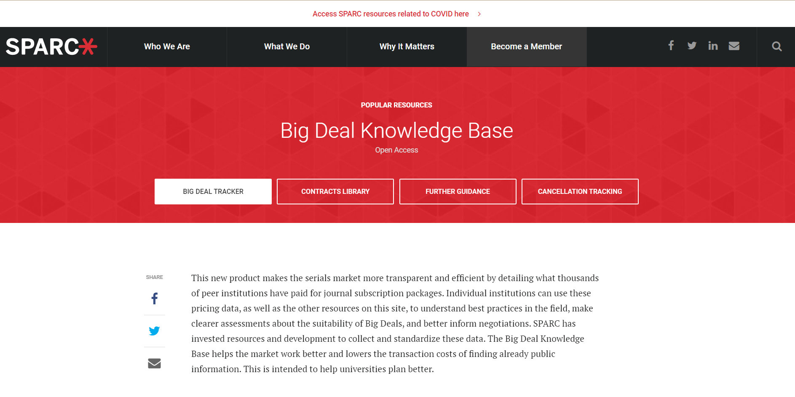
https://sparcopen.org/our-work/big-deal-knowledge-base/
Notes:
An excellent free resource to assist with this is the SPARC Big-deal-knowledge-base, which includes pricing, contracts, as well as cancellation tracking.

Slide 11
Things to note
Different institutions have negotiated different levels of discounts and concessions on licensing terms within their big deals
Thornton, J.B. & Brundy, C. (2021). Elsevier Title Level Pricing: Dissecting the Bowl of Spaghetti. Journal of Librarianship and Scholarly Communication, 9(General Issue), eP2410. https://doi.org/10.7710/2162-3309.2410
Notes:
Important to note:
Vendors want to make pricing complicated so it’s harder to have an apples to apples – each deal is unique and each package unique.
Different institutions have negotiated different levels of discounts and concessions on licensing terms within their big deals.
Thornton & Brundy examine this in their article.
If you examine different deals in the Big Deal Knowledge Base you will see different licensing concessions made by the vendor. For instance, one institution may have lost perpetual access rights while the another maintained them, but both received discounts.

Slide 12
Transparency Lists
Institutionally created lists of subscription resources with pricing shared openly in compliance with vendor agreements. Some examples (not exhaustive)*
Canadian Association of Research Libraries
Cornell University
Simon Fraser University Library
University of Alberta Library
University of North Texas Library
Why striking NDAs on pricing is important!
Source: https://sparcopen.org/our-work/negotiation-resources/data-analysis/serials-transparency-list/
Notes:
Transparency lists are also very useful. This is where an institution shares openly pricing often through an institutional repository where they do not have a confidentiality agreement, so they are in compliance with vendor agreements. This is why striking NDAs on pricing is so important!

Slide 13
Evaluate pricing over time
While other institutions may not have your exact package you can look at overall trends over time at different institutions.
Notes:
You should evaluate pricing over time. While other institutions may not have your exact package you can look at overall trends over time at different institutions.

Slide 14
4. Using during the negotiation
How do I apply what I’ve learned?
Notes:
You are probably asking how do I use all this information when negotiating. How do I apply what I’ve learned?

Slide 15
Planning
Evaluate how flexible do you think they are price.
  What do their profit margins look like?
  What news and rumors have you heard about the product and or the company?
  Can you find pricing?
  Are there alternatives?
Don’t forget to think beyond pricing and consider looking at openly available contracts.
Notes:
During negotiation planning you want to evaluate how flexible do you think they are on price.
What do their profit margins look like?
What news and rumors have you heard about the product and or the company?
Can you find comparable pricing?
Are there alternatives?
Don’t forget to think beyond pricing and consider looking at openly available contracts, which allows you to figure out how you might be able to shape the licensing agreement in your favor.

Slide 16
During the negotiation - Always
Use your new knowledge to keep yourself centered. You are asking for what you need and desire to foster a sustainable business relationship!
Notes:
Understanding your vendor’s position during the negotiation allows you to always use this new knowledge to keep yourself centered. You are asking for what you need and desire to foster a sustainable business relationship!

Slide 17
During the negotiation – Be strategic!
If they claim they are struggling too – knowing their profit numbers means you can push back.
If you have other’s pricing that are better – use it and ask for an explanation about the difference.
Have you seen the licensing clause you desire in other library contracts with that vendor? If so, be prepared to share this information when faced with pushback about a change in the license.
Notes:
You also can use the information you find strategically during the negotiation:
If they claim they are struggling too – knowing their profit numbers means you can push back.
If you have other’s pricing that are better – use it and ask for an explanation about the difference.
Have you seen the licensing clause you desire in other library contracts with the vendor? If so, be prepared to share this information when faced with pushback.

Slide 18
During the negotiation – Be Strategic
If you are in a prolonged complicated negotiation with a large publisher, it may be worth looking deeper into their financial picture, especially considering:
  Cost savings have not been passed down to us in price
  Many vendors have increased staffing while libraries are being forced to cut to the bone.
Be aware that pointing out these facts (backed up with numbers you can find in their financial statements) may put the vendor on the defensive and should only be done when it seems like you can’t get them to move.
This may be necessary when negotiating for large contracts with strategic significance.
Notes:
If you are in a prolonged complicated negotiation with a large publisher, it may be worth looking deeper into their financial picture, especially considering cost savings have not been passed down to us in price and many have increased staffing while libraries are being forced to cut staffing to the bone.
Be aware that pointing out these facts (backed up with numbers you can find in their financial statements) may put the vendor on the defensive and should only be done when it seems like you can’t get them to move.
This may be necessary when negotiating for large contracts with strategic significance.

Slide 19
The next two videos in this lesson
Finding vendor financial information
Understanding vendor financial information
Notes:
The next two videos in this lesson will walk you through:
Finding vendor financial information
Understanding vendor financial information

Slide 20
Credits
This presentation is the creative work of Katharine V. Macy, Collection Assessment Librarian & Subject Liaison for Business and Economics at Indiana University - Indianapolis, https://orcid.org/0000-0002-6283-7143
Presentation template by SlidesCarnival
Notes:
Here are the credits for this presentation.

