Slide 1
Evaluating the Impact of Community-Engaged Scholarship: Implications for Promotion and Tenure
ICHE Faculty Leadership Conference
February 15, 2019
Heather Coates, MLS, MS
IUPUI University Library Center for Digital Scholarship

Slide 2
What are the core concepts of research evaluation, bibliometrics, and altmetrics?
Are metrics fit for purpose for evaluating research?
Are metrics fit for purpose for evaluating researchers?
What are some common mistakes in using metrics?
How can we use metrics responsibly?
How can P&T processes reward community engaged research?
Notes:
Disclaimer – I’m going to start from the basics here because we often lose sight of our assumptions, the limitations of what we can measure, and the limitations and biases present in our organizational and societal structures and which are reflected in the data themselves. I want to take about 5 minutes to make sure we are all on the same page when we talk about research, metrics, and evaluation processes.

Slide 3
What are the core concepts of research evaluation?
activities – actions that people can take on scholarly products
direct measurement – observable actions, effects, etc.
indirect measurement – gathering information from other sources
indicators – a measure that must be sufficiently proven to correlate with the associated concept
normalization – how data are put into appropriate context for the evaluation purpose
Notes:
Direct measurements are typically observable, demonstrable phenomena
Indirect measurements are what we often use because many things that we want to study are not directly observable
Analogy for student assessment – direct assessment is when we evaluate student products; indirect assessment is when we conduct surveys
Analogy in our personal lives – we can’t measure how much we love our family members, but we can measure acts of love, kind words, and other behaviors that we accept as proxies

Slide 4
What is rewarded in the P&T process?
 | Productivity
 | Quality
 | Prestige
 | Reputation
 | Impact
 | Professional growth
Notes:
Imprimatur – license, validation

Slide 5
What is rewarded in the P&T process?
Count of publications, typically journal articles | Productivity
“High impact” journals, “top tier” presses | Quality
Exclusivity, longevity, imprimatur, eminent editors and/or reviewers | Prestige
Word of mouth, perception, being established | Reputation
Journal Impact Factor, citation counts per article | Impact
General increase or upward trajectory in quantity and or quality of work over time | Professional growth
Notes:
Imprimatur – license, validation

Slide 6
High-level mental model for research
Inputs
knowledge generation happens here
Outputs
Outputs
Outputs
Impact
Notes:
Institutions value grant dollars, publications, and patents because we have decent systems in place to count, measure, and track those things

Slide 7
What are the core concepts of bibliometrics?
Bibliometrics is the statistical analysis of publications such as articles, books, and other sources. It is not the quantitative measurement of all scientific activities.
Units of measurement: inputs, outputs
inputs include people, instruments, money, space, etc.
outputs include articles, books, data, code, models, algorithms, etc.
Concepts: use, visibility, impact, quality
Notes:
Gringas, 2016: Evaluation implies taking stock, at one point in time, of the state of the activities of an individual or organization (Ch 3); Rankings are essentially a form of public advertisement (Ch 3)

Slide 8


What is the metric about?
Journal/Venue Level Metrics
Output/Article Level Metrics
Author Level Metrics

Slide 9
What are the core concepts of bibliometrics?
Bibliometric indicators are generally derived from a core set of inputs and outputs
Publications per author
Publications in a field over time
Citations per article
Citations patterns between journals
Co-authorship patterns between countries

Slide 10
What are the core concepts of altmetrics?
Altmetrics are indicators for activities taking place on social media platforms, such as Twitter, Facebook, CiteULike; typically considered to be complementary to bibliometrics, rather than a replacement
Activities include view/download, discuss, save, cite, recommend
By default, these are item-level metrics (about the article, book, data, etc.)
Notes:
Gringas, 2016: Evaluation implies taking stock, at one point in time, of the state of the activities of an individual or organization (Ch 3); Rankings are essentially a form of public advertisement (Ch 3)

Slide 11
Another mental model
Products
Activities
Indicators
Journal articles
Books
Book chapters
Conference presentations & papers
Abstracts
White papers
Reports
Data
Code, algorithms
Models, simulations
View
Download
Bookmark
Like
Share
Discuss
Engage
Review
Cite
Adopt/Implement
Citation counts
Views & downloads
h-index
Relative Citation Ratio
Media coverage
Reviews
Eigenfactor Article Influence Scored
Altmetric Attention Score
Notes:
Products: articles, books, book chapters, white papers, reports, data, software, algorithms, models, simulations
Activities
Evidence: count/tally, normalized score, ranking, peer review, reviews, evaluations, informal commentary, recommendation letters
Metrics refer to numeric evidence, typically automated counts
Indicators: specific, concrete metrics that demonstrate a type of research impact
Impact: advancing knowledge, community benefit, economic benefit, clinical implementation, legislation & policy, Translating Research Into Practice (TRIP)

Slide 12
Are metrics fit for purpose for evaluating research?
Is the metric a valid indicator for the variable being evaluated?
Example: Journal Impact Factor (JIF)
In any given year, the impact factor of a journal is the number of citations received in that year by articles published in that journal during the two preceding years, divided by the total number of [research, proceedings, and review] articles published in that journal during the two preceding years.
# of citations to all items published in 2011-2012
# of articles published in 2011-2012
Note: the JIF is not a good predictor of whether an individual article will be highly cited, which is how many people interpret it
Notes:
What it is good for is comparing journals of different sizes, which is useful for journal editors, librarians, and researchers

Slide 13
Are metrics fit for purpose for evaluating research?
Is the metric a valid indicator for the variable being evaluated?
Example: raw citation counts
Coverage for journal articles is much greater than for other types of products
Raw counts are meaningless without context – what is the primary research product of the field, what is the citation half-life for the field
Example: h-index
Typically available only for journal articles, favoring articles over other products
Favors more senior scholars – increases with time
Favors productivity over quality, but not measure either well
Does not behave predictably – does not necessarily increase as citations or publications increase

Slide 14
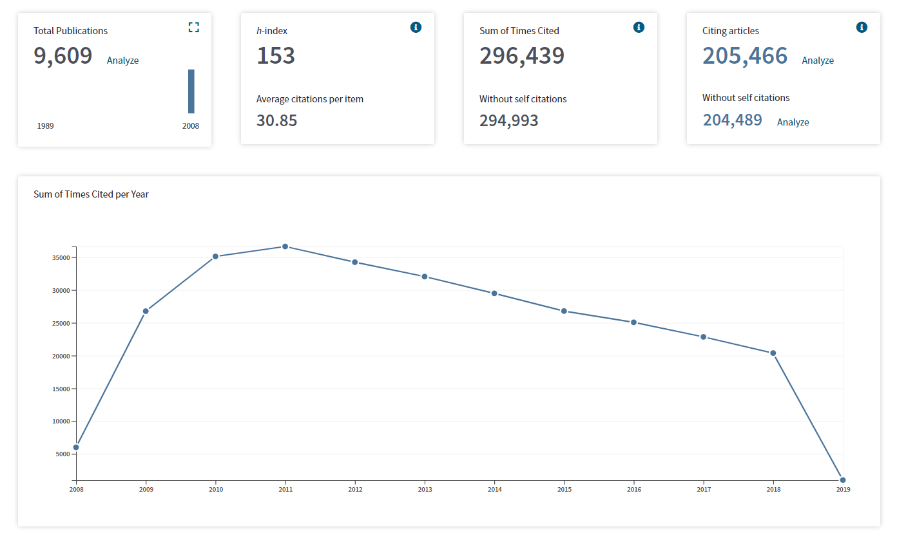
Subject = Infectious Diseases
Notes:
Web of Science search 20190203
SU="Infectious Diseases") AND DOCUMENT TYPES: (Article)Refined by: PUBLICATION YEARS: ( 2008 OR 2008 )
Timespan: 2008-2018. Indexes: SCI-EXPANDED, SSCI, A&HCI, CPCI-S, CPCI-SSH.
Screenshot is of citation analysis for 2008 publications
NOTE: The Citation Report reflects citations to source records indexed within a product. We recommend that you perform a Cited Reference Search to include citations to items that are not indexed in the product. (https://images.webofknowledge.com/images/help/WOS/hp_citation_report.html)

Slide 15
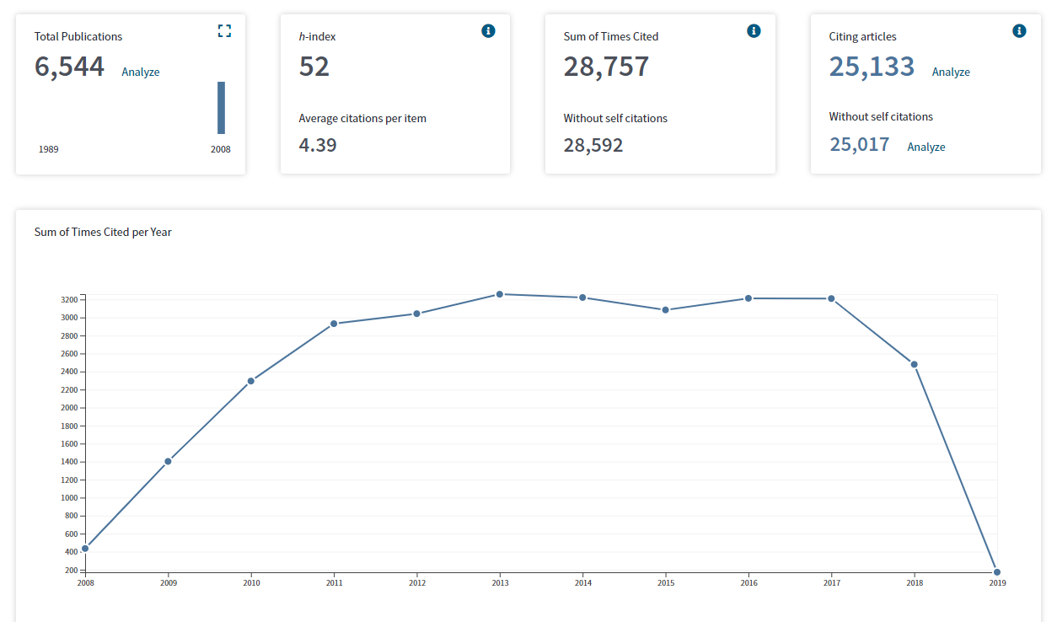
Subject = History
Notes:
Web of Science search 20190214
SU="history") AND DOCUMENT TYPES: (Article)
Timespan: 2008. Indexes: SCI-EXPANDED, SSCI, A&HCI, CPCI-S, CPCI-SSH.

Slide 16
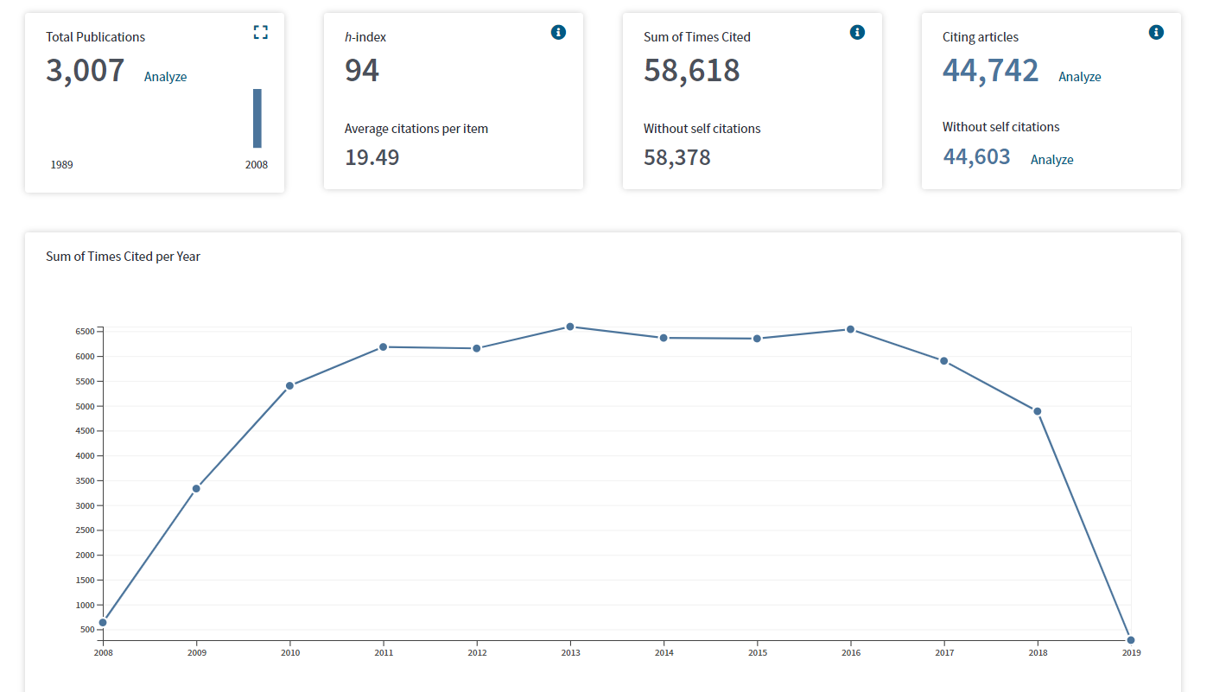
Subject = Information Science & Library Science
Notes:
Web of Science search 20190203
(SU="Information Science & Library Science") AND DOCUMENT TYPES: (Article)Refined by: PUBLICATION YEARS: ( 2008 )
Timespan: 2008-2018. Indexes: SCI-EXPANDED, SSCI, A&HCI, CPCI-S, CPCI-SSH.

Slide 17
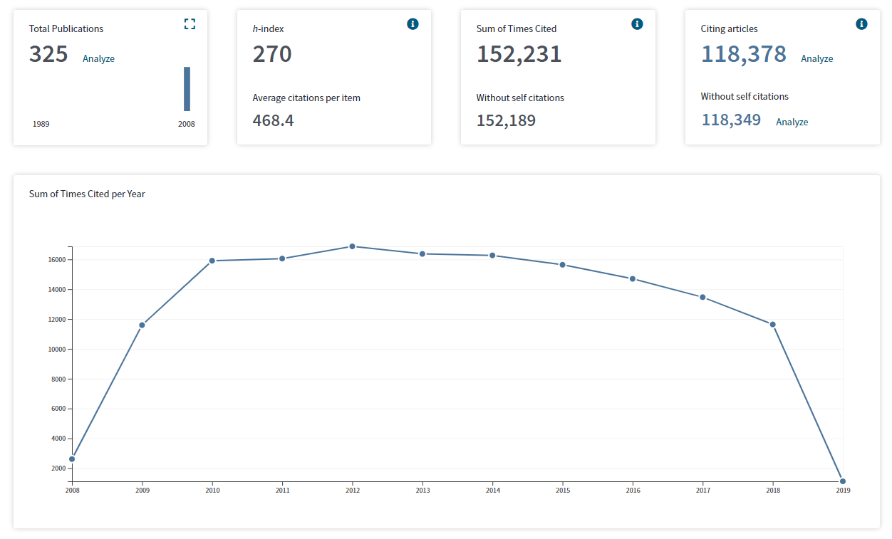
2008 articles = 24,149
Subject = Oncology
Subject = Oncology
Notes:
Web of Science search 20190214
SU="Oncology") AND DOCUMENT TYPES: (Article)Refined by: ESI Top Papers: ( Highly Cited in Field )
Timespan: 2008. Indexes: SCI-EXPANDED, SSCI, A&HCI, CPCI-S, CPCI-SSH.

Slide 18
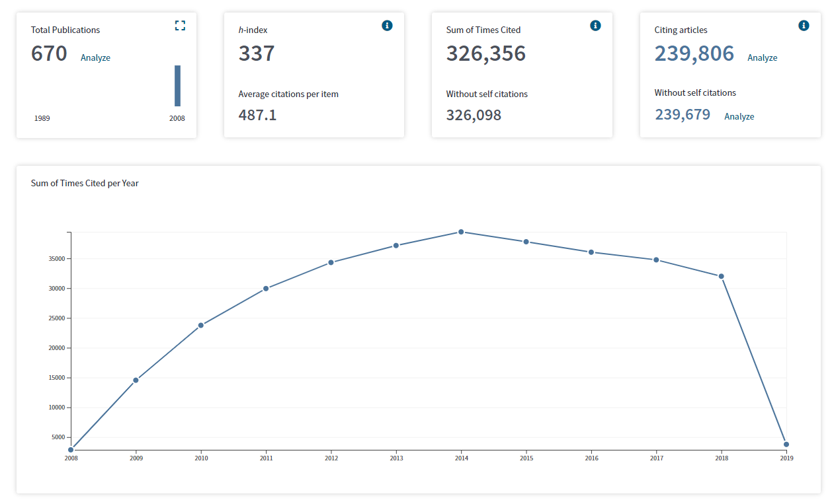
2008 articles = 76,291
Subject = Materials Science
Notes:
Total publications
Web of Science search 20190214
(SU="Materials Science") AND DOCUMENT TYPES: (Article)Refined by: ESI Top Papers: ( Highly Cited in Field )
Timespan: 2008. Indexes: SCI-EXPANDED, SSCI, A&HCI, CPCI-S, CPCI-SSH.

Slide 19
Are metrics fit for purpose for evaluating researchers?
Is the data relevant to the variable being evaluated?
Is the metric a reliable indicator for the variable being evaluated?
Citations are a reasonable indicator for scholarly impact
The Journal Impact Factor is not an indicator of the quality or impact for a particular article
Are program, school, or country level data being used to evaluate individuals?
It may not be feasible to adequately normalize and contextualize data for an individual scholar in a particular field
Increasingly, organizational schools, departments, and programs cross traditional disciplinary boundaries
Notes:
For example, a school of public health may include faculty whose background is psychology, nursing, social work, informatics

Slide 20
Are metrics fit for purpose for evaluating researchers?
Are the available data representative of all publication activity across the globe? Are the data available? Are the available data comprehensive? reliable?
Web of Science & Scopus do not contain representative samples; significant unevenness by country of author, language of the publication, and discipline (Sugimoto & Lariviere, 2018)
Field classifications in citation indices are more granular for the natural and medical sciences than the social sciences and humanities, so normalization for the latter is less precise (Sugimoto & Lariviere, 2018)
“It is one thing to identify indicators for an assessment; it is quite another to ensure that the data to construct them are available, reliable, and accessible at an affordable price.” (Gringas, 2016, Ch 4)
Notes:
Web of Science – English represents nearly 95% of all indexed papers
Scopus - English represents 87% of indexed papers
Topics related to public services – education, health, etc. – vary from country to country and international interest may be low; international impact may be low, while local impact is high
Field classifications can be a problem for highly disciplinary areas of research

Slide 21
What are some common mistakes in using metrics?
Using metrics as indicators of quality
Forgetting the limitations
inherent in the bibliometric approach
the properties of the data
of the available data
the ways in which the sociocultural context influences what research is done, by whom, and for what rewards.

Slide 22
What are some common mistakes in using metrics?
Using the Journal Impact Factor uncritically
As a measure of quality for an individual article
As a measure of quality for an individual scholar’s work
Without context – quartile rankings, disciplinary comparison, citation half-life
Exclusively, without other evidence
Using the h-index
Presenting a metric or raw count without context and normalization
Disconnect between the metrics presented and the story
Using rankings in place of evaluation

Slide 23
How can we use metrics responsibly?

Slide 24
Metrics do not constitute evaluation. They are indicators to be used and considered as evidence for specific claims.
Notes:
Metrics/indicators support expert evaluation, rather than replacing it. Bibliometric evaluation is a form of sampling, though skewed and not random; understanding the characteristics of that sample is crucial for interpretation and application.
There is a good technical reason for this called the ecological inference fallacy – which occurs when inferences about the nature of individuals are deduced from inferences about the group to which those individuals belong

Slide 25
We value what we can measure
We measure what we value
Notes:
Metrics experts, like Ludo Waltman, do not believe that individual researchers should be evaluated or assessed based solely on indicators; expert qualitative judgment is necessary
We cannot assess anything if we do not first identify the mission and objectives of the organization in question

Slide 26
San Francisco Declaration on Research Assessment
General Recommendation
1. Do not use journal-based metrics, such as Journal Impact Factors, as a surrogate measure of the quality of individual research articles, to assess an individual scientist’s contributions, or in hiring, promotion, or funding decisions.
For institutions
4. Be explicit about the criteria used to reach hiring, tenure, and promotion decisions, clearly highlighting, especially for early-stage investigators, that the scientific content of a paper is much more important than publication metrics or the identity of the journal in which it was published.
5. For the purposes of research assessment, consider the value and impact of all research outputs (including datasets and software) in addition to research publications, and consider a broad range of impact measures including qualitative indicators of research impact, such as influence on policy and practice.
Notes:
First set of principles for responsible use of metrics
Arose out of the American Society of Cell Biology
Fairly narrow focus on abuse of journal metrics and scientific research

Slide 27
San Francisco Declaration on Research Assessment
For researchers
15. When involved in committees making decisions about funding, hiring, tenure, or promotion, make assessments based on scientific content rather than publication metrics.
16. Wherever appropriate, cite primary literature in which observations are first reported rather than reviews in order to give credit where credit is due.
17. Use a range of article metrics and indicators on personal/supporting statements, as evidence of the impact of individual published articles and other research outputs [11].
18. Challenge research assessment practices that rely inappropriately on Journal Impact Factors and promote and teach best practice that focuses on the value and influence of specific research outputs.

Slide 28
The Leiden Manifesto
Quantitative evaluation should support qualitative, expert assessment.
Measure performance against the research missions of the institution, group, or researcher.
Protect excellence in locally relevant research.
Keep data collection and analytical processes open, transparent, and simple.
Allow those evaluated to verify data and analysis.
Account for variation by field in publication and citation practices.
Base assessment of individual researchers on a qualitative judgement of their portfolio.
Avoid misplaced concreteness and false precision.
Recognize the systemic effects of assessment and indicators.
Scrutinize indicators regularly and update them.
http://www.leidenmanifesto.org/

Slide 29
How can we use metrics responsibly?
Remember the role of cumulative advantage: “Researchers who are affiliated with prestigious institutions are more likely to receive citations (even when controlling for author and document characteristics), articles in journals of high reputation receive more citations than those in lower regarded journals (controlling again for confounding factors), and researchers who have more citations (as well as publications) are more likely to gain additional citations in a nonlinear manner compared with those who have fewer citations. In short, science, like other social activities, is one where the rich get richer.” (Sugimoto & Lariviere, 2018)
Notes:
Matthew effect – proposed by Merton – recognition was more likely to be given to those who already had high degrees of recognition than to those who were less well known

Slide 30
How can P&T processes reward community engaged research?
Evaluation should be driven by values, rather than what is easy to measure.
Evaluation should be driven by the goals of the funder, institution, the department or school, and the researchers.
Structure the review process as one of qualitative expert judgement of a candidate’s portfolio.
Recognize and value many methods of inquiry, rather than valuing the scientific process as conducted by academic experts over all else.

Slide 31
How can P&T processes reward community engaged research?
Value and reward the work that goes into knowledge generation rather than centering rewards on publications.
Explicitly recognize community, professional, and others as peers in the co-creation of new knowledge. Allow them to serve as both external reviewers and providers of recommendations.
Explicitly acknowledge that the timeframe for many types of research may extend beyond the pre-tenure period. Support thoughtful consideration of intermediate outcomes based on goals set forth by the researchers.

Slide 32
How can P&T processes reward community engaged research?
Institutions should do more to support administrators and faculty in conducting evaluations in a transparent and responsible manner.
Develop or adopt a set of guiding principles for using metrics and other indicators in evaluation processes (e.g., DORA, Leiden Manifesto).
Provide adequate training for department chairs, Associate Deans, and administrators in evaluating portfolios outside their field.
When external data sources will be used for evaluation purposes, demand better and more transparent documentation regarding the sources and limitations of data licensed from vendors like Clarivate Analytics (Web of Science, Journal Citation Reports), Elsevier (Scopus), Digital Measures (Academic Insight), Academic Analytics.

Slide 33
References
Gingras, Y. (2016). Bibliometrics and research evaluation: Uses and abuses. MIT Press.
Hicks, D., Wouters, P., Waltman, L., de Rijcke, S., & Rafols, I. (2015). Bibliometrics: The Leiden Manifesto for research metrics. Nature News, 520(7548), 429. https://doi.org/10.1038/520429a
San Francisco Declaration on Research Assessment. https://sfdora.org/read/
Sugimoto, C. R., & Larivière, V. (2018). Measuring research: What everyone needs to know. Oxford University Press.
Wilsdon, J., Allen, L., Belfiore, E., Campbell, P., Curry, S., Hill, S., …Johnson, B. (2015). The Metric Tide. https://doi.org/10.13140/RG.2.1.4929.1363

Slide 34
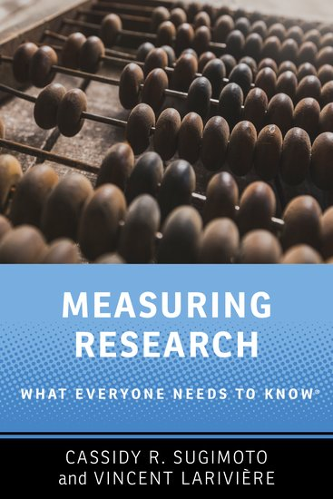
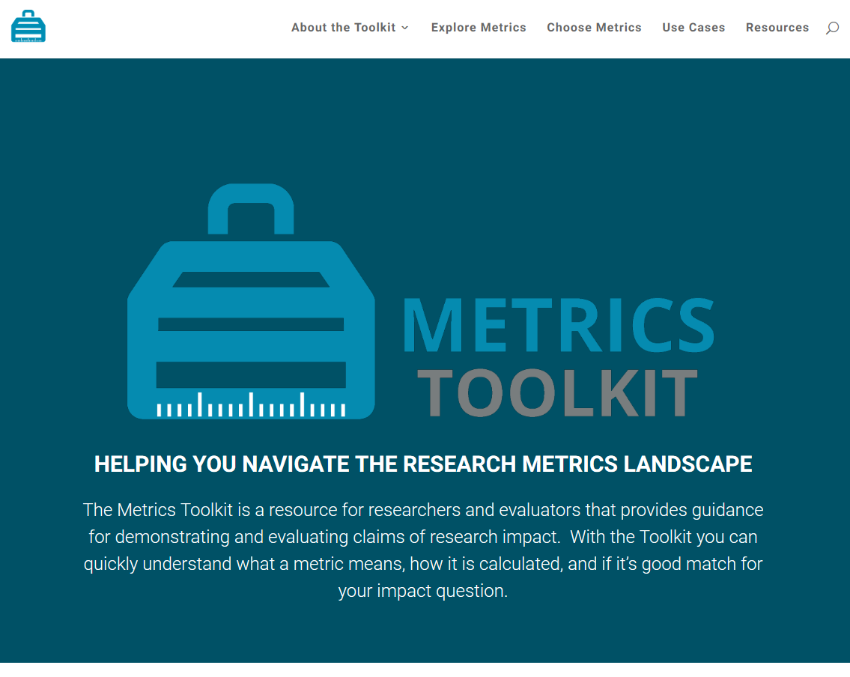
Resources
http://www.metrics-toolkit.org/
http://www.worldcat.org/oclc/1027811013

Slide 35

Heather L. Coates
Digital Scholarship & Data Management Librarian
Interim Co-Director, IUPUI University Library Center for Digital Scholarship
University Data Steward for Research Data
ORCID: 0000-0003-4290-6997
hcoates@iupui.edu

