Slide 1

THE VALUE OF FLOOR TIME
Evaluating Where Students Are &
Where They Want to Go
Leigh Rupinski | 2024
Notes:
Welcome!

Slide 2

AGENDA
1
  Introduction
  Understand “Floor time” as a concept
  Explain how to build a “floor” in evaluations
  Discuss how to progressively develop and evaluate student skills
  Q & A
Objectives
Notes:
This is our outline for today's session. I'll start with a brief introduction of myself, my role, and my institution to give you some context.
Next, we'll talk about what is floor time? So we can understand what it is as a concept
Then I'll explain how to build a floor using evaluations
And finally, we'll discuss how to progressively develop and evaluate student skills
There will be time for Q&A at the end.

Slide 3
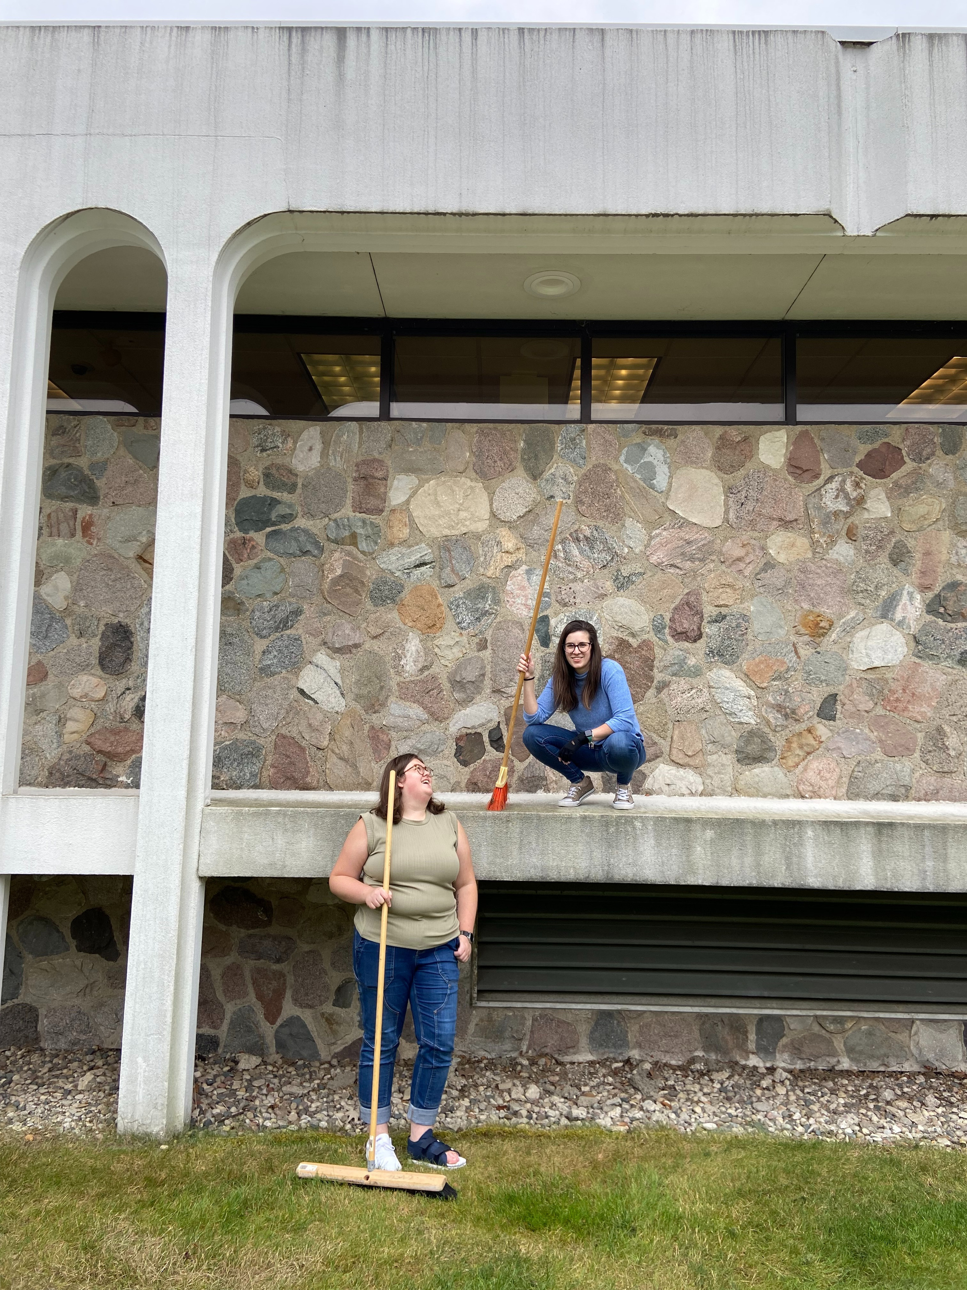
HELLO!
2
  Leigh Rupinski
  Archivist at Grand Valley State University
  Student supervisor for > 10 years in various roles
  Currently I supervise 5 student employees and an intern
  Mom of 3 small children
Introduction
Notes:
Hello! My name is Leigh Rupinski.
I am the Archivist for Public Services and Community Engagement at Grand Valley State University in Michigan.
I am the student supervisor for our Special Collections and University Archives location. I have been a student supervisor for over 10 years in various roles.
Currently I supervise 5 student employees and 1 intern.
I am also the mother of 3 small children (which is relevant!)

Slide 4
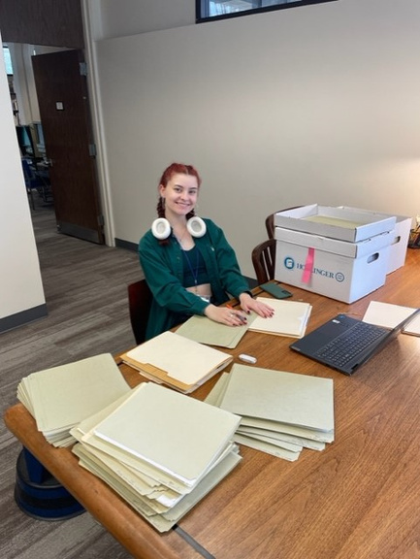
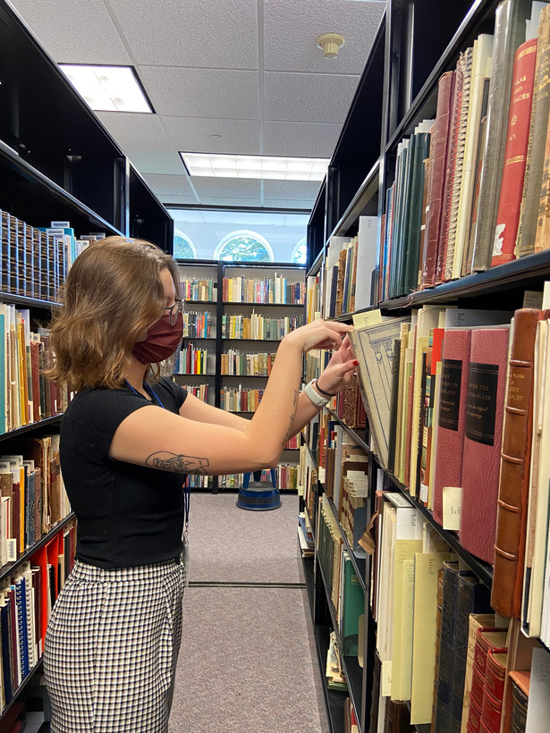
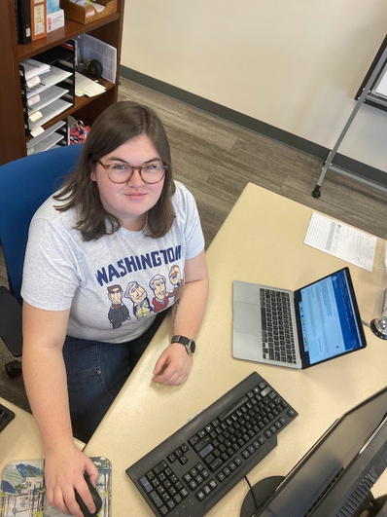
THE JOB
3
  Small archives and special collections within a larger academic library
  Students mirror the peer-to-peer service model in our greater Library system at the Reading Room service desk
  More specialized job skills needed
  Conduct variety of projects including digitization, inventory, processing, social media, exhibitions, etc.
Introduction
Notes:
Grand Valley State University is a medium size institution serving about 22,000 students.
Our Special Collections and University Archives is a separate location within the academic library unit.
Students mirror the peer-to-peer service model in our greater Library system by providing the first point of contact at our Reading Room service desk.
Students employed with me need more specialized skills! In addition to the service point staffing (and the reference and customer service skills it requires), students may conduct a wide variety of other projects including digitization, inventorying collections, processing, creating social media content, designing exhibitions, and more.

Slide 5
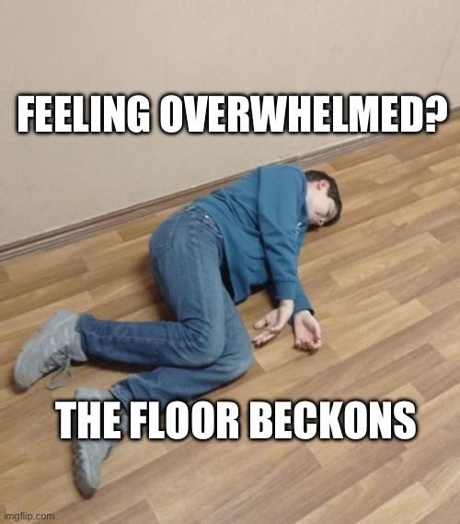
WHAT IS “FLOOR TIME”?
4
  10-15 minutes lying on the floor to decompress and ground yourself.
  A therapeutic technique of engaging with a child’s interests and then creating challenges to promote development.
r/adhdmeme
hapimaskshop
Definitions
Notes:
I was first introduced to this concept by my Gen Z students abruptly lying down on the floor. So I did what any self-respecting millennial librarian would do and googled it. Turned out, it's a real thing! "Floor time" is a popular trend with the youths. It is 10-15 minutes (or less) of lying on the floor to decompress and ground yourself.
It's also (I discovered) a trademarked therapeutic technique often used with autistic or children with ADHD, of engaging with a child's interests and then creating challenges to promote development.
With small children, we often get down on the floor with them for playtime. "Get down on their level" - if your parents, this probably sounds familiar. But if we think about what that really means - getting down at their level is physically demonstrating that we care about what they are doing, we are focusing our attention on them in that moment, and we might even want to engage in their play or interests.
Both uses of the word get at my approach to student employee evaluations.

Slide 6
WHERE’S THE FLOOR?
5
For our position, I have students rate themselves in categories such as: customer service, communication skills, productivity, understanding the job, and reliability, around the mid-term.
Then I evaluate them.
Then we discuss where we match and where we don’t. AND WHY.
Takeaway #1:
Self-evaluation tells you where they think the floor is vs. where you think the floor is.
Early Evaluation
Takeaway #2:
Each student is different.
Start on their floor.
Notes:
Now, I'm not suggesting that you need to lie down on the floor with your students. We're taking that concept in a more metaphorical direction here.
The importance of both iterations of floor time, to me as a student supervisor, is that the ground is 1) safe and 2) it's where the child leads.
So if we transfer those principles to students in the workplace...
We want to build a safe "floor" for students to grow from, and they can help us do that by directing how they see themselves and how they want to grow.
So I start with a student self-evaluation around the semester midterm. I have students rate themselves in categories such as customer service, communication skills, productivity, if they feel like they understand the job, reliability, etc. They pick a rating between 1 and 5, with an option for "Making Progress" (which means they haven't gotten to practice a skill enough yet to evaluate. This occasionally happens with customer service in particular - if no one comes in during your shift times, it's hard to judge that one!). Then there is space for the student to comment on why they gave themselves that rating. Their self-evaluation tells you where the student sees their floor.
Critically, this might not be accurate. Which is why after the student self-evaluates, I also evaluate them on the same scale and make comments.
Then we have a conversation where we discuss where we match, where we don't, and why that is. We can't build anything meaningful if we don't agree on where the floor (or baseline) is. I can't set growth expectations if we don't agree on what needs to be improved.
So that initial conversation sets us up to co-create a floor. It also introduces the idea of safety and praise. We demonstrate that we care about what they think by having that initial self-evaluation. And we can talk the students up here! Give them feedback!
In this stage, it also helps us set up individualized plans. Every student is different. It doesn't make sense to evaluate an adult, returning student who's been in the workforce previously the same way we would evaluate a student who's never had another job before. Their floors are going to look different!

Slide 7
LESSONS LEARNED
6
1
Students need help recognizing strengths!
They are often much harder on themselves than I am
On The Floor
Have a coach mindset
What does development look like for this student? This means identifying potential weaknesses or the student’s desired growth areas early
2
3
Prioritize trust and safety
The floor is a safe space, where the student leads.
Notes:
Some lessons I've learned over the years of doing student evaluations.
First, students need help recognizing strengths! (Honestly, so do I!) Students are often much harder on themselves than I am. That's part of doing the matching evaluations - I frequently see students mark themselves down in reliability because they got sick once or came in late twice. If they followed all the procedures to notify me of their absence, that's not being unreliable! These "mis-matches" open the door for good conversations about professional expectations and how we define "success".
Second, it's so important to have a coach mindset. I really see this struggle with perfectionists. I'm going to admit - I am not one! My default mindset is what one of my students summarized as "first draft". We write a first draft, and then we edit, edit, edit. Similarly, all the work we do can be iterated. Maybe it wasn't perfect the first time. That doesn't mean we can't go back and fix it! With students, this means thinking about: what does development look like for this particular student? It might be baby steps! But it's important to have the initial conversation and agree on areas of potential weakness and growth early on so we can make progress!
And thirdly, these evaluations need to prioritize trust and safety. They are building our floor. The floor is a safe space, where the student leads. If you use it as a tool to jump on them, criticize without praise or understanding, it will crumble the foundational relationship. And that's really hard to come back from! So we always want to be respectful of the student, their opinions, and what they choose to share in this space. (I.e. T's diagnoses)

Slide 8
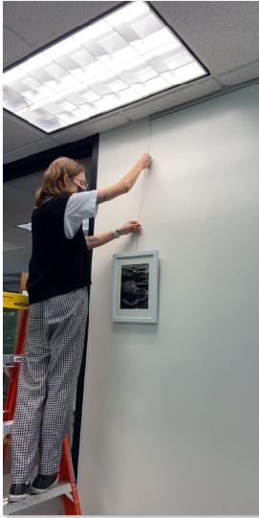
OFF THE FLOOR
7
Development
Ask the students what their goals are
Match available projects
Feedback & Honest Praise
Continue to build morale
Point out improvements
Come back to the floor when necessary
Off the Floor
Notes:
Ok. So now we've established each student's floor. Where do we go from here?
Make sure part of your evaluation conversation includes an element of "what are you interested in" or "what are your career goals" (this might also have come out when you hired them!)
I keep a list of available projects throughout the semester that I can pair to students' interests. I also have a list of "anytime" tasks that can be done (you guessed it) any time someone needs a break. Some of my favorite "anytime" projects are social media content, research for a blog post, or updating/improving documentation.
I want to emphasize that helping students grow does not necessarily mean they need big, flashy projects! Students are there to help YOU get tasks done. Part of student learning might be working through tedious metadata creation or reviewing catalog records - but students will still learn from these! Attention to detail, project management, even just how libraries operate!
We also want to continue to praise honestly. Focus on what they are doing well. Take responsibility when errors occur (how many times have I given instructions I thought were clear, but ended up confusing the student?) Point out where they can improve! Maybe they are writing metadata, but it needs more descriptive detail. Tell them so! "This is a great start. I would love to see some additional information added. Here's an example." Remember, sometimes improvements are baby steps, or happen in iterations. This is NOT wasted time. It's essential to learning!
And remember to use your floor. If a student is having a rough week, adjust! Let them go back to the floor (safe projects that aren't as challenging, or even doing homework at the desk) until they're in a better place to tackle something new and challenging again. This reinforces the safety of your workplace relationship.

Slide 9
KEEP GOING
9
Ask for Input
Evaluation does not stop after the first reflection.
Check in conversations can be informal during shifts BUT...
Setting aside time for focused attention is helpful too.
  What projects have you liked?
  What didn’t you like? Why?
  How can I improve?
Off the Floor
Identify Strengths
  Where has the student excelled?
  Where has the student demonstrated improvement?
  How can we keep moving forward?
Notes:
Don't forget to keep evaluating! Evaluation shouldn't stop after the first reflection. In fact, it's probably occurring naturally as they progress in working on projects and can often feel pretty informal.
That being said I do like to have a more structured connection time around the end of the semester, especially if I know students are going to be returning.
Again, I emphasize letting them lead and asking for their input. These second evaluations tend to be more conversationally based with open-ended questions: What projects have you liked working on so far? What didn't you like? Why? How can I improve as your supervisor?
Over the past couple years, I've added in a section of questions to ask students to really think about their strengths. And for me to as well! It's so easy to get caught up in "this student takes soooo long to get a task done! Or this student is easily distracted!" Try flipping it instead - what strengths does that show? That can help frame the conversation for a student. For example, I had a student who took AGES to create exhibitions. But they were always beautiful works of art in the end! Our evaluation conversations frequently revolved around, "your end products are fantastic but how can I help you with the timeline/planning process?" Then we tried different strategies to help his creative process!
Related to that, think about how even if a student isn't fully where you want them to be yet - have they demonstrated improvement? Encourage them to continue improving and look for ways you can support that!
Ex: "You're getting better at asking me questions when you need to! Would it help to set regularly check-ins during your Wednesday shift?"

Slide 10
KEEP GOING!
8
Reflection
Set Goals
  What are you most proud of working on here?
  What skills have you built here that have helped you outside of work?
  What can you improve?
  What would you like to try?
  What’s something that might help in your future career?
Off the Floor
Notes:
If you're really lucky, you'll have students working for you for multiple years. Keep building off that floor! Ask questions like: What are you most proud of working on here? What skills have you built here that have helped you outside of work?
And then think about how to set goals for their future. One of the worst parts about being a student supervisor is that our employees all graduate eventually! So help them think about that (even when it makes me want to cry) - What can they improve on? Is there anything they'd like to try doing they haven't gotten a chance to yet? What's something that might help in their future career path? What ideas do they have for what to work on?

Slide 11
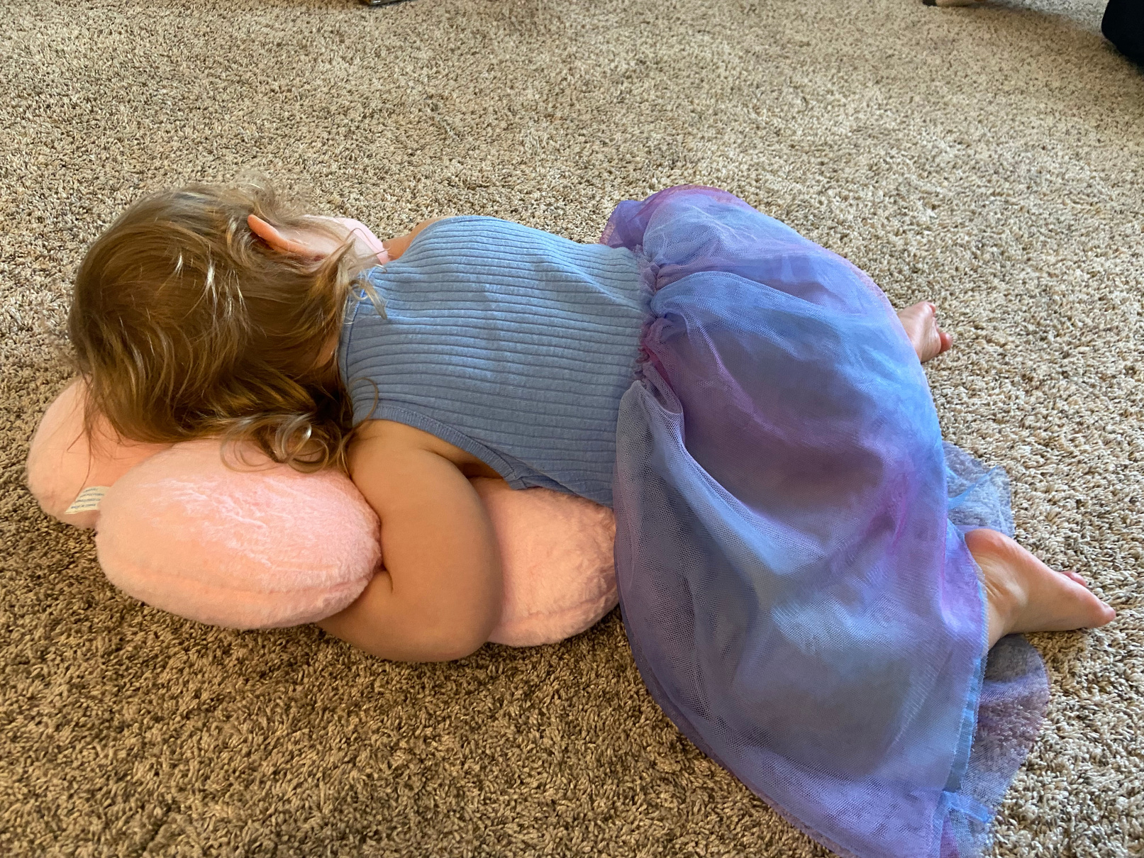
BACK TO THE FLOOR
8
The floor is where your workplace relationship is strongest - our foundation!
When life is overwhelming, encourage students to reset on the floor. This can be literal floor-time, or less so, like worrying less about “accomplishing” a project and letting the student dictate what they work on for a few hours or a day
Floor Time
Notes:
And remember, our metaphorical floor is all about building a safe relationship. It's our foundation!
We care about students holistically - not just about the work they perform for us.
Sometimes, life is overwhelming! Encourage students to reset on the floor. This could be literal floor time - getting to take a break with no expectations! Or it can be a little less literal, like helping them to worry less about finishing a project (assuming there's no deadlines), or letting the student choose what they work on for a few hours, a shift, or a week. Returning to "comfortable" tasks can help reset a student's attitude toward work and ease stress and anxiety.
This photo is of my youngest child practicing her own floor time. She loves to do "comfy floor time" at night, with someone she loves. Sharing that comfortable space and attention before bed reduces her anxiety and calms her body down!

Slide 12
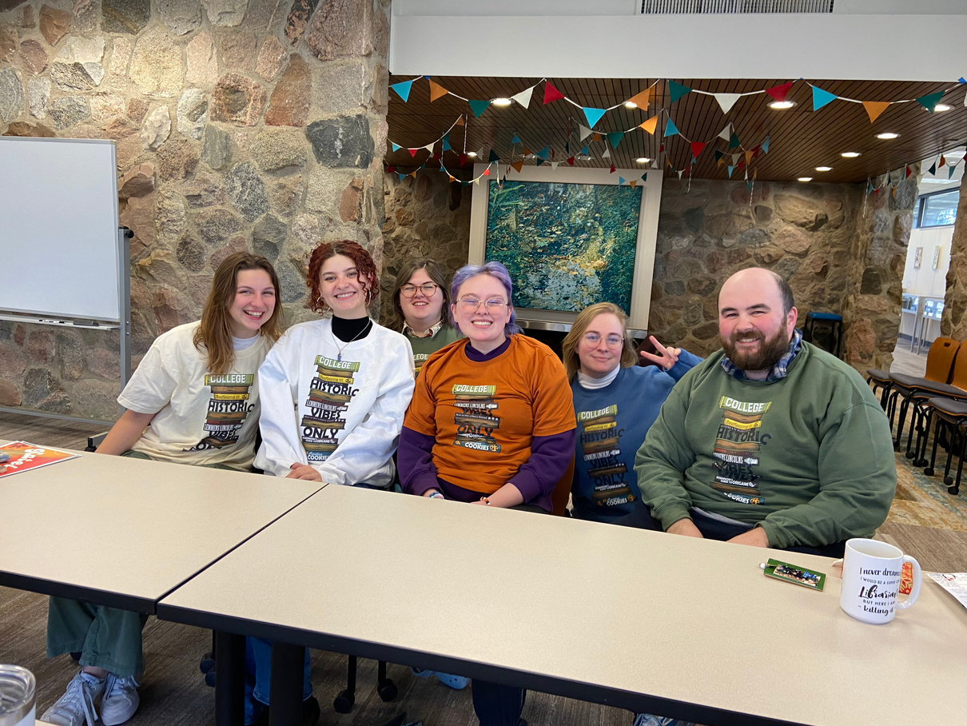
IS IT A CRISIS?
12
Building a relationship from the floor helps build trust and create a safe environment where the student knows they are supported
This also means you may have an environment where students feel safe to have a crisis, ask for help, and speak freely about their lives and school experiences. Know your resources for support!
My student employee crew in 2022, wearing a student-designed shirt
Psychological Safety
Notes:
My students laugh at me all the time because when they first started doing floor time I'd ask them, "Is this floor time or is it a crisis?" (I still ask them this every time, but some of them have just started telling me before they drop to the floor!)
They can laugh, but asking the question is a sign of caring that reinforces our safe environment.
I've had more than one student end up reporting back "It's a crisis". While I never wish my students to be in crisis, it does help me understand what the student needs in that moment.
EX: Katelyn and her computer.
Once, floor time ended up with the student crying because he was so stressed out and overwhelmed. Without that moment, I would never have guessed. I was able to give him choices about a next step (visit the counseling center together, call the counseling center, etc.) He choose the option that felt best to him.
Of course, this means you have an environment where students feel safe enough to have a crisis! Congratulations? But that also means you should know your resources to support them!

Slide 13

EVALUATION IS CARING
12
Evaluations are hard, but they are also an essential practice to demonstrate caring for our student employees.
  Opportunities for students to direct their own growth and learning
  Opportunities for us as supervisors to share expectations, build relationships, and create a safe work environment
Conclusion
Notes:
Evaluations often get a bad reputation. They can ignite difficult conversations. It's tough to "rate" someone else.
But evaluations are also an essential practice to demonstrate caring for our students.
Evaluations are opportunities for students to direct their own growth and learning.
They are opportunities for us to establish and build relationships with our students that create a safe work environment.

Slide 14
THANK YOU
Questions?
SEAL Symposium | 2024
Leigh Rupinski
rupinskl@gvsu.edu
Notes:
Thank you! If you want to chat more about any of this, or get samples of evaluations, please feel free to email me!
I'll take any questions now.

