Slide 1
Urban Displacement and the Making of a University
Denise Rayman: IUPUI Ruth Lilly Special Collections and Archives
Addressing Nonprofits’ Historical Harm to Minority Groups through Radical Transparency
IUPUI
Notes:
If you don’t know IUPUI has an archives of philanthropy

Slide 2
How can today’s nonprofits address their past?
Many nonprofits have harmed minority or vulnerable groups in their past. Those harmed may still be living, or the harm lives on in cultural memory. Nonprofits who ignore or deny consequences of their past actions may struggle to build and maintain their reputations and relationships in the community, despite their current work.
We are completing a historical transparency project to address IUPUI’s racist history, by sharing internal documents about the creation of our campus and the subsequent destruction of the Indiana Avenue neighborhood.
This project draws on theory and praxis from the memory profession around transparency as a method of social repair, and I will compare it to current trends in financial and governance transparency in nonprofits, ultimately showing a broader concept of public transparency within the nonprofit industry as a valuable tool for social justice.
Notes:
We are all grappling with structural racism both personally and professionally right now, IUPUI included
Radical transparency is one tool that can be used for social justice in repairing historic harm
We are working on a transparency project around IUPUI’s displacement of Black families to build their campus
I’m going to present theories and evidence around transparency that nonprofits can use to work with their own bad history

Slide 3

Current transparency work in nonprofits
Most nonprofit transparency is financial, with some compulsory (namely, filing 990s)
Transparency is an industry-wide value, with products such as GuideStar transparency ratings
However, nonprofit leaders still fear transparency will be used to harm their organizations (Friedman & Wolcott, 2018)
Transparency/full disclosure after a crisis event (such as fraud) is unsuccessful at rebuilding trust (Willems & Faulk, 2019)

Slide 4
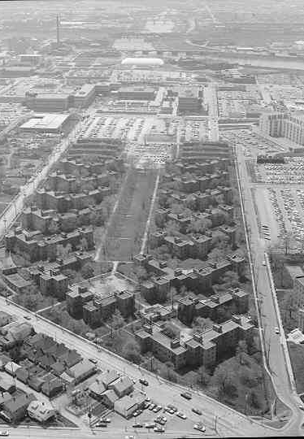
Transparency theories in the memory field
Lockefield Gardens, 1980,
razed 1983
Participatory Archives (Huvila, 2008)
Decentralized curation: public involved in what archives collect
Radical user orientation: Value materials’ use over preservation
Public contextualization of archives: transparency in appraisal and processing decisions
Post-custodial (post-colonial) Archives (Bastian, 2020)
Who has access to records about them?
Digital surrogacy: to keep physical objects in cultural ownership
Notes:
These are from an archivist’s perspective and not a historian’s perspective, which are actually quite different
Case of Native American Boarding Schools – records in Bureau of Indian Affairs in NARA

Slide 5
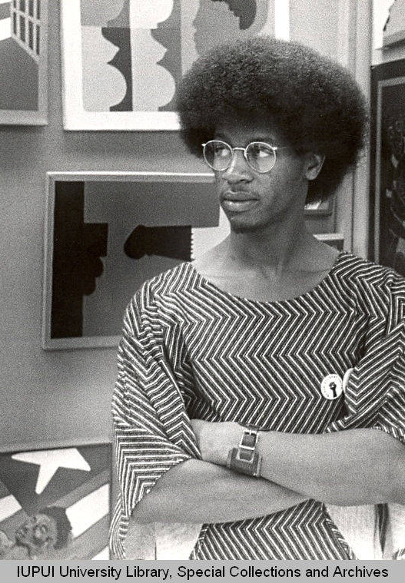
What is “radical” transparency?
Originated in the tech field to describe potential of massively networked information (Heemsbergen, 2016)
Expanded with other “radical” social concepts
Transparency that is uncomfortable, that gives the public the information and tools to judge your organization
Downside: reduces other forms of traditional disclosure, such as narrative (Birchall, 2014)
Anthony Tate, Black Student Union President and Herron Student, 1972

Slide 6
A brief history of IUPUI’s land
IUPUI is on the Westside of downtown Indianapolis, a Black area of the city since formerly enslaved African Americans came here after the Civil War, a community centered around Indiana Avenue.
At the time of IUPUI’s expansion the neighborhood was estimated to be 95% Black, and two thirds of residents were homeowners.
Redlining and close proximity to the White River (an open sewer) meant it very under-developed compared to other areas of Indy in the 1950s, and easily targeted for “slum clearing” projects
IUPUI gutted the neighborhood from 1960s-1980s to build a downtown campus

Slide 7
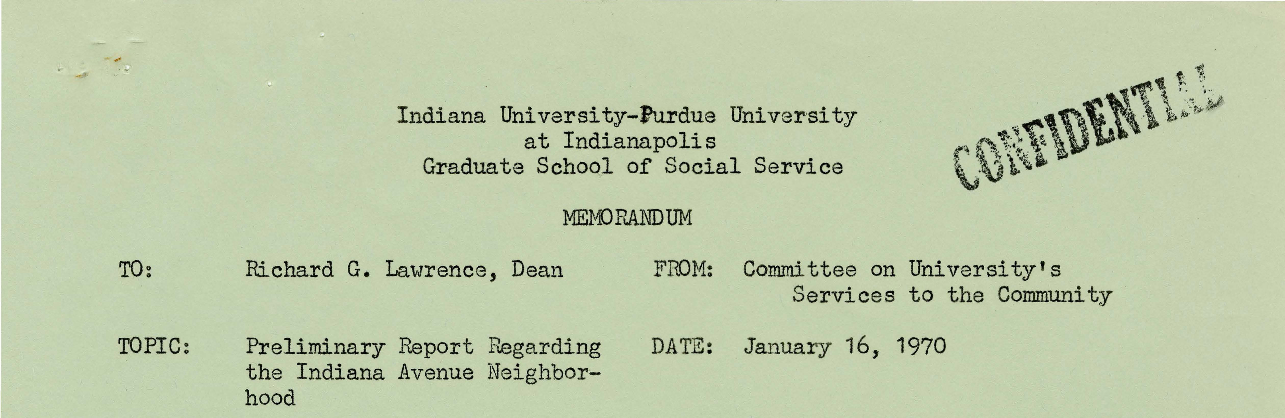
You can’t hide blood on white gloves
Notes:
Like many, my research was scuppered by COVID. In the before times, we had planned community events around this collection, including scan a thons for family documents, and honoraria for community elders to speak, but didn’t happen
I had planned interviews with community elders and their children about how this disclosure made them feel about IUPUI, to provide evidence about if this transparency improved their perception of us, but that didn’t happen. Maybe next year. We do have some anecdotal experience with one family that appreciated the documents
So I’ll share some dirty laundry with you, the sorts of things you can share if you’re brave

Slide 8
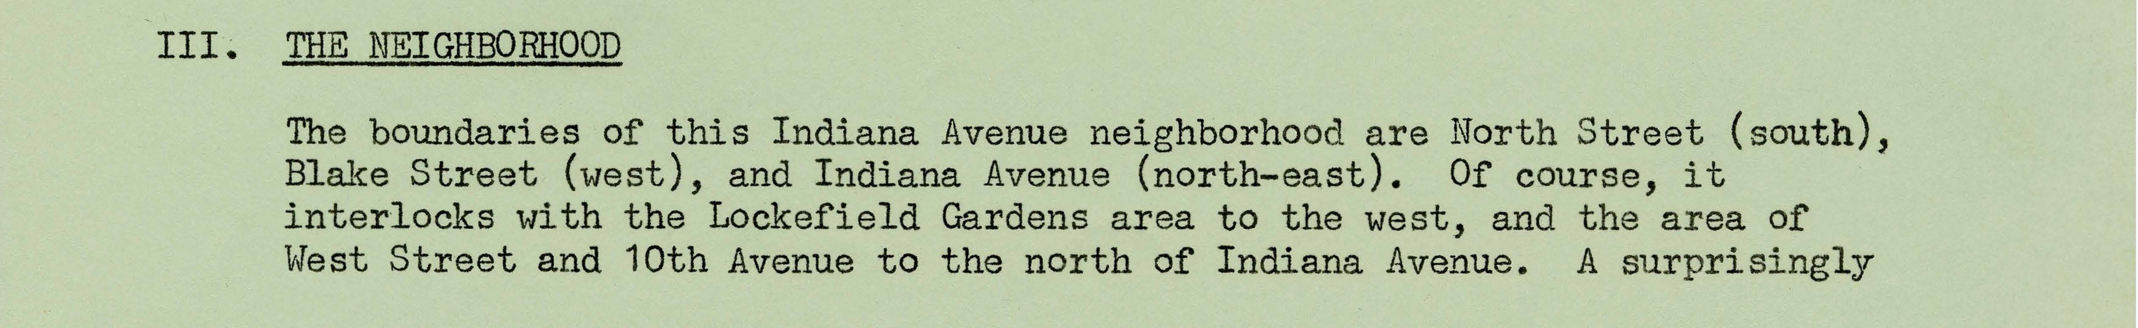
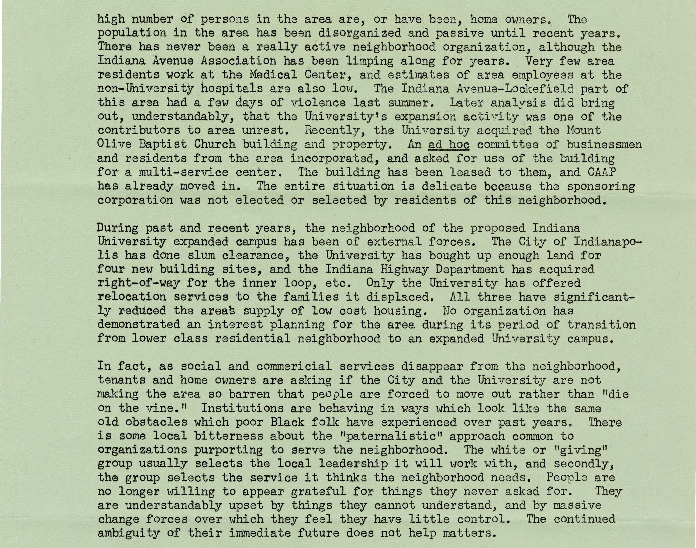

Slide 9






Notes:
University acknowledges their action contribute to neighborhood violence

Slide 10
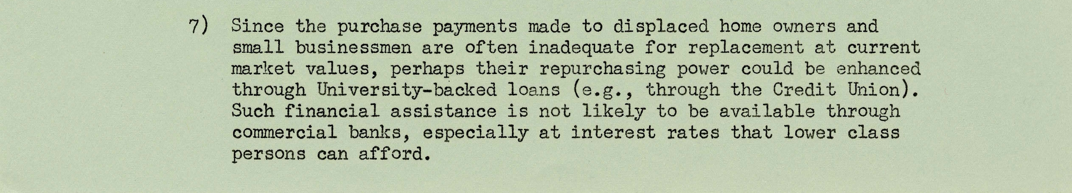

Slide 11


Notes:
The “fair market value” is not enough to buy a comparable house in Indy

Slide 12
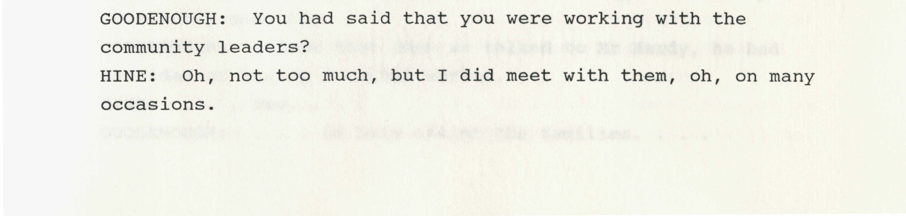
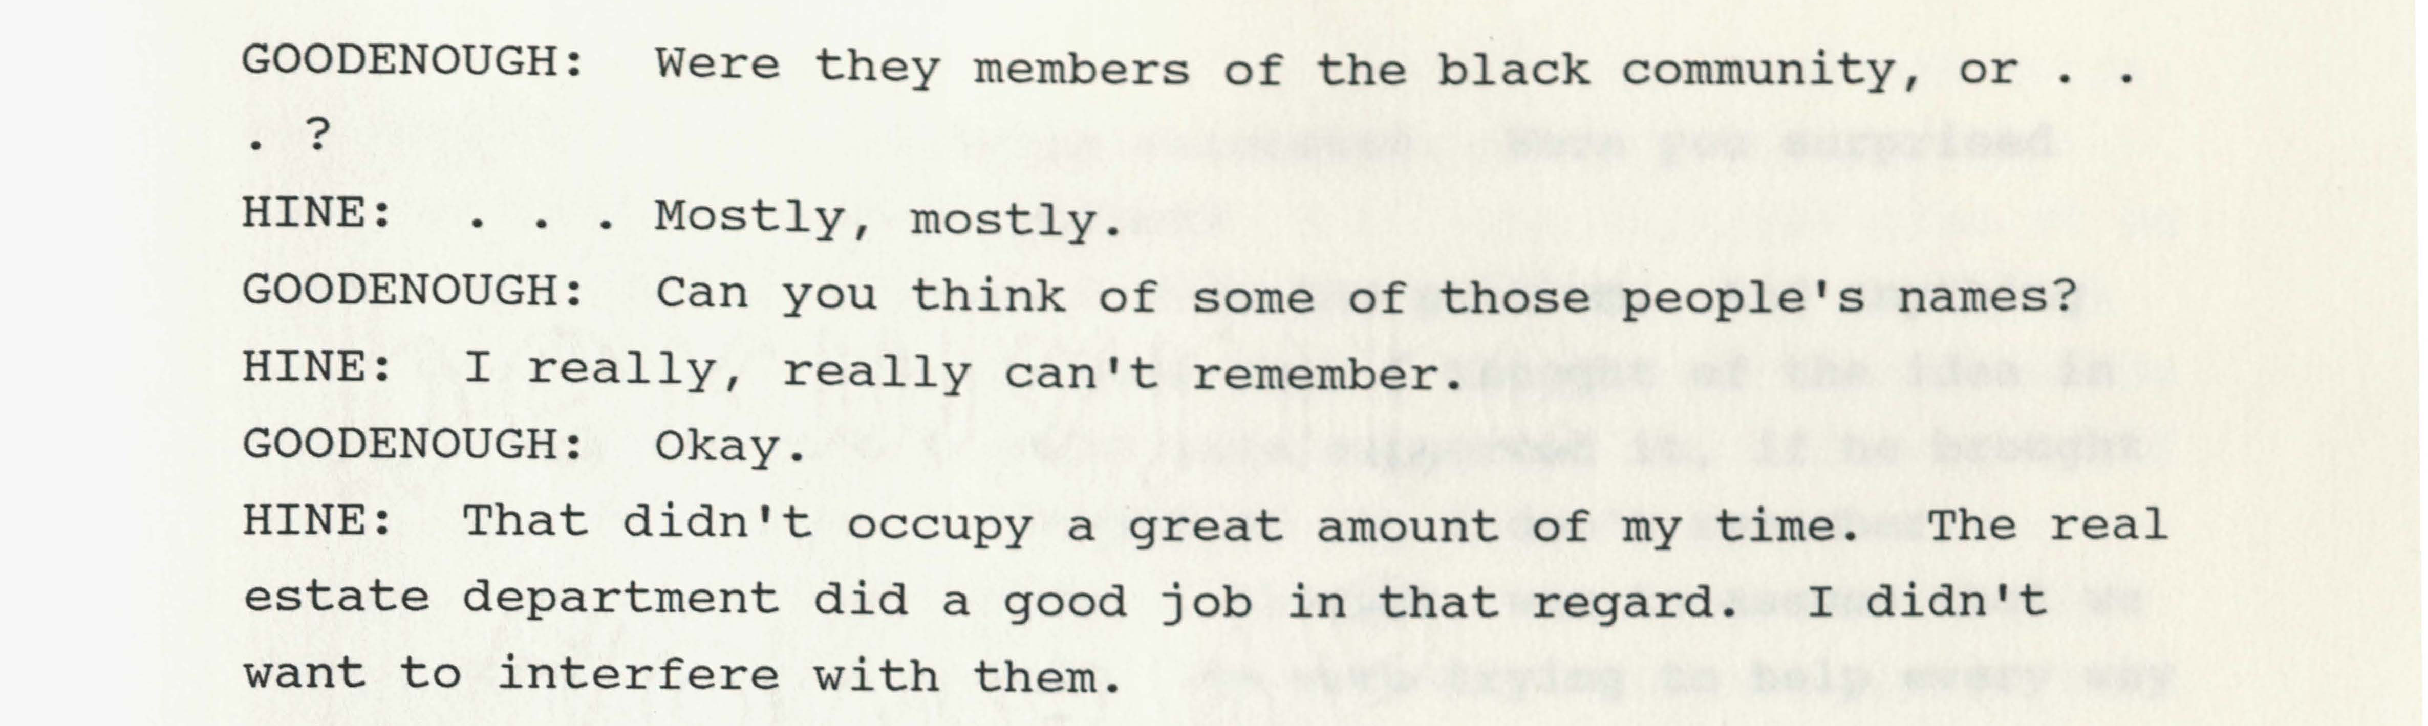
1990 Oral History Interview with Chancellor Hine
Notes:
Unlike confidential memo, always a public document, but now online and searchable

Slide 13




1990 Oral History Interview with Chancellor Hine

Slide 14
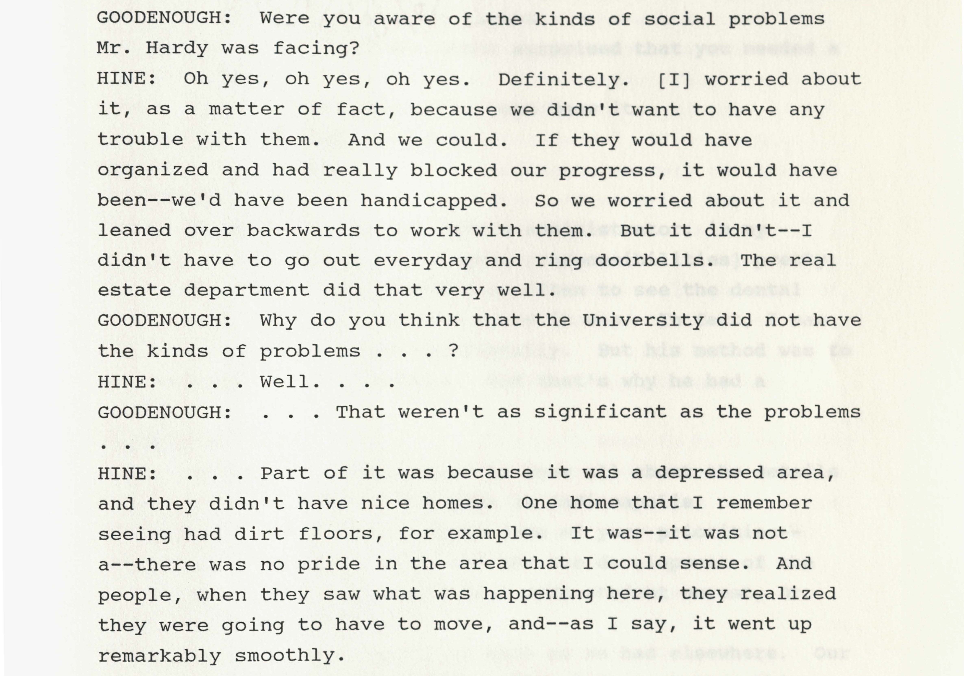

Slide 15















Slide 16
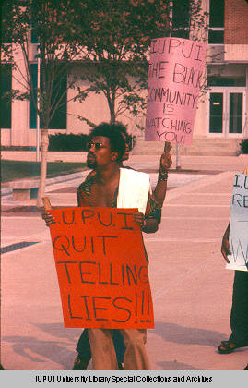
Historical transparency for nonprofits
It is better to be proactive rather than reactive about your bad history, before it is weaponized against you
Planned Parenthood and Margaret Sanger/eugenics
American Red Cross and racism in the 1927 Great Mississippi Flood
Everyone frantically renaming buildings
Every American organization today is grappling with their complicity structural racism.
Black Student Union protest
at IUPUI campus, c. 1970

Slide 17
Denise Rayman
drayman@iupui.edu
Ruth Lilly Special Collections and Archives: http://ulib.iupui.edu/special
Check out the online collection (new uploads as we go): https://ulib.iupuidigital.org/digital/collection/UDMU/search

