Slide 1
Upskilling the promotion and tenure process
Training administrators for responsible use of research impact metrics
Heather Coates, Jere Odell, Caitlin Pike
IUPUI University Library Center for Digital Scholarship
Notes:
Submitted proposal:
School and departmental administrators are tasked with evaluating the research output of their faculty as part of the promotion and tenure review process. At our institution, this evaluation is communicated in a letter describing the dissemination venues for the candidate’s research publications, typically journals. Seen in one light, the letter is an opportunity for the school or departmental administrator to advocate for the candidate. However, the focus on dissemination venue rather than on the article or product itself wastes an opportunity to describe the value of the candidate’s work in the context of their discipline and institution. Instead of providing rich information about the work, these letters often copy content from the publisher website and provide Journal Impact Factors, when available, without context.
To encourage schools and departments to produce stronger letters in the assessment of a candidate’s dissemination venues, we developed a targeted training for Associate Deans for Research and Department Chairs. The opportunity to develop this training resulted from a broader conversation with faculty about journal cuts and other changes in the library’s strategy for providing access to scholarly content. The faculty asked the library to provide training about changes in scholarly publishing, citation metrics, and altmetrics. Given the time constraints of the audience, our training focuses on providing practical guidance for using and understanding new sources of evidence when writing and reading evaluation letters for promotion and tenure. In addition to describing the content and the institutional context for the training sessions, we will discuss the long-term implications of this effort.

Slide 2
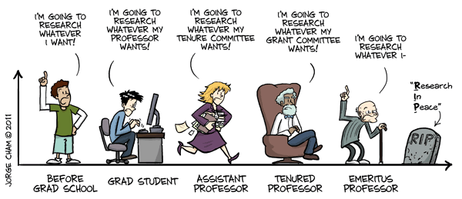
Evaluation Context
http://phdcomics.com/comics/archive.php?comicid=1436

Slide 3
Evaluation for P&T @ IUPUI
External Reviewers
Unit Committee
Campus Committee
*Associate Dean or Department Chair
School Committee (sometimes)
Chief Academic Officer
Chancellor
IU/Purdue President
IU Board of Trustees

Slide 4
The Evaluation Task
Provide an assessment of the dissemination outlets in the candidate's area of excellence (or in all areas for a balanced case), such as the quality of journals, peer-reviewed conferences, and venues of presentations or performance.
Stature of journals, presses, editions, galleries, presentations, and other means…
Special care taken in assessing stature of journals devoted to practice, theory development in teaching and professional service…
Authorship convention
https://academicaffairs.iupui.edu/PromotionTenure/IUPUI-Guidelines/

Slide 5
Skills for Evaluating Venues
Core concepts of research evaluation
Research Metrics literacy
Knowledge of publishing and other norms for the discipline and field (authorship, speed/volume of publication, journal reputation, peer review practices)
Ability to retrieve relevant information efficiently and effectively

Slide 6



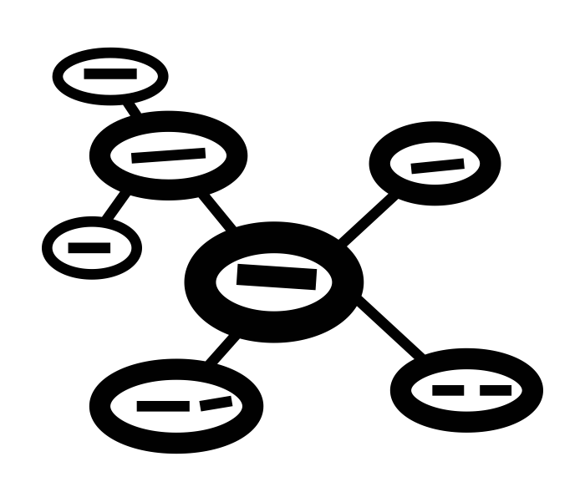
Constraints

Slide 7
We value what we can measure

Slide 8
Other Challenges
The candidate may not clearly identify the source of the evidence presented
Evidence is distributed across a huge number of systems and platforms
The sources of this evidence can vary with each candidate
Campus-level standards define Excellence in research, but do not describe quality criteria or standards for journals, books, presses, exhibit venues, etc.
While many metrics are apparently simple (counts, frequencies, rankings derived from frequencies), the biases and limitations of the underlying data are often poorly documented, understood, and constantly changing

Slide 9
Sub-optimal Evaluation Practices
Assumption that publication in a certain journal = impact
Assumption that publication in a certain journal = quality
Re-using journal descriptions from publisher sites
Presenting the Journal Impact Factor without necessary context
  Year unspecified
  Using the 2-year JIF when 5-year JIF is more appropriate for the field
  Without Quartile Ranking or value range
Vague descriptions of the journal or press as “reputable”, “prestigious”, or “Tier 1” without evidence substantiating those claims
Failing to consider presentations at national and international conferences
Notes:
Constraints + Challenges → Sub-optimal evaluation practices

Slide 10
The Training: Goals
Outcome: Improve the relevance of the information provided to better advocate for the candidate
Examine underlying purpose of this component of the evaluation
Introduce the core concepts of research evaluation
Provide resources to support developing foundational skills in research metrics literacy
Provide resources to support efficient and effective retrieval of evidence, including but not limited to research metrics
*NOT Publishing and authorship norms for each discipline/field
Notes:
Skills described earlier:
Core concepts of research evaluation
Research Metrics literacy
Knowledge of publishing and other norms for the discipline and field (authorship, speed/volume of publication, journal reputation, peer review practices)
Ability to retrieve relevant information efficiently and effectively

Slide 11
The Training
The state of scholarly dissemination (Oh my!)
Introduce core concepts of research evaluation to dispel misconceptions about publishing, Open Access, and research metrics
  Operationalizing quality, impact, prestige
  Levels of evidence
  Evidence & metrics
Describe the strengths and limitations of commonly used metrics
Resources
  Terminology Reference Sheet
  Sources for metrics
Support them in applying this information to the evaluation task

Slide 12
We value what we can measure
We measure what we value

Slide 13
Long-term Strategy
School/Dept Guidelines
Guides for Faculty & Reviewers
OAA Workshops
Campus Guidelines
Reviewer Workshop
School/Dept Workshops
Metrics Consults

Slide 14
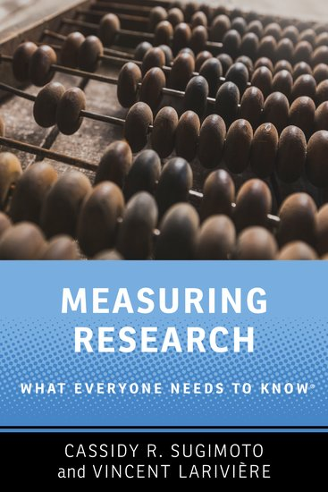
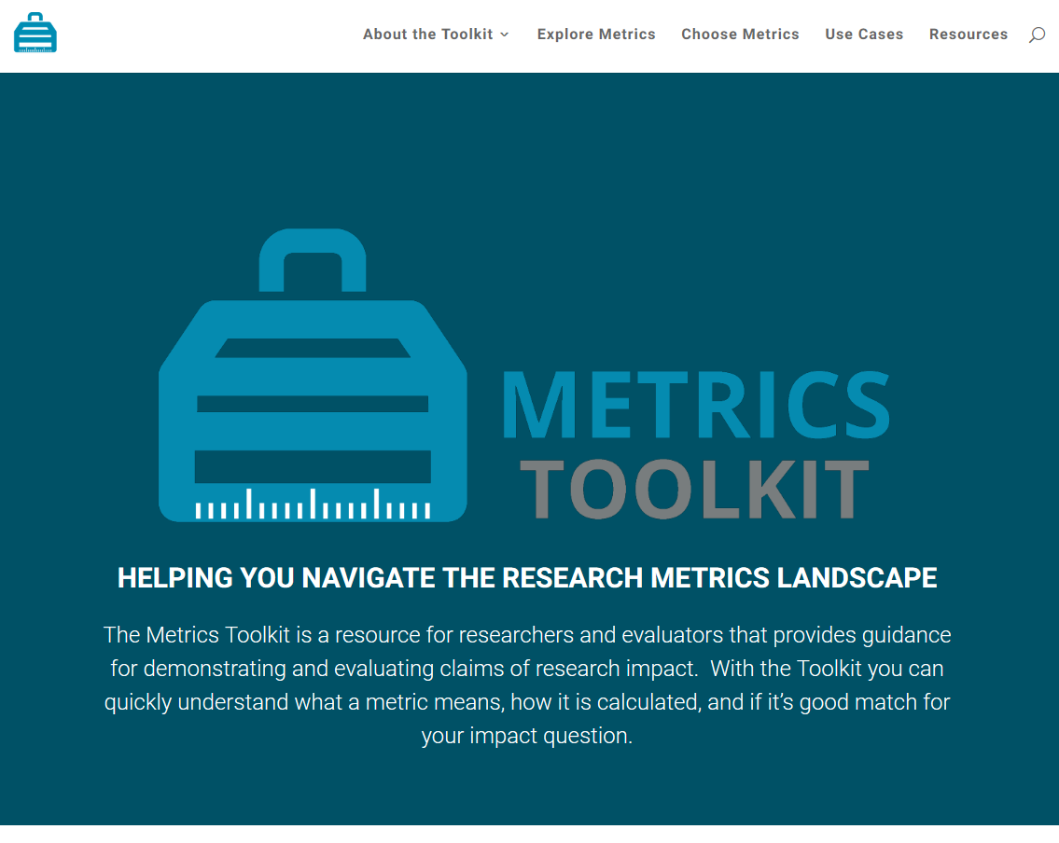
http://www.metrics-toolkit.org/
http://www.worldcat.org/oclc/1027811013

Slide 15
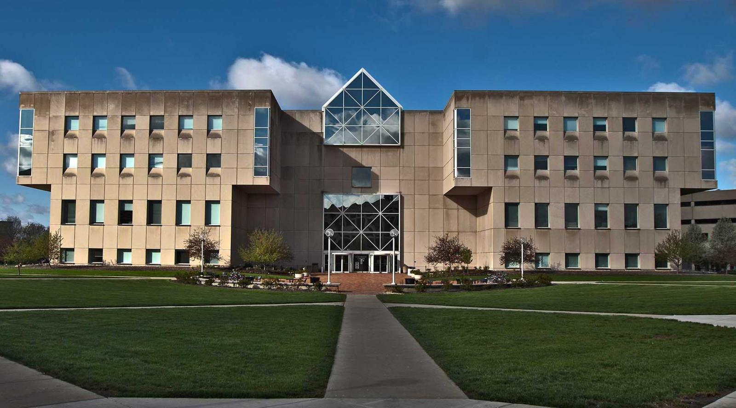
Heather L. Coates
Digital Scholarship & Data Management
Librarian
University Data Steward for Research Data
hcoates@iupui.edu
ORCID: 0000-0003-4290-6997
Jere D. Odell
Scholarly Communication Librarian
jdodell@iupui.edu
ORCID: 0000-0001-5455-1471
Caitlin A. Pike
Research Engagement Coordinator
caiapike@iupui.edu
IUPUI University Library

Slide 16
Image Attribution
Noun Project
  Mindmap by Leslie Tom from the Noun Project
  deadline by Ralf Schmitzer from the Noun Project
  group by mikicon from the Noun Project
  Scale by Musket from the Noun Project

