Slide 1

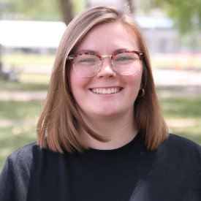
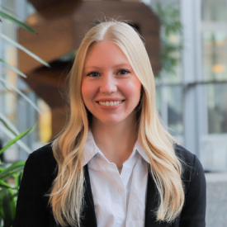
From Program Review to Strategic Blueprint: Translating Assessment Insights Into Effective Strategic Planning
Emily Braught
Director, Assessment and Planning
Mary Knarr
Director, Marketing and Communications

Slide 2

Learning outcomes
Explain the Four I’s Model and its relevant to transforming program review insights into strategic actions.
Identify lessons learned, potential pitfalls, and best practices from case studies of program reviews
Describe at least three practical techniques for mapping program review insights to strategic objectives

Slide 3
CONTEXT

Slide 4
Who We Are
Vice Chancellor for Student Affairs
Assessment
Marketing
Finance
Office of the Vice Chancellor
Dean of Students
Campus Health
Health and Wellness Promotion
Counseling and Psychological Services
Campus Recreation
Student and Family Connection
Campus Center
Housing and Residence Life
Conduct and Student Support
Accessible Educational Services
Multicultural Center
Program Reviews required every 5-7 years units for each unit and the division.
The division leads to inform strategic plan and then programs scaffold from there
Notes:
Do we need the org chart part? Can we just offer the context for program reviews?

Slide 5
PROGRAM REVIEW

Slide 6
Program review process
Campus wide process supported by a central office outside of student affairs
Review committee identified of external and internal stakeholders not directly related to the unit being evaluated
  External stakeholders are compensated
A two-day, on-site review is planned with several sessions with a variety of stakeholders
The team undergoing review prepares a report for the review committee that contains a lot of data, current challenges, current strengths, and questions to answer
  Questions guide the review committee's work/report

Slide 7
Program review process
At the very end of the day, the review committee provides an outline of their top recommendations to the director of the department and then the division's leaders
Review committee has ~1 month to share their final report, which is reviewed by division leaders and department director
Repeat in 5 to 7 years!

Slide 8
Challenges of program reviews
Program reviews yield a wealth of insights into an organization's strengths, weaknesses, opportunities, and threats
Process is short, and review committee gets A LOT (and competing) information to sort through
Reports provided by review committee vary—not a set structure for providing findings and recommendations

Slide 9
Challenges of program reviews
Often times, reviewers share what to improve, but further consideration about institutional-specific steps to improve is left out
After program reviews conclude, practitioners are often left with little guidance on what happens next
  No expectation or process on how to evaluate or implement recommendations and address findings
  BUT they are expected to prepare a "response" report several months later

Slide 10
Opportunities for program review
Department and divisional leaders can consider using program reviews as a launching point
Leverage to convert insights into a strategic framework/plan with actionable tasks and goals
Build buy-in at all levels in the unit to drive meaningful change and foster long-term success

Slide 11
CROSSAN’S
FOUR I’S
MODEL

Slide 12
Intuiting
Individuals recognize patterns and possibilities
Interpreting
Individuals need to make sense of new ideas and communicate it to others. This involves articulating the idea and sharing it with colleagues, which helps in refining and understanding the concept better.
Integrating
At this stage, the interpreted ideas are discussed and developed further within groups. This collaborative process leads to shared understanding and collective action, integrating the new knowledge into the group's practices.
Institutionalizing
Finally, the new knowledge or practices become embedded in the organization's routines, policies, and structures. This ensures that the learning is sustained and becomes a part of the organizational culture
Based on their experiences and subconscious insights.
Personal and often intuitive process where new ideas or solutions begin to form.

Slide 13
Intuiting
Individuals recognize patterns and possibilities
Interpreting
Individuals make sense of new ideas and communicate it to others. Articulating ideas and sharing them with colleagues helps to refine and understanding concepts better.
Integrating
Interpreted ideas are discussed and developed further within groups. This collaborative process leads to shared understanding and collective action, integrating the new knowledge into the group's practices.
Institutionalizing
New knowledge or practices become embedded in the organization's routines, policies, and structures. Learning is sustained and becomes a part of the organizational culture
Based on their experiences and subconscious insights.
Personal and often intuitive process where new ideas or solutions begin to form.
For organizational learning to occur, information interpretation is necessary, not just information distribution (Huber, 1991).
Individual and organizational learning often depends on the quality and depth of reflection opportunities made available (Chism, 2004).

Slide 14
Intuiting
Individuals recognize patterns and possibilities
Interpreting
Individuals make sense of new ideas and communicate it to others. Articulating ideas and sharing them with colleagues helps to refine and understanding concepts better.
Integrating
Interpreted ideas are discussed and developed further within groups. This collaborative process leads to shared understanding and collective action, integrating the new knowledge into the group's practices.
Institutionalizing
New knowledge or practices become embedded in the organization's routines, policies, and structures. Learning is sustained and becomes a part of the organizational culture
Based on their experiences and subconscious insights.
Personal and often intuitive process where new ideas or solutions begin to form.
FEEDFORWARD
FEEDBACK

Slide 15
CASE STUDIES

Slide 16
CASE 1 CASE 2
Division of Student Affairs
  Review: October 2022
  Report provided: December 2022
  Response document: Summer 2023
Unit strategic plan: Student Affairs Marketing and Communications
  Review: November 2023
  Report provided: January 2024
  Response document: Fall 2024

Slide 17
CASE 1: DIVISION STRATEGIC PLAN
Questions Asked:
Is the division’s organizational structure appropriately aligned with national trends to best support students?
What strategies could be implemented to meet the needs of the ever-changing demographics of our student population?
How should the division position itself to ensure all students are aware of the various ways they are supported?
Is the division appropriately funded to adequately deliver high-quality programs and services?
If not, what areas need attention? In support of its employees, what further action(s) might leadership take to increase staff engagement, improve morale, and remain competitive when it comes to attracting and retaining qualified staff?
What are your recommendations on how the division might better utilize its current facilities and resources to meet student needs today and in the future?

Slide 18
CASE 1: DIVISION STRATEGIC PLAN
Recommendation Consolidation: How can similar recommendations be grouped together for efficiency?
Bucketing Process: How do the suggestions relate to one another?
Feasibility Process: How realistic is this suggestion?
Prioritization Activity: Which of the feasible suggestions are most important?

Slide 19
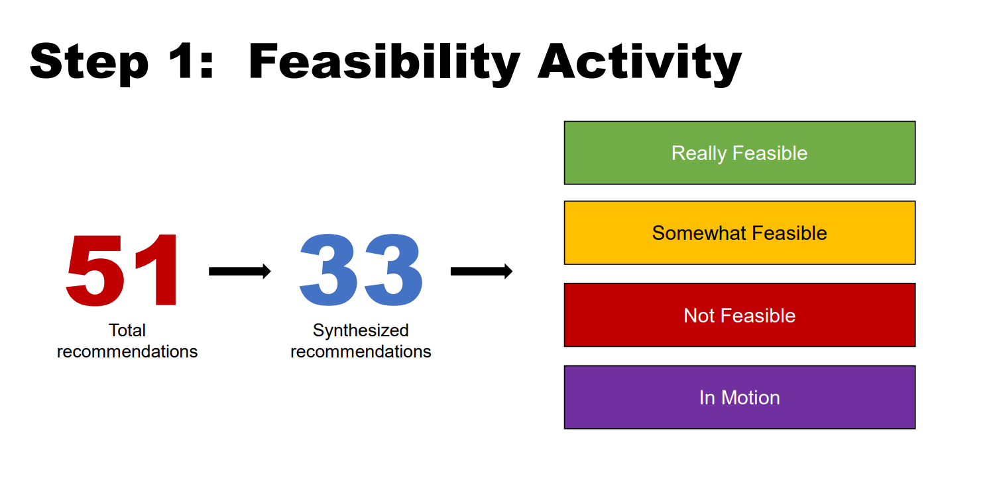
CASE 1: DIVISION STRATEGIC PLAN

Slide 20
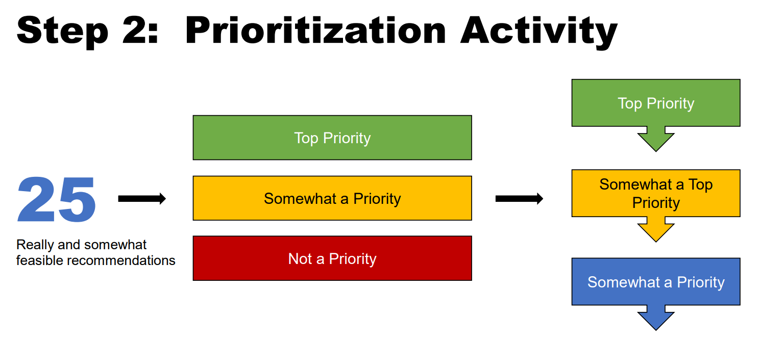
CASE 1: DIVISION STRATEGIC PLAN

Slide 21
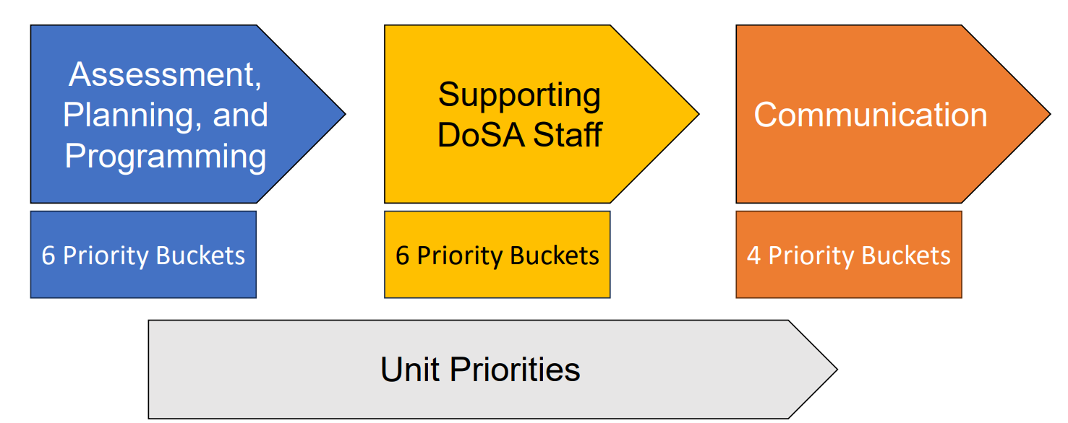
CASE 1: DIVISION STRATEGIC PLAN

Slide 22
CASE 1: DIVISION STRATEGIC PLAN
Division Wide Results Presentation
  Used as a platform for soliciting staff interest in strategic planning process and committed to three strategic priorities directly aligned with program review “buckets”
Unit Check In Meetings
Strategic Planning Kickoff

Slide 23
CASE 1: DIVISION STRATEGIC PLAN
Outlining goals: strategic planning working groups develop goals using program review suggestions and feasibility as a guide in each strategic priority
Taking it a step further: working groups brainstormed action items that help us achieve these goals
Share drafted goals and receive feedback: many iterations across different communities and groups, using multiple formats
Outline metrics and timelines: Refer back to priority buckets to as guideposts

Slide 24
CASE 1: DIVISION STRATEGIC PLAN
Priority Bucket 1 in Assessment, Planning, and Programming
More information is needed about student data: student demographics, student needs, and interests.
Use equitable assessment strategies to measure student experiences and make improvements. Implementing equitable assessment strategies will help us ensure our programming is what our students need and aid us in telling the division’s story.
Due to diverse student body, emphasis on DEI must be enhanced.
Strategically use data for advocacy and decision making.
Improve coordination of data collection and data sharing within and between units to reduce duplication of efforts.
Develop clear assessment plans that measure desired outcomes, program quality and ROI for high-scale, high-time, and/or high-cost programs or services. Document how assessments translate into actionable improvements.
Increase student involvement at each stage of the assessment cycle. Incentivize participation in coordinated student feedback opportunities.
Incorporate direct and varied qualitative and quantitative measures of student learning and engagement across divisional assessments.

Slide 25
CASE 1: DIVISION STRATEGIC PLAN
Priority Bucket 1 in Assessment, Planning, and Programming
More information is needed about student data: student demographics, student needs, and interests.
Goal 1: Enhance the quality and reach of divisional programs and services. Enhancing the quality and reach of student programming enables the division to focus on improving student access to inclusive experiences during divisional programs and services, thereby ensuring every student will benefit from programming that promotes academic and social success and improved well-being.
Due to diverse student body, emphasis on DEI must be enhanced.
Strategically use data for advocacy and decision making.
Improve use of existing student data sources and incorporate new student data sources to inform improvements to the reach and quality of programs and services.
Develop and conduct an assessment every two years to study student needs and the quality and impact of DoSA programs and services.
Outline desired outcomes for all DoSA’s programs. Align cocurricular learning outcomes with functionally relevant established university frameworks.
Increase reach to student populations not consistently engaged in DoSA programs and through a variety of strategies.

Slide 26
CASE 1: DIVISION STRATEGIC PLAN
Priority Bucket 1 in Assessment, Planning, and Programming
More information is needed about student data: student demographics, student needs, and interests.
Goal 1: Enhance the quality and reach of divisional programs and services. Enhancing the quality and reach of student programming enables the division to focus on improving student access to inclusive experiences during divisional programs and services, thereby ensuring every student will benefit from programming that promotes academic and social success and improved well-being.
Due to diverse student body, emphasis on DEI must be enhanced.
Strategically use data for advocacy and decision making.
Improve use of existing student data sources and incorporate new student data sources to inform improvements to the reach and quality of programs and services.
Develop and conduct an assessment every two years to study student needs and the quality and impact of DoSA programs and services.
Outline desired outcomes for all DoSA’s programs. Align cocurricular learning outcomes with functionally relevant established university frameworks.
Increase reach to student populations not consistently engaged in DoSA programs and through a variety of strategies.

Slide 27
CASE 1: DIVISION STRATEGIC PLAN
Strategic Planning Kickoff: Morning extended meeting with all division members, sitting with their unit
Strategic Planning Workbook: Paper workbook distributed for staff to keep in their office. Conversation guided during kickoff using workbook content. Leftovers used for onboarding new staff.

Slide 28
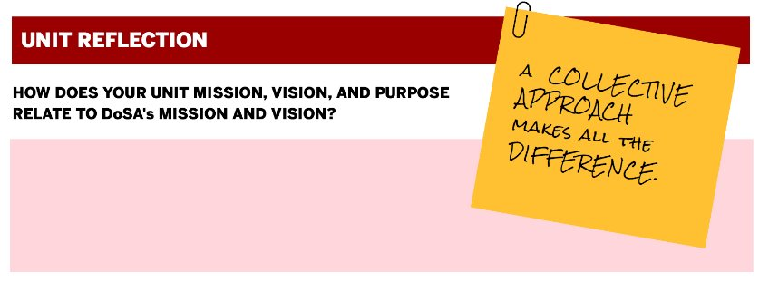
CASE 1: DIVISION STRATEGIC PLAN

Slide 29

CASE 1: DIVISION STRATEGIC PLAN

Slide 30
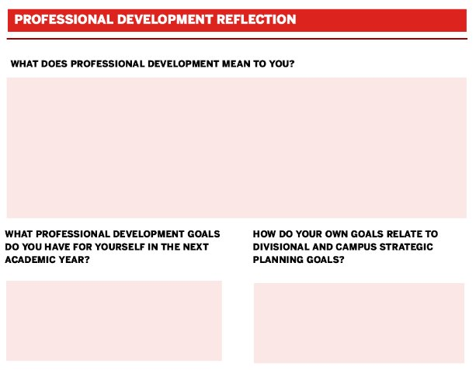
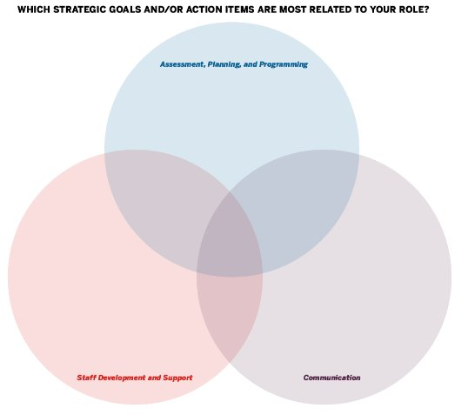
CASE 1: DIVISION STRATEGIC PLAN

Slide 31
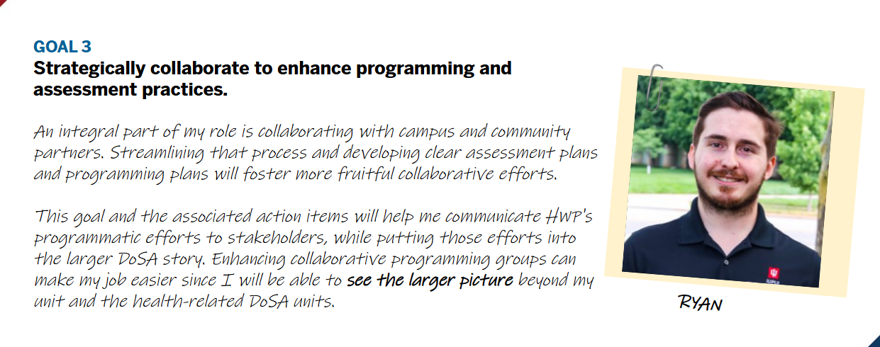
CASE 1: DIVISION STRATEGIC PLAN

Slide 32
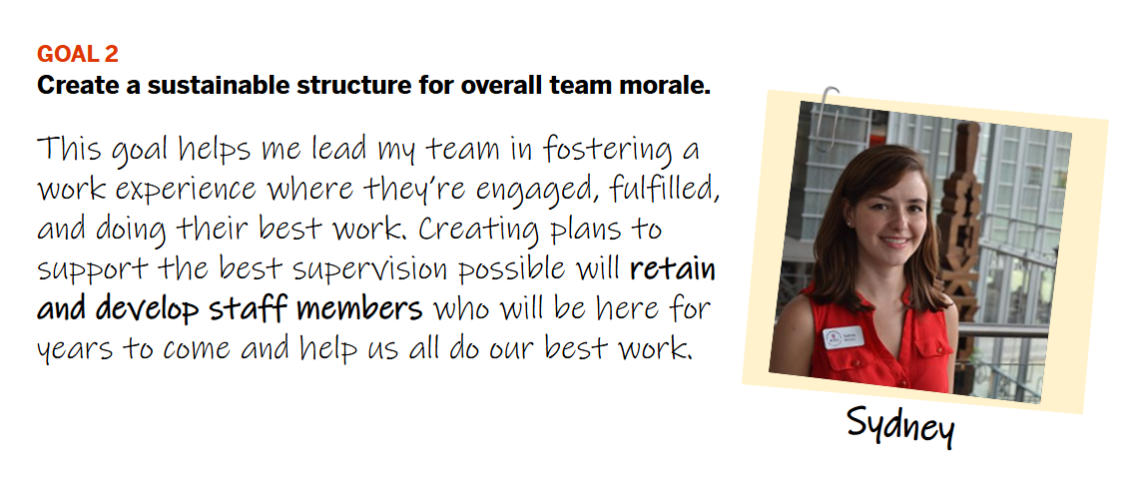
CASE 1: DIVISION STRATEGIC PLAN

Slide 33
CASE 2: UNIT STRATEGIC PLAN—Marketing and Communications
Review team:
  One colleague from the Division of Student Affairs who was an active, frequent partner of Marketing and Communications
  Director of Communications from another division on the IU Indy campus
  Director of Marketing for IU Bloomington's Student Life office
  Director of Marketing for Purdue University's Student Life department
  Director of Marketing for the College of Nursing at Michigan State
  All were contacted and invited to participate by the director of the unit (me!). It was important I found folks who understood the unique experience of marcomm in a student affairs unit.

Slide 34
CASE 2: UNIT STRATEGIC PLAN—Marketing and Communications
Questions posed:
  Given financial constraints that could limit us from hiring additional people, how could we shift staff responsibilities to better meet divisional needs?
  How can we aid the division by generating more revenue and attracting more customers?
  What innovative strategies, such as increasing video content and enhancing digital communications, should we incorporate into our work? How can we achieve incorporating these innovative strategies?
  How can we improve unit efforts towards more equitable programs, practices, and policies?

Slide 35
CASE 2: UNIT STRATEGIC PLAN—Marketing and Communications
Self-study report for review team:
  Illuminated strengths and challenges (based on internal/external staff feedback)
  Outlined mission, vision, values
  Provided history of the formation of the unit
  Data and characteristics about current work, who is served, etc.
  Facilities and HR information related to unit
  Unit activities and accomplishments
  Unit org chart
  How we support student success and strategic priorities
  Financial support and fiscal health

Slide 36
CASE 2: UNIT STRATEGIC PLAN
Recommendation Consolidation: How can similar recommendations in the report be grouped together for efficiency?
Feasibility Process: How realistic is this suggestion?
Prioritization Activity: Which of the feasible suggestions are most important?
Bucketing Process: How do the suggestions relate to one another to create themes?

Slide 37
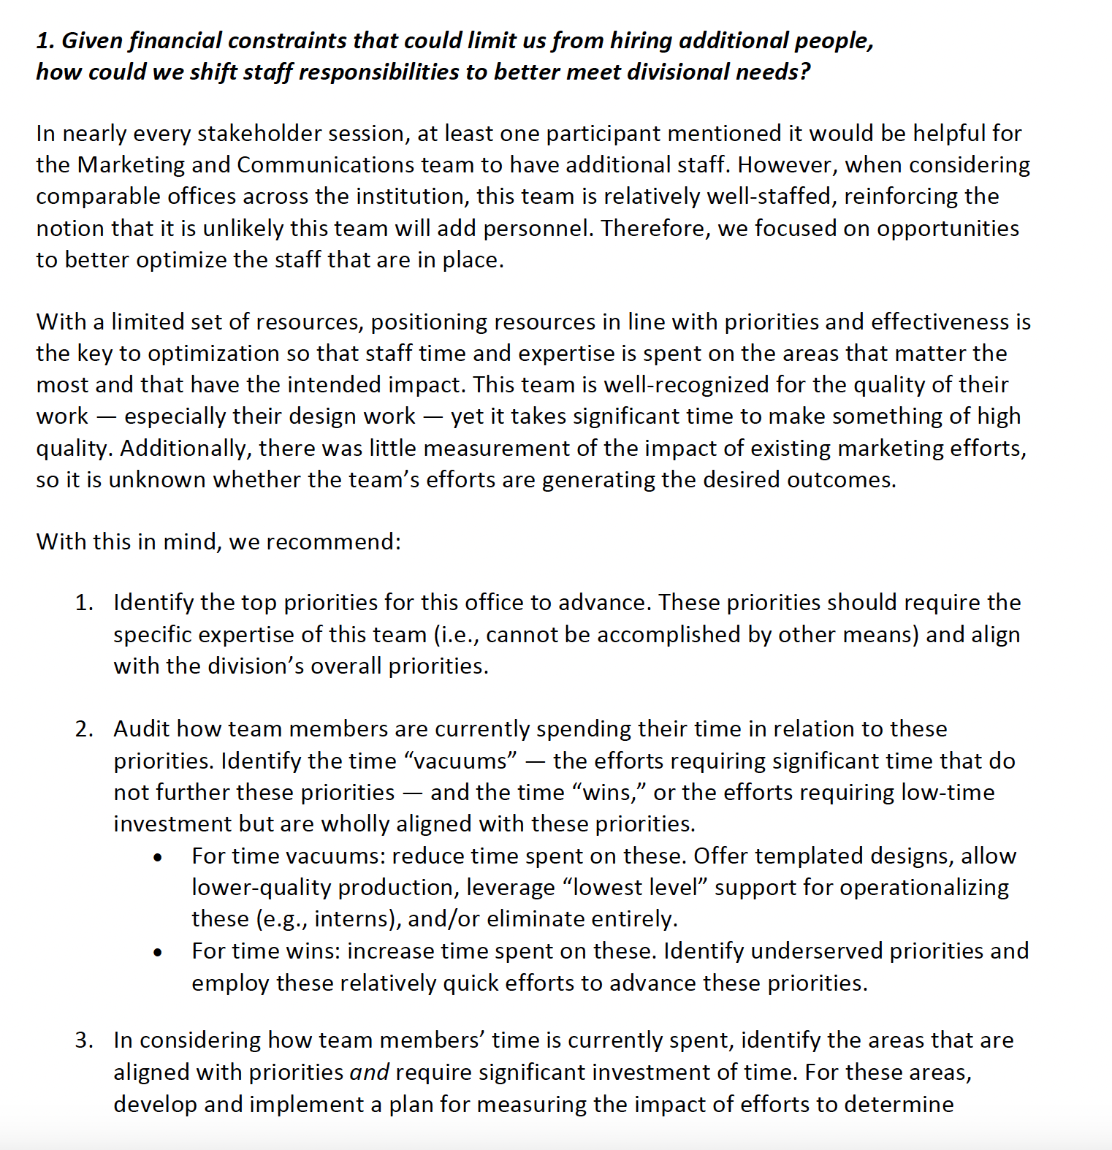
One section of recommendations as an example.
Final report had 43 recommendations consolidated into 35.
19 really feasible, 3 somewhat feasible, 1 not feasible, and 12 in-motion recommendations were identified
Not feasible and in-motion removed.
Prioritized the remaining 22.

Slide 38
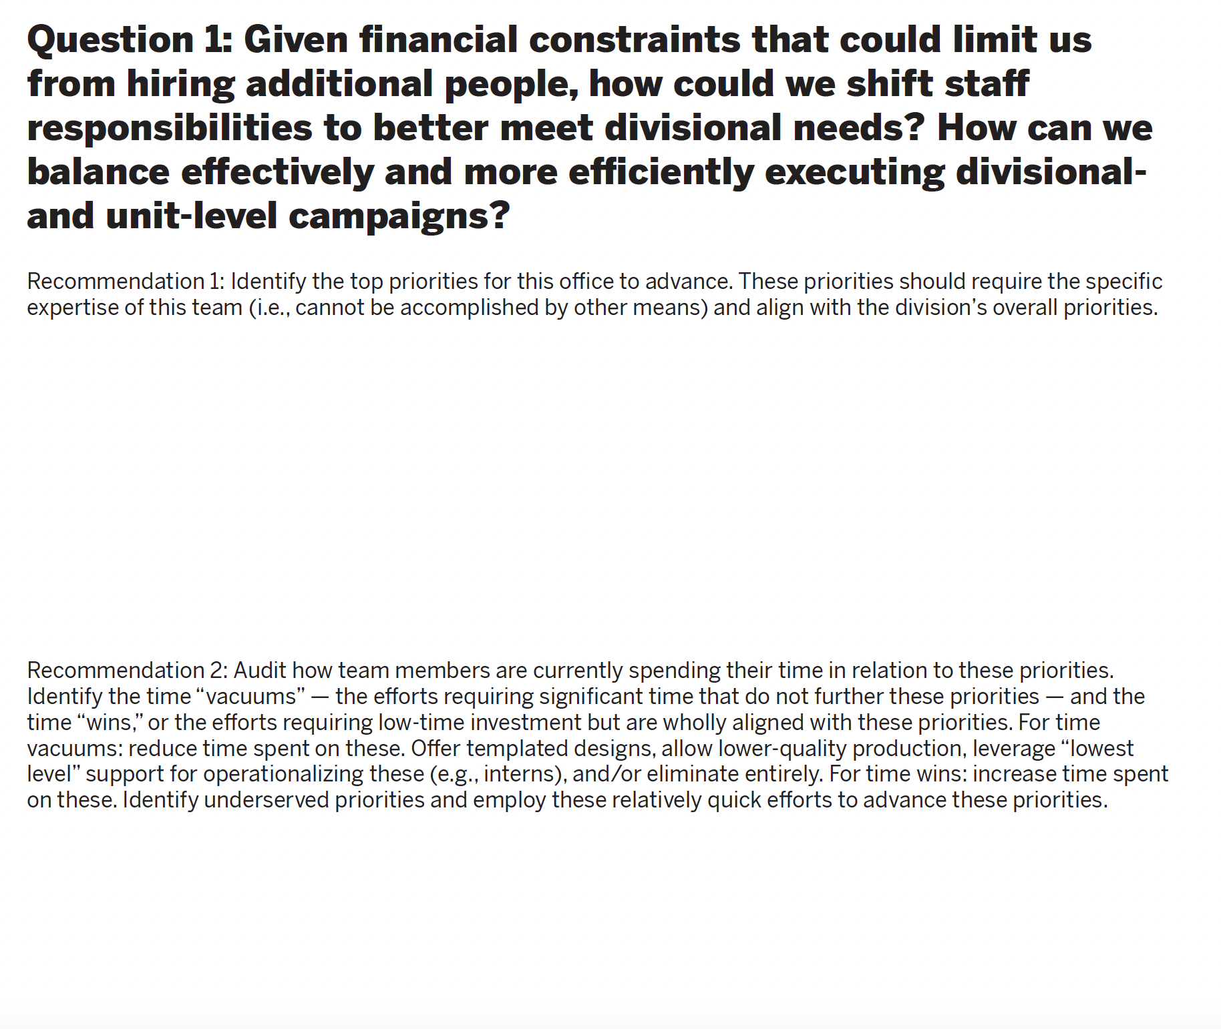
Sticky notes with 0, 1, 2, or IM under each recommendation. All members of the team participated.
0 = Not feasible
1 = Somewhat feasible
2 = Really feasible
IM = In-motion

Slide 39
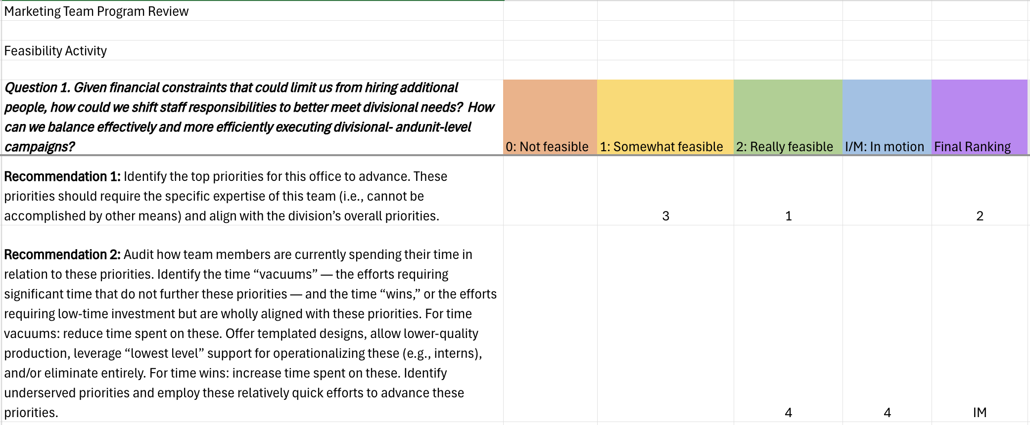

Slide 40
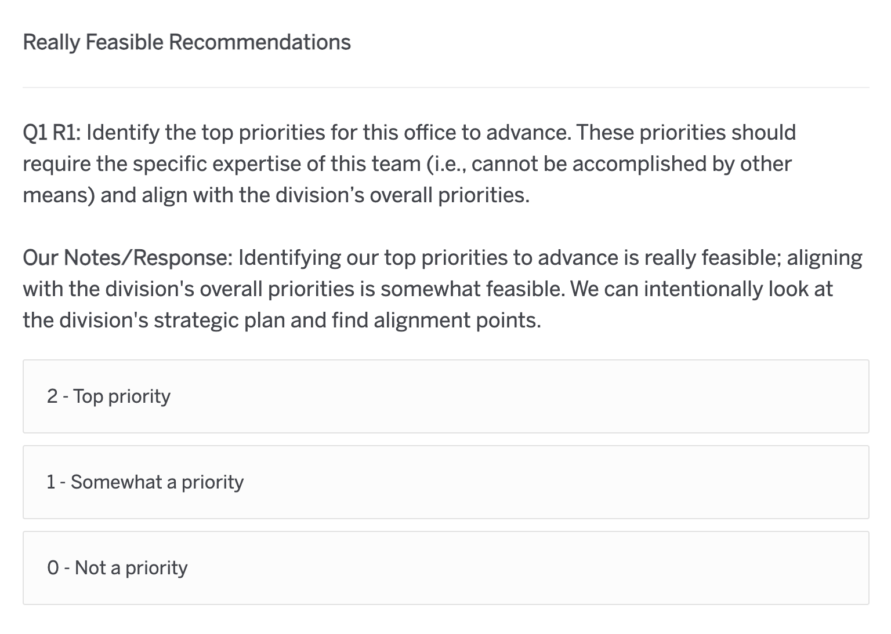
Staff completed Qualtrics form anonymously, and scores were averaged.

Slide 41
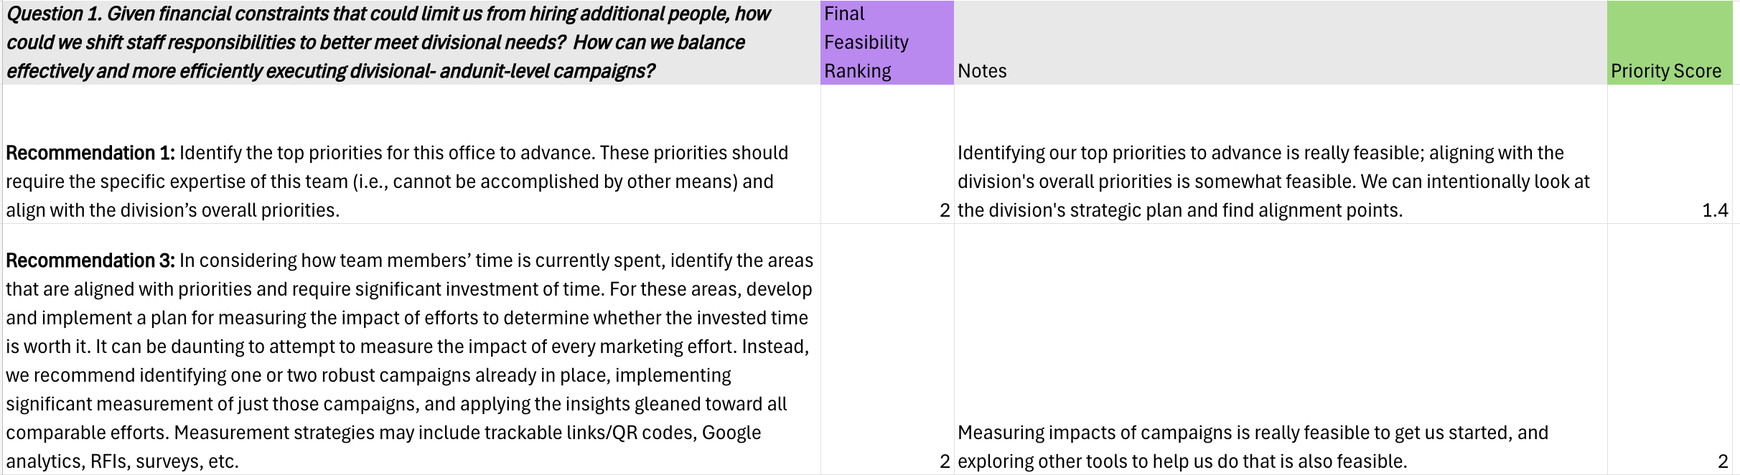

Slide 42
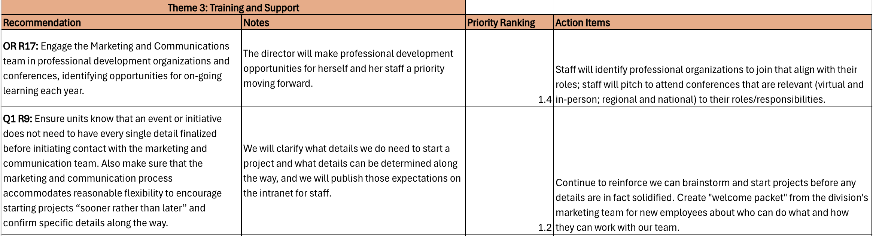

Slide 43
CASE 2: UNIT STRATEGIC PLAN
Three themes developed:
  Theme 1: Operational Updates
  Theme 2: Measuring Impact
  Theme 3: Training and Support
Our team combed through the recommendations within each theme by priority level, developing action items and tasks to accomplish

Slide 44
CASE 2: UNIT STRATEGIC PLAN
Dozens of recommendations were easy to implement almost immediately
  Shifting staff responsibilities, leveling up interns and student employees to create efficiencies, reducing duplication in processes, getting rid of some services altogether, etc.
Team spent most of 2024 implementing the recommendations that were quick/easy within the three themes
Team is now working on accomplishing remaining goals, which are embedded in staff annual goals, performance evaluations, team/unit goals, and divisional goals.

Slide 45
CASE 2: UNIT STRATEGIC PLAN
Remaining action items do not have a timeline for completion.
There are about 20 action items on our list to complete, with about 5 of them in motion right now.
We didn't build a "traditional" strategic plan, but we set strategic action items and goals to keep us accountable in accomplishing our tasks.
Moving forward and leveling up is the goal, and the full staff is on board.

Slide 46
RETURNING TO
CROSSAN’S
FOUR I’S
MODEL

Slide 47
Intuiting
Individuals recognize patterns and possibilities
Interpreting
Individuals make sense of new ideas and communicate it to others. Articulating ideas and sharing them with colleagues helps to refine and understanding concepts better.
Integrating
Interpreted ideas are discussed and developed further within groups. This collaborative process leads to shared understanding and collective action, integrating the new knowledge into the group's practices.
Institutionalizing
New knowledge or practices become embedded in the organization's routines, policies, and structures. Learning is sustained and becomes a part of the organizational culture
Based on their experiences and subconscious insights.
Personal and often intuitive process where new ideas or solutions begin to form.
FEEDFORWARD
FEEDBACK
Comprehensive program reviews that guide strategic planning efforts should be iterative, embracing both feedforward and feedback processes and repeating key group and organizational learning steps.

Slide 48
Intuiting
Individuals recognize patterns and possibilities
Interpreting
Individuals make sense of new ideas and communicate it to others. Articulating ideas and sharing them with colleagues helps to refine and understanding concepts better.
Integrating
Interpreted ideas are discussed and developed further within groups. This collaborative process leads to shared understanding and collective action, integrating the new knowledge into the group's practices.
Institutionalizing
New knowledge or practices become embedded in the organization's routines, policies, and structures. Learning is sustained and becomes a part of the organizational culture
Based on their experiences and subconscious insights.
Personal and often intuitive process where new ideas or solutions begin to form.
FEEDFORWARD
FEEDBACK
No such thing as one and done. These processes take time. Moving “backward” is important – by design!

Slide 49
Benefits to allowing program review to drive strategic planning
Efficient, as strategic planning typically
Enables longer time periods for staff to building understanding of core topic areas, resulting in higher capacity
Enables transparency in how strategic planning goals emerge and what leaders are doing with program review results
You start with a list of tasks and action items that align with your units' goals, identifying easy wins, common themes for change, etc.
Gives strategic planning groups a guided kickstart with tangible ideas and a direction to move

Slide 50
Things to remember:
Not always a perfect fit, still empower strategic planning teams to be adaptable and responsive to anticipated needs
Team members may change over extended time period; don’t assume high levels of knowledge for program review results coming into the strategic plan
Unit/campus needs/goals vs. personal opinions: Is the goal/action item in the strategic plan good for the larger group or good for our students?

Slide 51
QUESTIONS & DISCUSSION

