Slide 1

the ONEAL project
ONEAL = Open Negotiation Education for Academic Libraries
An IMLS funded project to teach negotiation skills to academic library workers who work with vendors

Slide 2
Foundations Module
Foundations | Introduction to the Curriculum
 | Contracts & Licensing
 | Introduction to Negotiations
 | Negotiation Planning Part 1: Strategy
 | Negotiation Planning Part 2: Internal Review
 | Negotiation Planning Part 3: Vendor Research
Issues | Accessibility
Notes:
Last spring we launched the Foundations Module. No matter what type of library concepts in the introduction to Negotiations lesson and the Negotiation Planning Part 1: is widely applicable to all libraries. Contracts & licencing is academic library in the united states licensing focused. Again if you all have materials that will help us flesh out contracts and licensing modules for your geographic region please reach out. The internal review lesson is focused on analyzing internal library data to prepare for a negotiation. The vendor research lesson is centered on finding industry research, company research, and pricing trends. The accessibility lesson was created by two expert content creators and I think is particularly relevant with the changes in legal requirements and website accessibility in the next few years.

Slide 3
Curriculum Content
Lesson Plans
Recorded Lectures
Hands-on Exercises
Carefully constructed to maximize learning
Over 5 hours of recorded videos with accessible alt.
Using best pedagogical practice
Case Studies
Workbook
Group Activities
Best way to improve is to practice!
All lessons are available for individual download or in workbook.
To support classes and larger group learning
Notes:
Each lesson consists of three parts – a Watch/Read/Listen section that provides the introductory materials necessary for the lesson, a Review section that provides additional resources , and a Do section that allows the learner to apply what they have learned in a hands-on way. All the hands-on activities are available either all together as a workbook that can be completed alongside the curriculum, or as individual downloads that allow the learner to focus on specific lessons. One of the key activities that runs through the curriculum is a negotiation journal, which encourages the learner to reflect on their planning for negotiations, the vendor’s reaction, and the results of negotiation. Learners are also encouraged to journal throughout the lessons in structured and unstructured ways.
Case studies and group activities are also available as part of the curriculum, providing opportunities to enhance and deepen learning.

Slide 4
New Strategies Module – Mar/Apr 25
Developing values-driven negotiations
Introduction to power mapping and applications
Additional content on contract and licensing terms
AI showing up in everything!
Strategies for engagement: students, faculty, library workers, administrators

Slide 5
Privacy & Surveillance
Issues Module Lesson Coming Mar/Apr 2025!
Notes:
We are working with some expert content creators to create an entire lesson centered on privacy and surveillance issues we plan on publishing in spring 2025.

Slide 6
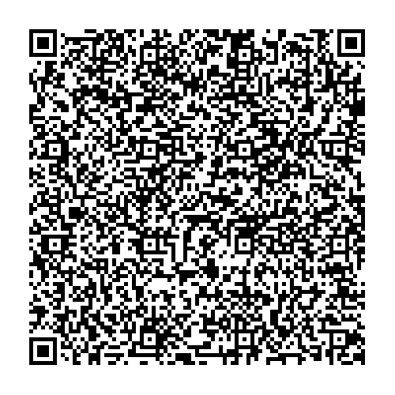
Hot Topic Resource Handout
Notes:
Now the fact is that we are dealing with the wild west in regards to some topics like AI. To help everyone here get better versed in these topics The ONEAL project consolidated a list of resources to help you further understand several topics including AI, Privacy & Surveillance, and negotiating Text & Data Mining. We are actively working to incorporate these topics within the curriculum.

Slide 7
THANKS!
https://oneal-project.org/
Katharine V. Macy, Project Director
macyk@iu.edu
Notes:
If you would like to learn more about the ONEAL project please visit your website. You will note that there is information about the project, links to the curriculum, and the library worker Discord where folks can seek advice and support as they complete the curriculum and are navigating negotiations. We hope to build additional communities in the future that allow library workers and vendors to also connect. We hope this project will continue to grow and expand because I truly believe that when everyone develops negotiation skills it enables better conversations and can foster sustainable relationships between libraries and vendors.

Slide 8
https://sparcopen.org/our-work/negotiation-resources/oneal/
Access the curriculum

