Slide 1
Fundamentals of Assessing Student Learning Outcomes
Campus Compact of Indiana
November 20, 2015

Slide 2
WELCOME
Review folders
Introductions: Please share
Name, Institution, What do your students learn in your course or program?
Notes:
Review registration.

Slide 3
Fundamentals of Assessing
CIVIC Learning Outcomes
Campus Compact of Indiana
November 20, 2015
Anne Weiss & Kristin Norris

Slide 4

Today we will…
Explain why & how
Assessment is important;
We are all weak in defining and refining civic outcomes (to assess/measure);
We can coordinate assessment plans for civic outcomes!!!

Slide 5
Outcomes for Today
Identifying the difference between a goal and objective for student learning across a curricular or co-curricular community engagement intervention.
Writing measureable outcome statements.
Conducting a scan of a specific learning goal and the rubrics associated with it in order to form an appreciation of the various ways to artriculate and measure outcomes.
Outline a plan for assessing civic outcomes.

Slide 6

Getting a Pulse: Tell us
On a scale of 1-10, how confident are you that….
  Have developed measurable outcomes for your course/program?
  Have created processes that provide good evidence of that learning outcome?
  Are able to assess the student learning?
  Based upon evidence, know what to do differently in your course/program in order to increase student learning?
  Why are you/are you not confident? What is causing you to question?

Slide 7
Thank you
Moving on: Why Outcomes & Assessment Matter

Slide 8
Why Outcomes & Assessment Matter
Commonly asked questions
Getting beyond ‘doing good’
Intentional decision making
Strategic plan and civic mission of institutions

Slide 9
Why Outcomes & Assessment Matter:
Importance of Good Questions
What do you need to know and why?
Refining your questions; Your question should dictate everything
  your plan
  your methods
  your approach
  your measures
  Every.thing!

Slide 10
Why Outcomes & Assessment Matter:
Rigor in Assessment
Rigorous thinking
Hypothesis exploration (Starts with a good question)
Systematic approach
Builds upon prior research
Contributes to the field
Triangulation across inquiry
Creates useful, relevant knowledge
                (Patton, 2012)

Slide 11
Why Outcomes & Assessment Matter:
Schöen’s Reflective Practitioner
Trait of a good professional
Reflection in-action
Attentive to new knowledge
Curious, test ideas, adjust practices
Revise plans and practices - why are you doing this?

Slide 12
Why Outcomes & Assessment Matter:
Tell a Story
Inputs | Outputs | Outcomes | Impacts
All the resources put into the project to enable the delivery of outputs | All the activities undertaken and products and services delivered | The changes, benefits, learning or other effects that result from the outputs | The effect of a project at a higher or broader level, in the longer term, after a range of outcomes have been achieved

Slide 13
Why are student-based civic learning outcomes important?
At the course level
  Build a foundation for your course
  Define your expectations
  Describe how your course is relevant to the students’ personal, academic, and/or professional development
  Keep you focused on what is important
  Enable students to articulate what they are learning and have learned.

Slide 14
Why are student-based civic learning outcomes important?
At the unit/lesson level
  Build a structure for a unit or session
  Focus each unit or session
  Give learners a clear picture of what to expect
  Provide criteria for constructing assessments
  Guide the selection of learning activities
  Teach learners how to be successful

Slide 15
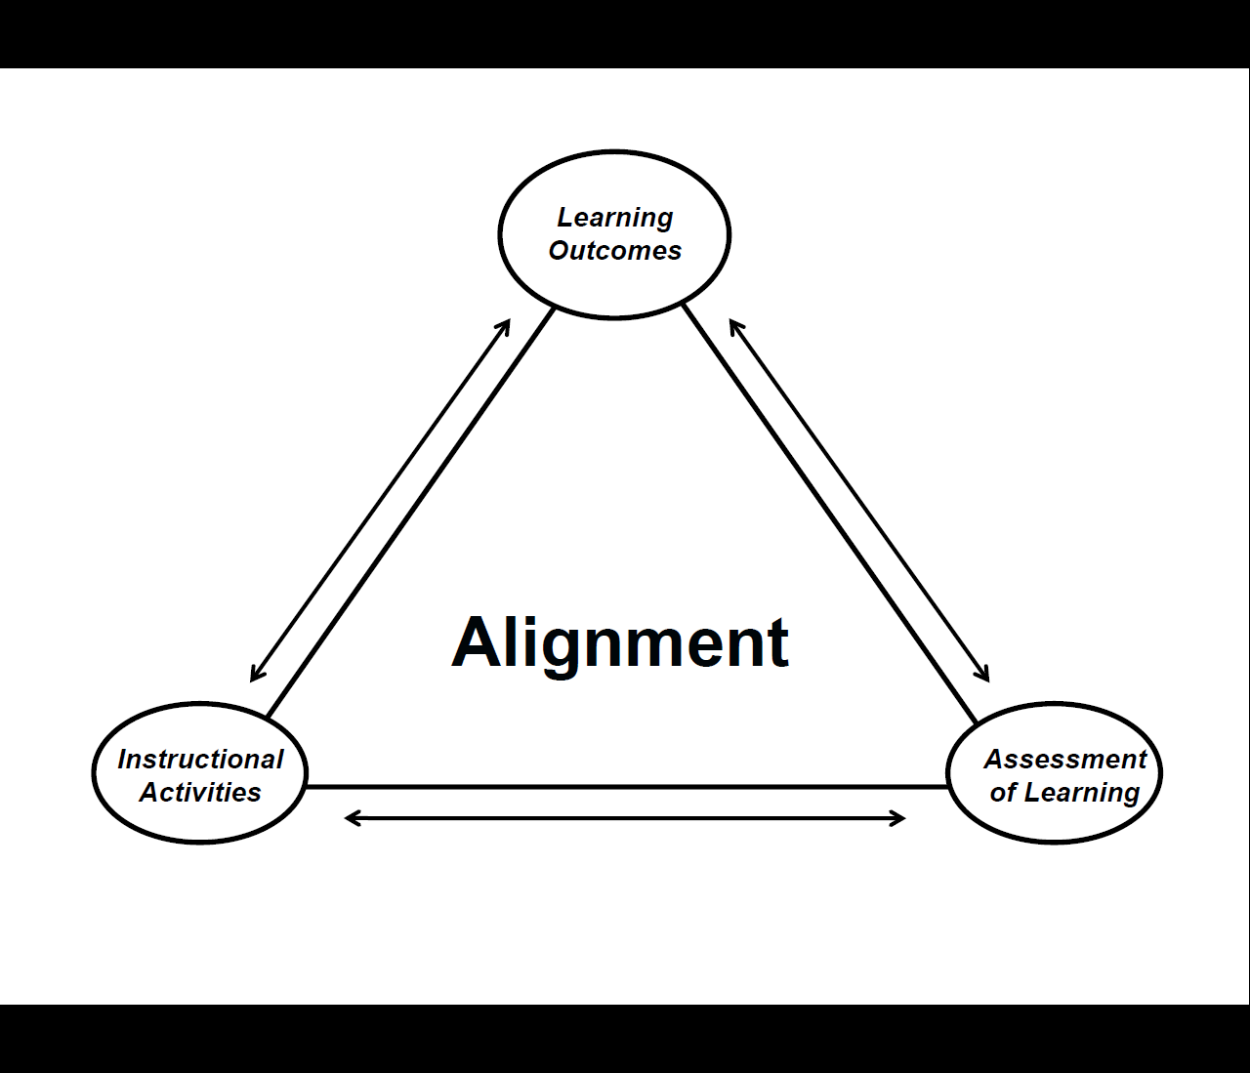
Assessment MUST Inform Decisions and Practices

Slide 16
Let’s Get to Work
Starting with
CIVIC GOALS & OUTCOMES
in mind

Slide 17
Levels of civic learning
Institution
IUPUI
School
Center/ Office
Liberal Arts
Center
GOALS
Department
Program of Study
Program
Communication Studies
Org. Comm
Scholarship
Course
Course
Project 1
Intro to Public Speaking
Group Comm
Alter. Breaks
Project 1
Project 2
Project
Project 2
Persuasive Speech
Informative Speech
Capstone
Traning Team Leaders
OUTCOMES
Notes:
Kristin

Slide 18
We must differentiate between
GOALS
OUTCOMES
Ambiguous, General Statements
Large/Meta-level
Long range
Should be consistent with the mission of the institution
Specific
Measurable
Contain Active Verbs
Operationalized

Slide 19
Example: Course in Dental Health 101
GOAL
OUTCOMES
Understand proper dental hygiene.
Identify the active ingredient in toothpaste through lab and recitation exercises.
Explain why teeth should be cleaned at least twice per year by a professional dentist through a well constructed essay and presentation.

Slide 20
Goals
Goals will not allow:
  Students to know what is expected of their work.
  Colleagues to know the focus of your department’s pedagogy.
  Employers to know what your student can do!

Slide 21
Activity
Create civic goal(s) for your program or course
Review an example of a civic goal

Slide 22

Describe the Ideal Graduate
In terms of civics, citizenship, public and/or community engagement.
What does the student know? (cognitive)
What can the student do? (kinesthetic)
What does the student care about? (affective)
Civic Goal(s)
associated with your course or program

Slide 23
Describe the Ideal Graduate
REMINDER: Goals can be…
Broad
Ambiguous, general
Long range
Civic Goal(s)
associated with your course or program

Slide 24
Pair & Share
Find a partner, share a CIVIC goal, run through the checklist.

Slide 25
Describe the Ideal Graduate
Checklist for your goal(s):
Are they consistent with your institution’s mission?
Are your goals aligned with civic values (e.g., access, equity, inclusion)?
Do your goals describe desired performance?
Civic Goal(s)
associated with your course or program

Slide 26
Review a Civic Goal
Civic Minded Graduate

Slide 27
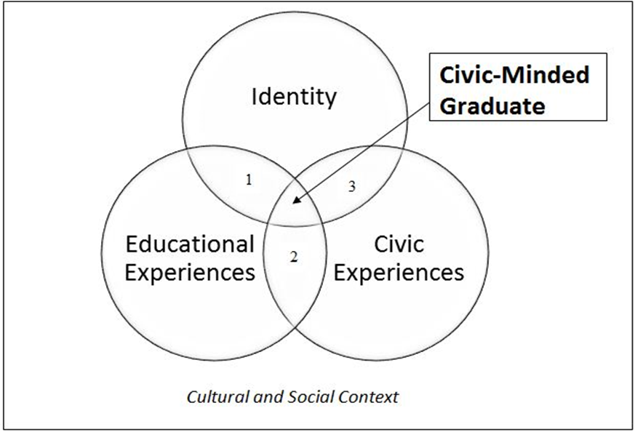
Civic Mindedness
What is it?

Slide 28
Goal: Civic Minded Graduate
OBJECTIVES
Self and Civic Identity
Active Participant in Society to Address Social Issues
Integration of Education to Address Social Issues
Benefit of Education to Address Social Issues
Collaboration with Others across Difference
Understands how Social Issues are Addressed in Socieity
Civic Communication
Knowledge of Civil Society
Reciprocal Relationships with Community Partners
Global Perspective

Slide 29

BREAK
Walk away for 10 minutes, seriously
stand up,
walk out
now.

Slide 30
Let’s Get Specific
broad CIVIC Goal>> with CIVIC Objective(s)>>
toward specific CIVIC Outcome(s)

Slide 31
Civic Outcome Statements Should…
Describe what students should be able to do, based on their learning histories…
Rely on active verbs that identify what students should be able to demonstrate, represent, or produce over time. (Maki, 2004; Adelman, 2015)
Be operationalized (where or how are students enacting the verb)
Exist across and within different levels.
Inform decisions & practices!!!!

Slide 32
Civic Outcome Statements Should Be…
Specific
Measurable
Operationalized
Useful
Meaningful, and
Allow for one or more methods of data collection and measurement to be tied with the intended outcome.

Slide 33
Review the objective “CIVIC Identity” across measures
Count off by six: 1, 2, 3…6
Find your cohort
In the folder, on the right hand side, colored sheets of paper:
  Group 1= pink, Group 2= purple; Group 3= blue;
  Group 4= yellow, Group 5= teal; Group 6= green

Slide 34
Activity
Play with some verbs

Slide 35
Civic Identity
Groups of 4:
Pick one verb in your set, create one objective, and operationalize it.
Repeat by picking a new set of verbs… REPEAT
Group that completes the most verb “sets” gets a prize!

Slide 36
Share
Each group pick one or two CIVIC outcomes to share.
Feedback provided by facilitators and colleagues.

Slide 37
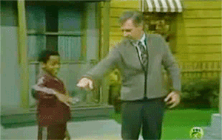
Break DANCE!!
10 minute break.
If he can do it, so can you!

Slide 38
Developing an Assessment Plan
Using the Matrix

Slide 39
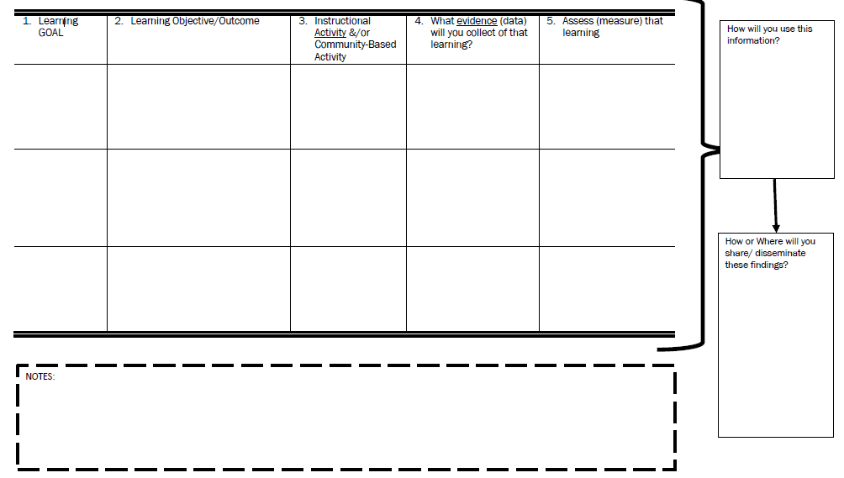

Slide 40
Completing the Matrix
Step 1: Insert your Learning Goals and Learning Outcome/Objective (columns 1 and 2)
Step 2: Identify course/program activities (e.g., reflections, dialogue, readings, events, trainings) – which learning outcome do they align with?
  Note: If an activity doesn’t align with one of your learning outcomes, then why are you doing it?
  Note: What happens if you’ve identified a set of program outcomes yet none of your activities can be mapped to that outcome? You have a gap in your programming

Slide 41
Completing the Matrix (cont.)
Step 3: Identify your sources of evidence or “data” (column 4)

Slide 43
Data
What are you looking at/through to measure learning?

Slide 44
What are you looking at/through for learning?
Data considerations: What do you need, does it already exist, how will you collect it
How will you report your findings? Who needs to know?
Example tools and strategies

Slide 45
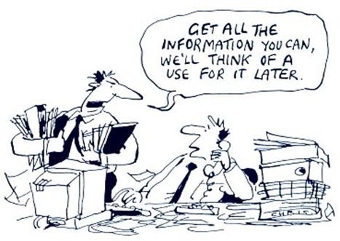
So you say you have data…..
Questions to consider:
What data do you already have?
What types of data are you collecting on a regular basis?
How are you currently using your data? Are you using all of it?
internal purposes vs. external purposes
What are you still unable to do with your data? Why?
Who decides what you collect, how you ask the questions, and how it is used?
Do you need more data? If so, what data do you need?
What lens(es) are you using when you consider these questions

Slide 46
Sources of Evidence of Student Learning
Surveys (QR Code vs. email, timing)
Capturing the discussion during reflection sessions
Focus Group
Observations
Wordle
Second-hand reflection (in the classroom the next day)
Pictures
SYSTEMATIC, CREATIVE

Slide 47
Assessment Tools for Measuring Civic Learning
A general list

Slide 49
Already Existing Tools or Processes at Your Campus
Faculty Annual Report
Campus Climate Survey
Alumni Survey
Faculty/Staff Survey
“PULSE” Surveys
Initiatives; Course Tags
NSSE, BCSSE, CCSSE

Slide 50
Tools for Measuring CIVIC Outcomes
Do not create your own (reliability, validity)
Do find others:
  See folder,
    AAC&U Value Rubrics,
    CMG Rubric,
    Others.

Slide 51
Lunch
Eat
Listen: Quick reminders & Other things to consider
Reflection: Closing the Assessment Loop

Slide 52
Developing Outcomes
Tips & Reminders

Slide 53
General Hints, Tips, and Lessons Learned
Doesn’t happen in isolation
Iterative process
The process is just as important as the product – creates shared understanding and buy-in
Overwhelming and potentially frustrating at first

Slide 54
Self-check Questions
Is it clear what you are assessing?
Is the intended outcome measurable?
  Active verbs, active verbs, active verbs
Is the intended outcome measuring something useful AND meaningful?
How will this outcome be measured?

Slide 55
Other Factors Influencing Civic Outcomes
Student Characteristics
  Prior volunteer/service experience
  Hours worked off campus
  Unmet financial need
  Empathic concern
Faculty Characteristics
  Level of experience with community engagement
  Gender
Service
  Contact: Direct vs indirect service
  Project vs hours
  Student self-select partner or project vs assigned
  Percieved value of service to organization
Reflection
  How often and when
  Dialogue/Discussion vs. Written
  Community partner involvement

Slide 56
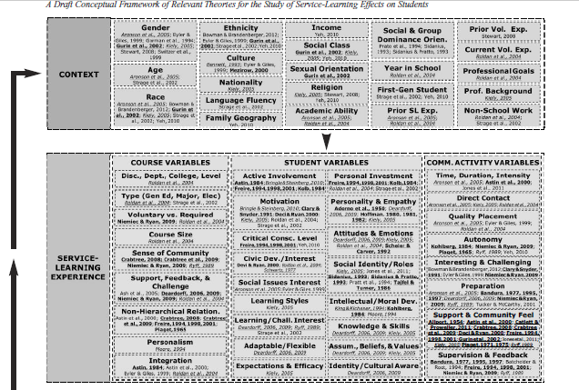
Other Factors Influencing Civic Outcomes

Slide 57
Closing the Assessment Loop
If you are not using the data you are collecting – STOP
Who needs this information and what do they care about? What is the best way to communicate/tell your story?
Need to know vs Nice to know
Starts with a good question

