Slide 1
Imagine a better way
OpenCon 2016 | Washington, DC
Heather L. Coates, MLS, MS @IandPangurBan
Digital Scholarship & Data Management Librarian
IUPUI University Library Center for Digital Scholarship
Notes:
I’d like to thank Nick for inviting me to be here. I’m incredibly honored to speak to you all today.
Acknowledge the privilege of my position – in the US, in a research university, in a well resourced library, with administrative support for Open
I’m not going to propose a technical solution to a cultural problem.

Slide 2
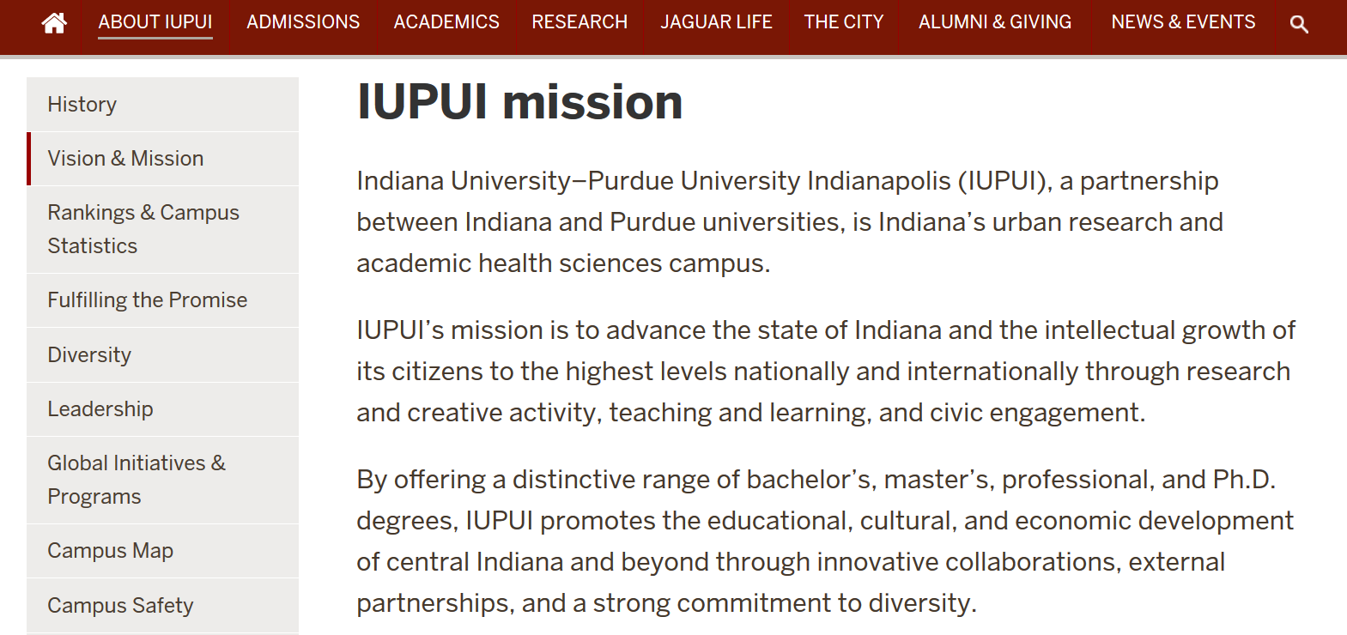
https://www.iupui.edu/about/vision-mission.html

Slide 3
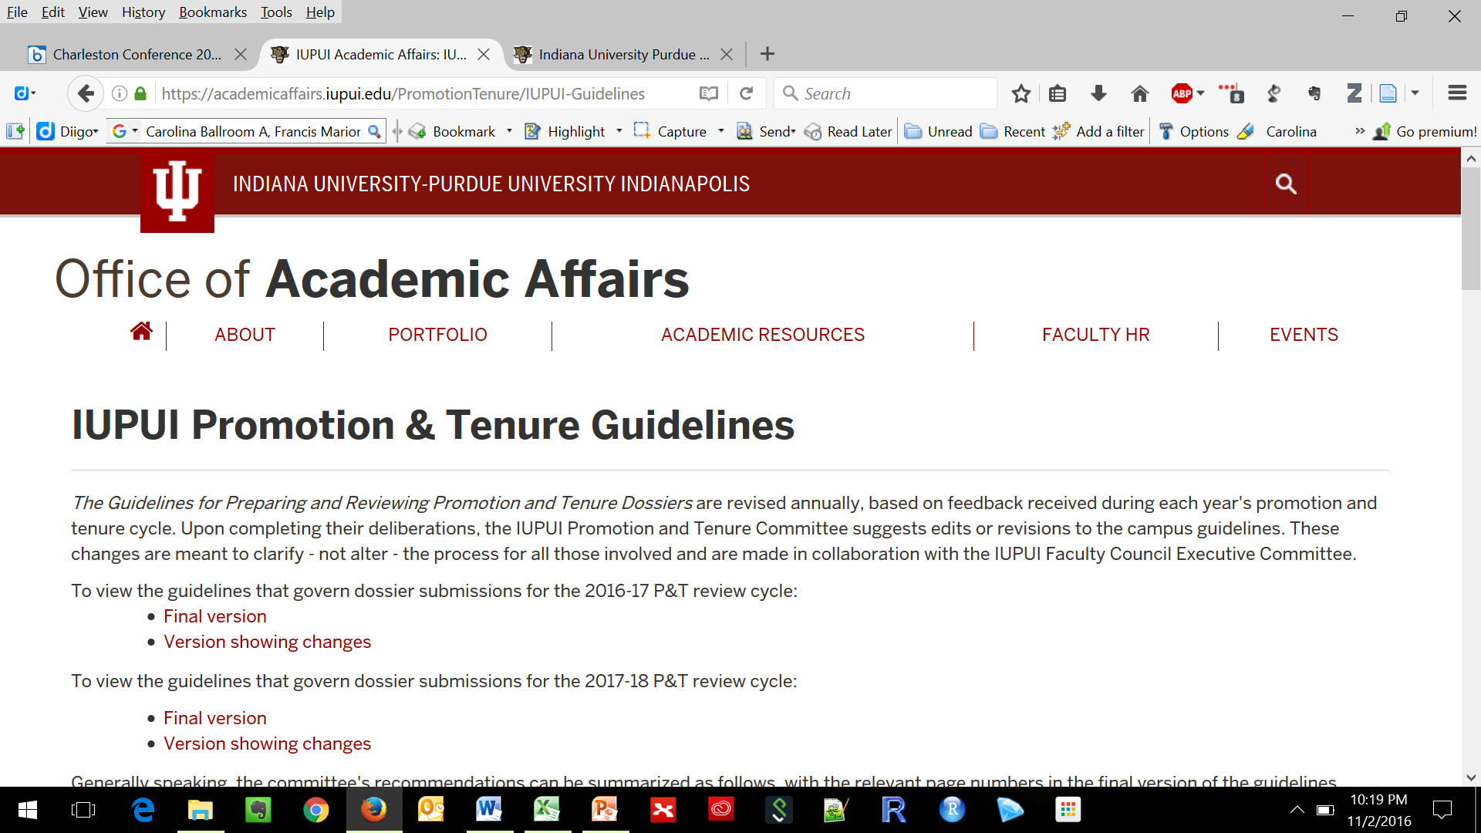
https://academicaffairs.iupui.edu/PromotionTenure/IUPUI-Guidelines
Notes:
One of the reasons that Nick invited me to speak to you is that

Slide 4
Faculty Governance
Promotion & Tenure Guidelines – campus, school, & departmental levels
Open Access Policy (Fall 2014)
Education
Workshops
Consultations
Practice
Modelling the practices we want to see
Discuss impact on professional advancement
Open Access Fund
Notes:
How have we changed practice to support and perpetuate this narrative? Engagement in faculty governance has led to addition of OA as a campus value and we are collaborating with specific schools and departments to revise guidelines at those levels. Our education efforts include workshops & consultations to help faculty make a stronger case for promotion and tenure. We have been able to change practice by modelling the practices we advocate for, openly discussing how those practices are affecting our own professional advancement, and by establishing an Open Access Fund.

Slide 5
What is the purpose of a dossier?
A tool to communicate to your colleagues and administrators:
the purpose, significance, and impact of your scholarship*
how your scholarship supports the mission of the department/school
how your scholarship supports the mission of the institution
*Scholarship is inclusive of research & creative activity, teaching, and service
Notes:
Align your dissemination choices with your values, your department’s values, your institution’s values,

Slide 6
Scholarly communication
Choices about how you communicate and disseminate your scholarship reflect your values, your goals, and your priorities.
Who are your collaborators? Stakeholders? Participants?
What kinds of products does your scholarship create?
What types of impact do you want to achieve?

Slide 7
Scholarly communication
Making informed choices requires knowledge of how scholarship can be disseminated as well as clearly defined goals describing
Who you want to reach [audience]
What you want to communicate [message]
In what venue or format [medium]
To achieve what goal [category of impact]
Notes:
Good scientific communication principles emphasize the first three, but I think we also need to keep in mind the type of impact we are trying to achieve.

Slide 8
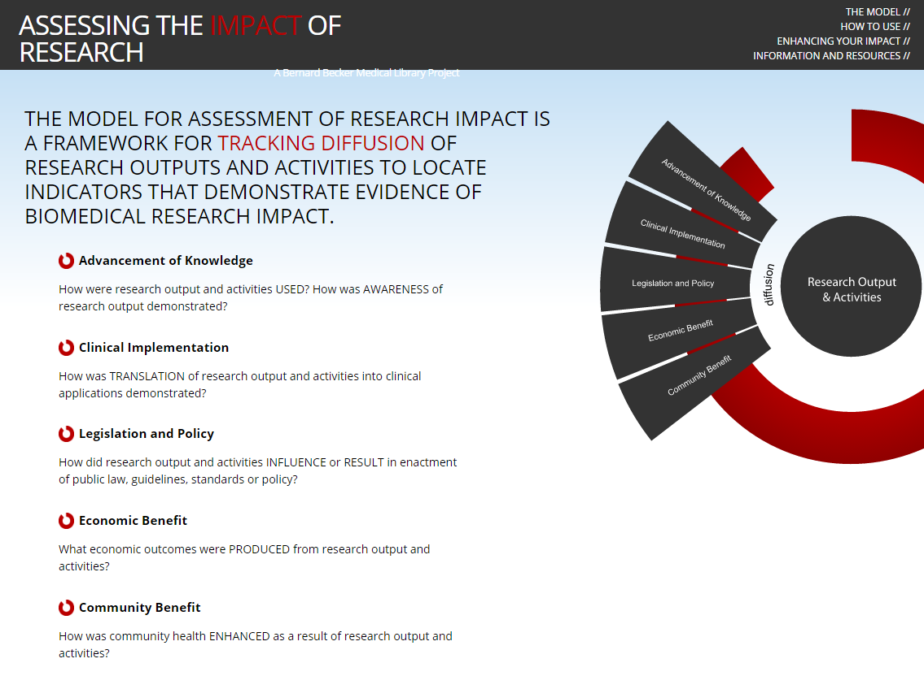

Slide 9
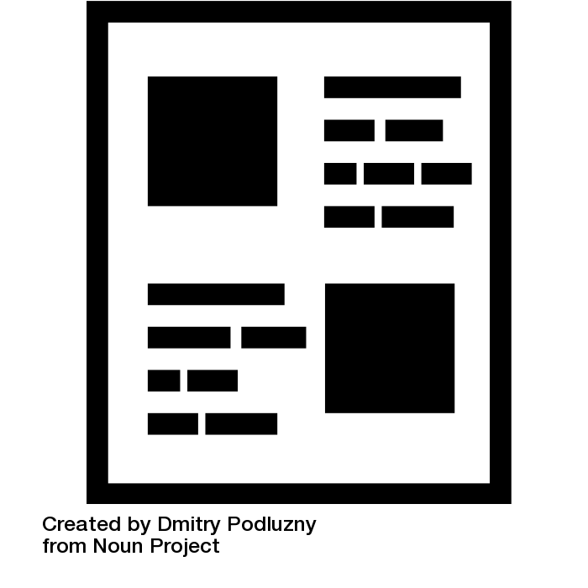
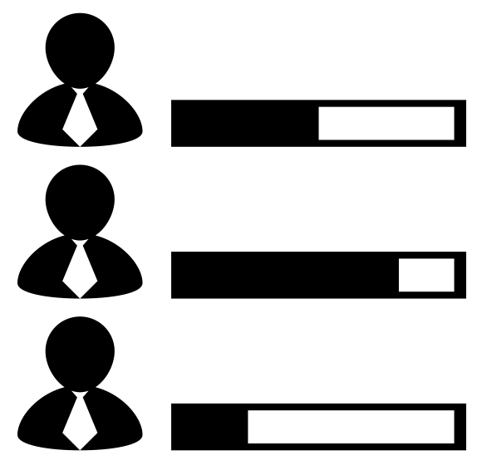

Slide 10


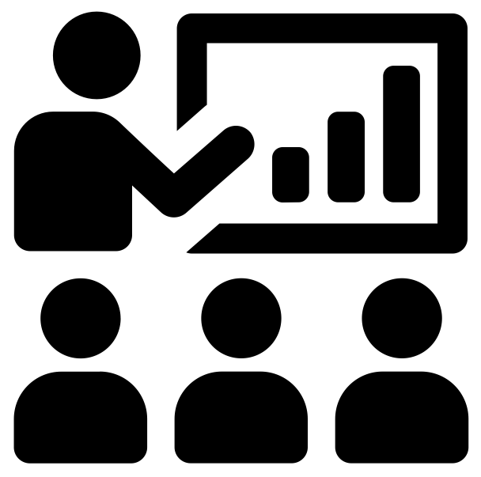
Notes:
Current dossier model
products = publications & grants
impact = citations, JIF, narrative statements about quality, reputation, etc.
The old way of valuing scholarship is very self-referential and closed

Slide 11
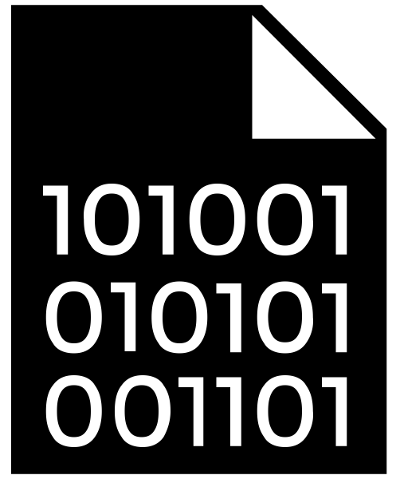

Notes:
Right now, we are in a rapid transition period. The types of scholarly products that “count” is expanding

Slide 12

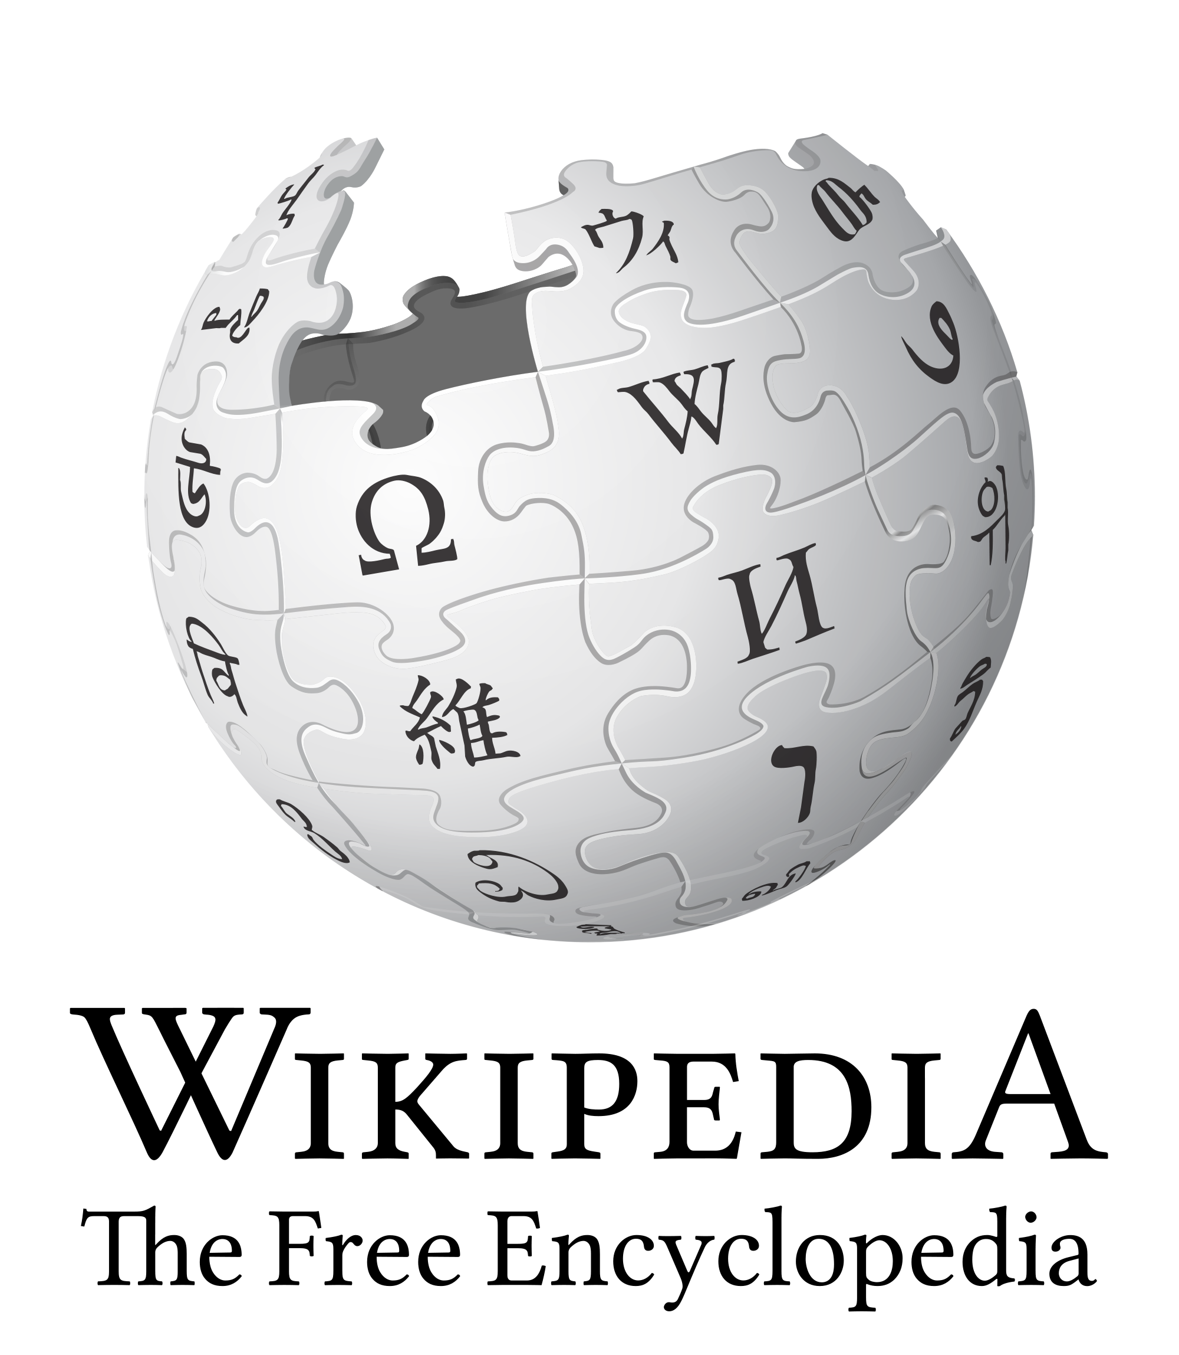







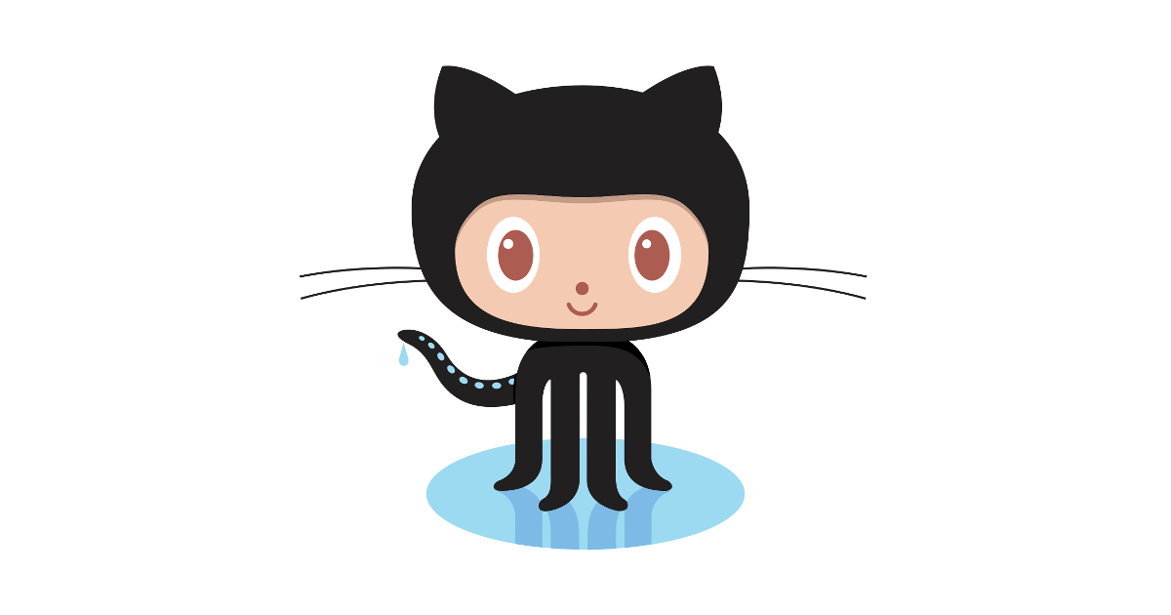





Notes:
As are the types of metrics available, but we are still learning what these metrics data mean. Too often, their use is driven by sheer availability, rather than the strategic and thoughtful dissemination.

Slide 13
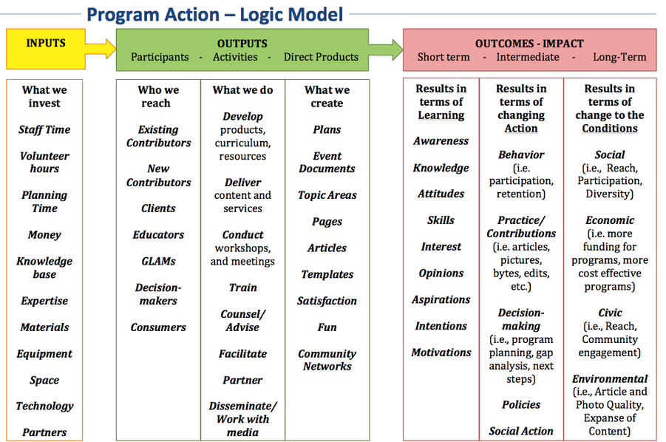

Slide 14
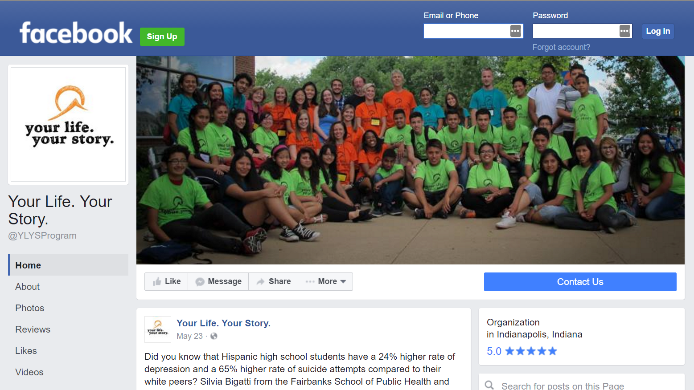
Notes:
A great example of community engaged research with direct community benefit comes from our school of public health
Silvia Bigatti: Your Life. Your Story Latino Youth Summit
http://news.iu.edu/releases/iu/2014/11/apha-2014-iu-research.shtml
https://www.facebook.com/YLYSProgram/
http://news.iupui.edu/releases/2016/06/your-life-your-story.shtml
http://indianapublicmedia.org/stateimpact/2016/08/18/latino-camp-identity-depression/

Slide 15
"Your Life. Your Story." includes a resilience-building curriculum, a mentoring component with IUPUI undergraduates, physical activity and emotional expression activities including art, music, storytelling, technology and dance, said Conrad, who serves as the program director. All activities are designed to provide teenagers with outlets to further develop their identities and sense of self, and to give them the ability to communicate their stories.
Preliminary results since the program started are promising, Conrad said. After a single week of summer camp, the team found that participants had a statistically significant increase in resilience and a statistically significant decrease in depressive symptoms. At the end of the year, the researchers hope to see that those trends have continued, she said.
"The 'Your Life. Your Story.' program has the potential to create a large and lasting impact, not only in Indianapolis, but across Indiana and even nationwide," Conrad said. "We think it is something that could be tailored to other types of underserved or marginalized youth as well, and we hope to expand it.“
Source: http://news.iu.edu/releases/iu/2014/11/apha-2014-iu-research.shtml
Notes:
Ex: community benefit
Silvia Bigatti: Your Life. Your Story Latino Youth Summit
https://www.facebook.com/YLYSProgram/
http://indianapublicmedia.org/stateimpact/2016/08/18/latino-camp-identity-depression/

Slide 16
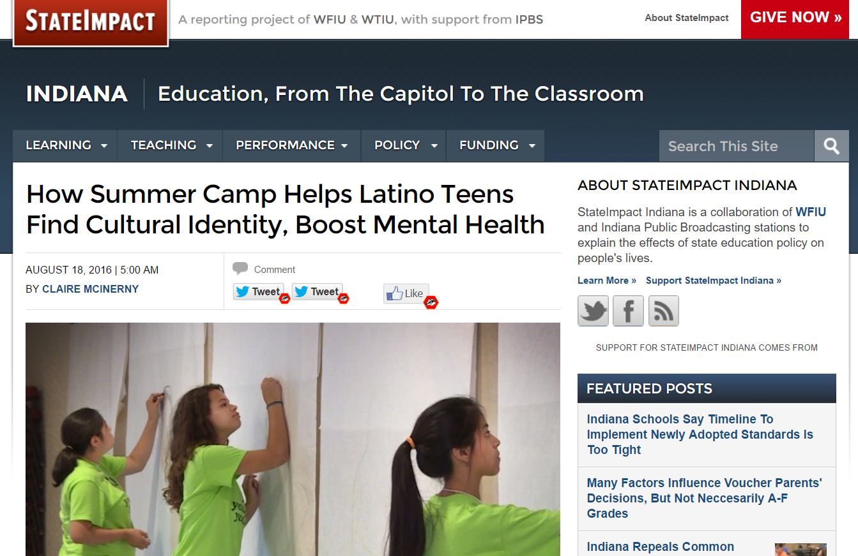
Notes:
Taking this approach to disseminating your work and documenting its impact doesn’t require you to publish in expensive Western journals, or even English-language journals; you don’t even have to get a DOI

Slide 17
A model dossier?
Based on a communication and dissemination strategy
Is about the scholar
Story first
Describes the types of impact sought and achieved
Supported by a mix of quantitative and qualitative evidence
Notes:
What does openness do for us? It is a process, not an end goal

Slide 18
VALUES
Equitable access, both technologically and culturally
Integrity and long-term preservation of the scholarly record
Incentives should balance importance of process and products
Engagement with communities outside of academia
Support the next generation of scholars
Notes:
What does openness do for us? It is a process, not an end goal

Slide 19
How DO we create this future?
Engage in faculty governance
Discuss research evaluation with your department chair, Dean, colleagues, and campus administration
Question and push the boundaries – don’t blindly accept the status quo
Be a champion of open
Be honest about openness
Notes:
TAKE ACTION
***Like Ahmed said, change is hard and it may take time to for your impact to be felt or seen

Slide 20
MORE INFORMATION
National Center for Faculty Development & Diversity: http://www.facultydiversity.org/
Inspiring Australia – Principles for Science Communication: http://inspiringaustralia.net.au/toolkit/principles-for-science-communication/
Odell, J., Coates, H., & Palmer, K. (2016). Rewarding open access scholarship in promotion and tenure: Driving institutional change. College & Research Libraries News, 77(7), 322-325.
Altmetrics for Team Science: http://www.slideshare.net/goldenphizzwizards/metrics-for-team-science
Coates, Heather (2016): Heather Coates dossier for promotion & tenure at IUPUI (figshare). doi:10.6084/m9.figshare.3413698.v2

Slide 21
Image Credits
Publish: https://thenounproject.com/search/?q=article&i=74762
Evaluate: https://thenounproject.com/search/?q=peer+review&i=210141
Article: https://thenounproject.com/search/?q=article&i=74762
Book: https://thenounproject.com/search/?q=book&i=547809
Binary code: https://thenounproject.com/search/?q=binary+code&i=177042
Data stream: https://thenounproject.com/search/?q=data+stream&i=160443

Slide 22
questions
How do we support researchers in becoming effective communicators about their research?
How can we support researchers in planning the first and subsequent chapters of their career?
How can we develop clear P&T guidelines that offer flexibility with regards to the mix of products, formats, evidence, and impact?
How can we support P&T review committees in evaluating such a diverse range of evidence?

