Slide 1
International Students Library Employees as Affective-service Providers
Shu Wan
History Department
University at Buffalo

Slide 2
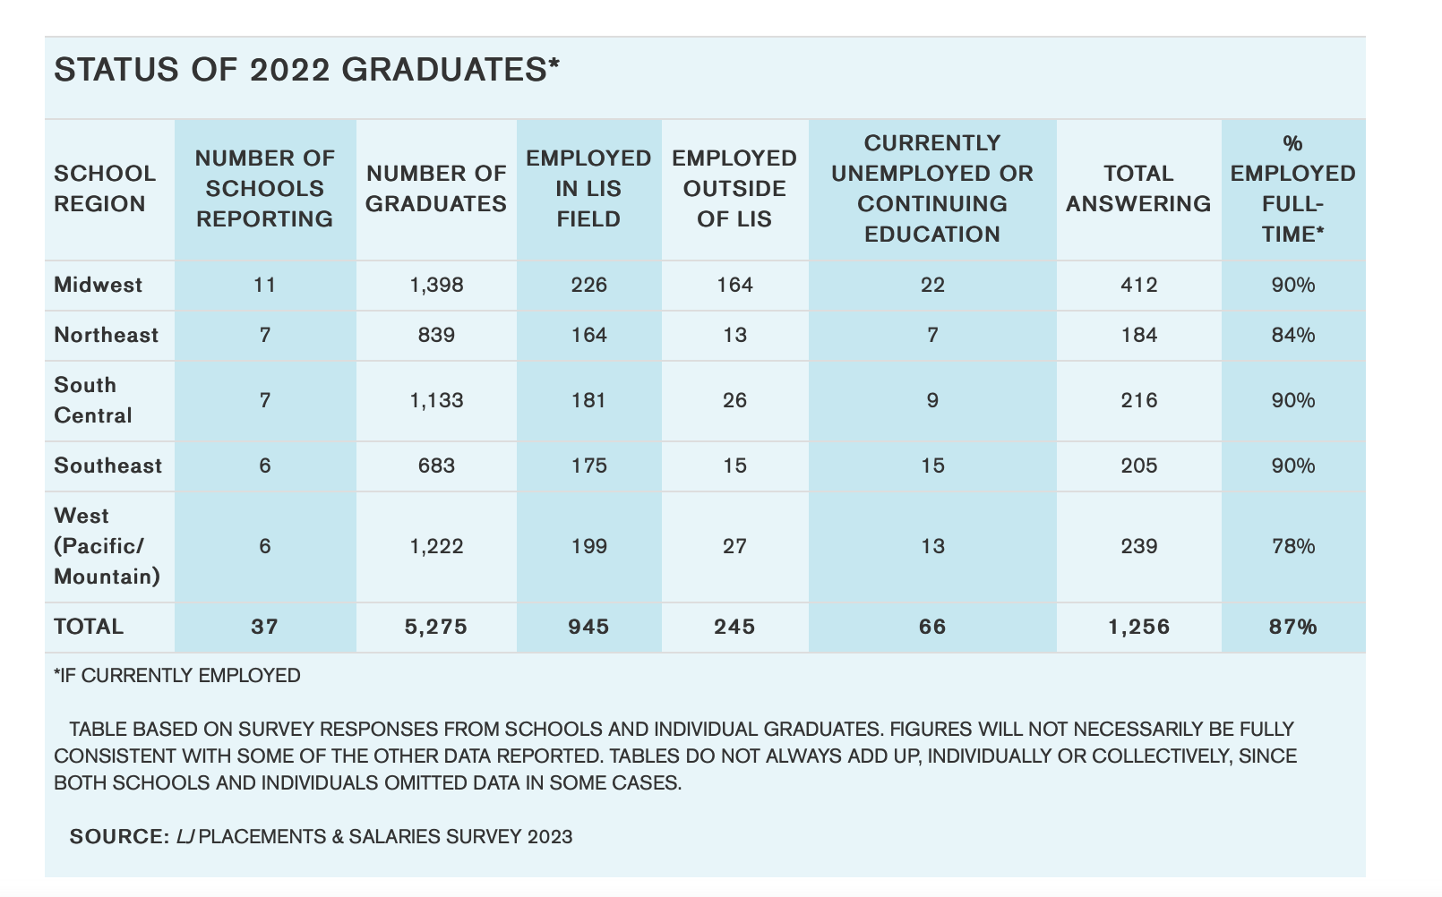
Academic Library Jobs Market in the Crisis

Slide 3
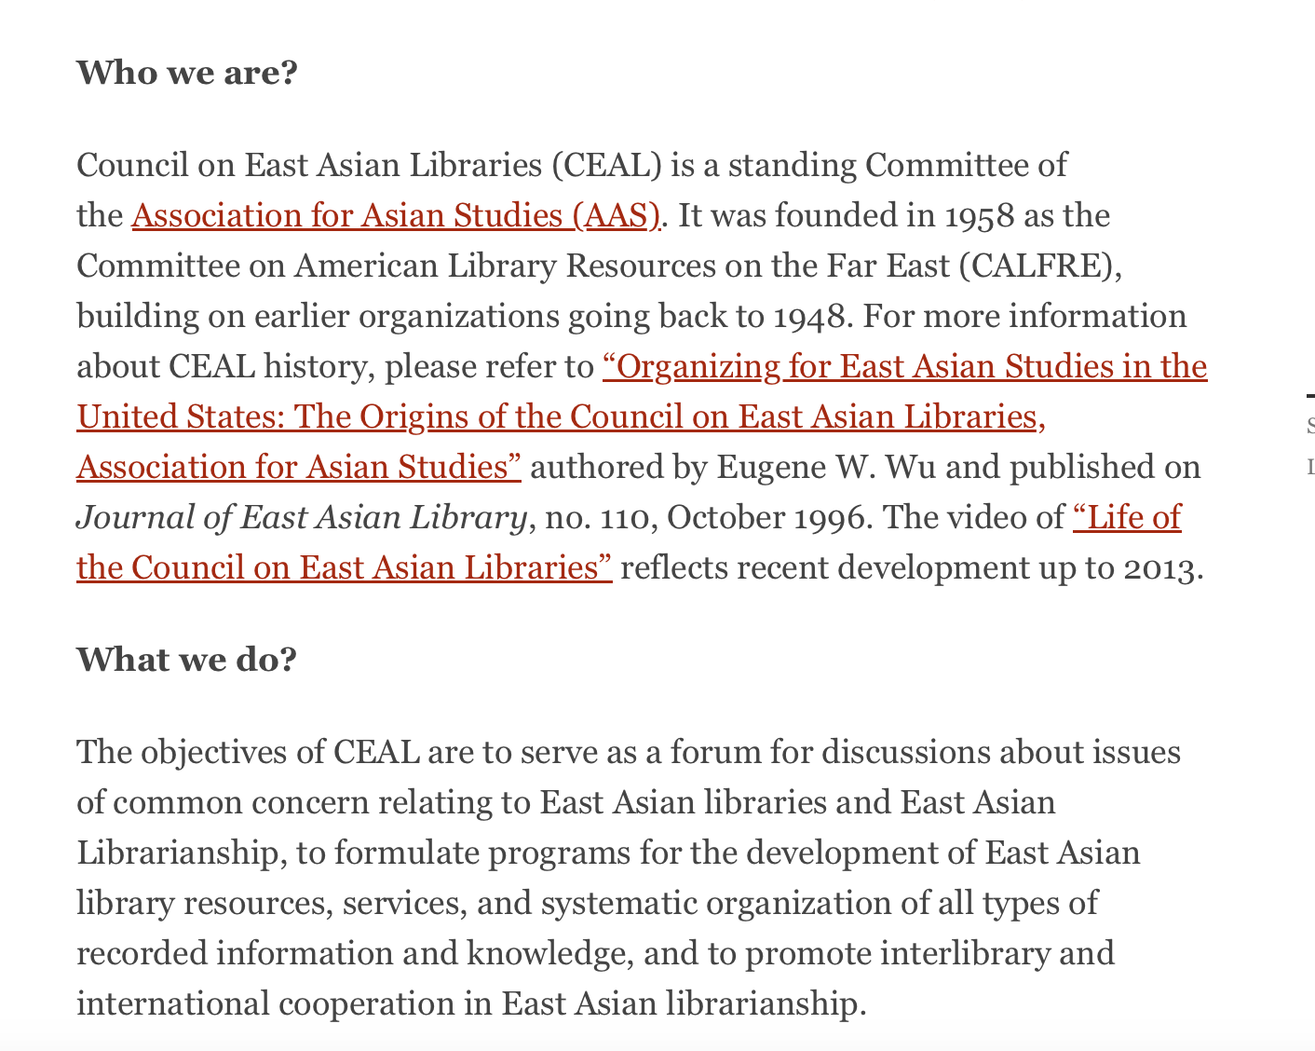
East Asian Librarians for East Asian Studies

Slide 4
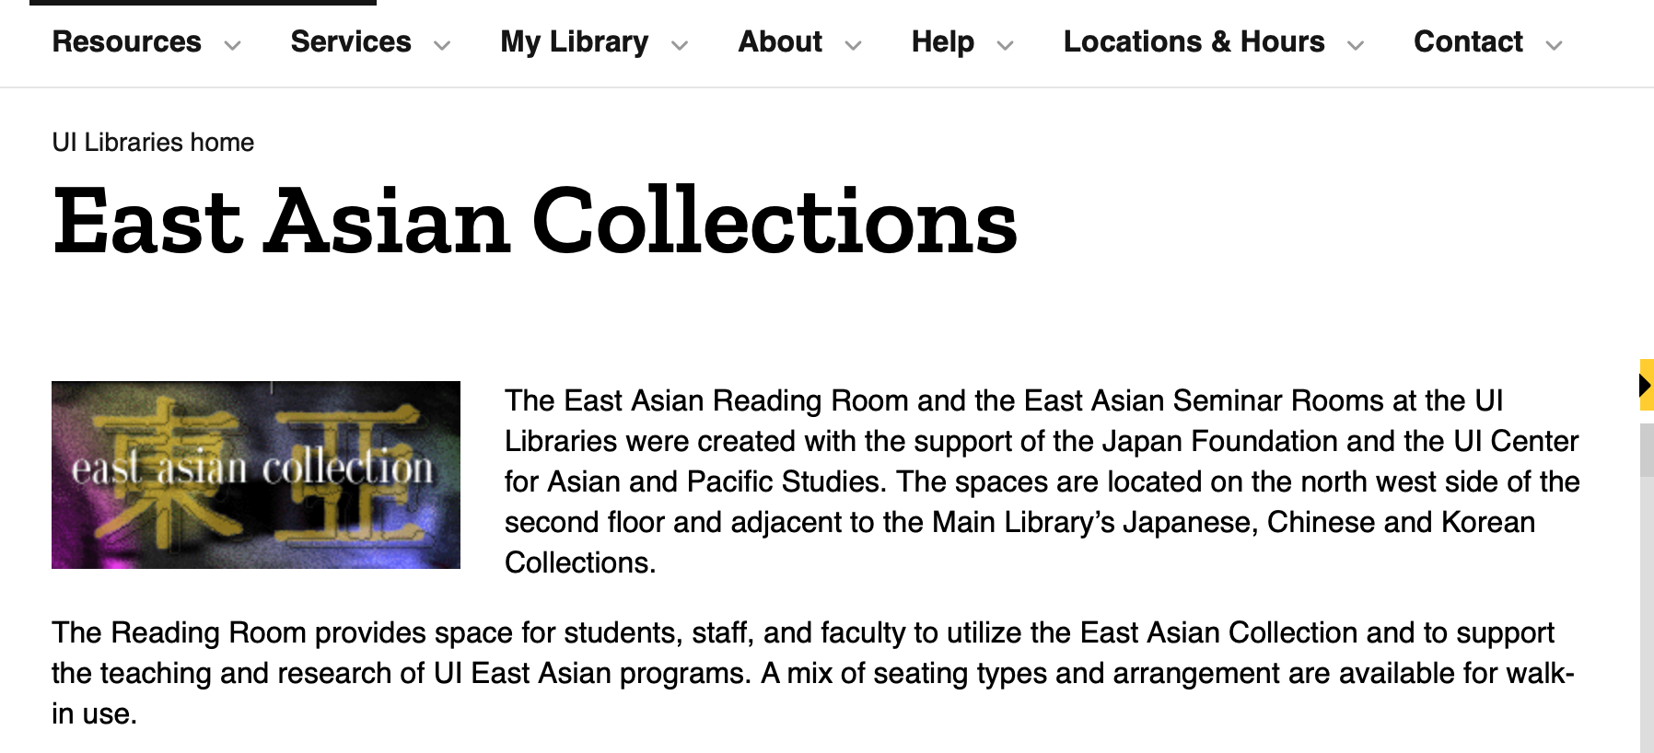
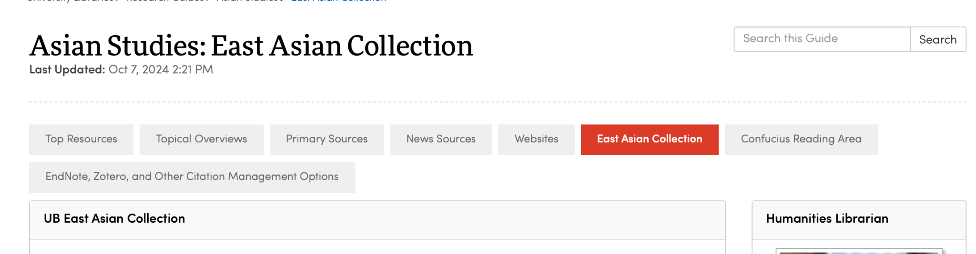
UI vs. UB

Slide 5
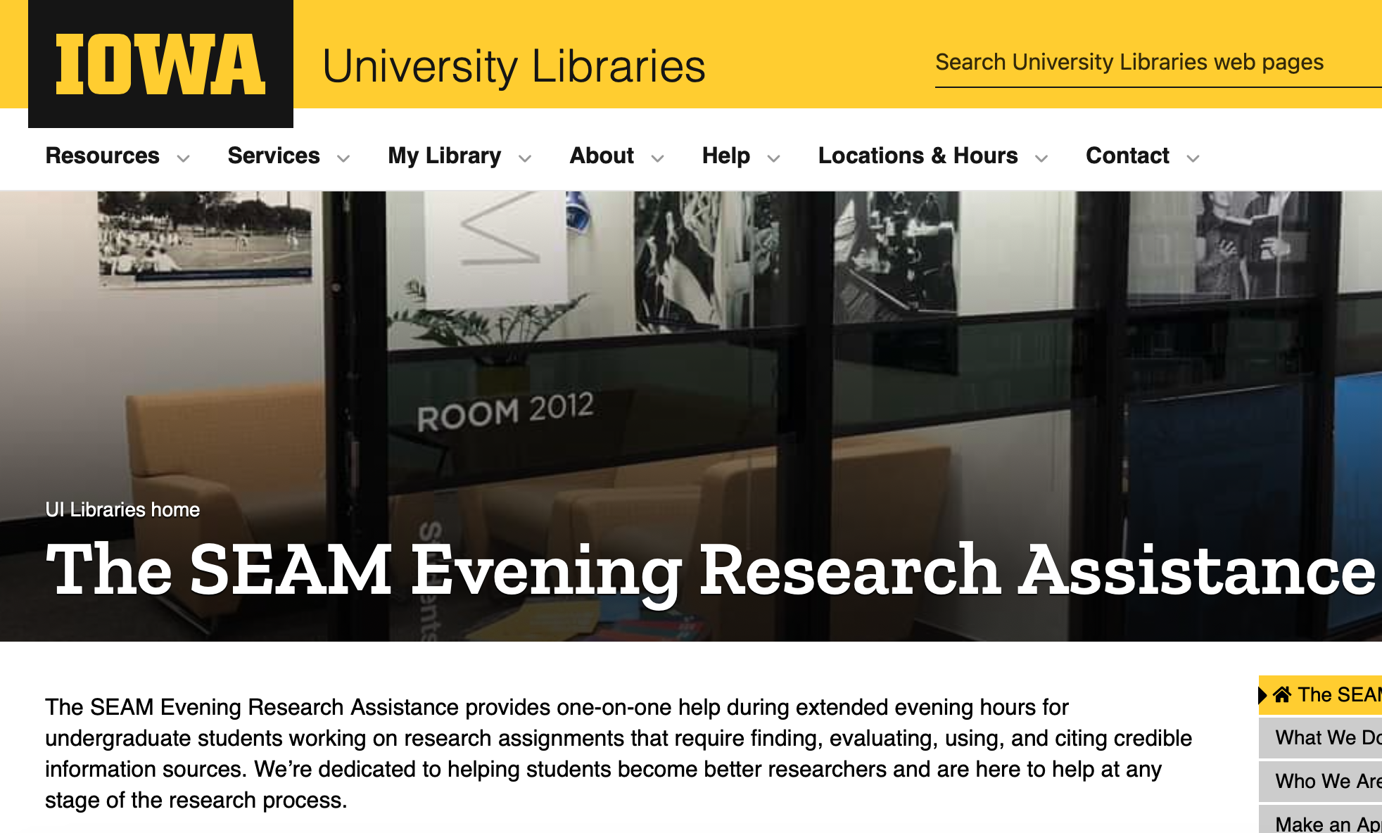
Being a the only non-white and East Asian-originated student librarian

Slide 6
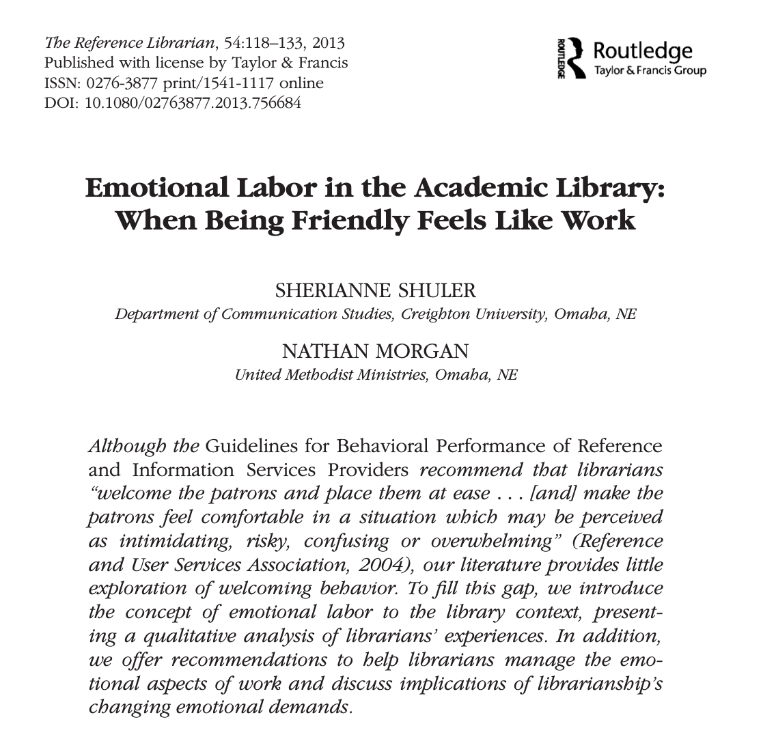
Affective Services: Beyond Being Friendly

