Slide 1
SCHOOL OF SOCIAL WORK
Examining the intersection of mental illness and suicidal risk in the shadow of a pandemic: A Machine Learning Approach
Saahoon Hong, Betty Walton, & Hea-Won Kim
Indiana University School of Social Work
2021 TCOM Conference

Slide 2
Faculty Disclosures
Saahoon Hong: My spouse, significant other, or I have not had any relevant financial relationships during the past 12 months.
Betty Walton: My spouse, significant other, or I have not had any relevant financial relationships during the past 12 months.
Hea-Won Kim: My spouse, significant other, or I have not had any relevant financial relationships during the past 12 months.

Slide 3
Introduction

Slide 4
10 Leading Causes of Death, United States
2019, All Races, Both Sexes (CDC, 2019)
https://webappa.cdc.gov/cgi-bin/broker.exe

Slide 5
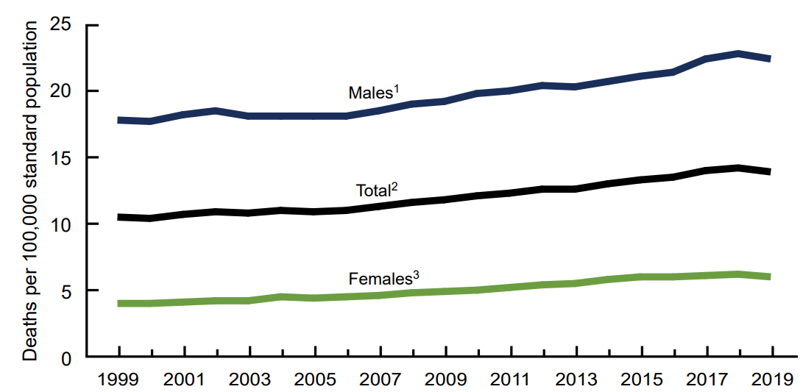
Age-adjusted suicide rates by sex (Hedegaard, 2021)
https://www.cdc.gov/nchs/data/databriefs/db398-H.pdf

Slide 6
Suicide plans (n=3.5 m)
Suicide attempts (n=1.4 m)
Suicide thoughts (n=12 million adults)
Suicidal thoughts and behaviors (SAMSHA, 2020)
Suicide plan & attempts (n=1.2 m)
Suicide attempts without plan (n=0.2 m)

Slide 7
Psychosocial Factors (stress, unemployment), somatic diseases
Causal relationships: Suicidal Behavior (Hegerl, 2016)
Behavioral Health Needs (depression, schizophrenia, addiction, etc.)
Suicidal Risk

Slide 8
Suicidal Risk in the COVID-19 Pandemic (Gunnell et al., 2020)
Increasing the suicide risk
An increasing suicide rate
Adverse effects of the Pandemic on people at risk for suicide
Intersection of mental illness and suicidal risk

Slide 9
ANSA items associated with suicidal risk
Suicidal risk factors (Hegerl, 2016)
Machine learning approach

Slide 10
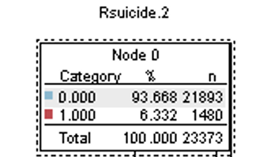
ANSA in the calendar year 2019-2020

Slide 11

Learning Objectives
IDENTIFICATION
1
DIFFERENCITION
2
Differentiate the pattern of ANSA’s actionable needs before and during the pandemic among adults at risk for suicide.
DESCRIPTION
3
Describe what type of mental illness is critically associated with adults’ suicidal risk during the pandemic.
CONSIDERATION
4
Consider how to address the intersection of mental illness and suicidal risk for the suicidal recovery model.
Identify the pattern of ANSA’s actionable items in behavioral health needs during the pandemic among adults at risk for suicide.

Slide 12
Indiana Study: Actionable Mental Health Needs Associated with Suicidal Risk
Agenda
2. Suicide Prevention/Recovery
3. Discussion
4. Q & A

Slide 13
Indiana Study: Actionable Mental Health Needs Associated with Suicidal Risk

Slide 14
Practice Gap/Educational Need
Gap = To develop the suicidal prevention/recovery model for adults with mental illness during the pandemic and better serve them in the mental health system, it is necessary to ensure that we can apply the TCOM tool (ANSA) to identify, screen, and monitor the intersection of mental illness and suicidal risk.
Need = The progressive use of machine learning might help us detect different mental health states and identify intersections between the target response and input features of mental health states.

Slide 15
Research Questions
To examine the intersection of mental illness and suicidal risk among adults aged 18 or above in 2019 and 2020, respectively.

Slide 16
Method
Participants. Adults aged 18 and above who participated in the Midwestern state-funded mental health service (n=29,267) in the calendar year of either 2019 or 2020.
Measures. The Adult Needs and Strengths Assessment (ANSA) items in the six domains: (1) strengths, (2) life functioning, (3) cultural factors, (4) caregiver needs and resources, (5) behavioral health needs, and (6) risk behaviors. We focused on the behavioral health needs items, excluding strength items.

Slide 17
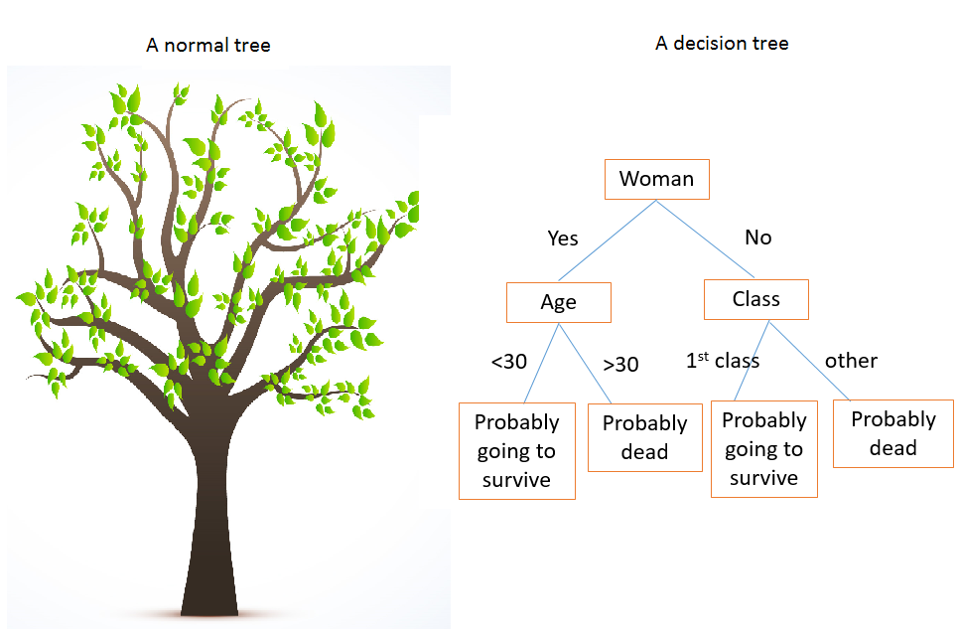

Analysis. Chi-square automatic interaction detection (CHAID), the tree-based machine learning algorithms, was used to identify the intersection of mental illness and suicidal risk and determine their classification accuracy.
Image by Vishal Maini From Machine Learning for Humans Part 2.3

Slide 18
Machine Learning Approach
Progressive use of machine learning aims to detect and monitor different mental health states and identify between the target response and a set of input features of interest (i.e., Garcia-Ceja et al., 2018; Tate et al., 2020).

Slide 19
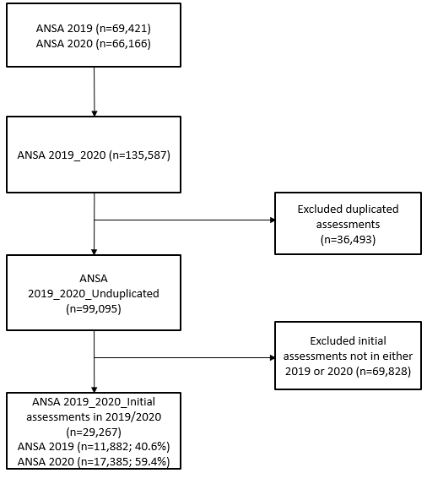
Flowchart of the dataset development

Slide 20
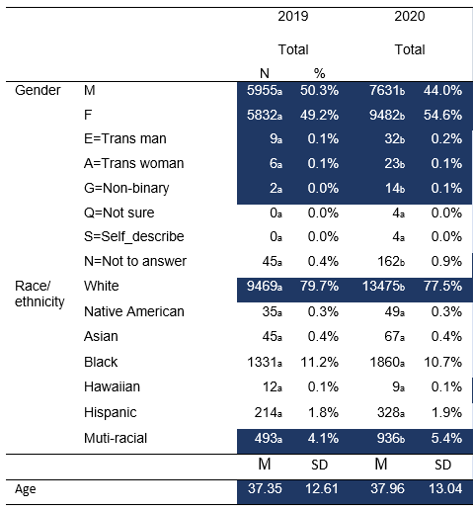
Demographic information

Slide 21
 |  | 2019 |  | 2020 |  | Total (n=29,267) |  | Difference
 |  | N | % | N | % | N | %
Life functioning | Femployment.2 | 3537_{a} | 29.8% | 5811_{b} | 33.4% | 9348 | 31.9% | Increased
 | Flegal.2 | 4672_{a} | 39.3% | 5553_{b} | 31.9% | 10225 | 34.9% | Decreased
 | Fsleep.2 | 4976_{a} | 41.9% | 8377_{b} | 48.2% | 13353 | 45.6% | Increased
Behavioral health | BHpsychosis.2 | 847_{a} | 7.1% | 1911_{b} | 11.0% | 2758 | 9.4% | Increased
 | BHimpulsecontrol.2 | 3126_{a} | 26.3% | 5156_{b} | 29.7% | 8282 | 28.3% | Increased
 | BHdepression.2 | 5699_{a} | 48.0% | 10525_{b} | 60.5% | 16224 | 55.4% | Increased
 | BHanxiety.2 | 5762_{a} | 48.5% | 10797_{b} | 62.1% | 16559 | 56.6% | Increased
 | BHinterpersonal.2 | 2124_{a} | 17.9% | 3499_{b} | 20.1% | 5623 | 19.2% | Increased
 | BHantisocialbehavior.2 | 683_{a} | 5.7% | 869_{b} | 5.0% | 1552 | 5.3% | Decreased
 | BHadjtotrauma.2 | 3806_{a} | 32.0% | 7082_{b} | 40.7% | 10888 | 37.2% | Increased
 | BHangercontrol.2 | 2207_{a} | 18.6% | 3612_{b} | 20.8% | 5819 | 19.9% | Increased
 | BHeatingdisturbance.2 | 344_{a} | 2.9% | 633_{b} | 3.6% | 977 | 3.3% | Increased
 | BHsubstanceuse.2 | 4391_{a} | 37.0% | 5749_{b} | 33.1% | 10140 | 34.6% | Decreased
Risk behaviors | Rdangertoothers.2 | 274_{a} | 2.3% | 365_{a} | 2.1% | 639 | 2.2% | Not changed
 | Rselfinjuriousbeh.2 | 322_{a} | 2.7% | 530_{a} | 3.0% | 852 | 2.9% | Not changed
 | Rotherselfharm.2 | 890_{a} | 7.5% | 1357_{a} | 7.8% | 2247 | 7.7% | Not changed
 | Rexploitation.2 | 550_{a} | 4.6% | 906_{b} | 5.2% | 1456 | 5.0% | Increased
 | Rgambling.2 | 58_{a} | 0.5% | 91_{a} | 0.5% | 149 | 0.5% | Not changed
 | Rsexualaggression.2 | 29_{a} | 0.2% | 43_{a} | 0.2% | 72 | 0.2% | Not changed
 | Rcriminalbehavior.2 | 2890_{a} | 24.3% | 3606_{b} | 21.4% | 6496 | 22.6% | Decreased
Actionable needs by year

Slide 22
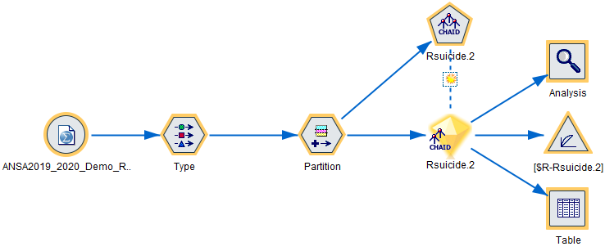
Building the modelling algorithms

Slide 23
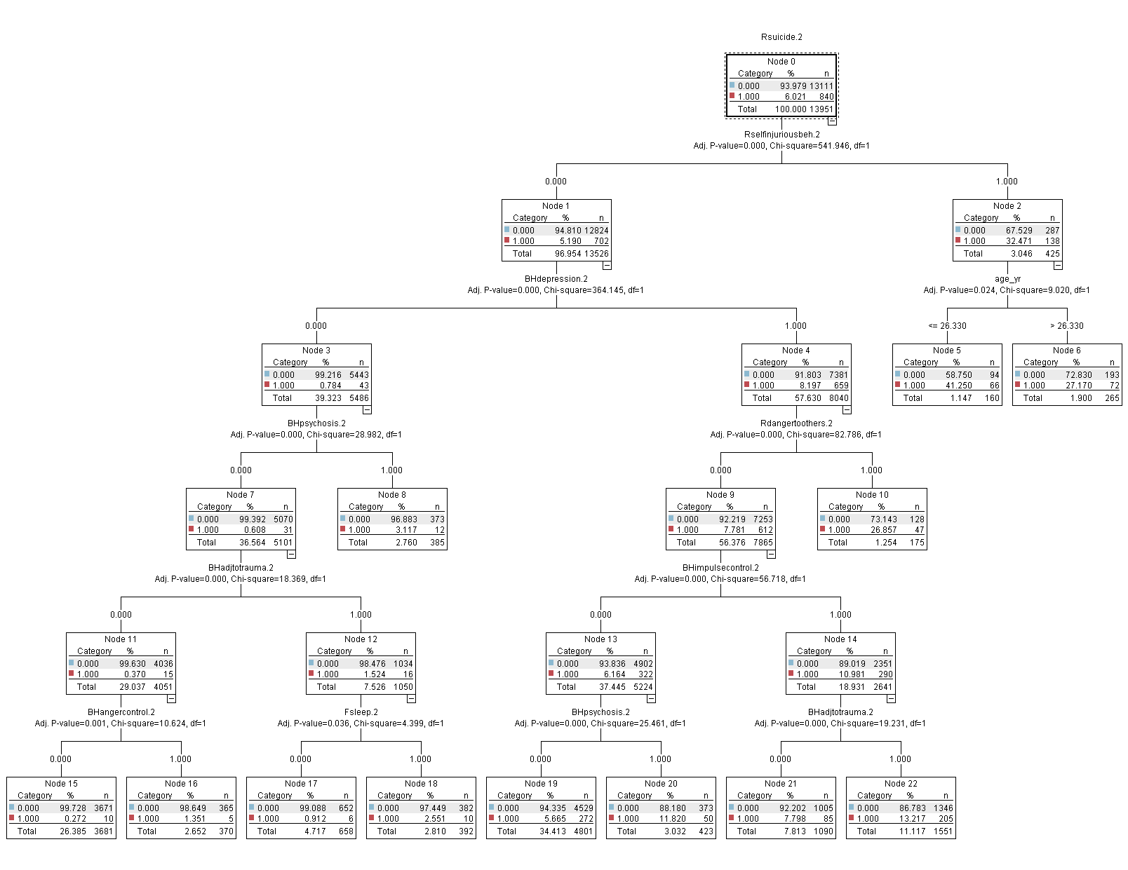
2020: CHAID Decision Tree

Slide 24
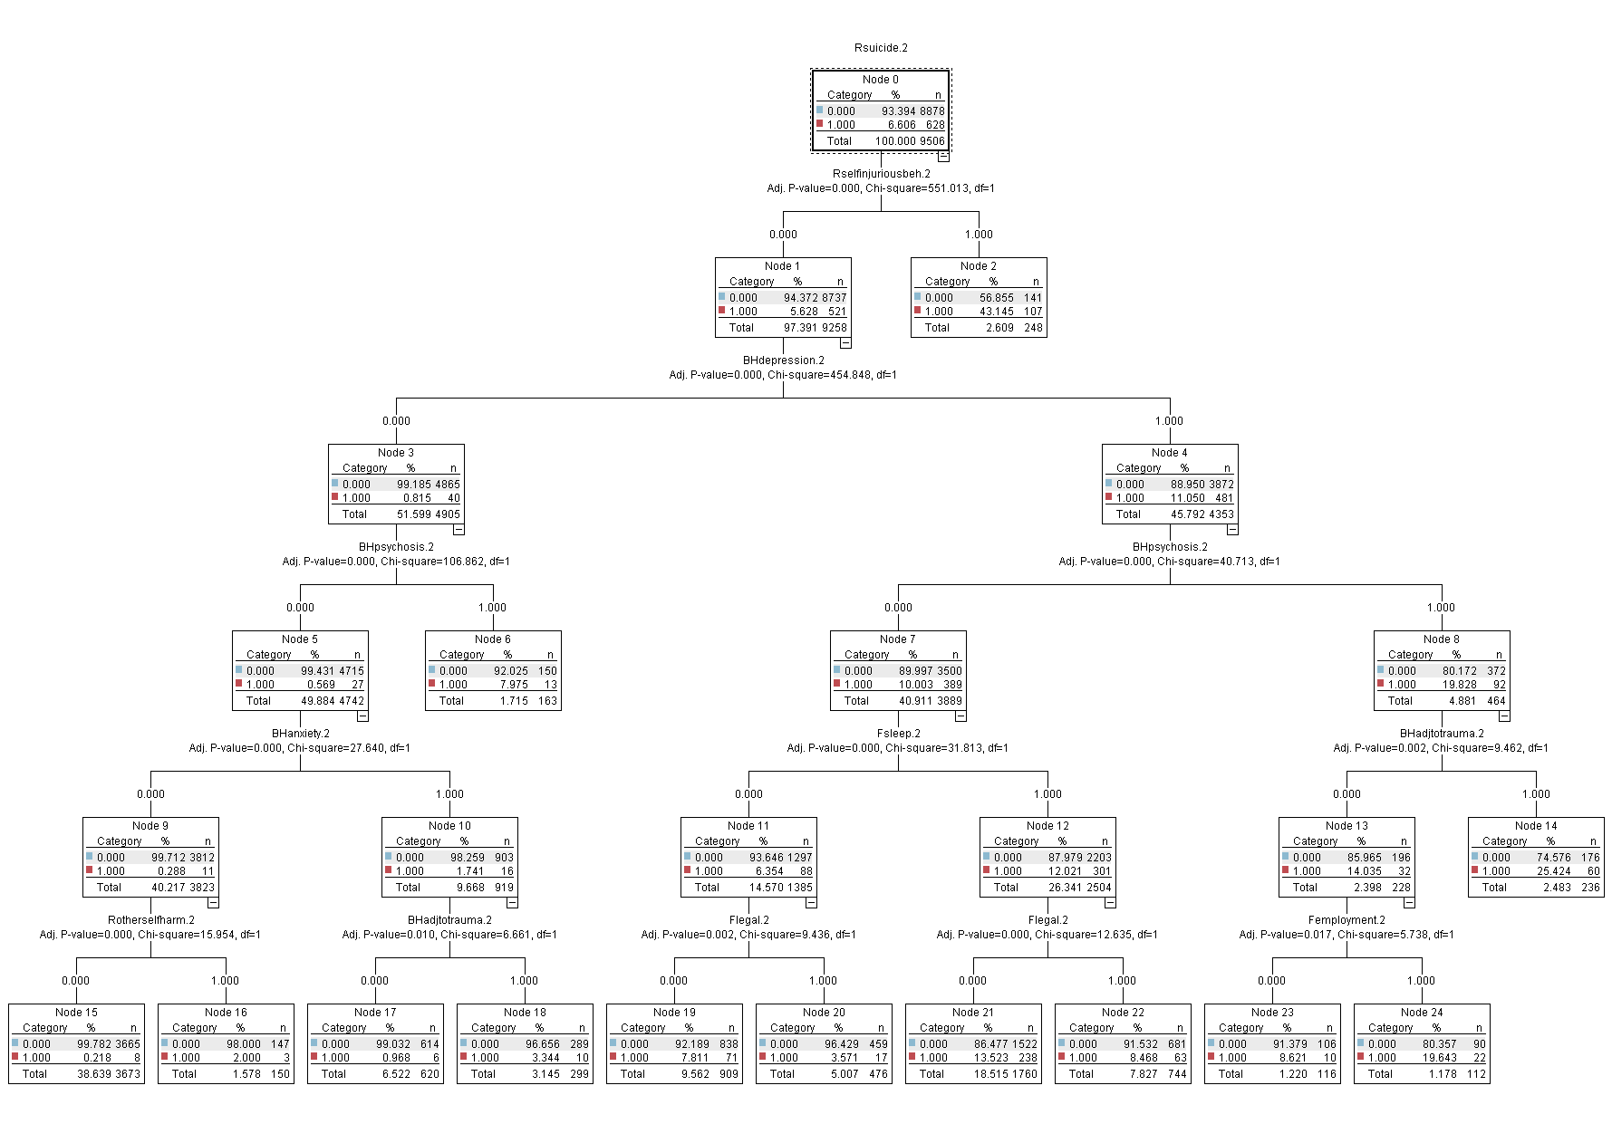
2019: CHAID Decision Tree

Slide 25
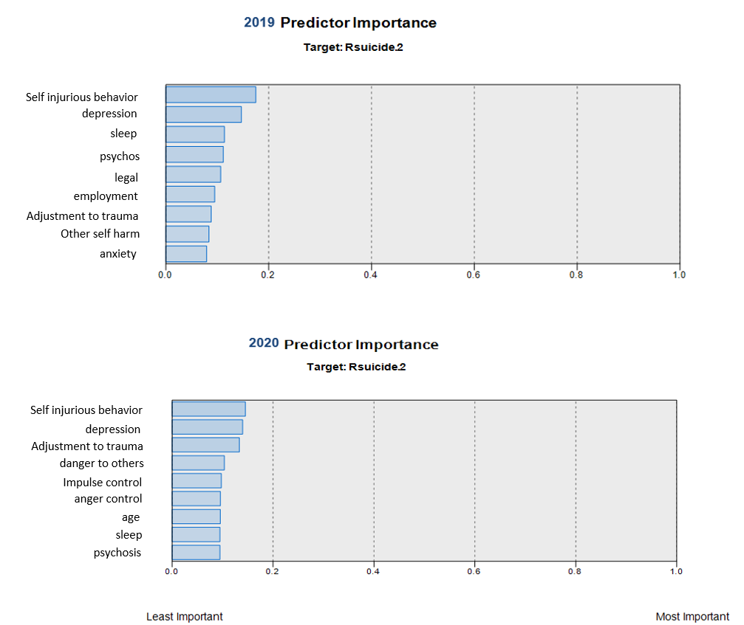
Predictor Importance Charts: 2019 vs. 2020

Slide 26
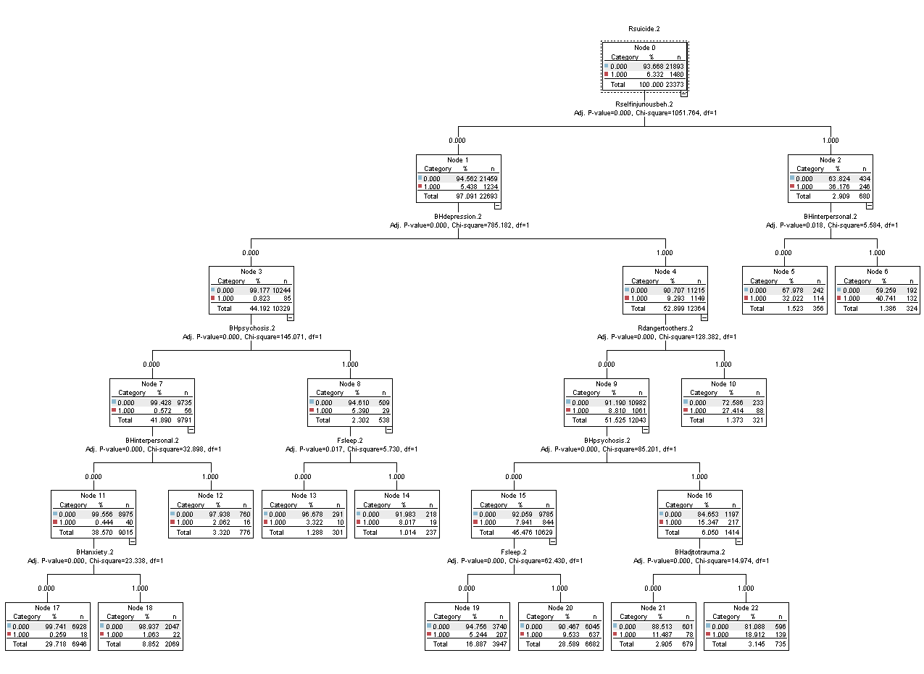
Overall CHAID Decision Tree

Slide 27
Node | Predictions | Suicidal Risk | Probability | Population
6 | If (Rselfinjuriousbeh.2: Yes) and (BHinterpersonal.2: Yes) | Yes | 40.74 | 132
5 | If (Rselfinjuriousbeh.2: Yes) and (BHinterpersonal.2: No) | Yes | 32.02 | 114
10 | If (Rselfinjuriousbeh.2: No) and (BHdepression.2: Yes) and (Rdangertoothers.2: Yes) | Yes | 27.41 | 88
22 | If (Rselfinjuriousbeh.2: No) and (BHdepression.2: Yes) and (Rdangertoothers.2: No) and (BHpsychosis.2: Yes) and (Bhadjusttotrauma.2: Yes) | Yes | 18.91 | 139
21 | If (Rselfinjuriousbeh.2: No) and (BHdepression.2: Yes) and (Rdangertoothers.2: No) and (BHpsychosis.2: Yes) and (Bhadjusttotrauma.2: No) | Yes | 11.49 | 78
20 | If (Rselfinjuriousbeh.2: No) and (BHdepression.2: Yes) and (Rdangertoothers.2: No) and (BHpsychosis.2: No) and (Fsleep.2: Yes) | Yes | 9.53 | 637
19 | If (Rselfinjuriousbeh.2: No) and (BHdepression.2: Yes) and (Rdangertoothers.2: No) and (BHpsychosis.2: No) and (Fsleep.2: Yes) | Yes | 5.24 | 207
14 | If (Rselfinjuriousbeh.2: No) and (BHdepression.2:No) and (BHpsychosis.2: Yes) and (Fsleep.2: Yes) | Yes | 8.02 | 19
13 | If (Rselfinjuriousbeh.2: No) and (BHdepression.2:No) and (BHpsychosis.2: Yes) and (Fsleep.2:No) | Yes | 3.32 | 10
12 | If (Rselfinjuriousbeh.2: No) and (BHdepression.2:No) and (BHpsychosis.2:No) and (BHinterpersonal.2:Yes) | Yes | 2.06 | 16
18 | If (Rselfinjuriousbeh.2: No) and (BHdepression.2:No) and (BHpsychosis.2:No) and (BHinterpersonal.2:No) and (Bhanxiety.2: Yes) | Yes | 1.08 | 22
17 | If (Rselfinjuriousbeh.2: No) and (BHdepression.2:No) and (BHpsychosis.2:No) and (BHinterpersonal.2:No) and (Bhanxiety.2: No) | Yes | 0.26 | 18
Overall Predictions of At risk for Suicide

Slide 28
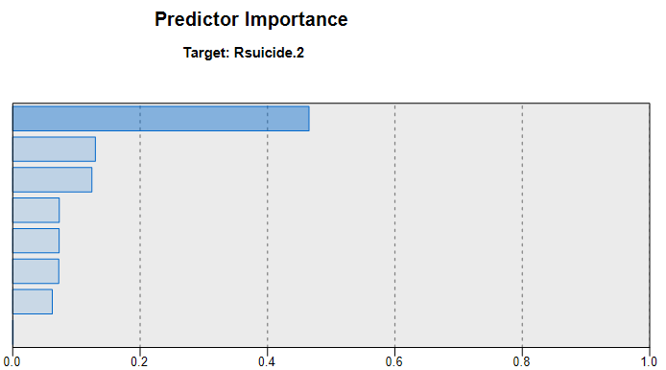
Overall Predictor Importance Chart
Self injurious behavior
depression
danger to others
psychosis
adjustment to trauma
anxiety
sleep
interpersonal

Slide 29
In the Pandemic year, self-injurious behavior, depression, adjustment to trauma, danger to others, impulse control, anger control, age, sleep, and psychosis were identified as the critical factors associated with suicidal risk.
Danger to others, impulse control, anger control, and age were associated with suicide risk only in 2020, but not in 2019.
Legal and employment were not shown in the 2020 suicidal risk chart, while they were identified in 2019.
Overall, self-injurious behavior, depression, danger to others, psychosis, adjustment to trauma, anxiety, sleep, and interpersonal were intersected with suicidal risk.
Results

Slide 30
Suicidal Prevention/Recovery Model

Slide 31
Suicide prevention/recovery (Suicide Prevention Resource Center, 2021)
Identify and Assist
Respond to Crisis
Life Skills and Resilience
Effective Care/Treatment
Care Transitions/Linkage
Connectedness
Notes:
This model of suicide prevention above was drawing on the U.S. Air Force Suicide Prevention Program.
Based on that, Effective suicide prevention models should include the following key components:
Identify and assist persons at risk for suicide
Respond effectively to individuals in crisis
Enhance life skills and resilience
Ensure access to Effective mental health care and treatment for suicidal risk
Support safe care transitions and create organizational linkage
Promote social connectedness and support.
https://www.sprc.org/effective-prevention/comprehensive-approach
https://www.sprc.org/comprehensive-approach/identify-assist
https://www.cdc.gov/suicide/strategy/
Download the Suicide Prevention Strategic Plan pdf icon[PDF – 266 KB]
Download the Suicide Prevention Strategic Plan Overview pdf icon[PDF – 185 KB]
Read more about CDC’s Research Priorities in Suicide Prevention pdf icon[PDF – 3 pages]

Slide 32
Implications for Practice
Identifying behavioral health needs among adults with suicide risk
1
Addressing an array of intersections of suicidal risk and mental health
2
Providing a care plan following by TCOM philosophy
3
Monitoring and resolving behavioral health needs among adults with suicide risk
4
Notes:
From the practical point of view in the ANSA , we can suggest identifying mental health needs, addressing an array of intersections of mental health needs and suicidal risk.
We can, then, provide a care plan and monitor and resolve mental health needs among adults at risk for suicide.
https://www.sprc.org/comprehensive-approach/identify-assist

Slide 33
Suicide prevention/recovery: ANSA
Notes:
Based on the decision tree algorithms identified in the Indiana study, suicide prevention programs should consider the intersection of Self-injurious behavior, depression, danger to others, psychosis, adjustment to trauma, anxiety, sleep, and interpersonal problems.

Slide 34
Discussion

Slide 35
What challenges and achievements of suicide prevention have you experienced?
Any suggestions to overcome those challenges?
Notes:
Open it for Discussion and any Questions about this study.

Slide 36

Notes:
Open it for Discussion and any Questions about this study.

Slide 37


Acknowledgement
This study was developed through a collaborative effort
by the
IU School of Social Work
and
DMHA

Slide 38
Reference
Centers for Disease Control and Prevention (CDC) (2021). WISQARS Leading Causes of Death Reports, 1981-2019. Available from https://webappa.cdc.gov/sasweb/ncipc/leadcause.html.
Garcia-Ceja, E., Riegler, M., Nordgreen, T., Jakobsen, P., Oedegaard, K. J., & Tørresen, J. (2018). Mental health monitoring with multimodal sensing and machine learning: A survey. Pervasive and Mobile Computing, 51, 1-26.
Gunnell, D., Appleby, L., Arensman, E., Hawton, K., John, A., Kapur, N., ... & Yip, P. S. (2020). Suicide risk and prevention during the COVID-19 pandemic. The Lancet Psychiatry, 7(6), 468-471.
Hedegaard, H., & Warner, M. (2021). Suicide mortality in the United States, 1999-2019.
Hegerl U. (2016). Prevention of suicidal behavior. Dialogues in clinical neuroscience, 18(2), 183–190.
Substance Abuse and Mental Health Services Administration (SAMHSA)(2020). Key substance use and mental health indicators in the United States: Results from the 2019 National Survey on Drug Use and Health (HHS Publication No. PEP20-07-01-001, NSDUH Series H-55). Rockville, MD: Center for Behavioral Health Statistics and Quality, Substance Abuse and Mental Health Services Administration. Retrieved from https://www.samhsa.gov/data/
Suicide Prevention Resource Center (2021). Suicide prevention/recovery. Available from https://www.sprc.org/comprehensive-approach/identify-assist
Tate, A. E., McCabe, R. C., Larsson, H., Lundström, S., Lichtenstein, P., & Kuja-Halkola, R. (2020). Predicting mental health problems in adolescence using machine learning techniques. PloS one, 15(4), e0230389.

Slide 39
Contact Information
Saahoon Hong, Ph.D.
Assistant Research Professor
Indiana University School of Social Work
saahong@iu.edu
Betty Walton, Ph.D.
Associate Research Professor
Indiana University School of Social Work
beawalto@iu.edu
Hea-Won Kim, PhD
Associate Professor
Indiana University School of Social Work
heakim@iupui.edu
INDIANA UNIVERSITY SCHOOL OF SOCIAL WORK

