Slide 1
Text KMACY731 once to 22333 to join, then text your message
Or respond at PollEv.com/kmacy731
How do you feel about negotiations?
Respond as many times as you like.

Slide 2
NEGOTIATE LIKE AN MBA
How to conduct principled negotiations for library resources

Slide 3
YOUR EXPERIENCES
1
Think – Pair – Share
Poll Everywhere
Notes:
Turn a person near you and share your experiences with negotiation. How did you learn to negotiate? What challenges have you faced when negotiating (internal and external)
Ask the group to share some thoughts
Share the Poll
Level set – how this workshop will address issues identified in opening discussion

Slide 4
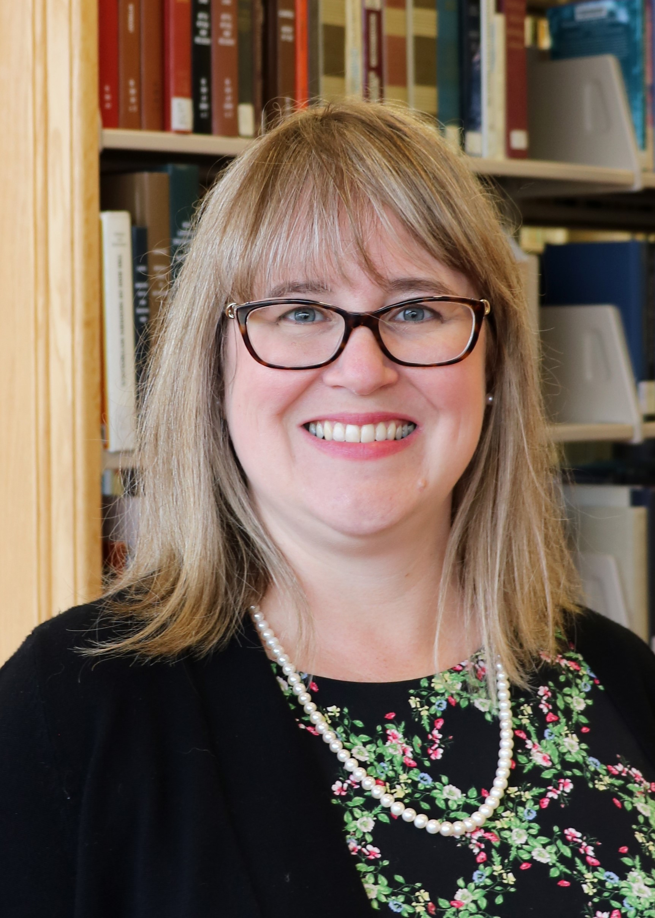
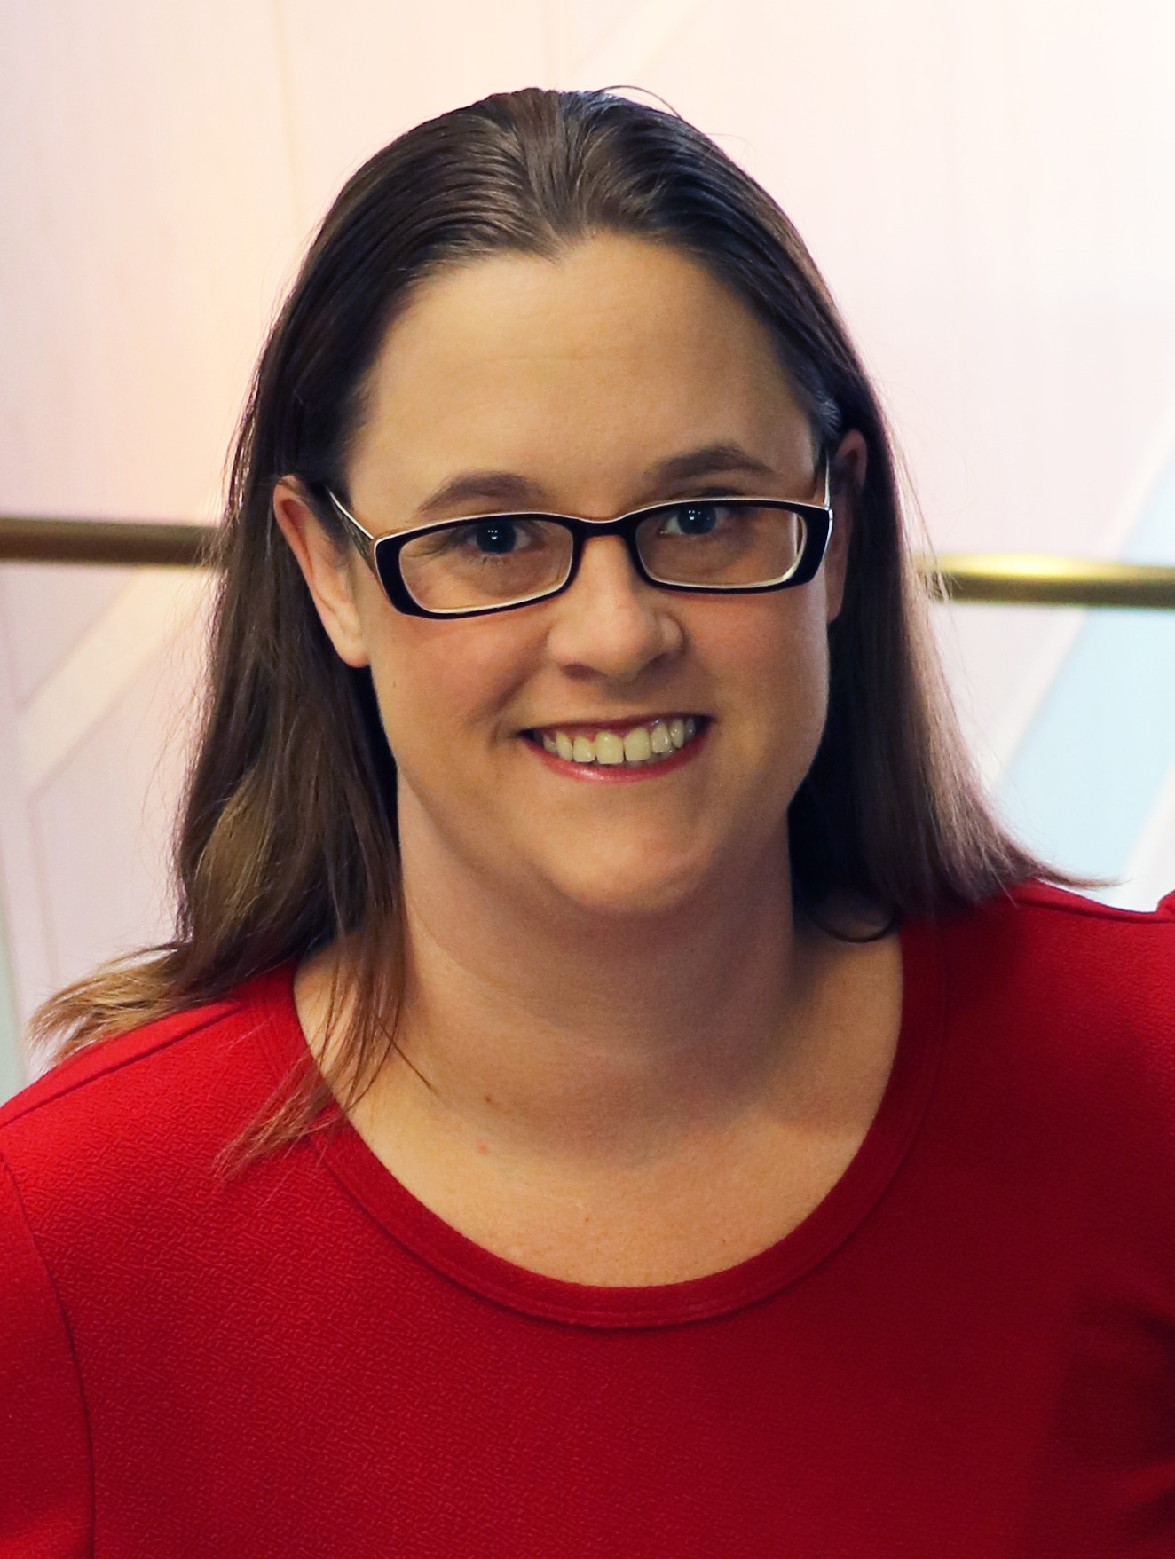
macyk@iupui.edu; Twitter: @kvmacy
ORCID https://orcid.org/0000-0002-6283-7143
Katharine V. Macy, MBA, MLIS
Collection Assessment Librarian,
IUPUI University Library
Caitlin Pike MLIS, MPH
Research Engagement & Scholarly Communications Coordinator, IUPUI University Library
caiapike@iupui.edu; Twitter: @libris_fidelis
ORCID https://orcid.org/0000-0002-5758-1737

Slide 5
PRINCIPLED NEGOTIATIONS
2
Striving for Mutual Gain

Slide 6
TYPES OF NEGOTIATORS – Two Traditional Roles
SOFT
Focuses on position
“Friends”
Values agreement
More likely to make concessions to avoid conflict
Yields to pressure
Too much trust
HARD
Focuses on position
Adversaries
Needs to “win”
Demands concessions to maintain relationship
Applies pressure
Distrustful
Fisher, R., Ury, W., & Patton, B. (1991). Getting to Yes: Negotiating Agreement Without Giving In (2nd ed.). New York: Houghton Mifflin Company.

Slide 7
A Third Way – The Principled Negotiator
PRINCIPLED
Focuses on interests
Relationships based on trust, empathy, and respect.
Sustainability
Not about the money, it’s about the utility!
Allows negotiators to adjust tactics
Fisher, R., Ury, W., & Patton, B. (1991). Getting to Yes: Negotiating Agreement Without Giving In (2nd ed.). New York: Houghton Mifflin Company.

Slide 8
PRINCIPLED NEGOTIATORS
“Problem-solvers seeking a win/win situation…Hard on the issues, but soft on the approach to people”
Crawford, A. R. (2008). Licensing and Negotiations for Electronic Content. Resource Sharing & Information Networks, 19(1/2), 15–38. https://doi.org/10.1080/07377790802498523

Slide 9
FOUR ELEMENTS OF PRINCIPLED NEGOTIATION (FISHER, 2011)
People | Separate the people from the problem
Interests | Focus on interests, not positions
Options | Invent multiple options looking for mutual gains before deciding what to do
Criteria | Insist that the result be based on some objective standard
Fisher, R., Ury, W., & Patton, B. (1991). Getting to Yes: Negotiating Agreement Without Giving In (2nd ed.). New York: Houghton Mifflin Company.

Slide 10
STRUCTURE OF NEGOTIATIONS
3
MOST OF THE WORK GOES INTO PHASE 1!

Slide 11
STRUCTURE OF NEGOTATIONS
Pre-Game
Initiating and maintaining relationships
Preparation for the negotiations
In principled negotiations, this is where the most time is spent!
Game
The negotiation
Plan what strategies you can use during the negotiation in pre-game!
Post-Game
Following up and maintaining relationships
TRUST!
Thompson, L. (2008). The truth about negotiations. New Jersey: FT Press.

Slide 12
PRE-GAME
2
The bulk of the effort!

Slide 13
PRE-GAME PROCESS
Build & maintain relationships – Trust!
Collect & analyze data
Plan your negotiation strategies

Slide 14

PREPARATION THAT DOES NOT WORK!
Psyching up!
It makes the negotiation more personal and makes the focus positional.
Image by rubyblossom
Thompson, L. (2008). The truth about negotiations. New Jersey: FT Press.
Notes:
Whether or not you succeed becomes your identity!

Slide 15
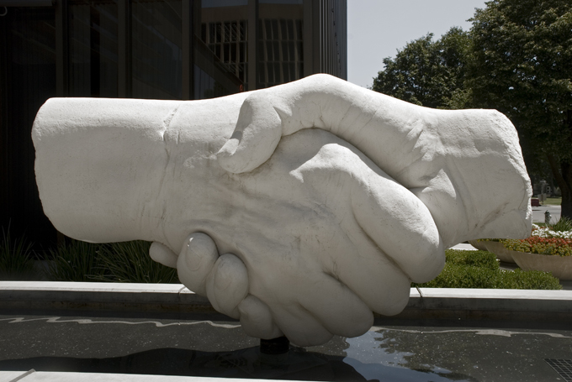
PREPARATION THAT DOES WORK
Planning that considers both parties’ interests
Image by Nicola Barnett

Slide 16
Own Your Terms
Negotiation Planning Vocabulary
Notes:
Pun intended

Slide 17
BATNA
Best Alternative to Negotiated Agreement
Notes:
What you would do if you fail to reach a negotiated agreement.
Cancel
Resubscribe, but look for later alternatives
Look for another car, job, etc.
During the negotiation you don’t want to reveal your BATNA (unless you have absolutely reached an impass) but you can signal at your BATNA. Don’t lie about your BATNA. I you say you walk away point is X but it is really Z and they talk you down to Z you will have a difficult time in future negotiations. The other party may ask about your walk away point – divert them away from this by emphasizing you are negotiating for the entire value of the package which can include other things such as support, authorized user access, removing NDAs, fixing price increases, etc.
BATNA can change over time. One year you may choose to resubscribe, but if a deal goes south the vendor has to know you will be looking for alternatives.
Open Access, PDA, and AOD is allowing libraries to change their BATNAs
Be careful to not reveal this early, if at all.
Don’t just determine your own BATNA, research your other party’s. Are subscriptions down, sales flat, are there new competitive products….

Slide 18
Reservation Price
$
The bottom line, the point in the negotiation where you can go either way. Informed by the BATNA.

Slide 19
ZOPA
Zone of Possible Agreement
$10,000
Min
Seller
$12,500
Max Buyer
Spangler, B. (2003). Zone of Possible Agreement (ZOPA). In Beyond Intractability. Retrieved from http://www.beyondintractability.org/essay/zopa
Notes:
The overlap between the reservation price of both parties. During the negotiation you are trying to determine the ZOPA.

Slide 20
CONCESSIONS
What you are willing to give up
Notes:
Plan carefully, or you risk giving up too much. Be sure to fully explore the interests.

Slide 21
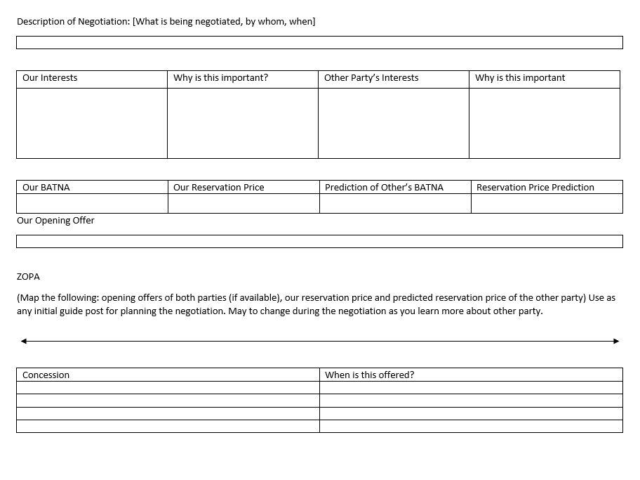
Negotiation Worksheet
Helpful guide for preparing for any type of negotiation

Slide 22
PLANNING YOUR NEGOTIATION
Internal review – Determining your interests
Price sensitivity to the resource
Licensing requirements
  Library policy
  University policy
Other considerations
  Accessibility

Slide 23
PRICE SENSITIVITY
The extent to which buyers are sensitive to price increases.
Porter, M. E. (2008), “The five competitive forces that shape strategy”, Harvard Business Review, Vol. 86 No. 1, pp. 78–93.

Slide 24
PRICE SENSITIVITY FACTOR METRICS
Price Sensitivity Factor | Metric
Proportion of total cost | Portion of spend
The level of differentiation between products | Content coverage (i.e. overlaps, uniqueness)
The importance of product/service to the buyer for offering a quality service or product to their own customers | Cost per use Cost per citation Stakeholder use in research or teaching (curriculum) Uniqueness within the collection Consortia agreements
The level of competition among end users (customers) | Competitive products Substitutes
Notes:
The first factor is the proportion of total cost this can be determined by understanding a resource’s portion of the total collection spend.
The second factor is the level of differentiation between products. This is where understanding a resources content coverage, how it overlaps or is unique, is helpful.
The third factor is the importance of a product/service to the buyer for offering a quality service or product to their own customers. So this is about how important is the resource we are buying for us to be able to serve our patrons. Metrics that helps us understand this factor are cost/use, cost per citation, stakeholder use in research or teaching (curriculum), uniqueness within the collection or in the world (archives), and consortia agreements.
The final factor is the level of competition among end users (customers). This is the hardest one for many to wrap their arms around. A good example is the encyclopedia market. A competitive product from recent years is Wikipedia, which is gaining our users attention and completely diverting users from using library services for this type of information. Another example is users getting news information from Twitter or Facebook as opposed to traditional sources. Understanding competitive products and substitutes that our patrons may use in or outside the library to meet an information need helps us understand this factor.

Slide 25

LICENSING REQUIREMENTS - EXAMPLES
AUTHORIZED USE / RESTRICTIONS
How the database may be used. Often specifies not for commercial purposes.
PRICING AND TERM
May also include information on renewal and pricing at renewal. May include clauses to fix price increases.
TERMINATION
Clause specifies how vendor may terminate the contract if customer is in violation. It is in the customer’s best interest to be well defined.
👪
AUTHORIZED USERS
This includes specifying whether walk-ins have access to the resource.
NDAs/ CONFIDENTIALITY
Non-disclosure agreements on pricing. Vendors often want these, while libraries do not.
Other Terms
Product updates, Performance, Payment, Force Majeure, Applicable Law, Dispute Resolution, Indemnification, Entire Understanding, Amendment, Enforceability, Severability
Crawford, A. R. (2008). Licensing and Negotiations for Electronic Content. Resource Sharing & Information Networks, 19(1/2), 15–38. https://doi.org/10.1080/07377790802498523

Slide 26
PLANNING YOUR NEGOTIATION
External review– Determine their interests
Financials
News & rumors
Competitive offerings (content and pricing)
Opening available pricing data
Price other acquisition models for content (e.g. on demand)

Slide 27
KNOW YOUR POWER POSITION IN THE DEAL
Who is the target customer of the resource?
  Academic Resource vs Professional Practice
Can you benefit from consortia agreements?
  Agreements should increase your relative bargaining power
What are your alternatives?
  BATNA
  Competitive Landscape
What goals does this purchase help you achieve?
What values does it support?

Slide 28
Pre-Game When You Have Little Time
Identify Goals
Goals should reflect interests and explain why it’s important.
Brainstorm Options
What are your alternatives?
Plan Opening Move
Helps anchor your negotiation.
The why helps create solutions during negotiations.
What are deal breakers vs deal makers?
Represents ideal situation.
Thompson, L. (2008). The truth about negotiations. New Jersey: FT Press.

Slide 29
THE GAME
2
Strategies to use during negotiations

Slide 30
FIRST OFFERS – ANCHORS YOUR POSITION
Your ideal offer that outlines
Price / Price Increases
Term
License Terms
Other (Support, Accessibility, Training)
Often vendors make first offer, trying to anchor changes in their favor. Libraries should determine value and derive a counteroffer when this happens. Or, when appropriate, be proactive by submitting a first offer based on determined value to the vendor.
Example: VIVA (Virginia’s Academic Library Consortium)

Slide 31
FRAMING
Plan carefully how you frame
Offers and counter offers
Concessions
Decisions can be framed as a win or a loss.
Remember humans are risk averse.

Slide 32
NEGOTIATE ISSUES SIMULATANEOUSLY, NOT SEQUENTIALLY
The value of a deal is not just monetary
If you need to negotiate terms beyond pricing it’s best to do it simultaneously
Start with your ideal offer – where you win it all, knowing you will likely need to make concessions.
Plan concessions carefully and don’t reveal too early.
Thompson, L. (2008). The truth about negotiations. New Jersey: FT Press.

Slide 33
MAKE MULTIPLE OFFERS OF EQUIVALENT VALUE SIMULTANEOUSLY
Example
Willing to sign a 3-year contract
Determine value of contract with fixed price increase, fixed price per year, and pay all three years up front.
Determine what license concession you wish from the vendor depending on pricing agreement.
Thompson, L. (2008). The truth about negotiations. New Jersey: FT Press.

Slide 34
TRUST DURING THE GAME!
FOUR KINDS OF REPUTATION
Liar-Manipulator
Tough-but-Honest
Nice and Reasonable
Cream Puff
Relationships are important!
Thompson, L. (2008). The truth about negotiations. New Jersey: FT Press.

Slide 35
POST-GAME
2
Maintaining trust
Notes:
Cement the deal, perhaps with an email that outlines the conversation, while you wait for a contract.
If the deal goes your way don’t gloat. If it doesn’t go your way remain cordial and don’t act out. Unless you are willing to burn that bridge and potentially other bridges.
Just a sidenote on timely response after the deal: remember you are negotiating with people whose performance and compensation is tied to their activity, so if you may an agreement in April/early May it is important to get agreements signed and perhaps make payment if appropriate before the end of that quarter as a good faith effort for your rep.

Slide 36
SUGGESTED DATABASES FOR RESEARCHING VENDORS
Bloomberg
Hoovers
Mergent Online
Factiva
Orbis
Privco
S&P Global Capital IQ or S&P Global Netadvantage
Article databases: ProQuest Central, Business Source Complete

Slide 37
LARGE GROUP CASE STUDY
Review Case Study (15 minutes)
Small Group Discussion (20 minutes)
Large Group Consensus (15 minutes)

Slide 38
BREAK
15 MINUTES

Slide 39
WATCHING THE GAME
Fish bowl activity & debrief

Slide 40
SMALL GROUP CASE STUDY
Small Groups (2-3 people)
  Groups that prep library: A,B,C,D
  Groups that prep vendor: E,F,G,H
30 minutes prep time
20 minutes negotiations
  A/E
  B/F
  C/G
  D/H
  Assign a chief negotiator but feel free to integrate more than one person during the negotiation. If negotiating feels uncomfortable, I encourage you to take this role.
  Those not actively negotiating, take notes.
Notes:
Break out of your comfort zone

Slide 41
Break
10 minute break then meet with your small group pairings

Slide 42
SMALL GROUP DISCUSSION
Were you able to find agreement? Why or why not?
Notetakers: What did each side do well?
Chief Negotiators: What seemed easier than expected? Difficult? Uncomfortable?
What would you approach differently?

Slide 43
LARGE GROUP DISCUSSION
Case 2
Best Practices in Libraries
Resources
Q&A
Evaluations

Slide 44
CREDITS
Special thanks to all the people who made and released these awesome resources for free:
Presentation template by SlidesCarnival

