Slide 1
Safe Spaces in Tech & Higher Education
Alice Jones• Amanda Bonilla

Slide 2
Messages I have heard about my sexual orientation….
Pair up with someone you haven’t talked with yet. (10 minutes, 5 minutes each)
    Answer the questions provided
    How does this process feel? What came up for you during this activity?

Slide 3

LANGUAGE MATTERS
When working with LGBT students, it is often difficult to understand the language that they use to identify themselves and each other. Understand first and foremost that language will change with the culture.

Slide 4
Terminology

Slide 5
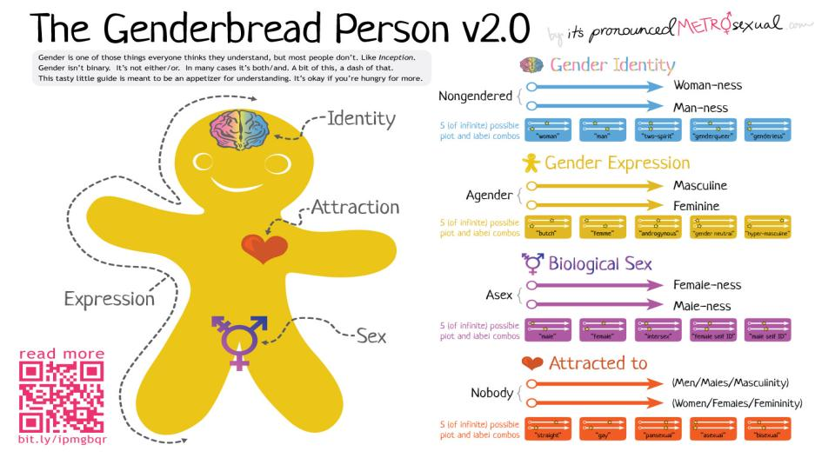
A Guide to Gender:

Slide 6
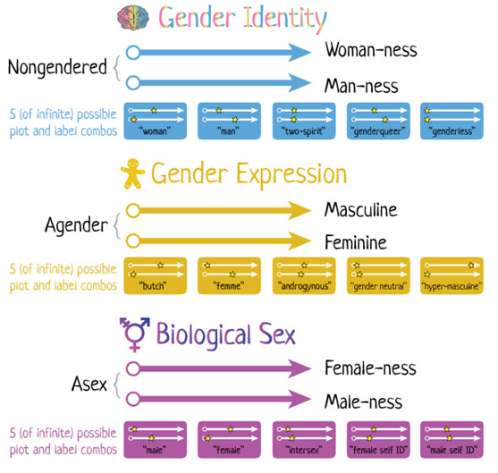

Slide 7
Pyramid of Alliance
ALLIANCE
Commitment to Change
(Monetary Aide,
Job Choice,
Organizations, Education)
Initial Acts of Alliance
(Interrupt Jokes, Provide Information,
Speak up)

Slide 8
What is Allyship

Slide 9
Action Plan
Level 1
  Level 2
    Level 3
      Level 4

Slide 10
Closing: People as Safe Spaces

Slide 11
Help Us Improve and Grow
Thank you for participating
in today’s session.
We’re very interested in your feedback. Please take
a minute to fill out the session evaluation found within
the conference mobile app, or the online agenda.

