Slide 1

CREATING ADVANTAGE
When you feel you have little power
How to Read a Contract Webinar Library Futures / Authors Alliance / SPARC March 13, 2024 at 1pm EDT

Slide 2

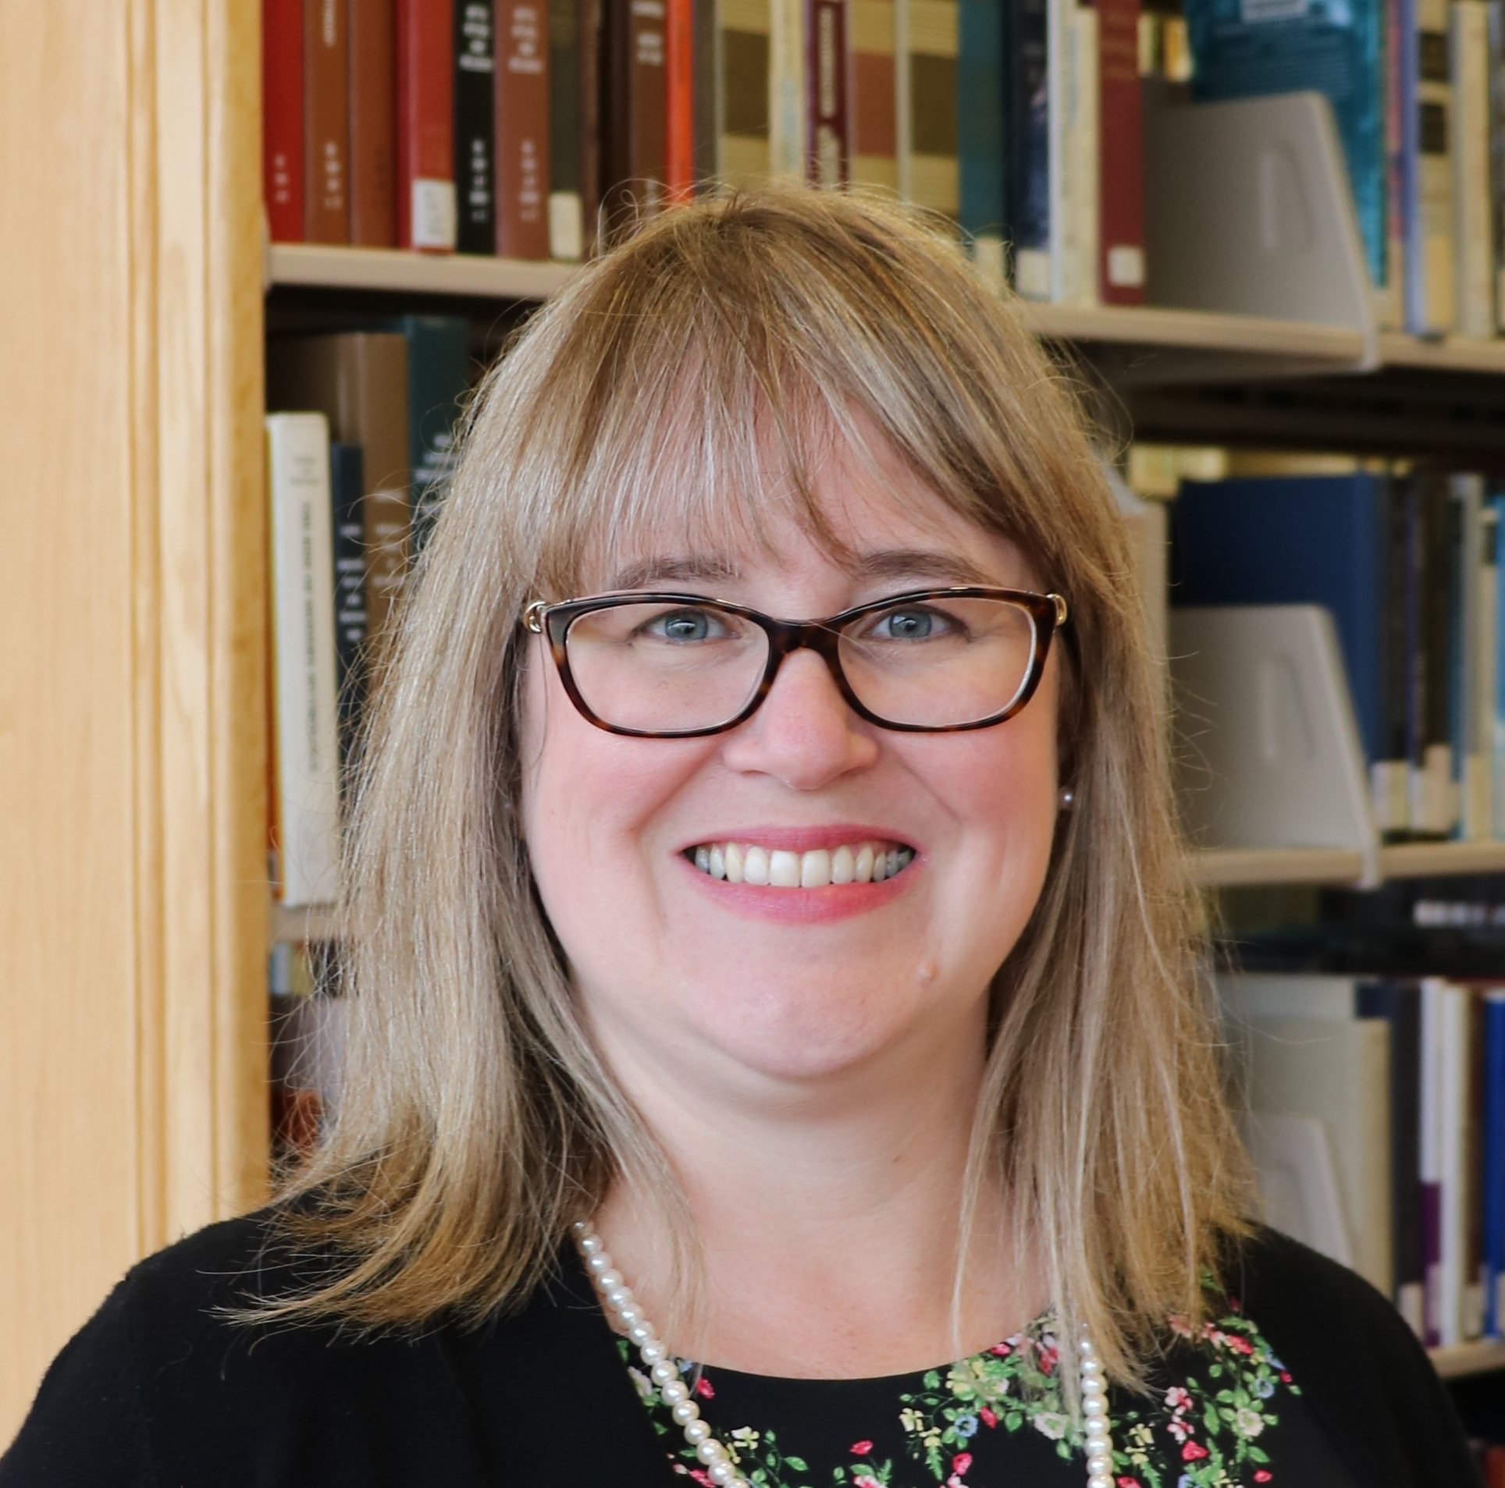
WHO AM I?
the ONEAL project
(Open Negotiation Education for Academic Libraries)
https://oneal-project.org/
KATHARINE V. MACY
Project Director of the ONEAL Project Collection Assessment Librarian
Indiana University – Indianapolis (IUPUI)
macyk@iu.edu

Slide 3

--Schaerer, M., Schweinsberg, M., & Swaab, R. I. (2018).
Negotiators with stronger alternatives set higher aspirations (Pinkley et al., 1994; Wong, 2014), demand more from their opponent (de Dreu, 1995), and behave more agentically to achieve their goals (Magee et al., 2007). “

Slide 4

Help my BATNA is weak!
Strategies for improving creating advantage during your contract negotiation
Notes:
BATNA = Best Alternative to A Negotiated Agreement

Slide 5


MENTAL SIMULATION
Imagine you have a strong alternative. What would you ask for? How would you restructure your initial offer or your counter offer? Center yourself there.
The research has shown that you may have to come down, but this will set your start point higher and result in a more positive outcome than if you started with a weak BATNA anchoring what you feel like you can ask for.
Schaerer, M., Schweinsberg, M., & Swaab, R. I. (2018).

Slide 6


IF-THEN SCENARIO PLANNING
Outline scenarios that could occur and how you will react. This can include reacting to negative behaviors, responding to claims and retorts from the vendor, and knowing how you will adjust based on tactics.
Jäger, A., Loschelder, D. D., & Friese, M. (2017).

Slide 7
RESOURCES
SPARC CONTRACTS LIBRARY
LIBLICENSE
ONEAL DISCORD
https://sparcopen.org/our-work/big-deal-knowledge-base/contracts-library/
Moderated forum for library workers wishing to discuss negotiations
https://oneal-project.org/discord/
Licensing information, resources, discussion forum
https://liblicense.crl.edu

Slide 8
ONE LAST TIP FOR LIBRARY LEADERS…
Always before signing a negotiated license double check that nothing has changed with the business terms in the agreement while you were negotiating the other licensing terms.
Check pricing, price increase, agreement term (time period), renewal, and termination clauses
This advice is based on a cautionary tale shared with us at ONEAL.

Slide 9


ONEAL FOUNDATIONS LAUNCH LATE MARCH
CONTRACTS & LICENSING
NEGOTIATION STRATEGY
INTERNAL ANALYSIS
Common issues in contracts and licensing
Research-based best practices
Understanding your own data in negotiation planning tem
INTRO TO NEGOTIATIONS
VENDOR RESEARCH
ACCESSIBILITY
Negotiation anxiety, business relationships, principled negotiation
Finding and understanding vendor financial information
Advocating for accessibility with vendors

Slide 10

THANKS
Join our mailing list and we’ll email Foundations Module launches
https://forms.gle/nw9bxqsxehxPTFoL8

