Slide 1
So you’re new to library publishing…
Me too!
Rachel Molina,
IU Indianapolis

Slide 2
My librarian journey
Diving directly into the deep end
Graduated with a B.A. in Fine Art, with the intention of becoming a book illustrator
Started graduate school for MLIS after working for a few years
Graduated with MLIS in May 2024
First library job as Open Publishing and Repository Librarian in November 2024
First job as a tenure-track faculty member as well as first library job in general
Only basic understanding of library publishing coming in
Notes:
Let’s start with a brief introduction to my librarian journey. I originally graduated with my bachelor’s in fine art with the intention of becoming a book illustrator. After floating around for a few years in various administrative roles, I decided to follow the path of other millennials who don’t know what to do next and enroll in grad school. I had some friends from undergrad who ended up in library work and they all loved it, and I had always been a big book person so I decided to get my MLIS. I graduated with my degree in May 2024 and began my job search, hoping to get a position on the IU Indy campus since I’d been working here already for about 6 years. I accepted my current position as the open publishing and repository librarian in November 2024, my first library position as well as my first experience being in a tenure track position. While I am coming right out of library school, I have basically no working experience in library publishing. Luckily my coworkers have been amazing at bringing me up to speed and helping me learn the ropes, and I’m very grateful for them in that regard. However, I wanted to do this chat because there’s nothing quite like being able to talk about your experiences with other people who are also new.

Slide 3

What brought you to library publishing?
Please take some time to share your library journey in the chat!
Notes:
So that’s my story! Now it’s time to share yours- please take a couple minutes and add how you found your way to library publishing in the chat.

Slide 4
Format of Chat
Three main questions that can be answered either by speaking or as text in the chat
  What things did you anticipate about working in library publishing, and how did the actual job differ from your expectations?
  What challenges have come to light since beginning this career?
  What do you wish your colleagues understood about being new in library publishing?
The goal is to make connections with others in similar circumstances. Let’s learn and grow together!
End with time to share positive experiences, triumphs, etc.
Notes:
Now we’ll go over the format of this chat moving forward. I’ve got three main questions that we’ll discuss, and you can feel free to respond either over voice or on the chat. The questions are: what things did you anticipate about working in library publishing, and how did the actual job differ from your expectations? What challenges have come to light since beginning this career? And what do you wish your colleagues understood about being new in library publishing? The goal of this chat is to make connections with others in similar circumstances so we can learn and grow together. We’ll end this chat with some time to share our positive experiences, personal triumphs, and other similar stories.

Slide 5
Question 1
Expectation
What things did you anticipate about working in library publishing, and how did the actual job differ from your expectations?
Reality
Notes:
Please go ahead and share in the chat or feel free to unmute and share via voice.

Slide 6
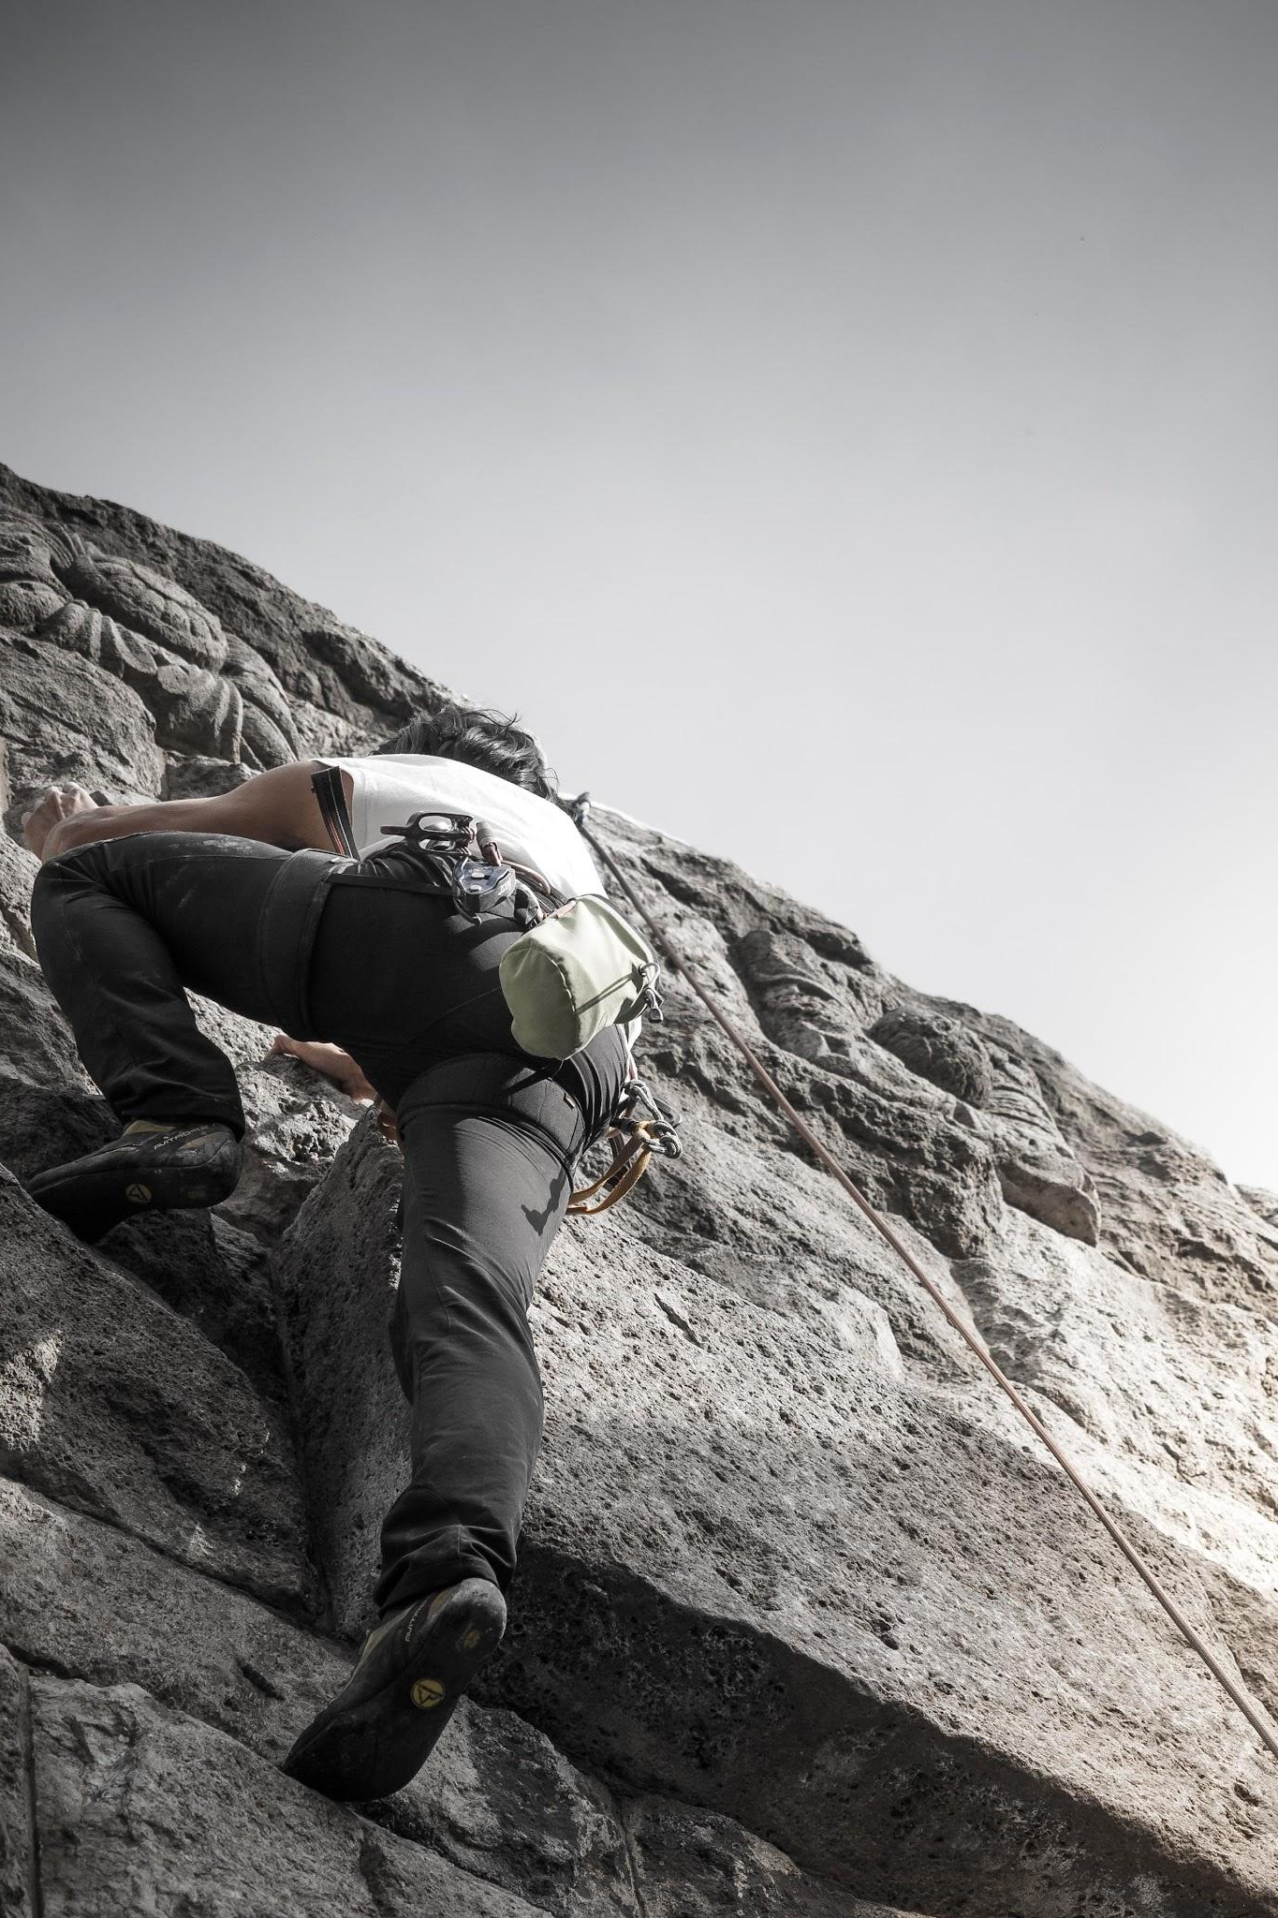
Question 2
What challenges have you faced since entering library publishing?
Notes:
Please go ahead and share in the chat or feel free to unmute and share via voice.

Slide 7

Question 3
What do you wish your colleagues understood about being new to library publishing?
Notes:
Please go ahead and share in the chat or feel free to unmute and share via voice.

Slide 8
Sharing time!
Notes:
That was some great discussion! We’ll move on to the final part of this chat.

Slide 9

You are all stars
R
r
RR
Rr
R
Please share some of your library publishing triumphs! Let’s celebrate our wins together!
Rr
rr
r
Notes:
Remember, you’re all stars! Let’s take some time to share with each other some of our accomplishments since getting into library publishing. Again, please go ahead and share in the chat or feel free to unmute and share via voice.

Slide 10
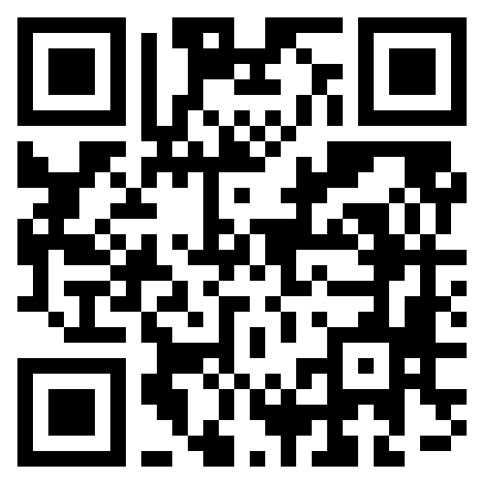
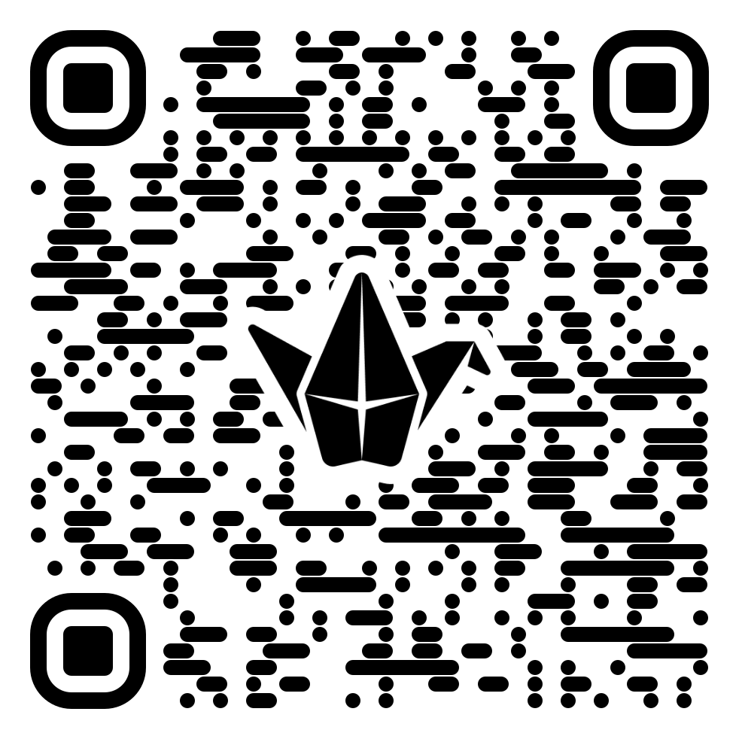
Keep the connections
Let’s find each other again!
1
2
Join the Newbie Librarian Discord server for daily conversation:
Introduce yourself on the presentation Padlet:
Notes:
I’d love if we could keep the connections we’ve made here today, and to help facilitate that I’ve created a couple group spaces for us to use after today. The first is a discord server for new librarians. We’ve already gotten some people in from other servers who are either new librarians in general like me, or are just new to their current role. If you haven’t used discord before, now’s the time to try it out! Along with the discord, I’ve created a padlet for you to share your contact information, if you would like to, post questions about issues you need help with, or otherwise share with each other if discord isn’t your thing. I hope to see you all in either or both places!

Slide 11
Thank
You!

