Slide 1
Diagnosis of vaginal infections using wet mount microscopy in underserved populations
Sam McCarty – MS2

Slide 2
Benefits to Wet Mount Microscopy in the IUSOC
Diagnosis of bacterial vaginosis using wet mount microscopy can allow for treatment plans made in the clinic within one visit
It is a relatively inexpensive diagnostic technique in cases of vaginitis
Common causes of vaginitis like bacterial vaginosis affect underserved populations at high rates compared to the rest of the United States (UptoDate)

Slide 3
Most prevalent causes of vaginitis in the United States
Hillier et al 2019
Bacterial Vaginosis (BV) -- overall prevalence of 29%
Vulvovaginal Candidiasis (VVC) -- overall prevalence of 20%
Trichomonas (TV) -- overall prevalence of 3%
BV, VVC, and TV make up over 90% of vaginal infections in the US (UptoDate)
Also must consider common STIs, including N. Gonorrhoeae and C. trachomatis (UptoDate)

Slide 4
Indications for the use of wet mount microscopy
Vieira-Baptista et al 2021
Used in diagnosis of vaginal infections
Used in evaluation of estrogen status
Used to assess for potential pelvic inflammatory disease

Slide 5
Diagnosing vaginitis
Sobel 2021
Patient History
  Presentations of burning, irritation, abnormal discharge, bleeding, dysuria
Evaluation of vaginal secretions
  pH stick tests: 4-4.5 indicates normal; > 4.5 indicates BV; 5-6 indicates TV
  Wet mount microscopy: visualization of Candidal buds and hyphae, motile trichomonas, clue cells, and increased PMNs.
  KOH whiff test: fishy odor after addition of KOH is indicative of TV
If microscopy results indicate Candida infection, follow up with culture is required

Slide 6
Procedure
Collect swab sample of the wall of the vagina and place swab into test tube with saline
For saline samples: place a drop of sample onto slide
For KOH samples: apply 1 drop of sample and 1 drop of KOH onto slide
  A fishy odor from the sample indicates BV infection
  Wait 3-5 minutes before observing sample under the microscope
Observe slide for WBC, clue cells, candida, and trichomonas
  visualization of trichomonas or candida is indicative of infection
  visualization of >5 WBC per HPF (40x) is indicative of vaginitis
  increased WBC without clue cells indicates other source of infection and need for further workup

Slide 7
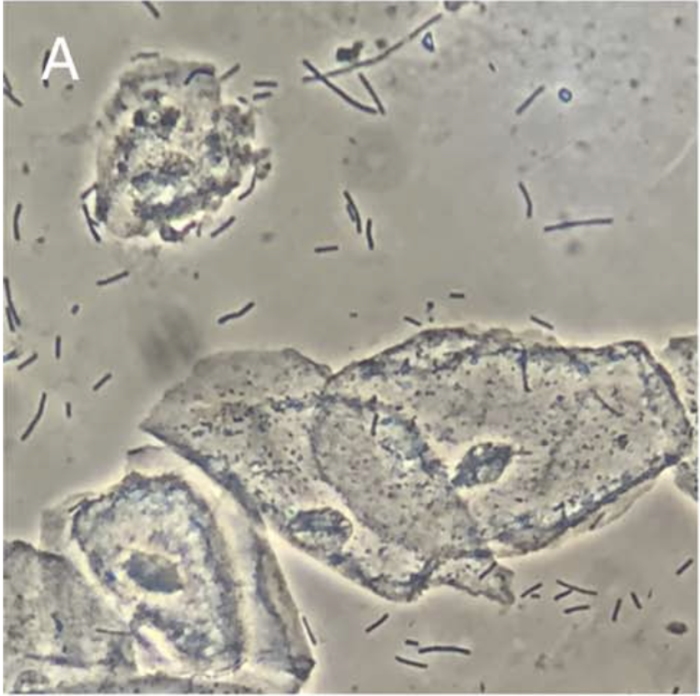
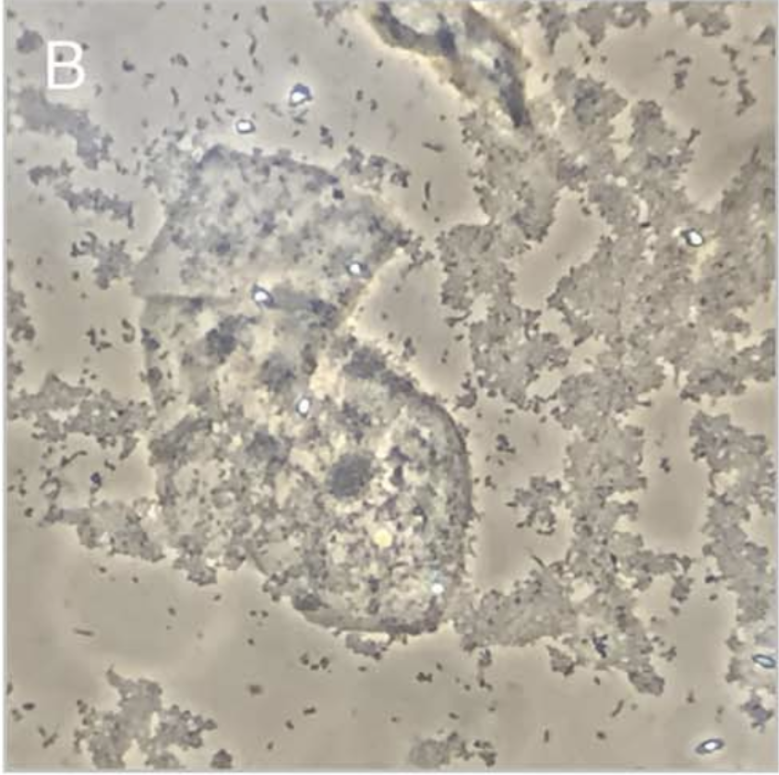
Bacterial Vaginosis
Vieira-Baptista et al 2021

Slide 8
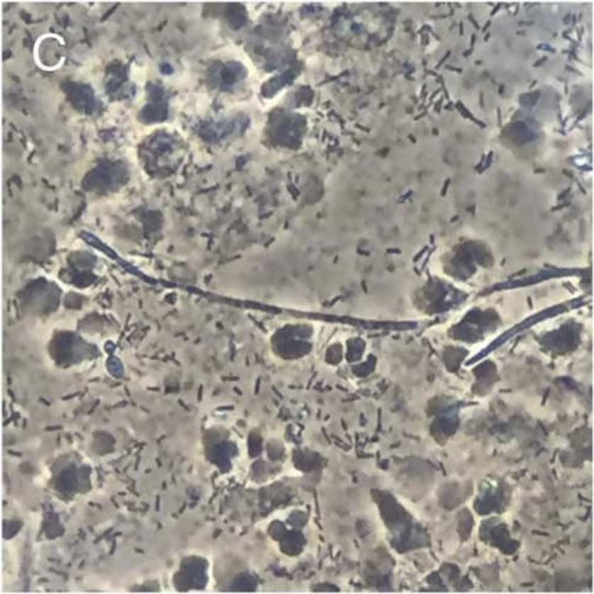
Vulvovaginal Candidiasis
Vieira-Baptista et al 2021

Slide 9
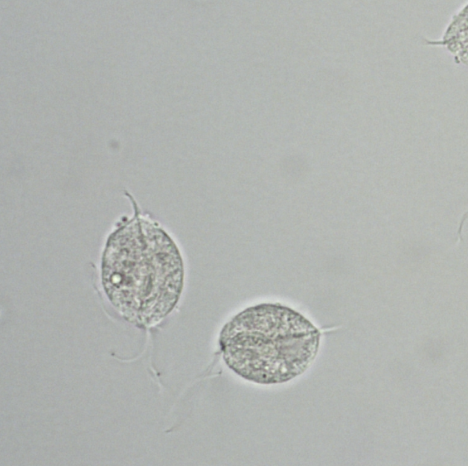
Trichomonas

Slide 10
Usefulness of wet mount microscopy in low resource settings
Vieira-Baptista et al 2021
Cause of Infection | Sensitivity | Specificity
Trichomoniasis | 25-82% | 98-100%
Bacterial vaginosis | 82-100% | 93-97%
Candidiasis | 43.9-78% | 75-88.9%

Slide 11
Diagnosing sexually transmitted infections in resource-constrained settings
Wi et al 2019
Syndromic management of STIs (including wet mount microscopy) can be less effective than other, more expensive, laboratory based methods
Other more effective methods include: nucleic acid amplification tests (NAATs) and other antibody tests
However, these are more expensive, time consuming, and require well-equipped laboratory settings

Slide 12
Conclusions from Wi et al 2019
Moving towards the development of more sensitive and specific POCTs in the diagnosis of vaginitis and STIs can help to diagnose these infections, especially in low-resource settings
Using wet mount microscopy and other syndromic management techniques are currently very effective and realistic ways to diagnose causes of vaginitis

Slide 13
Diagnosing vaginal infections at the IUSOC
Hillier et al 2021
Using wet mount microscopy, whiff tests, and possibly pH stick testing can be reasonable and timely manners of diagnosing our neighbors coming into the IUSOC with symptoms of vaginitis
Management of BV, VVC, and TV on the same day as a patient is diagnosed can help to reduce the incidence of return visits for the same complaints

Slide 14
References
Sobel JD. Approach to females with symptoms of vaginitis. In: UptoDate, Eckler K (Ed), UpToDate.
Vieira-Baptista P, Grinceviciene S, Oliveira C, Fonseca-Moutinho J, Cherry F, Stockdale CK. J Low Gen Tract Dis. [Internet] 2021;25: 172-180.
We TE, Ndowa FJ, Ferreyra C, Kelly-Cirino C, Taylor MM, Toskin I, Kiarie J, Santesso N, Unemo M. Journal of the International AIDS Society. [Internet]. 2019,22: 8-18.
Hillier SL, Austin M, Macio I, Meyn LA, Badway D, Beigi R. CID. [Internet] 2021;05: 1538-543.

