Slide 1

It’s a business relationship
Characteristics of successful business relationships & importance of trust
Module 1: Foundations – Introduction to Negotiations
the ONEAL project
Notes:
It’s a business relationship: characteristics of successful business relationships & the importance of trust. This is the second video in the Introduction to Negotiations lesson of the Foundations module. In this video we are going the going to define business relationships, describe the characteristics of successful business relationships including the importance of trust. Then introduce how interpersonal trust plays into negotiations and creates reputation.

Slide 2
Business Relationship
A relationship between a institution (business firm, non-profit, or government entity) selling a product or service to another institution and not directly to consumers.
Notes:
A business relationship is a relationship between an institution (business firm, non-profit, or government entity) selling a product or service to another institution and not directly to consumers. Sometimes called a Business-to-Business or B2B relationship. Yes, libraries aren’t a business but the business management literature divides selling relationships as B2B or B2C (Business to Consumer). The nature of the relationships are different, and it affects contracts and business terms such as pricing.
One good example we can see and use when talking to another stakeholder such as a faculty member is how the pricing for an e-book is different from if they buy themselves a personal copy on Amazon versus a library purchasing a user-license for lending. When selling to an eBook to a consumer, the reach is limited. The consumer is going to read it and may have the ability to share it with a limited number of friends and family. It’s a simple, single transaction with terms and conditions that are not negotiated. However, a library purchasing an license is much more complex. The publisher wishes to limit access to just students, staff, and faculty who are affiliated with that institution as well as limit how that eBook is used. The library has its own goals and interests such as protecting user information and desiring eLending rights. As a result, pricing is higher, and a more complex set of licensing terms is established. Libraries also want to buy or subscribe to many items and want stability with relationships that they establish with vendors, which requires contracts that outline the legal parameters of their agreement including business terms.

Slide 3
CHARACTERISTICS OF SUCCESSFUL BUSINESS RELATIONSHIPS
Legal relationship through contracts
Transparency & clear communication
Partnering to problem solve and meet needs of both parties
Notes:
Successful business relationships do three things:
establish their legal relationships through contracts
practice clear communication and strive for transparency
and partner with each other to problem solve and find creative solutions that will meet the needs of both parties in the relationship.

Slide 4
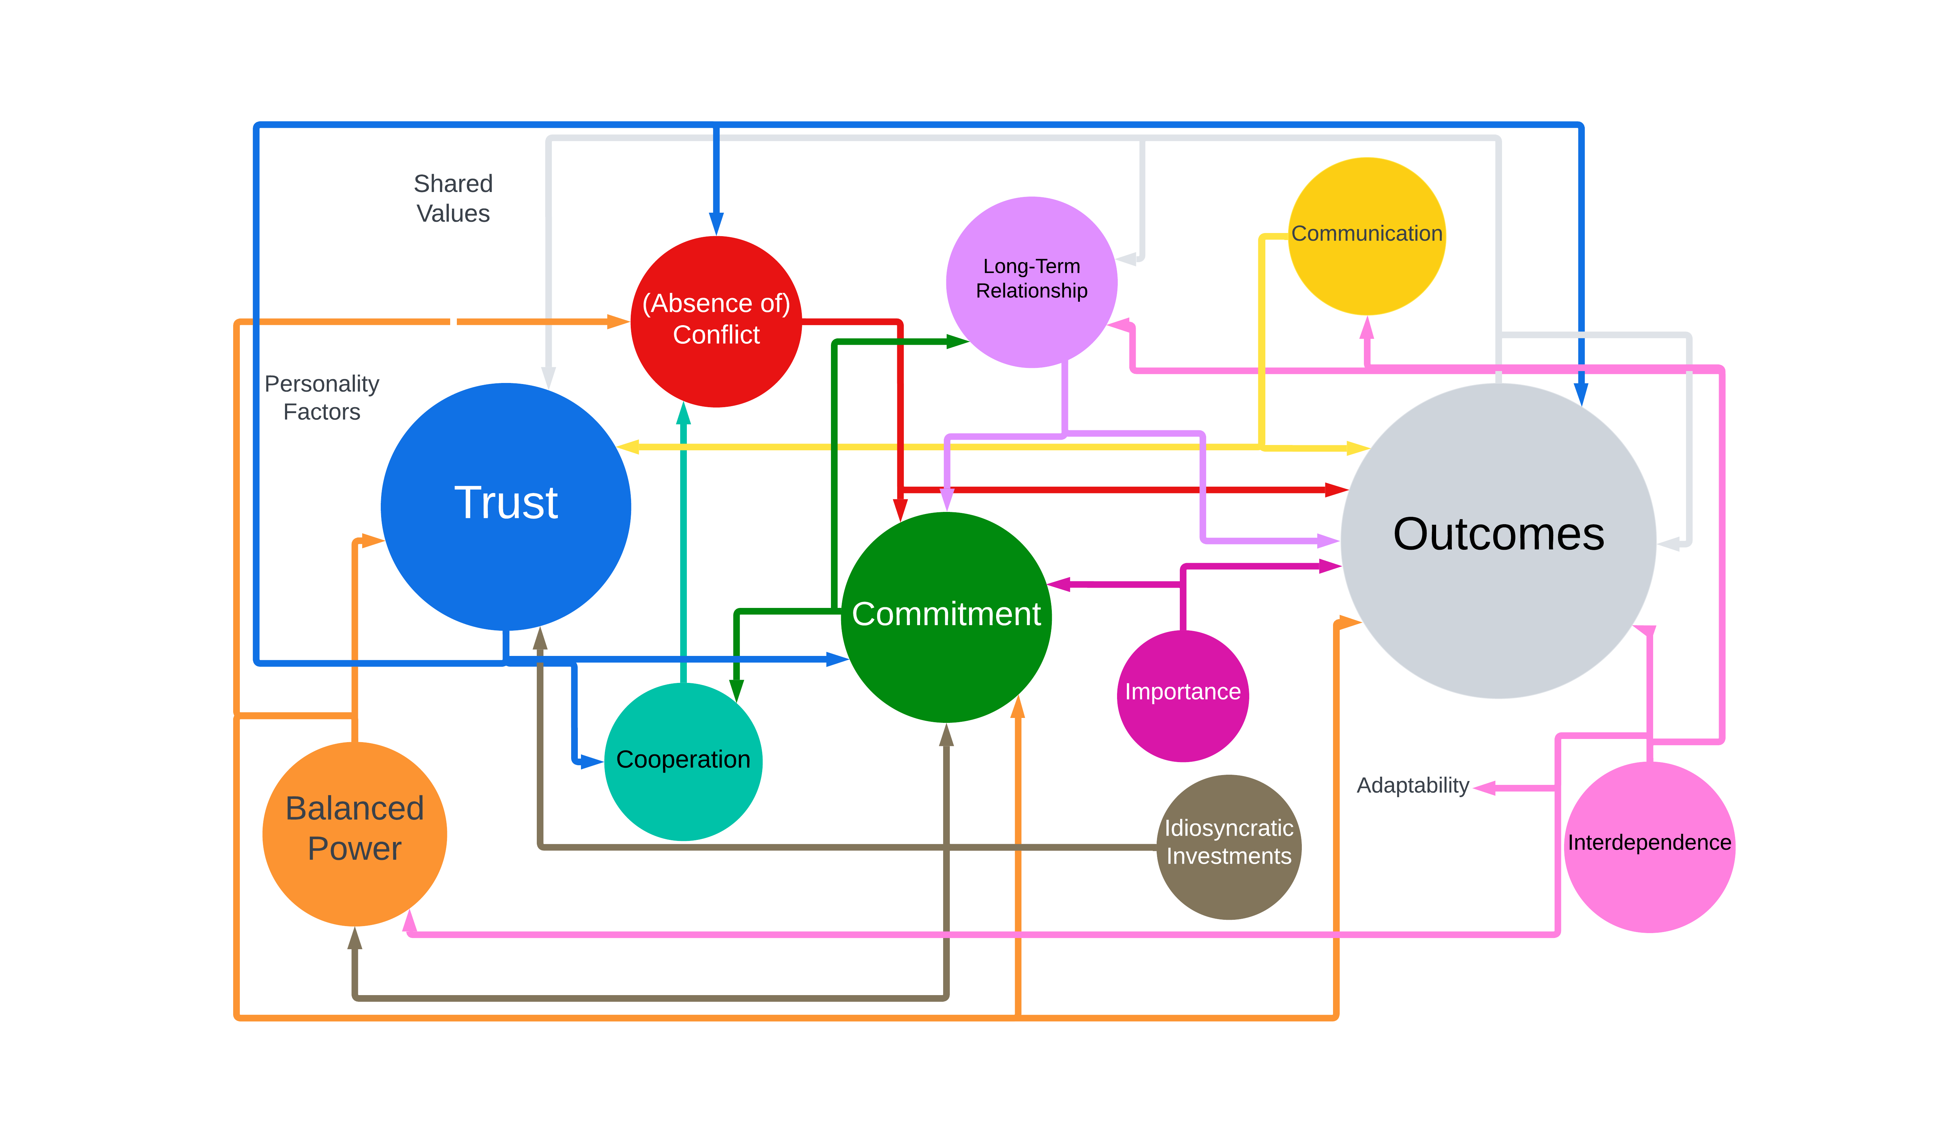
Trust is a key determinate in the outcomes of business relationships
Iacobucci, D., & Hibbard, J.D. (1999). Toward an encompassing theory of business marketing relationships (BMRS) and interpersonal commercial relationships (ICRS): An empirical generalization. Journal of Interactive Marketing, 13 (3), 13-33.
Notes:
There are many things that determine successful outcomes in business relationships and as you can see it is complicated because those determinates influence each other. As seen in this diagram, Iacobucci and Hibbard’s research shows that trust is one of the most important factors in business relationships. The arrows in this diagram demonstrate that Trust impacts commitment, conflict or the absence of conflict, cooperation, the long-term relationship and outcomes. Many factors impact trust including shared values, personality factors, communication, power, and outcomes. Notice that outcomes and trust impact each other in a feedback loop.

Slide 5
TWO TYPES OF TRUST IN BUSINESS RELATIONSHIPS
Interpersonal Trust
This is the trust that happens between an individual library professional and a sales representative
Interorganizational Trust
This is collective trust an organization has toward a business partner i.e. how a library organization feels toward a particular vendor.
Akbar Zaheer, Bill McEvily, Vincenzo Perrone, (1998) Does Trust Matter? Exploring the Effects of Interorganizational and Interpersonal Trust on Performance. Organization Science 9(2):141-159.
https://doi.org/10.1287/orsc.9.2.141
Notes:
There are two types of trust
All business relationships have both interpersonal and interorganizational trust.
Interpersonal trust is the trust that happens between two individuals from two organizations within the business relationship. It is the relationship between the library professional and the sales representative.
Interorganizational trust is the collective trust an organization has toward a business partner. For instance, it may be how a library organization, consortium, or even the profession as a whole feels about particular vendors.

Slide 6
IINTERPERSONAL TRUST DURING NEGOTIATIONS
FOUR KINDS OF REPUTATION
Liar-Manipulator
Tough but Honest
Nice and Reasonable
Cream Puff
Relationships are important!
Croson, R., and Glick, S. (2001). “Reputations in negotiation.” In Hock, S.J., Kunreuther, H.C., and Gunther, R.E. (eds.). Wharton on Making Decisions (pp. 177-186) Hoboken, NJ: Johns Wiley and Sons.
Notes:
You should work to maintain interpersonal trust during negotiations, as it effects both your reputation and the relationship.
Research shows that there are four primary types of negotiation reputation.
Liar-Manipulator
Tough but Honest
Nice and Reasonable
Cream Puff
Most of us want to target tough-but-honest or nice-and-reasonable. Also, if you are a “cream puff” don’t expect to get to tough but honest over night. It’s also perfectly okay to be nice and reasonable….just always negotiate to your interests not your position. Position is about how you view yourself and the vendor (friend or adversary, winner or loser) but interests is about trying to figure out how to satisfy your most important values and needs.
If you are negotiating with a Liar-Manipulator we will be teaching you strategies for dealing with unacceptable behavior in the next lesson: Negotiating Planning Part 1
Above all relationships are important. When interpersonal trust breaks down and becomes systemic, interorganizational trust will breakdown, which is very difficult to rebuild.

Slide 7
TYPES OF NEGOTIATORS – Two Traditional Roles
SOFT
Focuses on position
“Friends”
Values agreement
More likely to make concessions to avoid conflict
Yields to pressure
Too much trust
HARD
Focuses on position
Adversaries
Needs to “win”
Demands concessions to maintain relationship
Applies pressure
Distrustful
Fisher, R., Ury, W., & Patton, B. (1991). Getting to Yes: Negotiating Agreement Without Giving In (2nd ed.). New York: Houghton Mifflin Company.
Notes:
There are two traditional roles that many negotiators fall into: soft and hard negotiators.
Both soft and hard negotiators focus on position, which is how you view the other person and how you view yourself before and after a negotiation. It tends to turn things personal where there are more winners and losers and a higher likelihood of at least one party being highly dissatisfied.
For instance, soft negotiators want to be viewed as friends with who they negotiate with (this is a viewpoint that is positional) and highly value agreement. They are much more likely to concede things that they would rather not to find agreement. They tend to yield to pressure and trust too much.
Meanwhile hard negotiators are all about winning and view the other side as an adversary (again this is a positional viewpoint). They demand concessions to maintain the relationship, apply pressure, and are distrustful of the other side.
I think we can all think of negotiations we’ve witnessed with soft and hard negotiators. I believe as librarians, the high need to people please can lead us to being soft negotiators and when we encounter vendors who are hard negotiators it helps perpetuate the angst we feel when trying to ask for the things we really need in order to sustainably manage access to our collections.
Both sides need to strive to create a successful business relationship and behaving as a soft or hard negotiator is not going to get that done.

Slide 8
A third way!
Striving for mutual gain through principled negotiation.
Fisher, R., Ury, W., & Patton, B. (1991). Getting to Yes: Negotiating Agreement Without Giving In (2nd ed.). New York: Houghton Mifflin Company.
Notes:
The good news is that there is a third way. You don’t have to be a soft or hard negotiator, you can become a principled negotiator, a concept discussed in the classic negotiation text “Getting to Yes”, where you work to strive for mutual gain during your negotiation by being focused on the interests of both parties. We will dive more deeply into understanding how to be a principled negotiator in the next video.

Slide 9
BIBLIOGRAPHY & CREDITS
Akbar Zaheer, Bill McEvily, Vincenzo Perrone, (1998) Does Trust Matter? Exploring the Effects of Interorganizational and Interpersonal Trust on Performance. Organization Science 9(2):141-159. https://doi.org/10.1287/orsc.9.2.141
Croson, R., and Glick, S. (2001). “Reputations in negotiation.” In Hock, S.J., Kunreuther, H.C., and Gunther, R.E. (eds.). Wharton on Making Decisions (pp. 177-186) Hoboken, NJ: Johns Wiley and Sons.
Fisher, R., Ury, W., & Patton, B. (1991). Getting to Yes: Negotiating Agreement Without Giving In (2nd ed.). New York: Houghton Mifflin Company.
Iacobucci, D., & Hibbard, J. D. (1999). Toward an encompassing theory of business marketing relationships (BMRS) and interpersonal commercial relationships (ICRS): An empirical generalization. Journal of Interactive Marketing, 13(3), 13-33.
This presentation is the creative work of Katharine V. Macy, Collection Assessment Librarian & Subject Liaison for Business and Economics at Indiana University - Indianapolis, https://orcid.org/0000-0002-6283-7143
Presentation template by SlidesCarnival
Notes:
Bibliography & Credits

