Slide 1
Defining and Measuring Research Impact in the Humanities
Duke University Center for International & Global Studies | April 5, 2023
Heather L. Coates
Notes:
Thank you so much for the kind introduction and for inviting me to talk to you all today.
I’m looking forward to a great discussion, so let’s dive in.

Slide 2
Roadmap
How metrics data are generated
Implications for metrics
Metrics for research evaluation
Using metrics responsibly
Discussion
Notes:
To establish some common ground, we’ll take the first 15 minutes to explore how the data used to derive metrics are generated and to consider the implications for the metrics themselves. Then, we will talk about using metrics in different research evaluation processes. Finally, I’ll share how we are implementing practices for using metrics responsibly at my library.

Slide 3
How metrics data are generated
Notes:
All metrics are numbers, but how are they generated? Where does the data come from?

Slide 4
Types of metrics
Object
Venue (Journal)
Product (Article, Book)
Author
Data Type
Citations
Altmetrics
  Webometrics
  Social media metrics
Notes:
First, I want to clarify some of the terminology that I’ll use throughout this presentation.
I typically talk about metrics using two broad categories – based on the object that is being described and the type of data used to generate the metric.

Slide 5











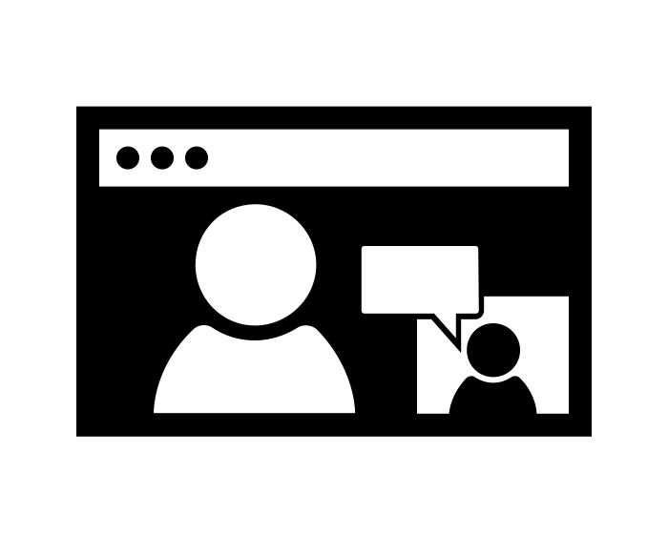












How metrics data are generated
PID
</>
Notes:
This diagram is a very informal attempt to visualize how metrics data are generated.
In the yellow oval, we have scholarly products such as articles, books & chapters, conference presentations & papers, as well as data and code.
We engage with these products within a networked environment using a variety of tools – through news and media coverage, social media, and internet browsers. We can save, bookmark, and annotate these products using tools such as Zotero, Mendeley, CiteULike, and Hypothesis.
Metrics aggregators including Digital Science, Clarivate Analytics, and Elsevier, harvest the digital traces of these activities and use them to calculate metrics.

Slide 6
How metrics data are generated
Products
Activities
Indicators
Journal articles
Books
Book chapters
Conference presentations & papers
Abstracts
White papers
Reports
Data
Code, algorithms
Models, simulations
View
Download
Bookmark
Like
Share
Discuss
Engage
Review
Cite
Adopt/Implement
Citation counts
Views & downloads
Eigenfactor Article Influence Score
Field Normalized Citation Impact
Relative Citation Ratio
Media coverage
Reviews
Altmetric Attention Score
h-index
User demographics
Notes:
Another visualization of this idea is here
The products we create exist in an online environment where we can interact with them in various ways, described here as activities.
These activities leave digital traces and are aggregated and counted to create indicators, which are often simple counts.
In the case of citation metrics, we have more mathematically sophisticated metrics that are based on decades of research evidence. In the case of altmetrics, we do not yet have sufficient evidence.

Slide 7
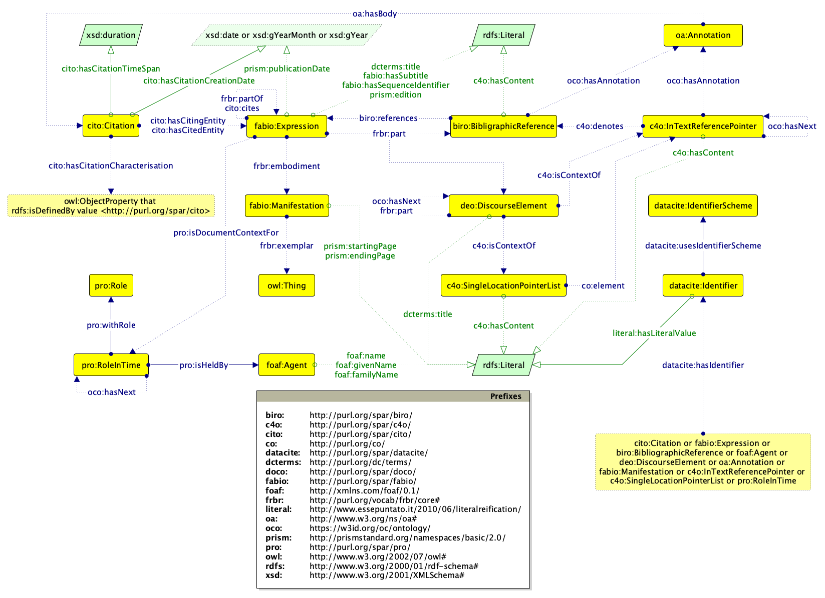
Source: https://opencitations.net/model
Notes:
The image is of the OpenCitations Data Model (OCDM), which is the metadata model used for the data stored in all the OpenCitations' datasets..
Making accurate and reliable connections between products, activities, and users is quite difficult and time consuming. Think about everything that needs to work for
a citation to a publication to be “counted”?
a view or download of a publication to be “counted”?
a blog or Wikipedia or policy mention of a publication to be “counted”?

Slide 8
metadata makes connection and retrieval possible
Notes:
Metadata enables many of the connections necessary for retrieval and calculation of indicators
However, we know that many places under invest in the creation of high quality metadata.
Keep that in mind as we explore the limitations as biases of metrics.

Slide 9
The data are not neutral
Who is able to conduct research & creative activities
Who is able to find an appropriate venue for publishing their work
What types of publishers have adequate resources to make products discoverable and accessible (metadata)
Which venues are indexed in a citation database or by scholarly search engines
Which scholars, reviewers, and administrators have access to data
Does the aggregator devote sufficient resources to cleaning & curating metadata
Biases in citation databases have been well-documented for coverage, language, geography, field of research, and genre
Notes:
Like all systems created by humans, the publishing ecosystem contains inequities. There are many opportunities for introducing bias.
Consider…(points on the slide)
Metrics are only as good as the underlying data
Singh, V. K., Singh, P., Karmakar, M., Leta, J., & Mayr, P. (2021). The journal coverage of Web of Science, Scopus and Dimensions: A comparative analysis. Scientometrics, 126(6), 5113–5142. https://doi.org/10.1007/s11192-021-03948-5
Martín-Martín, A., Thelwall, M., Orduna-Malea, E., & Delgado López-Cózar, E. (2020). Google Scholar, Microsoft Academic, Scopus, Dimensions, Web of Science, and OpenCitations’ COCI: A multidisciplinary comparison of coverage via citations. Scientometrics. https://doi.org/10.1007/s11192-020-03690-4

Slide 10
Coverage in citation databases
Web of Science
13,600+ journals
13.2 million items
16 books
40,000 book chapters
6.7% of content is Social Sciences
1.3% of content is Arts & Humanities
Scopus
40,300+ journals
18 million items
163,711 books
1.2 million book chapters
8.7% of content is Social Sciences
2.7% of content is Arts & Humanities
Dimensions
77,400+ journals
28.1 million items
116,643 books
3.9 million book chapters
14.4% of content is Social Sciences
3.5% of content is Arts & Humanities
Source: Singh et al, 2021
Notes:
Metrics are also shaped by the selection of items for inclusion in the data used to derive them. Most often, metrics are calculated on specific data sets such as Web of Science, Scopus, and Dimensions.
As you can see, there are substantial differences in coverage across Web of Science, Scopus, and Dimensions. Inclusion in one or more of these indexes or “databases” is essentially required for an item/scholar/journal to have access to normalized citation metrics.
Each citation database uses a different classification schema for fields of research or subject areas:
Singh, V. K., Singh, P., Karmakar, M., Leta, J., & Mayr, P. (2021). The journal coverage of Web of Science, Scopus and Dimensions: A comparative analysis. Scientometrics, 126(6), 5113–5142. https://doi.org/10.1007/s11192-021-03948-5
Wang, Q., & Waltman, L. (2016). Large-scale analysis of the accuracy of the journal classification systems of Web of Science and Scopus. Journal of Informetrics, 10(2), 347–364. https://doi.org/10.1016/j.joi.2016.02.003
Martín-Martín, A., Thelwall, M., Orduna-Malea, E., & Delgado López-Cózar, E. (2020). Google Scholar, Microsoft Academic, Scopus, Dimensions, Web of Science, and OpenCitations’ COCI: A multidisciplinary comparison of coverage via citations. Scientometrics. https://doi.org/10.1007/s11192-020-03690-4

Slide 11
Research on altmetrics tells us…
The grand challenges in the study and use of altmetrics are heterogeneity, data quality, dependencies (Haustein, 2016)
Reliability across different sources is low to moderate, depending on the altmetric and aggregator
  Although aggregators use similar sources, methodological approaches for collecting, processing, and reporting the data differ (Zahedi & Costas, 2018)
Notes:
Since the social media platforms and web technologies that altmetrics are derived from are much newer, we do not yet have the same depth of evidence about the meaning and utility of altmetrics.
What we do know is that there are three key challenges: heterogeneity, data quality, and dependencies of the data on the platforms from which they are derived (Haustein, 2016)
Heterogeneity means that a tweet is not the same as a Facebook share is not the same as a blog mention; or, at least we don’t have evidence to indicate that they are equivalent
Zoreh Zahedi & Rodrigo Costas found that reliability across different sources of altmetrics is low to moderate, depending on the altmetric and aggregator
There are three conceptual elements related to methodological approaches (Zahedi & Costas):
data collection approaches - document types tracked, social media sources covered, API
aggregation and reporting approaches - public vs. private data, level of detail (raw data vs aggregated data at the output level), scholarly object identifiers tracked, data processing approaches (combine tweets and retweets, count unique tweeters, etc.)
updating approaches - different criteria for updating the data (daily, weekly) are applied

Slide 12
Coverage by altmetric aggregators
Altmetric
Captures broadest range of altmetric activities
Nearly all (91%) of articles have been mentioned on Twitter
Broader coverage of tweets, media mentions, and blog mentions
PlumX
Covers more articles with Mendeley readers (98.7% vs. 95.8% for Altmetric)
Broader coverage than CrossRef Event Data (as of 2017)
CrossRef Event Data (still in beta in 2017)
Captures more Wikipedia citations (32%) than Altmetric.com (2.99%) and PlumX (2.21%)
Not a metrics provider - process the data yourself
Source: Ortega, 2018
Notes:
A 2018 article by Ortega compared the coverage of three Altmetrics aggregators, which is summarized here.
Over the last 5 years a lot has changed, so this picture may have changed. In particular, I’m curious about how the CrossRef Event Data has matured.
Díaz-Faes, A. A., Bowman, T. D., & Costas, R. (2019). Towards a second generation of ‘social media metrics’: Characterizing Twitter communities of attention around science. PLOS ONE, 14(5), e0216408. https://doi.org/10.1371/journal.pone.0216408
Ortega, J. L. (2018). Reliability and accuracy of altmetric providers: A comparison among Altmetric.com, PlumX and Crossref Event Data. Scientometrics, 116(3), 2123–2138. https://doi.org/10.1007/s11192-018-2838-z

Slide 13
Bibliometrics data are non-normal
Lotka’s law
Bradford’s law
20% of researchers produce about 80% of
published documents
The majority of citations are received by relatively few journals (Pareto distribution)
Matthew effect
Recognition is more likely to be given to those who already have high degrees of recognition
Notes:
All data have limitations and biases, so it is important to be a critical consumer of data and the metrics derived from them

Slide 14
Implications for metrics
Notes:
Now I’d like to take some time to explore what we know about the data and the implications for the metrics themselves

Slide 15
Community norms & technical choices
Why to cite
When to cite
Where to cite
Which version to cite
Number of items to cite per publication
Publisher expectations & limitations
Whole or fractional counting
Timeframe for counting
Source data
Data cleaning decisions – matching, aggregation, deduplication, corrections, etc.
Quality of publisher provided metadata & curation necessary
Notes:
In general, both community norms and technical choices influence the validity of metrics for any particular product, metric, and field.
One of the key principles of citation analysis is that you do not compare citation metrics for different disciplines because of differences in citation density, which are shaped by the publishing norms of each field.
Source: Waltman, L. (2015). A review of the literature on citation impact indicators. ArXiv:1507.02099 [Cs]. http://arxiv.org/abs/1507.02099

Slide 16
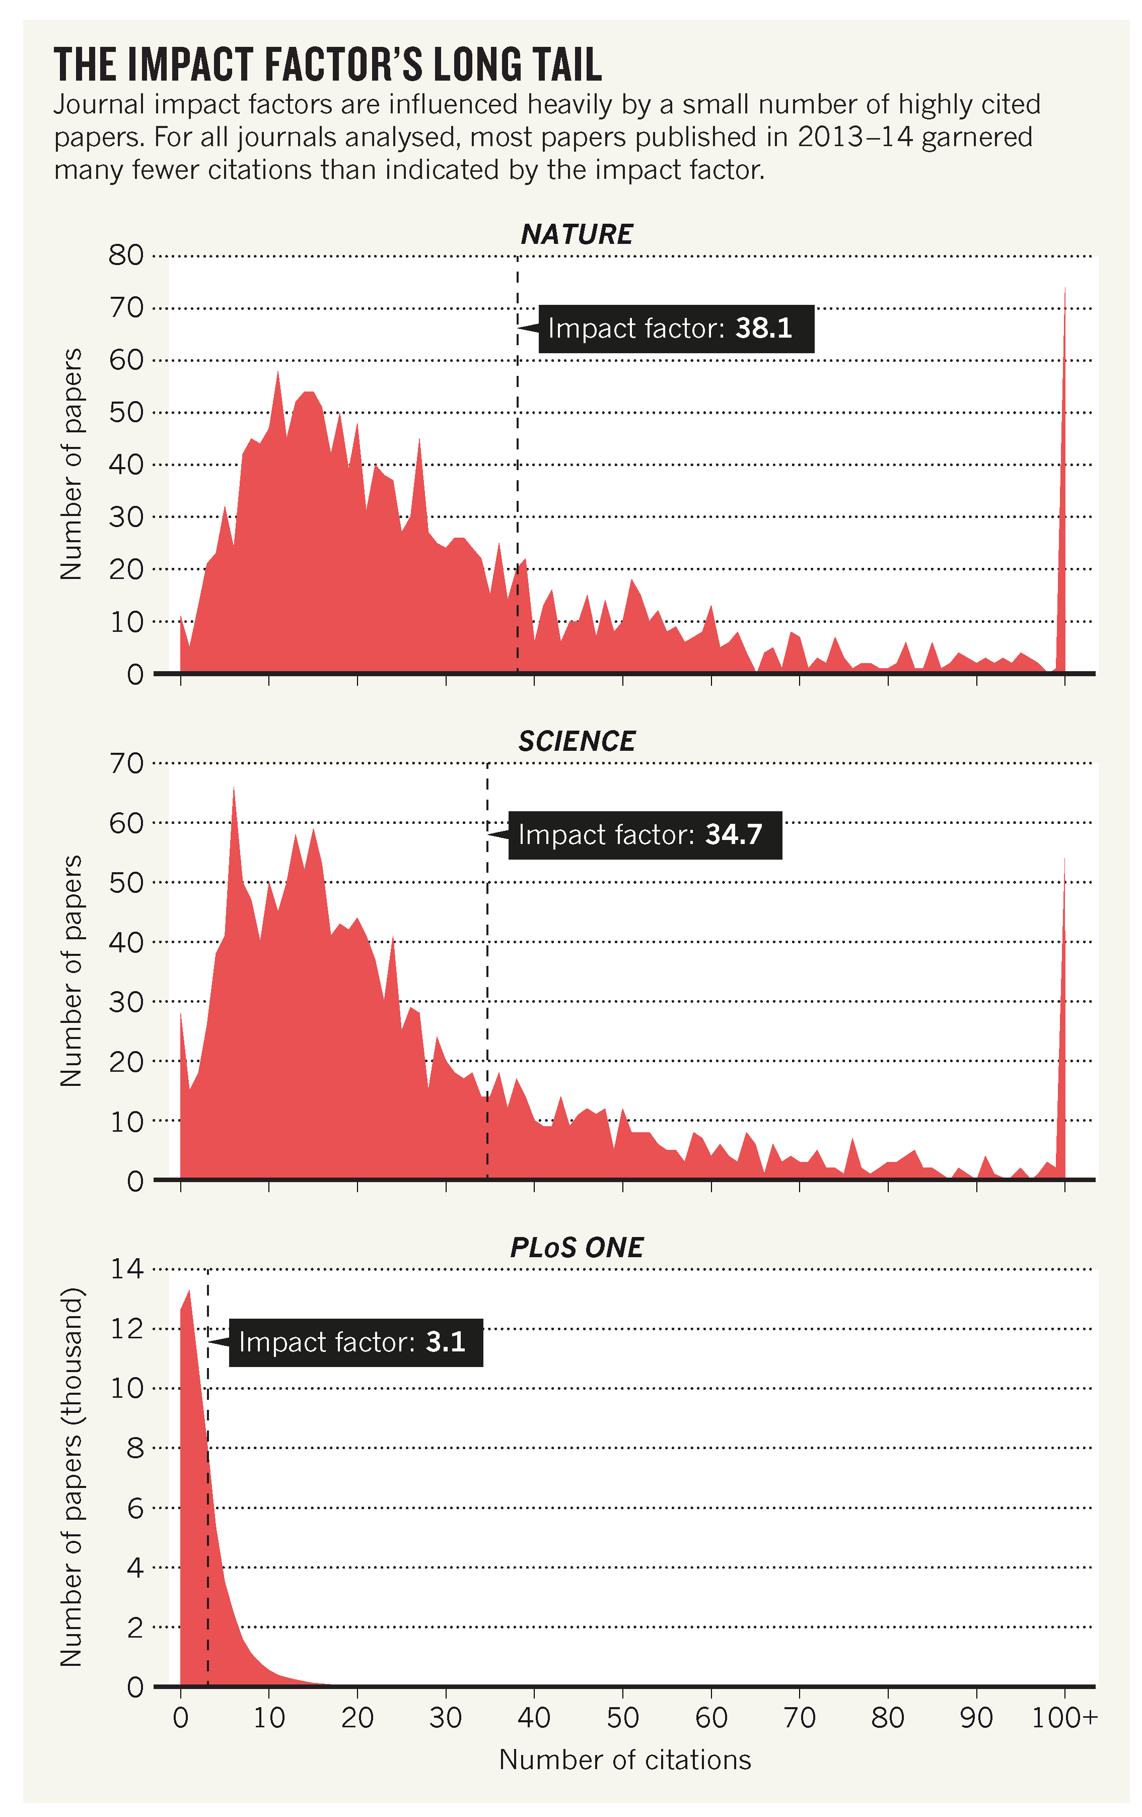
Journal Impact Factor
Typically, 65-75% of the articles have fewer citations than indicated by the JIF
Source: Callaway, 2016
“The co-option of JIFs as a tool for assessing individual articles and their authors, a task for which they were never intended, is a deeply embedded problem within academia.”
Source: Larivière et al (2019)
Notes:
One metric that is especially misunderstood and misused is the Journal Impact Factor.
The JIF is a publication metric reflecting the annual average (mean) number of citations to articles published in a particular journal. For example, the 2018 JIF reflects citations to articles published in 2016-2017.
Callaway demonstrated that the majority– anywhere from 65-75% - of articles published in a journal receive fewer citations than indicated by the JIF. For example, if you publish in a journal with a JIF of 3, you might expect that your article will receive 3 citations. But most will receive fewer than 3 citations.
These graphs also show how skewed the citations are – most articles receive relatively few citations, while a very small minority receive a high number of citations. These outliers skew the JIF, because it is an average or mean.

Slide 17
The unit of analysis matters
Noise and gaps in the data show up differently at different levels of analysis. Results at the macro level may not hold up at the meso or micro levels
Nations (macro)
Disciplines (macro)
Programs (meso)
Individuals (micro)
Notes:
The literature also tells us that the unit of analysis matters.
While the bibliometric data may be robust enough to conduct studies of national or disciplinary patterns, there may be gaps that affect the validity of results at lower levels, such as for institutions or programs.
This is particularly true for data at the level of individuals. In fact, many bibliometricians caution against using metrics to evaluate individuals.

Slide 18
SSH research differs from science
SSH has a stronger national and regional orientation – language and journals
SSH is published less in journals and more in books
SSH has a slower pace of theoretical development
SSH is less collaborative
SSH is directed more at a non-scholarly public
Many national & regional journals are not covered by WoS
WoS overrepresents English language SSH journals by 20-25%
Book coverage in WoS is very limited
Notes:
Based on bibliometric perspective…the evidence suggests

Slide 19

Metrics Toolkit 2.0 Demo
Notes:
Unless you are a bibliometric scholar or professional, it isn’t realistic to expect to remember the nuances of the data sources and metrics. That is one of the key reasons we developed the Metrics Toolkit. It’s a free resource designed to help scholars and evaluators understand and use citations, web metrics, and altmetrics responsibly in the evaluation of research. It provides evidence-based information about research metrics across disciplines, including how each metric is calculated, where you can find it, and how each should (and should not) be applied.
I’d like to take a couple of minutes to show you the Metrics Toolkit 2.0, which we are working on right now. We have revised the schema to make it more accessible to new users, are finishing up another round of literature reviews and post updates, and are migrating to a new platform.
Show the following pages:
New schema
How to
Journal Acceptance Rate
Wikipedia citations or Twitter mentions

Slide 20
Metrics in the context of research evaluation

Slide 21
Research evaluation for P&T
Excellence
Impact
Prestige
Notes:
In the context of P&T we often talk about concepts like research excellence, impact, and prestige but it is rare that these concepts are operationalized sufficiently for us to evaluate them consistently and accurately.
How does it show up?
When does it begin to appear?
Where do we look for it?
How do we know it when we see it?
How do we measure it?

Slide 22
Unpacking “impact” and “excellence”
Becker Model for Research Assessment
Advancement of Knowledge
Clinical Implementation (or Translating Research into Practice)
Community Benefit
Economic Benefit
Legislation & Policy
inorms Research Evaluation WG: SCOPE Process
START with what you value
CONTEXT considerations
OPTIONS for evaluating
PROBE deeply
EVALUATE your evaluation
Notes:
I want to share two tools that we use and recommend to our faculty to help unpack impact and excellence and move towards a shared understanding of what they look like for their school, department, or field.
The Becker Model for Research Assessment comes out of a biomedical context, but we have found it incredibly useful as a starting point for unpacking what types of impact scholars are aiming for in their work.
The inorms SCOPE process provides guidance for groups or units to reconsider how research evaluation is embedded into various processes, such as P&T.
It is rooted in three principles - SCOPE Principles
Evaluate only where necessary - Evaluation is not always the right strategy.
Evaluate with the evaluated – Any evaluation should be co-designed and co-interpreted by the communities being evaluated.
Draw on evaluation expertise – We should apply the same rigor to our evaluations that we apply to our academic research.

Slide 23
What type of impact could your work have?
Advancement of Knowledge
Publications, collaborations, materials, methods, tools, data, trainees, software, training materials, patents, etc.
Clinical Implementation
(or TRIP)
Community Benefit
Study findings lead to public awareness of risk factors, identification of lifestyle intervention, etc.
Legislation & Policy
Study cited in legislation or regulation, study team members invited to serve on committees or advisory boards, etc.
Economic Benefit
Clinical decision aids, consumer adoption, study cited in guideline or CE materials, improved reporting, etc.
Study findings result in reduced costs in delivery of services, further funding, new products or companies, etc.
Notes:
Here is a brief extract from the Becker Model of the types of evidence that might be available to demonstrate the five types of impact.
We use this as a starting point to encourage candidates, reviewers, and administrators to consider the enormous range of potential evidence that can demonstrate advancement of knowledge, legislative & policy changes, etc.

Slide 24
Metrics in promotion & tenure evaluation
Metrics are indicators, not direct measures, of impact, prestige, reputation
Metrics are not a substitute for evaluating quality, which is contextual and best done by peer review
Use normalized metrics when they are available
Present metrics alongside qualitative evidence
Context is crucial for reviewers
Notes:
Models for producing scholarship differ by nations, disciplines, research methods, communities – be careful when comparing publications or people
Normalized metrics are those which have been adjusted to compare similar articles – typically by field or discipline, publication year/time, and article type

Slide 25
Using metrics as a candidate for P&T
Metrics should support, not drive, your case
For each area of research, describe the products, and integrate evidence (including metrics) relevant to key products that substantiate claims of attention, use, impact
Statements
  Big picture of your career
  Roadmap to your research and scholarly products
  Highlight key things
Evidence
  Elaborate on things statements
  Summary-level evidence - highlights
Appendices
  More detailed evidence

Slide 26
Evaluating research for awards, honors, etc.
Understand the explicit and implicit criteria
Choose the most compelling and relevant evidence that demonstrates how you have met those criteria
Use a mix of qualitative and quantitative evidence (story + numbers)
Make it as easy as possible for the reviewers to connect the evidence presented to the criteria
Notes:
Similarly, when we are evaluating research and creative activity for awards and other honors, there are some elements consistent with P&T.
Metrics can provide part of the evidence, but they should not drive the application

Slide 27
Evaluation for research development
Metrics should support, not drive, research development efforts
  Recognize and celebrate funding, breakthrough discoveries, highly competitive honors, rankings
  Match potential collaborators with funding opportunities
  Communicate the value of research to the public
How can we broaden the types of research and creative activities that are celebrated and made visible?
How can libraries and research development partner to advance DEIABJ+ at our institutions?
Notes:
Research development professionals serve a key function in making visible the research and creative activities happening at their institutions. However, they may not have expertise in scholarly publishing or research metrics. Regardless, metrics-based tools are being used in their work. We are still trying to understand how to support this group at IUPUI, so I still have more questions than advice.

Slide 28
Other evidence is necessary
Adoption of your theory/model/instrument by practitioners
Re-use of your course materials
Relationships developed with practitioners, patients, the public
Affecting change in how stakeholders think or discuss an issue
Public engagement with your program
Increases in the civic literacy of adults across central Indiana
Increased understanding of an issue by the state legislature resulting from ongoing policy discussions
Notes:
Metrics are only one form of evidence
Some of the most important changes we want to see are very difficult or resource-intensive to measure

Slide 29
Using metrics responsibly

Slide 30
IUPUI UL Research Metrics Services: Service Philosophy
In 2017, a group of librarians began to formalize a service to support individuals and organizations in using research metrics for research evaluation. This service evolved out of long-standing reference support for retrieving metrics from our various databases. However, simply providing readily available metrics or teaching others how to retrieve them further perpetuates inequities in our publishing ecosystem and higher education generally. Research metrics are not neutral or objective. Metrics alone do not constitute evaluation; they are merely one type of evidence. Responsible use of metrics requires librarians to understand and effectively communicate the limitations of and biases in the underlying data, situate metrics in the appropriate context, and advocate for the value of peer review in evaluating scholarship and scholars.
IUPUI University Library Metrics Service Philosophy
Notes:
This is an except from our Service Philosophy
Focus on the bolded text

Slide 31
Making (all) your work count by increasing visibility, discovery, and use
Institutional, society, funder reward systems tend to value a subset of scholarly publications to the exclusion of other products and work
The publishing ecosystem makes a small subset of journal articles and a very few books or book chapters highly visible
Certain types of scholarship and products are significantly less visible than others, leading to the Matthew Effect
Institutional evaluation, in particular, relies heavily on metrics that are derived from data about journal articles
Notes:
Our goals are to help scholars get credit for all the work they do
To make the invisible more visible
Make the connection between the inequities and gaps in the current systems and the specific practices we’re recommending > introduce here, but continue to reinforce them throughout the sections
Types of scholarship disadvantaged in the current systems: locally-oriented efforts like community-engaged scholarship, work done by or about under-represented groups, highly politicized topics like gun violence in the US, the school to prison pipeline, racism in medicine
Types of products disadvantaged in the current systems: Conference presentations, reports, white papers, international journals, niche or interdisciplinary journals, and non-English language journals
Most vendor tools marketed to leadership vastly oversimplify or hide the uncertainty in the data they are using…but they have fancy graphics

Slide 32
Research Metrics Services @ IUPUI UL
Services include
  Presentations and training for faculty, staff, and students
  Consultations with candidates for P&T and reviewers/admin
  Advocacy that reaches all stakeholders
  Events (e.g., Research Impact Challenge for authors & readers)
  Resources
In AY 2022-2023, all subject liaisons at University Library were trained to provide individual metrics consultations to P&T candidates
Collaborate with other campus libraries (professional schools)
  https://researchmetrics.iupui.edu/index.html
Notes:
As of this semester, our metrics services include

Slide 33
Principles & practices
Leiden Manifesto
Quantitative evaluation should support qualitative, expert assessment.
Measure performance against the research missions of the institution, group or researcher.
Protect excellence in locally relevant research.
In Practice
Inform stakeholders about the biases and limitations associated with metrics and the underlying data. Encourage use of other forms of evidence.
Use the Becker Model for Research Assessment to introduce different type of impact and discuss how such impact shows up.
Use the Becker Model to expand the range of indicators and evidence of impact that are used.
Notes:
I won’t go into detail for all of these, but I wanted you to have the information for consideration.
Explain 1 & 2

Slide 34
Principles & practices
Leiden Manifesto
Keep data collection and analytical processes open, transparent, and simple.
Allow those evaluated to verify data and analysis.
Avoid misplaced concreteness and false precision.
Scrutinize indicators regularly and update them.
In Practice
Provide context and source information when using or reporting evidence.
Recommend citing summary tables of metrics in evidence sections or appendices. Use persistent links.
Round the Journal Impact Factor (JIF) to one decimal place.
Refer to the Metrics Toolkit. Share expertise across disciplines. Keep up with the literature.
Notes:
Explain 2 & 3

Slide 35
Principles & practices
Leiden Manifesto
Account for variation by field in publication and citation practices.
Base assessment of individual researchers on a qualitative judgement of their portfolio.
Recognize the systemic effects of assessment and indicators.
In Practice
Provide and recommend normalized metrics, when available.
Provide relevant examples for how metrics cannot capture the full range of impact of a scholar’s work.
Provide examples of the harms and unintended effects of too strongly relying on metrics to shape publishing decision.
Notes:
Explain 1

Slide 36
Principles & practices
DORA
Do not use journal-based metrics, such as Journal Impact Factors, as a surrogate measure of the quality of individual research articles…
For the purposes of research assessment, consider the value and impact of all research outputs…and consider a broad range of impact measures including qualitative indicators of research impact…
In Practice
Recommend that scholars and reviewers avoid using the JIF. Provide this policy brief to leadership.
Encourage deposit of other research outputs into repositories to increase discovery and access, as well as potential use. Provide examples of other types of impact evidence.
Notes:
We are doing our best to gently discourage leaders from using the JIF by providing better alternatives.
For the purposes of research assessment, consider the value and impact of all research outputs (including datasets and software) in addition to research publications, and consider a broad range of impact measures including qualitative indicators of research impact, such as influence on policy and practice.

Slide 37
measure what matters
Notes:
Instead of valuing what we can measure, what if we measure what we value?
Goodhart’s Law: “When a measure becomes a target, it ceases to be a good measure” > THERE IS NO ONE-SIZE FITS ALL METRIC
From Agate et al (2020)
The tyranny of the quantifiable is partly the failure of language and discourse to describe more complex, subtle, and fluid phenomena, as well as the failure of those who shape opinions and make decisions to understand and value these slippier things. It is difficult, sometimes even impossible, to value what cannot be named or described, and so the task of naming and describing is an essential one in any revolt against the status quo of capitalism and consumerism”. — Rebecca Solnit (2014, p. 97)
Agate, N., Kennison, R., Konkiel, S., Long, C. P., Rhody, J., Sacchi, S., & Weber, P. (2020). The transformative power of values-enacted scholarship. Humanities and Social Sciences Communications, 7(1), Article 1. https://doi.org/10.1057/s41599-020-00647-z
Pull in HumetricsHSS work here

Slide 38
Describing your community context
How does your community understand and describe impact?
How does your community understand and describe quality?
How does your community understand and describe prestige?
Notes:
Community can be a field, a department, school, professional organization – any group with shared goals
What assumptions are made? What assumptions go unchallenged?

Slide 39
Next Steps
Explore resources individually and together
  DORA Case Studies & Resource Library
  HumetricsHSS
  iNORMS Scope Framework
Establish a dialogue about the values of your field or community.
Work towards a shared understanding of terminology and definitions.
Describe characteristics of those values. What would evidence look like?
Interrogate how existing metrics speak to (or not) those values.
Notes:
It isn’t a shared understanding until it is documented

Slide 40

Thank you!
Notes:
Having these conversations is an important step in changing the culture of research evaluation in higher education. It’s a joy to share our experiences and what we’ve learned and to learn from others.

Slide 41

Heather L. Coates
Co-founder of the Metrics Toolkit
Digital Scholarship & Data Management Librarian, IUPUI University Library
Indiana University Data Steward for Research Data
hcoates@iupui.edu
ORCID: 0000-0003-4290-6997

Slide 42
References
Agate, N., Kennison, R., Konkiel, S., Long, C. P., Rhody, J., Sacchi, S., & Weber, P. (2020). The transformative power of values-enacted scholarship. Humanities and Social Sciences Communications, 7(1), Article 1. https://doi.org/10.1057/s41599-020-00647-z
Callaway, E. (2016). Beat it, impact factor! Publishing elite turns against controversial metric. Nature News, 535(7611), 210. https://doi.org/10.1038/nature.2016.20224
Haustein, S. (2016). Grand challenges in altmetrics: heterogeneity, data quality and dependencies. Scientometrics; 108(1), 413-423. https://doi.org/10.1007/s11192-016-1910-9
Larivière, V., Kiermer, V., MacCallum, C. J., McNutt, M., Patterson, M., Pulverer, B., Swaminathan, S., Taylor, S., & Curry, S. (2016). A simple proposal for the publication of journal citation distributions. BioRxiv, 062109. https://doi.org/10.1101/062109
Martín-Martín, A., Thelwall, M., Orduna-Malea, E., & Delgado López-Cózar, E. (2020). Google Scholar, Microsoft Academic, Scopus, Dimensions, Web of Science, and OpenCitations’ COCI: A multidisciplinary comparison of coverage via citations. Scientometrics. https://doi.org/10.1007/s11192-020-03690-4
Moed, H. (2005). Citation Analysis in Research Evaluation. https://doi.org/10.1007/1-4020-3714-7
Ortega, J. L. (2018). Reliability and accuracy of altmetric providers: A comparison among Altmetric.com, PlumX and Crossref Event Data. Scientometrics, 116(3), 2123–2138. https://doi.org/10.1007/s11192-018-2838-z

Slide 43
References
Prins, A. A. M., Costas, R., Leeuwen, V., N, T., & Wouters, P. F. (2016). Using Google Scholar in research evaluation of humanities and social science programs: A comparison with Web of Science data. Research Evaluation, 25(3), 264–270. https://doi.org/10.1093/reseval/rvv049
Singh, V. K., Singh, P., Karmakar, M., Leta, J., & Mayr, P. (2021). The journal coverage of Web of Science, Scopus and Dimensions: A comparative analysis. Scientometrics, 126(6), 5113–5142. https://doi.org/10.1007/s11192-021-03948-5
Sugimoto, C. R., & Larivière, V. (2018). Measuring research: What everyone needs to know. http://ebookcentral.proquest.com/lib/umontreal-ebooks/detail.action?docID=5160923
Thelwall, M. (2021). Measuring Societal Impacts of Research with Altmetrics? Common Problems and Mistakes. Journal of Economic Surveys, 35(5), 1302–1314. https://doi.org/10.1111/joes.12381
Wang, Q., & Waltman, L. (2016). Large-scale analysis of the accuracy of the journal classification systems of Web of Science and Scopus. Journal of Informetrics, 10(2), 347–364. https://doi.org/10.1016/j.joi.2016.02.003
Waltman, L. (2015). A review of the literature on citation impact indicators. ArXiv:1507.02099 [Cs]. http://arxiv.org/abs/1507.02099
Zahedi, Z., & Costas, R. (2018). General discussion of data quality challenges in social media metrics: Extensive comparison of four major altmetric data aggregators. PLOS ONE, 13(5), e0197326. https://doi.org/10.1371/journal.pone.0197326

Slide 44
Presentation design
This presentations uses the following typographies and colors:
Titles: Roboto Slab
Body copy: Source Sans Pro
Download for free at:
https://www.fontsquirrel.com/fonts/roboto-slab
https://www.fontsquirrel.com/fonts/source-sans-pro
You don’t need to keep this slide in your presentation. It’s only here to serve you as a design guide if you need to create new slides or download the fonts to edit the presentation in PowerPoint®

Slide 45
Credits
Special thanks to all the people who made and released these awesome resources for free:
Presentation template by SlidesCarnival
Photographs by Unsplash

