Slide 1
The "Civic-Minded Graduate" Construct for Assessing Civic Outcomes
Julie Hatcher, Ex. Dir.
(jhatcher@IUPUI.edu)
Robert G. Bringle, Senior Scholar
(rbringle@iupui.edu)
Center for service and learning
30th anniversary Campus Compact Conference
March 21st, 2016

Slide 2
Goals for 30-minute Session
What is a “civic-minded graduate” (CMG)?
What tools are available to assess the CMG construct?
Perhaps… more importantly … how could a construct such as CMG improve your programs (e.g., design, assessment, story)?
Notes:
We thank IARSLE for inviting us ….. Asked about our most project and this is it!

Slide 3
IUPUI Center for Service and Learning
Co-Curricular & Staff Engagement
  Sam H. Jones Community Service Scholars
  Voluntary service, Alternative Breaks, listserv
  Community Work Study
Faculty, Academic & Scholarly Engagement
  Service learning courses
  Faculty Learning Communities & programs
  Partnerships across campus (e.g., ISL, CER, TLC’s)
  Research and Program Evaluation

Slide 4
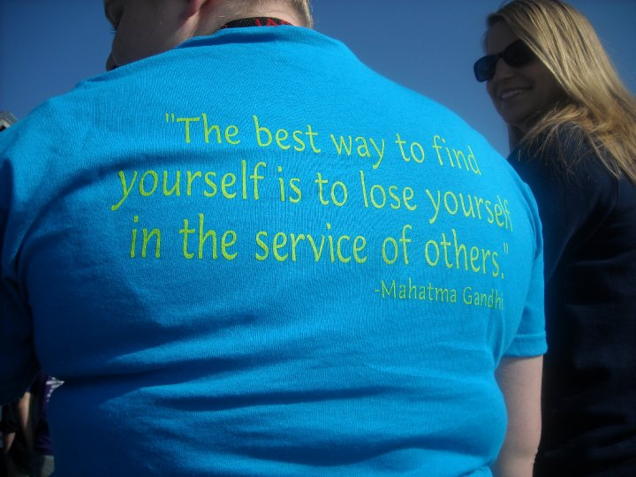
A Fundamental Question – “To What End?”
What is educationally-meaningful service?
Notes:
This is the question that the CSL considered for several years→ what are the common outcomes to all or most of our civic engagement activities?

Slide 5
Civic-Mindedness
“a person’s inclination or disposition to be knowledgeable of and involved in the community, and to have a commitment to act upon a sense of responsibility as a member of that community”
(Steinberg, Bringle, & Hatcher, 2011)
Notes:
To be civic-minded, one must possess the KSDs obtained through engagement in opportunities for civic learning. A civic identity is developed when someone is civically engaged and they reflect upon their experiences to the point where it becomes part of one’s identity.

Slide 6
CMG as a “North Star”
  A civic-minded graduate is one who
  is formally educated and
  has the capacity and orientation to work with others
  in a democratic way
  to improve the community.
  (Hatcher, 2011)

Slide 7
Domains of CMG: Civic Knowledge
  More than purely academic knowledge (dates, places, important civic or political events)
  Knowledge of volunteer opportunities (ways to contribute to society and of nonprofit organizations)
  Knowledge of contemporary social issues (current events and the complexity of issues in modern society)
Notes:
We don’t want to assume everyone knows what we mean when we say we are trying to cultivate the KSDs in our students without being explicit in what that looks like and the ways in which we can accomplish this task. Trying to make the implicit explicit.
Civic knowledge comes from multiple sources including community members (Battistoni, 1997). This includes a deeper knowledge of public issues, their underlying causes, and how different community members understand issues. Morton (1997) includes learning about how individuals and community groups have effected change in their communities as a key element (Battistoni, in press, p. 6).

Slide 8
Domains of CMG: Civic Skills
  Communication and Listening (ability to communicate with others and listen to divergent points of view)
  Diversity (understanding the importance of, and the ability to work with others from diverse backgrounds)
  Consensus-building (ability to work across difference to come to an agreement or solve a problem)
Steinberg, Bringle, & Hatcher (2011)
Notes:
Vary by discipline
Important in preparing students to be active participants in society
Traditionally defined as part of a liberal education
Associated with workforce development

Slide 9
Domains of CMG: Civic Dispositions
  Valuing community engagement (understanding the importance of service to others, and being actively involved in the community)
  Self-efficacy (have the desire to take personal action, with a realistic view that the action will produce the desired result)
  Social trustee of knowledge (feeling a sense of responsibility and commitment to use the knowledge gained in college to serve others)
Steinberg, Bringle, & Hatcher (2011)
Notes:
Identifying civic dispositions can become a contentious subject, especially in public institutions reluctant to breach the subject matter. However, dispositions is an important dimension of civic learning. Saltmarsh (2005) presents the key democratic values as participation, justice, and inclusion – values he believes “can be widely agreed upon and shared”(p.55

Slide 10
Domains of CMG: Behavioral Intentions
A stated intention to be personally involved in community service in the future
Steinberg, Bringle, & Hatcher (2011)
Notes:
Identifying civic dispositions can become a contentious subject, especially in public institutions reluctant to breach the subject matter. However, dispositions is an important dimension of civic learning. Saltmarsh (2005) presents the key democratic values as participation, justice, and inclusion – values he believes “can be widely agreed upon and shared”(p.55

Slide 11
Civic-Minded Graduate (CMG)
Identity
Civic Experiences
Educational Experiences
Civic-Minded Graduate
1
3
2
Cultural Norms and Social Context

Slide 12
Sample Student A
Personal
Identity
Educational Experiences
Civic
Experiences
Notes:
Student who is active in the community (e.g., politics, church), and interested in education, buth the academic and civic are independent.

Slide 13
Sample Student B
Personal
Identity
Educational Experiences
Civic
Experiences
Notes:
Student who is enrolled in a SL course, but it doesn’t mean anything to the student.

Slide 14
Potential Factors Influencing Civic-Mindedness
“Civic-Mentor”
Structured Reflection
Personal
Identity
Educational Experiences
Civic
Experiences
Dialogue Across Difference
Prior Experiences
(Norris, 2011)
Notes:
What are the factors that we think increase overlap and drive the triple intersection?

Slide 15
Assessment: CMG Scale
30-item self-report measuring knowledge, skills, dispositions, and behavioral intentions
  Paper, online administration
  Adaptable: course, major, or ….. “My education at IUPUI” – depends on the research question
Notes:
Multiple assessment procedures for CMG→ 1st: self-report

Slide 16
Assessment: CMG Narrative and Rubric
Prompt: I have a responsibility and a commitment to use the knowledge and skills I have gained as a college student to collaborate with others, who may be different from me, to help address issues in society.
Notes:
2nd

Slide 17
Assessment: CMG Interview and Rubric
Types of community involvement
Motives
Identity
Future involvement
Problem situation
Notes:
3rd

Slide 18
Research Results (4 Studies)
Overall, CMG Survey, Narrative, and Interview all showed good reliability
Converging evidence on all three measurement procedures establishes validity for Civic Minded Graduate
CMG Scale not correlated with Social Desirability, r = .13, p > .05.
CMG correlated with the Integrity with which persons do service

Slide 19
Research Results (4 Studies)
Number of service learning courses taken (in all 4 studies)
CMG correlated with civic identity and academic identity
Correlated with all of Morton’s (1996) types of service (direct service, programs, advocacy)

Slide 20
Research Results (4 Studies)
Correlated with
Openness to Diversity
Self-efficacy
Principle of Caring
All six motives of the Volunteer Functions Inventory (values, understanding, social, career, enhancement, protective)
Universal Orientation Scale (non-prejudicial orientation)
Social Skills Inventory

Slide 21
Across All Studies
Provides additional construct validity evidence about the nature of CMG
CMG related to a broad range of motives for service, functions of service, types of community involvement, skills
Related to service learning, but causality unclear
CMG is tapping integration of civic w/ identity

Slide 22
Developmental Models
Deci and Ryan’s Self-Determination Theory
Intergroup Contact Hypothesis
Baxter-Magolda’s Self-Authorship and Learning Partnerships Models
Notes:
Deci and Ryan’s Self-Determination Theory, which provides a framework for examining the internalization of motivation
Intergroup contact hypothesis, which identifies the conditions under which interactions between individuals who are different can produce empathy, understanding, and more positive attitudes
Baxter-Magolda’s self-authorship and Learning Partnerships models that structure students experiences in college to develop self-authorship (i.e., internally constructed) and cognitive maturity that occurs when learners are intellectual partners with faculty and staff in activities related to civic growth.

Slide 23

Picture that portrays collective network
Notes:
How might you use, or how can you imagine that we have used, the CMG construct to influence service learning course design as well as co-curricular programs.

Slide 24
Implications of CMG – To what end?
Service Learning Courses - reflection
Application(s) and Award(s) criteria
Program Design and Evaluation
Academic Units (e.g., majors)
Institutional Assessment & Story
Represent “CMGs” to external audiences
Research -- understand change/growth
CMG is now in campus strategic plan

Slide 25
To What End/So What?
Improve CSL programs
  Provides consistency of purpose across programs
  Training sessions, applications, awards
  “Civic Pathways Initiative” on ePortfolio
Improve SL courses and curriculum
  Departmental grants to develop clear civic outcomes across curriculum; use and modify CMG tools
  Faculty development workshops; reflection prompts

Slide 26
CMG/CMP: Not Just For Students
Students
5
1
10
Faculty
Administrators
4
9
2
6
8
7
Community Organization
Community Residents
3

Slide 27
Location of CMG Tools
    IUPUI’s Open Source Scholarworks Site
      CMG http://scholarworks.iupui.edu/handle/1805/2667
      North Star Article (http://hdl.handle.net/1805/2667)
    CSL Website
      http://csl.iupui.edu/assessment/onlinetools.cfm
    Canvas – Indiana University course management system

Slide 28
Recent Publications
Bringle, R. G., & Steinberg, K. (2010). Educating for informed community involvement. American Journal of Community Psychology, 46, 428-441.
Bringle, R. G., Studer, M. H., Wilson, J., Clayton, P. H., & Steinberg, K. (2011). Designing programs with a purpose: To promote civic engagement for life. Journal of Academic Ethics, 9(2), 149-164.
Hatcher, J. A. (2011). Assessing civic knowledge and engagement. In Assessing complex general education outcomes, New Directions for Institutional Research, no. 149, pp 81-92, Jossey-Bass, San Francisco.
Steinberg, K, Hatcher, J. A., & Bringle, R. G. (2011). A north star: Civic-Minded graduate. Michigan Journal of Community Service Learning.

Slide 29

8th Annual
IUPUI Connecting Campuses with Communities
May 9-13, 2016, Indianapolis, IN http://csl.iupui.edu/about/conferences/connecting.shtml
Service Learning Institute
Mon. May 9 – Wed. May 11th
Research Academy
Wed. May 11 – Fri. May 14
Institute Objectives
Academy Objectives
To increase the number of high quality service learning courses
To share promising practices and generate new ideas
To enhance reflection, assessment, and partnerships in service learning classes
To build a network of service learning practitioners
To strengthen research on service learning and community engagement courses
To advance the scholarship of teaching and learning
To provide consultation and feedback on research ideas
To build a network of service learning scholars
Notes:
Connecting campuses with communities is a partnership between the Center for Service and Learning at IUPUI and Indiana Campus Compact. Attendees can attend either or both of the events. Teams or individuals CSL convenes the Research Academy. Look forward to seeing you at IARSLCE.

Slide 30

Questions

Slide 31
Integration
The importance of interpersonal relationships to civic development and particular relationship qualities that are important
The importance of norms and expectations about the nature of the relationships
Connections to others (diverse others)
Cooperative relationships that have common goals (i.e., democratic)

Slide 32
Integration
Self-determination theory also:
provides an analysis of when the civic interest and motives will decrease due to experiences (e.g., extrinsic rewards, controlling circumstances)
suggests intervention strategies for those who lack internalized motivation

