Slide 1
Expand your Collection Horizons with Negotiation Skill Development to Address Today and Tomorrow’s Challenges
Katharine V. Macy, Project Director
The ONEAL Project
Academic Law Libraries Special Interest Section Webinar
March 4, 2025

Slide 2
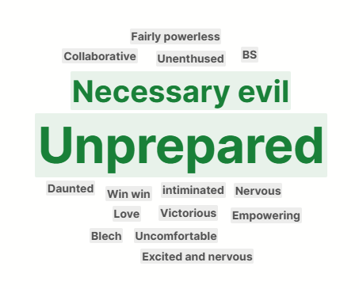
How do you feel bout negotiations?
Notes:
Opportunity for participants to respond in the chat if available

Slide 3

Planning and executing negotiations is very similar to chess
Notes:
David Oliver in How to Negotiate Effectively states, “Negotiation is in some ways like chess. You are prepared to sacrifice particular pieces in the interest of winning the game. In chess you know the pieces, but you can't see into the other person's mind. In negotiation you don't necessarily know the "pieces". You have to discover and develop your own pieces and find ways of uncovering your counterpart's.”

Slide 4

the ONEAL project
ONEAL = Open Negotiation Education for Academic Libraries
An IMLS funded project to teach negotiation skills to academic library workers who work with vendors

Slide 5
93 attendees
20 library workers
35 interviewees
Average attendance to three community forums in Fall 2022
Participated in Curriculum Planning Workshop in November 2022
Qualitative research study in Spring 2023
26 pilot testers
Completed the Foundations curriculum in Fall 2023
Notes:
Nothing for the community without the community.
We are at Charleston so I know some of you are thinking, but what about the vendors! You are right, in this first phase of the project we focused on developing foundations to teach negotiations to library workers and entirely focused on the community needs from that point of view. Going forward the ONEAL project plans on incorporating more voices. For the initial grant the focus was academic libraries in the US. We want to incorporate more points of view including vendor perspectives and international library workers and voices. In order to make that work though we will need more folks from across the community to help contribute to the creation and maintenance of these resources. Please reach out to us if you would like to get involved.

Slide 6
Foundations Module
Foundations | Introduction to the Curriculum
 | Contracts & Licensing
 | Introduction to Negotiations
 | Negotiation Planning Part 1: Strategy
 | Negotiation Planning Part 2: Internal Review
 | Negotiation Planning Part 3: Vendor Research
Issues | Accessibility
Notes:
Last spring we launched the Foundations Module. No matter what type of library concepts in the introduction to Negotiations lesson and the Negotiation Planning Part 1: is widely applicable to all libraries. Contracts & licencing is academic library in the united states licensing focused. The purpose is to help learners be more comfortable reading a contract but we make very clear that we are not giving legal advice and encourage working with general counsels. The internal review lesson is focused on analyzing internal library data to prepare for a negotiation. The vendor research lesson is centered on finding industry research, company research, and pricing trends. The accessibility lesson was created by two expert content creators and I think is particularly relevant with the changes in legal requirements and website accessibility in the next few years.

Slide 7
Curriculum Content
Lesson Plans
Recorded Lectures
Hands-on Exercises
Carefully constructed to maximize learning
Over 5 hours of recorded videos with accessible alt.
Using best pedagogical practice
Case Studies
Workbook
Group Activities
Best way to improve is to practice!
All lessons are available for individual download or in workbook.
To support classes and larger group learning
Notes:
Each lesson consists of three parts – a Watch/Read/Listen section that provides the introductory materials necessary for the lesson, a Review section that provides additional resources , and a Do section that allows the learner to apply what they have learned in a hands-on way. All the hands-on activities are available either all together as a workbook that can be completed alongside the curriculum, or as individual downloads that allow the learner to focus on specific lessons. One of the key activities that runs through the curriculum is a negotiation journal, which encourages the learner to reflect on their planning for negotiations, the vendor’s reaction, and the results of negotiation. Learners are also encouraged to journal throughout the lessons in structured and unstructured ways.
Case studies and group activities are also available as part of the curriculum, providing opportunities to enhance and deepen learning.

Slide 8
New Strategies Module – Mar/Apr 25
Developing values-driven negotiations
Introduction to power mapping and applications
Additional content on contract and licensing terms
AI showing up in everything!
Strategies for engagement: students, faculty, library workers, administrators

Slide 9
Privacy & Surveillance
Issues Module Lesson Coming Mar/Apr 2025!
Notes:
We are working with some expert content creators to create an entire lesson centered on privacy and surveillance issues we plan on publishing in spring 2025.

Slide 10
https://sparcopen.org/our-work/negotiation-resources/oneal/
Access the curriculum

Slide 11
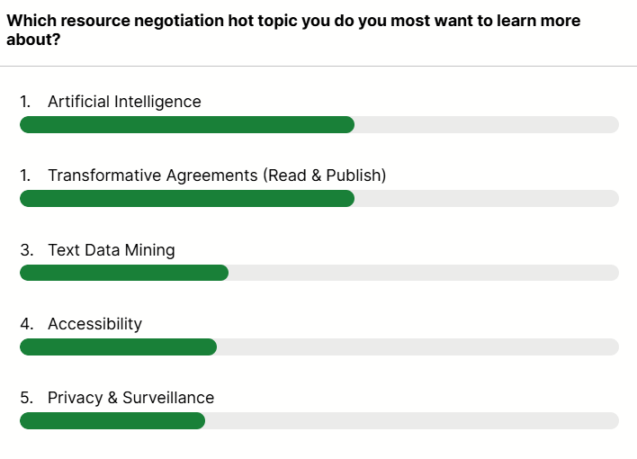
Notes:
One thing I think it’s important for all of us to consider and discuss are the hot topics facing us all in regards to negotiations.
Now the fact is that we are dealing with the wild west in regards to some topics like AI. To help everyone here get better versed in these topics The ONEAL project consolidated a list of

Slide 12
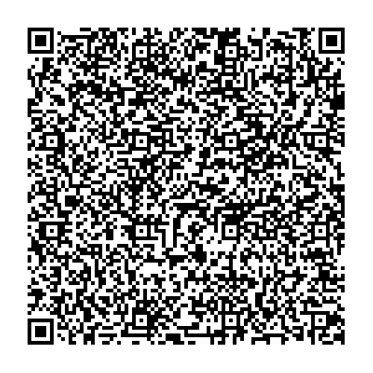
Hot Topic Resource Handout
Notes:
Now the fact is that we are dealing with the wild west in regards to some topics like AI. To help everyone here get better versed in these topics The ONEAL project consolidated a list of resources to help you further understand several topics including AI, Privacy & Surveillance, and negotiating Text & Data Mining. We are actively working to incorporate these topics within the curriculum.

Slide 13
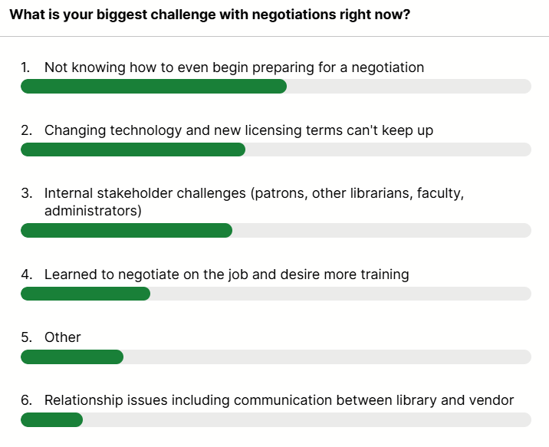
Notes:
Now I have one last poll question that may foster some discussion as we move into the Q&A

Slide 14
THANKS!
https://oneal-project.org/
Katharine V. Macy, Project Director
macyk@iu.edu
Notes:
If you would like to learn more about the ONEAL project please visit your website. You will note that there is information about the project, links to the curriculum, and the library worker Discord where folks can seek advice and support as they complete the curriculum and are navigating negotiations. We hope to build additional communities in the future that allow library workers and vendors to also connect. We hope this project will continue to grow and expand because I truly believe that when everyone develops negotiation skills it enables better conversations and can foster sustainable relationships between libraries and vendors.

